Slide 1
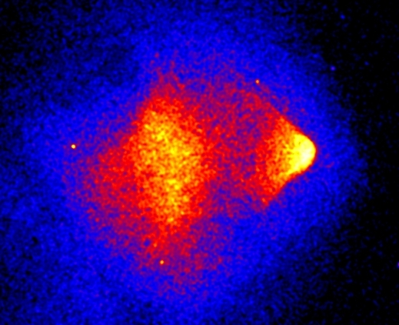
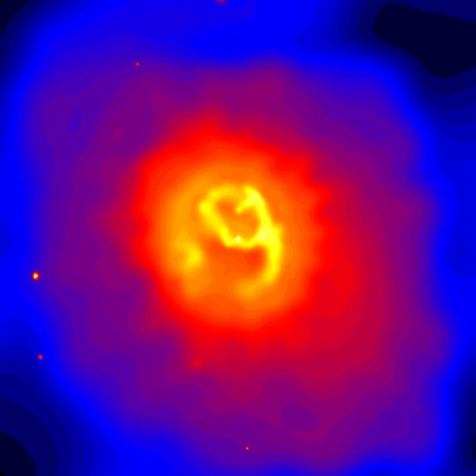
Galaxy Clusters:
Relaxation and Feedback
Ken Cavagnolo
Michigan State University

Slide 2
Collaborators at MSU
Megan Donahue - Advisor
Mark Voit - Co-advisor
Ming Sun - Post-doc
David Ventimiglia - Grad Student

Slide 3
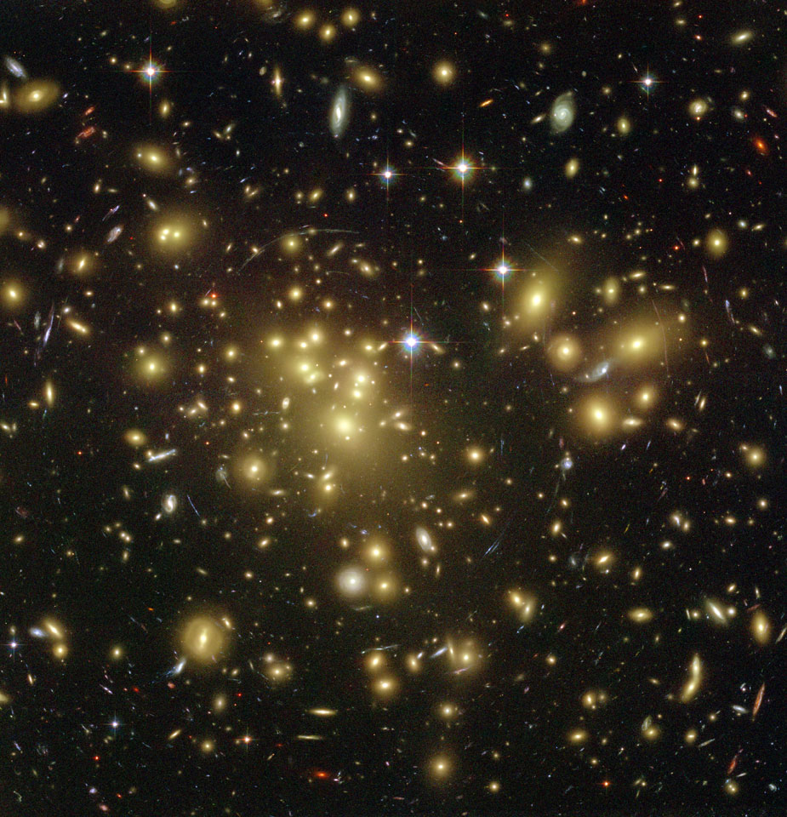
Galaxy Clusters Refresher
Abell 1689 in optical
100's to 1000's of galaxies
70-80% dark matter
30-20% baryons
Few Mpc in size
10¹³-10¹⁵ M☼
Stars and Galaxies aren't everything...
NASA / ACS Team / Benitez et al.

Slide 4
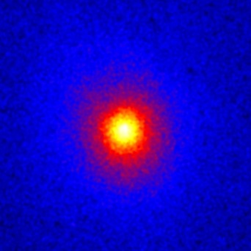
Galaxy Clusters Refresher
Abell 1689 in X-ray
Intracluster medium (ICM) is 60-90% of baryons
Hot: ≥ 10 million K
Diffuse: ≤ 10⁻¹ cm⁻³
Luminous: 10⁴²-10⁴⁵ ergs s⁻¹

Slide 5
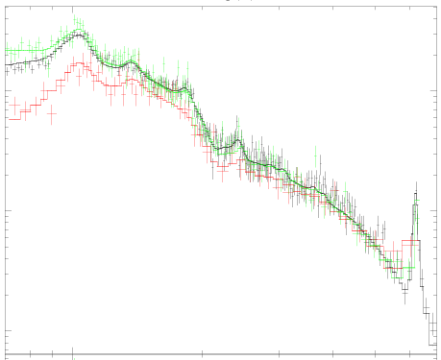
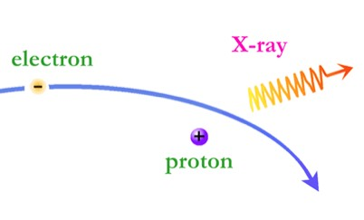
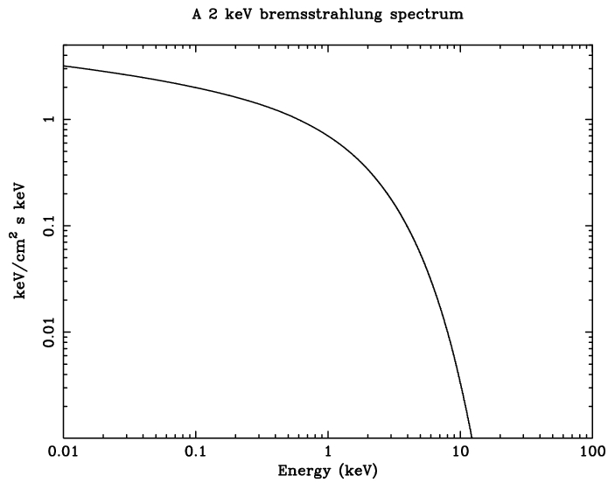
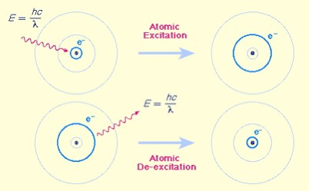
Galaxy Clusters Refresher
Dominant emission mechanism is thermal Bremsstrahlung
Chandra

Slide 6
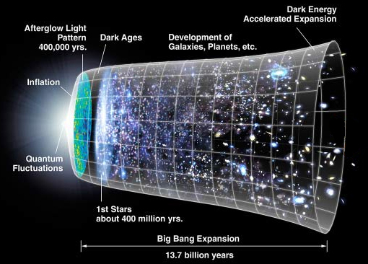
Why study galaxy clusters?
Cosmology
  Structure growth
  Need more precise masses
Galaxy Formation
  Explain Hubble Sequence
  Must understand feedback
NASA / JDEM

Slide 7
Why study galaxy clusters?
Cosmology
  Structure growth
  Need more precise masses
Galaxy Formation
  Explain Hubble Sequence
  Must understand feedback
NASA / JDEM

Slide 8
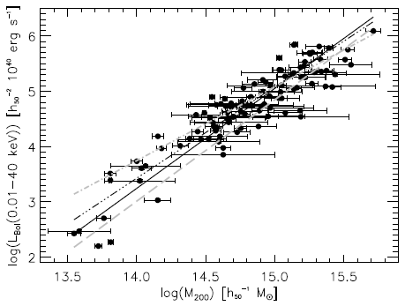
Cosmological Importance
of Relaxation
Clusters expected to be self-similar
Observables are mass surrogates, assuming equilibrium i.e. relaxation
Heating and cooling alter scaling relations
Precision cosmology requires knowledge of the scatter and how it evolves
Large dispersion
Large dispersion
Reiprich et al. 2001

Slide 9
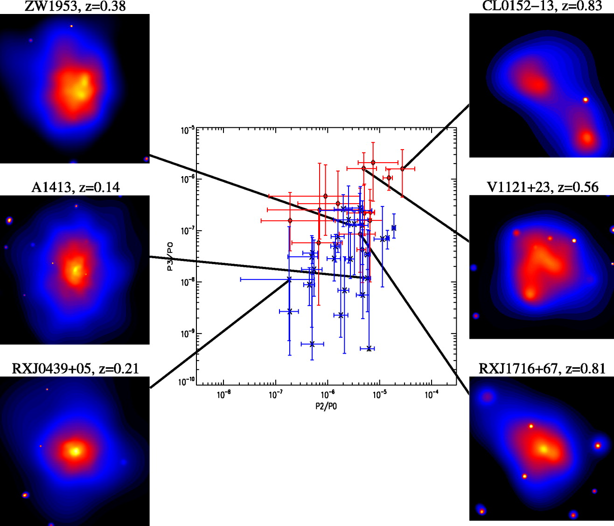
Cosmological Importance
of Relaxation
Is this problem tractable?
Quantify sub-structure through imaging analysis
What about an aspect independent measure?
Temperature skewing predicted by Mathiesen & Evrard 2001
Jeltema et al. 2005

Slide 10
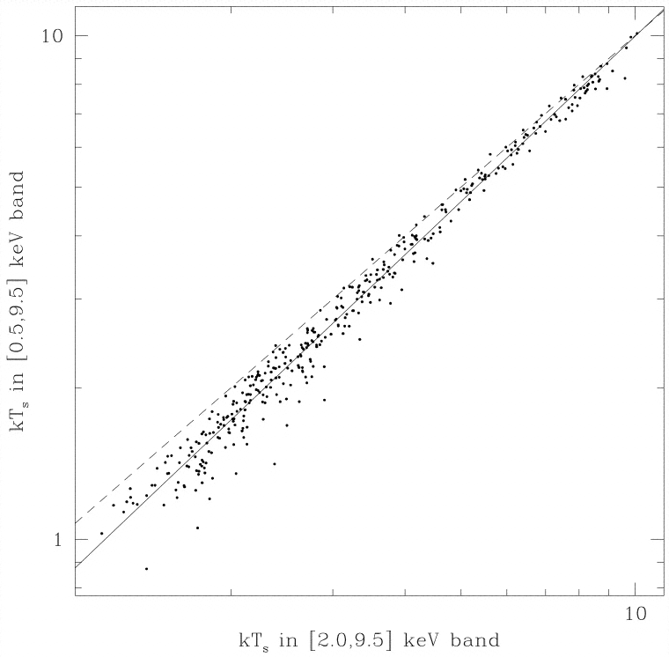
Cosmological Importance
of Relaxation
Mathiesen & Evrard 2001
Is this problem tractable?
Quantify sub-structure through imaging analysis
What about an aspect independent measure?
Temperature skewing predicted by Mathiesen & Evrard 2001
Temperature [0.5-9.5 keV]
Line of equality
Hotter hard-band temperature
Temperature [2.0-9.5 keV]

Slide 11
Temperature Inhomogeneity
How shall we quantify temperature skewing?
Broad-band temperature: 0.7-7.0 keV band
Hard-band temperature: 2.0-7.0 keV band
2.0 keV is in cluster rest frame
Define Hard-band to Broad-band Ratio:

Slide 12
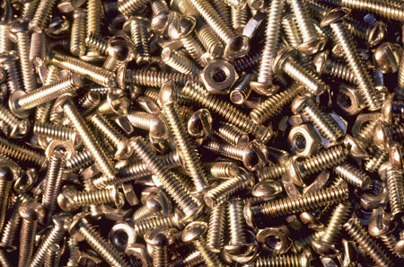
The Nuts and Bolts

Slide 13
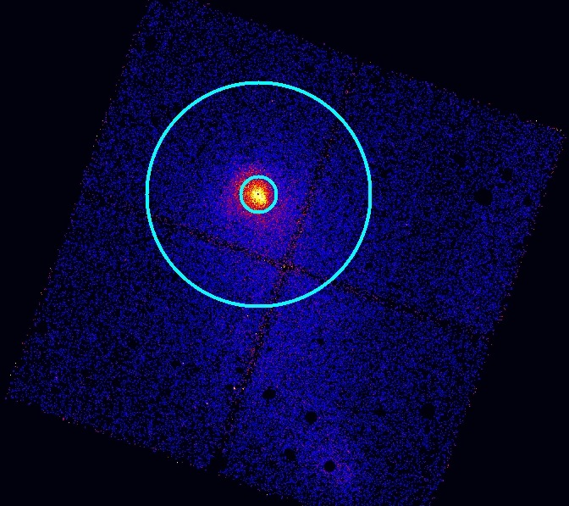
“THBR” Data Analysis
Collected clusters from Chandra Archive
+11 Msec, 300+ obs
Two apertures selected:
  R5000
  R2500
Cores excised
R₅₀₀₀
R2500
Core excluded!

Slide 14
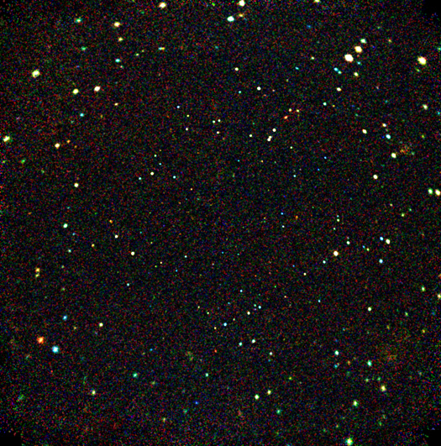
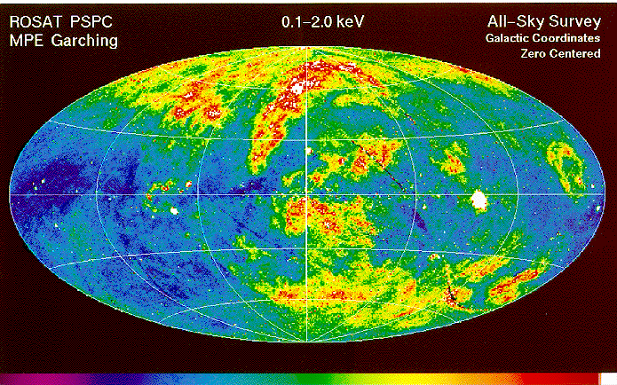
Chandra Deep Field-South
X-ray Background Consideration
Hard-particle background
Important at E > 2 keV
Correct spectral count rate
NASA/JHU/AUI/R.Giacconi et al.
Soft, local background
Spatially varying
Is problematic at E < 2 keV

Slide 15
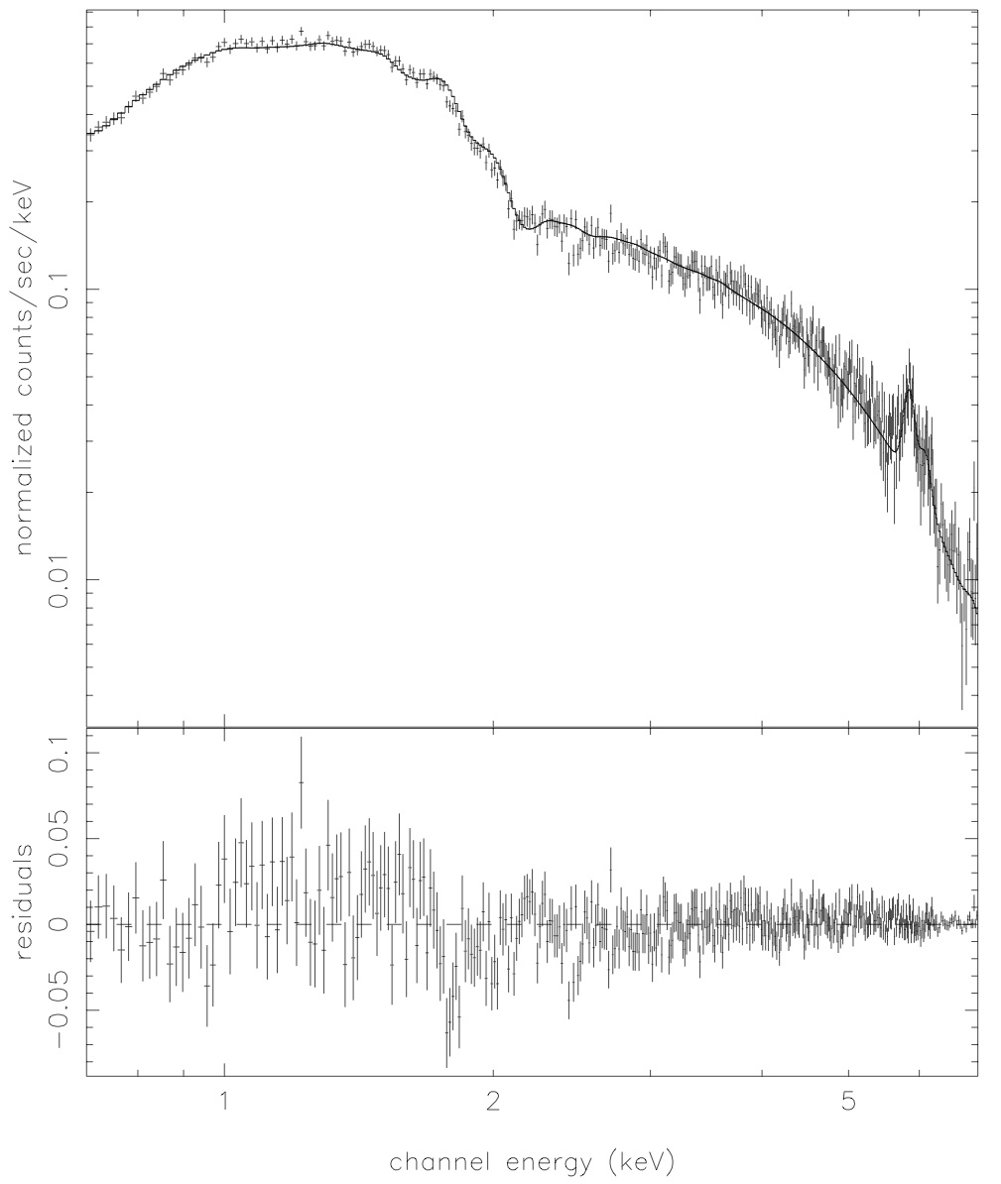
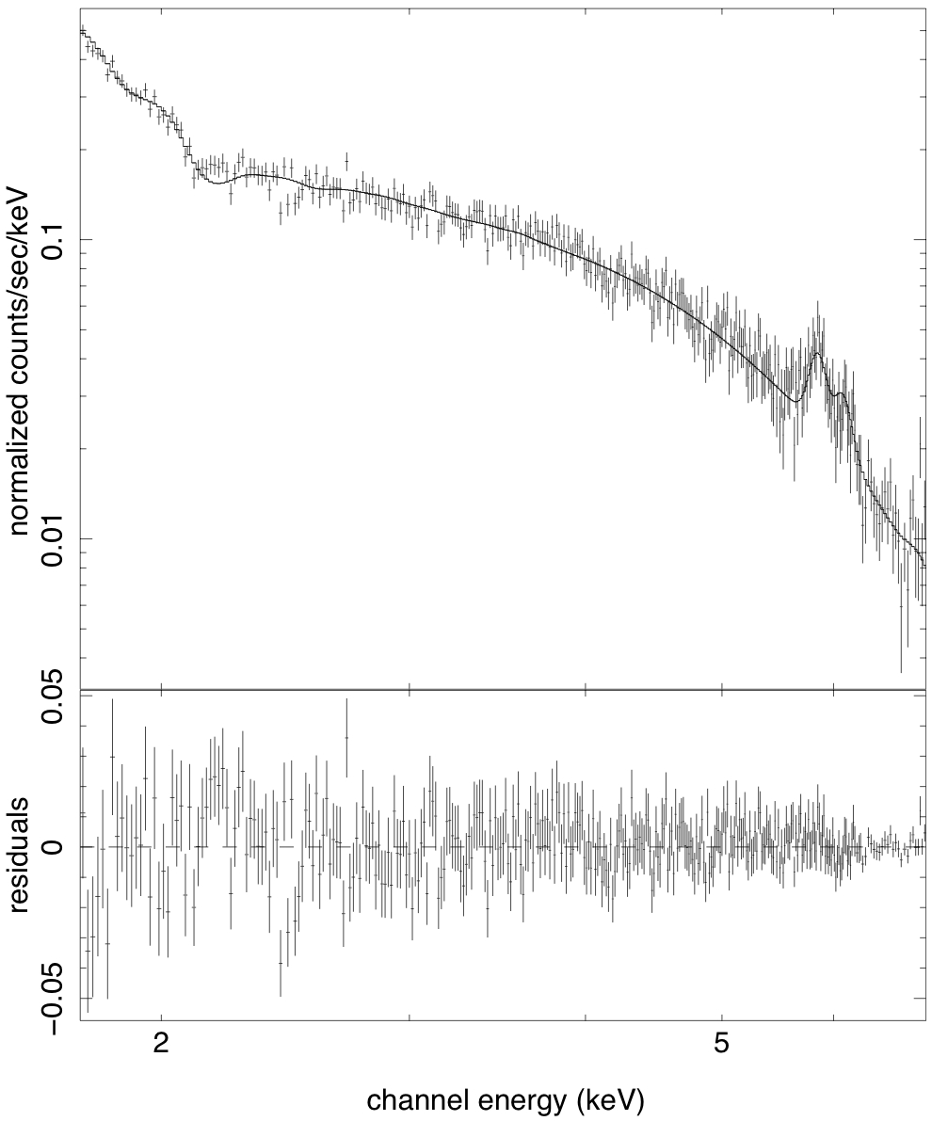
Inferring the gas temperature
Single-phase thermal plasma
Fixed absorbing NHI
Metal abundance is free
Soft background fixed and error added
Broad-band: 0.7-7.0 keV
Hard-band: 2.0'-7.0 keV
T_{X} = 7.41 ± 0.2 keV
T_{X} = 9.09 ± 0.5 keV

Slide 16
Inferring the gas temperature
Single-phase thermal plasma
Fixed absorbing NHI
Metal abundance is free
Soft background fixed and error added
Do this 180+ times,
and one finds...
Broad-band: 0.7-7.0 keV
Hard-band: 2.0'-7.0 keV
T_{X} = 7.41 ± 0.2 keV
T_{X} = 9.09 ± 0.5 keV

Slide 17
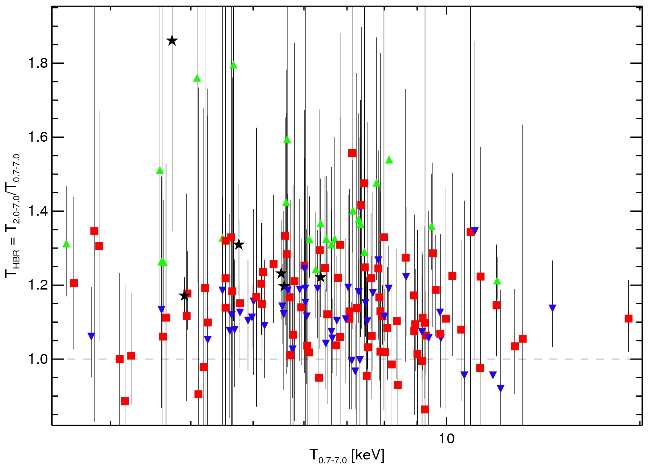
Net Skewing of THBR
Errors are large, but the number of clusters is also large.
T_{HBR} = 1.16 (SD 0.12 ; SDOM 0.01)
Black Stars: THBR > 1.1 + CC
Green Triangles: THBR > 1.1 + NCC
Red Squares: NCC
Blue Inverted Triangles: CC
Cavagnolo et al. 2008

Slide 18
Net Skewing of THBR
Before moving on, let's distinguish between cool core (CC) and non-cool core (NCC) clusters
T_{HBR} = 1.16 (SD 0.12 ; SDOM 0.01)
Black Stars: THBR > 1.1 + CC
Green Triangles: THBR > 1.1 + NCC
Red Squares: NCC
Blue Inverted Triangles: CC
Cavagnolo et al. 2008

Slide 19
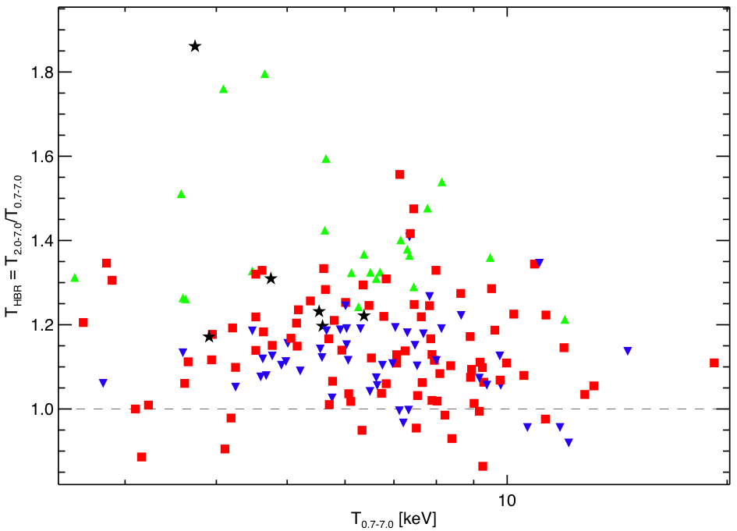
Net Skewing of THBR
T_{HBR} = 1.16 (SD 0.12 ; SDOM 0.01)
Black Stars: THBR > 1.1 + CC
Green Triangles: THBR > 1.1 + NCC
Red Squares: NCC
Blue Inverted Triangles: CC

Slide 20
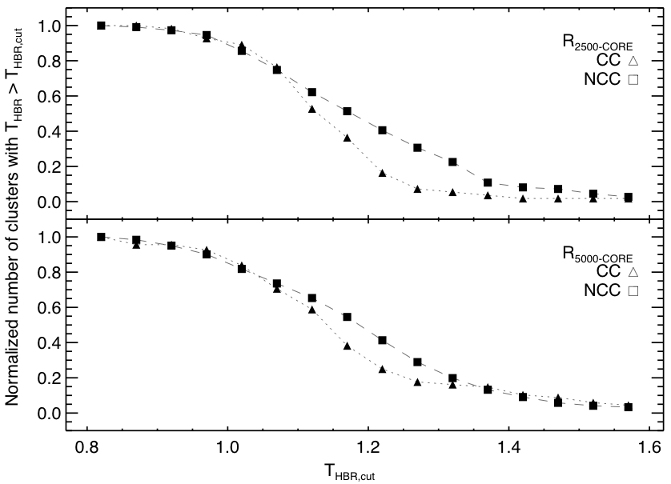
Culling out Cool Cores using T_{HBR}
Increasing values of THBR “prefer” non-cool cores
Robust against choice of cool core definition

Slide 21
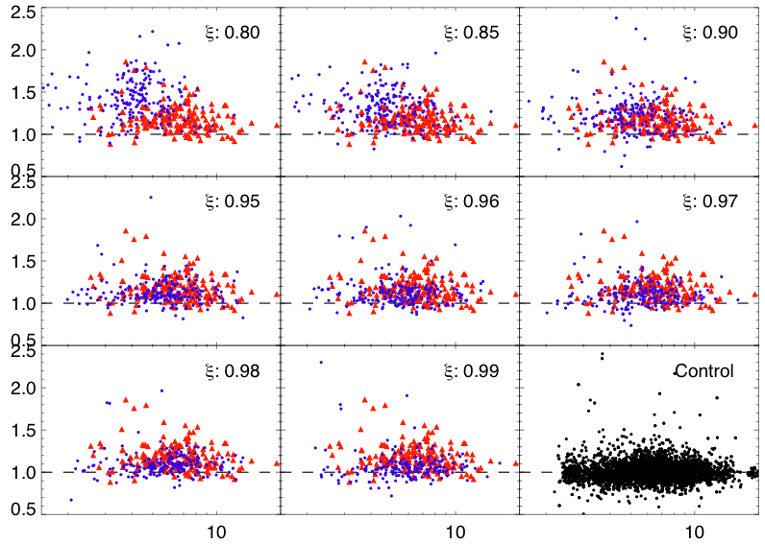
Simulations and Systematics
Simulate two-phase gas
Repeat spectral analysis
Observe skewing in sims but not in control
Dispersion in observation > control
THBR
Tfull [keV]

Slide 22
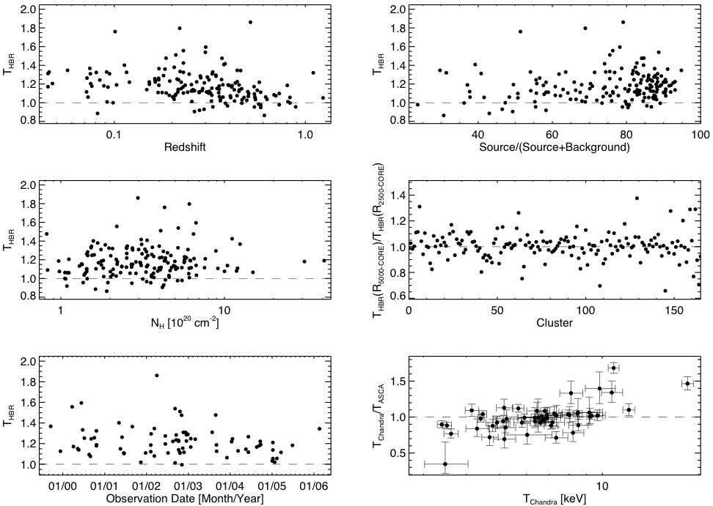
Simulations and Systematics
Trend?
No trend
No trend
No trend
No trend
Trend?

Slide 23
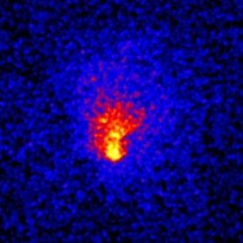
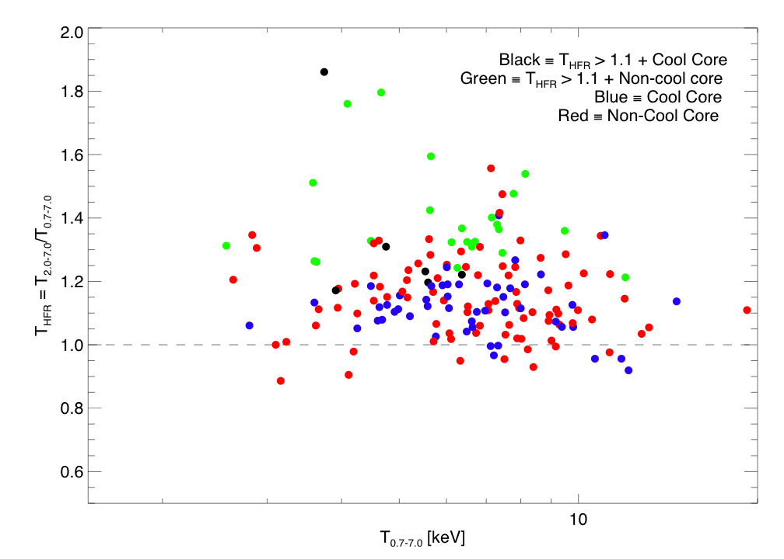
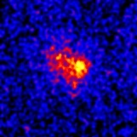
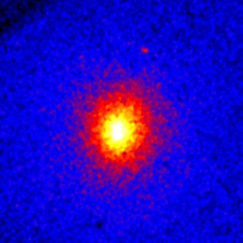
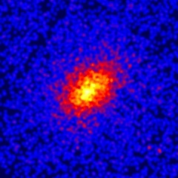
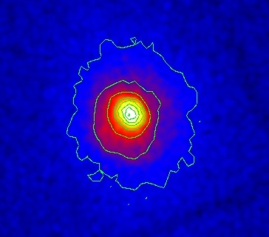
Putting It All Together
MS1008
THFR >> 1
NCC -- merger
RXJ1525
THFR >> 1
CC? -- merger?
A1689: odd 'ball'?
A963
THFR ~ 1
CC – strong lens
A68
THFR ~ 1
NCC – strong lens
RXJ1720
THFR > 1
CC – cold front

Slide 24
Abell 1689: not so relaxed
MLens ≈ 2×MX-ray (Andersson & Madejski 2004)
Non-axisymmetric temperature structure (Andersson et al. 2006)
Sub-structure in optical
Non-Gaussian galaxy redshift distribution
Low gas fraction: ~7% (XMM)
Morphological tests would never spot this as “unrelaxed”

Slide 25
Cosmological Importance
of Relaxation
Temperature inhomogeneity is a problem
Appears to be something we can quantify
Calibrate between temperature ratio and relaxation using N-body/SPH simulations
Could be very useful tool for quantifying scatter in mass-observables
Now, what of the feedback issue...?

Slide 26
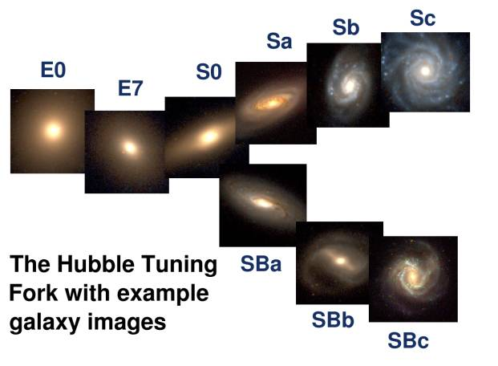
Why study galaxy clusters?
Cosmology
  Structure growth
  Need accurate masses
Galaxy Formation
  Explain Hubble Sequence
  Must understand feedback
Hubble Tuning Fork
SDSS

Slide 27
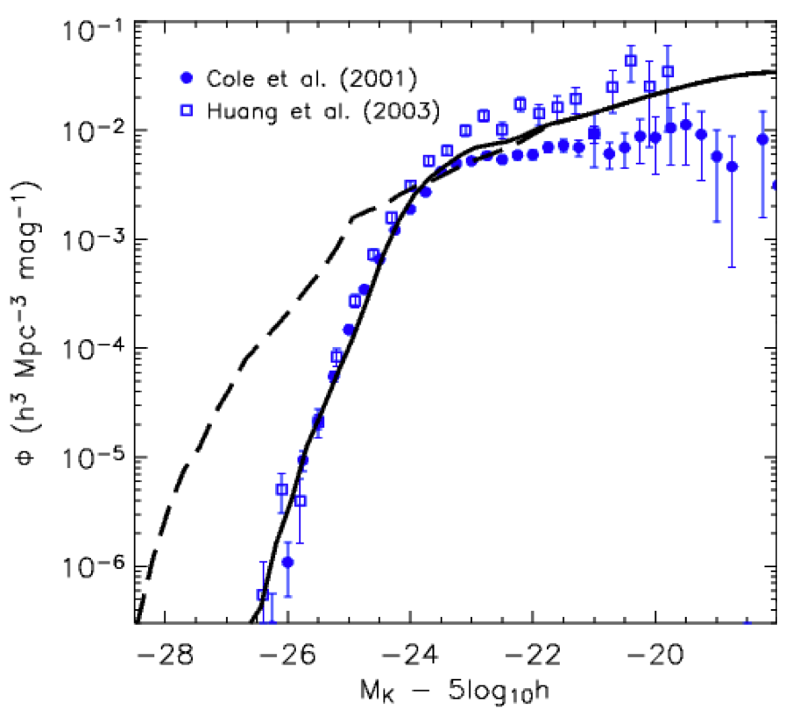
Importance of Feedback
Theory predicts:
  Too many massive, blue galaxies
  Too many dwarf galaxies
The trouble with old ellipticals
  Vigorous feedback at high-z
  “Down-sizing” problem
Central galaxy in groups and clusters are not growing unabated
Croton et al. 2006

Slide 28
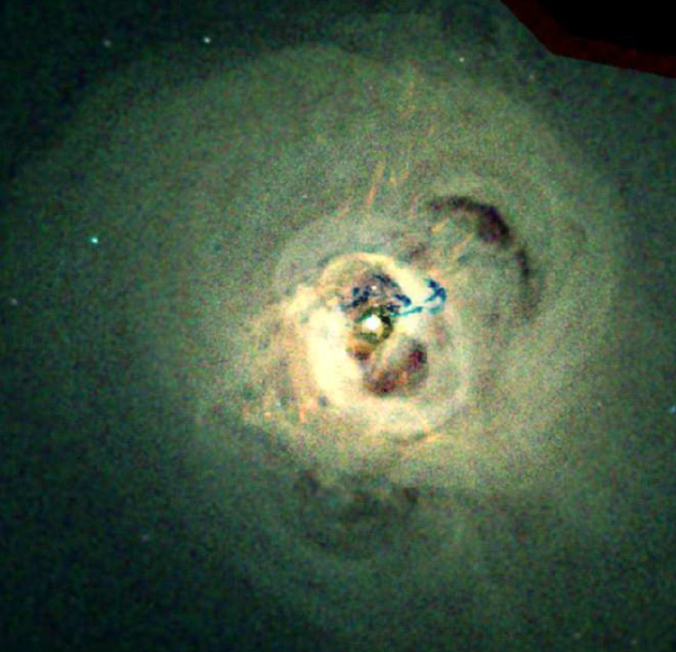
Importance of Feedback
Perseus
Central cooling time of ICM much shorter than Hubble age
Expect massive flows of cool gas into core
But star formation isn't rampant, why?
Take a look at right...
NASA / CXC / IoA / A.Fabian et al.

Slide 29
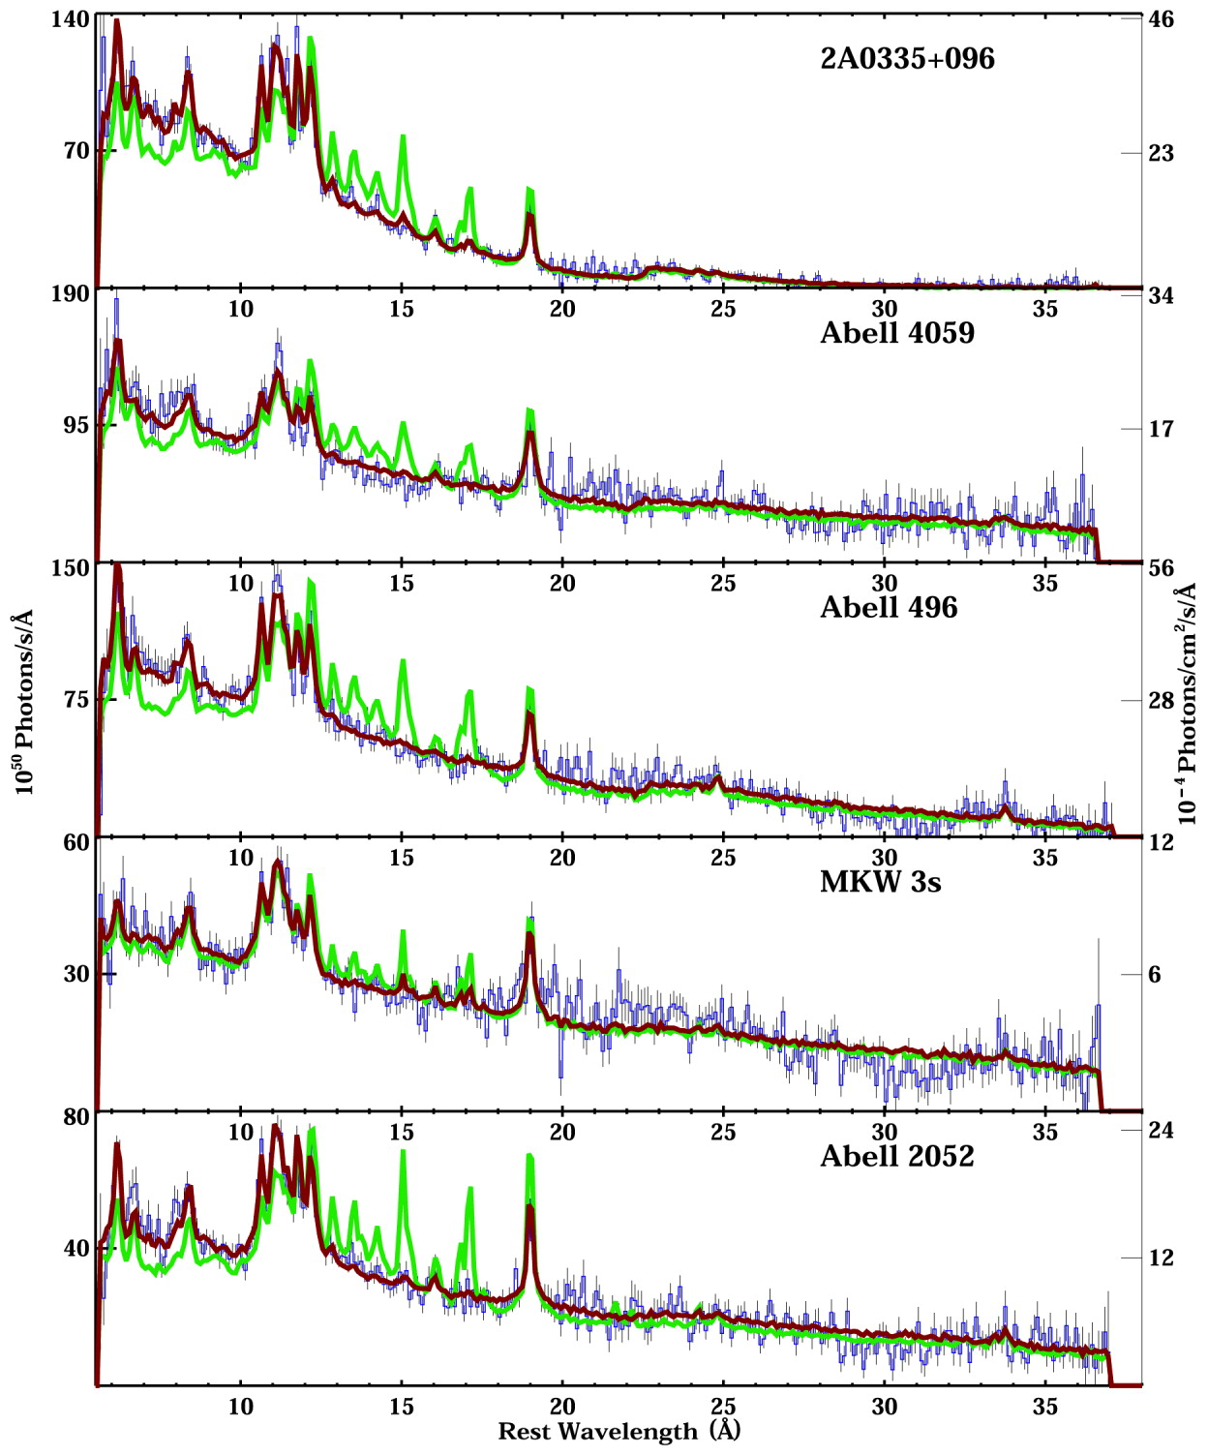
Blue: data
Maroon: best-fit
Green: predicted
Cooling
Trickles
T ≤ ⅓Tvirial is missing
Feedback heating ICM?
Peterson et al. 2003

Slide 30
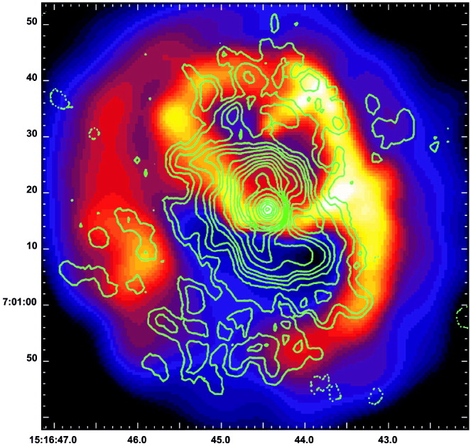
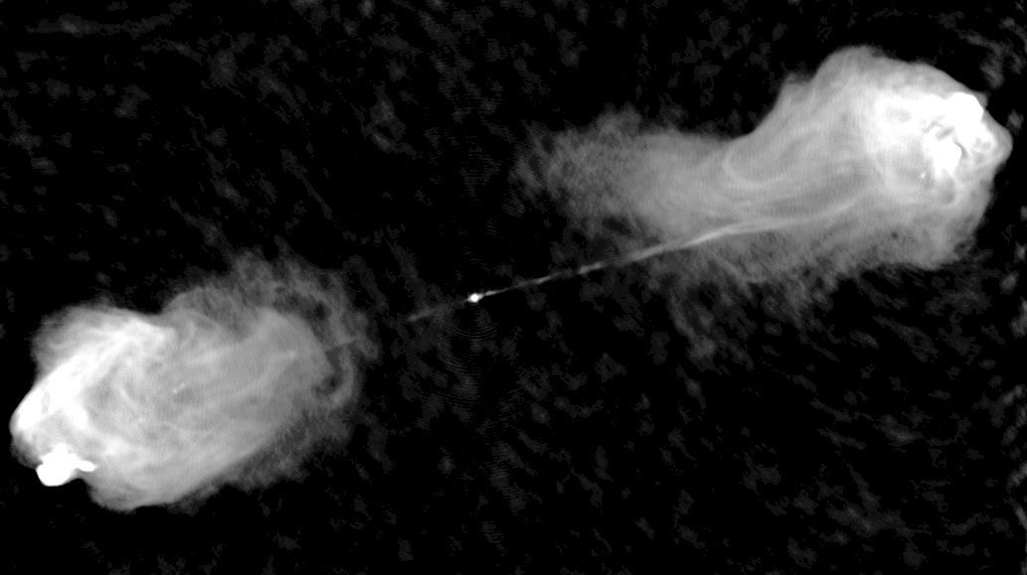
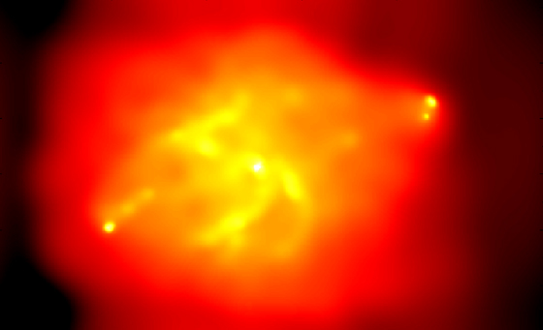
Importance of Feedback
X-ray + Radio contours
Feedback heating now widely accepted
Very, very modest star formation
AGN are active
Galaxy growth slowed
How do we make sense of all this?
Our 'close to the data' approach:
  Study cooling ICM
  Better understand feedback
  Work toward self-regulation model
  Focus on ICM entropy...
Abell 2052
Cygnus A
Radio
X-ray

Slide 31
ICM Entropy
Like PB&J, temperature and density are better together.
Fundamental property of ICM
Dark matter halo and entropy structure dictate X-ray observables
Entropy is beholden to thermal history

Slide 32
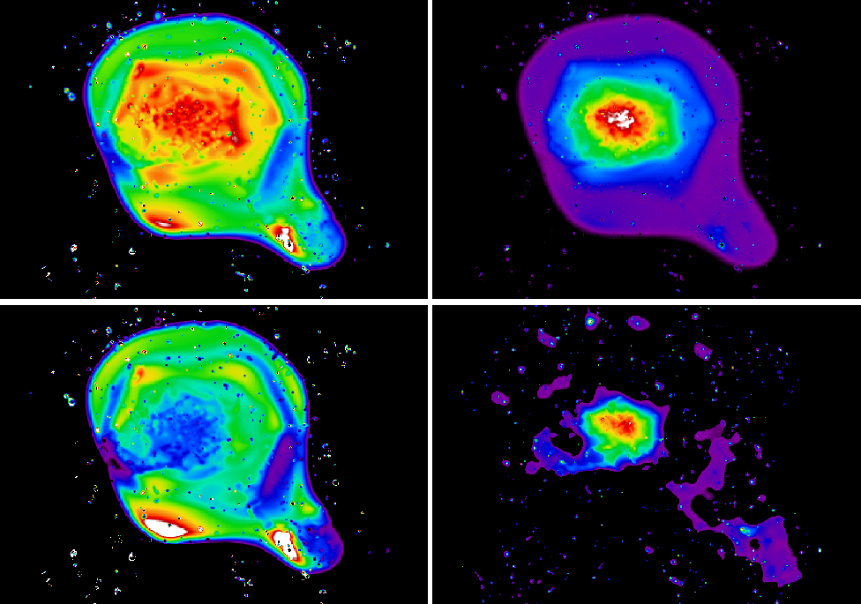
Entropy from Observables
Temperature
÷
=
Density
Entropy
Define “entropy” as adiabatic constant
K = Pρ^{-5/3} or...
K = Tnelec^{-2/3}
Coma Cluster
Schuecker et al. 2004

Slide 33
Properties of Entropy
In a gravity only Universe... radial entropy distribution follows power-law
Potential wells are entropy sorting devices
Departures from power-law indicative of past heating and cooling

Slide 34
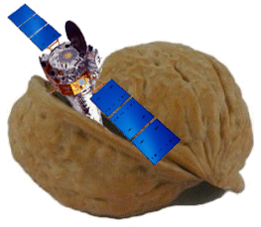
◄ Oh, hi there.
Chandra data reduction...
in a nutshell

Slide 35
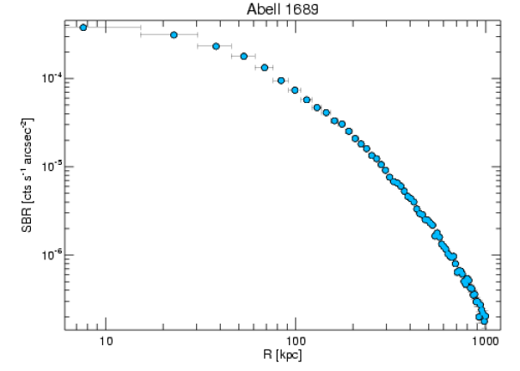
Chandra Data Reduction...
in a nutshell
Standard reduction
Extract surface brightness profiles
  Background subtracted
  Exposure corrected
  Point source cleaned
Extract and fit temperature profile
Deproject surface brightness
Monte Carlo the errors
Convert to electron density profile
Calculate entropy profile
Fit entropy models
Profit

Slide 36
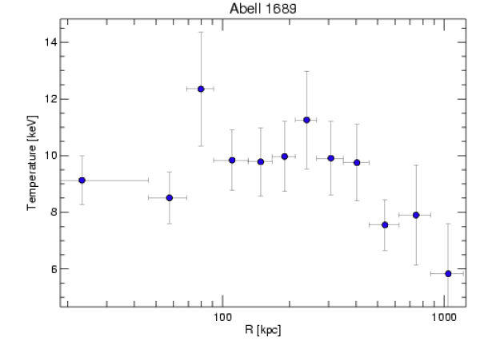
Chandra Data Reduction...
in a nutshell
Standard reduction
Extract surface brightness profiles
  Background subtracted
  Exposure corrected
  Point source cleaned
Extract and fit temperature profile
Deproject surface brightness
Monte Carlo the errors
Convert to electron density profile
Calculate entropy profile
Fit entropy models
Profit

Slide 37
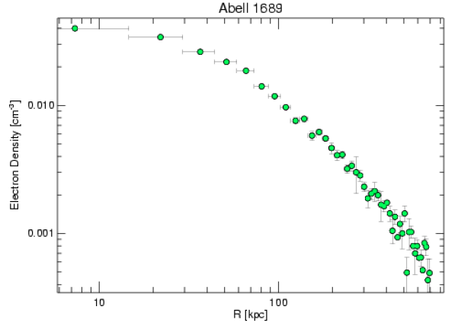
Chandra Data Reduction...
in a nutshell
Standard reduction
Extract surface brightness profiles
  Background subtracted
  Exposure corrected
  Point source cleaned
Extract and fit temperature profile
Deproject surface brightness
Monte Carlo the errors
Convert to electron density profile
Calculate entropy profile
Fit entropy models
Profit

Slide 38
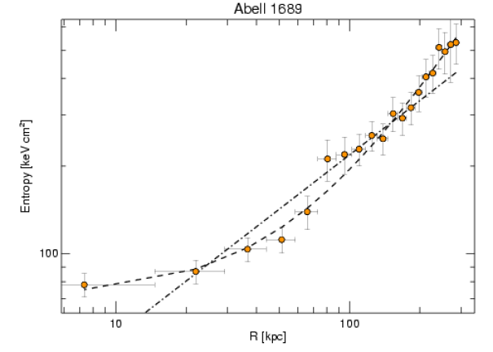
Chandra Data Reduction...
in a nutshell
Standard reduction
Extract surface brightness profiles
  Background subtracted
  Exposure corrected
  Point source cleaned
Extract and fit temperature profile
Deproject surface brightness
Monte Carlo the errors
Convert to electron density profile
Calculate entropy profile
Fit entropy models
Profit
(A)
(B)

Slide 39
Chandra Data Reduction...
in a nutshell
Standard reduction
Extract surface brightness profiles
  Background subtracted
  Exposure corrected
  Point source cleaned
Extract and fit temperature profile
Deproject surface brightness
Monte Carlo the errors
Convert to electron density profile
Calculate entropy profile
Fit entropy models
Profit
Do this 190 times,
and one gets...

Slide 40
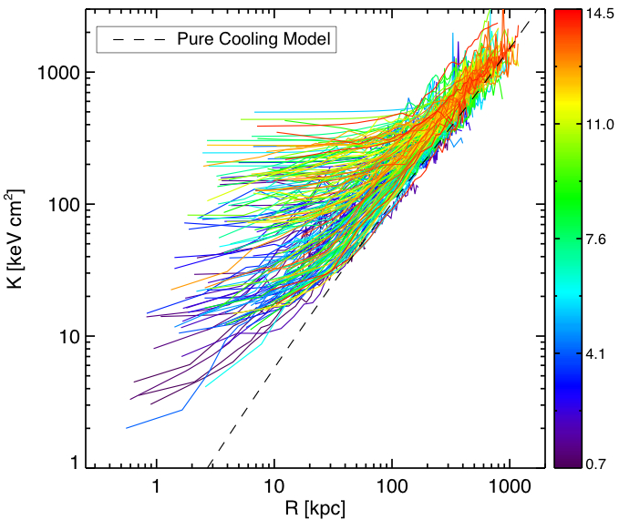
ACCEPT: Athenæum of Chandra Cluster Entropy Profile Tables
All results will be publicly available online.
This includes all profiles, tables, spectra, reduced data, figures, et cetera.

Slide 41
ACCEPT: Athenæum of Chandra Cluster Entropy Profile Tables
Entropy profiles do not follow power-law
Converge to self-similar model at large radii
Quasi-steady state induced by AGN every ~100 Myr
More than meets the eye?
Profiles follow form:

Slide 42
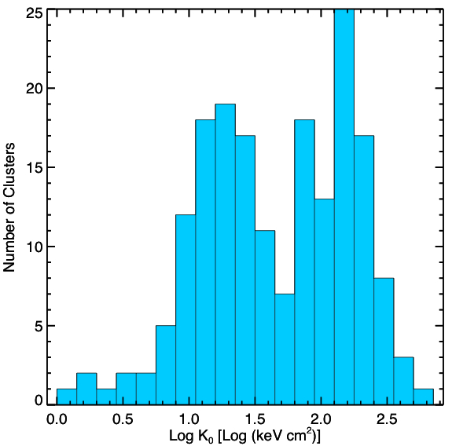
Bimodal entropy distribution

Slide 43
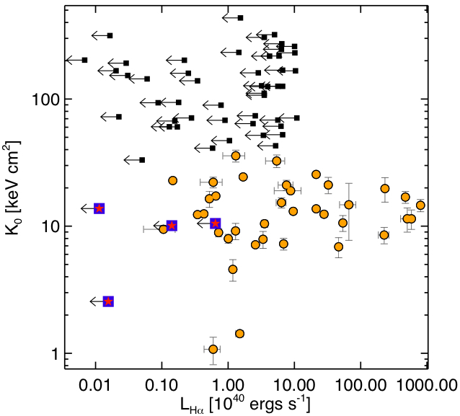
Assume Hα as star formation indicator; Star formation loves low entropy
Conduction interfaces can also produce Hα

Slide 44
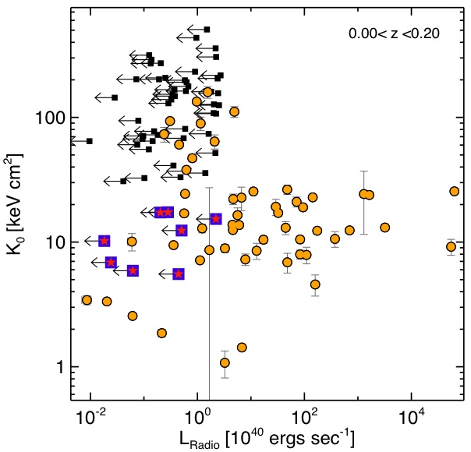
Radio-loud sources like low entropy too!
Most likely AGN, but might also be relics, ghosts, detached lobes, or reaccelerated regions

Slide 45
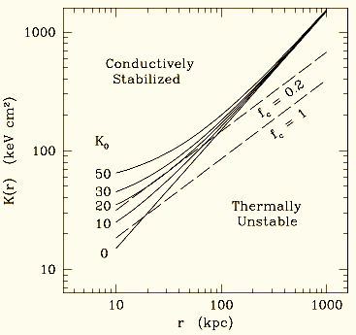
Conductive Stability
When does a multi-phase medium form?
K0 ≤ 20-30 keV cm² appears to be threshold
Conduction can't wipe out cool gas below threshold
Are we closer to understanding feedback?
Voit et al., in prep.

Slide 46
Entropy lifecycle?
Conductive
Stability
10⁴⁵ AGN
Mergers
Were never cool?
>10⁶¹ AGN

Slide 47
Conclusions
We've found...
Hard-band to broad-band temperature ratio correlates with cluster dynamic state
Low entropy environs promote feedback
Characteristic entropy threshold for feedback activity
IMHO, CXO is one of the greatest pieces of scientific equipment ever built.

Slide 48
The road ahead
Watch for papers in Mar-Apr... and Ming Sun's work on galaxy groups!
Await results of simulation work
Apply all scatter reduction techniques
Entropy scaling relations
Further explain bimodality
Use multimodality for timescale tests
Refine model for conductive stability
Low entropy & no feedback
High entropy & with feedback
Low frequency radio survey?
Radio dating?
SZE study of high-z entropy?
Test various pre-heating models
2D analyses
Online searchable database

Slide 49
Intentionally left blank

