Slide 1
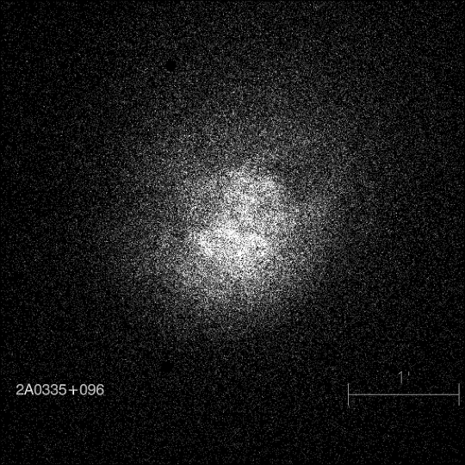
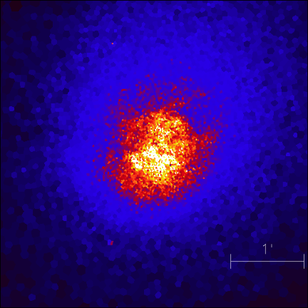

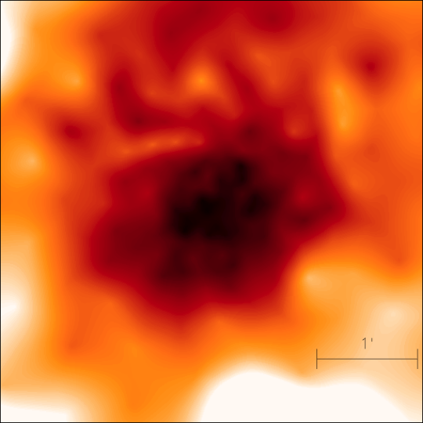
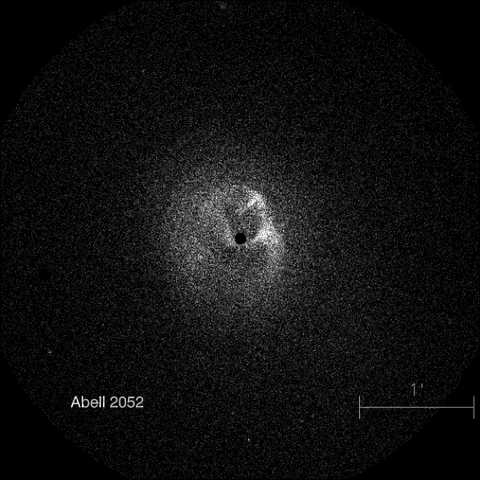
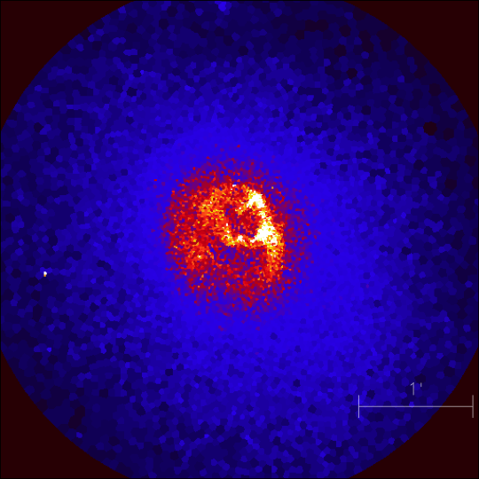


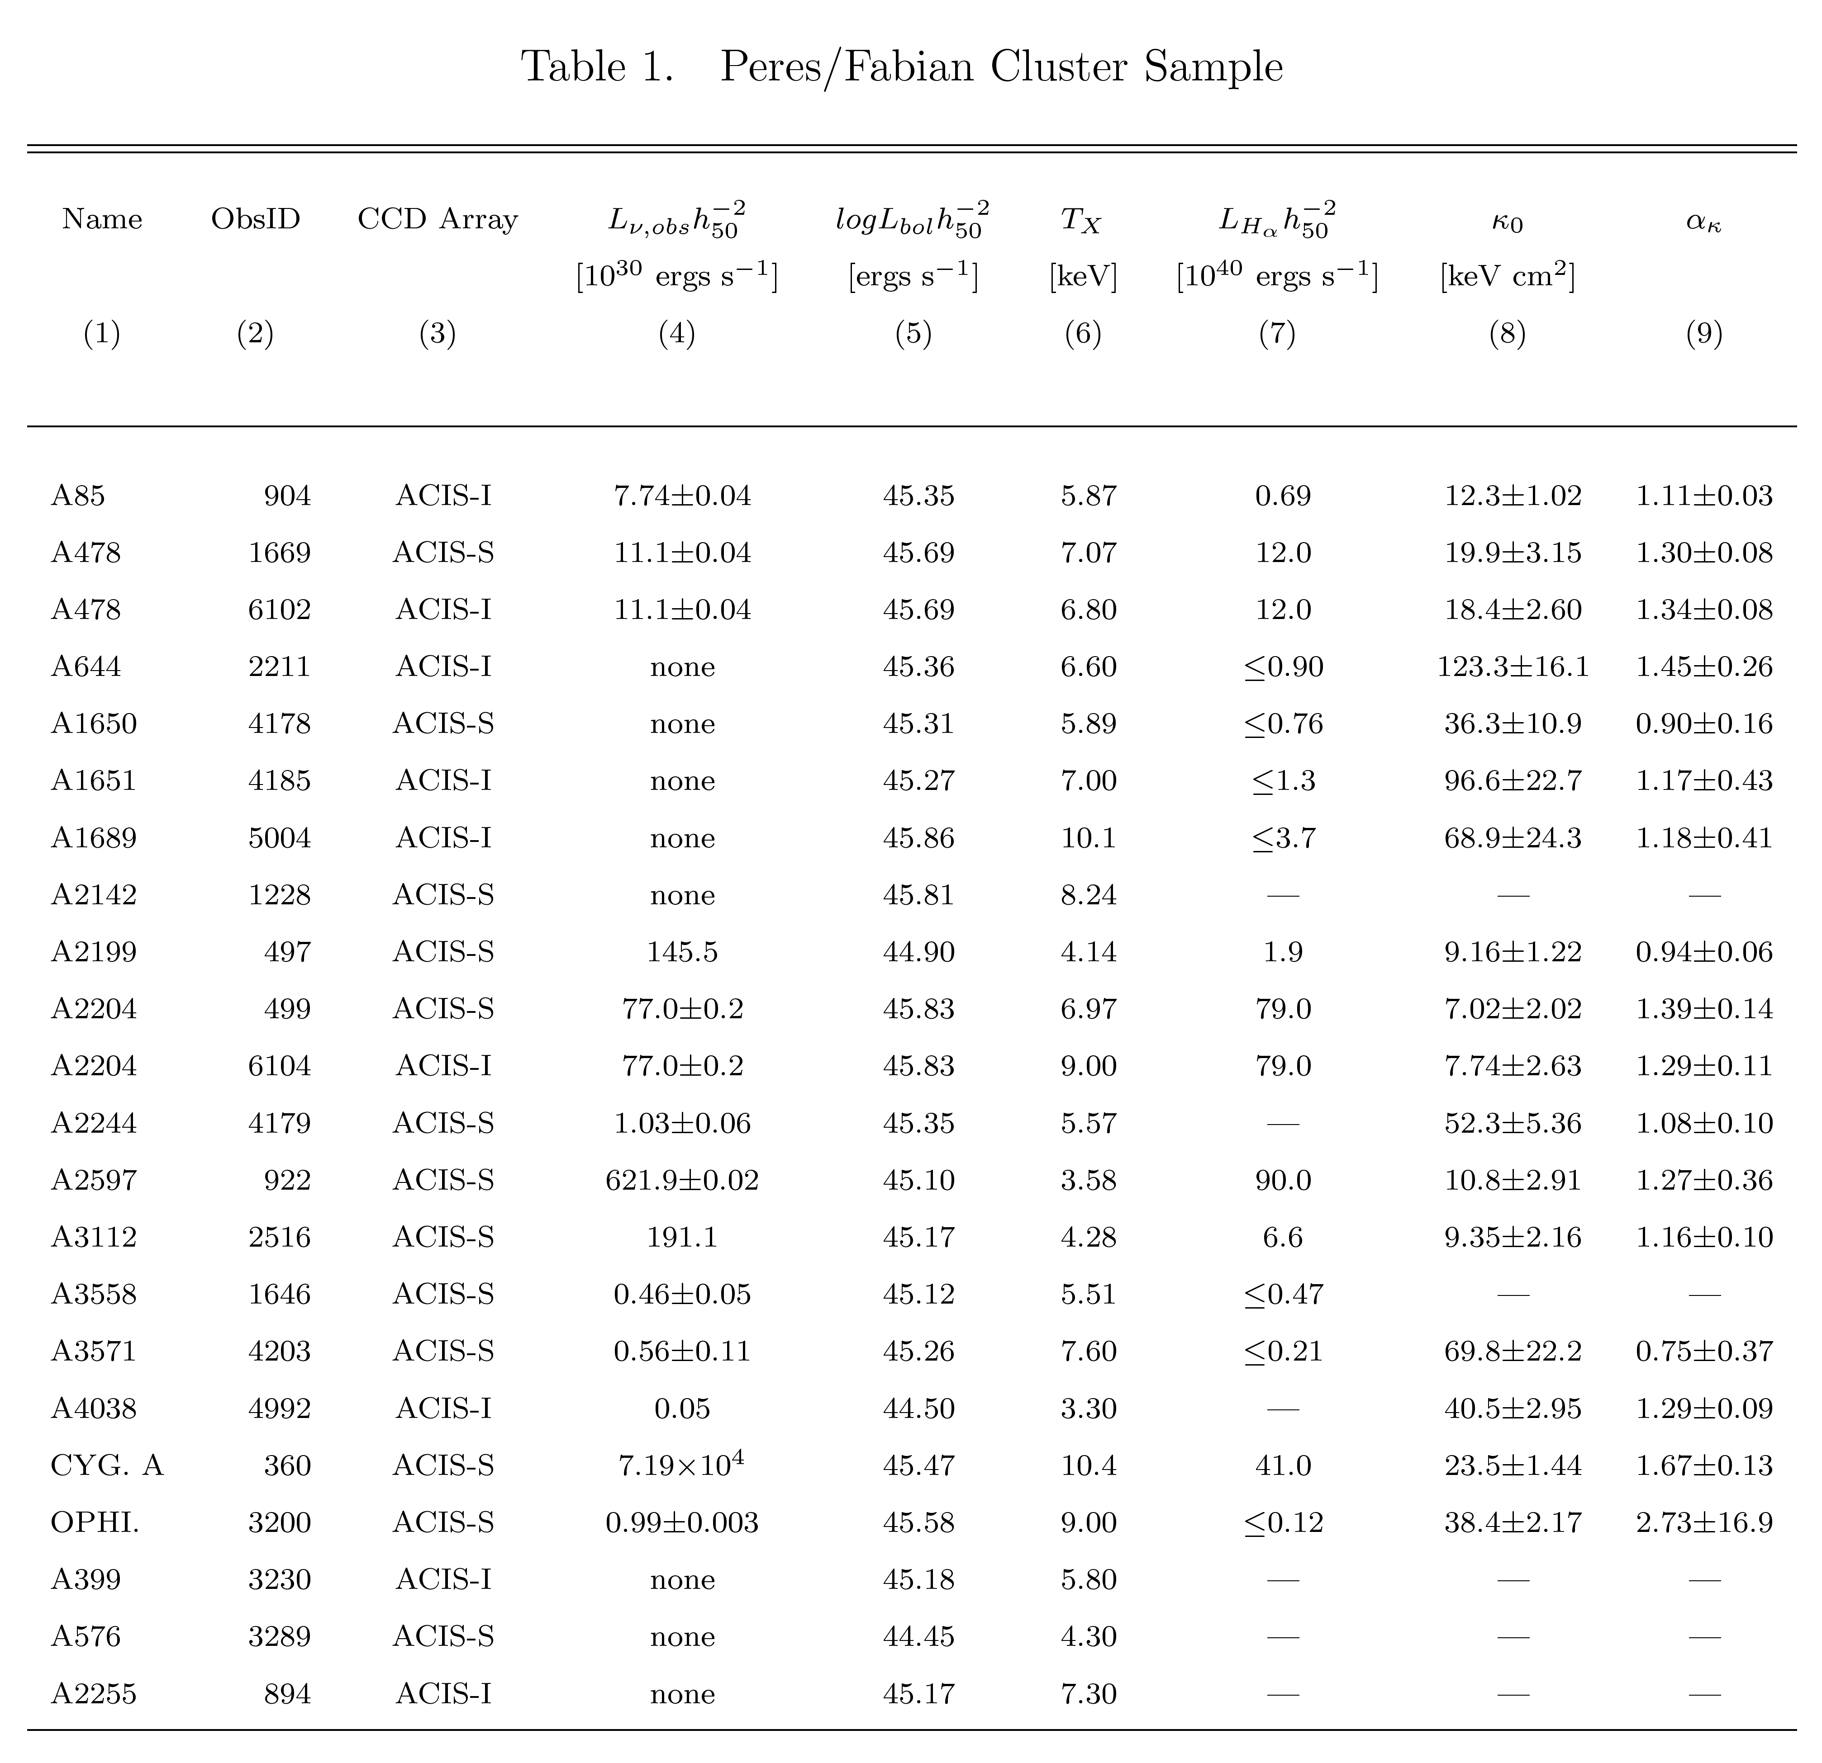
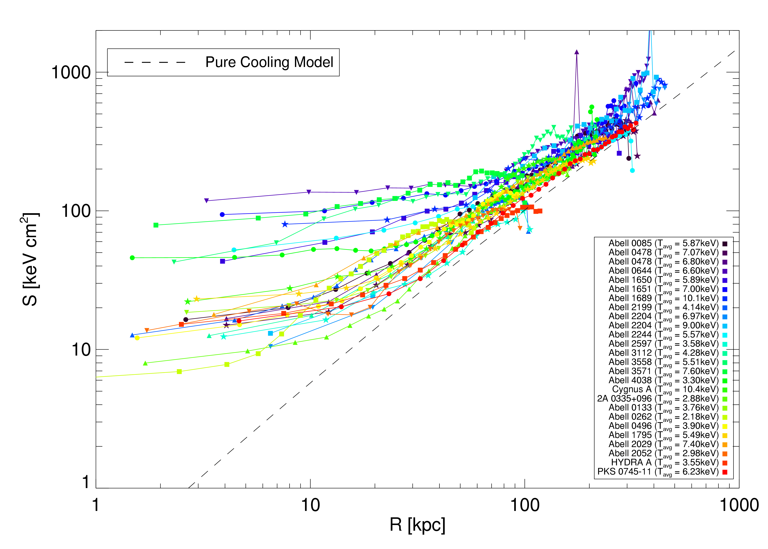
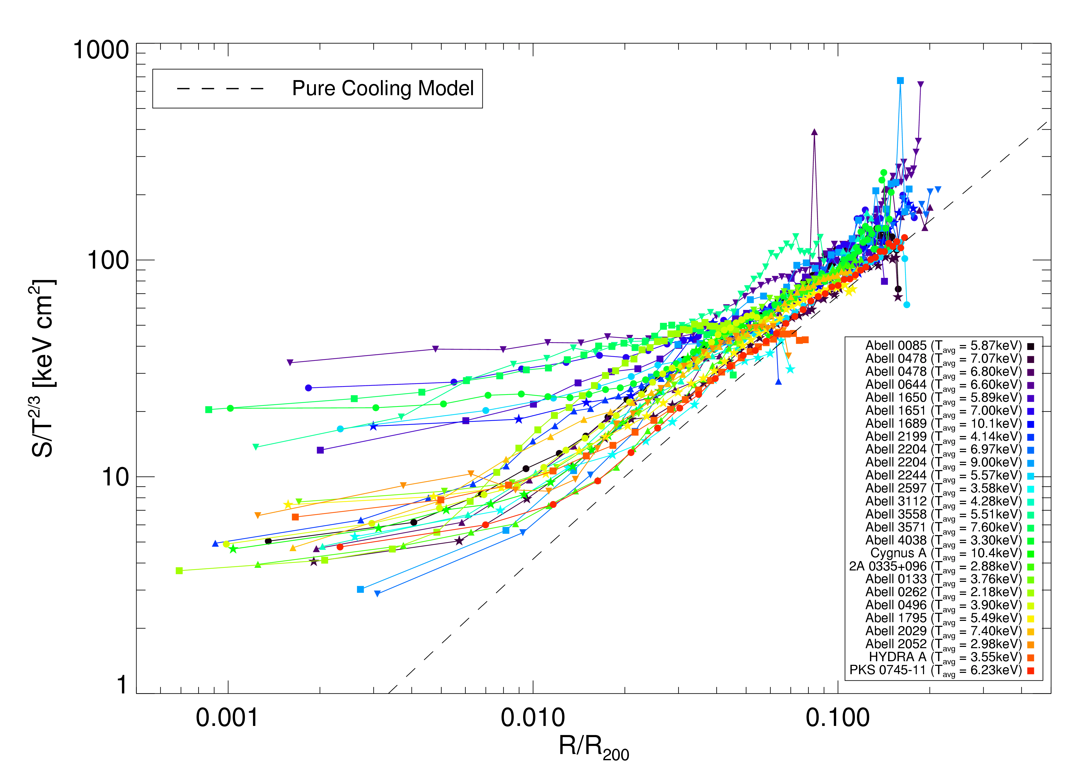
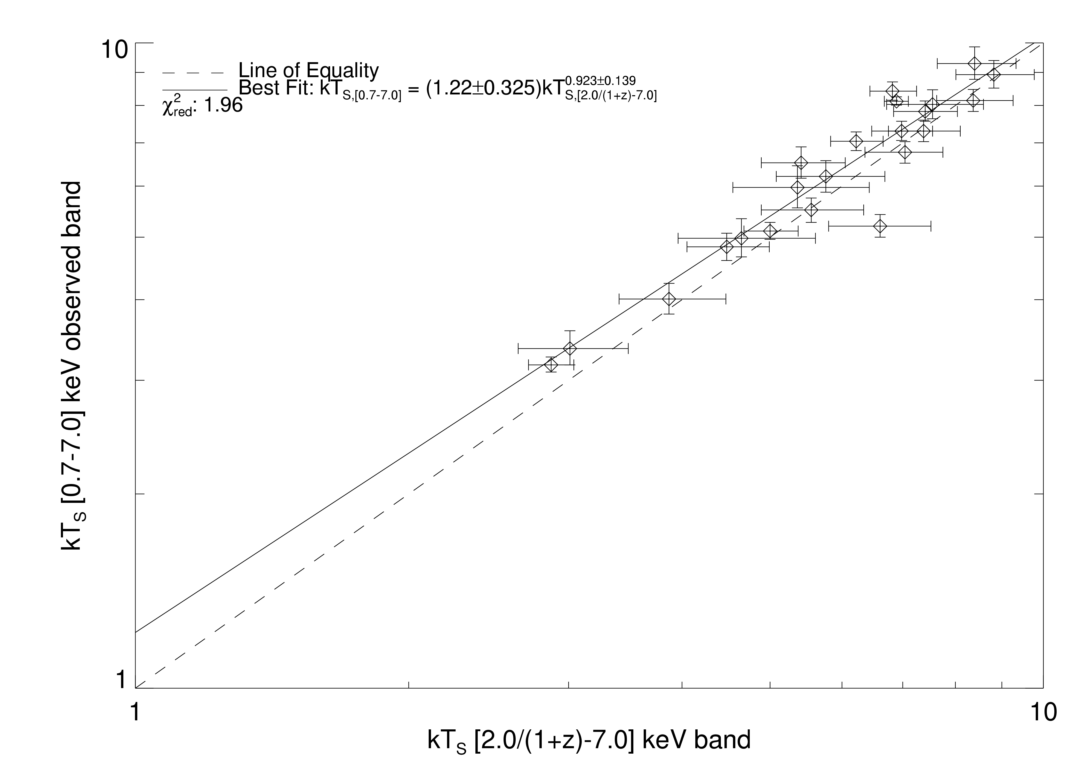
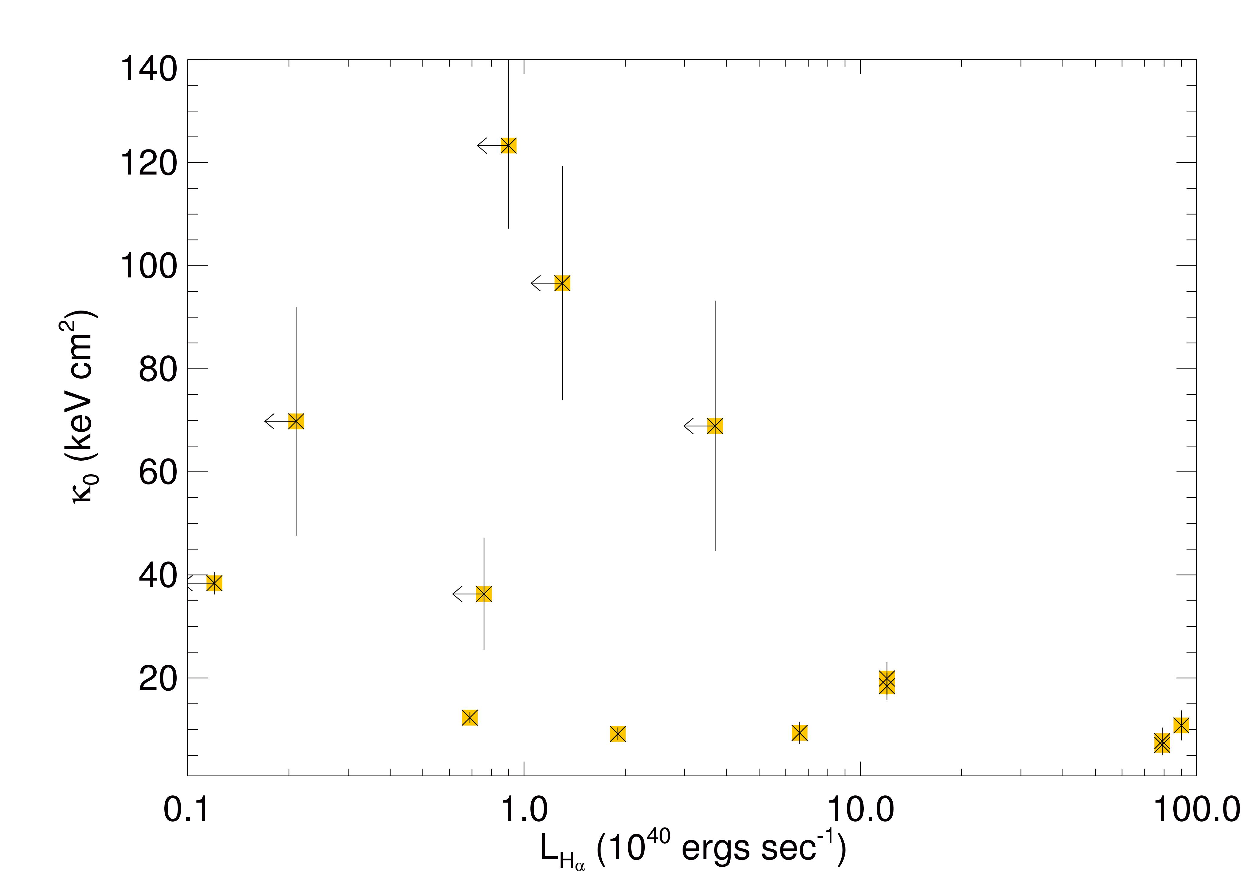
Studies of Entropy Distributions in X-ray Luminous Clusters of Galaxies
K.W. Cavagnolo, M.E. Donahue, G.M. Voit, M. Sun (Michigan State University),
A.E. Evrard (University of Michigan)
ABSTRACT
PROJECT SUMMARY
TEMPERATURE MAPS
We present entropy distributions for a sample of galaxy clusters from the Chandra public archive, which builds on our previous analysis of nine nearby, bright clusters. By studying the entropy distribution within clusters we quantify the effect of radiative cooling, supernovae feedback, and AGN feedback on cluster properties. This expanded sample contains both cooling flow and non-cooling flow clusters while our previous work focused only on classical cooling flow clusters. We also test the predictions of Mathiesen and Evrard (2001) by checking whether the spectral fit temperature is an unbiased estimate of the mass-weighted temperature, and how this estimate effects the calculation of the intracluster medium mass. Temperature and entropy maps for the clusters in our sample using the Voronoi Tessellation method as employed by Diehl et al (Diehl S., Statler T.S., 2005, MNRAS, 000, 1) will also be presented. These maps serve as a prelude to future work in which we will investigate how well such maps may represent the "true" projected quantities of a cluster by comparing deprojected real and simulated clusters from our sample and the Virtual Cluster Exploratory, respectively. Our discussion focuses on tying together feedback mechanisms with the breaking of self-similar relations expected in cluster and galaxy formation models.
The properties of a cluster’s entropy distribution can be understood by looking at the X-ray structure of the cluster.
Entropy distributions offer clues to understanding how large scale structure forms in the Universe.
Since the gravitational collapse of gas within a dark matter potential is adiabatic, the only mechanism by which entropy can be changed within the gas is by heating or cooling. Hence, detailed study of a cluster’s entropy distribution tells us about the feedback and cooling properties within the cluster.
For our purposes, entropy has been defined as S=Tn_{elec}^{-2/3}
By fitting and deprojecting a cluster’s temperature and density as a function of radius, we derive radial profiles of the entropy within the cluster.
We also apply a new binning technique to our cluster sample to examine the 2D structure of clusters.
We are also analyzing cluster X-ray spectra to search for signatures of hierarchical formation: the “Mathiesen/Evrard Test”.
Adaptive Binning Technique provided by S. Diehl and T. Statler of Ohio U. (poster 202.03; astro-ph/0512074)
Raw Image_x0003__x0003__x0016__x0003__x0016__x0003__x0003__x0016_
A.Binned S/N 5
We use a new adaptive binning technique from Diehl and Statler that preserves flux in bins that are adaptively sized to a specified signal-to-noise ratio.
Adaptively binned images which reproduce or enhance cluster sub-structure can be used to investigate the 2D temperature, pressure, and entropy structure caused by AGN feedback or mergers.
Temp. Map S/N 30
Interpolated Map
X-RAY CLUSTER PROPERTIES
HOW DO CLUSTER CORE
ENTROPY PROFILES DIFFER?
A catalog of maps for Chandra X-Ray cluster data will serve as a fiducial for making comparisons with similar maps generated from simulated cluster data of the Virtual Cluster Exploratory, a collection of public cluster simulations under development by A. Evrard at the University of Michigan.
The comparison between the models and these maps is to check check how well simulations explain the correlation and range of global, radial, spectral, and imaging characteristics in an ensemble of real clusters
Raw Image_x0003__x0003__x0016__x0003__x0016__x0003__x0003__x0016_
A.Binned S/N 5
ENTROPY PROFILES AND AGN FEEDBACK
The latest sample in our expanding entropy library is drawn from Peres, Fabian, et al. (1998) which analyzed cooling-flow cluster data taken with ROSAT. Our sample of Chandra observations, as is the sample of Peres/Fabian, is flux-limited down to 1.7x10⁻¹¹ ergs cm⁻² sec⁻¹. We then selected clusters with mass deposition rates >70 M_{O} yr⁻¹ to see if our predictions based on a previous entropy analysis of very luminous X-Ray cooling flow clusters are consistent (Donahue et al. 2005). The first results of this analysis are presented here, but the next phase of this project is to incorporate clusters which were not classified as cooling flows and explore how they fit into our model of cooling flow regulation via AGN feedback.
The profiles presented below come from deprojected, extrapolated spectral temperature fits for our sample. The two plots are of un-scaled and scaled entropy overlaid with the pure cooling model for a NFW profile. We are characterizing the radially-averaged entropy distributions in these clusters, together with their X-ray, optical (H-alpha), and radio properties, to determine what affects the central entropy in clusters.
Temp. Map S/N 30
Interpolated Map
Entropy profiles exceed a pure cooling model by several tens of keV cm². This is consistent with the AGN heating of cluster cores model detailed in Voit and Donahue (2005).
CAN WE SEE EVIDENCE FOR HIERARCHICAL STRUCTURE FORMATION IN X-RAY SPECTRA?
Spectrally resolved simulations of clusters by Mathiesen and Evrard (2001) predict a deviation in the mass-weighted average temperature of clusters that is dependent on the bandpass selected for spectral fitting. This effect may be indicative of cool gas accreting into clusters and can be tested by fitting temperatures in the [0.7-7.0]keV and [2.0_{rest}-7.0]keV bandpasses of Chandra observations. 113 (z<0.85) clusters have been taken from the Chandra archive as the foundation for a volume-limited sample. A sub-sample of clusters are being used to investigate the systematics of our analysis, including calibration and background uncertainties.
The long cooling times associated with boosted core entropy levels are consistent with AGN outbursts and subsequent regulation of cooling.
Early results show a weak trend toward hotter temperatures in [2.0_{rest}-7.0]keV compared to [0.7-7.0]keV, however this likely is the result of either not properly fitting the hard-background or including too much background with apertures which are too large.
0.33
Avg
Does Hα emission in cluster cores correlate with lower central entropy?
There is a trend such that the central entropy for clusters with more luminous Hα regions at their center tends to be low. Hα spectra taken using 2”x2” apertures centered on the cluster core.
CONCLUSIONS
REFERENCES
S
The entropy slope >100 kpc for the clusters we have studied so far are remarkably similar.
The central entropy levels, however, vary from 7-120 keV cm², and clusters like Coma have even higher entropy levels.
Clusters with large Hα and/or large radio luminosities tend to have the lowest central entropy and therefore the shortest central cooling times (Donahue et al. 2005, Donahue et al. astro-ph/0511401, Voit 2005).
Diehl S., Statler T.S., 2005, MNRAS, 000, 1
Donahue M.E., Voit G.M., O’Dea C.P., Baum S.A., Sparks W.B., 2005, ApJ, 630, 13
Donahue M.E., Horner D.J., Cavagnolo, K.W., and Voit G.M., 2005, astro-ph/0511401
Mathiesen B.F., Evrard, A.E., 2001, ApJ, 546, 100
Peres C.B., Fabian A.C., Edge A.C., Allen S.W., Johnstone R.M., and White D.A., 1998, MNRAS, 298, 416
Voit G.M., Donahue M.E., 2005, ApJ, 634, 955
Many regards to Chandra for grants: SAO AR3-4017A and SAO AR5-6016X, and also to NASA for funding

