Slide 1
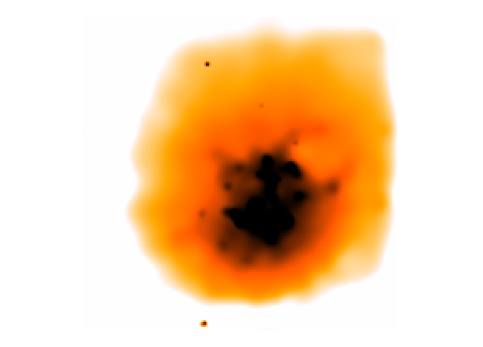
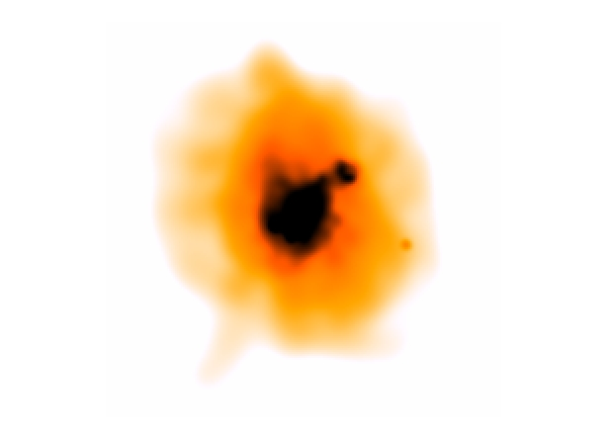
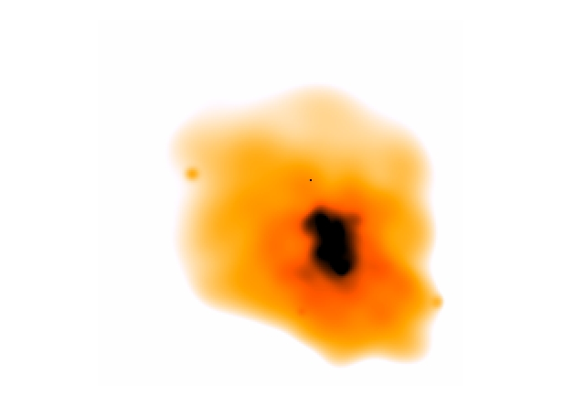
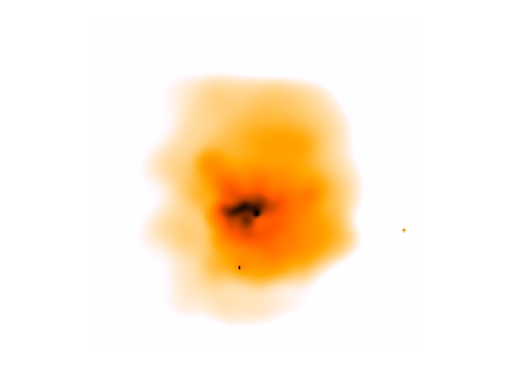
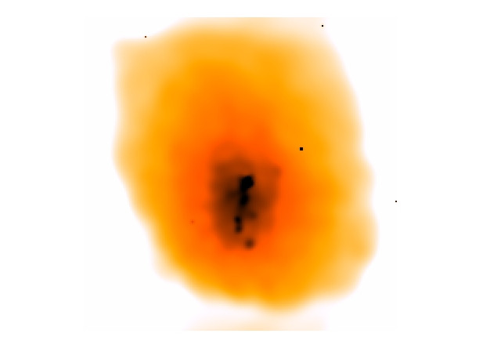
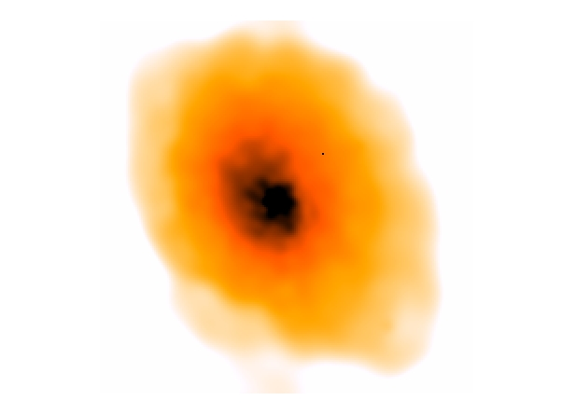
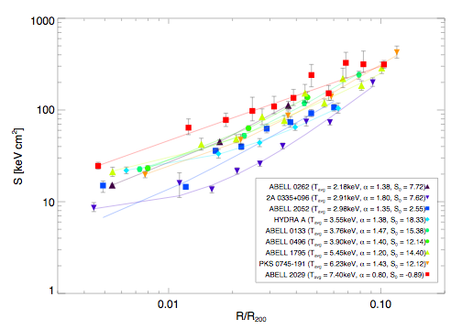
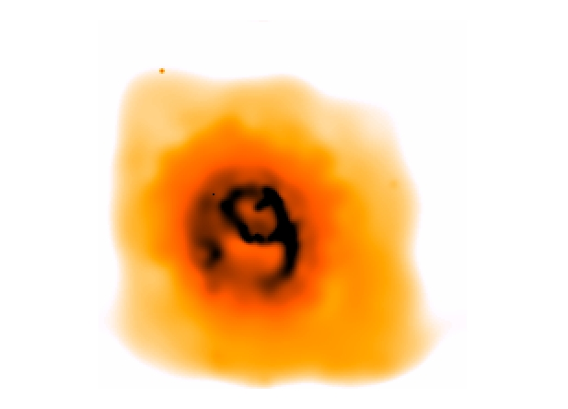
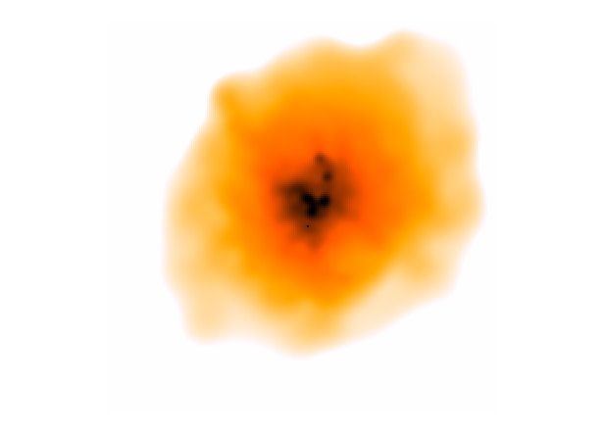
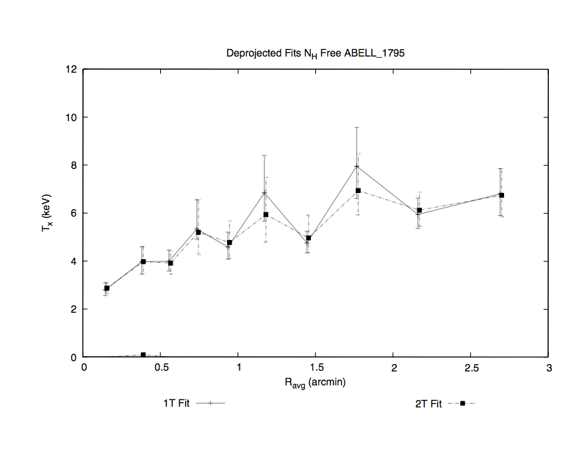
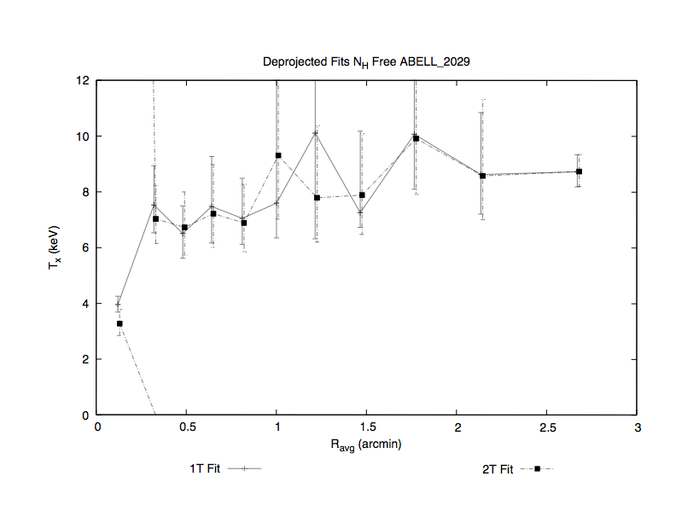
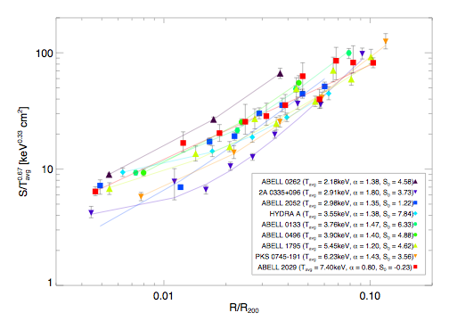
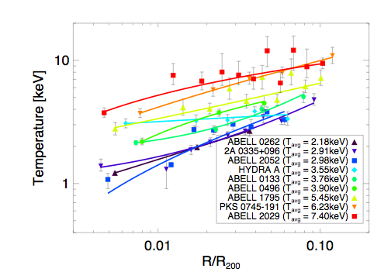
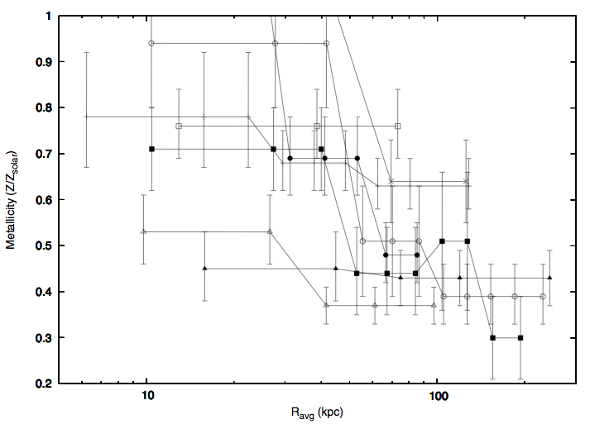
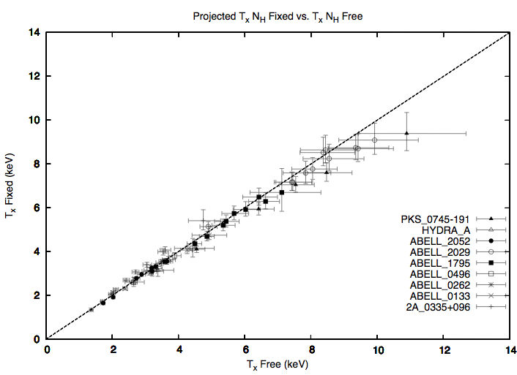
Entropy Distributions in the Cores of Nearby X-ray Luminous Clusters of Galaxies
K.W. Cavagnolo, M.E. Donahue, G.M. Voit (Michigan State University)
D.J. Horner (Goddard Space Flight Center), A.E. Evrard (University of Michigan)
ABSTRACT
PROJECT SUMMARY
DATA SAMPLE
We present entropy distributions for 11 bright galaxy clusters from the Chandra public archives. For each cluster, we fit projected one and two temperature mekal models using XSPEC to annular regions of 20,000 counts each. We also derived one- and two-temperature deprojected profiles in order to estimate radial entropy profiles. We present temperature and entropy maps for these clusters. We discuss how well such maps may represent the “true” projected quantities by comparing theoretical models from the Virtual Cluster Exploratory with maps derived in similar ways to our data. By studying the entropy distribution within clusters we quantify the effect of radiative cooling, supernovae feedback, and AGN feedback on cluster properties. We also discuss systematic uncertainties arising from assumptions made about geometric symmetry in deprojection models and the practice of fixing the absorption column density to the Galactic value and other systematics arising from treatment of the data.
The properties of a cluster’s entropy distribution can be fully understood by looking at the X-ray structure of the cluster
These cluster characteristics offer clues to better understanding the details of how large scale structure forms in the Universe
Since the gravitational collapse of gas within a dark matter potential is adiabatic, the only mechanism by which entropy can be changed within the gas is by heating or cooling
Hence, detailed study of a cluster’s entropy distribution tells us about the feedback and cooling properties within the cluster
For our purposes, entropy has been defined as S=Tn_{e}^{-2/3}
By fitting a cluster’s temperature and density as a function of radius, we derived a radial profile of the entropy within the cluster
The profiles serve as the foundation of a library that will be used to compare with theory (such as the VCE) and other X-ray observations to help explain the similarity breaking of clusters and groups
Our sample of clusters is composed
of apparently relaxed clusters from the
Chandra Public Archive
We selected clusters without
much substructure
2A 0335+096
z=0.0347
Abell 133
z=0.0554
25 kpc
50 kpc
50 kpc
Abell 262
z=0.0163
Abell 496
z=0.0317
50 kpc
Abell 2029
z=0.0761
DATA FITTING
Data was processed using CIAO 3.1.2 and CALDB 2.28
Fits were done with Mekal code in XSPEC 11.3.1 for several types of runs:
Galactic hydrogen column density (N_{H}) frozen or free combined with Fe free per annulus or free but tied to neighboring annuli
With each new version of the CALDB our fits required fewer second, cooler temperature components for the cluster cores
We also found that deprojection did not significantly change the temperature fits for the clusters
ENTROPY PROFILES
_x0010_
Entropy profiles go as R^{1.32} in the core with a low central value. When extended deep within the core the entropy does not flatten out as predicted by theory.
50 kpc
Abell 1795
z=0.0622
50 kpc
Abell 2052
z=0.0353
50 kpc
Hydra A
z=0.0522
50 kpc
PKS 0745-191
z=0.1028
50 kpc
When scaled to average cluster temperature to the 2/3 power, the profiles steepen and tighten their grouping; indicating that cooling/heating processes are similar
POWER LAW FITS OF ENTROPY PROFILES
The slopes of the entropy profiles were estimated with two models
S(r)=S₀+(r/r_{s})^{α} where S₀ is the initial entropy and r_{s} is an arbitrary scale radius
It is curious that the power law slope in the cooling/feedback dominated region of 0.1r₂₀₀ is so similar to the S∝r^{1.1} power law created by gravitational structure formation at r>0.1r₂₀₀
If heating is episodic in these clusters, then the time scale between episodes is 10⁷-10⁹ yrs
Fit temperature is plotted as a function of scaled virial radius. Average temperatures are those taken from ASCA. Fits extend to deep within most cluster cores.
CONCLUSIONS AND FUTURE WORK
Model 1
Our clusters have pronounced metallicity gradients with the highest values in the cores. We coupled neighboring annuli because metallicity measurements require more counts.
We must now consider what might be the source of heating and cooling that gives rise to the S∝r relation found in cluster cores
The sample will be expanded to more clusters from the Chandra archive because we have a pipeline for this type of analysis
The analysis will be furthered by creating 2D temperature and entropy maps of sample clusters
We will also be comparing observations to 2D projections of 3D models from Gus Evrard’s Virtual Cluster Exploratory
S(r)=A(r/<T>^{1/2})^{α} where A is a normalization value and r is in Mpc
Any model to compensate for radiative cooling must account for this S∝r slope in the region 0.01r₂₀₀-0.1r₂₀₀
QUESTIONS RAISED
When N_{H} was left free, the fit systematically increased for clusters with higher temperatures. This systematic is relevant for global temperature measurements of hot, high redshift clusters.
Why is the slope of entropy in the core, <0.1r₂₀₀, so similar to the slope at >>0.1r₂₀₀?
How does the projected appearance of a cluster relate to its virialized state?
Can we find observables that quantify a cluster’s position on the mass-temperature and mass-luminosity relations?
Is it possible to quantify the degree of virialization?
How well do deprojected quantities reflect the actual properties; does the assumption of symmetry in deprojection have a significant impact on our ability to accurately study clusters?
Model 2
The poor chi-squared in the model fits for 2A 0335+096 and Abell 2052 are related to the radio sources in their cores and the complex X-ray structure caused by these sources

