Slide 1

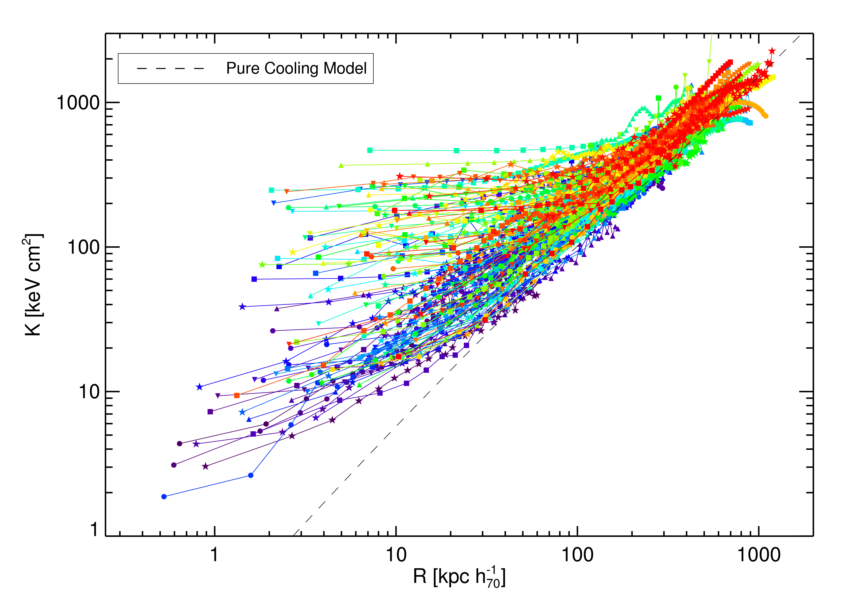
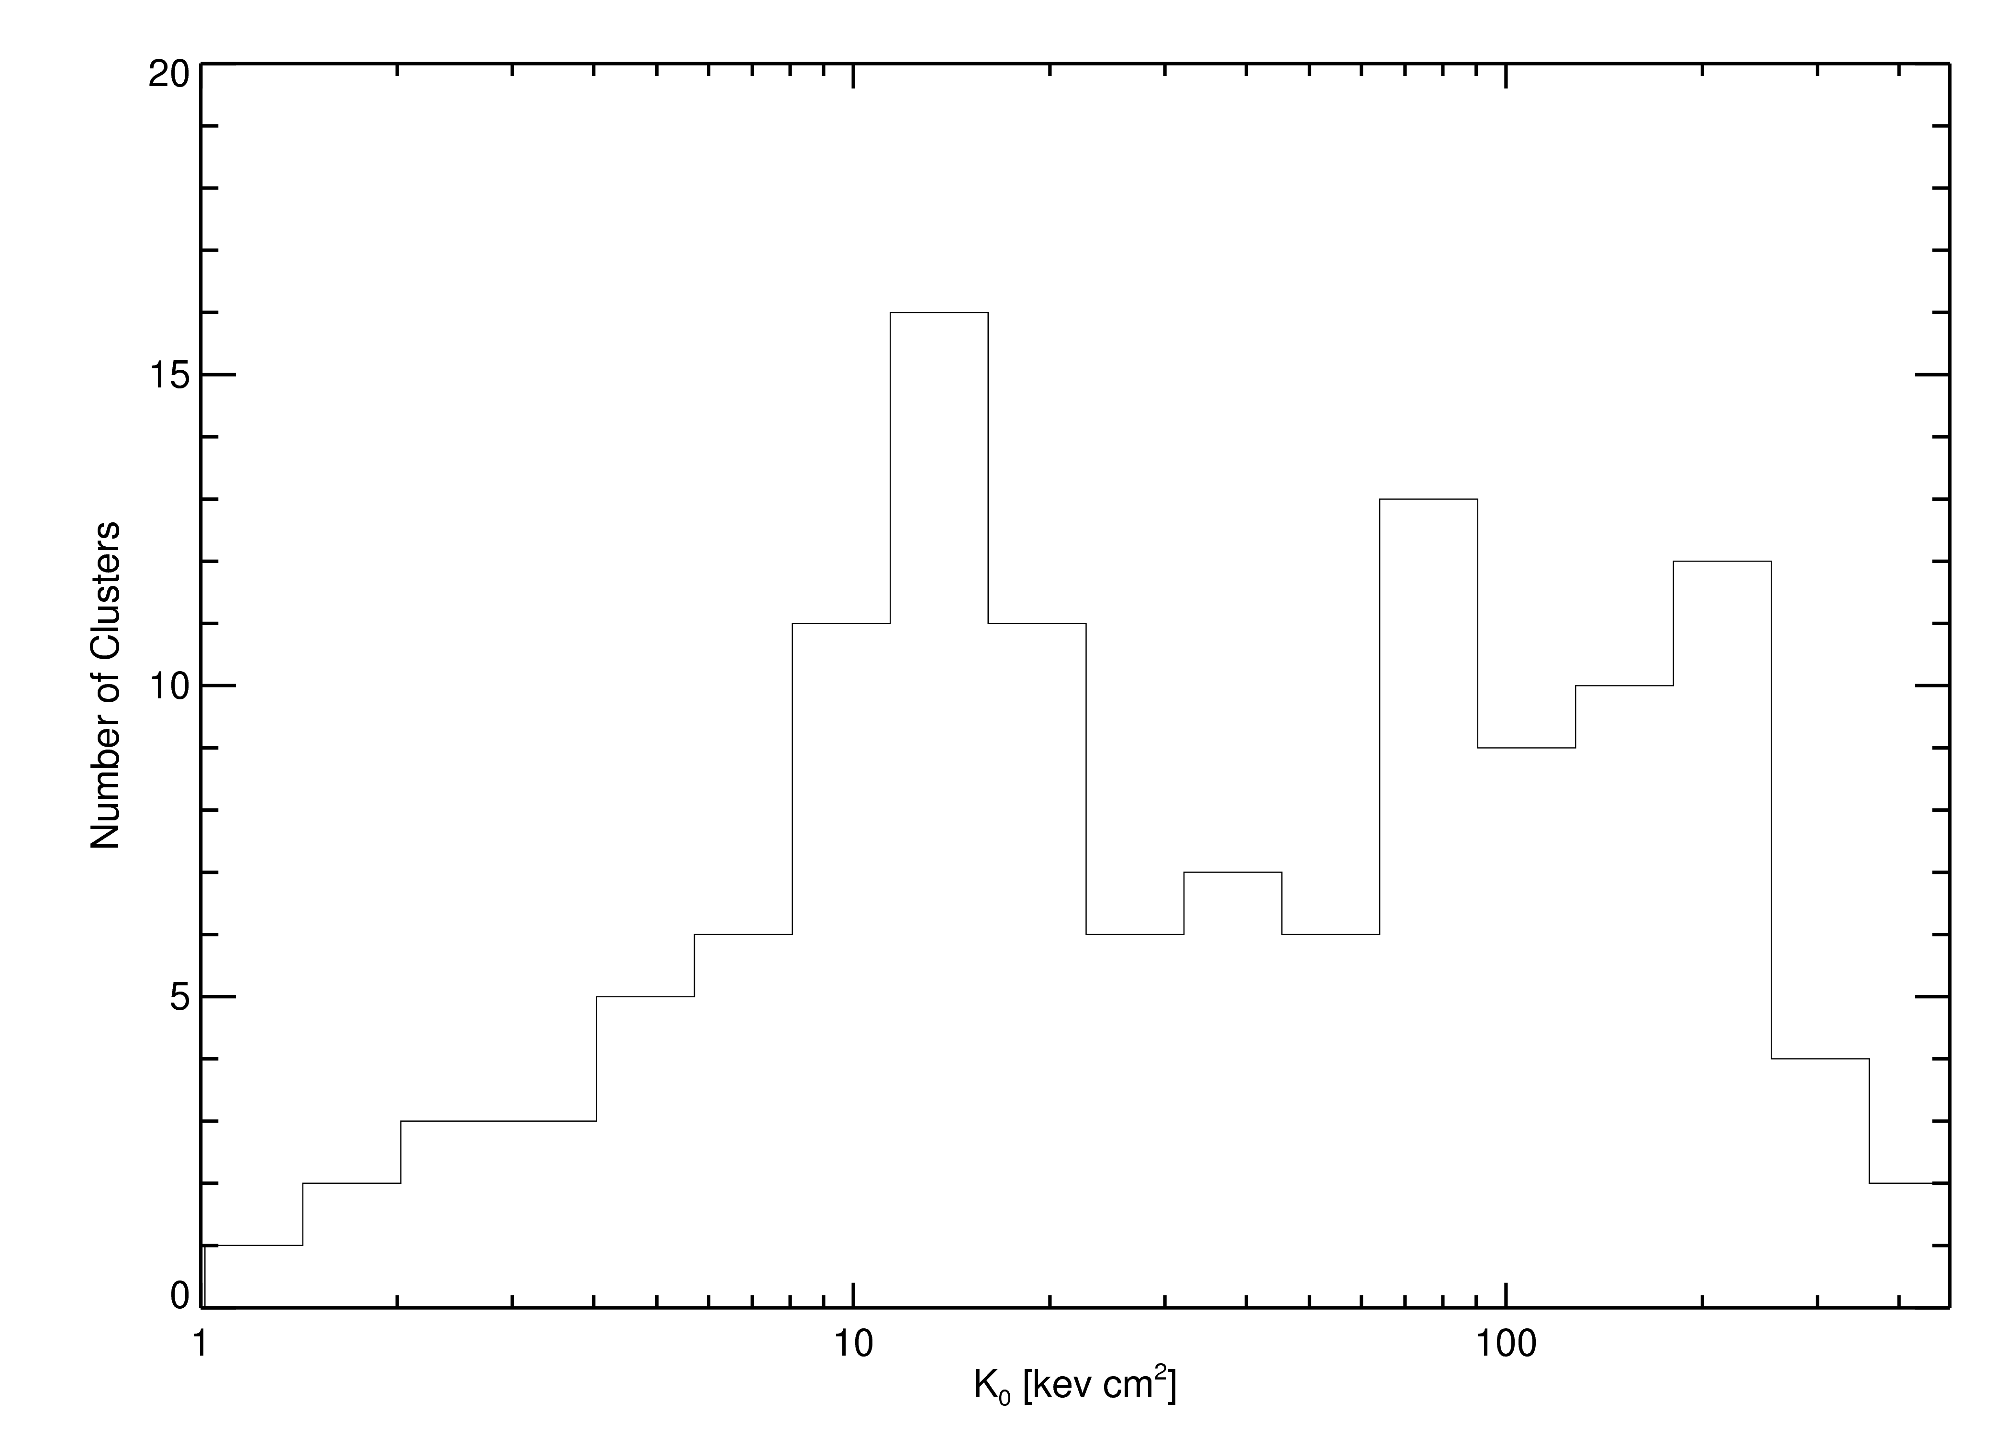
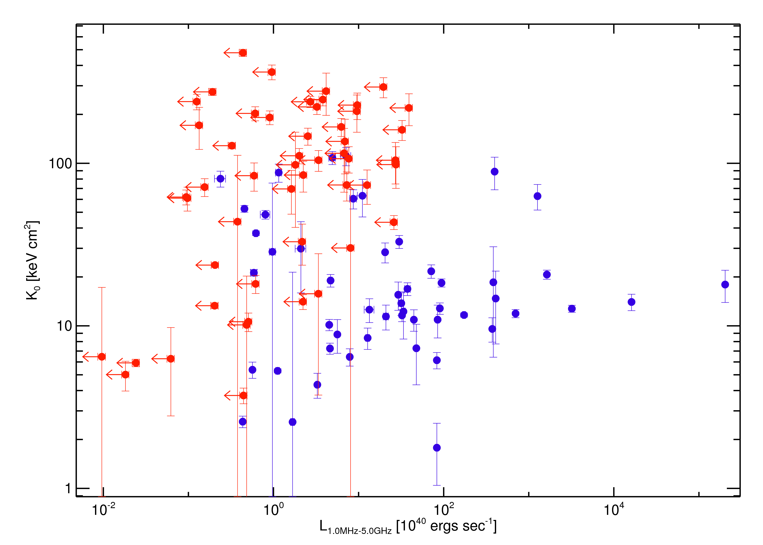
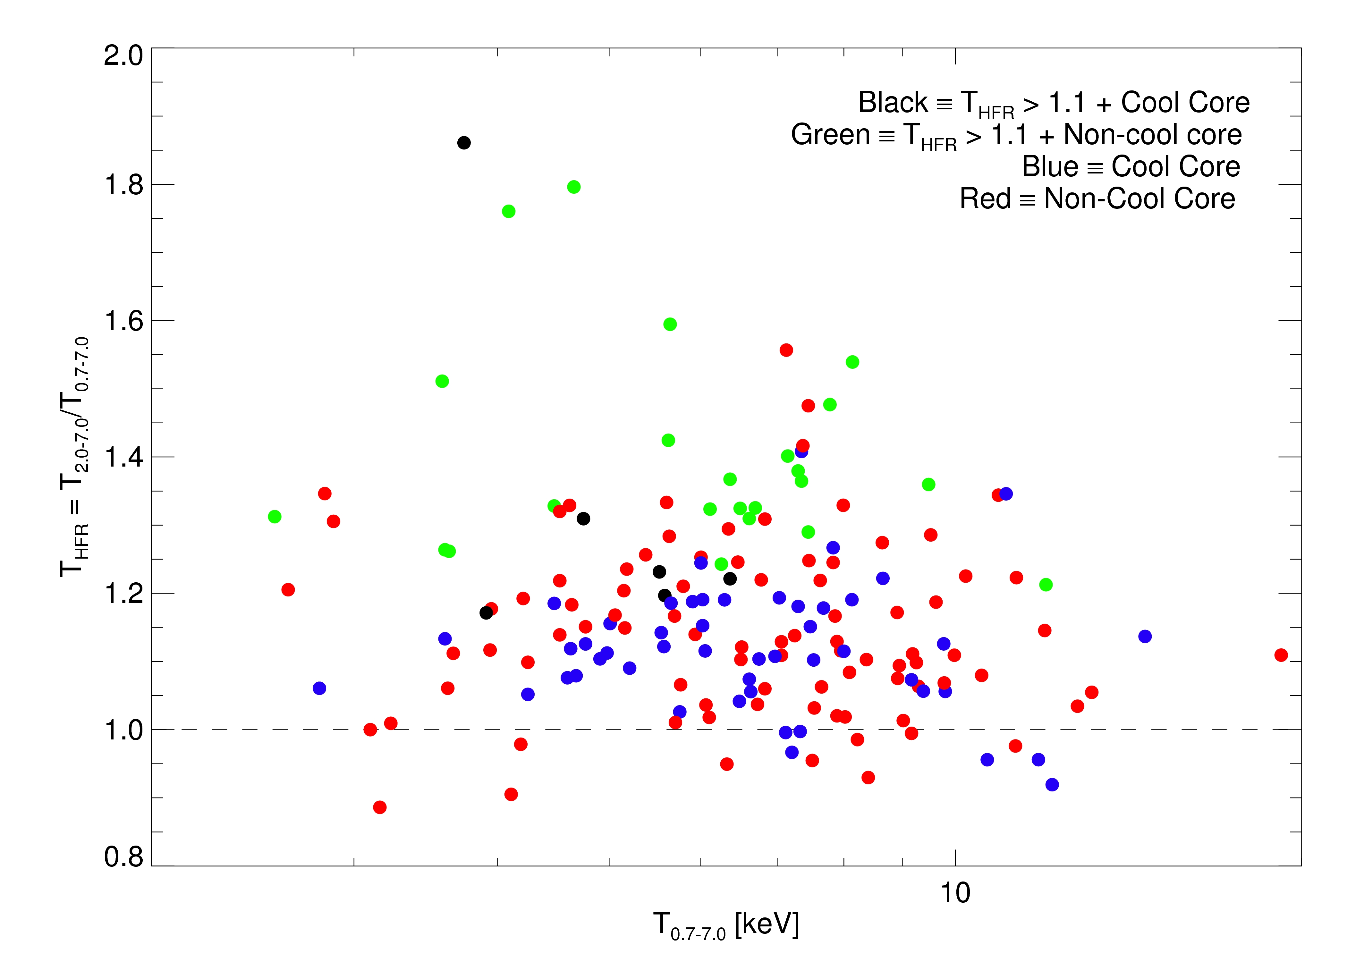
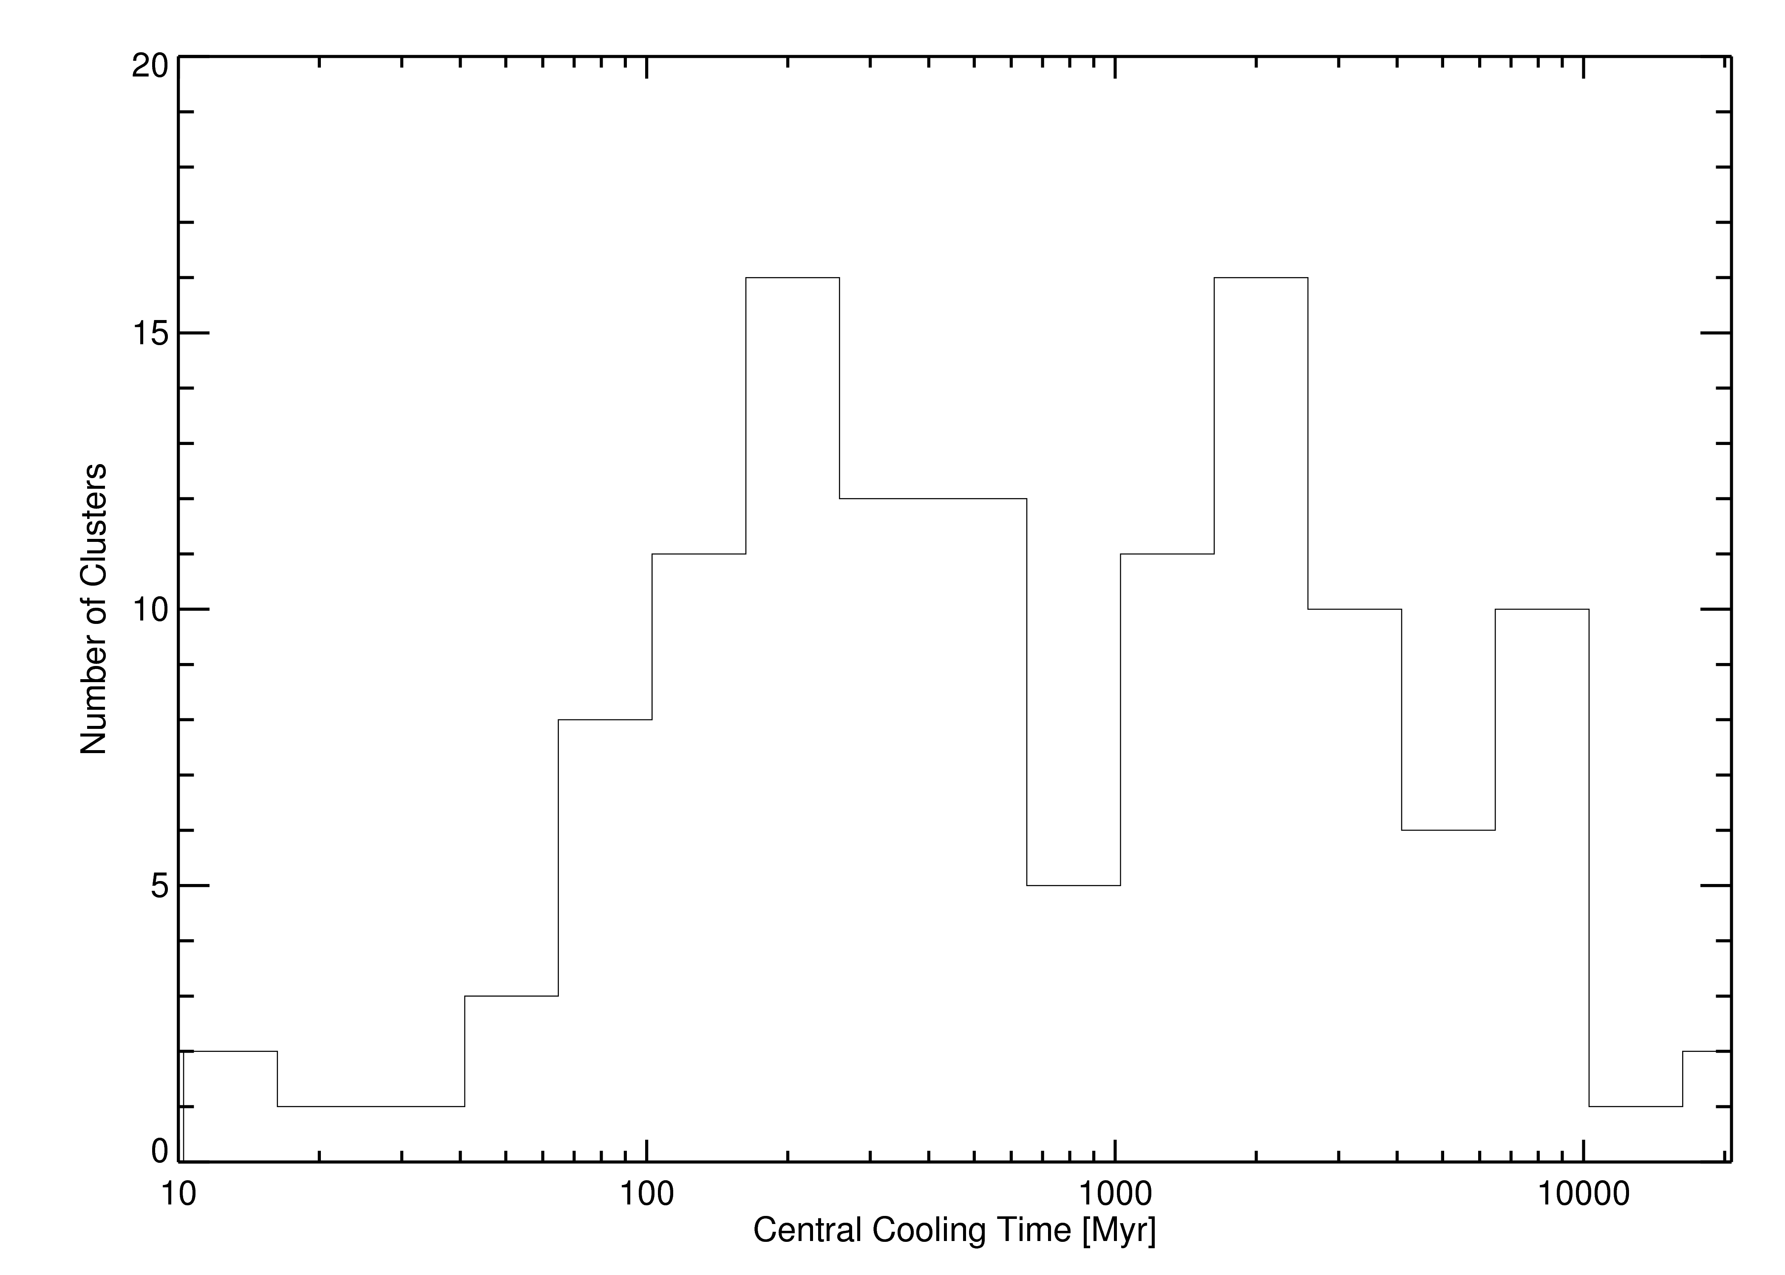
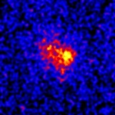
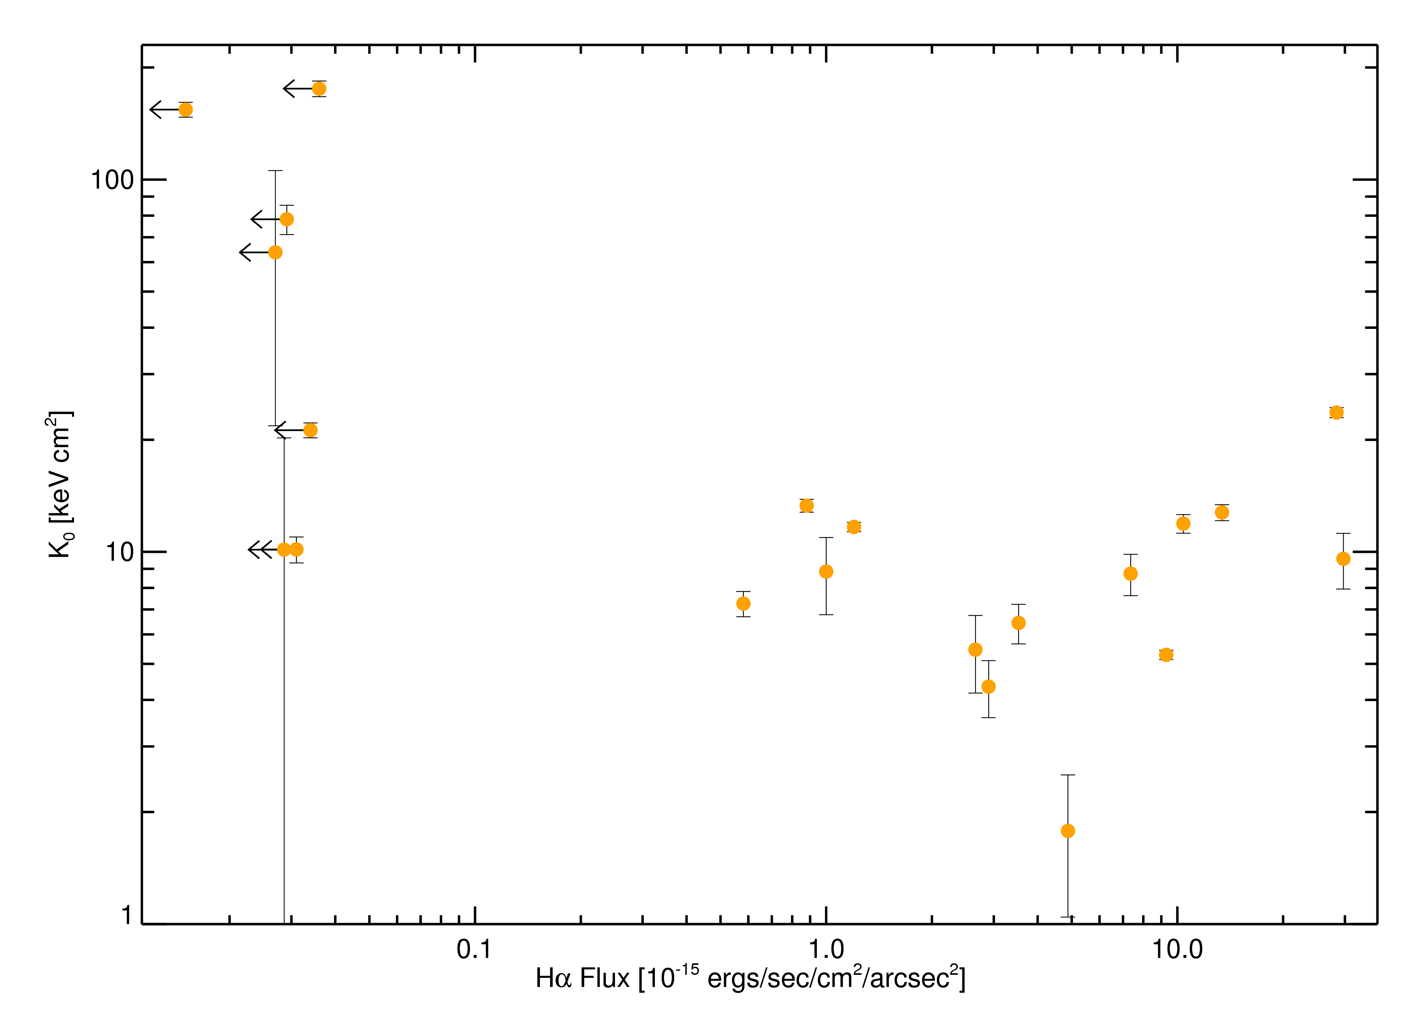
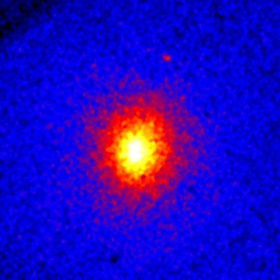
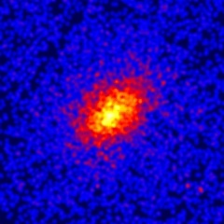
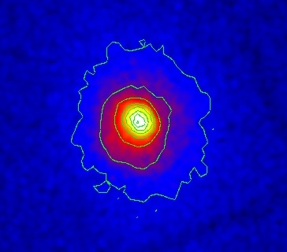
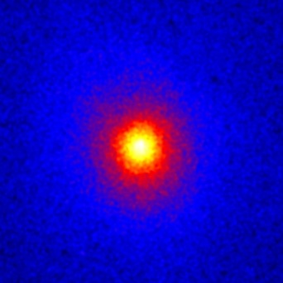
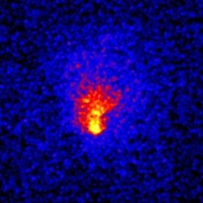




The Entropy-Feedback Connection and Quantifying Cluster Virialization
Kenneth W. Cavagnolo, Megan Donahue, G. Mark Voit, Ming Sun
Michigan State University
ABSTRACT
PROJECT SUMMARY
RADIAL ENTROPY DISTRIBUTIONS
Understanding the entropy of intracluster gas is the key to understanding 1) the feedback mechanisms active within clusters and 2) the role of the cluster environment on galaxy formation. In this poster, we present and describe radial profiles of the entropy distribution in cluster gas. We also examine a metric proposed to quantify the degree of cluster virialization which may in turn reduce scatter in scaling relations, thus increasing clusters utility in cosmological studies. We discuss the interconnection of central entropy with radio luminosity and Hα emission. We describe the distribution of central entropy levels in our sample and briefly discuss what can be learned about the range of central heating mechanisms and the timescale of feedback mechanisms from this distribution. We also present work in which we explore the band-dependence of the inferred X-ray temperature of the ICM for 179 clusters. We compare the X-ray temperatures inferred for single-temperature fits of global spectra when the energy range of the fit is 0.7-7.0 keV (full) and when the energy range is 2.0/(1+z)-7.0 keV (hard). We find, on average, the hard-band temperature is significantly higher than the full-band temperature. Upon further exploration, we find the ratio THARD/TFULL is enhanced preferentially for clusters which are known merger systems and for clusters which do not have detectable cool cores.
Intracluster gas entropy distributions offer clues to better understanding the mechanisms which break self-similarity through feedback and cooling -- such as AGN and star formation (SNe).
We define entropy, via temperature and density, as the adiabatic constant : K(r)=TX(r)n_{e}(r)^{-2/3}.
X-ray properties of a cluster depend on the dark matter potential shape and entropy distribution -- entropy is more fundamental than either temperature or density alone.
Our collection of clusters from the Chandra Data Archive covers a wide variety of core properties, including classic “cooling flows”, mergers, and non-cool core clusters.
Chandra has fundamentally altered the view of clusters as being either “relaxed” or “unrelaxed”.
For cluster's to yield 1% level constraints on the dark energy equation of state we must quantify their dynamical state and correct for deviations from mean mass-scaling relations.
Testing metrics for quantifying relaxation is an important next step.
Curves color coded by global cluster temperature: blue=cool, red=hot
WK0R: THE RADIO STATION FOR LOW ENTROPY
BIMODALITY IN CENTRAL ENTROPY
Central radio luminosities calculated using flux of NVSS source within 20'' of cluster centroid.
Range of radio luminosities decreases with increasing central entropy.
Suggests accretion onto supermassive black hole in cD galaxy (the driver of radio feedback) preferentially occurs in low entropy environments.
Entropy profiles derived for 131 clusters from their individual deprojected surface brightness (0.7-2.0 keV) and temperature profiles.
Profiles pile-up near ~10-20 keV cm² and ~100-300 keV cm² with low scatter; this is consistent with models of AGN feedback.
Moderate central entropy of ~50 keV cm² is moestly populated, is this indicative of a short-lived cluster phase?
Profiles converge to self-similar values at R > 100 kpc.
Entropy pedestal in cluster cores is nearly universal.
Are clusters without central pedestal on the verge of an AGN outburst?
High K0 favors low LRADIO
Red circles are upper-limits of non-detections in NVSS (flimit~2.5 mJy)
QUANTIFYING CLUSTER VIRIALIZATION
Mathiesen & Evrard '01 suggests hard-band (2.0rest-7.0 keV) to full-band (0.7-7.0 keV) temperature ratio (THFR) as a diagnostic for cluster dynamical state.
For a collection of 193 clusters from the Chandra Data Archive we measure a net skew for THFR of 1.16 (σ = 0.12; σμεαν = 0.01).
We find increasing values of THFR favor non-cool core clusters and mergers; we suggest THFR is connected to cluster dynamic state.
THFR is a promising complimentary aspect-independent measure for a cluster's degree of relaxation.
Shown above is the distribution of central entropy for our full cluster collection
Central entropy looks to be bi-modal with characteristic values of 15±11 keV cm² and 153±88 keV cm².
Moderate central entropy clusters may be highly transient or are uninteresting and thus not observed with Chandra.
Abell 2199:
very young radio source embedded in a strong cool core.
Questions which still need answers in feedback models:
How is large scale ICM structure regulating central gas accretion?
What does the AGN energy injection function look like?
How exactly is energy of radio and non-thermal sources thermalized?
RXJ1525
Bi-modality indicates there are characteristic timescales for feedback and cooling. Central cooling times of ~100 Myr is consistent with AGN feedback model. Clusters with long central cooling times may have experienced powerful AGN outbursts in addition to strong merger events.
OPTICAL LINE EMISSION AND LOW ENTROPY GAS
Recent merger?
Does Hα emission in cluster cores correlate with lower central entropy?
There is a trend such that the central entropy for clusters with luminous Hα regions at their center tends to be low. Suggests star formation is fueled by low entropy gas condensing onto/into galaxies near core.
“Mind the gap”: is star formation in cluster cores like a toggle -- on or off?
CONCLUSIONS
S
AGN activity and star formation are associated with low central entropy, suggesting that feedback is regulating cooling in cluster cores.
A central entropy pedestal of ~10 keV cm² is a characteristic feature of cooling flow clusters.
The distribution of central entropies in clusters appears to be bimodal.
THFR is correlated with dynamical state of a cluster, making it a promising tool for quantifying cluster relaxation.
A963
A68
RXJ1720
A1689
MS1008
CC & lenser
NCC & lenser
Strong cold front
NCC & merger
NCC & merger

