Slide 1
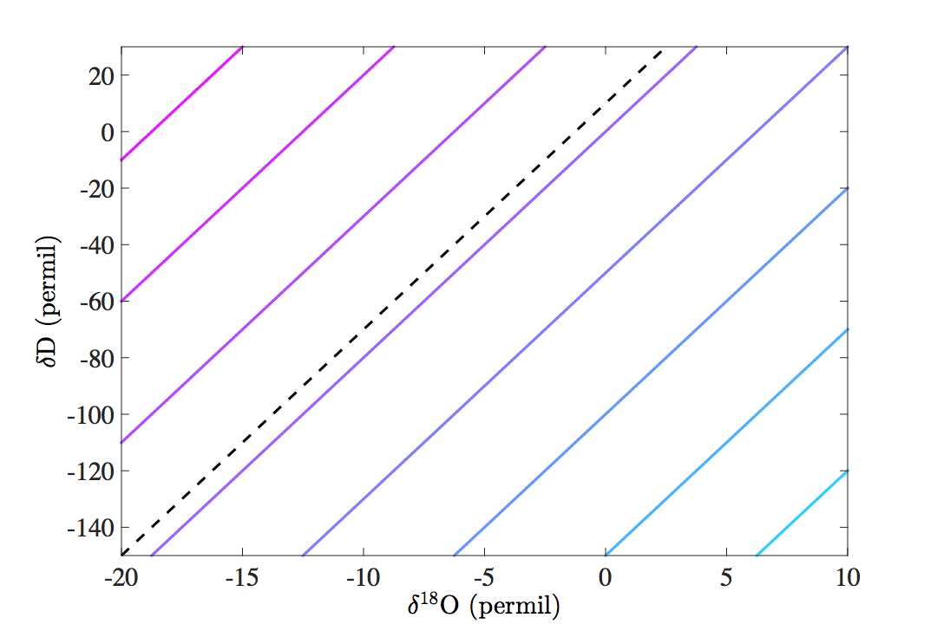
150
d-excess
100
Leaf water
Source water
Transpiration
50
d-excess = 0 permil
GMWL
-50
-100
-150
-200

