Slide 1

The Crypt-Keepers
Kevin Black, Thomas Johnson, Davis Knowles, Stephanie Nickerson, Jourdan Norman & Vaughn Smith

Slide 2

Crypto What?
A digital currency used to buy goods and services
Uses online ledger instead of physical bills or coins
Uses blockchain technology – decentralized across many computers
More than 10,000 different publicly traded cryptocurrencies
Total Value as of 5/27 was in excess of $1.7 trillion, according to CoinMarketCap
Bitcoin is the most popular
Currency of the future!?!?!?

Slide 3

Project Overview
Developed a machine learning model to predict Bitcoin prices utilizing historical data

Slide 4

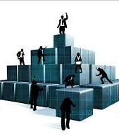
How Did We Build It

Slide 5


Slide 6


Opportunities
Expand the model to compare other commodities (i.e., oil), traditional currencies or other cryptocurrencies

Slide 7


