Slide 1
Intro to Docker
A Local Cassandra Cluster
KC Berg
CTO @ JumpCloud Inc.
http://www.jumpcloud.com

Slide 2
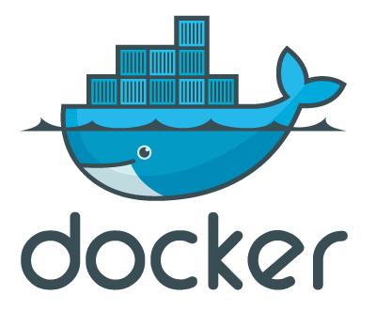
What is Docker?
A daemon that manges Linux containers
https://www.docker.io

Slide 3
What does Docker manage and use?
LCX Linux Containers | http://linuxcontainers.org/
AUFS (stackable unification fs) | http://aufs.sourceforge.net/
Linux cgroups | http://en.wikipedia.org/wiki/Cgroups
IP network namespace | http://blog.scottlowe.org/2013/09/04/introducing-linux-network-namespaces
https://www.docker.io/learn_more/

Slide 4
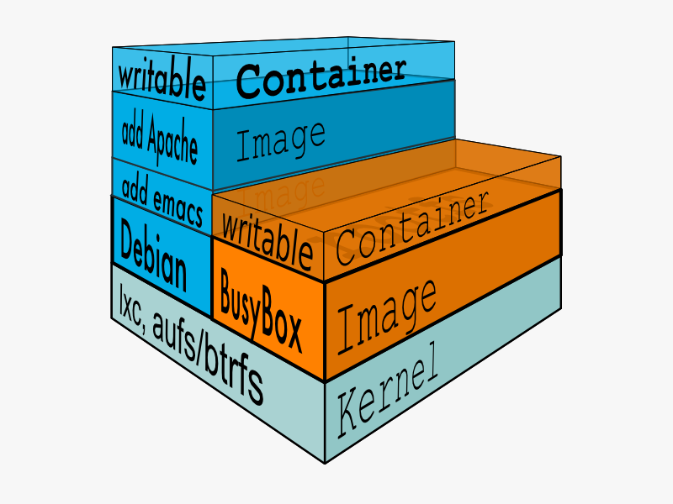
Docker lets you build in layers!

Slide 5
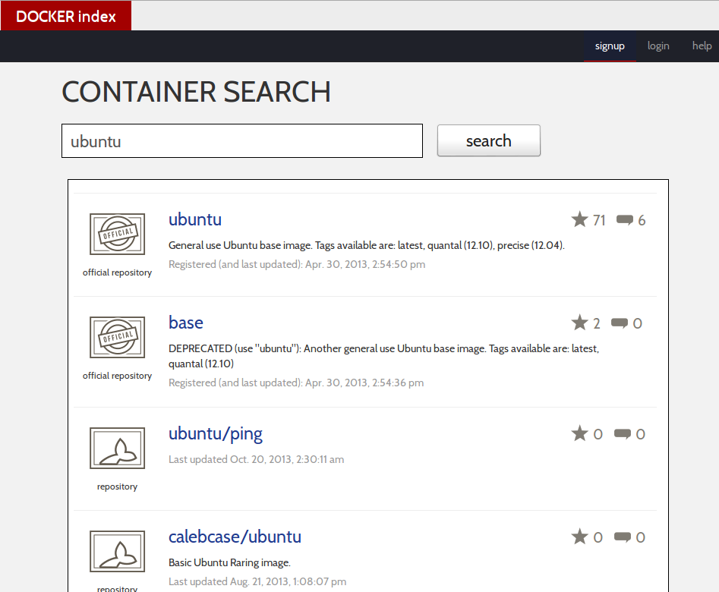
Docker has a community!
https://index.docker.io

Slide 6
Find and pull an image from index.docker.io
# docker search ubuntu
NAME DESCRIPTION STARS TRUSTED
...
gerhard/ubuntu Ubuntu 13.04 base image 0
dockerfile/ubuntu Trusted Ubuntu ... 5 [OK]
...
# docker pull dockerfile/ubuntu
Pulling repository dockerfile/ubuntu
1a791700f081: Download complete
27cf78414709: Download complete
b750fe79269d: Download complete
...

Slide 7
Show Docker images
# docker images
REPOSITORY TAG IMAGE ID CREATED VIRTUAL SIZE
kc/cassandra latest 96cdc1037f00 2 days ago 2.378 GB
kc/cassandra-ctrl latest 8c34f7b09557 2 days ago 2.418 GB
dockerfile/ubuntu latest 1a791700f081 5 days ago 488.4 MB
<none> <none> 24a9394847c4 7 days ago 442.9 MB
poklet/cassandra latest 10e76b316b41 2 weeks ago 541.4 MB
ubuntu-bind9 latest 6b13bb872630 3 weeks ago 257.8 MB
ubuntu 12.04 8dbd9e392a96 9 months ago 128 MB
ubuntu latest 8dbd9e392a96 9 months ago 128 MB
ubuntu precise 8dbd9e392a96 9 months ago 128 MB
ubuntu 12.10 b750fe79269d 10 months ago 175.3 MB
ubuntu quantal b750fe79269d 10 months ago 175.3 MB
#

Slide 8
Let's run a container!
Start an interactive container
# docker run -t -i -name test dockerfile/ubuntu /bin/bash
[ root@ae081774b702:~ ]$
List running containers
# docker ps
CONTAINER ID IMAGE COMMAND CREATED STATUS PORTS NAMES
ae081774b702 dockerfile/ubuntu:latest /bin/bash 2 min... Up 2 min.. test

Slide 9
What's happening here?
Docker started a container based on the ubuntu image we pulled
/bin/bash is running in the container
The container will only run as long as /bin/bash is running

Slide 10
This image doesn't have what I need
[ root@ae081774b702:~ ]$ python
bash: python: command not found
[ root@ae081774b702:~ ]$ apt-get install -y python
Reading package lists... Done
Building dependency tree
...
Setting up python (2.7.3-0ubuntu7) …
[ root@ae081774b702:~ ]$ python -V
Python 2.7.3
[ root@ae081774b702:~ ]$

Slide 11
Save your change as an image!
[ root@ae081774b702:~ ]$ exit
# docker ps
CONTAINER ID IMAGE COMMAND CREATED STATUS PORTS NAMES
# docker ps -a
CONTAINER ID IMAGE COMMAND CREATED STATUS ... NAMES
ae081774b702 dockerfile/ubuntu:latest /bin/bash 22 min.. Exit 0 test
be0651c5aff0 dockerfile/ubuntu:latest /bin/bash 24 min.. Exit 0 silly_archimede
# docker commit test kc/ubuntu-python
4ba854b9ad80c3acfa7d90b3a1fca10ee0c6e1309647adb628752f1982d982e5
# docker images
REPOSITORY TAG IMAGE ID CREATED VIRTUAL SIZE
kc/ubuntu-python latest 4ba854b9ad80 25 seconds ago 514 MB
kc/cassandra latest 96cdc1037f00 2 days ago 2.378 GB
kc/cassandra-ctrl latest 8c34f7b09557 2 days ago 2.418 GB
...

Slide 12
Let's try something cool!
A local Cassandra cluster
Host system (10.x.x.x dhcp)
Cassandra network
(192.168.1.0/24)
node1 (seed)
192.168.1.1
node4 (seed)
192.168.1.4
ctrl
192.168.1.100
node2
192.168.1.2
node5
192.168.1.5
node3
192.168.1.3
node6
192.168.1.6

Slide 13
Some networking
Pipework - https://github.com/jpetazzo/pipework
Modify your host iptables
# cat ./enable-forwarding-for-interface.sh
#/bin/bash
iface=”br1”
iptables -I FORWARD 1 -i $iface -o $iface -j ACCEPT
iptables -I FORWARD 2 -i $iface ! -o $iface -j ACCEPT
iptables -I FORWARD 3 -o $iface -m conntrack --ctstate RELATED,ESTABLISHED -j ACCEPT
# sudo ./enable-forwarding-for-interface.sh

Slide 14
Get a Cassandra base image and customize it
Host shell
# docker pull poklet/cassandra
# docker run -u root -name cassandra_base -t -i poklet/cassandra /bin/bash
bash-4.1#
Container shell
bash-4.1# curl -s https://raw2.github.com/jpetazzo/pipework/master/pipework > /usr/local/bin/pipework
bash-4.1# chmod 755 /usr/local/bin/pipework
bash-4.1# vi /usr/local/bin/start.sh

Slide 15
Checkout /usr/local/bin/start.sh
Container shell
#!/usr/bin/env bash
IP=`hostname --ip-address`
SEEDS="$1,$IP"
echo Configuring Cassandra to listen at $IP, with seeds: $SEEDS
DEFAULT=/etc/cassandra/default.conf
CONFIG=/etc/cassandra/conf
rm -rf $CONFIG
mkdir -p $CONFIG
cp $DEFAULT/cassandra.yaml $DEFAULT/log4j-server.properties $CONFIG
sed -i -e "s/^listen_address.*/listen_address: $IP/" $CONFIG/cassandra.yaml
sed -i -e "s/^rpc_address.*/rpc_address: 0.0.0.0/" $CONFIG/cassandra.yaml
sed -i -e "s/- seeds: \"127.0.0.1\"/- seeds: \"$SEEDS\"/" $CONFIG/cassandra.yaml
echo Starting Cassandra...
cassandra -f

Slide 16
Modify /usr/local/bin/start.sh
Container shell
#!/usr/bin/env bash
getIP() {
inet=(`ip addr show eth1 | grep "inet\ "`)
tmp=(${inet[1]//\// })
echo $tmp
}
/usr/local/bin/pipework --wait
IP=`getIP`
SEEDS="$1,$IP"
echo Configuring Cassandra to listen at $IP, with seeds: $SEEDS
DEFAULT=/etc/cassandra/default.conf
CONFIG=/etc/cassandra/conf
rm -rf $CONFIG
mkdir -p $CONFIG
cp $DEFAULT/cassandra.yaml $DEFAULT/log4j-server.properties $DEFAULT/cassandra-env.sh $CONFIG
sed -i -e "s/^listen_address.*/listen_address: $IP/" $CONFIG/cassandra.yaml
sed -i -e "s/^rpc_address.*/rpc_address: 0.0.0.0/" $CONFIG/cassandra.yaml
sed -i -e "s/- seeds: \"127.0.0.1\"/- seeds: \"$SEEDS\"/" $CONFIG/cassandra.yaml
echo Starting Cassandra...
cassandra -f

Slide 17
Modify /etc/cassandra/default.conf/cassandra-env.sh
Container shell
...
# jmx: metrics and administration interface
#
# add this if you're having trouble connecting:
# JVM_OPTS="$JVM_OPTS -Djava.rmi.server.hostname=<public name>"
#
# see
# https://blogs.oracle.com/jmxetc/entry/troubleshooting_connection_problems_in_jconsole
# for more on configuring JMX through firewalls, etc. (Short version:
# get it working with no firewall first.)
inet=(`ip addr show eth1 | grep "inet\ "`)
ip=(${inet[1]//\// })
JVM_OPTS="$JVM_OPTS -Dcom.sun.management.jmxremote.port=$JMX_PORT"
JVM_OPTS="$JVM_OPTS -Dcom.sun.management.jmxremote.ssl=false"
JVM_OPTS="$JVM_OPTS -Dcom.sun.management.jmxremote.authenticate=false"
JVM_OPTS="$JVM_OPTS -Djava.rmi.server.hostname=$ip"
JVM_OPTS="$JVM_OPTS $JVM_EXTRA_OPTS"

Slide 18
Save your changes as a new image!
# docker commit cassandra_base kberg/cassandra
800cbfc2d92cfd6cab839b337a0cb3f1e1a352622fd4ece9e95f77934c66b75a
#

Slide 19
Let's orchestrate a node!
# mkdir cassandra-data
# vim start-node.sh
#!/bin/bash
projectdir="/home/kberg/docker-cassandra-cluster"
nodename=$1
nodeip=$2
seeds=$3
datadir=$projectdir/cassandra-data/$nodename
mkdir -p $datadir
docker run -v $datadir:/var/lib/cassandra:rw -name $nodename -d kberg/cassandra start.sh $seeds
./pipework br1 $nodename $nodeip/24
:wq!
#

Slide 20
Let's orchestrate all the nodes!
# vim start-all-nodes.sh
#!/bin/bash
nodes="node1:192.168.1.1 \
node2:192.168.1.2 \
node3:192.168.1.3 \
node4:192.168.1.4 \
node5:192.168.1.5 \
node6:192.168.1.6"
seeds="192.168.1.1,192.168.1.4"
for n in $nodes
do
parts=(${n//:/ })
echo "./start-node.sh ${parts[0]} ${parts[1]} $seeds"
./start-node.sh ${parts[0]} ${parts[1]} $seeds
done
#

Slide 21
Fire up the cluster!
# ./start-all-nodes.sh
./start-node.sh node1 192.168.1.1 192.168.1.1,192.168.1.4
040dbaa5ef3016b2f7272f97e76c735832c4ad23c543647257991f944409d8fd
./start-node.sh node2 192.168.1.2 192.168.1.1,192.168.1.4
af3f9a9f34be3f6fb28c5da57b158b81cfb22d4233ecfcbe0053e18d76fa122e
./start-node.sh node3 192.168.1.3 192.168.1.1,192.168.1.4
508cb02f4c4dd85d1912ad814e194df4e99961c0aa1cb3179d844c9b17a92433
./start-node.sh node4 192.168.1.4 192.168.1.1,192.168.1.4
430f94beac5ca1cf665b2bdf9a3860a5b9cbfe901f348447e4f5e188e8522559
./start-node.sh node5 192.168.1.5 192.168.1.1,192.168.1.4
220dcaf208e6f90f971034dfd31fcd3f7fb8f2b93b686ccc57622da1d4770158
./start-node.sh node6 192.168.1.6 192.168.1.1,192.168.1.4
4d3aae38e70eced26b4e137efd3fe4167d4213df8cfa6fbf34d61435bb97dd01
#

Slide 22
Inspect the fruits of our labor.
# docker ps
CONTAINER ID IMAGE COMMAND CREATED STATUS PORTS NAMES
4d3aae38e70e kberg/cassandra:latest start.sh 192.168.1.1 3 minutes ago Up 3 minutes node6
220dcaf208e6 kberg/cassandra:latest start.sh 192.168.1.1 3 minutes ago Up 3 minutes node5
430f94beac5c kberg/cassandra:latest start.sh 192.168.1.1 3 minutes ago Up 3 minutes node4
508cb02f4c4d kberg/cassandra:latest start.sh 192.168.1.1 3 minutes ago Up 3 minutes node3
af3f9a9f34be kberg/cassandra:latest start.sh 192.168.1.1 3 minutes ago Up 3 minutes node2
040dbaa5ef30 kberg/cassandra:latest start.sh 192.168.1.1 3 minutes ago Up 3 minutes node1
# brctl show br1
bridge name bridge id STP enabled interfaces
br1 8000.26af10921bb7 no vethl7114
vethl7226
vethl7331
vethl7440
vethl7575
vethl7827

Slide 23
Let's access the cluster network
Container shell
# docker run -name ctrl -t -i kberg/cassandra /bin/bash
bash-4.1# ifconfig
eth0 Link encap:Ethernet HWaddr DA:5C:D7:72:DF:3E
inet addr:172.17.0.16 Bcast:0.0.0.0 Mask:255.255.0.0
inet6 addr: fe80::d85c:d7ff:fe72:df3e/64 Scope:Link
UP BROADCAST RUNNING MTU:1500 Metric:1
RX packets:21 errors:0 dropped:0 overruns:0 frame:0
TX packets:6 errors:0 dropped:0 overruns:0 carrier:0
collisions:0 txqueuelen:1000
RX bytes:4389 (4.2 KiB) TX bytes:468 (468.0 b)
lo Link encap:Local Loopback
inet addr:127.0.0.1 Mask:255.0.0.0
inet6 addr: ::1/128 Scope:Host
UP LOOPBACK RUNNING MTU:65536 Metric:1
RX packets:0 errors:0 dropped:0 overruns:0 frame:0
TX packets:0 errors:0 dropped:0 overruns:0 carrier:0
collisions:0 txqueuelen:0
RX bytes:0 (0.0 b) TX bytes:0 (0.0 b)
bash-4.1#
Host shell
# ./pipework br1 ctrl 192.168.1.100/24
#

Slide 24
Let's access the cluster network (cont.)
Container shell
bash-4.1# ifconfig
eth0 Link encap:Ethernet HWaddr DA:5C:D7:72:DF:3E
inet addr:172.17.0.16 Bcast:0.0.0.0 Mask:255.255.0.0
inet6 addr: fe80::d85c:d7ff:fe72:df3e/64 Scope:Link
UP BROADCAST RUNNING MTU:1500 Metric:1
RX packets:21 errors:0 dropped:0 overruns:0 frame:0
TX packets:6 errors:0 dropped:0 overruns:0 carrier:0
collisions:0 txqueuelen:1000
RX bytes:4389 (4.2 KiB) TX bytes:468 (468.0 b)
eth1 Link encap:Ethernet HWaddr F6:62:B4:AD:8C:75
inet addr:192.168.1.100 Bcast:0.0.0.0 Mask:255.255.255.0
inet6 addr: fe80::f462:b4ff:fead:8c75/64 Scope:Link
UP BROADCAST RUNNING MULTICAST MTU:1500 Metric:1
RX packets:11 errors:0 dropped:0 overruns:0 frame:0
TX packets:3 errors:0 dropped:0 overruns:0 carrier:0
collisions:0 txqueuelen:1000
RX bytes:2677 (2.6 KiB) TX bytes:238 (238.0 b)
lo Link encap:Local Loopback
inet addr:127.0.0.1 Mask:255.0.0.0
inet6 addr: ::1/128 Scope:Host
UP LOOPBACK RUNNING MTU:65536 Metric:1
RX packets:0 errors:0 dropped:0 overruns:0 frame:0
TX packets:0 errors:0 dropped:0 overruns:0 carrier:0
collisions:0 txqueuelen:0
RX bytes:0 (0.0 b) TX bytes:0 (0.0 b)
bash-4.1#

Slide 25
Let's access the cluster network (cont.)
Container shell
bash-4.1# nodetool -h 192.168.1.1 status
xss = -ea -javaagent:/usr/share/cassandra/lib/jamm-0.2.5.jar -XX:+UseThreadPriorities -XX:ThreadPriorityPolicy=42
-Xms7954M -Xmx7954M -Xmn800M -XX:+HeapDumpOnOutOfMemoryError -Xss256k
Datacenter: datacenter1
=======================
Status=Up/Down
|/ State=Normal/Leaving/Joining/Moving
-- Address Load Tokens Owns (effective) Host ID Rack
UN 192.168.1.5 40.81 KB 256 31.6% 90200dde-48ab-424d-b438-336fd0caa1cf rack1
UN 192.168.1.4 57.18 KB 256 35.2% 0eda9b84-6a2c-41ea-8a00-a576f4312612 rack1
UN 192.168.1.6 40.85 KB 256 34.2% 8d98f96d-b823-4903-b802-861dbe3d1811 rack1
UN 192.168.1.1 40.85 KB 256 32.9% f358da74-7194-438e-8abd-4c062fe94347 rack1
UN 192.168.1.3 40.85 KB 256 31.2% 74162ad5-44de-472b-a7aa-596277acc163 rack1
UN 192.168.1.2 40.81 KB 256 34.9% d7b19bf8-bf6f-46b4-8779-20239dee3848 rack1
bash-4.1#

Slide 26
What else?
Expose ports between containers
Publish container ports to the host
Publish your images to index.docker.io
Attach to running containers
Inspect logs of containers
Import/Export images as tar files
Link containers together
Do all this same stuff with the REST interface instead of the cmd line

Slide 27
Q/A
http://www.docker.io/
https://github.com/jpetazzo/pipework
http://www.datastax.com/docs
https://github.com/kcberg/docker-cassandra-cluster-presentation

