Slide 1
CMP_SC / INFOTC 4630
FALL 2026
Snake Escape
Prototype I
Presented By Kyle Blank

Slide 2
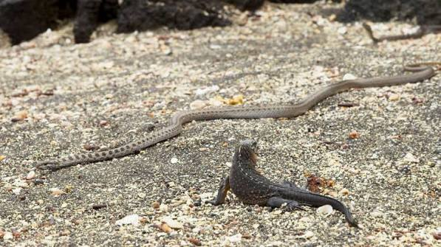
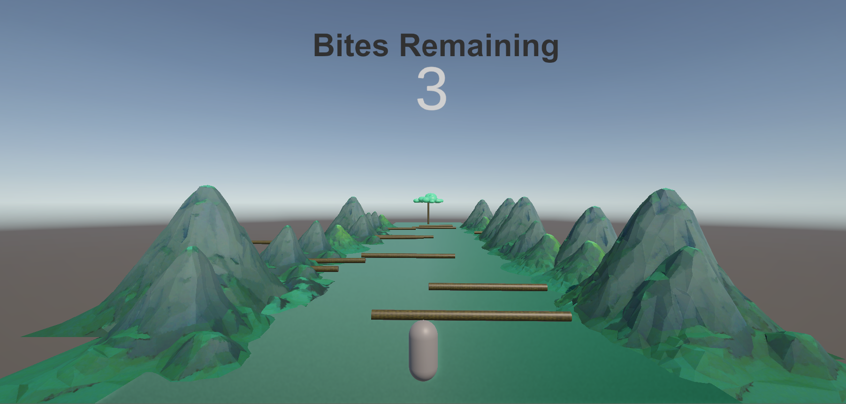
CMP_SC / INFOTC 4630 · GAME DEVELOPMENT
The idea in one sentence
Maneuver obstacles and snakes to get to the tree before being bitten 3 times.
My goal is to make a increasingly fast paced escape runner inspired by the Galapagos Iguana and racer snakes.

Slide 3
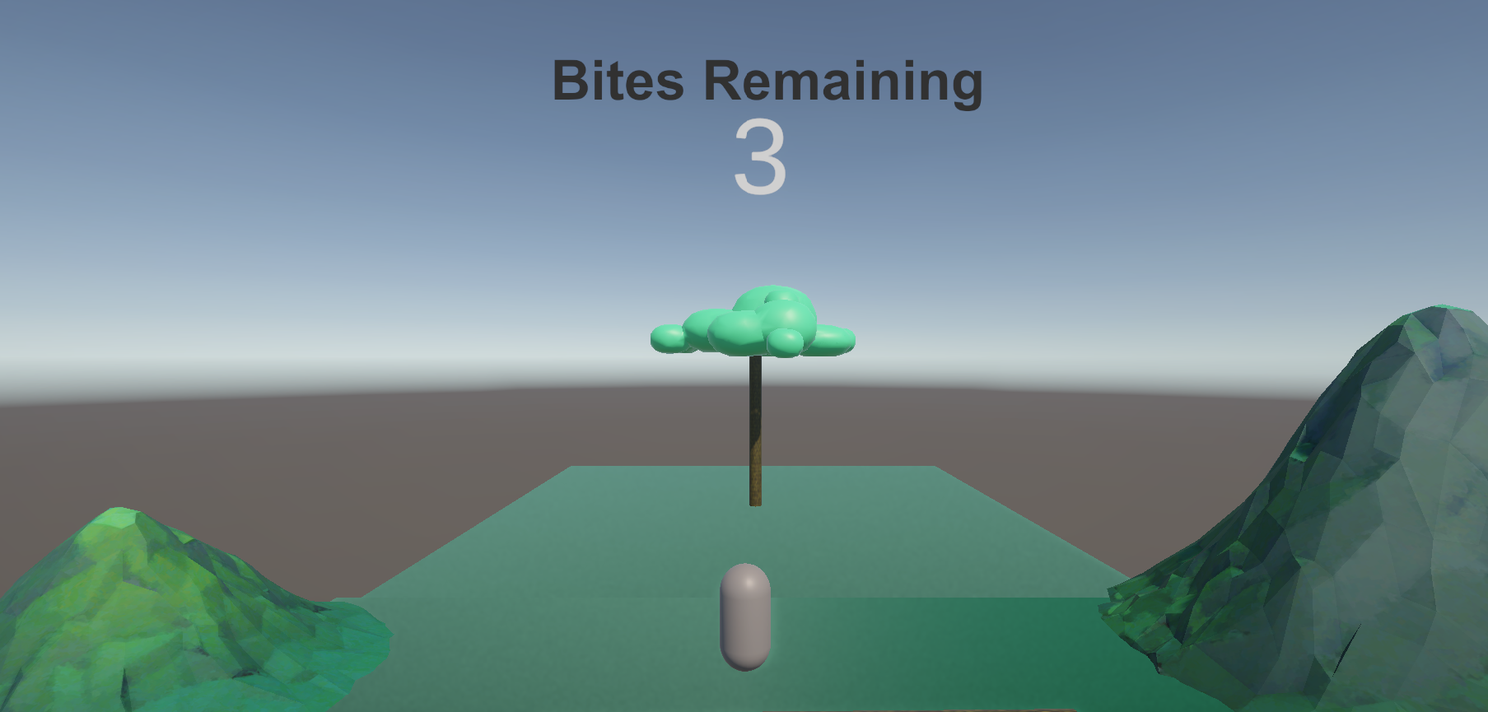
CMP_SC / INFOTC 4630 · GAME DEVELOPMENT
1
Main gameplay loop
Spawn at top of lane
6
2
Repeat / end
Maneuver down the canyon
Continue while Playing
Restart on Win / Loss
5
3
Update progress
Avoid snakes (can be bitten 3 times)
4
Win after 3 deliveries,
Lose when lives reach 0
Reach the safe zone (tree)

Slide 4
CMP_SC / INFOTC 4630 · GAME DEVELOPMENT
Required systems implemented
Player | Movement + Object interactions
Snake | Spawn, Movement
Game manager | Lives(0-3), respawn on fail, next level on win
Events | Destination and hazard triggers

Slide 5
CMP_SC / INFOTC 4630 · GAME DEVELOPMENT
One improvement after Playtesting
Observation: Players enjoyed the momentum building aspect, and scoring did not reset
What I changed
Kept original movement mechanics (will still be altered a bit later), and fixed scoring system after a win/loss
Result to show: a screenshot, a before/after comparison

Slide 6
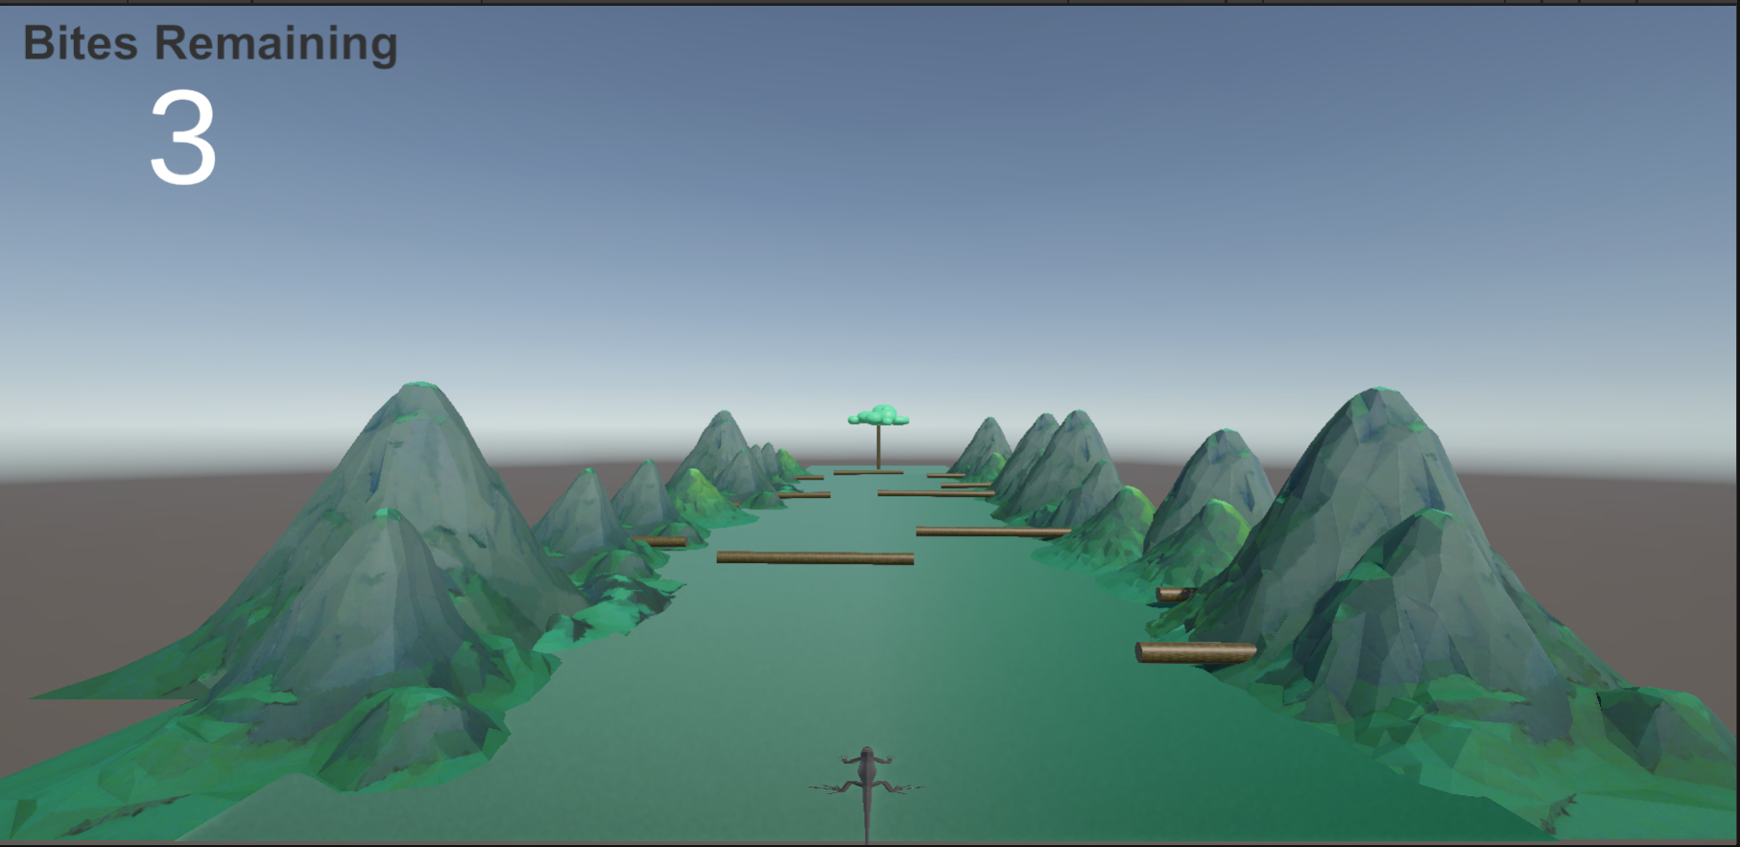
CMP_SC / INFOTC 4630 · GAME DEVELOPMENT
Live demo
A short-recorded backup would be helpful, (in case of any issues).

Slide 7
CMP_SC / INFOTC 4630 · GAME DEVELOPMENT
What would I improve next?
I would like to make a more snake looking prefab with animation for the snake obstacles, and make it so that the level generates as the player moves through it.
Thanks! Questions?

