Slide 1
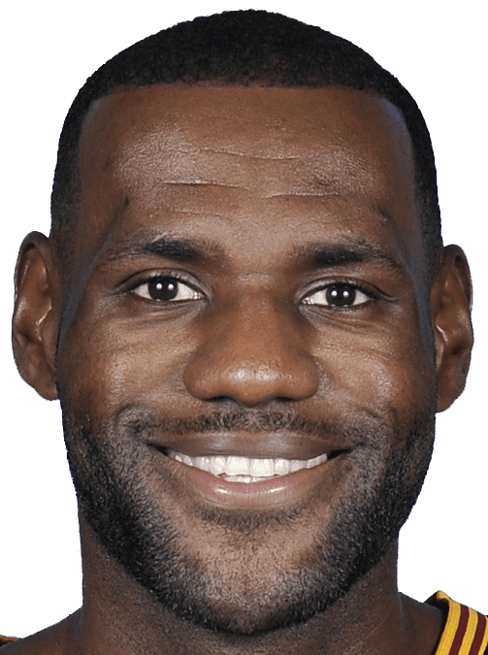
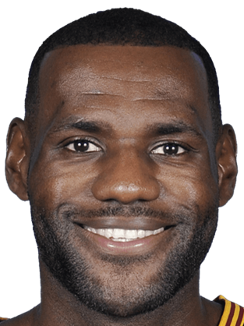
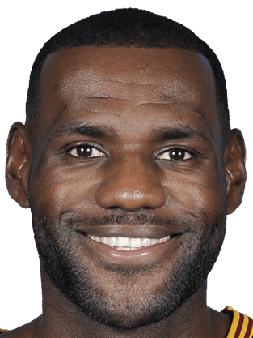
http://blog.siriusxm.com/2016/09/22/nba-radios-top-25-players-5-1-lebron-james-still-reigns-supreme/

Slide 2



