Slide 1
Evaluation of Collisional-Radiative Model for Argon I on the Texas Helimak
Qualifier Seminar by
K. Carter Dodd
Adviser: Kenneth Gentle, William Rowan

Slide 2
Goals
Understand and test structure of a collisional-radiative model for Ar I.
Compare predictions of model using the Texas Helimak.

Slide 3
Emission Spectroscopy
Passively gain information on state of plasmas
  Plasma constituents, impurities, ionization states
  Density
  Temperature
  Bulk motion

Slide 4
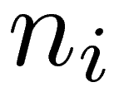
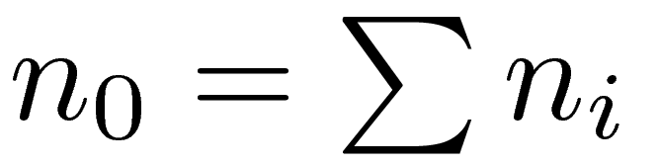
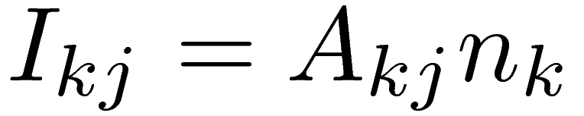
Atomic States as Populations
Each state is independent population.
Spectral line intensity proportional to population density.

Slide 5
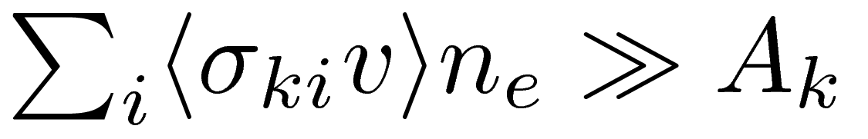
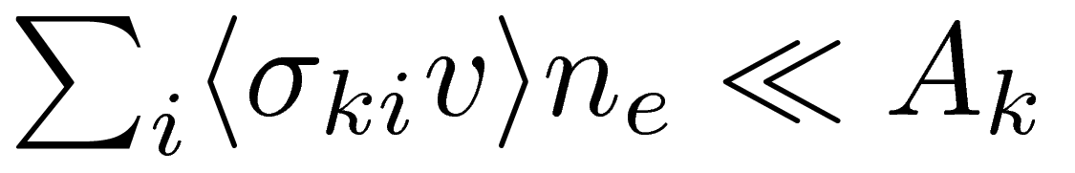
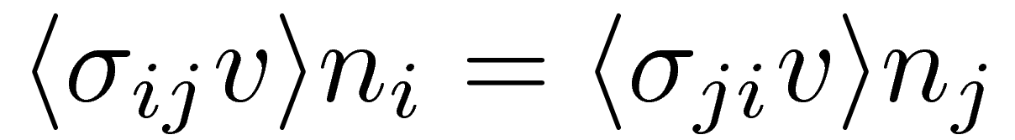
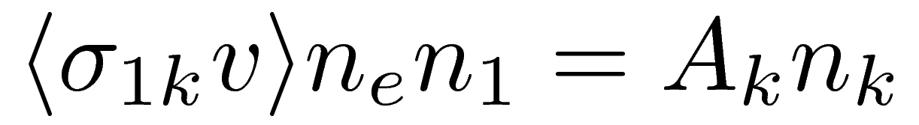
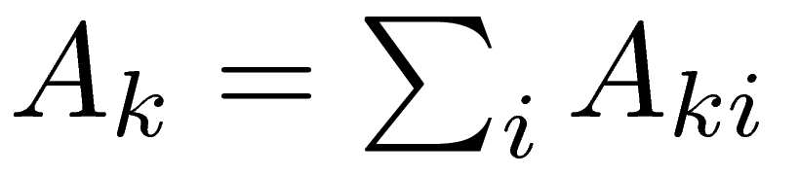
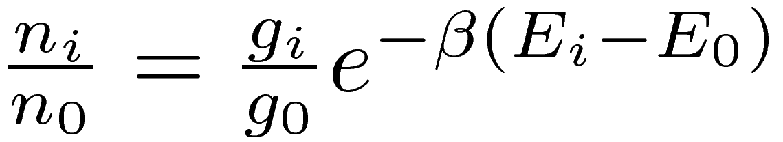
Simple Models for Populations
High Density
Collisional Transitions Dominate (detailed balance)
Thermal Equilibrium
Low Density
Radiative Transitions Dominate (“coronal” limit)

Slide 6
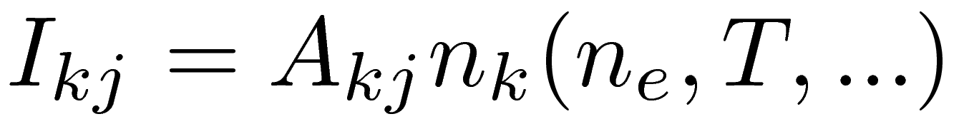
Collisional-Radiative Model
Medium Density: develop full rate equations.
Can include many different rate processes.
Solve system of equations for level population, which then gives line emission.
In principle, could be “inverted” for density, temperature, ...

Slide 7
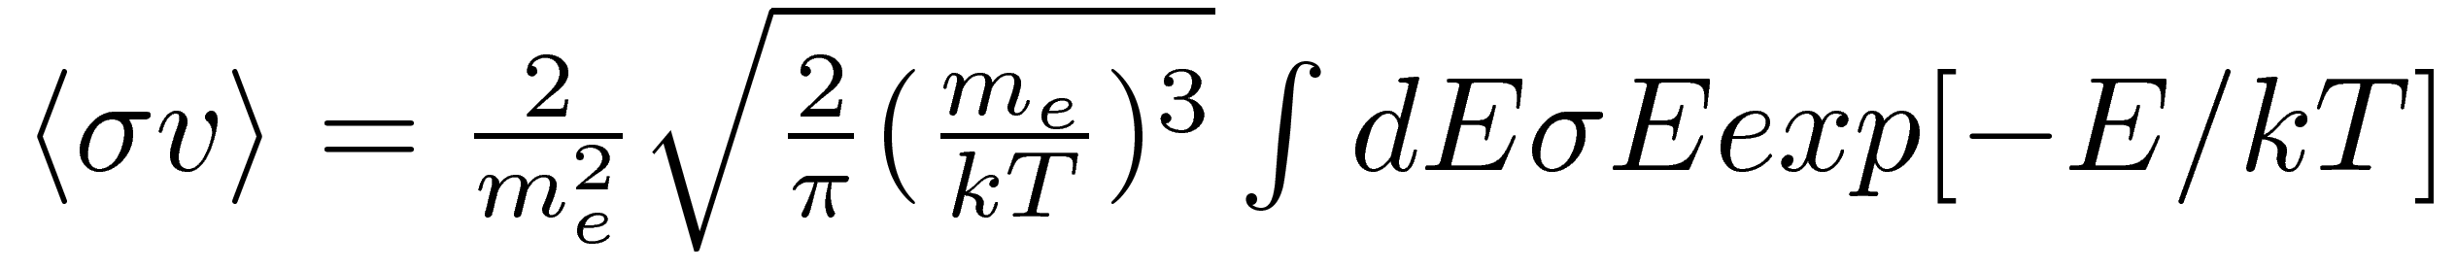
Collisional Processes
Electron and atomic impact excitation, de-excitation, ionization, and three-body recombination
Assume isotropic Maxwellian distribution.
Example semi-empirical cross-section:

Slide 8
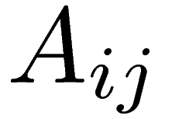
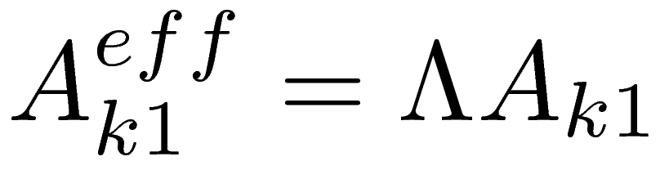
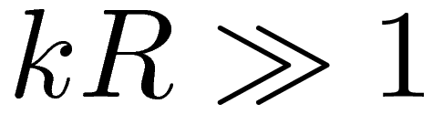
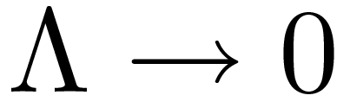
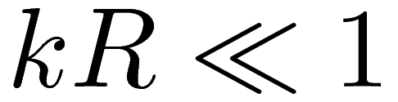
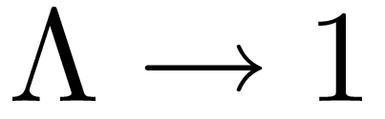
Radiative Processes
Photo-excitation, photo-ionization, radiative decay, and radiative recombination.
  Spontaneous emissions:
  Photo-excitation accounted for by escape factor:
  Optically thick:
  Optically thin.

Slide 9
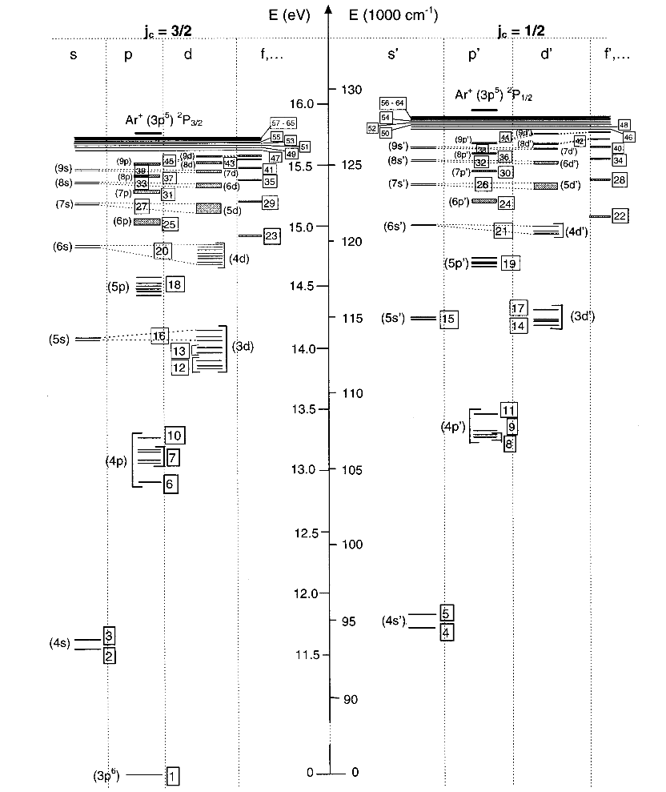
Argon Level Model
Complex level structure.
Levels of similar energy are grouped together to simplify model. Is this valid?
Can higher levels be removed? Compare results to models which do not include them.
Level population solution depends on plasma parameters: neutral density, ion density, and electron temperature and density.
[2]

Slide 10
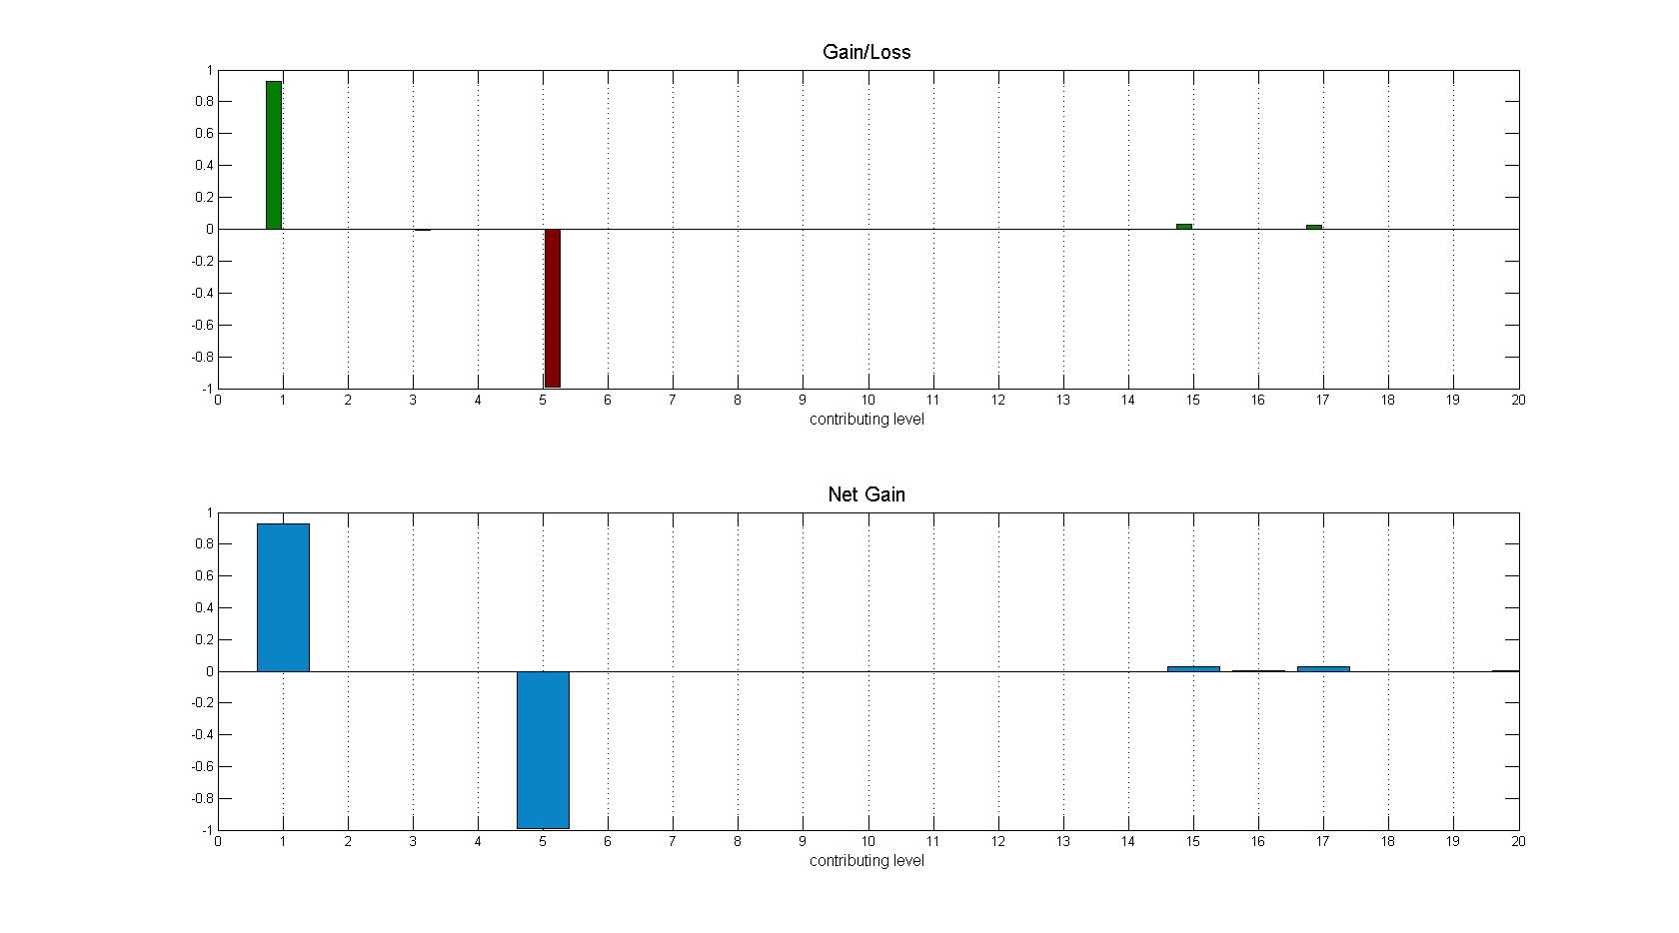
Level 11 Populating

Slide 11
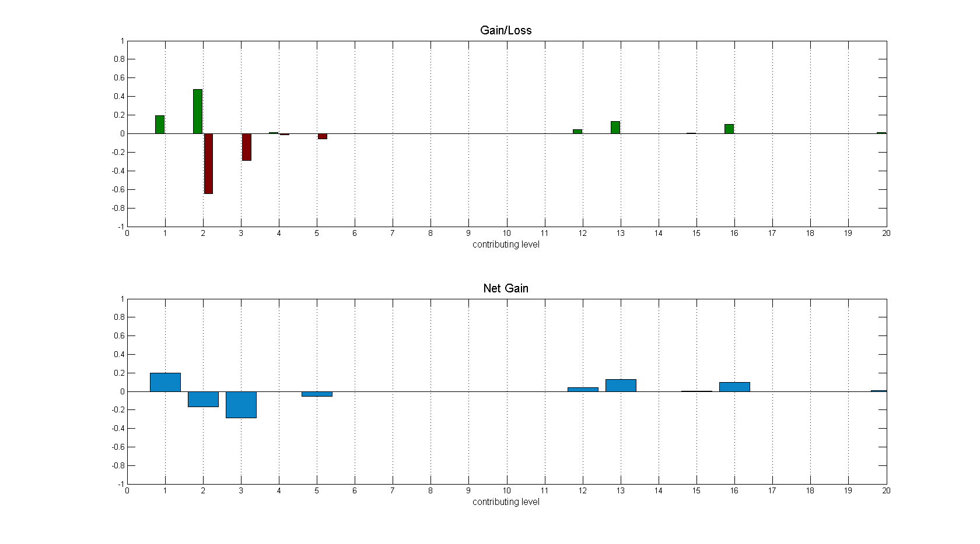
Level 7 Populating

Slide 12
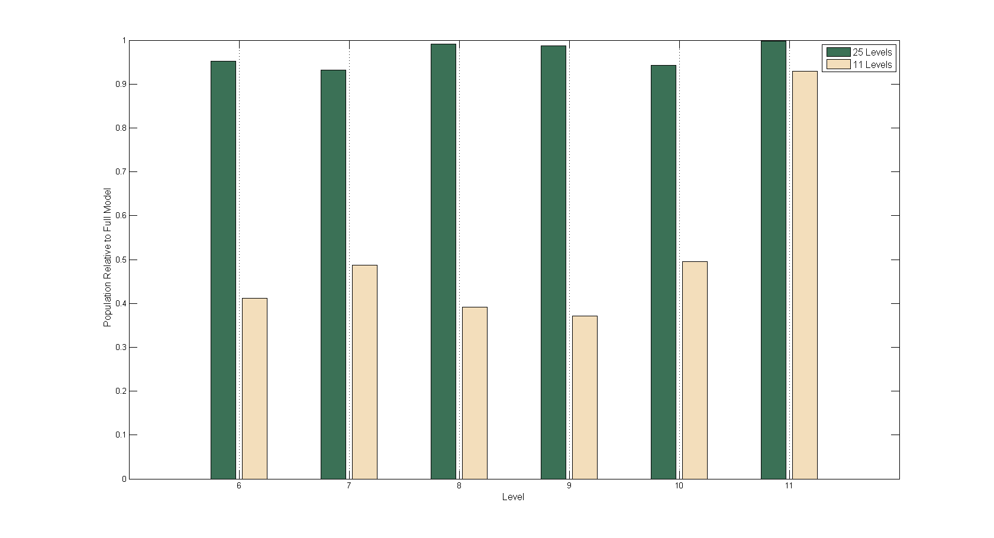
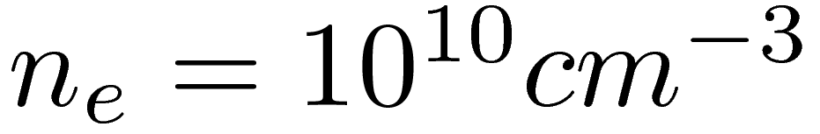
Removing Higher Levels
(makes a difference in absolute, and relative, populations)

Slide 13
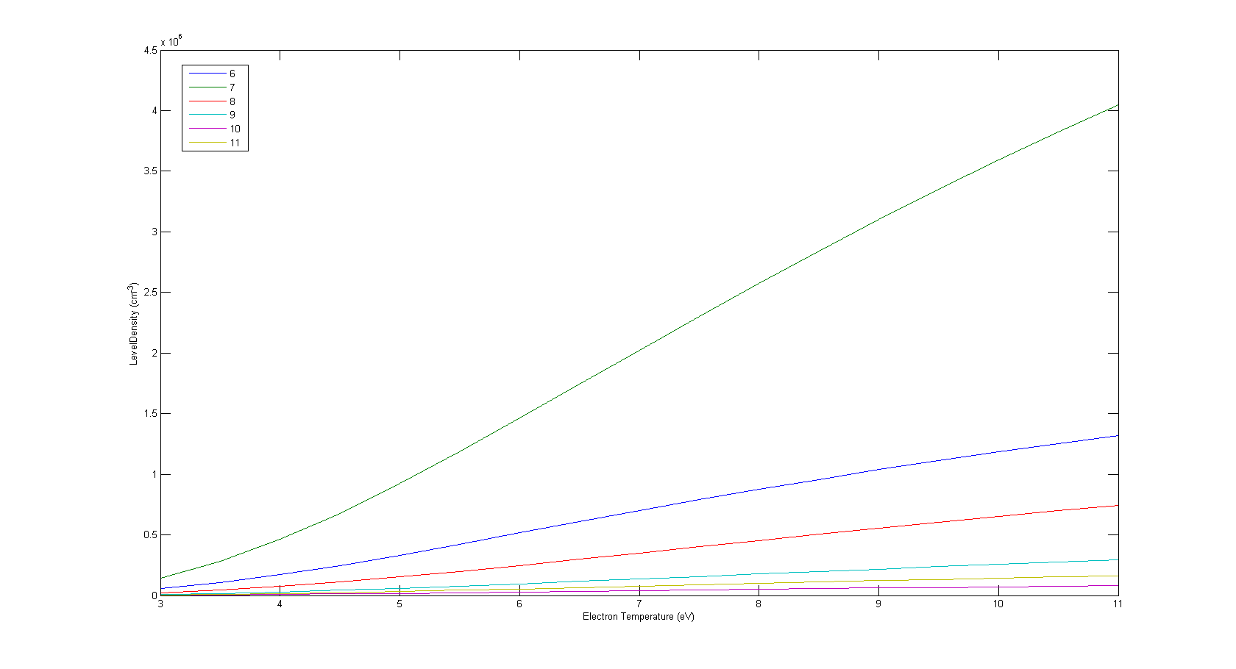
Te Dependency

Slide 14
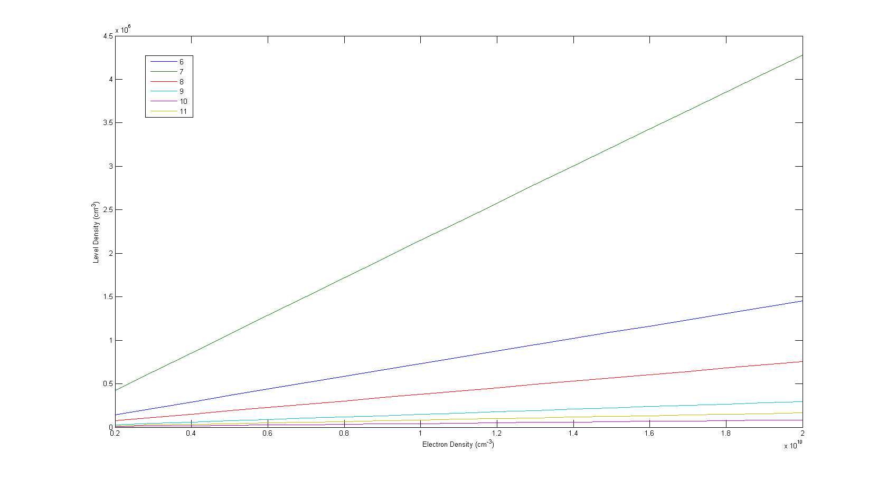
ne Dependency

Slide 15
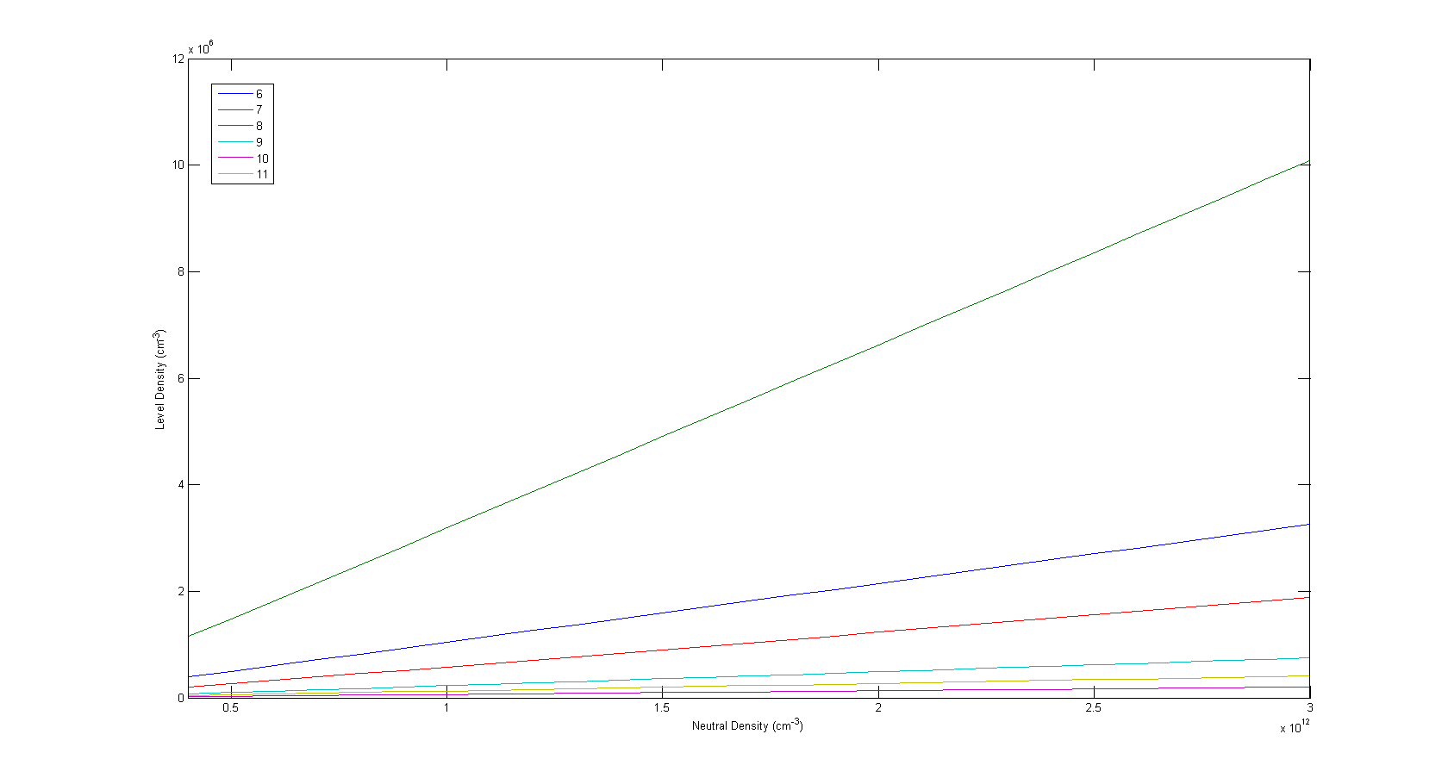
N0 Dependency

Slide 16
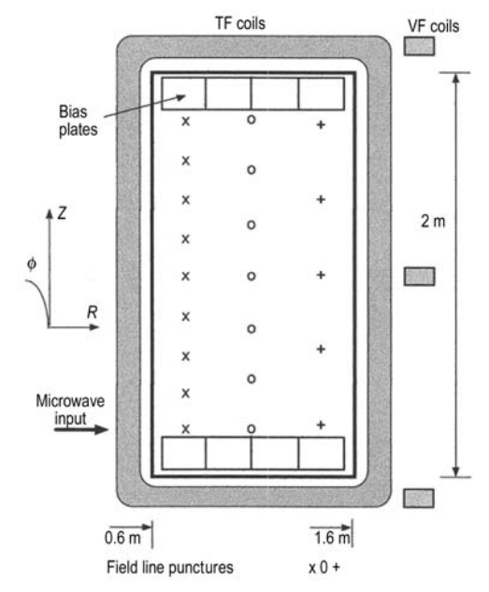
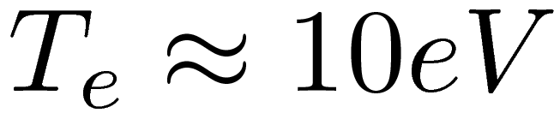
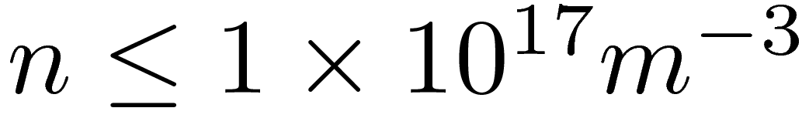
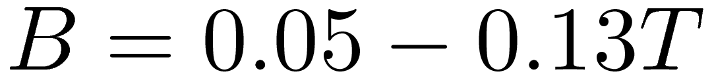
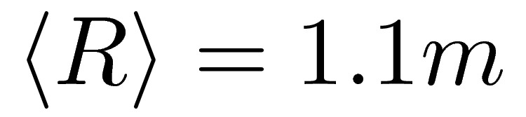
Texas Helimak
ECRH: 6kW @ 2.45GHz
Uniformity in vertical direction.
Variations in radial direction.
Measurement of electron temperature and density via Langmuir probes at top and bottom.
Parameters
[3]

Slide 17
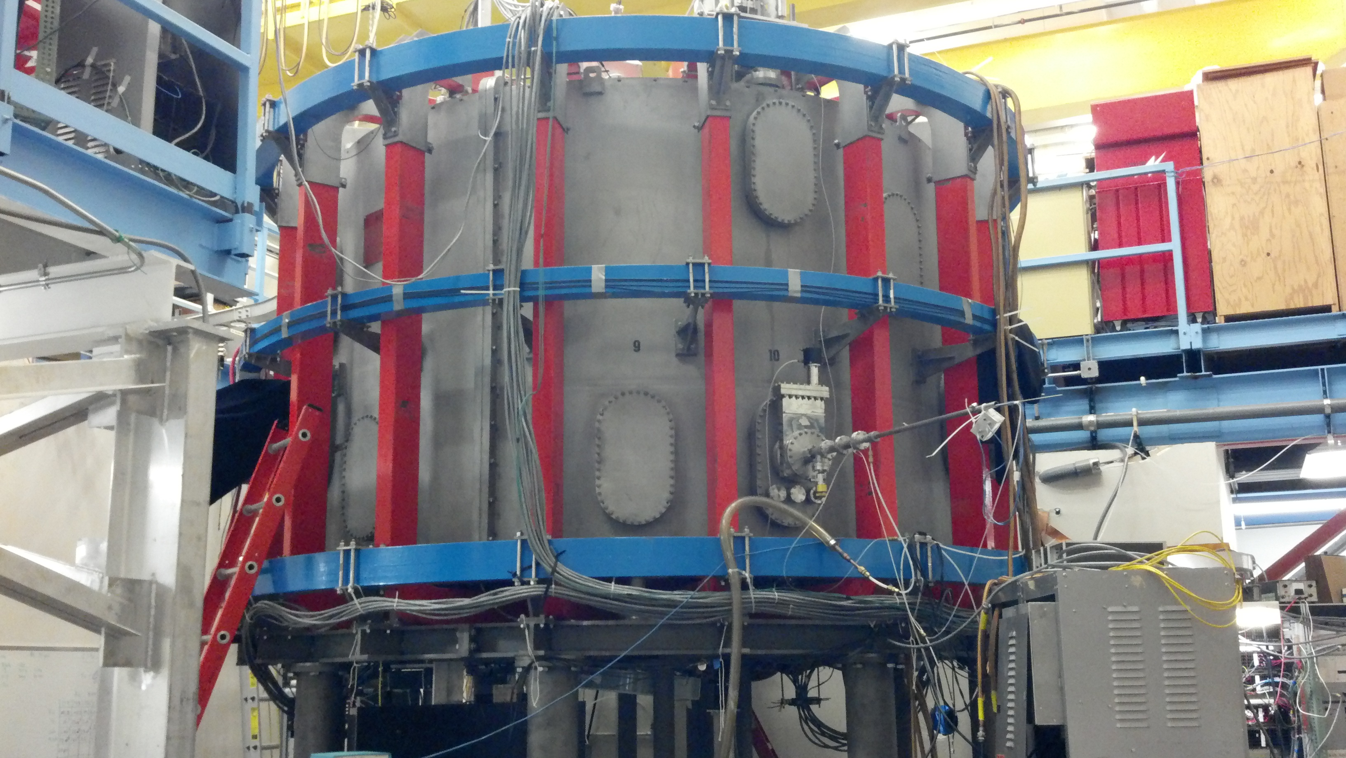
External Photo

Slide 18
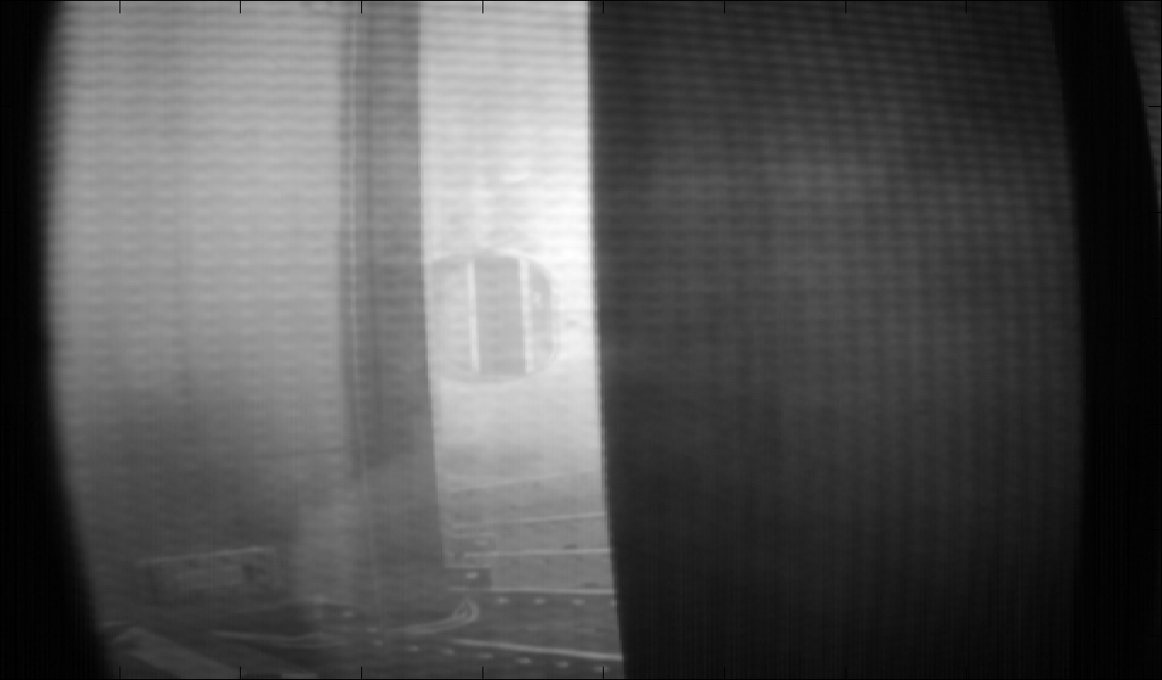
Internal Photo

Slide 19
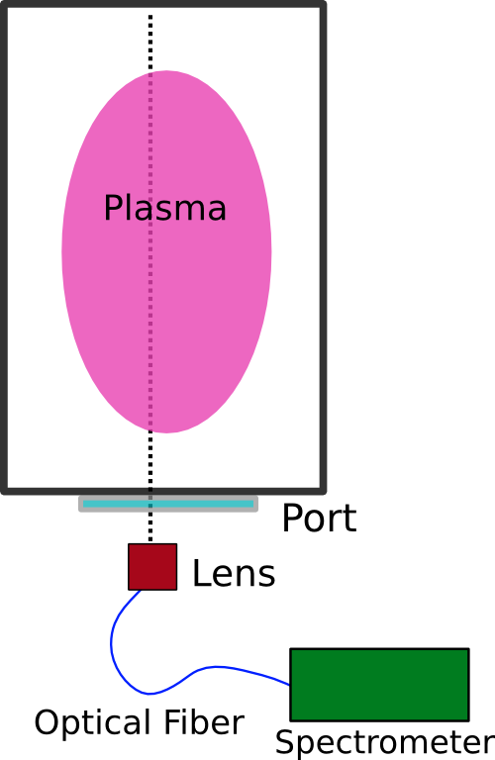
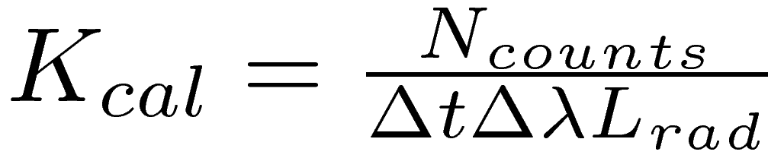
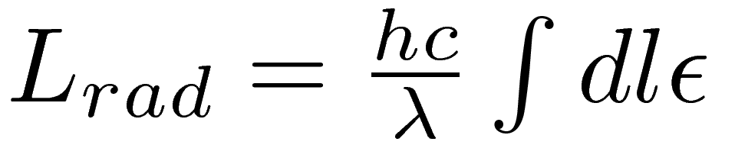
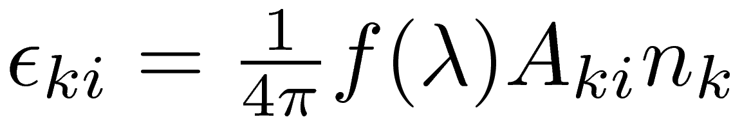
Measurement Method
One radial position per shot.
Calibration for view-port, lens, fiber, and spectrometer.
Assume uniformity of plasma

Slide 20
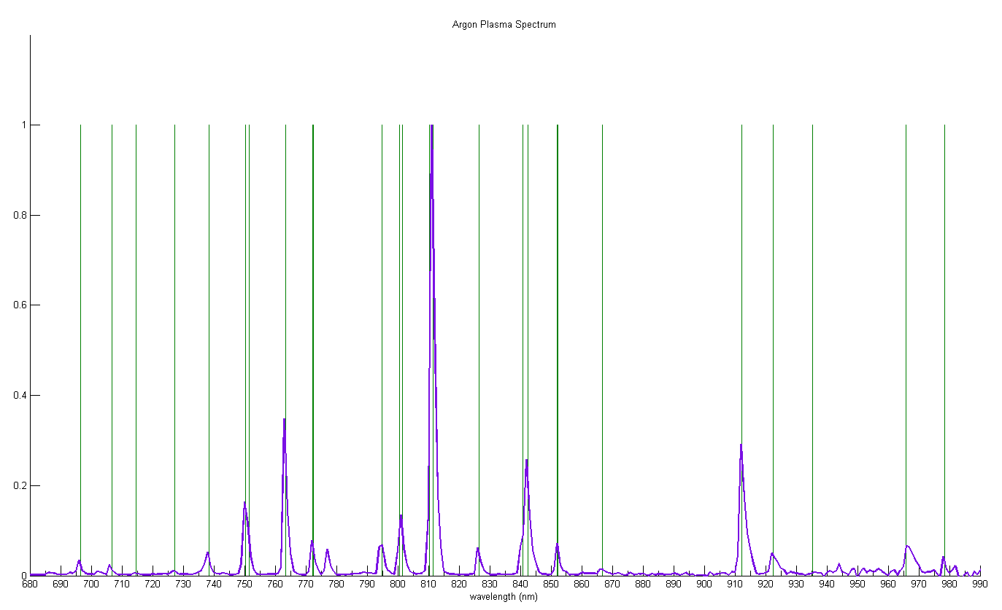
Argon Plasma Spectrum

Slide 21
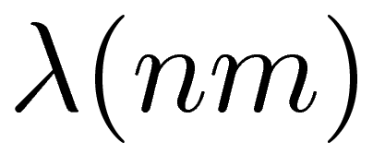
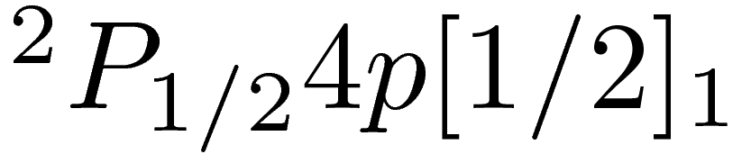
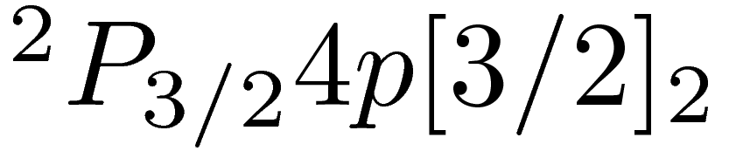

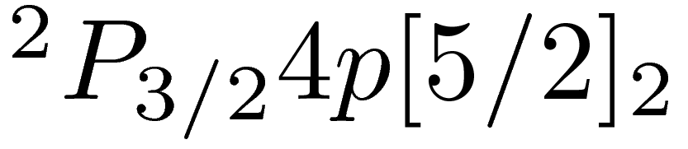
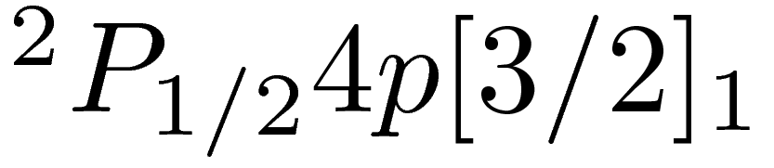
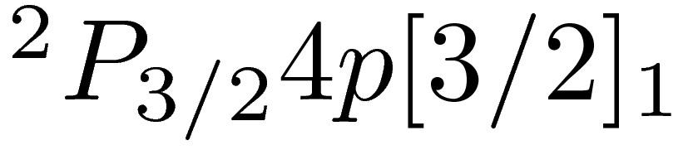

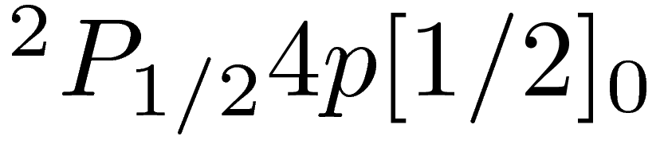
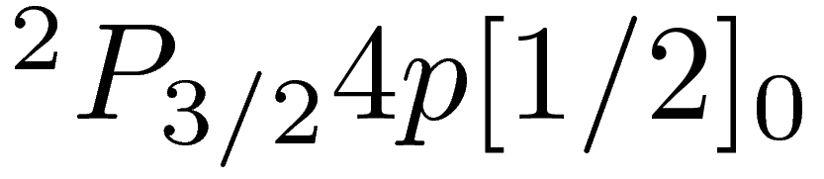
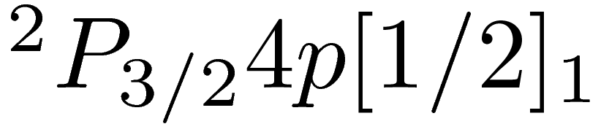
Measured Lines
Upper Level
Model
Upper Level
Model
696.54
9
800.616
7
706.72
8
801.479
7
714.70
8
810.369
7
727.29
9
811.531
7
738.398
8
826.452
9
750.387
11
840.821
8
overlap
751.465
10
842.465
7
763.51
7
852.144
8
772.376
7
866.79
7
772.421
9
912.3
6
794.818
8
922.45
7

Slide 22
Measured Lines (cont.)
Upper Level
Model
935.42
7
965.78
6
978.45
7

Slide 23
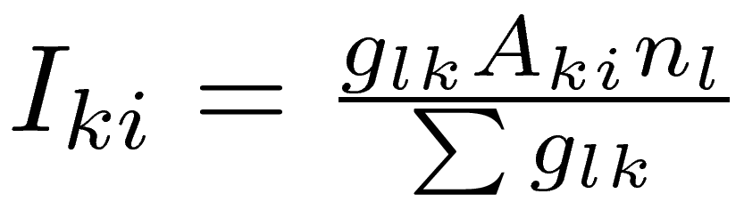
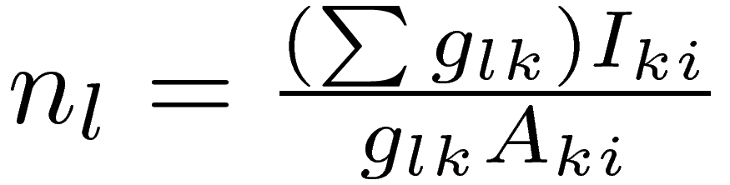
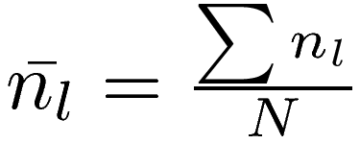
Measure and Fit to Level Density
Intensity proportional to level density.
Average values from all independent lines.
Neutral density as free parameter: Te, ne fixed at each position.

Slide 24
Temperature & Density Est.
(at radial positions where spectra were taken)

Slide 25
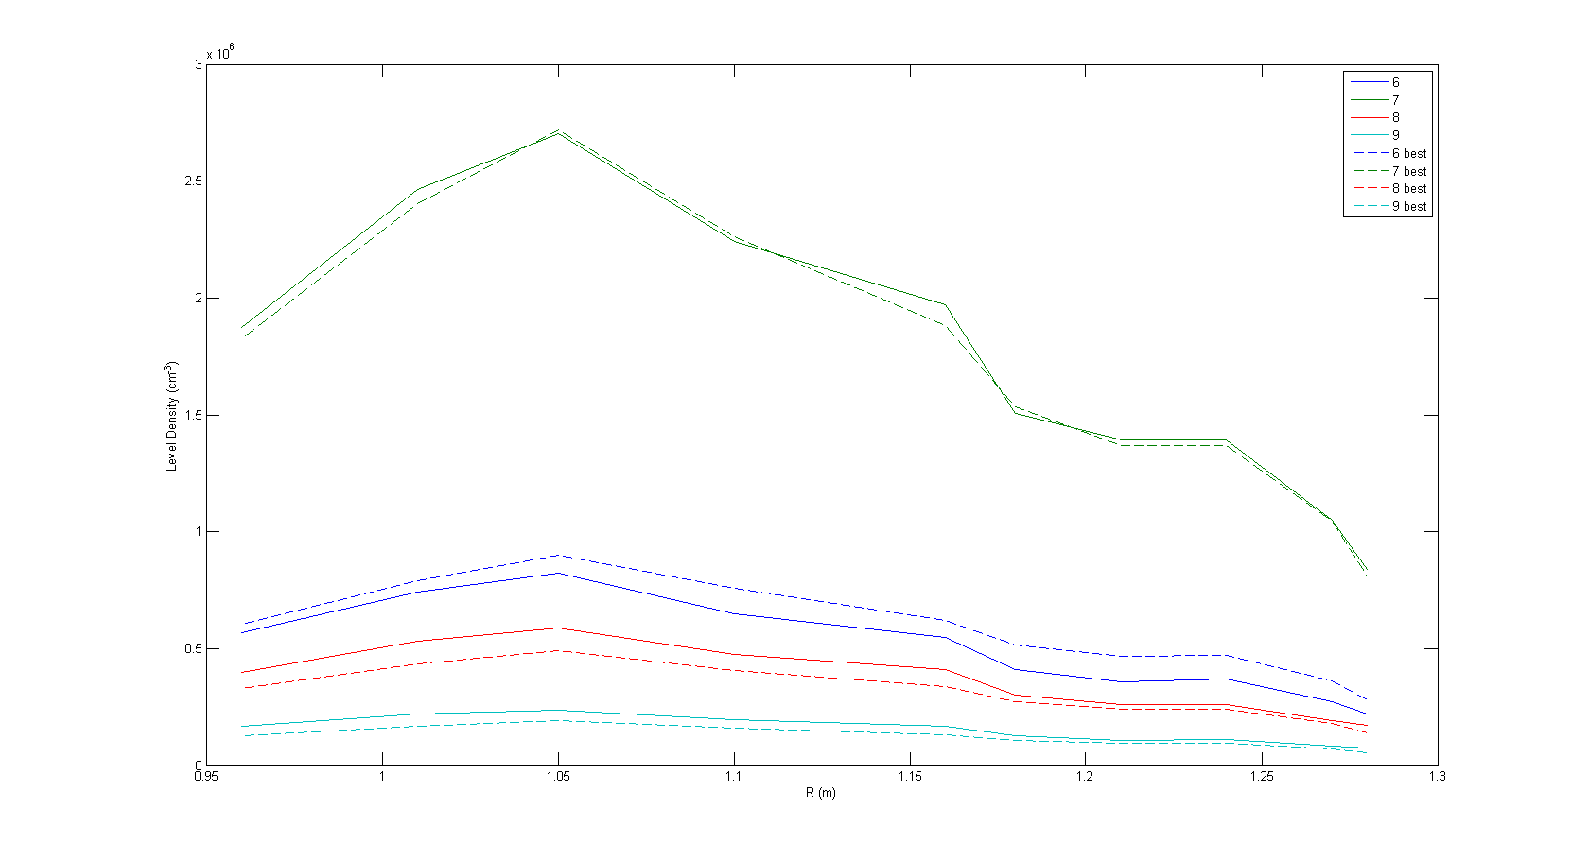
Level Densities

Slide 26


Comparison of Lines
Radial position R = 0.96m
Coeff. Of Det.

Slide 27

Measured Versus Best Fit

Slide 28


Comparison of Lines (cont.)
Radial position R = 1.27m
Coeff. Of Det.

Slide 29




Neutral Density Best Fit
Fill Pressure:

Slide 30
Fitting to Measure ne and Te
Absolute level densities depend on n0, ne, and Te nearly linearly.
Must depend on relative intensities to remove ambiguities.
  Only 6 independent levels for all measured lines.
  Choose lines to represent levels.

Slide 31

Est. Level Population Ratios
~10% or less variation

Slide 32


Testing Level Groupings
Level 7 and 8 in model consists of several non-degenerate physical levels.
Line intensities determined by statistical weight:
All lines should predict the same level density.
Line ratios should be fixed, and not depend on plasma parameters.

Slide 33

Level 7 Line Ratios
3.1
0.58
0.2

Slide 34

Level 7 Line Ratios (cont)
Radial Position R=0.96m

Slide 35

Level 8 Line Ratios
2.94
2.19
2.23
0.01

Slide 36

Conclusions
Levels up to level 25 in model are important to predict absolute and relative intensities.
Produces good fit to measured intensities with some deviations. ( )
Fitted values show variations of neutral density.
Fitting to determine electron density or temperature more difficult from the measured lines.
Grouping of some levels may not be justified.

Slide 37
References
I.I. Sobelman, L.A. Vainshtein, and E.A. Yukov, Excitation of Atoms and Broadening of Spectral Lines (Springer-Verlag Berlin Heidelberg New York 1981)
A. Bogaerts et al, Journal of Applied Physics Vol. 84, No. 1, 121 (1998)
K. Gentle, Huang He, Texas Helimak, Plasma Science and Technology, Vol.10, No. 3 (Jun. 2008)
H. R. Griem, Principles of Plasma Spectroscopy (Cambridge University Press 1997)
E. M Sciamma, Plasma Spectroscopic Diagnostic Tool Using Collisional-Radiative Models and its Application to Different Plasma Discharges For Electron Temperature and Neutral Density Determination, U. Texas Austin Dissertation (2007)

