Slide 1

Duffie Cooley | @mauilion
Field CTO Isovalent @ Cisco
How did that happen?
is it a security problem
Notes:
Hello Everyone!
So amazing to be here with you in Austin!
I am Duffie Cooley I am the field CTO at Isovalent. We were acquired by Cisco which we now call ciscovalent. and we are still doing all the things that we did as part of Isovalent. So my job hasn’t changed too much.
Come say hello! I can be reached as mauilion just about everywhere.

Slide 2
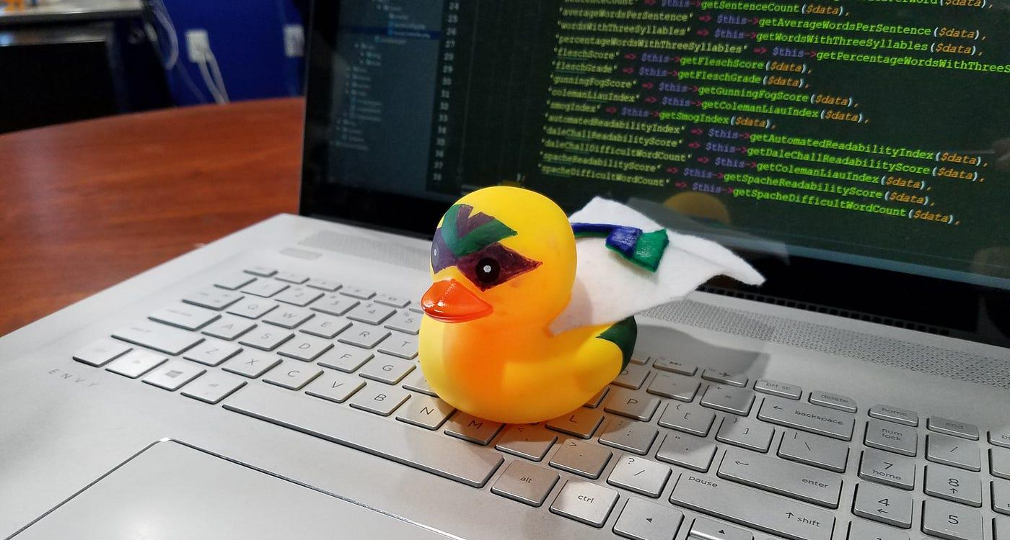
Perspective
Notes:
Perspective!
In philosophy, a perspective is a specific way or manner through which a person thinks about something.[1] This figurative usage of the expression dates back to 1730.
It is often described as the context for opinions, beliefs or experiences.
It’s a fascinating topic.
When you are troubleshooting or converting an idea to code or thinking about a hard problem. Your perspective is the tool you use.
Like any tool perspective can be built up made stronger. When we share our experiences or challenges we strengthen our own perspectives.
For me one of the best ways to improve my perspective is teaching. Sharing ideas and hearing the questions. The questions almost always show me a side of a problem I have not thought about!
How many of you have heard of rubber duck debugging?
this is where you describe a problem that you are running into out loud often to another person but sometimes to a house plant or a rubber duck. And the act of describing the problem is enough to shift your perspective on it and help you solve it.
When we share our time with each other, our stories, examples of challenges we have experienced we also widen our perspectives. very few problems worth solving can be fully understood with only a single perspective. It takes questions and experiences to really understand a problem.
One such problem this all applies to is Security!
Here is another perspective..

Slide 3
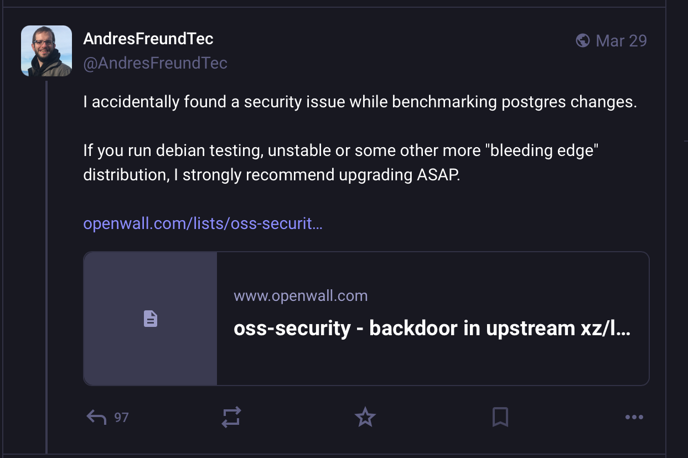
Notes:
This was posted after Andres happened upon something that didn’t seem right. In his experience ssh shouldn’t be using so much cpu time as part of this testing. So he was curious about why this behavior was happening.

Slide 4
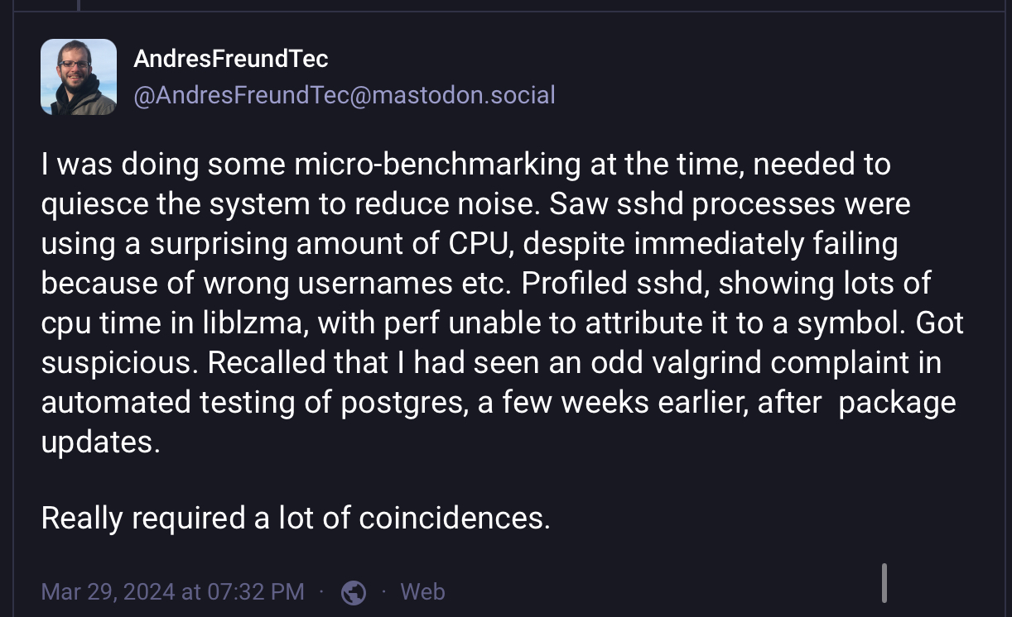
https://research.swtch.com/xz-timeline
Notes:
Andres has some experience with profiling tools and while benchmarking some Postgres changes, noticed that openssh performance wasn‘t as expected he dug a little deeper and found one of the most interesting and sophisticated software supply chain attacks of our time. A contributor to the open source library liblzma worked for years to gain maintainer access and embed functions in the library that when called would allow a user with keys that were not explicitly allowed by ssh access via ssh. If you’d like to read more about the issue there are many writeups about it including this one by Russ Cox that captures a timeline of events.

Slide 5

be curious
Notes:
Be Curious.
How often have you been working on some piece of code whether it’s infra code or application code or looking at test results and thought. Huh… How did that happen?
And then mash that /retest button?
I know that we all have things to do! We all feel the pressure of time.
When you thought I wonder if or how did that happen? ThIs was an opportunity to be curious. to dig deeper. To think about the problem differently that you did.
Each of these opportunities represent a way to improve our perspective, the quality of our work and sometimes we can find things we didn’t think possible.

Slide 6
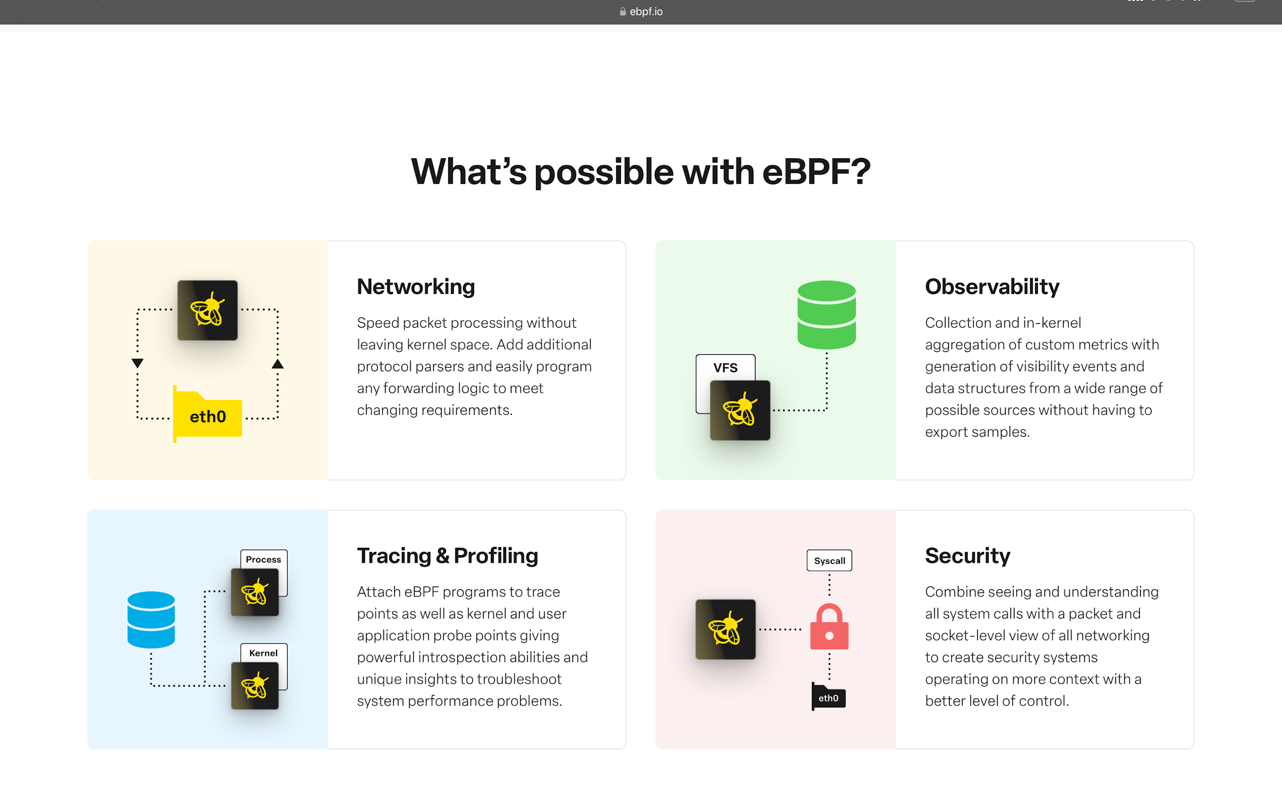
https://ebpf.io
Notes:
So how can we experiment with this? What are some tools out there that enable us to feed our curiousity? Where do we get this valuable experience and context that is needed widen our perspective?
For me one of the big things in the last few years has been ebpf. This is an incredible technology that has the ability to gather context at any layer of the stack. From handling deep packet inpection to network security. From application profiling like what Andres was doing to limiting the attack surface of the linux kernel that all containers on a host share.
before containers we had a tool called auditd. This kept track of everything happening on a system so that it could be reviewed for odd behaviors and such. With containers and the addition of things like network namespaces and pid namespaces. All the bits that make up a running container auditd and tools like it can’t keep up with the context!
ebpf to the rescue. With functionality from ebpf helpers and frameworks we can get all that context and more!
Also it’s a thriving ecosystem of tooling out there that is focused on providing answers to questions like..
What if the problem I am having is DNS?
Where is my application spending most of it’s cpu time? What can I do to improve the performance of it?
At the end of the day you can’t improve what you can’t measure. Tools like these even if only used to measure provide incredible insight into what’s happening.

Slide 7
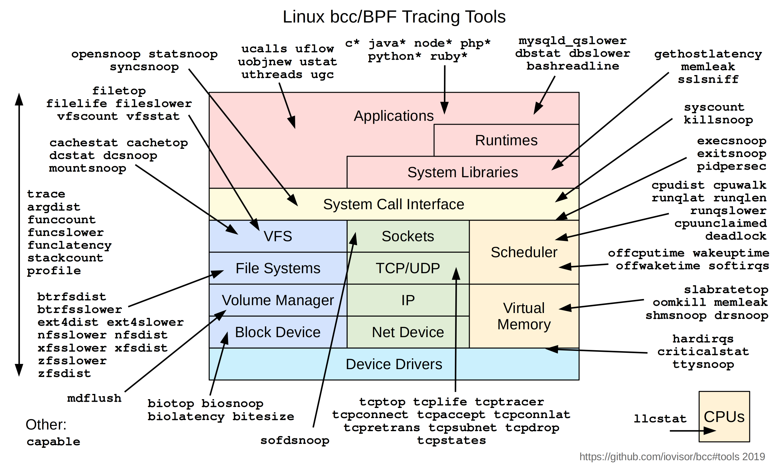
https://github.com/iovisor/bcc
Notes:
- Tools for BPF-based Linux IO analysis, networking, monitoring, and more
One of the folks involved very early in the ebpf effort was brendan greg.
BCC is a toolkit for creating efficient kernel tracing and manipulation programs built upon eBPF, and includes several useful command-line tools and examples. BCC eases writing of eBPF programs for kernel instrumentation in C, includes a wrapper around LLVM, and front-ends in Python and Lua. It also provides a high-level library for direct integration into applications.

Slide 8




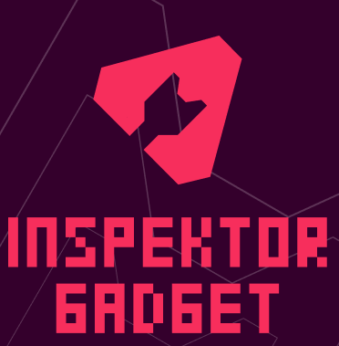


BPFTRACE
Notes:
BPFTRACE bpftrace is a high-level tracing language for Linux eBPF. inspired by tools like DTrace and SystemTap. bpftrace uses LLVM as a backend to compile scripts to eBPF bytecode and makes use of BCC as a library for interacting with the Linux eBPF subsystem as well as existing Linux tracing capabilities and attachment points.
Inspektor gadget:
nspektor Gadget is a collection of tools (or gadgets) to debug and inspect Kubernetes resources and applications. It manages the packaging, deployment and execution of eBPF programs in a Kubernetes cluster, including many based on BCC tools, as well as some developed specifically for use in Inspektor Gadget. It automatically maps low-level kernel primitives to high-level Kubernetes resources, making it easier and quicker to find the relevant information.
Tracee:
Tracee is a runtime security and observability tool that helps you understand how your system and applications behave.
It is using eBPF technology to tap into your system and expose that information as events that you can consume.
Events range from factual system activity events to sophisticated security events that detect suspicious behavioral patterns.
Parca Track memory, CPU, I/O bottlenecks broken down by method name, class name, and line number over time. Without complex overhead, in any language or framework. Using Parca's UI the data can be globally explored and analyzed using various visualizations to quickly and efficiently identify bottlenecks in code. Parca uses eBPF to collect profiling data and uses libbpf-go to interact with the kernel.
Pixie is an open source observability tool for Kubernetes applications. Pixie uses eBPF to automatically capture telemetry data without the need for manual instrumentation. Developers can use Pixie to view the high-level state of their cluster (service maps, cluster resources, application traffic) and also drill down into more detailed views (pod state, flame graphs, individual full body application requests).
Cilum and Tetragon are projects hosted by the cncf that enable security observability and networking for Kubernetes. these each produce event streams

Slide 9
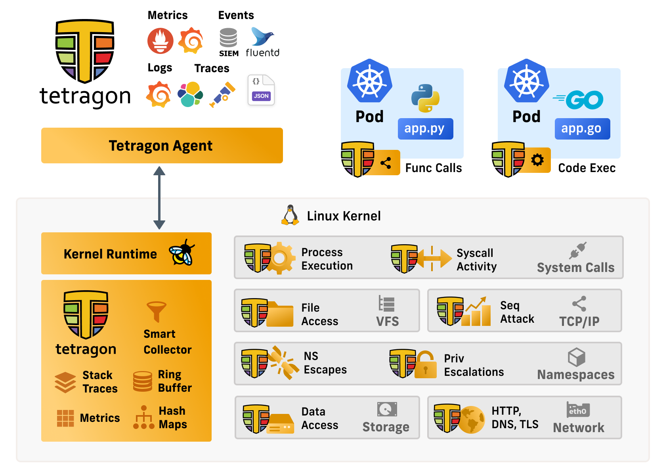
https://tetragon.io
Notes:
Tetragon is a tool that gathers context from the Linux kernel and other sources and emits events that show you what’s happening at a lower level it can be useful to understand all the things that are happening on a system when trying to understand things better.

Slide 10
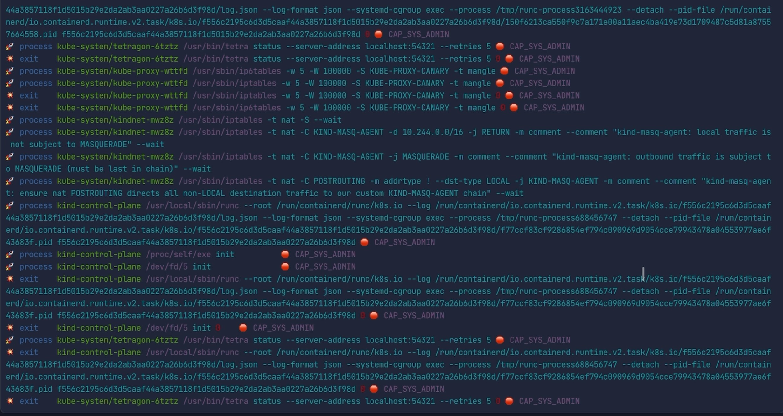
Notes:
a default configuration of Tetragon will show you all the things that are starting stopping and running all those actions that are happening. In this example we can see Kobe proxy programming iptables with services that are defined in the cluster. We can see the tetra cli a tool for inspecting this stuff checking for new events.
This is just the tip of the iceberg tho! There is a ton more we can dig into. Whether permissions or capabilities even what libraries are loaded. And all we can see we can also make policy decisions on.

Slide 11
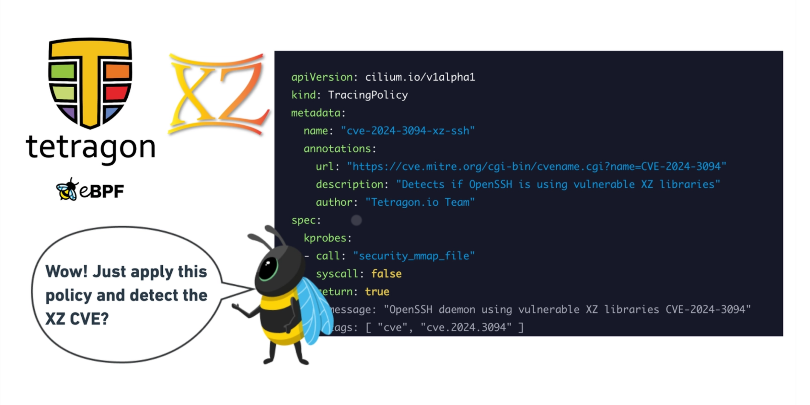
https://isovalent.com/blog/post/ebpf-tetragon-xz-utils-cve-policy/
Notes:
Remember the xz example? Tetragon can detect not just things have been executed but what libraries are loaded it can then take action when it sees things that shouldn’t happen.

Slide 12
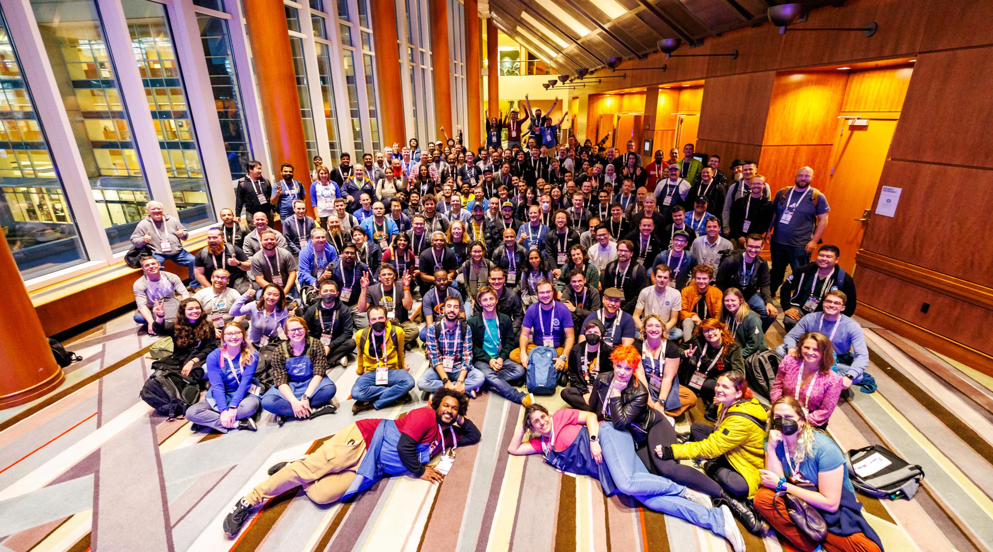
Shared Perspective

Slide 13
Resources
ebpf.io
cilium.io/newsletter
isovalent.com/labs
github.com/cncf-tags
kubernetes.dev

Slide 14


