Slide 1



One Control Plane, Three Clouds:
The Kubernetes Architecture Behind Astro
Goutam Tadi

Slide 2


Who am I & What is Astro
Goutam Tadi - Engineering at Astronomer
engineering
Building the Kubernetes Control plane that powers Astro. Focus on cluster provisioning, manifest generation, security, and deployment lifecycle management.
Astro - Managed Airflow
hub
Scalable Architecture
Hundreds of K8s clusters and billions of tasks
settings_input_component
Control Plane
Manages hundreds of dataplane Kubernetes clusters
rocket_launch
Operator Model
Deploys Apache Airflow via custom operators

Slide 3

format_quote
"Successful design is not the achievement of perfection but the minimization and accommodation of imperfection."
— Henry Petroski, engineer and author
Notes:
Petroski was an American engineer specializing in failure analysis
Petroski worked at the University of Texas at Austin from 1968–74

Slide 4

AGENDA
🏗️ The Scale Context
☁️ Multi-Cloud Kubernetes Architecture
🔁 Ops at Fleet Scale
⚙️ Custom Operators & CRD Design
📈 Auto Scaling Strategy
🛡️ Reliability & Resilience
👁️ Observability at Fleet Scale
🚀 Key Lessons
Notes:
Security and Margins are an implicit part of all of this

Slide 5

🏗️ The Scale Context
cloud
Multi Cloud
AWS, GCP and Azure
hub
K8s Clusters
Hundreds independently managed in multiple regions
task_alt
Airflow Tasks
Billions of tasks handled globally
business
Market Reach
Startups to Fortune 500 Enterprises
settings_input_component
Lifecycle Ops
One K8s Operator per dataplane for full deployment

Slide 6


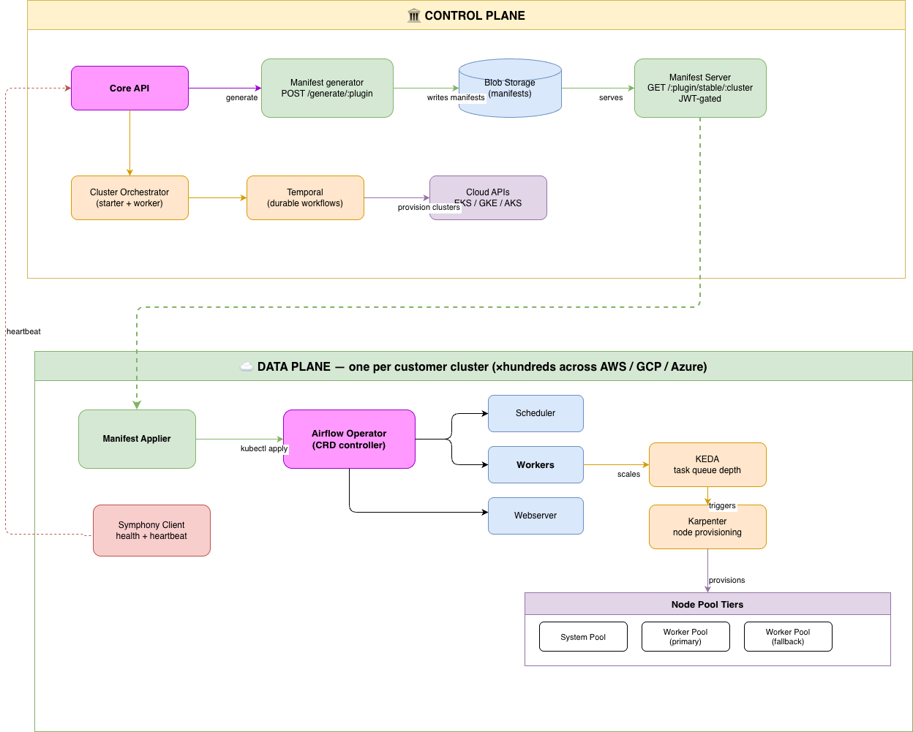
☁️ Multi-Cloud Kubernetes Architecture
Notes:
Layers of concern - separation of responsibilities
Cohort based rollouts
Plugin based manifests

Slide 7

🔁 Ops at Fleet Scale
Operational Challenges
Cluster configuration must stay consistent across hundreds of clusters
Rolling out a change to the fleet cannot be a big-bang event
Clusters must self-correct when going offline/online without human intervention
Eliminate any Single Point of Failures
Architecture Solutions
Pull-based manifest delivery
Per-cluster versioning
Server-side apply
Blob storage as the distribution layer
Notes:
Airflow deployment YAML generation in parallel and apply considering fairness and priority
Plugin based manifest delivery
Client side apply vs Server side apply

Slide 8

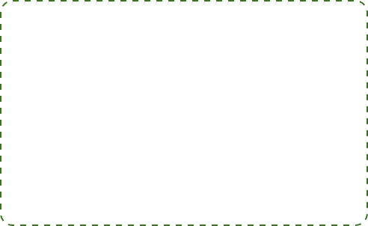
⚙️ Custom Operators & CRD Design
Problems to Solve
Monolithic operators are impossible to maintain for 8+ components.
K8s lacks native awareness of external cloud dependencies.
Deletion requires race-condition-free cleanup of cloud resources.
Parent + Sub-Operator Pattern
Airflow Operator (Parent) owns:
Scheduler, Workers, Web Server, Triggerer, PgBouncer, StatsD
Other Operators:
db operator, cert-manager…
How Manifest Generator Orchestrates It
• Sequential Generation: Airflow plugin generates sub-operator manifests in sequence.
• Feature-Flag Control: Enabled/disabled per cluster without code deploys.
• Self-Healing Config: ConfigMap hash annotations trigger automatic pod restarts.
Notes:
Airflow deployment YAML generation in parallel and apply considering fairness and priority
Plugin based manifest delivery
Client side apply vs Server side apply
How do you manage the complete lifecycle of an Airflow deployment — database, workers, scheduler, webserver, autoscaling, observability — using Kubernetes primitives without building a monolithic controller?

Slide 9
📈 Auto Scaling Strategy
Operational Challenges
Single strategies fail across diverse workload types (short-burst vs long-running).
CPU/RAM metrics lag behind actual queue depth (idle pods vs 1000+ tasks).
Reactive autoscalers cause minutes of pending time for new nodes.
Managing manual node pools for heterogeneous workloads is unscalable.
Strategic Components
KEDA: Multi-cloud scaling based on event-driven metrics (Task Queue), not just resource usage.
Karpenter / CA: Intelligent node provisioning; selects cost-efficient instances and consolidates underutilized nodes.
Node Tiers: Ensures workload isolation. Infrastructure and system pods never compete with workers.
insights
Notes:
CGNAT addresses for pods
Node Local DNS
MNG vs Karpenter
Cluster Autoscaler silent failures
Karpenter Consolidation policies
Custom bin pack scheduler

Slide 10

🛡️ Reliability & Resilience
Core Reliability Challenges
Rolling updates & node drains kill long-running Airflow tasks mid-execution without warning.
Health probes: too aggressive kills healthy pods; too lenient routes traffic to broken ones.
Shared component failures (DNS, Registry) cascade across every workload simultaneously.
Multi-cloud DR: Cloud region outages require manual intervention for failover.
Regional image pulls balloon pod cold-start times, hurting scale-up during bursts.
Strategic Resilience Guardrails
TerminationGracePeriodSeconds Protection for long tasks.
DR Support Standby clusters for multi-cloud failover.
NodeLocal DNS & ndots Reducing DNS resolution latency.
Per Dataplane Registry Localized image pulls for speed.
Deployment Limits Preventing cluster saturation.
No Spot Instances Ensuring stability for critical workers.
Notes:
DNS Registration & Certificate Provisioning at Fleet Scale

Slide 11

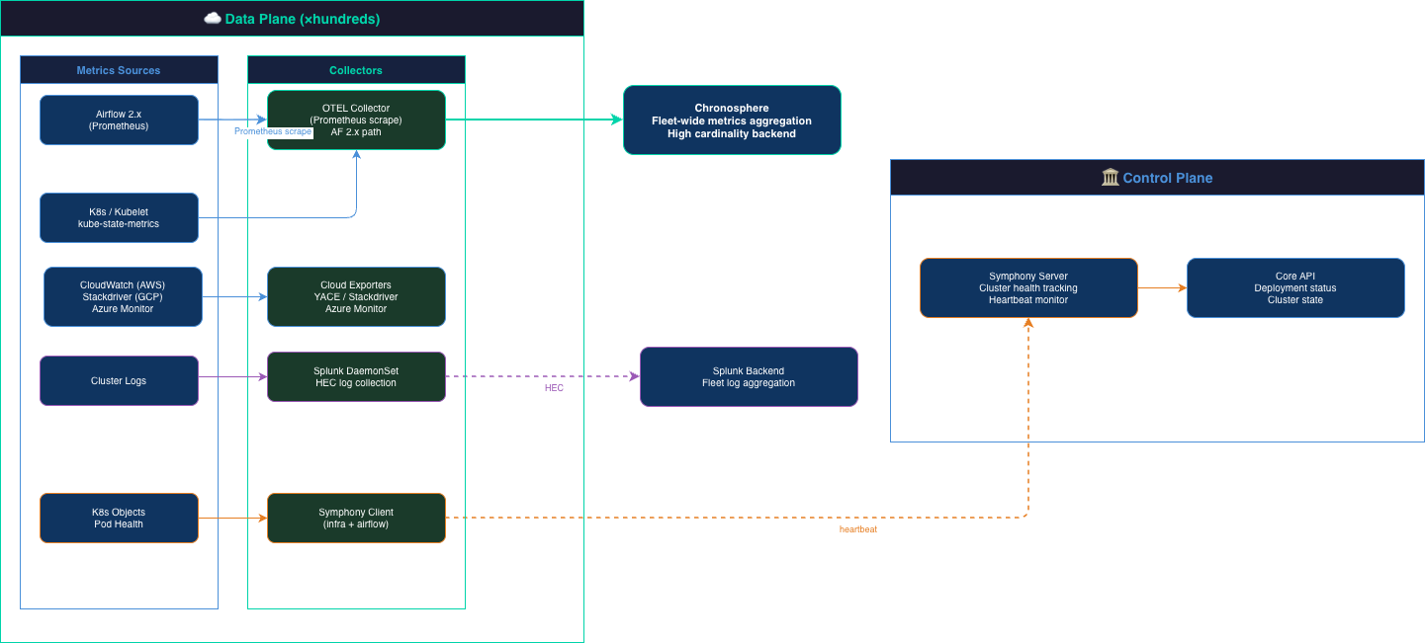
👁️ Observability at Fleet Scale
Notes:
Airflow deployment YAML generation in parallel and apply considering fairness and priority
Plugin based manifest delivery
Client side apply vs Server side apply

Slide 12
🚀 Key Lessons
01. Every SPOF follows the same pattern
Centralized shortcuts become fleet-wide blast radii at scale. Push logic closer to workloads to shrink failure domains.
02. Async beats sync at fleet scale
Direct RPC doesn't compose. Use pull-based reconciliation with durable stores; design for clusters being offline.
03. Defaults are design decisions
Kubernetes defaults optimize for single clusters. At scale, these defaults become constraints. Question them.
04. Primitives scale further than you think
Controllers and CRDs are robust foundations. What breaks are the assumptions layered on top of them.
05. Scaling belongs with the scheduler
Fixed infrastructure config (node groups, instance types) is the wrong place for scheduling decisions. Move them to where the information actually is — the pending pod queue.
06. Layered Architecture
At fleet scale, monoliths become incidents. Layers become the thing that lets you sleep at night — each one small enough to reason about, and replaceable without rebuilding everything above it.
Notes:
Airflow deployment YAML generation in parallel and apply considering fairness and priority
Plugin based manifest delivery
Client side apply vs Server side apply

Slide 13

format_quote
"Make it work, make it right, make it fast."
— Kent Beck

Slide 14
THANK YOU
Let's connect: https://www.linkedin.com/in/goutamtadi/

