Slide 1




The Post-Hypervisor Era
Unifying Brownfield VMs, AI, and Containers on a Single Control Plane
Myroslav Mishov
Private Cloud Infrastructure Architect | Principal SRE | Kubestronaut Founder, TECH EVOLVERS INC
linkedin.com/in/myroslavmishov/
All third-party trademarks, logos, and trade names are the property of their respective owners. Their use in this presentation is for illustrative purposes and does not imply any affiliation.

Slide 2



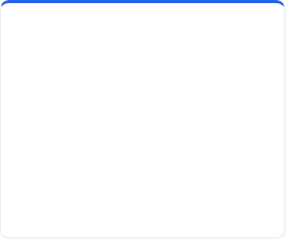







The Catalyst for Change
BREAK FREE FROM THE "LEGACY TRAP" OF TRADITIONAL HYPERVISORS
Skyrocketing Costs
Killed Velocity
IT Silos
Proprietary licensing is no longer a budget line item—it is an extortion tax draining your innovation fund.
Manual "ClickOps" and imperative workflows trap engineers in a loop of babysitting fragile VMs.
Forced to fund two separate departments: one for declarative Kubernetes, and one for legacy virtualization infra.
ARCHITECTURAL ROOT CAUSE: IMPERATIVE VS. DECLARATIVE STATE
IMPERATIVE CLICKOPS .
DECLARATIVE GITOPS .
# Babysitting the VM state… req = vcenter.reconfigure(vm_id, cpu=16) if req.status == "SUCCESS": vm.power_on() # Manual retry if ABC fails… # Results in State Drift
kind: VirtualMachine spec: running: true domain: { cpu: { cores: 16 } } # Reconciliation Loop: # Watch -> Diff -> Reconcile

Slide 3


The Hyperscaler Gap
Platform Feature | Legacy Virtualization | Modern Sovereign Expectation
Control Interface | Imperative. Traditional UI. Manual ClickOps and brittle scripts. | Declarative. K8s-native CRDs and GitOps reconciliation loops.
Network Model | Static. VLANs, VXLAN and Layer-3 firewall hair-pinning. | Dynamic VPC. Identity-based eBPF policy enforcement.
Storage IO Path | Contention. High hypervisor tax via heavy vSAN/HCI stacks. | Direct Path. Bypass hypervisor storage overhead.
Operational Logic | Ticket-Driven. Human-in-the-loop for scaling and remediation. | Autonomic. Controller-driven self-healing and auto-scaling.
API Consistency | Disparate. Disconnected silos for Storage, Network, VMs, K8s... | Unified. One K8s API for Pods, VMs, Storage, and AI.
Verdict:
We aren't just moving workloads.
We are restoring engineering velocity and reclaiming the raw performance of your hardware.
<number>

Slide 4


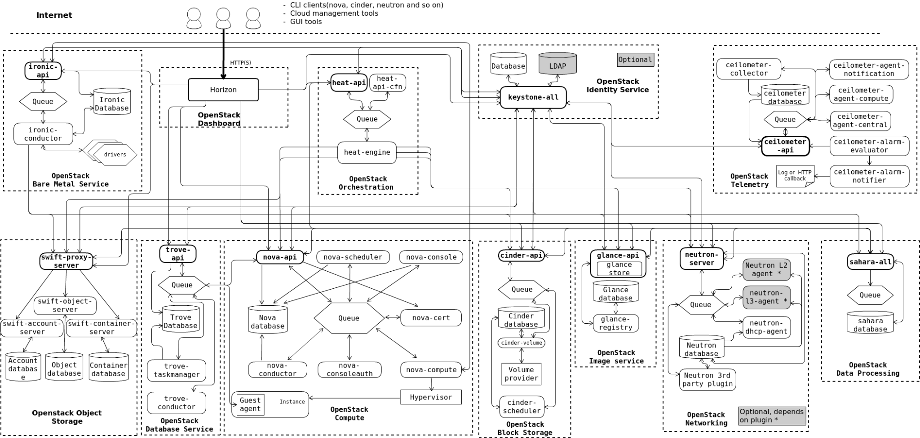
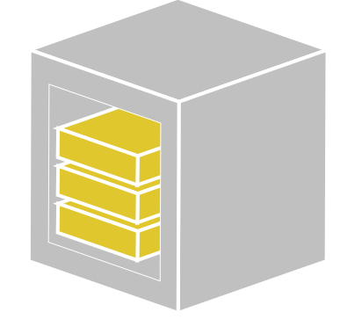
<number>
The penStack Near-Miss
WHEN ARCHITECTURAL COMPLEXITY BECOMES AN OPERATIONAL LIABILITY
ARCHITECTURAL POST-MORTEM
◈ Control Plane Entropy. Managing 14+ disparate projects (Nova, Neutron, Cinder...) created too many failure domains outside of the CNCF lifecycle.
POC ABORTED
◈ Prohibitive Upskilling Debt. Required a massive 12-month training cycle or hiring a completely new "Virtualization Silo" just to babysit the Control Plane.
◈ The "Second API" Problem. OpenStack adds a second, disparate imperative API. It does not converge with the existing K8s GitOps lifecycle.
Verdict:
We needed a radically simpler alternative.

Slide 5

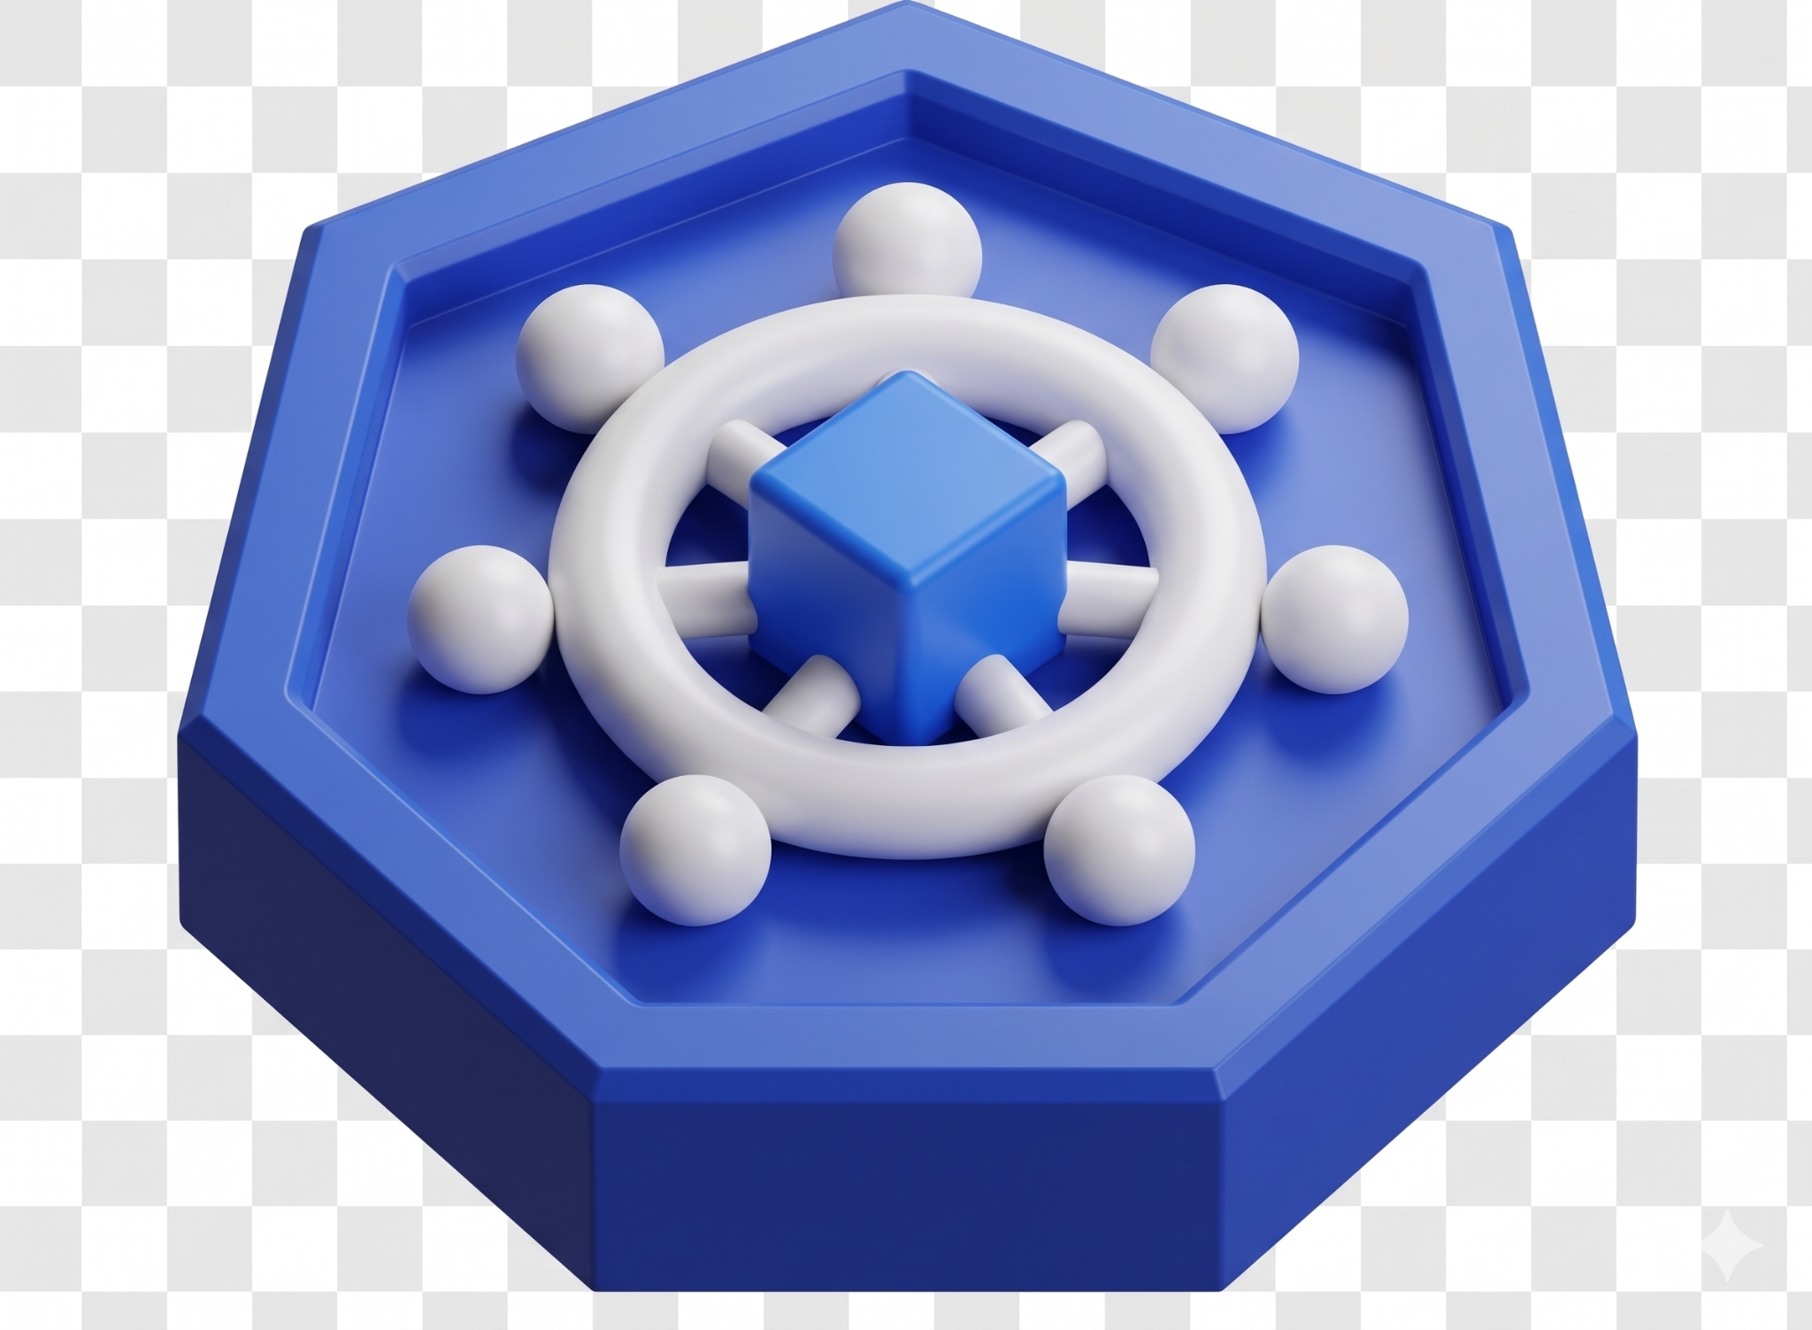
The Kubernetes Hypothesis
SHIFT TO WHAT WE LOVE
KubeVirt Engine: The ability to run a Virtual Machine natively inside a Pod was the exact paradigm shift needed.
The Catch: KubeVirt is an incredible engine, but it is not a complete platform.
Enterprise Requirements:: Building a Cloud means solving multi-tenancy, strict isolation, and providing intuitive self-service.

Slide 6








The Market Evaluation (opinionated)
ARCHITECTURAL LANDSCAPE ANALYSIS
OpenShift Virt
Proxmox VE
IBM-backed K8s stack. Enterprise-grade but high-cost per-core. Control plane is a proprietary "Black Box".
Stable KVM hypervisor. Lacks native K8s reconciliation loop and declarative GitOps state.
Nutanix AHV
Harvester
Hyper-converged leader. Strong HCI ecosystem, locked into AOS storage and specific proprietary hardware lifecycles.
Converged K8s+VM. Storage layers (Longhorn) struggle with Tier-1 DB latency and high-IOPS targets.

Slide 7











The Unified Architecture: CozyStack Deep Dive
LAYER 4: USER-SIDE SERVICES (TENANT ISOLATION)
Managed K8s Clusters
Virtualization
Stateful DBs
Managed via ClusterAPI & Kamaji
Legacy Linux/Windows via KubeVirt
PostgreSQL, MySQL, Redis via Operators
LAYER 3: PLATFORM SERVICES (MANAGEMENT & ROUTING)
Kamaji
MetalLB & HAProxy
SeaweedFS & FluxCD
VictoriaMetrics
Tenant Control Planes
Ingress & Routing
Object Store & GitOps
Observability with Grafana & Alerta
LAYER 2: INFRASTRUCTURE SERVICES (COMPUTE, STORAGE, NETWORK)
CRI + KubeVirt
DRBD & LINSTOR
Kube-OVN & Cilium
Container + VM Compute
Replicated Block Storage
VPC & eBPF Network Policies
LAYER 1: HARDWARE & OS – Talos Linux/Ubuntu/RHEL/Other + Kubernetes running on Bare Metal

Slide 8



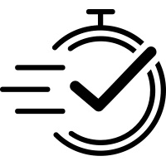
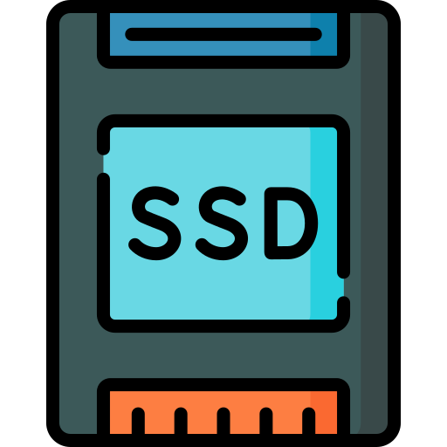
Bare-Metal Performance
Can this architecture handle high-load, tier-one databases? By leveraging LINSTOR for block storage natively on Kubernetes, we stripped out the vSAN storage tax completely.
Storage Write Latency (Lower is Better)
Legacy vSAN
0.5 - 2.0 ms
LINSTOR on K8s
0.030 - 0.080 ms
Delivering bare-metal disk IO latency to Tier-1 DBs, VMs and AI
Sustaining 3-7 GB/s Throughput

Slide 9



Unlocking AI with Fluid Hardware
ELIMINATING STRANDED CAPACITY VIA UNIFIED SCHEDULING
THE LEGACY TRAP
THE MODERN EXPECTATION
Static GPU Binding
Dynamic Hardware Path
Hard-wired allocation to specific VM clusters.
PCIe Passthrough: NUMA-Aware bare-metal performance.
Stranded Capacity: GPU sits idle if VM is idle.
Unified Scheduler: K8s manages GPU instances.
Fragmented ROI: Terrible utilization for H100 assets.
Fluid Workloads: Morning Inference | Night Batch.
Management Friction: Manual re-binding required.
MIG Orchestration: Multi-instance GPU partitioning.
Distributed RDMA Fabric: Pooling idle GPUs via RoCE v2.
Verdict:
We are moving from virtualization-centric silos to hardware-native orchestration. In the Sovereign era, hardware is a pool of primitives managed by the reconciliation loop, not a static assignment.

Slide 10
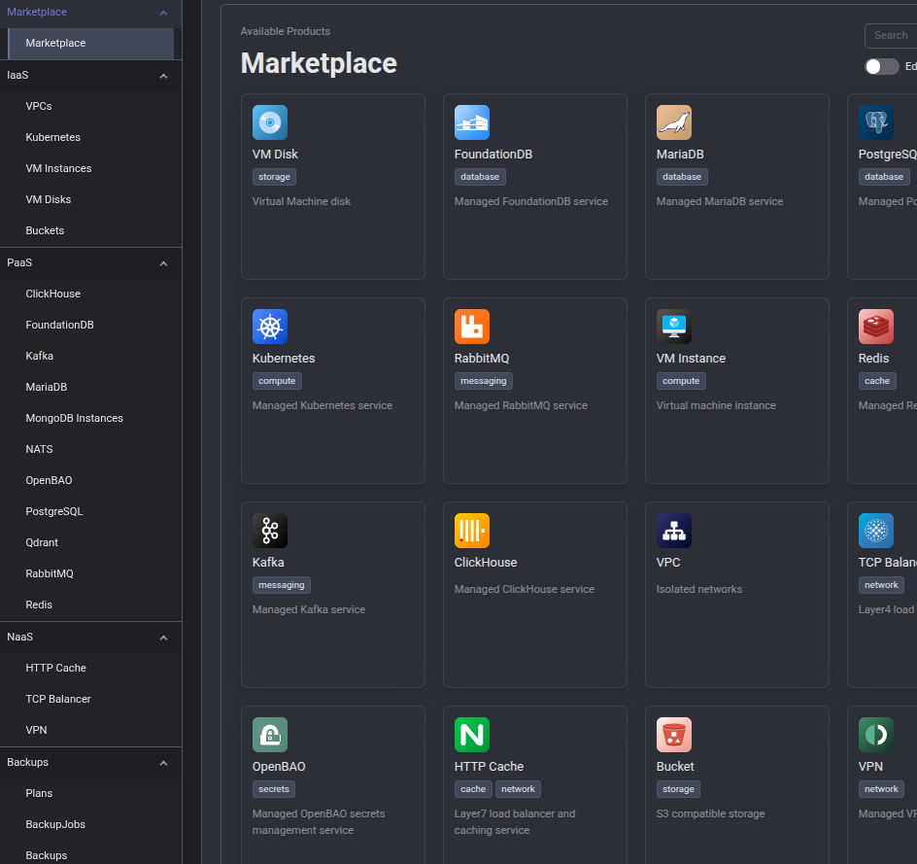

Democratizing Access
THE SELF-SERVICE UI
We promised developers a self-service hyperscaler experience. Architecture and performance do not matter much if the platform is not usable.
By hiding the complexity behind a simple, cloud-like portal, we empower developers.
Easiness of the public cloud, with the security of on-premise.

Slide 11


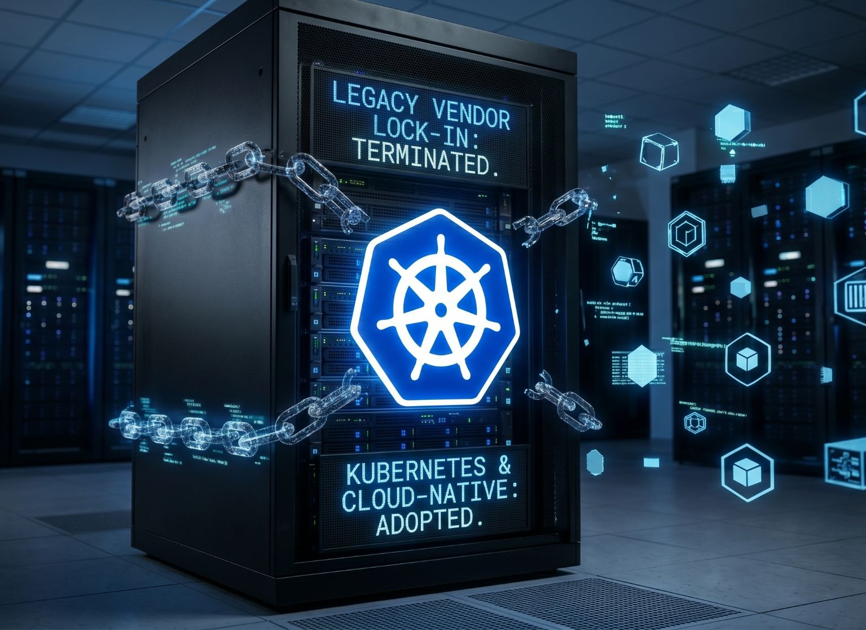
Production Readiness
ESCAPING THE "LEGACY TRAP"
Beyond the Lab: Currently running active POC and preparing for full production implementation.
Total Replacement: Stripping out the legacy virtualization stack entirely in favor of CNCF and open-source projects.
Regaining Control: Total ownership over your data, code, and infrastructure security without vendor extortion.
Proven at Scale: Kubernetes as orchestrator for everything, including mission-critical, legacy brownfield workloads on bare-metal.

Slide 12




Sovereign Compliance
ELEVATING THE PRIVATE CLOUD TO CRYPTOGRAPHIC SOVEREIGNTY
Hardware Root of Trust & Micro-Segmentation: Moving beyond logical namespaces. Enforcing TPM 2.0 attestation and default-deny CNI network boundaries down to the Top-of-Rack (ToR) switch.
Immutable Policy-as-Code: Eliminating configuration drift via GitOps and dynamic admission control (e.g., Kyverno). SOC 2 Type 2 guardrails are engineered directly into the cluster lifecycle.
Provable Evidence Generation: Aggregating unified, WORM-backed audit trails across the bare-metal, Kubernetes API, and workload layers to automate continuous compliance reporting.
Cryptographic Readiness: Enforcing strict KMS-backed persistent encryption at rest and preparing the service mesh for Post-Quantum Cryptography (PQC) standards in transit.
[If required] FedRAMP High / NIST 800-53 Readiness: Transitioning to strictly FIPS 140-3 validated cryptographic modules across the OS and network layers, establishing dedicated physical enclaves.
Part of Sovereign-Edge Compliance Orchestration (SECO): The proprietary framework required for sovereign scale-out.

Slide 13








The SECO Framework
SECURING SOVEREIGN CLOUD OPERATIONS
Hardware & Network Trust
Policy-as-Code & Cryptography
Continuous Provability
METHODOLOGY
METHODOLOGY
METHODOLOGY
Enforcing an immutable secure boot with TPM-attested identity and eBPF micro-segmentation.
Dynamic admission control for compliance guardrails paired with external KMS
High-performance log aggregation and unified observability for regulatory audit readiness.
Talos/Other Linux: Secure Boot
Kyverno/OPA: SOC 2 Policies
VictoriaLogs+Metrics: Auditing
TPM 2.0: Secure Attestation
OpenBao/HashiCorp Vault: KMS
Fluent Bit: Log Pipeline
Cilium: eBPF / Network Policies
Zero-Trust: Encryption at-rest and in-transit
Grafana+Alerta: Observability
Compliance is not a point-in-time checklist; it is a reconciliation loop.
By embedding SECO framework into the platform, we achieve continuous compliance and self-auditing.

Slide 14







The Brownfield Bridge
MIGRATION MECHANICS: VCENTER TO KUBEVIRT
LEGACY SOURCE
MIGRATION ENGINE
NEW ENVIRONMENT
Proprietary Abstraction
Direct Streaming IO
Declarative Logic
https://www.youtube.com/watch?v=2Fm8IJ7gyRg https://medium.com/@aminefennane10/migrating-from-vmware-to-kubevirt-a-practical-guide-to-kubernetes-native-virtualization-e6c70e94788a
Verdict:
Migration is a data-streaming process, not a rebuild ticket. By utilizing Warm-Sync (CBT) mechanics, we safely transition multi-terabyte mission-critical state with near-zero cutover windows.

Slide 15










Single Control Plane
The Post-Hypervisor era is here. Let's go build the Unified Cloud.
Unified Control Plane
Merge Bare-Metal, Managed K8S, PaaS, AI, and legacy VMs on a single cloud-native platform.
Operational Velocity
Kill the "Hypervisor Tax" and restore engineering speed via GitOps automation.
True Sovereignty
LET'S CONNECT
Full ownership of your code, your data, and your hardware platform. Zero lock-in.
/in/myroslavmishov/

