Slide 1
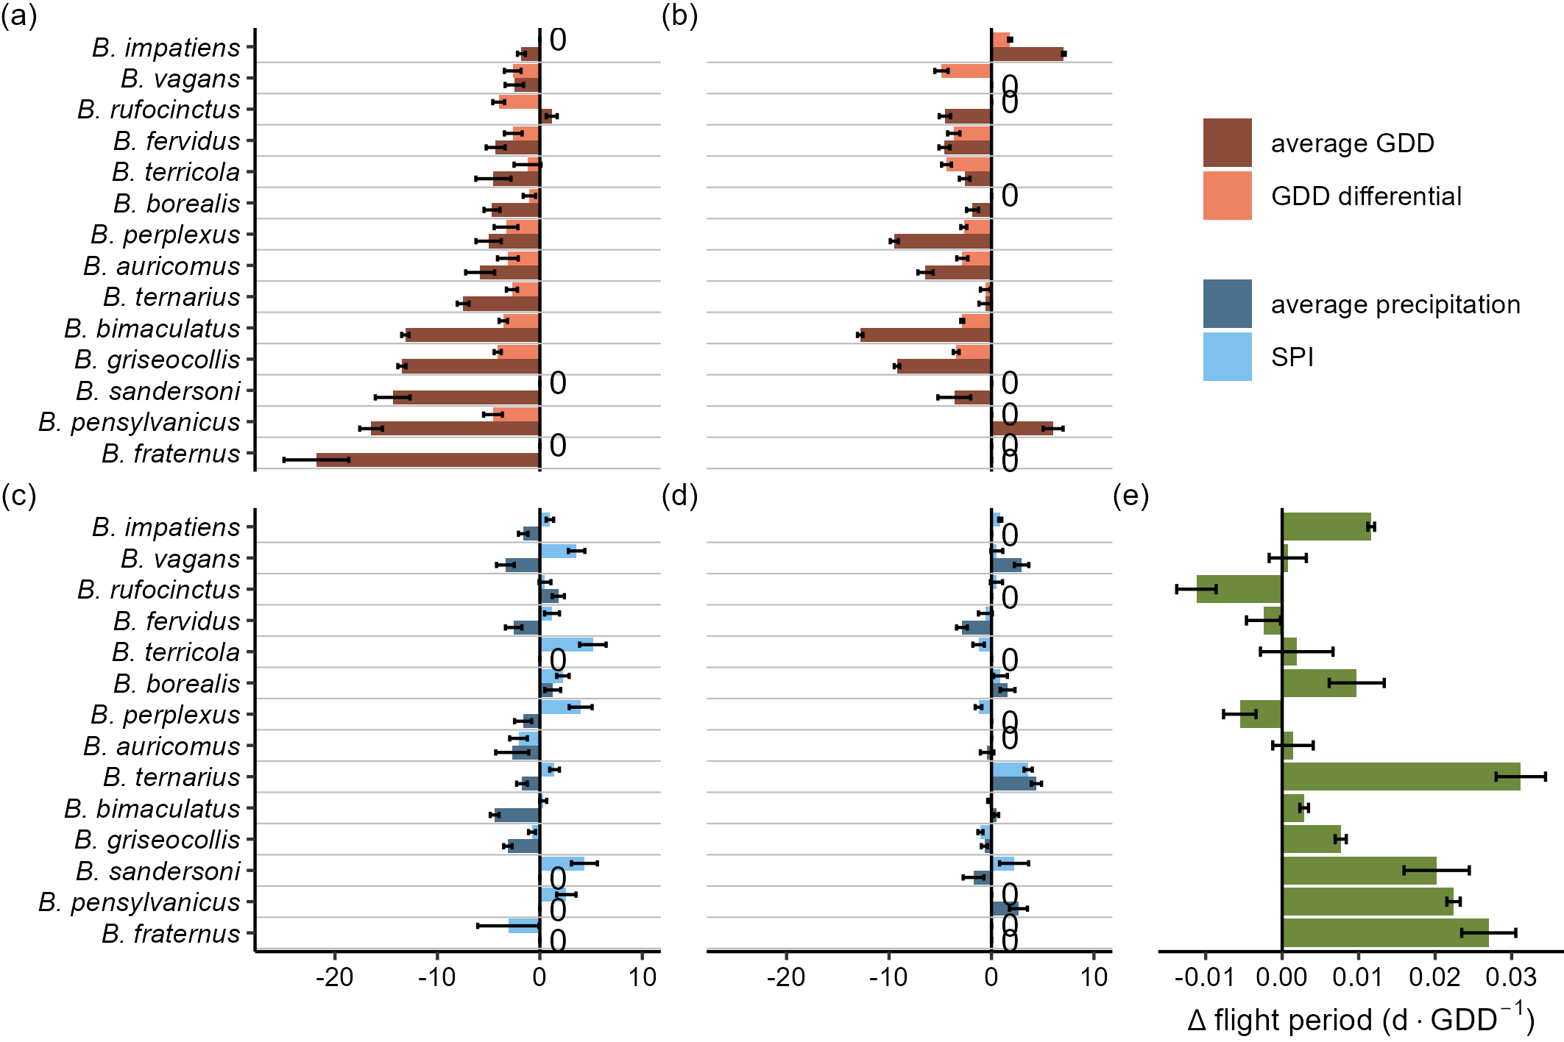
onset (τ = 0.1)
end (τ = 0.9)
standardized effect size

