Slide 1
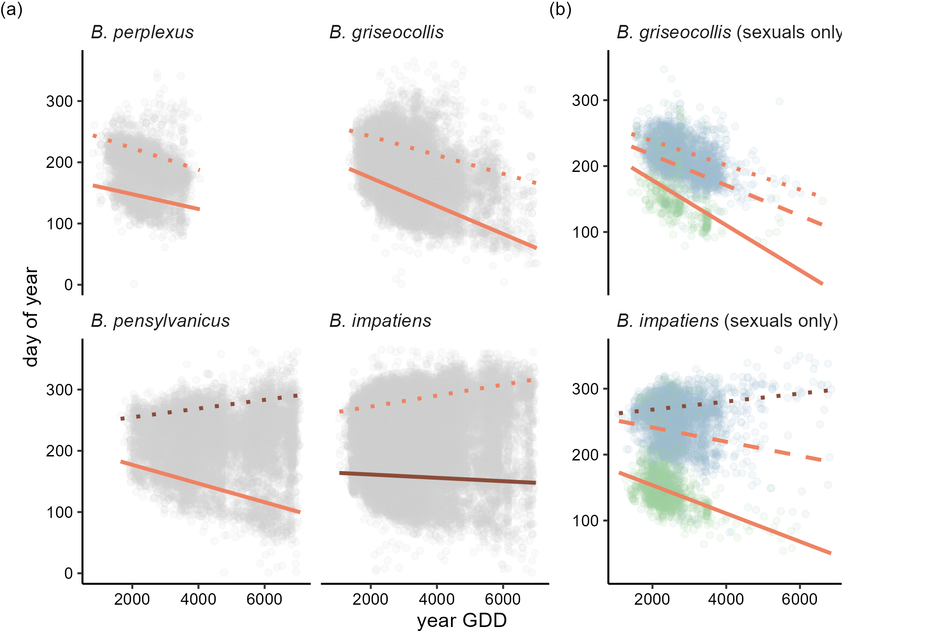
B. griseocollis (sexuals only)
Panel (a)
onset
end year GDD avg GDD
Panel (b)
♀ onset
♂ onset ♂ end year GDD avg GDD ♂ ♀

