Slide 1
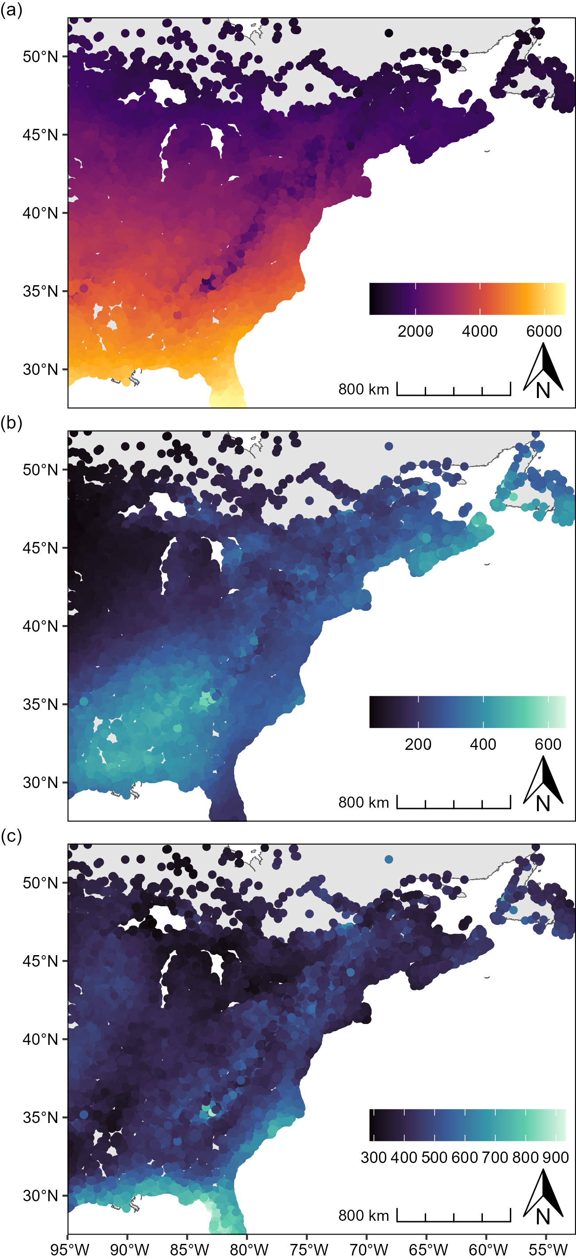
average annual GDD
average accumulated winter precipitation (mm)
average accumulated summer precipitation (mm)

Slide 2
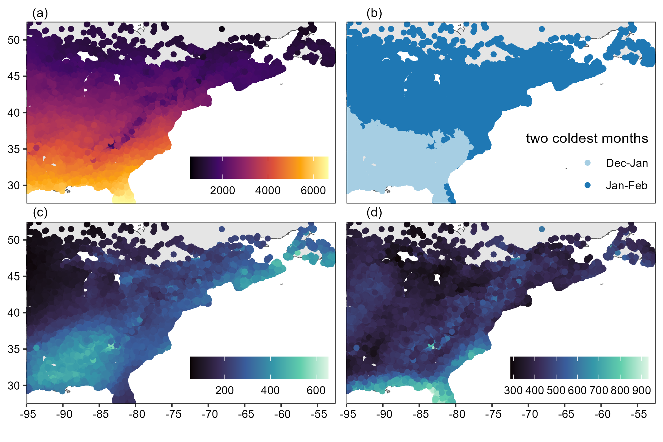
average annual GDD
two coldest months
average accumulated winter precipitation (mm)
average accumulated summer precipitation (mm)

