Slide 1
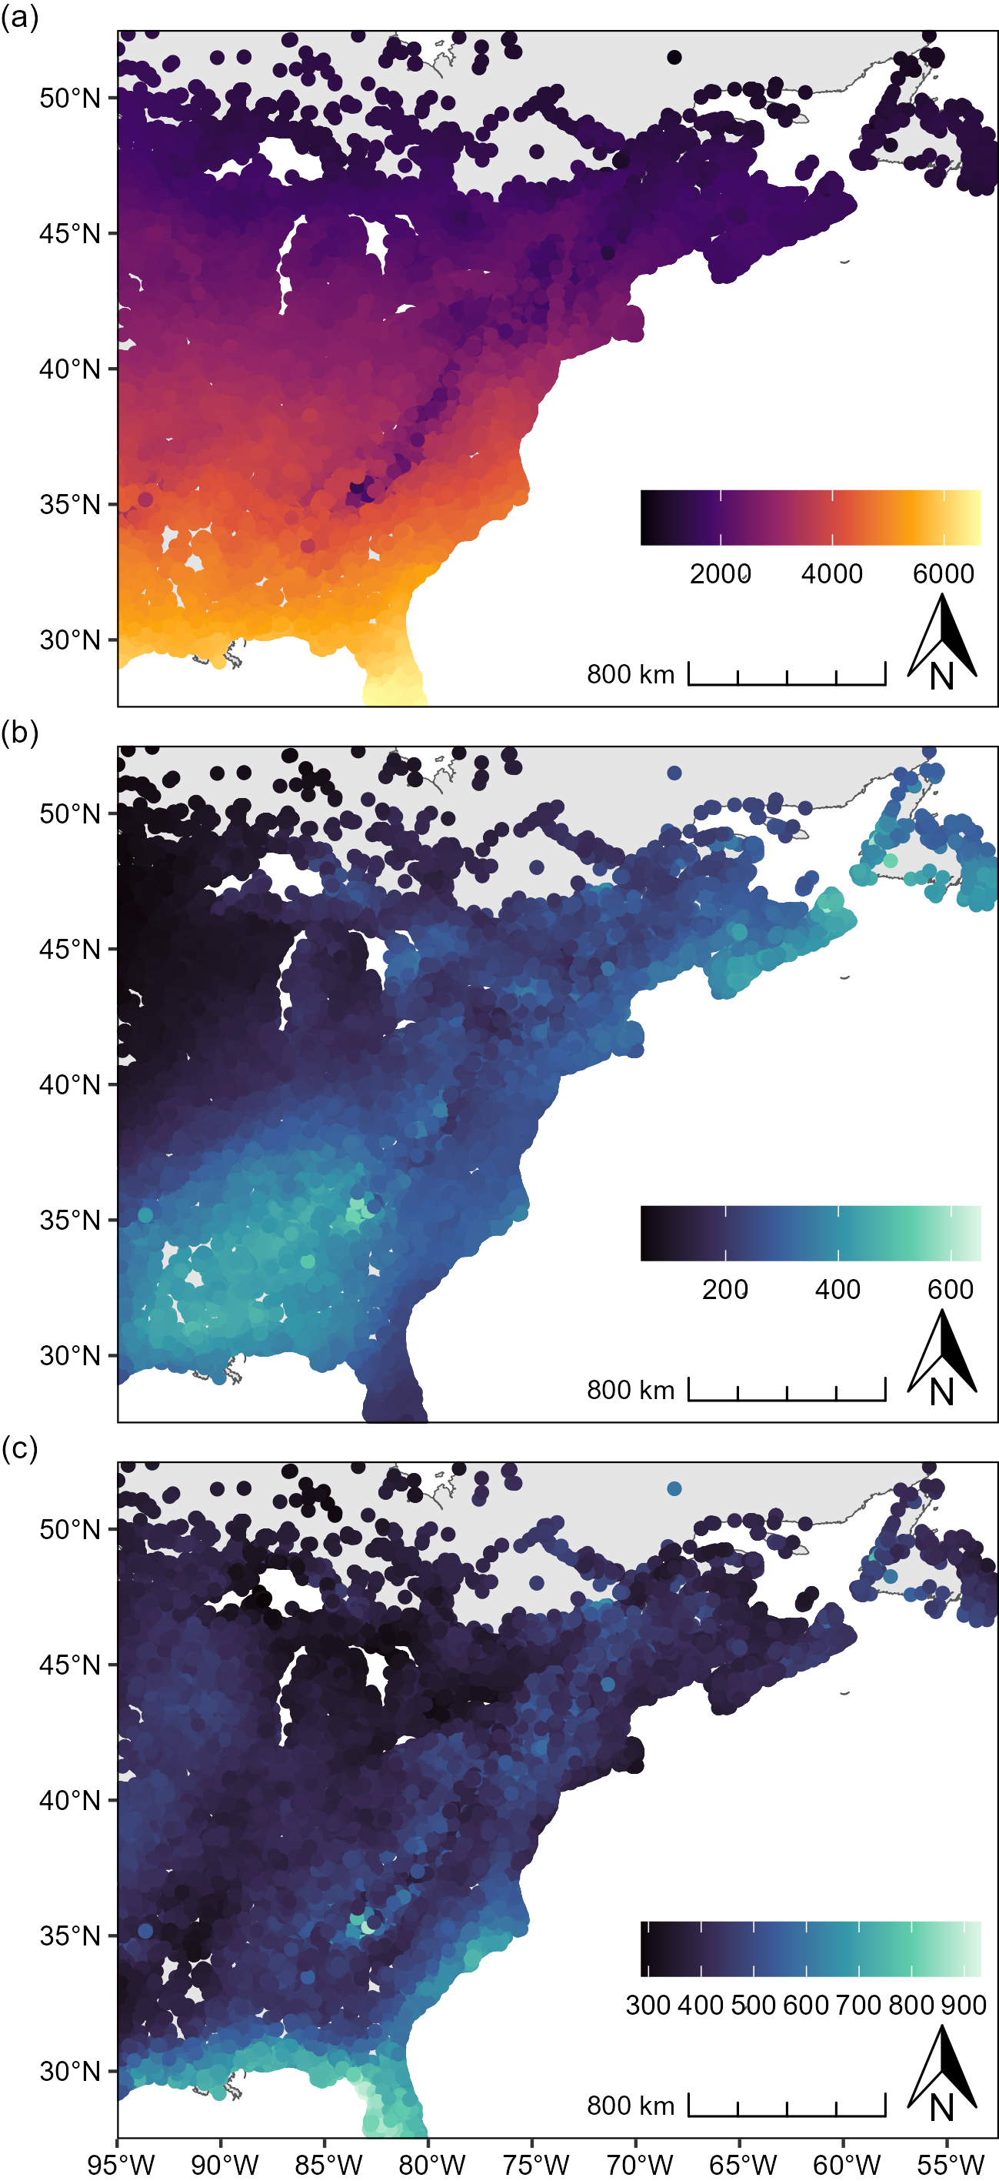
Figure S2
average annual GDD (ºC)
average accumulated winter precipitation (mm)
average accumulated summer precipitation (mm)

