Slide 1
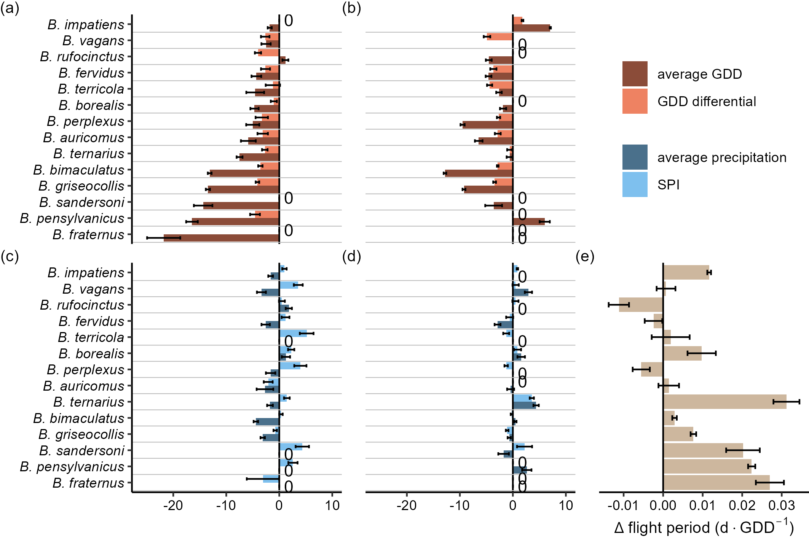
Figure 2
onset (τ = 0.1)
end (τ = 0.9)
standardized effect size

