Slide 1
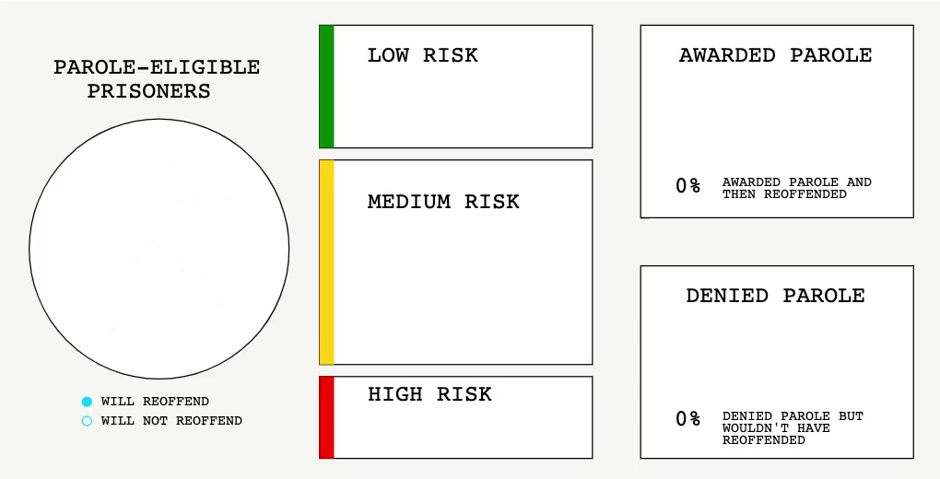
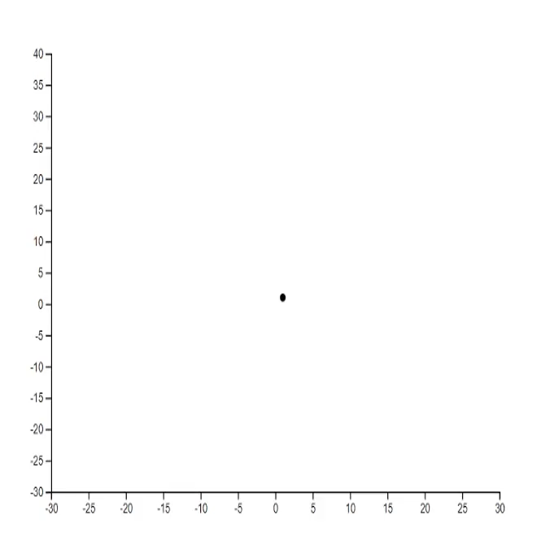
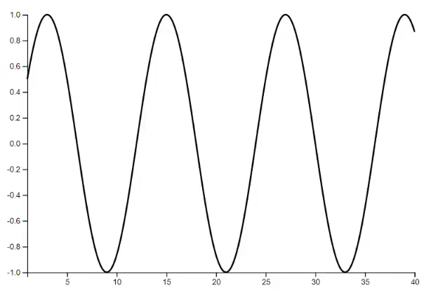
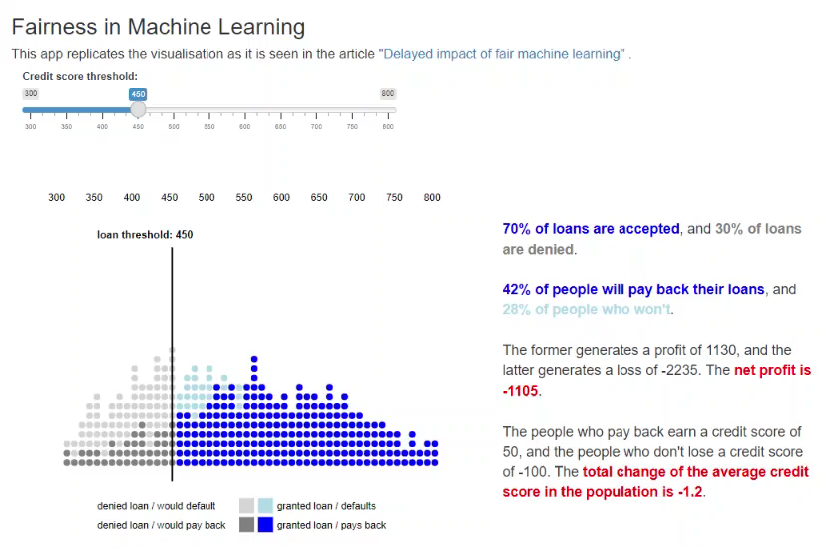
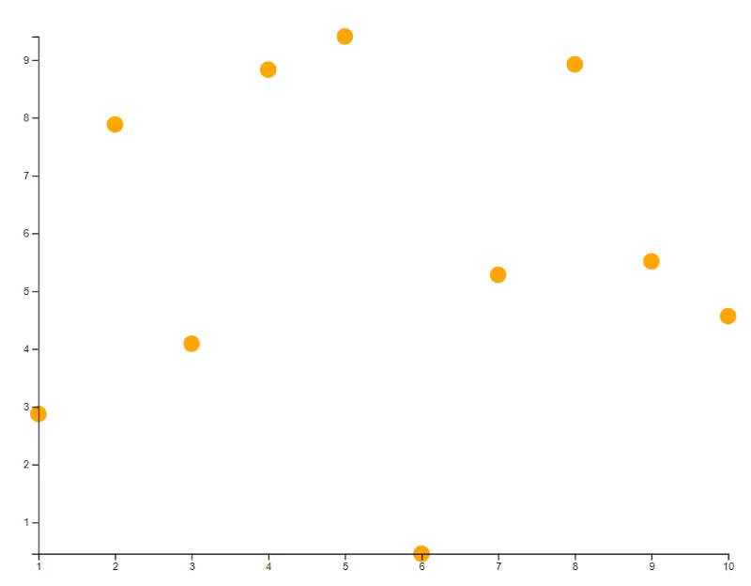
animate: A web-based graphics device[*] for animated visualisation in R
Syntax
Set up the device
library(animate)
device <- animate$new(width = 600, height = 400)
device$plot(...)
device$off()
Tips: Use attach(device) to save typing device$... every time.
Other examples
A visualisation beyond x-y plots
Chun Fung Kwok (Jackson)^{[1][2]} , Davis McCarthy^{[1][2]}
Repo: https://github.com/kcf-jackson/animate
Package website: https://kcf-jackson.github.io/animate/index.html
Target usage: Animated data visualisations
Examples:
agent-based modelling,
dynamical system,
sports data visualisation
creative coding, and
any charting beyond X-Y plots.
Frame-by-frame animation
# Plotting the sine curve
x <- seq(1, 40, 0.1)
y <- sin(x * pi / 6)
plot(x, y, type=“l”, id=“line-1”)
# Update the plot with the same id
for (n in 41:200) {
new_x <- seq(1, n, 0.1)
new_y <- sin(new_x * pi / 6)
plot(new_x, new_y, type=“l”, id=“line-1”)
Sys.sleep(0.02) # about 50 frames per second
}
Frame-by-frame animation is just re-plotting many times with a for-loop!
Video demo 4: An example replicated from “The new science of sentencing”
Video demo 1: Lorenz system, particle system and Hilbert curves.
Video demo 2: Frame-by-frame animation
A Shiny app example
Design
Based on base plot syntax, supports plot, points, lines, bars, abline, axis, text, image.
Live update (in contrast to pre-rendering)
Uses dynamic scale
Targets high frame rate
Keyframe animation
# Plot 10 points at random locations
x <- 1:10
y <- 10 * runif(10)
# Give each point an ID
id <- new_id(y, prefix=“points”)
plot(x, y, bg=“orange”, id=id)
# Update the plot with transition animation
new_y <- 10 * runif(10)
points(x, new_y, bg=“blue”, id=id, transition=TRUE)
# Update the plot with specific transition animation
new_y <- 10 * runif(10)
points(x, new_y, bg=“green”, cex=(1:10)*30, id=id,
transition=list(duration = 2000))
Keyframe animation is just re-plotting with transition option enabled!
Key Concepts
The supported base plot functions are extended by three arguments: id, transition, and style.
id is used to update the elements on the screen.
transition sets the parameters of the keyframe animation.
style sets the styles of the graphics elements. It supports (some) R parameters and (full) CSS styling.
(Usage are presented in the Syntax section on the right.)
Video demo 3: Keyframe animation
Video demo 5: An example replicated from “Delayed impact of fair machine learning”
Deployment
Support R Markdown Document (HTML document output)
Support Shiny app (for interactivity)
Support screencast to MP4 video output
See more at the package website @
https://kcf-jackson.github.io/animate/index.html !
Thank you for reading, and I hope you enjoy the rest of the useR!2022 conference.
[*] We refer to a collection of functions that produce graphics on the screen as the graphics device.
[1] St Vincent’s Institute of Medical Research, Melbourne, Australia. (Email: jkwok@svi.edu.au)
[2] The University of Melbourne, Melbourne, Australia.

