Slide 1
[MS Meishan] ADO issue Analysis
445239
2026/07/16

Slide 2
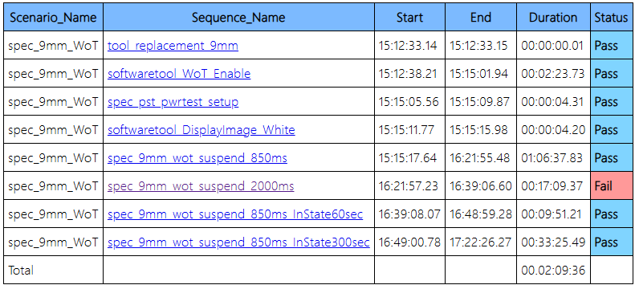
Summary
9mm WOT
Notes:
放大圖檔直線排列

Slide 3
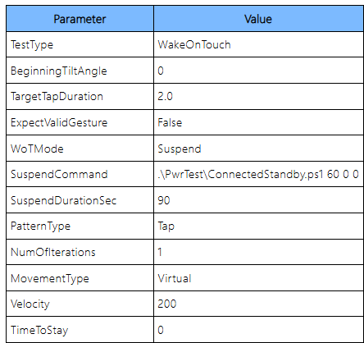
ADO issue
Test Method
The device enters suspend mode for 90 seconds, then a 2-second tap is applied. The test passes if the device remains asleep and fails if it wakes up.

Slide 4
ADO issue
Test Robot log
no Z-axis movement was observed in the Robot Movement Log.
Point | X(mm) | Y(mm) | Z(mm)
Home(Start) | 0.0631405338644981 | 0.0947645753622055 | 10.0000019073486
P1 | 15.9999942779541 | 15.999924659729 | 10.0000009536743
P2 | 89.8066024780273 | 15.9999370574951 | 10.0
P3 | 163.613204956055 | 15.9999389648438 | 9.99999904632568
P4 | 237.419799804688 | 15.9999618530273 | 10.0000019073486
P5 | 15.9999933242798 | 84.403076171875 | 9.99999904632568
P6 | 89.8066024780273 | 84.4030380249023 | 9.99999904632568
P7 | 163.613204956055 | 84.4030685424805 | 10.0000019073486
P8 | 237.419799804688 | 84.4030685424805 | 10.0000009536743
P9 | 16.0000019073486 | 152.806121826172 | 9.99999904632568
P10 | 89.8066024780273 | 152.806045532227 | 10.0000019073486
P11 | 163.613204956055 | 152.806106567383 | 10.0000009536743
P12 | 237.419799804688 | 152.806060791016 | 9.99999904632568
Home(End) | 0.936868369579315 | 0.90520316362381 | 10.0000009536743

