Slide 2



Decomposition based on the expanded terms from the Block structure formula
y
Project
Gm
Sweep
Project
Block 1
$$Q_{B_{1}}$$
Sweep
Project
Block 2
$$Q_{B_{2}}$$
Sweep
Project
…
Sweep
Residual
$$Q_{e}$$

Slide 3



Decomposition based on the expanded terms from the Treatment structure formula
Block1
Project
Trt1
$$Q_{{Trt_{1}(B}_{1})}$$
Sweep
Project
Trt2
$$Q_{{Trt_{2}(B}_{1})}$$
Sweep
Project
…
Sweep
Residual
$$Q_{{e(B}_{1})}$$

Slide 4
Decomposition procedures
Block1
Trt1
Trt1
Trt2
Project
AveEff
…
Project
Project
AveEff
Project
AveEff
Sweep
Project
Trt2
Trt1
Trt2
Project
AveEff
…
Project
AveEff
Project
AveEff
Sweep
Project
…

Slide 5
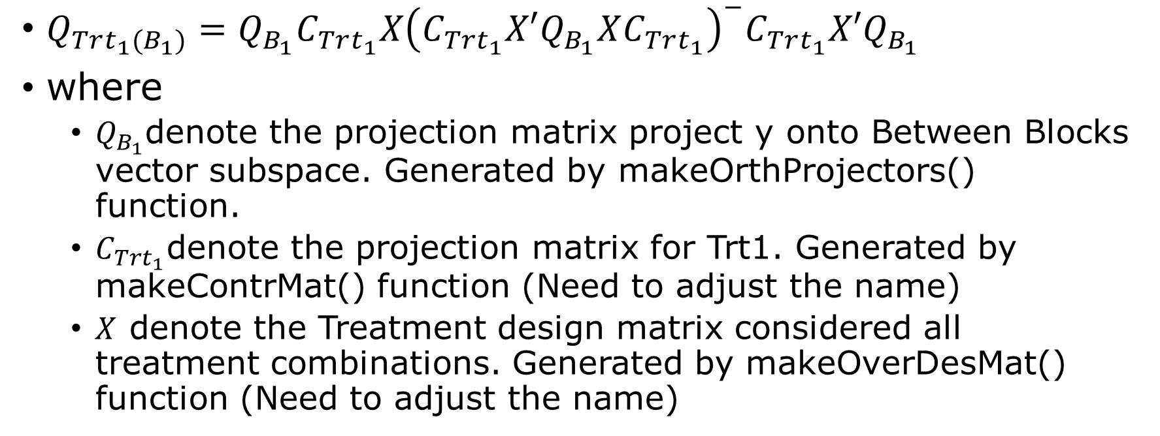
Block1
Project
Trt1
${Q_{{Trt_{1}(B}_{1})}=Q}_{B_{1}}C_{Trt_{1}}X{\left(C_{Trt_{1}}X′Q_{B_{1}}XC_{Trt_{1}}\right)}^{−}C_{Trt_{1}}X′Q_{B_{1}}$
where
$Q_{B_{1}}$denote the projection matrix project y onto Between Blocks vector subspace. Generated by makeOrthProjectors() function.
$C_{Trt_{1}}$denote the projection matrix for Trt1. Generated by makeContrMat() function (Need to adjust the name)
$X$ denote the Treatment design matrix considered all treatment combinations. Generated by makeOverDesMat() function (Need to adjust the name)

Slide 6
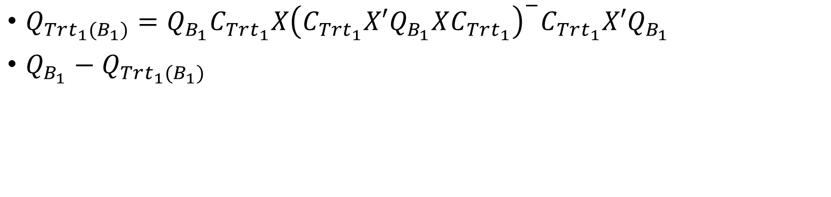
Block1
Project
Trt1
Sweep
Project
${Q_{{Trt_{1}(B}_{1})}=Q}_{B_{1}}C_{Trt_{1}}X{\left(C_{Trt_{1}}X′Q_{B_{1}}XC_{Trt_{1}}\right)}^{−}C_{Trt_{1}}X′Q_{B_{1}}$
$Q_{B_{1}}−Q_{{Trt_{1}(B}_{1})}$

Slide 7
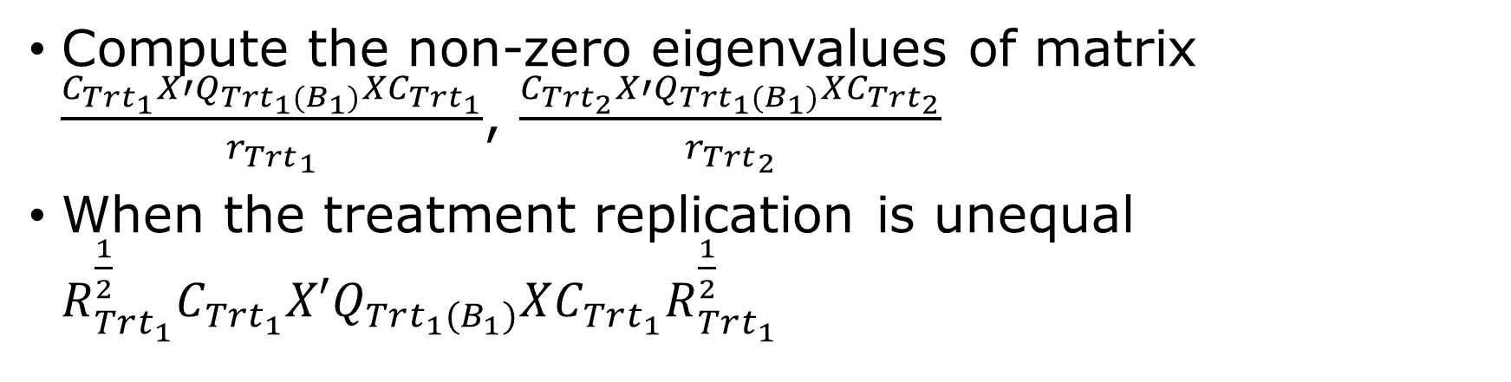
Block1
Trt1
Trt1
Trt2
Project
AveEff
…
Project
Project
AveEff
Project
AveEff
Compute the non-zero eigenvalues of matrix $\frac{C_{Trt_{1}}X′Q_{{Trt_{1}(B}_{1})}XC_{Trt_{1}}}{{r_{Trt}}_{1}}$, $\frac{C_{Trt_{2}}X′Q_{{Trt_{1}(B}_{1})}XC_{Trt_{2}}}{{r_{Trt}}_{2}}$
When the treatment replication is unequal ${R_{Trt_{1}}^{\frac{1}{2}}C}_{Trt_{1}}X′Q_{{Trt_{1}(B}_{1})}XC_{Trt_{1}}R_{Trt_{1}}^{\frac{1}{2}}$

Slide 8
Decomposition procedures
Block1
Trt1
Trt1
Trt2
Project
AveEff
…
Project
Project
AveEff
Project
AveEff
Sweep
Project
Trt2
Trt1
Trt2
Project
AveEff
…
Project
AveEff
Project
AveEff
Sweep
Project
…

