Slide 1
Data Structure and Algorithms
Learning Outlines
Describe the concepts of Data structure in data operations
Describe the Data Structure techniques in programming language
Use Data structure techniques in solving computer problems
Use various computer algorithms to design a program
Describe the stages in algorithm design
Use pseudo codes to design algorithms
Facilitator: Mr. Ali Khelef
Assistant Lecturer – EASTC
Email: ali.khelef@eastc.ac.tz

Slide 2
Data Structure
Data
Data are the raw facts that represent some things. Data can be in the form of quantities, characters, or symbols that can be stored and processed to generate useful information.
Structuring the data can facilitate the process of managing and processing the data
Data Structure
A data structure is a systematic way to store and organize data in order to facilitate the access and modifications of data.
It refers to the method of presenting of logical relationships between individual data elements related to the solution of a given problem.
Data Structures
Data structures are containers that hold and organize data in various ways.
They act as storage units that can be used to manage, manipulate, and retrieve information efficiently.
Types of Data Structures
Data structures can be classified as:
Linear Data structures
Non-linear Data structures

Slide 3
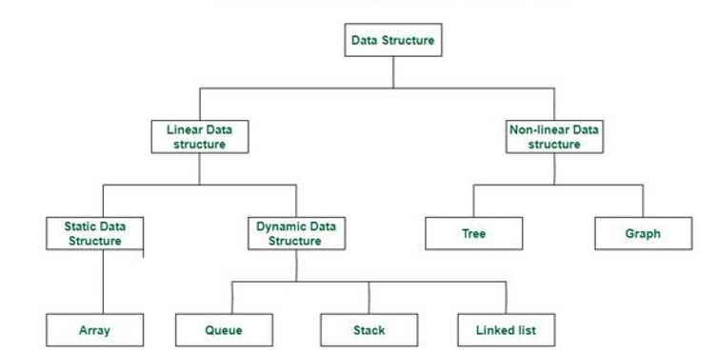
Types of Data Structure

Slide 4
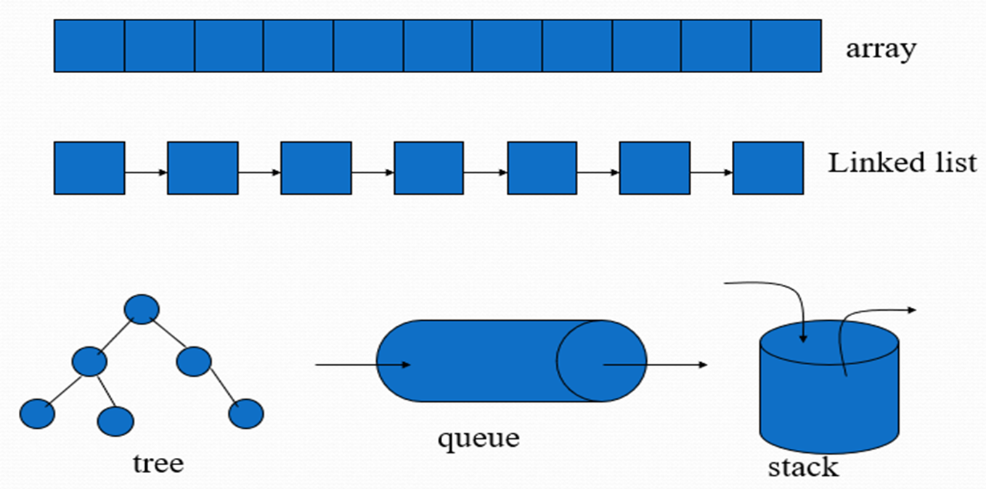
Types of Data Structure
Linear Data Structure:
These are the data structures in which its data elements are arranged sequentially. Linear Data Structures can be further classified into:
Static data structure: Data structure which has a fixed memory size. (e.g Array )
Dynamic data structure: Data structure which has no fixed memory size. It can be randomly updated during the runtime. (e.g queue, stack, link list)
Non-linear data structure:
These are the data structures where data elements are not placed sequentially. (e.g trees, graphs)

Slide 5
Data Structure
Questions (10 minutes)
Briefly explain why do we need data structures?
Explain the Applications of:
arrays.
Stacks
trees and graphs

