Slide 1
Software Requirements ANALYSIS DSU07316
Lecture 04

Slide 2
Software Requirements
Software requirements are description of features and functionalities of the target system.
Requirements convey the expectations of users from the software product.
The requirements can be obvious or hidden, known or unknown, expected or unexpected from client’s point of view.

Slide 3
TYPES OF SOFTWARE Requirements
A software requirement can be of 3 types:
Functional requirements
Non-functional requirements
Domain requirements

Slide 4
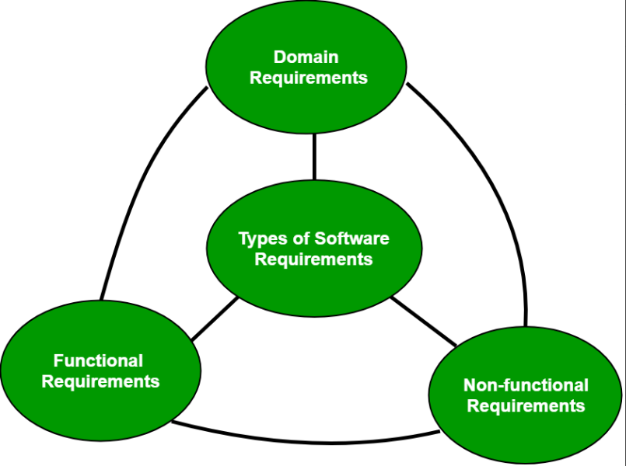
TYPES OF Requirements…

Slide 5
Functional requirements
These are the requirements that the end user specifically demands as basic facilities that the system should offer.
It can be a calculation, data manipulation, business process, user interaction, or any other specific functionality which defines what function a system is likely to perform.
All these functionalities need to be necessarily incorporated into the system as a part of the contract.

Slide 6
Functional requirements…
They are basically the requirements stated by the user which one can see directly in the final product.

Slide 7
Non-functional requirements
These are basically the quality constraints that the system must satisfy according to the project contract.
Nonfunctional requirements, not related to the system functionality, rather define how the system should perform
The priority or extent to which these factors are implemented varies from one project to other.
They are also called non-behavioral requirements.

Slide 8
Non-functional requirements…
They basically deal with issues like:
Portability
Security
Maintainability
Reliability
Scalability
Performance
Reusability
Flexibility

Slide 9
Non-functional requirements…
NFR’s are classified into following types:
Interface constraints
Performance constraints: response time, security, storage space, etc.
Operating constraints
Life cycle constraints: maintainability, portability, etc.
Economic constraints

Slide 10
Domain requirements
Domain requirements are the requirements which are characteristic of a particular category or domain of projects.
Domain requirements can be functional or nonfunctional.
Domain requirements are expectations related to a particular type of software, purpose or industry vertical

Slide 11
Domain requirements…
The common factor for domain requirements is that they meet established standards or widely accepted feature sets for that category of software project.
Software can be functional and usable but not acceptable for production because it fails to meet domain requirements.

Slide 12
Domain requirements…
Domain requirements typically arise in military, medical and financial industry sectors, among others. One example of a domain requirement is for software in medical equipment:
The software must be developed in accordance with IEC 60601 regarding the basic safety and performance for medical electrical equipment.

Slide 13
Requirement Engineering
Requirement engineering Refers to the process of gathering the software requirements from client, analyze and document them.
The goal of requirement engineering is to develop and maintain sophisticated and descriptive ‘System Requirements Specification’ document.

Slide 14
Requirement Engineering Process
It is a four step process, which includes –
Feasibility Study
Requirement Gathering
Software Requirement Specification
Software Requirement Validation

Slide 15
Feasibility study
When the client approaches the organization for getting the desired product developed, it comes up with rough idea about what all functions the software must perform and which all features are expected from the software.
This feasibility study is focused towards goal of the organization. This study analyzes whether the software product can be practically materialized in terms of implementation, contribution of project to organization, cost constraints and as per values and objectives of the organization. It explores technical aspects of the project and product such as usability, maintainability, productivity and integration ability.
The output of this phase should be a feasibility study report that should contain adequate comments and recommendations for management about whether or not the project should be undertaken.

Slide 16
Requirement Gathering
If the feasibility report is positive towards undertaking the project, next phase starts with gathering requirements from the user.
Analysts and engineers communicate with the client and end-users to know their ideas on what the software should provide and which features they want the software to include.

Slide 17
Software Requirement Specification (SRS)
SRS is a document created by system analyst after the requirements are collected from various stakeholders.
SRS defines how the intended software will interact with hardware, external interfaces, speed of operation, response time of system, portability of software across various platforms, maintainability, speed of recovery after crashing, Security, Quality, Limitations etc.

Slide 18
SRS…
The SRS is a specification for a specific software product, program, or set of applications that perform particular functions in a specific environment. It serves several goals depending on who is writing it.
First, the SRS could be written by the client of a system.
Second, the SRS could be written by a developer of the system. The two methods create entirely various situations and establish different purposes for the document altogether.
The first case, SRS, is used to define the needs and expectation of the users. The second case, SRS, is written for various purposes and serves as a contract document between customer and developer.

Slide 19
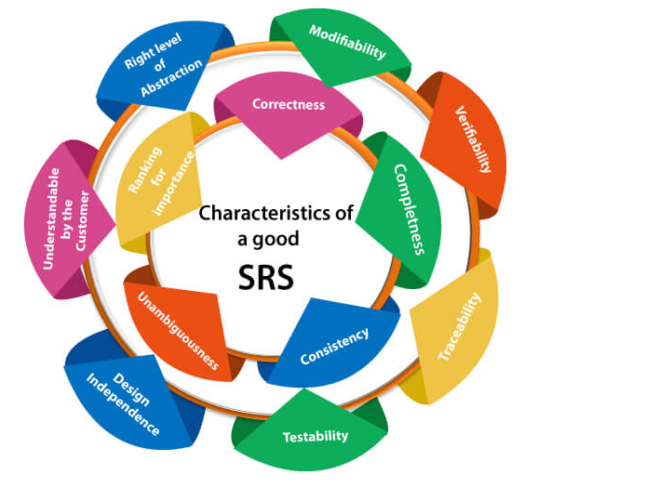
Characteristics of good SRS

Slide 20
Characteristics of good SRS…
Correctness: User review is used to provide the accuracy of requirements stated in the SRS. SRS is said to be perfect if it covers all the needs that are truly expected from the system.
Completeness: The SRS is complete if, and only if, it includes the following elements:
(1). All essential requirements, whether relating to functionality, performance, design, constraints, attributes, or external interfaces.
(2). Definition of their responses of the software to all realizable classes of input data in all available categories of situations.
(3). Full labels and references to all figures, tables, and diagrams in the SRS and definitions of all terms and units of measure.

Slide 21
Characteristics of good SRS…
Consistency: The SRS is consistent if, and only if, no subset of individual requirements described in its conflict. There are three types of possible conflict in the SRS:
(1). The specified characteristics of real-world objects may conflicts. For example,
(a) The format of an output report may be described in one requirement as tabular but in another as textual.
(b) One condition may state that all lights shall be green while another states that all lights shall be blue.
(2). There may be a reasonable or temporal conflict between the two specified actions. For example,
(a) One requirement may determine that the program will add two inputs, and another may determine that the program will multiply them.
(b) One condition may state that "A" must always follow "B," while other requires that "A and B" co-occurs.
(3). Two or more requirements may define the same real-world object but use different terms for that object. For example, a program's request for user input may be called a "prompt" in one requirement's and a "cue" in another. The use of standard terminology and descriptions promotes consistency.

Slide 22
Characteristics of good SRS…
Unambiguousness: SRS is unambiguous when every fixed requirement has only one interpretation. This suggests that each element is uniquely interpreted. In case there is a method used with multiple definitions, the requirements report should determine the implications in the SRS so that it is clear and simple to understand.
Ranking for importance and stability: The SRS is ranked for importance and stability if each requirement in it has an identifier to indicate either the significance or stability of that particular requirement. Typically, all requirements are not equally important. Some prerequisites may be essential, especially for life-critical applications, while others may be desirable. Each element should be identified to make these differences clear and explicit. Another way to rank requirements is to distinguish classes of items as essential, conditional, and optional.

Slide 23
Characteristics of good SRS…
Modifiability: SRS should be made as modifiable as likely and should be capable of quickly obtain changes to the system to some extent. Modifications should be perfectly indexed and cross-referenced.
Verifiability: SRS is correct when the specified requirements can be verified with a cost-effective system to check whether the final software meets those requirements. The requirements are verified with the help of reviews.
Traceability: The SRS is traceable if the origin of each of the requirements is clear and if it facilitates the referencing of each condition in future development or enhancement documentation.
Design Independence: There should be an option to select from multiple design alternatives for the final system. More specifically, the SRS should not contain any implementation details.

Slide 24
Characteristics of good SRS…
Testability: An SRS should be written in such a method that it is simple to generate test cases and test plans from the report.
Understandable by the customer: An end user may be an expert in his/her explicit domain but might not be trained in computer science. Hence, the purpose of formal notations and symbols should be avoided too as much extent as possible. The language should be kept simple and clear.
The right level of abstraction: If the SRS is written for the requirements stage, the details should be explained explicitly. Whereas, for a feasibility study, fewer analysis can be used. Hence, the level of abstraction modifies according to the objective of the SRS.

Slide 25
Properties of a good SRS document
Concise: The SRS report should be concise and at the same time, unambiguous, consistent, and complete. Verbose and irrelevant descriptions decrease readability and also increase error possibilities.
Structured: It should be well-structured. A well-structured document is simple to understand and modify. In practice, the SRS document undergoes several revisions to cope up with the user requirements. Often, user requirements evolve over a period of time. Therefore, to make the modifications to the SRS document easy, it is vital to make the report well-structured.

Slide 26
Properties of a good SRS document
Black-box view: It should only define what the system should do and refrain from stating how to do these. This means that the SRS document should define the external behavior of the system and not discuss the implementation issues. The SRS report should view the system to be developed as a black box and should define the externally visible behavior of the system. For this reason, the SRS report is also known as the black-box specification of a system.
Conceptual integrity: It should show conceptual integrity so that the reader can merely understand it. Response to undesired events: It should characterize acceptable responses to unwanted events. These are called system response to exceptional conditions.
Verifiable: All requirements of the system, as documented in the SRS document, should be correct. This means that it should be possible to decide whether or not requirements have been met in an implementation.

Slide 27
END

