Slide 1
RESEARCHMETHODOLOGY
STU08101

Slide 2
BACHELOR OF OFFICIAL STATISTICS YEAR 3 – SEMESTER 1: 30/10/2017 – 2/03/2018
 | 0800-0900 | 0800-1000 | 1400-1700
Monday |  |  | STU08101 LECTURE Dr. LyaroF. HALL
Thursday |  | STU08101 TUTORIAL Dr. LyaroF. HALL
Friday | STU08101 LECTURE Dr. LyaroF. HALL

Slide 3
LEARNING MATERIALS
Kothari, C.R. (2004). Research Methodology: Methods and Techniques. New Age International (P) Ltd., New Delhi.
Adam, J. and Kamuzora, F. (2008). Research Methods for Business and Social Studies. Mzumbe Book Project., Morogoro.
Aaker,D.A. , Kumar, V. and Day, G.S. (2005). Marketing Research. John Wiley and Sons., India.
Other related books and Journals
Handouts, research reports, internet materials and text books

Slide 4
STU08101 SUB-ENABLING OUTCOMES
1.1.1 Explain the scientific nature of research
1.1.2 Describe different types of research
1.1.3 Explain the two basic approaches in research
1.1.4 Explain the importance of research in socio-economic development
1.2.1 Select and define the research problem in the relevant socio-economic sector
1.2.2 Prepare a research proposal/plan
1.2.3 Prepare a research design for collection, measurement and analysis of data
1.3.1 Determine the population, sampling design and data collection instruments.
1.3.2 Apply research methods and techniques to analyze and interpret the results.
1.3.3 Prepare the layout of the research report

Slide 5
RESEARCH TITLE
Research title is the name of the topic investigated which sets the scene and summary of main ideas which justify the uniqueness and relevance of the study.

Slide 6
EXAMPLES-TITLES
An analysis of seasonality fluctuations in the oil and gas stock returns
The Effect of Technological Innovation on International Trade. A Nonlinear Approach
Behaviour of Micro An Assessment of External Factors Affecting Investment Decisions of Companies
The Impact of National Financial Regulation on Macroeconomic and Fiscal Performance after the 2007 Financial Shock – Econometric Analyses Based on Cross-Country Data
Challenges Associated with the Expansion of Deposit Insurance Coverage during Fall 2008
Uncertain Retirement and the Effects of Social Insurance on Savings, Wealth, and Welfare
Factors influencing farmers’ behavior in rice seed selling in the market: a case study in the Tarai region of Nepald
The Effect of Emissions on U.S. State Total Factor Productivity Growth

Slide 7
EXAMPLES-TITLES
Analyzing the Competitiveness of the Greek Sea Bream Exports in the European Union Market
Socioeconomic determinants of organic cotton adoption in Benin, West Africa
Factors influencing willingness to participate in multi-stakeholder platform by smallholder farmers in Northern Ghana: implication for research and development
The impact of food price increases on nutrient intake in Lebanon
Determinants of sheep and goat meat consumption in Switzerland
Economic performance of small ruminant production in a protected area: a case study from Tell Ar-Rumman, a Mediterranean ecosystem in Jordan
Sustainability assessment of food supply chains: an application to local and global bread in Italy

Slide 8
CHARACTERISTICS OF EFFECTIVE RESEARCH TITLE
Is a phrase (not a question or an exclamation) with utmost 15-20 words
It is written such that it promotes the readers attention
Use correct grammar, appropriate descriptive words
Does not use unknown abbreviations, jargons, or statistical results

Slide 9
CHARACTERISTICS OF EFFECTIVE RESEARCH TITLE
Each first word or nouns, pronouns, verbs, adjectives, and adverbs that appear between the first and last words are capitalized
Indicates the population, location, and scope of the study
Suggest a relationship between variables studied
Highlights on the outcome of the study.

Slide 10
RESEARCH GOAL AND OBJECTIVES
Goal-An observable and measurable end result having one or more objectives to be achieved within a more or less fixed timeframe (Business Dictionary, 2016).
Research goal is developed from the research problem and shows a target population using action verb

Slide 11
RESEARCH GOAL AND OBJECTIVES
Research objective is a statement showing what the research seek to achieve within a time frame and with available resources in order to answer research questions
Research objectives are developed from the goal in order cover the different aspects of the problem

Slide 12
RESEARCH OBJECTIVE
Use action verbs which are oriented towards the outcomes ( e.g. assess, examine, analyse, determine, evaluate, develop) that are specific enough to be evaluated
Research objectives are listed following a logical sequence
Research objectives are stated clearly and un ambiguously to show what is to be measured, achieved in a specified time (SMART)

Slide 13
SMART GOALS AND OBJECTIVE
Specific: clear about what, where, when, and how the situation will be changed;
Measurable: able to quantify the targets and benefits; i.e. show a variable to be quantified
Achievable: able to attain the objectives
(knowing the resources and capacities at the disposal of the community);
Realistic: able to obtain the level of change reflected in the objective; and
Time bound: stating the time period in which they will each be accomplished.

Slide 14
QUALITIES OF A GOOD RESEARCH QUESTION
A research question is a phrase used to find out knowledge or information regarding a research problem in order to contribute to the body of knowledge means of improving conditions or eliminating difficulties causing a problem

Slide 15
QUALITIES OF A GOOD RESEARCH QUESTION
It is relevant-addresses some real problem in the world
It has multiple possible answers
Linked to theories of topic learnt
Linked to previous researches but seek to offer something new not found in previous researches
It clearly states the variables to be studied

Slide 16
QUALITIES OF A GOOD RESEARCH QUESTION
It is linked to a research objectives
It has the potential to suggest directions for future research
It takes ethical issues into consideration (not lead to harm, or destroy confidentiality)
It is not biased in terminology or position
It is simple, or at least manageable
Interesting to the researcher

Slide 17
CLASS ACTIVITY
Consider the research title “Determinants of chicken meat consumption in Dar-es-salaam” REQUIRED:
Write down the study goal
Develop any two questions which will guide the investigation
For any question, develop a SMART Objective
Re-write above SMART objective if the following needs arise:

Slide 18
CLASS ACTIVITY
A need to collect data from the sample selected through quota sampling and then analysis be Chi-Square test
A need to collect data from the sample selected through stratified sampling method and analysis be Correlation
A need to collect data from the sample selected through systematic sampling method and analysis be ANOVA test
A need to collect data from the sample selected through cluster sampling method and analysis be Regression

Slide 19
RESEARCH HYPOTHESIS
A research hypothesis is a proposed explanation for occurrence of a phenomenon that based on known facts which need to be proved in a scientific way

Slide 20
CHARACTERISTICS OF RESEARCH HYPOTHESIS (KOTHARI, 2004)
Hypothesis should be clear and precise.
Hypothesis should be capable of being tested.
Hypothesis should state relationship between variables, if it is a relational hypothesis.
-A variable is a measurable characteristic that changes or varies.
-It may change from group to group, person to person, or even within one person over time.
-Any variable are measured following the measurement scale

Slide 21
Mathematical operations that are permitted for variables
Scale of Measurement
 | Nominal | Ordinal | Interval | Ratio
Properties | Identity | Identity Magnitude | Identity Magnitude Equal Interval | Identity Magnitude Equal Interval True Zero
Mathematical Operations | Count | Rank, Order | Addition Subtraction | Addition Subtraction Multiplication Division

Slide 22
CHARACTERISTICS OF RESEARCH HYPOTHESIS (KOTHARI, 2004)
Hypothesis should be limited in scope and must be specific.
Hypothesis should be stated in most simple terms
Hypothesis should be consistent with a substantial body of established facts
Hypothesis should be amenable to testing within a reasonable time.
Hypothesis must explain the facts that gave rise to the need for explanation.

Slide 23
TYPES OF HYPOTHESIS-NULL (H₀)
Is a hypothesis which declares no significant variation between specified populations and that any observed difference is due to sampling or experimental error.
Is the one which the researcher tries to disprove or reject
Is the opposite of the alternative hypothesis

Slide 24
TYPES OF HYPOTHESIS-ALTERNATIVE (H₁)
Alternative hypothesis- Is the opposite of the null hypothesis which is usually taken to be that the observations are the result of a real effect (with some amount of chance variation lay over).
The alternative hypothesis is believed to be true or hope to prove the truth
It is accepted if the null hypothesis is rejected

Slide 25
HYPOTHESIS
A hypothesis must pass an Inferential Statistical tests in order to establish its acceptance or rejection base on the probability value p

Slide 26
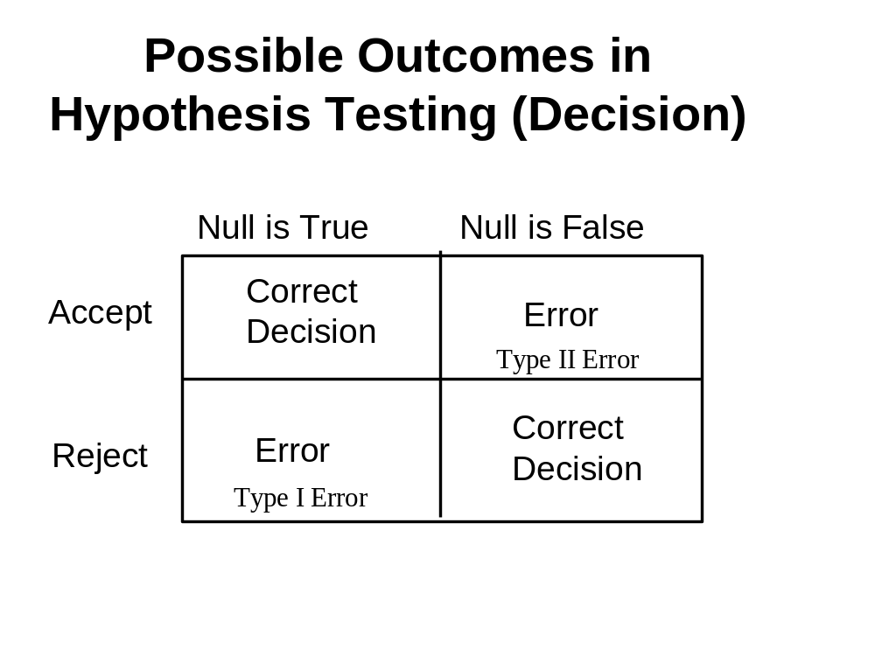
Type I Error: Rejecting a True Hypothesis
Type II Error: Accepting a False Hypothesis

Slide 27
The Three Distributions Used in Inferential Statistics
I. Population
Inference
III. Sampling Distribution of the Statistic
Selection
II. Sample
Evaluation

Slide 28
Steps in Statistical Testing
State the null (False) and alternative (True) hypotheses
Set alpha level, a value that determines level of rejection
Identify the appropriate test of significance
Identify the sampling distribution
Identify the test statistic
Compute the test statistic
Determine the degree of freedom
Compare computed test statistic against a tabled value

Slide 29
SOME INFERENTIAL STATISTICAL TESTS
Parametric
    T-tests (n≤ 30) or Z-test (n≥30)
    ANOVA/ ANCOVA- compare means of more than two groups
    Pearson correlation
    Multiple regression- determine relationships among variables etc.

Slide 30
SOME INFERENTIAL STATISTICAL TESTS
Four assumptions of parametric tests
  Normal distribution of the dependent variable
  Interval or ratio data
  Independence of subjects
  Homogeneity of variance
Advantages of parametric tests
  More statistically powerful
  More versatile

Slide 31
SOME INFERENTIAL STATISTICAL TESTS
Non-parametric
  Median test etc.
  Chi-Square- (Two-way table) to test association between non-numerical variables
  Spearman correlation
  Mann-Whitney test
  Kruskal-Wallis test
  Wilcoxon test
  Friedman's test
  Fisher Exact Probability test
  Kendall tau
  McNemar test
  Kolmogorov–Smirnov test

Slide 32
SOME INFERENTIAL STATISTICAL TESTS
Nonparametric tests are sometimes called distribution-free tests because they are based on fewer assumptions (e.g., they do not assume that the outcome is approximately normally distributed)
Situations limiting normality involves:
  Use of categorical variables or medians (e.g. nominal or ordinal variable or a rank)
  Presence of outliers
  Expected outcomes has clear limits of detection e.g. a continuous variable is measured imprecisely.

Slide 33
α Levels
If p value computed ≤ equal to α value (tabulated probability) the NULL (i.e. FALSE ) HYPOTHESIS IS REJECTED and vice versa
p < .01 (I will correctly reject the null hypothesis 99 of 100 times)
P < .05 (I will correctly reject the null hypothesis 95 of 100 times)
p < .10 (I will correctly reject the null hypothesis 90 of 100 times)

Slide 34
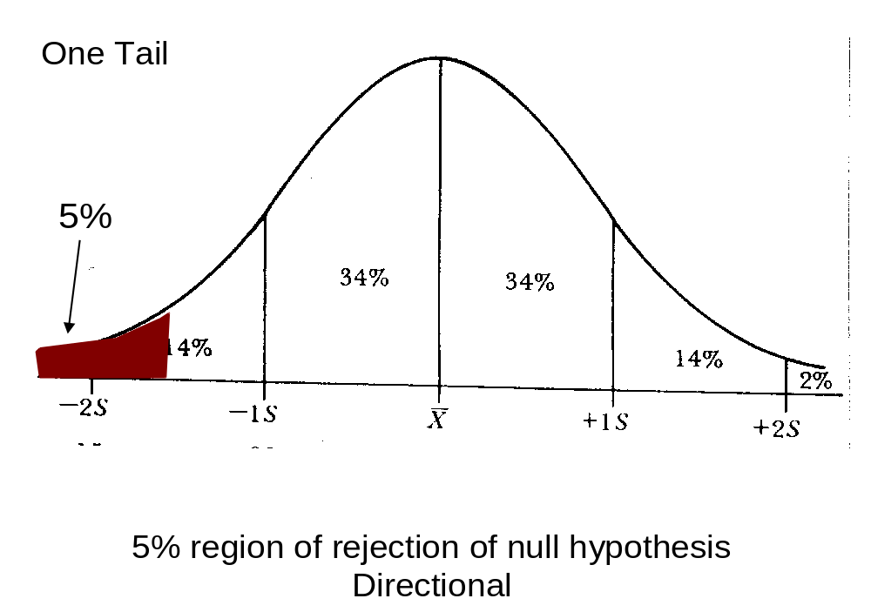

Slide 35
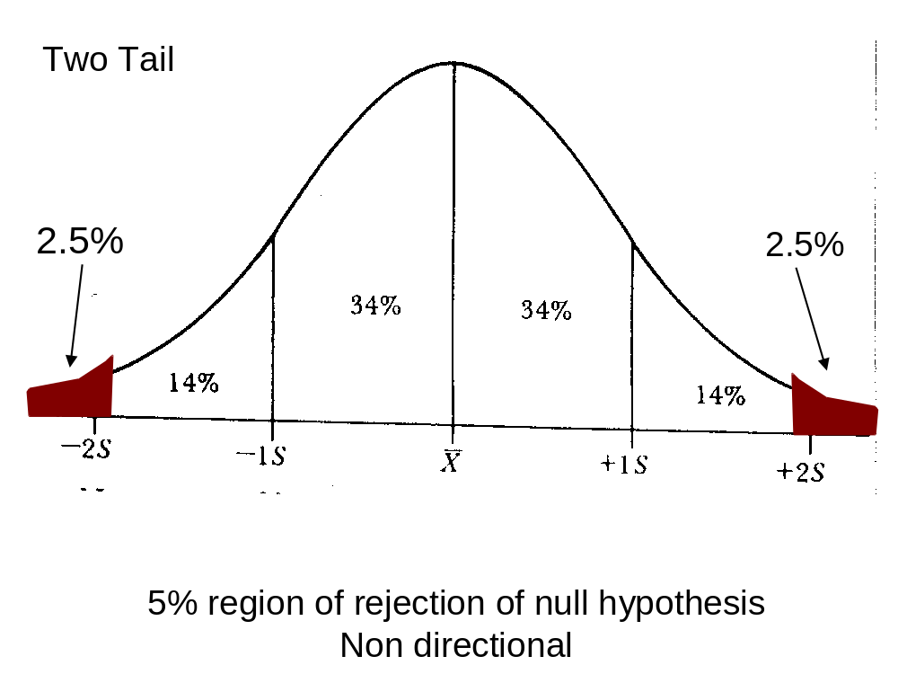

Slide 36
Statistical Test in relation to type of scale
 | Nominal | Ordinal | Interval | Ratio
Descriptive Statistics | Mode | Mode Median Range Statistics | Mode Median Mean Range Statistics Variance Standard Deviation | Mode Median Mean Range Statistics Variance Standard Deviation
Inferential Statistics | Non-Parametric Chi-Square | Non-Parametric Mann- Whitney U Kruskal-Wallis H Friedman ANOVA Spearman Correlation | Parametric t-test ANOVA Pearson Correlation | Parametric t-test ANOVA Pearson Correlation

Slide 37
Level of Measurement & Significance Tests
Chi-Square
  IV & DV are nominal and/or ordinal
t-test
  IV is nominal (group like men & women)
  DV is Interval/Ratio (or a scale)
ANOVA
  IV is nominal (group with 3 or more categories)
  DV is Interval/Ratio (or a scale)
Regression
IV(s) & DV are Interval/Ratio (or scales)
IV(s) can be dummy variables

Slide 38
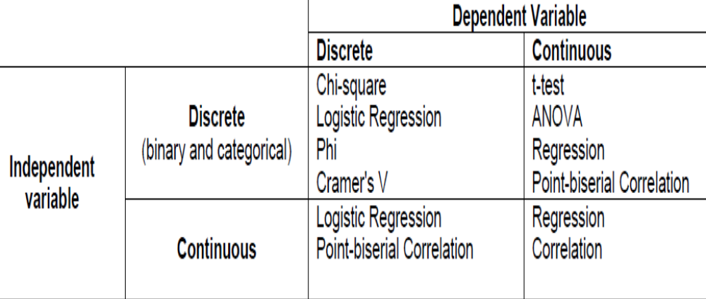
SUGGESTED STATISTICAL TEST
A detailed selection of test is summarized in the document >>>

Slide 39
HOMEWORK
Provide examples of H_{a} and H_{o}
Where do the following p-values 0.0043, 0.023, 0.7, 0.03, and 0.023 fall if:
  α=1%
  α=2.5%
  α=5%
  α=10%

Slide 40
THANK YOU!

Slide 41
SAMPLING

Slide 42
POPULATION
A population is a collection of elements about which we wish to make an inference.
A research population is generally a well-defined large collection of individuals or objects having similar characteristics, who are the main focus of a scientific query.
Characteristic present in a given population group distinguishes it from other groups.
It is for the benefit of the population that researches are done

Slide 43
SAMPLING
STUDY POPULATION
SAMPLE
TARGET POPULATION

Slide 44
POPULATION
Target Population-refers to the ENTIRE group of individuals or objects to which researchers are interested in generalizing the conclusions.
  The target population usually has varying characteristics and it is also known as the theoretical population.
  Forms a sampling Frame, which is the actual list of people or objects in the population who can be chosen for participation in the study

Slide 45
POPULATION
Accessible Population-is the population to which the researchers can apply their conclusions.
  This population is a subset of the target population
  Also known as the study population
  It is from the accessible population that researchers draw their samples.

Slide 46
SAMPLING
Sample- A subset of a population possessing characteristics similar to the population
Sampling-A statistical process in which a predetermined number of representatives or observations will be taken from a universe or larger population.
Sampling units are nonoverlapping collections of elements from the population that cover the entire population.

Slide 47
WHY DOING SAMPLING
All members of a population may not be available.
Cheaper
Less time consuming
More accuracy

Slide 48
SAMPLING PROCESS
Stages:
  Define the population of concern
  Specifying a sampling frame( i.e. a set of items or events possible to measure)
  Specifying a sampling method in order to select items from the sampling frame
  Determine the sample size ( for probability sampling one uses a sampling table)
  Implement the sampling plan
  Proceed with data collection
  Review the sampling process if required

Slide 49
Probability versus Nonprobability
Probability Samples: each member of the population has a known non-zero probability of being selected
  Methods include random sampling, systematic sampling, and stratified sampling.
Nonprobability Samples: members are selected from the population in some nonrandom manner
  Methods include convenience sampling, judgment sampling, quota sampling, and snowball sampling

Slide 50
SAMPLING TECHNIQUES FOR SURVEY
Probability samples – Randomness is the basis for sample selection and insures that the sample is a representative of the population.
Non-probability samples – Randomness is not the basis for selecting the sample.

Slide 51
SAMPLING
A sampling frame is a list of sampling units.As a remedy, we seek a sampling frame which has the property that we can identify every single element and include any in our sample .
A sample is a collection of sampling units drawn from a sampling frame.
Parameter: numerical characteristic of a population
Statistic: numerical characteristic of a sample

Slide 52
Census Sample
A census study occurs if the entire population is very small or it is reasonable to include the entire population (for other reasons).
It is called a census sample because data is gathered on every member of the population.

Slide 53
Random Sampling
Random sampling is the purest form of probability sampling.
Each member of the population has an equal and known chance of being selected.
When there are very large populations, it is often ‘difficult’ to identify every member of the population, so the pool of available subjects becomes biased.
  Software such as MS Excel even scientific calculators do generate random numbers or to draw directly from the columns

Slide 54
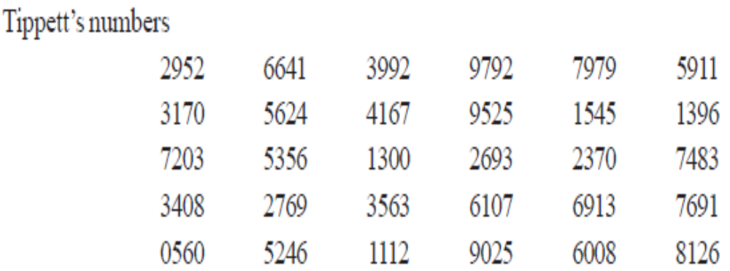
Various statisticians like Tippett, Yates, Fisher have prepared tables of random numbers which can be used for SRS

Slide 55
SRS
Suppose we need a sample of 10 units from a population of 5000 units, bearing numbers from 3001 to 8000.
Select 10 such figures from TOR numbers which lies between 3001 and 8000.
If we decide to read the TOR from L to R, starting from the first row, we obtain 6641, 3992, 7979, 5911, 3170, 5624, 4167, 7203, 5356, and 7483.
The units bearing the above serial numbers would then constitute our required random sample.

Slide 56
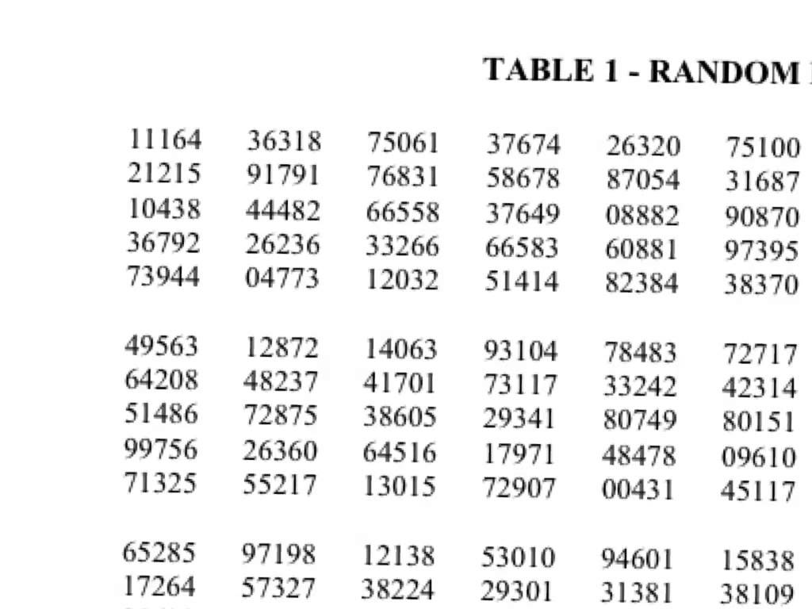

Slide 57
SYSTEMATIC SAMPLING
Systematic sampling relies on arranging the target population according to some ordering scheme and then selecting elements at regular intervals through that ordered list.
Systematic sampling involves a random start and then proceeds with the selection of every kth element from then onwards. In this case, k=(population size/sample size).
It is important that the starting point is not automatically the first in the list, but is instead randomly chosen from within the first to the kth element in the list.
A simple example would be to select every 10th name from the telephone directory (an 'every 10th' sample, also referred to as 'sampling with a skip of 10').

Slide 58
Systematic sampling example
Stack of 213 hospital admission forms; select a sample of 15
213/15 = 14.2 ; Select every 14th form
Starting point: random number between 1 and 14 (we choose 11)
First form selected is 11th from top
Second form selected is 25th from top (11 + 14 = 25)
Third form selected is 39th from top (11 + 2x14 = 39)

Slide 59
SYSTEMATIC SAMPLING……
ADVANTAGES:
Sample easy to select
Suitable sampling frame can be identified easily
Sample evenly spread over entire reference population
DISADVANTAGES:
Sample may be biased if hidden periodicity in population coincides with that of selection.
Difficult to assess precision of estimate from one survey.

Slide 60
STRATIFIED SAMPLING
Where population embraces a number of distinct categories, the frame can be organized into separate "strata."
Each stratum is then sampled as an independent sub-population, out of which individual elements can be randomly selected.
Every unit in a stratum has same chance of being selected.
Using same sampling fraction for all strata ensures proportionate representation in the sample.
Adequate representation of minority subgroups of interest can be ensured by stratification & varying sampling fraction between strata as required.

Slide 61
THINGS TO CONSIDER:STRATIFIED SAMPLING
  The bases of stratification, i.e. what characteristics should be used to subdivide the universe/population into strata?
  The number of strata, i.e. how many strata should be constructed and what stratum boundaries should be used?
  Sample sizes within strata, i.e. how many observations should be taken in each stratum?

Slide 62
STRATIFIED SAMPLING
Finally, since each stratum is treated as an independent population, different sampling approaches can be applied to different strata.
Drawbacks:
First, sampling frame of entire population has to be prepared separately for each stratum
Second, when examining multiple criteria, stratifying variables may be related to some, but not to others, further complicating the design, and potentially reducing the utility of the strata.
Finally, in some cases (such as designs with a large number of strata, or those with a specified minimum sample size per group), stratified sampling can potentially require a larger sample than would other methods

Slide 63
CLUSTER SAMPLING
Used when sampling frame is difficult to obtain, but clusters can be identified i.e. when the studied population is spread across a wide area such that SRS would be difficult to implement in accessing the selected sample.
If the total area of interest happens to be a big one, one can divide the area into a number of smaller non-overlapping areas (clusters)
Thereafter, apply SRS to select a number of clusters
Collect information on ALL elements in those clusters

Slide 64
CLUSTER SAMPLING
Example
Suppose one seek to about homeless people across a country, a number of towns are selected and a significant number of homeless people are surveyed in each town.

Slide 65
CLUSTER SAMPLING
Advantages:
Generating sampling frame for clusters is economical, and sampling frame is often readily available at cluster level
Most economical form of sampling
Larger sample for a similar fixed cost
Less time for listing and implementation
Also suitable for survey of institutions

Slide 66
CLUSTER SAMPLING
Disadvantages:
May not reflect the diversity of the community.
Other elements in the same cluster may share similar characteristics.
Provides less information per observation than an SRS of the same size (redundant information: similar information from the others in the cluster).
Standard errors of the estimates are high, compared to other sampling designs with same sample size

Slide 67
MULTISTAGE SAMPLING
Originates from cluster sampling
Sampling is done in more than one stage, i.e. larger clusters are further subdivided into smaller ones in order to target specific groupings when surveying.
Multi-stage sampling can in fact be easier to implement and create a more representative sample of the population than a single sampling technique.
Multi-stage sampling can help reduce costs of large-scale survey research

Slide 68
MULTISTAGE SAMPLING
Simple one-stage cluster sample:
  List all the clusters in the population, and from the list, select the clusters – usually with simple random sampling (SRS) strategy. All units (elements) in the sampled clusters are selected for the survey.
Simple two-stage cluster sample:
  List all the clusters in the population.
  First, select the clusters, usually by simple random sampling (SRS).
  The units (elements) in the selected clusters of the first-stage are then sampled in the second-stage, usually by simple random sampling (or often by systematic sampling).

Slide 69
Non-probability Sampling

Slide 70
Non-probability Sampling
  1. Convenience sampling
  Selection of cases based on what is easiest to do
    Experiments
    Exploratory and Qualitative research
    Avoid this if you can
  2. Quota Sampling
  Quota sampling is a method of stratified sampling in which the selection within strata is non-random. Selection is normally left to the judgment of the interviewer

Slide 71
Non-probability Sampling
  3. Snowball Sampling
  Respondent-driven sampling, initial respondents refer others to the researcher
    Usually used with hard-to-discover populations
    Bias introduced by structured nature of affiliation
    Can be improved with incentives to subjects to recruit a certain number of new respondents
  4. Purposive Sampling
  Targets select people for a sample because of their unique position
    Helps get understanding of systems or processes or information on a target population
    Not representative of population in general

Slide 72
CLASS ACTIVITY
Explain what data collection method will suit to collect information from sample units obtained through non-probability sampling methods
Consider the title “The Impact of Global Oil Prices on the Israel’s GDP Per Capita: An Empirical Analysis”. Explain which sampling techniques, data collection methods, and types of data analysis will be applicable

Slide 73
THANK YOU!

