Slide 1
Analysis Of Demographic Survey in washington, US
Using SAS
by Kumar Chamarty

Slide 2
Presentation Outline :
Background/Introduction
Objectives
Methodology
Conceptual Framework/Variables of the study
Descriptive Analysis
Research Question(s)/Hypothesis(Inferential/Predictive)
Results/findings
Conclusions
Recommendations
Appendix

Slide 3
Objective:
To study the demographics of washing to determine the features that are correlated with house owners.
Business Objective:
To Identify which regions are best to invest in the housing development project.

Slide 4
Methodology :
Missing values treatment:
HOMEOWNERS : Dropped the missing records
OTHER_INCOME_SOURCE : Dropped the column
NUMBER OF YEARS IN THE US: Missing data replaced with mean value.
AVG_EDU_LVL, NUM_IN_ARMY,: Missing data replaced with the mode.
Data
6,726 house holds
in Washington state at each individual level
LOT of information such as number of dependents and household income and ownership status IS DUPLICATED.
Data cleaning:
Summarized all the data at Household level.

Slide 5
Methodology contd….
SAS procedures used to accomplish.
PROC SQL & PROC SGPLOT were used to achieve most of the data manipulation and Analysis stuff.
DATA STEP was used to Manipulated row-wise data.
PROC LOGISTIC (Logistic Regression) was used to build our model to answer our business question.

Slide 6
STUDY FRAMEWORK
Region
Age
NUMER OF YEARS IN US
Highest Education Level
Number of people in the household
Children <14
Children<16
Children <18
Children <20
Home owners
Number of dependents
Whether they are currently employed
Did they work in farm or receive any profits from business
Household Income
Employment status
currently serving in the army previously served in the army.
Served In the Army or Not

Slide 7
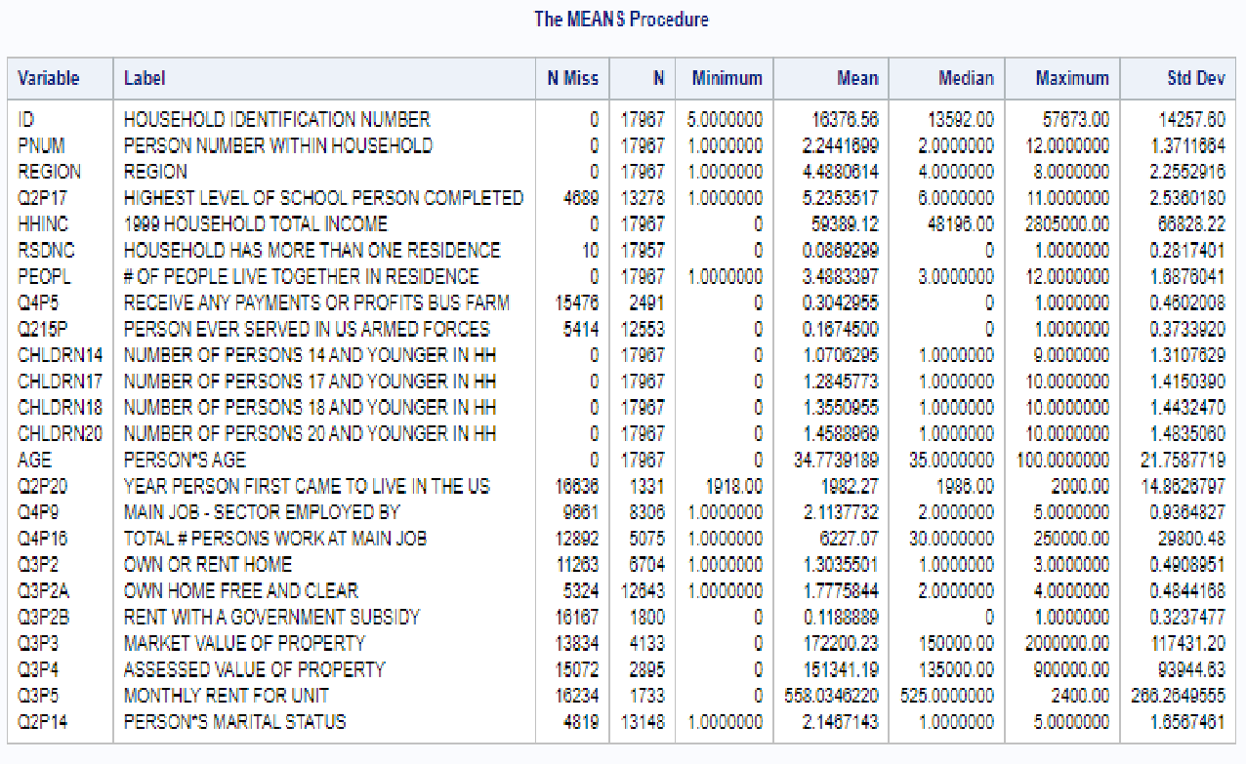
Summary of Initial Study Framework

Slide 8
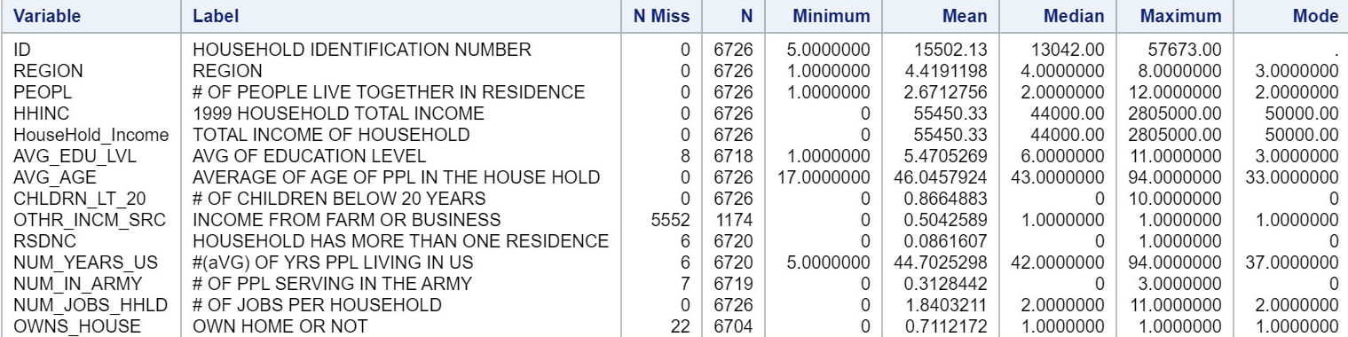
Summary of my final study framework

Slide 9
The distribution of Average Age of all the People in the Households.

Slide 10
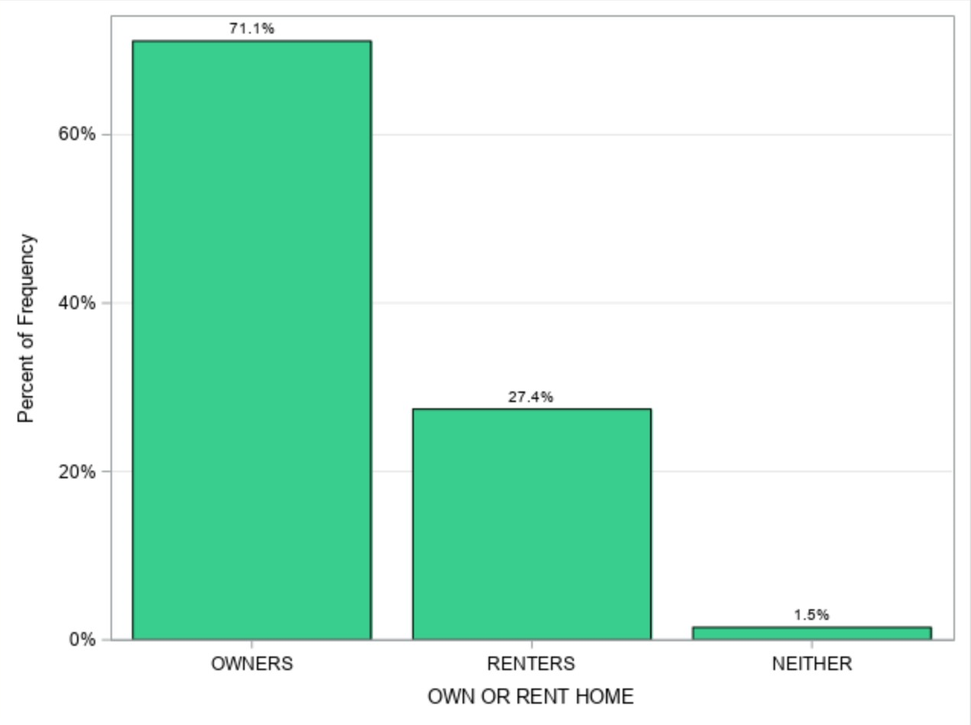
Frequency Distribution of Residence status:

Slide 11
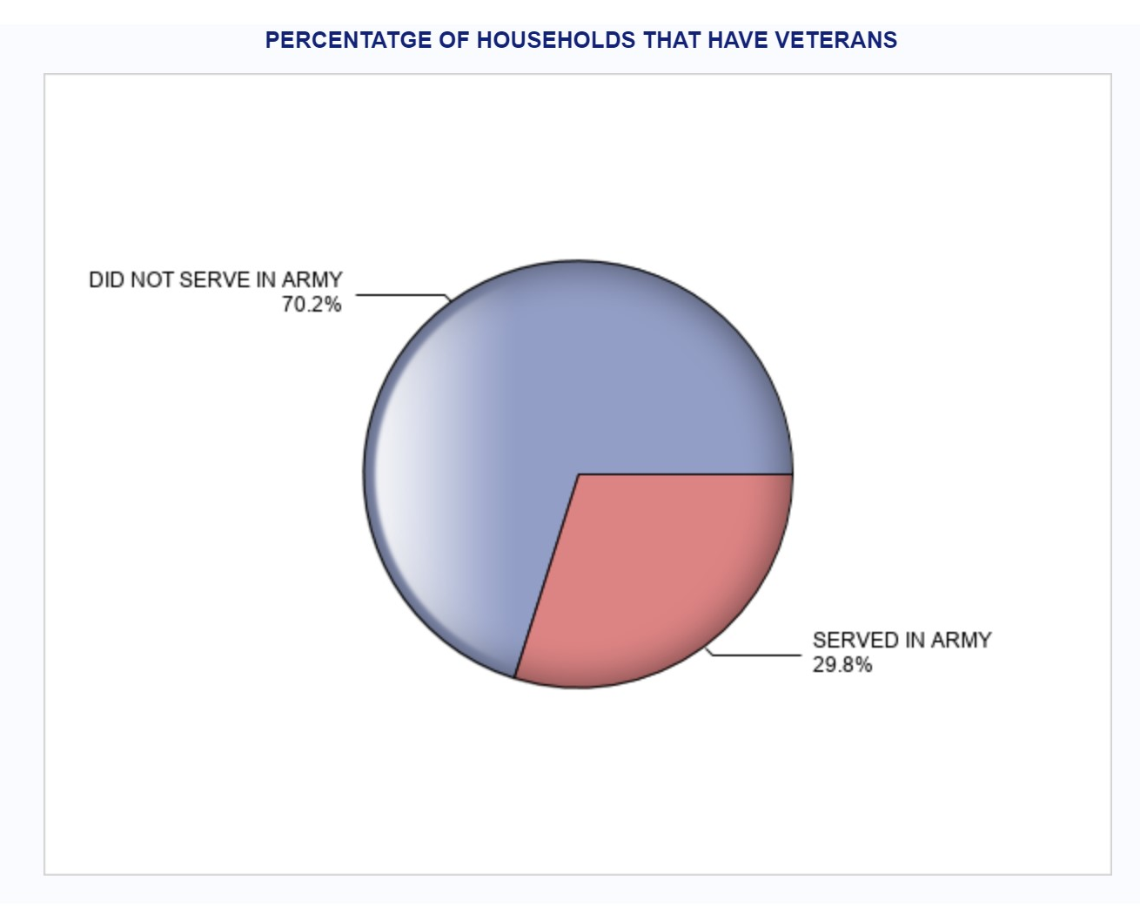
How Many of the Households have members that are currently serving or have previously served in the US Army?

Slide 12
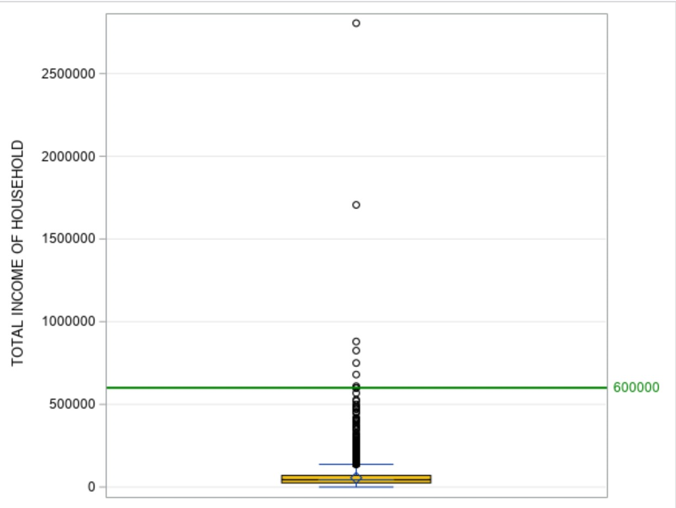
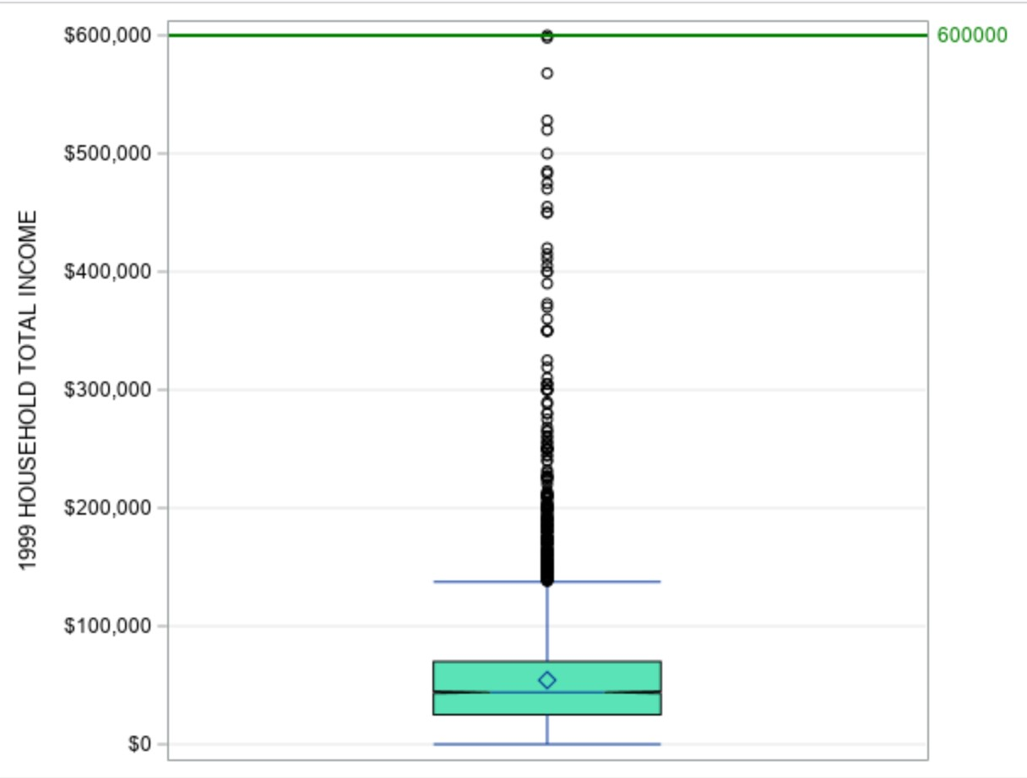
Household Income Analysis (outlier detection)

Slide 13
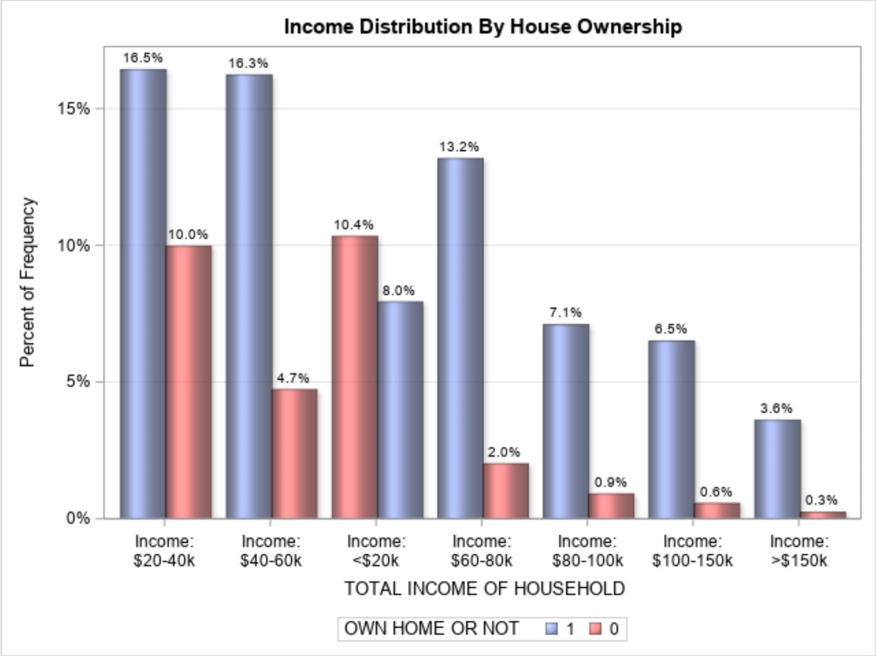
House Hold Income vs Home Ownership Analysis:

Slide 14
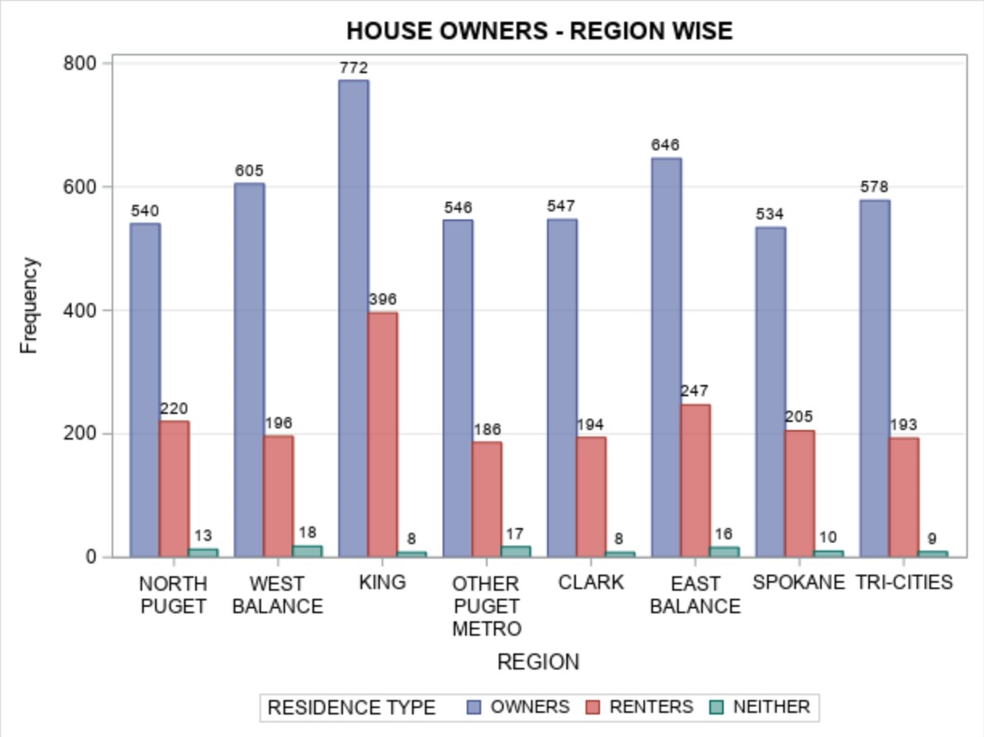
DISTRIBUTION OF RESIDENCE TYPE BY REGION:

Slide 15
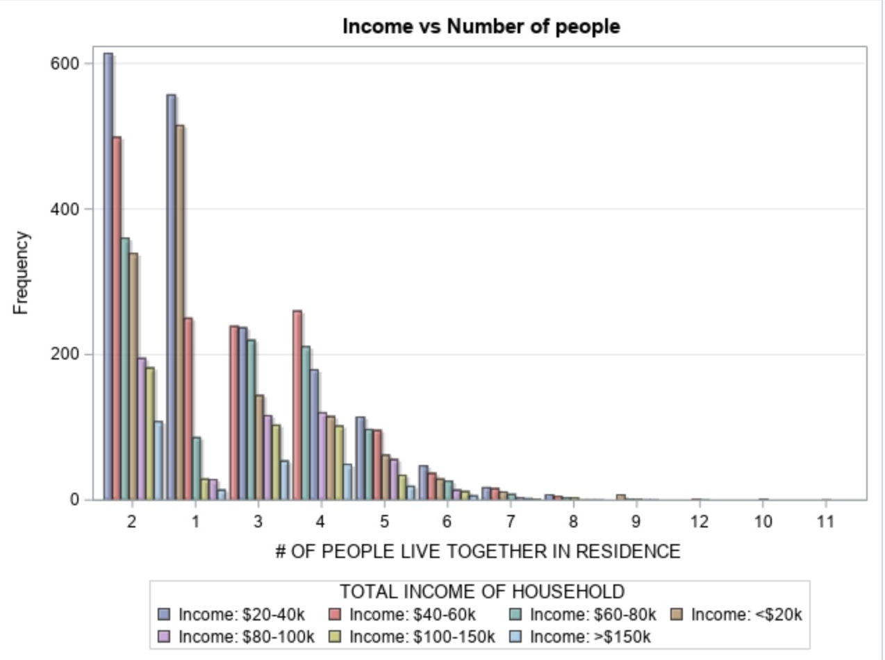
Do a greater number of adults in a household contribute to more income?

Slide 16
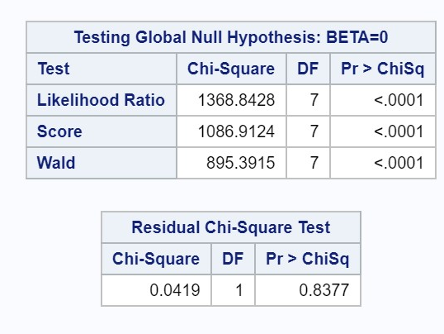
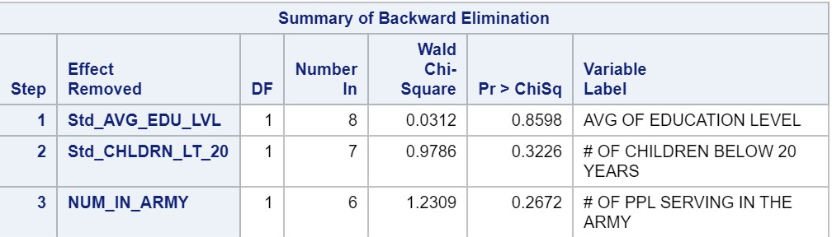
Logistic Modeling to identify the features affecting

Slide 17
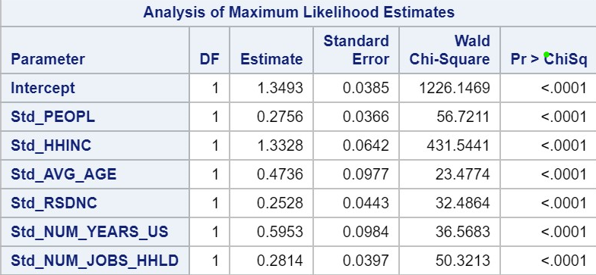

Slide 18
SUMMARY

Slide 19
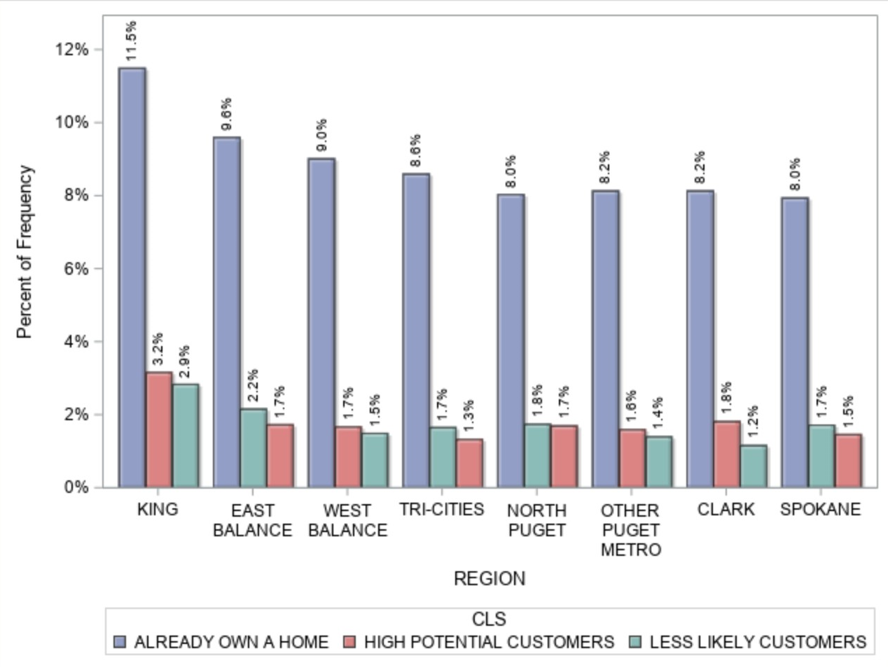
CONCLUSION:
AS PER OUR MODEL,
KING REGION HAS THE HIGHEST POTENTIAL FOR HOME BUYERS.
EVEN THOUGH KING ALREADY HAS A HIGH PERCENTAGE OF HOMEOWNERS, IT ALSO HAS THE HIGH ST %OF POTENTIAL CUSTOMERS

Slide 20
Sample Codes:

Slide 21
Sample Codes:

Slide 22
Q&A…?
Thank you…

