Slide 1

Crime Analysis in Chicago - 2019
Mini Project Using R
By
Kumar Chamarty (chamarty.Kumar1@gmail.com)

Slide 2
Background and Objectives ….
Background:
I have used the Crime data set from the year 2019.
The data has been downloaded from
https://data.cityofchicago.org/Public-Safety/Crimes-2001-to-present/ijzp-q8t2/data
The data consists of basic information on different types of crimes committed in the city of Chicago for the year, 2019.
Objectives:
To demonstrate basic data analytical skills in R using different packages.
Read the raw data from source, clean it and convert to a R supported data structured.
Analyze the data and provide any valuable info that is available.

Slide 3
Summary Of Data set
Columns in my data Set :
There are a total of 227765 records.
After removing the rows with NA values in the latitude and longitude columns, there are 226682 records.
Beat is the smallest geographical police unit. 3 to 5 Beats form a sector.
A Police District is a collection of 3 such sectors.
Ward is a city Council district
[1] Date [2] Block
[3] IUCR [4] Primary.Type
[5] Description [6] Location.Description [7] Arrest [8] Domestic
[9] Beat [10] District
[11] Ward [12] Community.Area
[13] FBI.Code [14] X.Coordinate
[15] Y.Coordinate [16] Year
[17] Updated.On [18] Latitude
[19] Longitude [20] Location

Slide 4
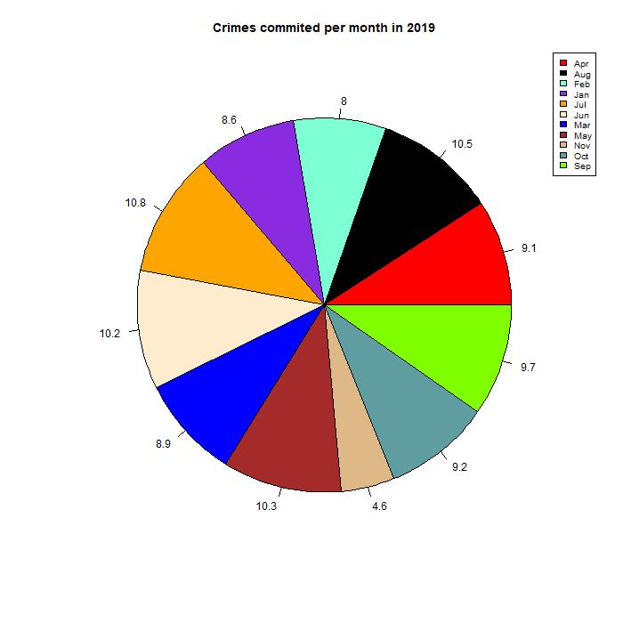
Total number of CRIMES PER Month in 2019

Slide 5
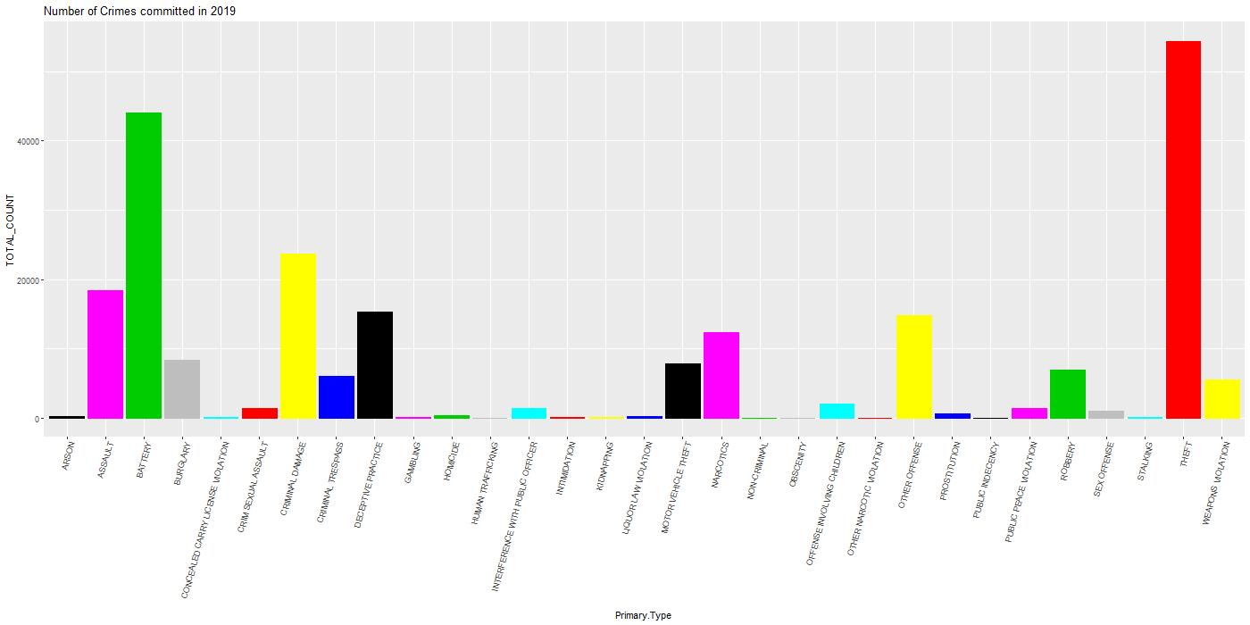
DIFFERENT crimes COMMITED IN CHICAGO IN THE YEAR 2019

Slide 6
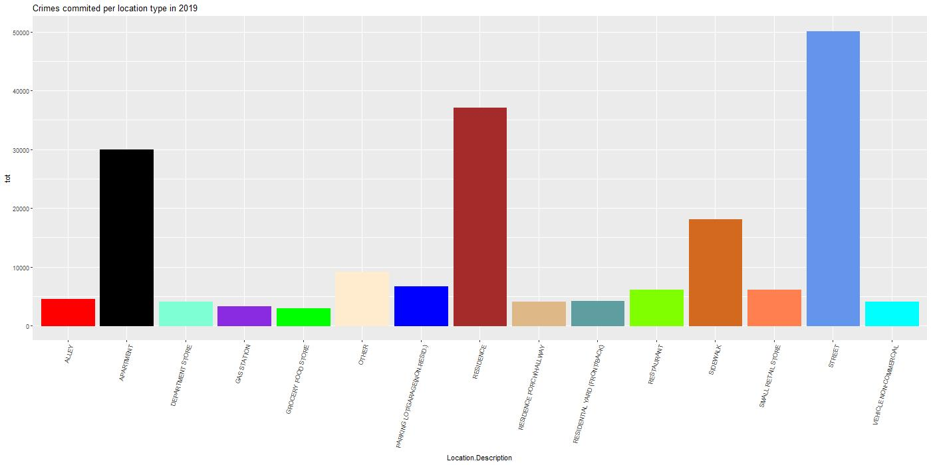
Top 15 location types where crime is highest

Slide 7
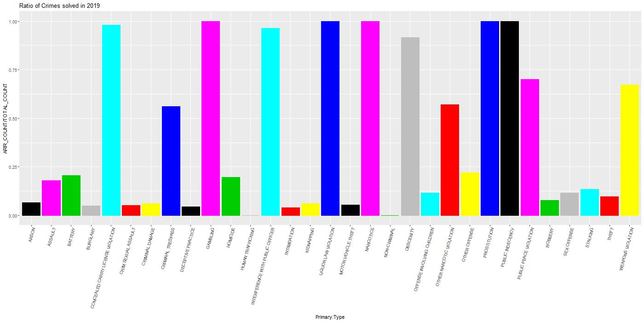
Crimes By Resolution ratio

Slide 8
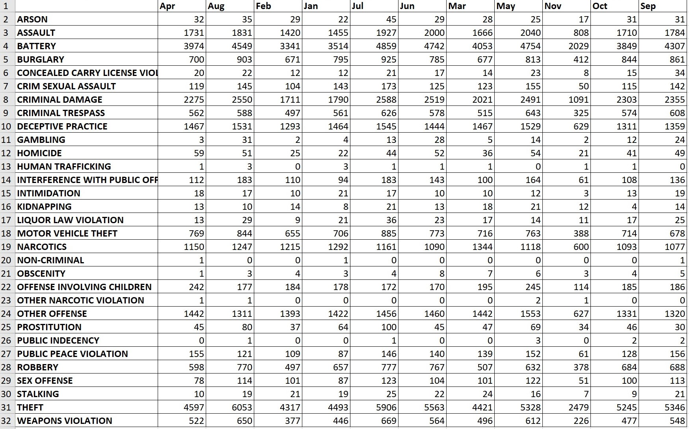
SUMMARY OF crimes GROUPED BY MONTH AND CRIME TYPE

Slide 9
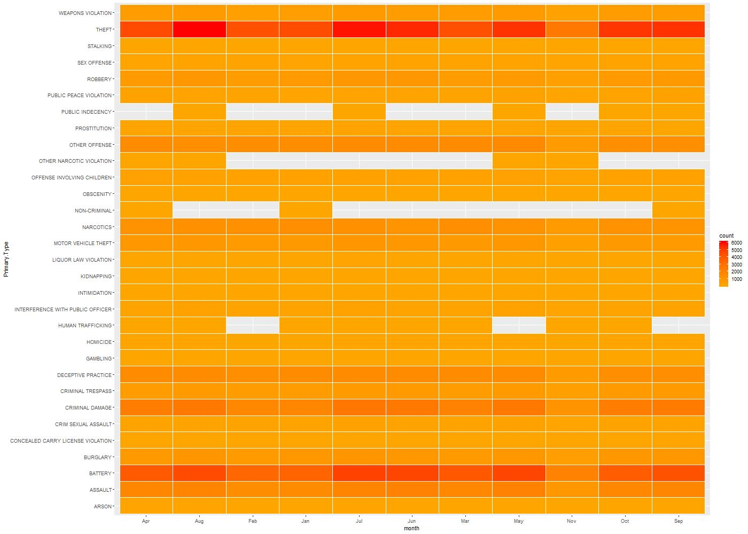
HAETMAP OF crimes BY MONTH AND CRIME TYPE

Slide 10
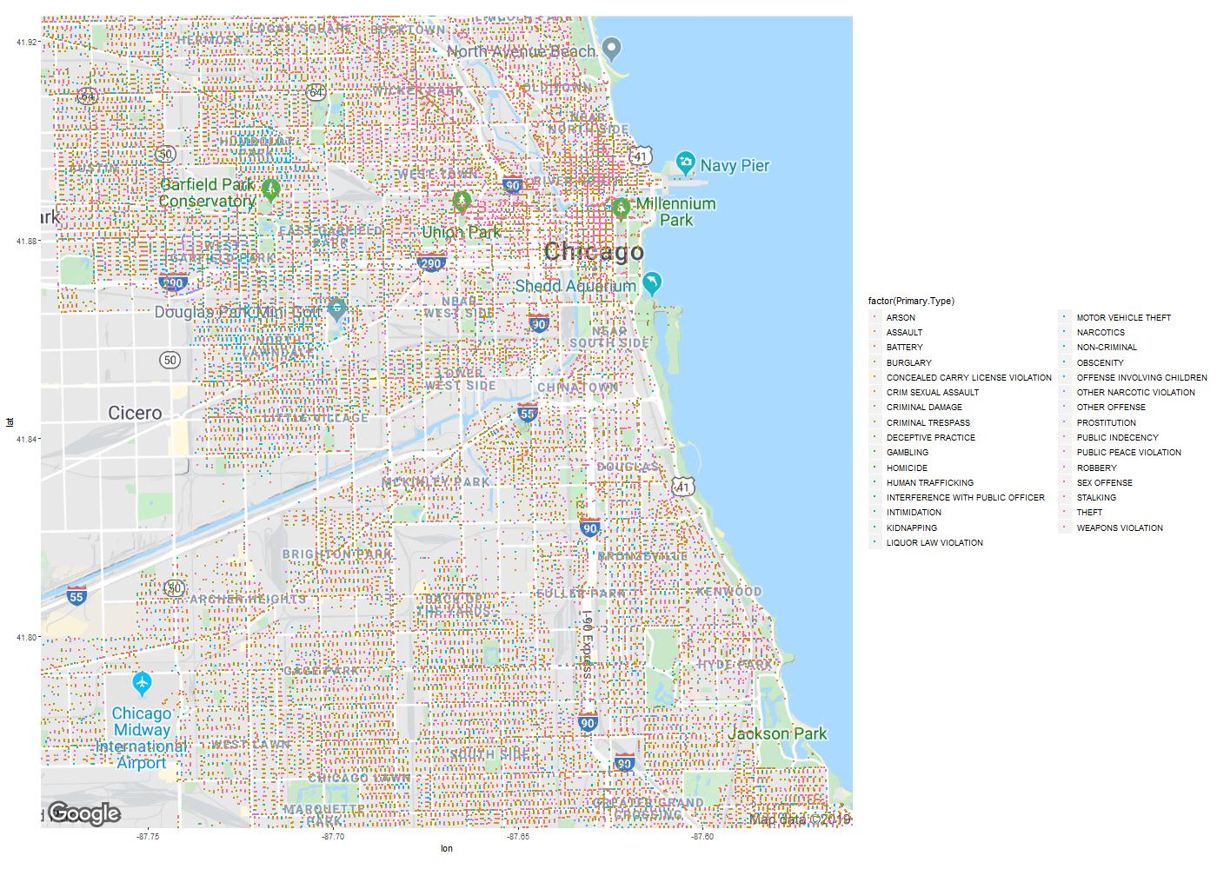
Geo Plotting of ALL the crimes in Chicago

Slide 11
Conclusion:
The most common type of crime in Chicago is Theft.
Crime has been recorded highest for the month of JULY.
Highest number of crimes have been known to occur on the streets.
Crimes related to Narcotics, Liquor violation, Gambling, Public indecency and Prostitution have been solved 100 %
In general, Chicago downtown seems to be recording highest levels of crimes
Beat # 1112 has made the highest number of arrests(1208). And tops the arrest rate charts with 59%.
District 11 has the best arrest rate of 40.5%

Slide 12
Thank You……

