Slide 1
Microbial Identification
Kevin Hansen

Slide 2
process
Import Data Set
Clean Data set
Data Exploration
Naïve Bayes Method
Decision Tree Method
Comparison/Interpretation

Slide 3
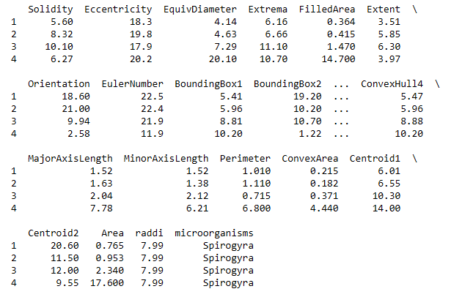
Import/clean
Imported
Data set was clean
No Nulls or NAs
Removed first column – Sample ID

Slide 4
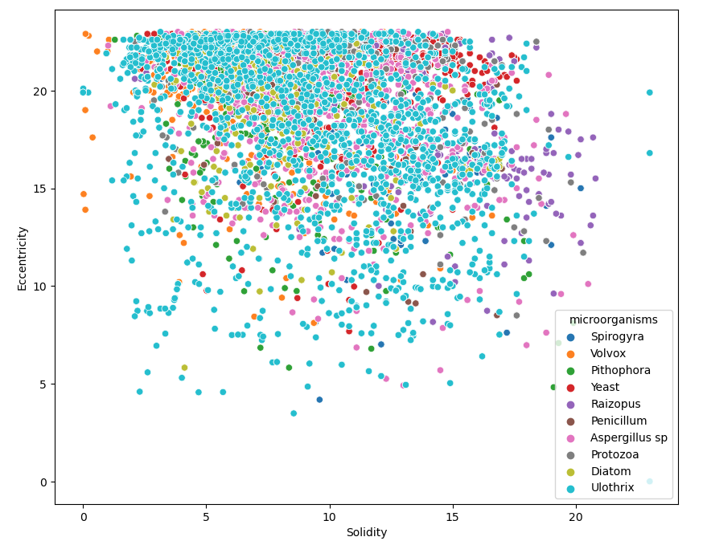
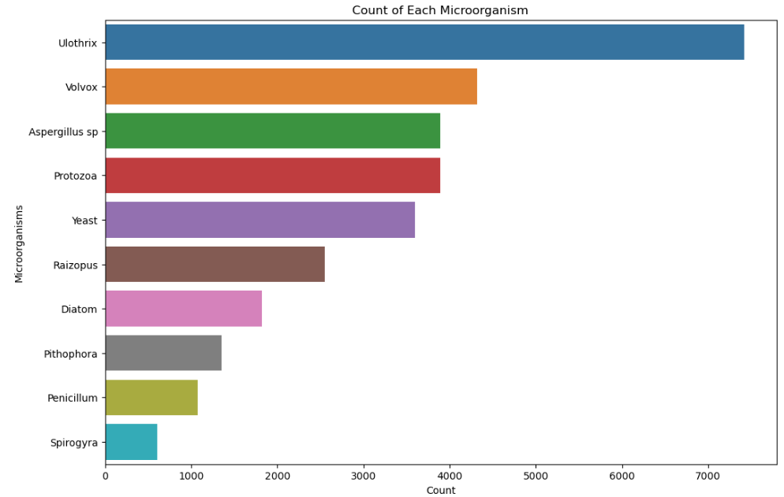
Data exploration

Slide 5
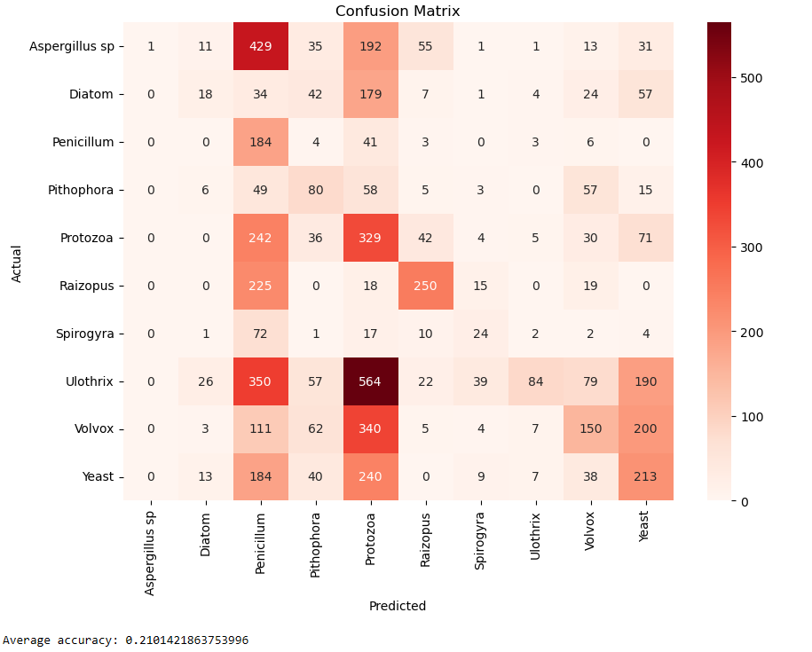
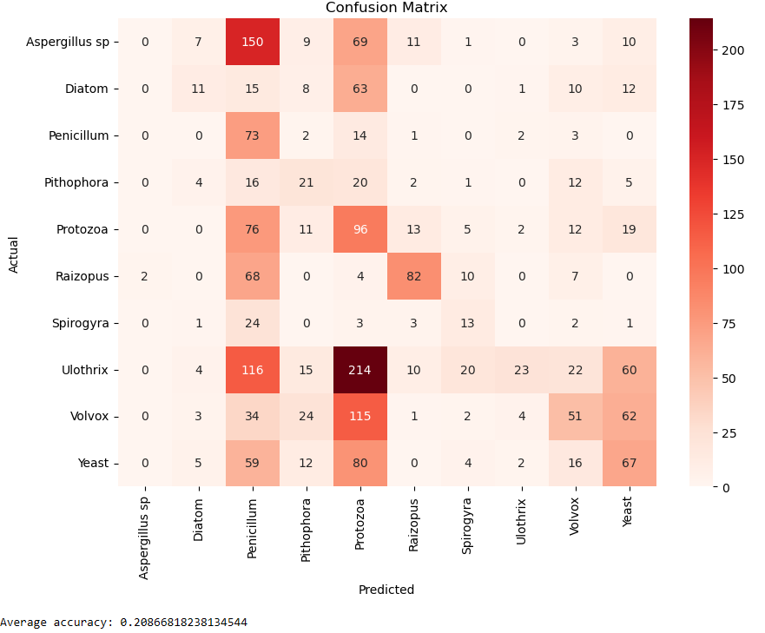
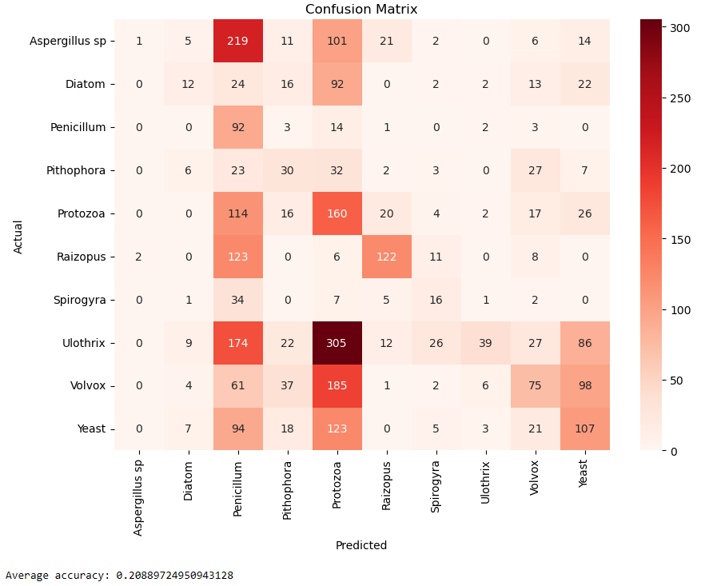
Naïve bayes
3 Models (5, 10, 15 splits)

Slide 6
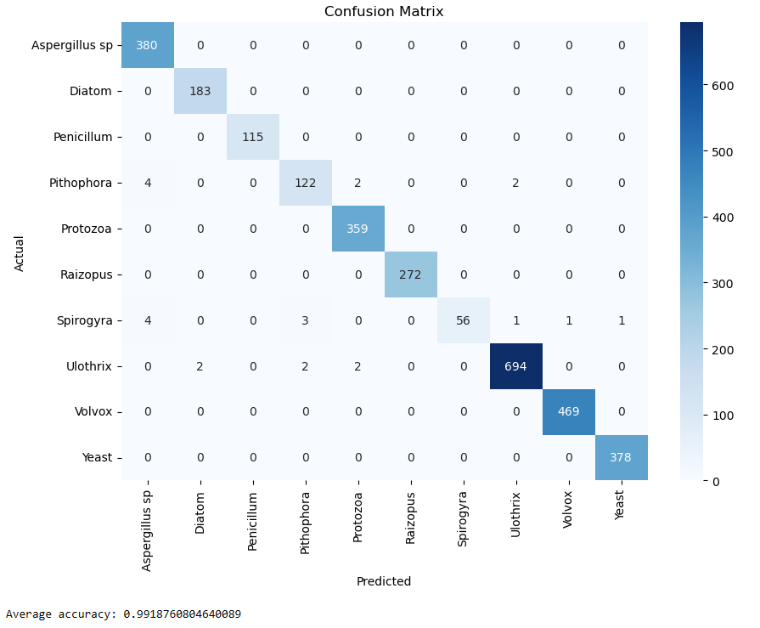
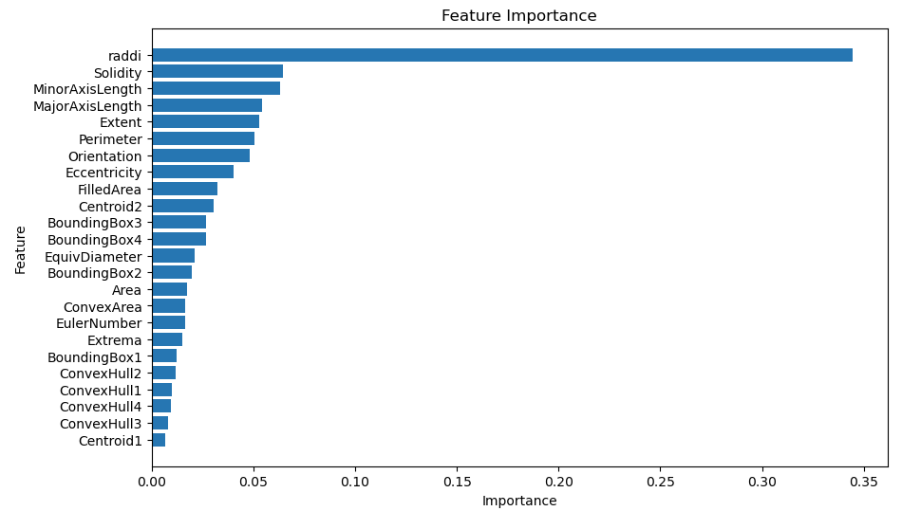
Decision tree
Extremely Accurate compared to the Naïve Bayes Method
Most important feature used to make prediction - Raddi

Slide 7
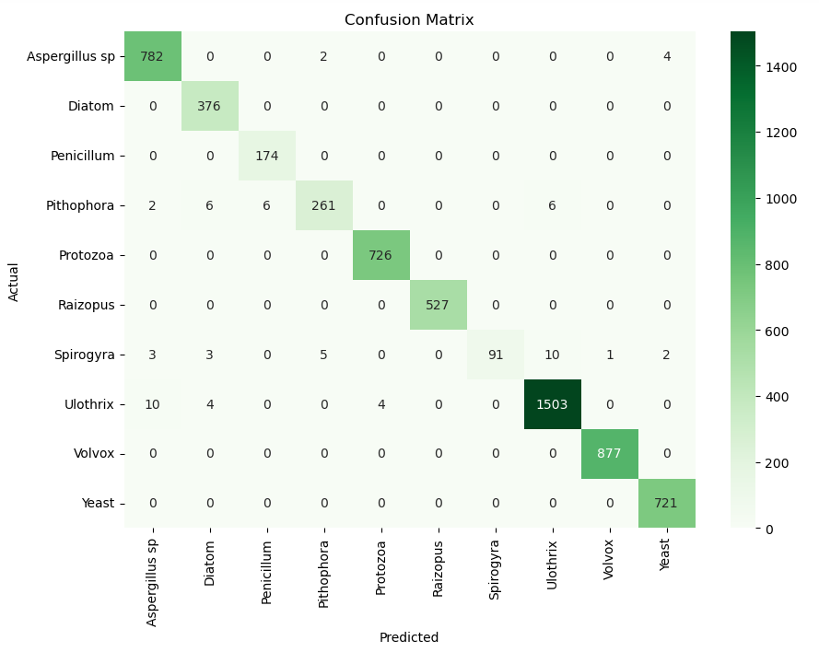
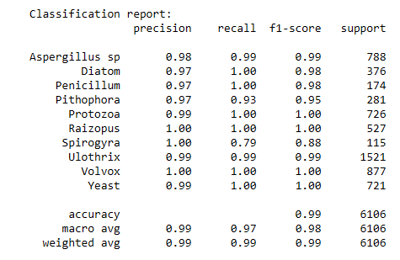
Decision tree Validation
Validating Decision Tree model to ensure that high accuracy is not due to overfitting
Split the data into training sets and validation sets to compare
Report shows the breakdown of each class and their key metrics

Slide 8
Results/Conclusion
Naïve Bayes Accuracy
~21%
Decision Tree Accuracy
~99%
Naïve Bayes is less accurate because it assumes that all features are independent of each other. This assumption can limit its accuracy when features are correlated.
Decision Trees handle non-linear relationships between features much better, this flexibility allows it to fit a wide range of data patterns
Because of these reasons Decision Tree is the significantly more accurate model that can be expanded to identify more Microbial Species with more data.

Slide 9
THANK YOU
Any questions???

