Slide 1
UI/UX

Slide 2
UX – User experience
User experience (UX) design is the process design teams use to create products that provide meaningful and relevant experiences to users. This involves the design of the entire process of acquiring and integrating the product, including aspects of branding, design, usability and function.
Products that provide great user experience (e.g., the iPhone) are thus designed with not only the product’s consumption or use in mind but also the entire process of acquiring, owning and even troubleshooting it. Similarly, UX designers don’t just focus on creating products that are usable; we concentrate on other aspects of the user experience, such as pleasure, efficiency and fun, too. Consequently, there is no single definition of a good user experience. Instead, a good user experience is one that meets a particular user’s needs in the specific context where he or she uses the product.

Slide 3
UX Designers consider the Why, What and How of Product Use
As a UX designer, you should consider the Why, What and How of product use. The Why involves the users’ motivations for adopting a product, whether they relate to a task they wish to perform with it or to values and views which users associate with the ownership and use of the product. The What addresses the things people can do with a product—its functionality. Finally, the How relates to the design of functionality in an accessible and aesthetically pleasant way.

Slide 4
7 factors of user experience
Useful – It should be useful to the customer, else it is of no use.
Useable – Enables users to effectively and efficiently achieve their end objective. For example, drive the car efficiently and you can also listen to radio and take calls. Efficient use of the tool is the main meaning of it.
Findable – It should be easy to locate. For example, a feature help should be easy to locate in the webpage.

Slide 5
7 factors of user experience
Credible – Ability to trust in the product. Customer should be able to trust in your product so that it can sell in the market.
Desirable – Conveyed through branding, image, identity, aesthetics and emotional design.
Accessible – Provides ux which can be accessed by users of a full range of abilities. Product should not be designed just with normal abilities, should b able to support users with disabilities like hearing issues, blurred vision etc

Slide 6
User centered design
What is User Centered Design?
User-centered design (UCD) is an iterative design process in which designers focus on the users and their needs in each phase of the design process.
In user-centered design, designers use a mixture of investigative methods and tools (e.g., surveys and interviews) and generative ones (e.g., brainstorming) to develop an understanding of user needs.

Slide 7
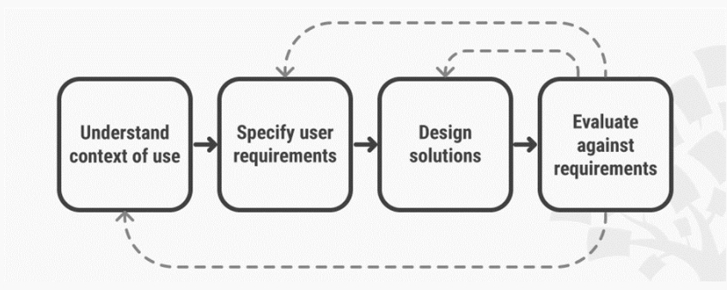
UCD
Generally, each iteration of the UCD approach involves four distinct phases. First, as designers working in teams, we try to understand the context in which users may use a system. Then, we identify and specify the users’ requirements. A design phase follows, in which the design team develops solutions. The team then proceeds to an evaluation phase. Here, you assess the outcomes of the evaluation against the users’ context and requirements, to check how well a design is performing. More specifically, you see how close it is to a level that matches the users’ specific context and satisfies all of their relevant needs. From here, your team makes further iterations of these four phases, and you continue until the evaluation results are satisfactory.

Slide 8
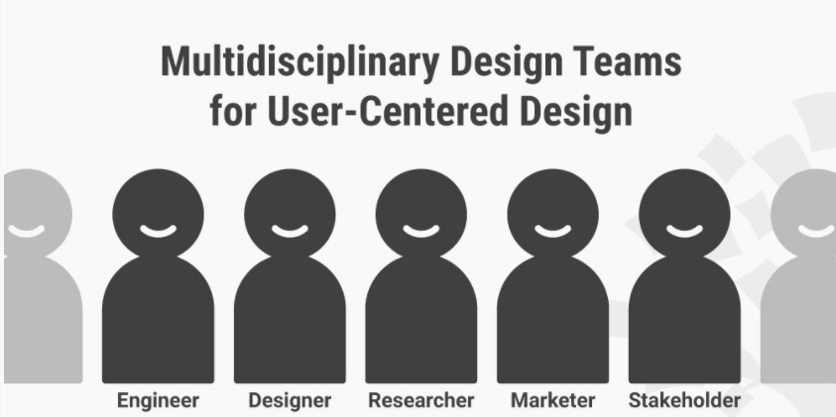
UCD
UCD Considers the Whole User Experience
In UCD, you base your projects upon an explicit understanding of the users, tasks and environments. The aim of the process is to capture and address the whole user experience. Therefore, your design team should include professionals from across multiple disciplines (e.g., psychologists, software and hardware engineers), as well as domain experts, stakeholders and the users themselves. Experts may carry out evaluations of the produced designs, using design guidelines and criteria. However, you should bear two crucial points in mind. First, to span the entire user experience, you must involve the users for evaluation. Second, you'll need to ensure long-term monitoring of use.

Slide 9
UCD
Investment in UCD Pays off
When your design team brings the users into every stage of the design process, you invest your effort and other resources into a powerful way of finding out what works well, what doesn’t and why. Your users are an early-warning system you can use to course-correct and fine-tune your design. They can expose many aspects—positive and negative—your team may have overlooked regarding such vital areas as usability and accessibility. That’s why it’s so important to understand how powerful the benefits of a user-centered design approach are.
distinguishes four ways in which UCD pays off:
With close user involvement, products are more likely to meet users’ expectations and requirements. This leads to increased sales and lower costs incurred by customer services.
Systems designers tailor products for people in specific contexts and with specific tasks, thereby reducing the chances of situations with a high risk of human error arising. UCD leads to safer products.
Putting designers in close contact with users means a deeper sense of empathy emerges. This is essential in creating ethical designs that respect privacy and the quality of life.
By focusing on all users of a product, designers can recognize the diversity of cultures and human values through UCD – a step in the right direction towards creating sustainable businesses.

Slide 10
User research
What is user research
User research is used to understand the user’s needs, behaviors, experience and motivations through various qualitative and quantitative methods to inform the process of solving for user’s problems.
Why is user research so important?
Great UX Design is grounded in great user research - driven by user insights while balancing priorities and technical feasibility.
User research helps uncover important and useful insights about the user and their needs. Until you know your user and their needs, emotions, feelings, struggles etc, you won’t be able to deliver a great user experience.
Including the user in the process
User research is a great opportunity to include the user in the design process. By collaborating with users, you are practicing user-centered design, which is crucial to creating a successful product for your users.

Slide 11
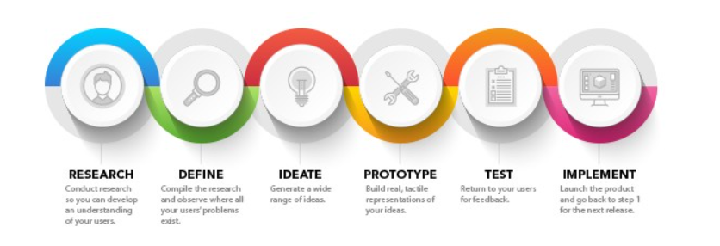
User research

Slide 12
User research
Researching with empathy in mind
It’s no surprise that empathy is the key to user-centered design. Empathy means putting aside your own assumptions to see things from someone else’s perspective.
What happens if you don’t do user research?
A lot of the times, teams or organisations may bypass or rush the process of user research with reasons like, “We don’t have the time or budget for user research” or, “We know enough about our users already to build the product”.
While user research does require upfront time to plan and execute, and conducting it may mean the design process takes longer, neglecting user research may put the organisation at a disadvantage in the long run.
‘Neglecting user research may put the organisation at a disadvantage in the long run.’
So what might be the price of not doing proper user research?
The product has great features that don’t solve the user’s problem
The product isn’t user-friendly as false assumptions are baked into the form and function of the product
The product causes confusion for the user

Slide 13
User research
Getting stakeholder and team buy-in
Great, you’re doing user research for a project or product. While this step is paramount to great UX, unless the research insights and knowledge is shared with your team and stakeholders, no amount of research will be sufficient.
‘Unless the research is shared with your team, no amount of research will be sufficient.’
It’s important to include or engage your team in the research or it may be difficult to get stakeholder buy-in. You may be working with Product Managers, Data Scientists, Engineers, and other stakeholders. Within your team, there are different viewpoints and priorities.
Design is a team sport, so it’s crucial to have your team understand why they are building a product and what problem they are solving before they jump into development.
Get your team and stakeholders involved in the research. Get your team members to take notes as you are conducting user interviews. Hold a workshop session with your team to analyse and sort through raw data from research. If that’s not possible, engage your team by sharing your research findings with them.
By inviting your team and stakeholders to participate and play a part in the user research, you create a shared understanding of the user’s needs, making it much easier to work towards the same goal, which is to create a solution that addresses the user’s needs.

Slide 14
User research
What user research doesn’t do
The goal of user research is to take the knowledge and insights gained from users to create user-centered solutions.
While user research informs design, it doesn’t immediately provide solutions to problems. There needs to be an exploration of ideas and design iterations before those solutions are reached.
There’s no ‘one size fits all’ approach
When it comes to doing user research, there’s ‘no ‘one size fits all’ approach. It all depends on the specific user group and context you are solving for.
These are different for every project and it is your job as the designer to define and understand these for every project.

Slide 15
User research - How to approach user research
The first thing to do before doing any research is to ask the right research questions. What is your research goal? What are you trying to understand?
Here’s a set of criteria to help you hone in on your research questions:
Be specific
Be focused and relevant to what you’re trying to understand
Make them practical with the resources you have
Make them actionable
Be flexible and don’t worry about which method to use (yet)

Slide 16
User research – Type of methods.
Stages of the product life cycle
Quantitative vs. qualitative
Attitudinal vs. behavioral
Stages of the product life cycle
Discovery
During the early stages of the design process, the key goal is to do exploratory research. Each project has its own context and specific user group that research should explore. Questions to ask:
What do users need?
What is already working and what isn’t?
Development
Now that you have developed your ideas and built wireframes and prototypes, you need to evaluate and validate whether your designs actually help users solve their problems.
Do users understand how it works?
How do users interact with your prototype?
Can users find what they are looking for?
Do the features look and feel right?

Slide 17
User research – Stages of product life cycle.
Live
As the design goes live, the goal is to measure how well the product meets user’s needs. The goal here is to measure the performance and aim to optimise the experience.
At this stage, feedback from users is really useful. Things may have changed and the product you created to solve user’s problems in the first place may no longer be the best solution anymore. The key is to proactively adapt and iterate if needed.
Methods include surveys, data analytics, bug reports.
In a nutshell, user research can be done at any stage of the product life cycle.

Slide 18
User research types.
Quantitative
Quantitative research is used to understand the ‘what’. This type of research can be measured numerically. For example, “How many people visited a store over a week” or “What percentage of users clicked this button”. This type of research explores large sample sizes of data to identify trends and patterns.
Qualitative
Qualitative research uncovers the ‘why’. “Why do users have a particular attitude towards a product?” and “What else do people see on the page?”
Qualitative research explores user’s attitudes, behaviors, and opinions. It provides key insights into understanding the context behind why trends and patterns arise.
Examples include user interviews, field studies, usability testing, and customer calls.
It’s important to use a mixture of both quantitative and qualitative methods to come to a holistic understanding of the user and problems to be solved. Both methods are useful for answering different research questions and cannot substitute one for the other.
Attitudinal
Attitudinal research seeks to assess why users have particular attitudes and feelings towards an experience. For instance, whether users enjoy using your product or not.
Behavioral
Behavioral research focuses on what users do with the product in question. This could be to find out how users navigate through a site.

Slide 19
Persona
What is persona in UX?
Personas are commonly used tools in UX design. It’s a representation of the real target audience data, collected in previous research phases such as user interview. It is suggested at this point to gather information from at least 6 interviews. The information collected will overlap and this is where you have to look for patterns. You can form personas from these overlapping information.
Personas are archetypical users whose goals and characteristics represent the needs of a larger group of users. Persona representations include behavioral patterns, goals, motivations, skills, attitudes, and background information, as well as the environment in which a persona operates. By using personas, our entire team can stay focused and create a design that serves real users.
Parts of personas
Photo
Name
Skills
Description
Goals
Problems
How do we create personas?
The first step of creating a persona is to collect data about the users’ motivations, expectations, difficulties, tasks, and goals from the users themselves.
Second, we harmonize the collected data by exploring patterns of behaviors, universal and specific needs as well as user goals.
Last, we build a description of each of our user archetypes by creating an actual person with a face, thoughts, fears and background stories. This is important because we can gain more empathy by thinking of them as real humans with real problems.

Slide 20
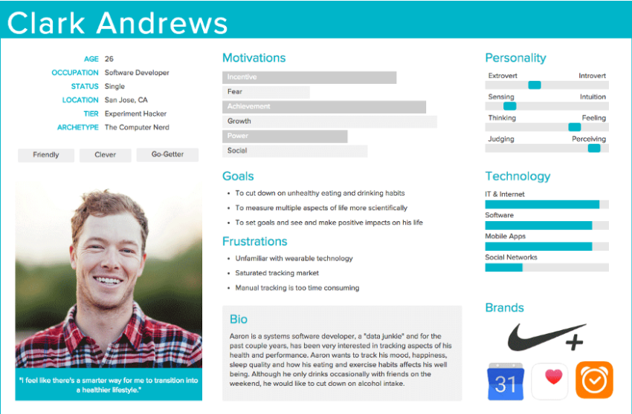
Persona
How do personas look like at the end?
The output is a graphical persona sheet. It is detailed enough to conjure empathy but it does not contain information irrelevant from the given project. It includes demographics and some additional personal details such as persona’s name and picture. More importantly, it includes what we know about her thoughts, feelings, knowledge, expectations, problems, and behavior.

Slide 21
Persona
How do personas fit into a design process?
Personas are replying to the question ‘Whom we are designing for?’ Defining the target groups of our products and services is one of the basic principles of UX and service design; if you’re trying to design for everyone you’ll end up designing for no one.
What is the use of personas?
Since personas are representing the user groups we want to serve, they are leading our way in the design process by reminding us which expectations, difficulties, behaviors and final goals our users have. We are relying on personas in every subsequent step such as creating flows, functions or interactions.
Further uses of personas
A persona is not only useful for designers but it can be further utilized whenever a certain business or marketing decision has to be made. It can also be used as a reference point to help newcomers understand the product vision and even layout new possible directions for innovation. A persona is not a final product. Instead, it is constantly changing and can be updated as a function of the product’s current state. This means that a persona can become an organic part of product development throughout the product’s lifecycle.
Finally, share your personas with as many colleagues as possible. Create posters of your personas and hang them throughout your office. Your goal is to create a shared understanding of just who you work for and how everyone can better serve them.

Slide 22
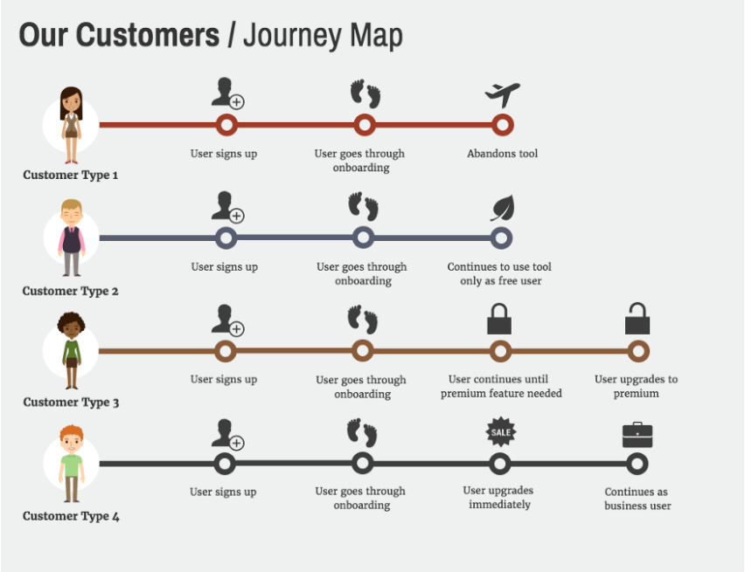
Persona
Personas and empathy maps
An empathy map is similar to a persona in the sense that it is also used as a guiding light throughout the design process. It gives a detailed portrayal of the given user types by answering four simple questions: what the user thinks, says, does and feels. Overall, empathy maps are great tools to help designers, product managers, stakeholders and other team members to understand users better, gain empathy for them and get familiar with their behavioral patterns.

Slide 23
Persona
Personas and mental models
With the help of mental models methodology, we are attempting to discover users’ mental representations about a given segment of reality. These representations do not always correctly depict reality, however, we act, decide and navigate in the world based on these models of reality. If we know people’s relevant mental models to our planned service or product, we can design logical, easy-to-use applications and services for them that includes content and functions which are answering real user needs.
Personas and user journeys
Users go through several mental and emotional states while interacting with systems. With experience maps, we can pinpoint the situations where the system’s relationship with the user gets critical. Identifying problematic situations helps us to find solutions for these potential obstacles.

Slide 24
Usability Analysis
The usability denotes the process of finding the user's need and then improving the user experience. Elegant and aesthetic, quick and user-friendly website enables you to transform the way your customers perceive and relate with you in the online environment. A good usable website can harvest huge revenues from your business and allows prospective customers to accomplish their task in the best possible way.
Every business probably are thinking how to attract more traffic to their page. The best option available, and the most viable one, is to get a usability analysis done. The truth is, if you don't have a webpage statistics tool embedded, you will never know how many people visited your page and left, and you won't even know their reasons for doing so. Your webpage might not perform to its potential just for a silly reason at times, which you might have accidentally overlooked, and it is then that a usability analysis report comes in handy. A professional analysis of the webpage will give you an ordered list of the changes you need to make in your page to make it better.
A usability analysis report gives you detailed instructions and recommendations to make your site more usable and user-friendly. Next important thing is the visual aspect, which comprises the logo and arrangement of elements on the homepage, and the overall look of the site.

Slide 25
Usability Analysis.
Usability Analysis is important for any website, but if you have a marketing or shopping webpage, you need to pay more attention now. The first thing your website should have is a clearly displayed certificate of trust and credibility, because if your page isn't trustworthy, a potential customer will waste no time in switching to an old and time-tested website instead of yours. Your products must be catalogued efficiently for presentation, and the shopping cart link must be conveniently placed for the user. The registration, login, forms and checkout links must be clear cut and precise, so that a customer has a happy shopping experience.

Slide 26
Empathy mapping.
As UX professionals, it is our job to advocate on behalf of the user. However, in order to do it, not only must we deeply understand our users, but we must also help our colleagues understand them and prioritize their needs. Empathy maps, widely used throughout agile and design communities, are a powerful, fundamental tool for accomplishing both.
Definition: An empathy map is a collaborative visualization used to articulate what we know about a particular type of user. It externalizes knowledge about users in order to 1) create a shared understanding of user needs, and 2) aid in decision making.

Slide 27
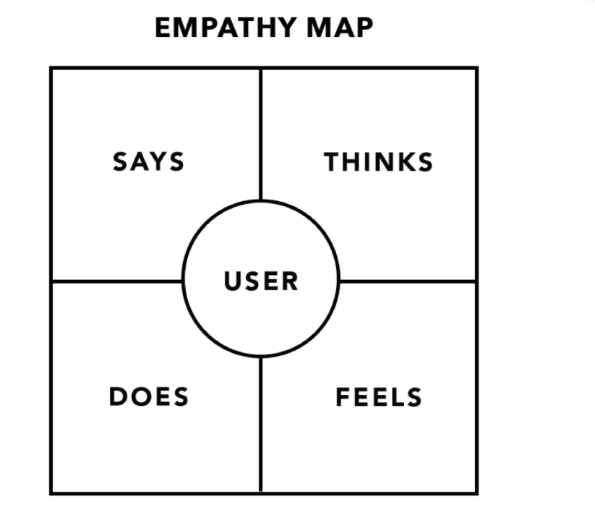
Empathy map format

Slide 28
Empathy map format
The Says quadrant contains what the user says out loud in an interview or some other usability study. Ideally, it contains verbatim and direct quotes from research.
“I am allegiant to Delta because I never have a bad experience.”
“I want something reliable.”
“I don’t understand what to do from here.”
The Thinks quadrant captures what the user is thinking throughout the experience. Ask yourself (from the qualitative research gathered): what occupies the user’s thoughts? What matters to the user? It is possible to have the same content in both Says and Thinks. However, pay special attention to what users think, but may not be willing to vocalize. Try to understand why they are reluctant to share — are they unsure, self-conscious, polite, or afraid to tell others something?
“This is really annoying.”
“Am I dumb for not understanding this?”

Slide 29
Empathy map format
The Does quadrant encloses the actions the user takes. From the research, what does the user physically do? How does the user go about doing it?
Refreshes page several times.
Shops around to compare prices.
The Feels quadrant is the user’s emotional state, often represented as an adjective plus a short sentence for context. Ask yourself: what worries the user? What does the user get excited about? How does the user feel about the experience?
Impatient: pages load too slowly
Confused: too many contradictory prices
Worried: they are doing something wrong

Slide 30
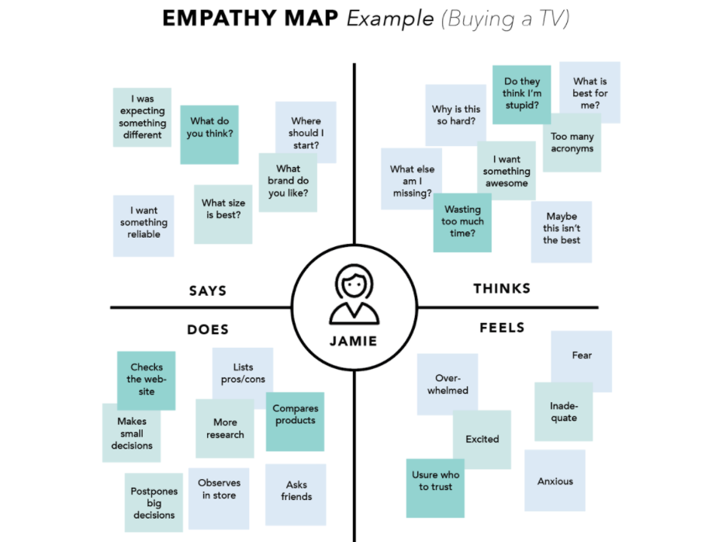
Empathy map for buying a tv.

Slide 31
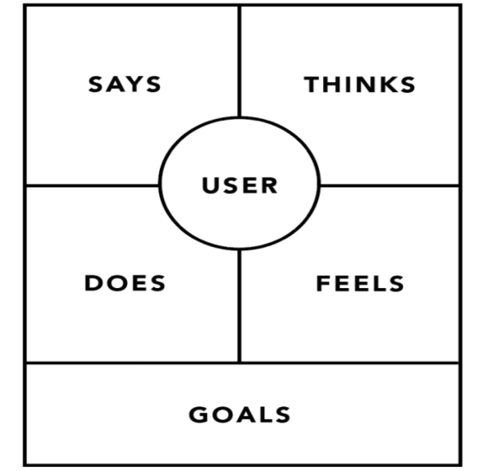
How to build empathy map.
Define scope and goals
What user or persona will you map?
Define your primary purpose for empathy mapping.
2. Gather materials – Resources and stationary required.
3. Collect research
4. Individually generate sticky notes for each quadrant
5. Polish and plan
If you feel that you need more detail or you have unique needs, adapt the map by including additional quadrants (like Goals) or by increasing specificity to existing quadrants. Depending on the purpose of your empathy map, polish and digitize the output accordingly.

Slide 32
Scenarios
What are User Scenarios?
Scenarios are personas with more details and with specific questions for the user.
User scenarios are stories which designers create to show how users might act to achieve a goal in a system or environment. Designers make scenarios to understand users’ motivations, needs, barriers and more in the context of how they would use a design, and to help ideate, iterate and usability-test optimal solutions.

Slide 33
User Scenarios Help Keep Designs User-Centered
User scenarios are valuable aids for designers to visualize aspects of their solutions which users might appreciate most in their contexts of use and with their unique needs and motivations.
To ideate toward accurate pictures of your users, their world and how your solution might solve their problems best, you begin by doing user research. Then, you create personas to represent your target users and flesh out their experiences to reflect realistic situations.

Slide 34
User scenario quesitons.
So, to have the ingredients for a user scenario, you first must clearly define the following factors:
Background – who are your users (including their knowledge base and skillset/s)?
Motivations – what goals do they want to achieve?
Tasks – what must they do to reach those goals?
Context of use – how will they encounter your design?
  Environment – where will they try to use it?
  Challenges – when they try to use it, what can get in their way (e.g., signal loss)?

Slide 35
User scenario in persona
Tips for Creating Compelling User Scenarios
You can create user scenarios as highly visual narratives or storyboards with pictures of the personas you’re modelling them on. Essential points to consider include these:
Provide the context of:
  Who – details of the persona.
  What their goals are.
  When they might perform tasks (including obstacles).
  Where they might do these (including obstacles).
  Why they want to do things, must perform subtasks, etc.

Slide 36
Mobile design.
What is Mobile UX Design?
Mobile UX encompasses the subjective experience that a user has with a mobile app. This includes both good and bad experiences, as well as emotions.
UX Design is the process of creating a product that is delightful to interact with and which provides a meaningful and relevant experience. It includes aspects like interaction, content, and sound design and takes the complete customer journey into consideration.

Slide 37
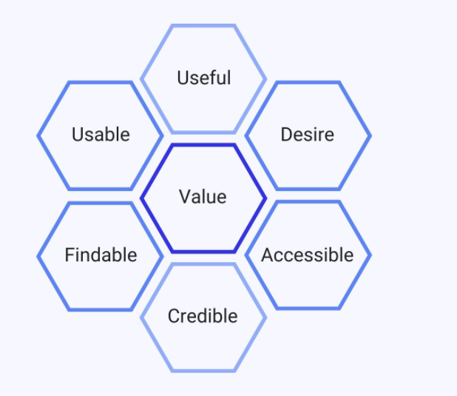
Elements of good Mobile UX design.
Useful:
The system must fulfill the users’ wishes and needs.
Usable:
The system must be as easy and self-describing as possible.
Desirable:
The style of the system must evoke positive emotions and appreciation. The user must want to use your system.
Findable:
Navigating through the system must be easy and self-describing. Moreover, the user must find important information quickly.
Accessible:
Disabled users, e.g. a user with very poor eyesight, must have the chance to use your system and get the same user experience as non-disabled users.
Credible:
The user must trust you and your product.

Slide 38
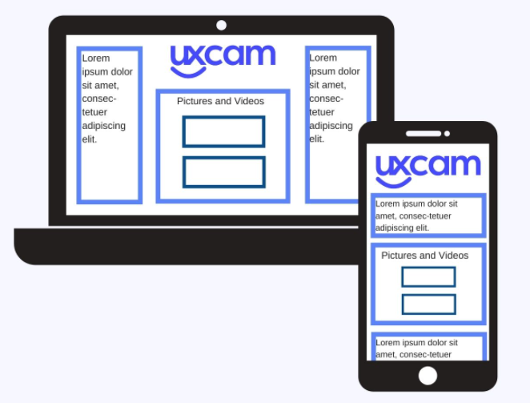
Mobile design - Size
SIZE
If you shrink your website to the common size of a 4 – 5 ½ inch mobile device without changing anything, it will look awful and confuse the user.
Pay attention: You have to decide which information is important enough to show it to your user on his smartphone and which information can be hidden, for example in a menu or on another page.
Moreover, because of the bigger screen size of desktops, you can arrange your content in several columns next to each other. For a great mobile UX design, you have to arrange your content in just one column. The user has to scroll down to see all the content.

Slide 39
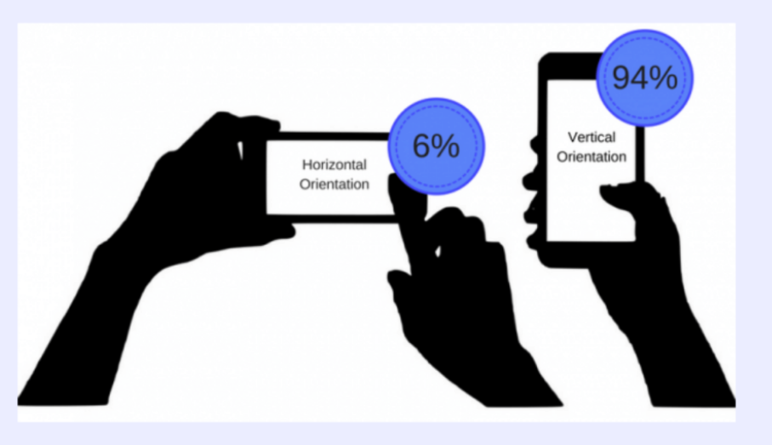
Mobile design – Screen orientation.
On mobile devices, the user has the option to change the screen orientation. 94% of the users use their smartphone vertically, while 6% use their smartphone horizontally.
Furthermore, 49% of users want to use their mobile phones with just one thumb. The bigger the screen size, the fewer points can be reached comfortably with one thumb.
Pay attention: You have to consider several aspects here. First, you have to make your mobile app usable in two different orientations. Second, you have to arrange the main features or clickable icons so that your user can reach everything with one thumb.

Slide 40
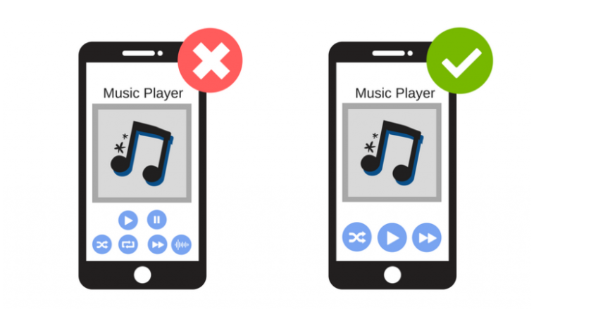
Mobile design – Navigation and input.
The size of the action icons is important. If there are too many action icons too close to each other, the chance of missteps is high. Make sure that the buttons are big enough to tap them with a finger.

Slide 41
Mobile design.
4. Environment : Realizing that the user wants to use your app everywhere, leads you to the point that your app should be well usable outside. You need to design your app with high contrast colors to make sure that your users can read everything, even if the sun is shining on their smartphone.
Sometimes users don’t trust mobile apps. They feel insecure to give all their private data to a mobile app. To not overstrain the user, ask only what is really important for using the app. Minimize the need for input for a perfect mobile UX design.
5. Split Screen : Newer smartphones do support split screens. It is not as commonly used as on the desktop, so the point is still important. You have to care about the majority of your users who have smartphones without the split-screen function. If the user needs to compare exchange rates or check the location of a town to use your app fully, and you don’t offer this functionality, he might have to leave your app and open a calculator or Google Maps. This can tempt him to completely close your app – maybe because he is distracted by another open app or annoyed because you haven’t offered him all the functions he needs for using your app completely.

Slide 42
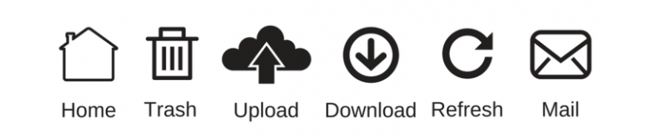
Mobile design.
6. Symbols : Symbols are relevant for both desktops and mobile devices. When the user uses different apps, he will learn the meaning of common symbols and icons. Make sure that you use symbols in a common way and not in an unexpected way. The unexpected use of symbols will confuse your user, and he might not want to continue using your app.

Slide 43
Lean UX
What is Lean UX??
Lean UX is focused on the experience under design and is less focused on deliverables than traditional UX. It requires a greater level of collaboration with the entire team. The core objective is to focus on obtaining feedback as early as possible so that it can be used to make quick decisions. The nature of Agile development is to work in rapid, iterative cycles and Lean UX mimics these cycles to ensure that data generated can be used in each iteration.

Slide 44
The Need for Assumptions in Lean UX
Lean UX is slightly different. You aren’t focused on detailed deliverables. You are looking to produce changes that improve the product in the here and now – essentially to mould the outcome for the better.
Assumptions are normally generated on a workshop basis. You get the team together and state the problem and then allow the team to brainstorm their ideas for solving the problem. In the process you generate answers to certain questions that form your assumptions.
Typical questions might include:
Who are our users?
What is the product used for?
When is it used?
What situations is it used in?
What will be the most important functionality?
What’s the biggest risk to product delivery?
There may be more than one answer to each question. That leaves us with a greater number of assumptions than it might be practical to handle. If this is the case, the team can prioritize their assumptions quickly following their generation. In general you would prioritize your assumptions by the risk they represent (what are the consequences of this being badly wrong? The more severe the consequence the higher the priority) and the level of understanding of the issue at hand

Slide 45
Creating a Hypothesis in Lean UX
The hypotheses created in Lean UX are designed to test our assumptions. There’s a simple format that you can use to create your own hypotheses, quickly and easily.
We state the belief and why it is important and who it is important to. Then we follow that with what we expect to achieve. Finally, we determine what evidence we would need to collect to prove that our belief was true.
The Minimum Viable Product and Lean UX
The Minimum Viable Product (MVP) is a core concept in Lean UX. The idea is to build the most basic version of the concept as possible, test it and if there are no valuable results to abandon it. The MVPs which show promise can then be incorporated into further design and development rounds without too much hassle.
This is a great way of maximizing your resources and one of the reasons that it works so well with Agile development –

Slide 46
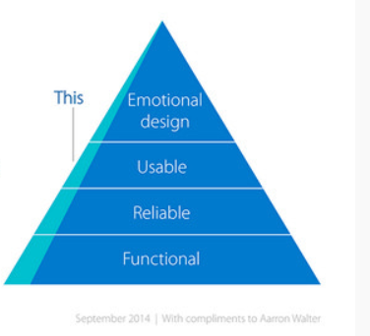
MVP

Slide 47
User Research and Testing in Lean UX
User research and testing, by the very nature of Lean UX, are based on the same principles as used in traditional UX environments. However, the approach tends to be “quick and dirty” – results need to be delivered before the next Agile Sprint starts; so there’s much less focus on heavy-duty, meticulously document outputs and more focus on raw data.

Slide 48
Content Strategy.
What is UX Content Strategy?
Content written specifically to aid the UX of a product or service is the UX Content Strategy. Unlike regular copywriting, UX writers are handed the task of writing crisp, brief copy or phrases that best describe a product or service to the end user. Content should also be tailored to the device that it is being created since the UX for a tablet or phone differs from that of a laptop screen. Progressive enhancement depending on the screen size must be incorporated in the overall UX content strategy.
While everyone agrees that having a UX content strategy is absolutely vital, one should definitely define a framework for generating, moderating and executing relevant content. Below pointers can come handy while setting up the UX content framework:

Slide 49
Content Strategy
Substance : The purpose of articulating a strategy is to design content to achieve business objectives. The content strategy has to demarcate one single, central message that can be reinforced by the entire UX content matrix. The UX content strategists have to work on effective content blueprints to structure an effective storyboard keeping in mind the audience of the content.
Structure : Structure is an essential part of UX content design. It defines the shape and thought-process behind how the content dictates what the strategy is trying to say. It arranges the content according to the priority and relevance by mapping messages to content, bridging details and stitching it together, such that it makes sense.
Workflow : As the word suggests, workflow dictates how content is managed and updated on a regular basis as per different exclusive or dependent roles and tools required to do so.
Governance : This is the part of the strategy that most UX content strategists Google for suggestions! Governance defines the policies, intermittent standards, and standard operating procedures that regulate content and its application in the organization in the present and in the future. This doesn’t mean that old content can’t be reused; it just might need some rework!

Slide 50
Benefits of Using the Right Content in UX
Have you ever used a mobile application with a seemingly attractive interface but poorly structured content? Yes, we all have! Even the most efficient website design can be rendered useless by bad content. It’s one of the biggest differentiators between apps that have higher ‘bounce’ and those who don’t.
The right content in UX can improve the navigation on the app and help the user find what he or she is looking for thereby improving conversion. In doing so, the content lends a definitive voice to the brand that serves as a prominent differentiator from its competitors. The right content in the right place is like an effective store manager who can assist the customer right from the shopping aisle to the billing desk.

Slide 51
Tips for effective content writing.
For the UX content strategy to work, the writing has to be on point. It’s a delicate balance between user-centric design and regular copywriting. This style of writing is all about appealing to the end users, helping them fulfill their need and building the right recall to the company and the brand.
Know your product : Every product has unique features and attributes that appeal to a certain set of customers. As a UX writer, it is up to to you to understand the product and give it a unique voice such that you can communicate everything the user needs to know. The product description must have articulate clearly demonstrate the characteristics while also establishing factors of differentiation over others in the market. For example, check out Paytm Money app tone and personality; it not only explains everything in detail but also accompanies the conversation with micro-interactions.
Speak for the brand : When it comes to UX & content design the messaging has to be consistent throughout. The product description, the website copy, the call to action, et cetera, everything about the brand must be cohesive. Customers must form and maintain the same impression of the brand with every growing interaction.
Know your customer : Every product caters to a different customer demographic which has its own unique set of tastes and preferences. While scripting conversations, make sure that you address the users in a way that it is familiar to them.
Lets Data drive the results : A/B testing is very important to figure out what works. Play around with different formats of UX content and design and compare them with relevant metrics like click-through-rate, open rates, placed order, downloads, et cetera. When you s tumble upon a formula that works, replicate and rule! (A/B testing (also known as split testing or bucket testing) is a method of comparing two versions of a webpage or app against each other to determine which one performs better. )

Slide 52
UX Sketching Is a Two-step Process
Idea Generation
In the initial step, multiple ideas are generated, but since they cannot be fully shaped, it is not uncommon for some of the elements to be incomplete or missing. The main thing is to consider different approaches and to decide which is the most efficient in the context of your task and the various constraints of the project.
Adding Detail and Refinement
Step by step, you settle on a few promising variants and proceed to work out the specifics, thus rendering some ideas unsuitable.

Slide 53
Getting Started with the Basics
Prepare your tools. Find the most convenient place possible, a large table with plenty of space. Take a lot of paper and prepare some pens and markers.
Warm up. In order to get ready, I recommend drawing some lines, circles, basic templates, and icons.
Define your goals. Decide what you want to draw. Set your aim and decide what story you have to tell. Determine the desired level of detailing. Decide whether you are ready to draw a lot.
Define your target audience. If you are doing this for yourself, you don’t need to worry about the way your sketch looks. However, if you intend to show your drawings to a client, make sure you allow some extra time to add more details to your sketch.
Set a time frame. Having decided on the amount of time you are ready to allocate for sketching, let’s say 30 minutes, will help you focus on your work.

Slide 54
Sketching.
Draw the edges. Draw the frames, a browser or phone window, a part of the interface, and so on.
Add the biggest or basic elements: menu, footer, main content.
Add details. Add relevant details, but keep them simple at this stage.
Add annotations and notes. These are required only if you’re planning to share the sketches. However, they can be useful even if you’re doing them for your eyes only.
Sketch alternatives. Sketch some quick alternatives to your solution.
Pick the best solution. Choose the best options.
Add shadow and bevel. This is particularly important for sharing purposes. Add a shadow to make your sketch visually appealing, which is important if you plan to share it with team members and/or clients.
Save the sketch. Take a photo or put it in a folder. I have a few paper trays on my table for sketches.
Share. I usually use one of the following sharing methods:
  Scan sketches via Evernote and provide a permalink to other team members or stakeholders.
  Take a photo and upload to InVision.
  Upload and map images to Realtimeboard.
  Or just email a photo.
Review the sketches and add notes. Take a break and then come back to your sketches a while later. Take a look at them again. Does the sketch still make sense to you? A good sketch must be easy to follow.

Slide 55
What is a wireframe
Wireframing is a practice used by UX designers which allows them to define and plan the information hierarchy of their design for a website, app, or product. This process focuses on how the designer or client wants the user to process information on a site, based on the user research already performed by the UX design team.
Wireframes drawn with paper and a pencil, or at a whiteboard, have the advantage of looking and being very easy to change, which can help tremendously in early conversations about your website or product.
With the help of paper-prototypes, you can test with end users at every stage of ideation and design. Changes at these stages are much easier—and therefore cheaper—than changes deemed necessary after coding is under way.
Switching later to software (after initially hand-drawing your wireframe) allows you to keep track of more detailed decisions.

Slide 56
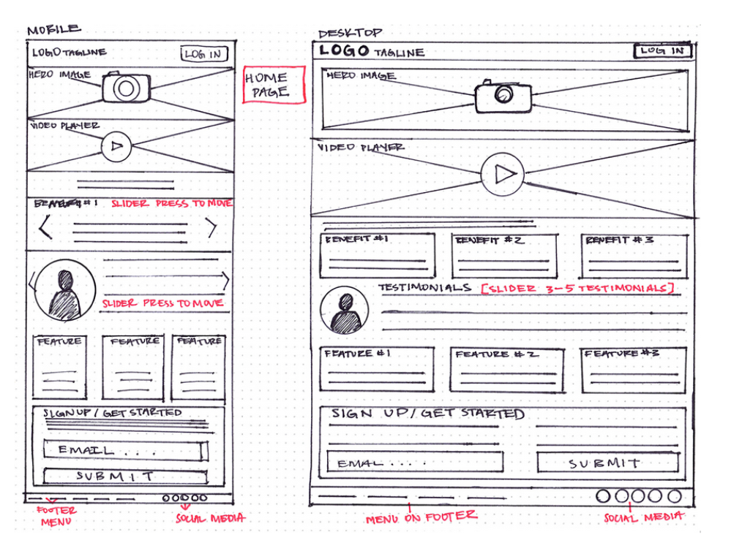
Wireframe on a sheet of paper.

Slide 57
Wireframe in 6 steps.
1. Do your research
Remember: UX design is a process, and wireframing isn’t the first step in this process. Before you even think about picking up a pen and paper, you need to have covered the first two steps; namely understanding who your audience is by way of user research, detailing requirements, creating user personas and defining use cases, and complementing this with further competitor and industry research. What does that mean? That means carrying out analysis of similar product lines to your own, digging into prevailing UX trends and best practises, and, of course, reviewing your own internal design guidelines.
2. Prepare your research for quick reference
You can imagine how much quantitative and qualitative data those various phases will produce. Well, that’s what you need to keep in mind while drawing out your wireframes
3. Make sure you have your user flow mapped out
Your wireframing is going to get very messy very quickly if you don’t have an idea of how many screens you’ll need to produce and the flow you expect the user to follow. It’s important to have a watertight concept of where your users will be coming from (which marketing channel, for example, and off the back of what messaging), and where you need them to end up. If you’re already well-acquainted with UX vocabulary, your internal voice will be alternately screaming “user flows” and “information architecture”.

Slide 58
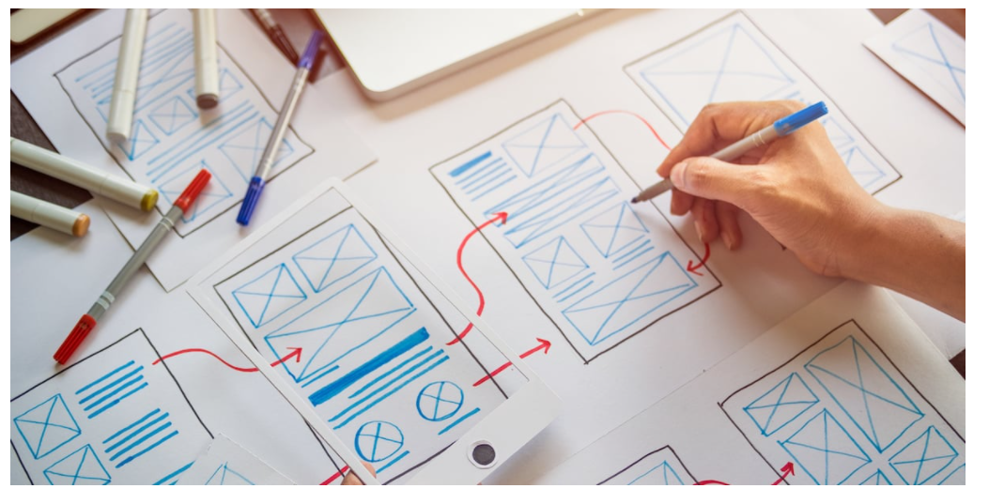
Wireframe – flow of screens.

Slide 59
Wireframe tips
4. Some more details to think :
How can you organise the content to support your users’ goals?
Which information should be most prominent? Where should your main message go? What should the user see first when arriving at the page?
What will the user expect to see on certain areas of the page?
Which buttons or touch points does the user need to complete the desired actions?
5. Add some more details : Now that screens are written, think of the following:
Usability conventions, such as putting the navigation at the top next to your logo, having a search box on the top right, and so on
Simple, instructional wording for i.e. calls-to-action
Trust-building elements: What do you need to build trust in your customers and where would be the best place to put these elements?
Tooltips to indicate any functionality that could be included in a prototype transition.
6. Start turning your wireframes into prototypes
Once you’ve documented and acted upon the feedback from your first prototype, you can start developing your high-fidelity prototypes.

Slide 60
Prototype
A prototype is a primitive version of something that will, potentially, be iterated upon until it is a final product.
Whether it’s a mobile app, a website or even the oven you use to cook your pizza, all of those things ideally will have gone through a prototyping process. You can think of prototypes as drafts. Drafts that will be edited until published. It is through this process of iteration and development that products and services come to life.
HTML Prototype: A HTML prototype is a prototype that has been built and developed using HTML. It’s a great option for people confident and fluent in coding languages. They’re not designed with any stylistic choices and are minimal in their appearance. That means there’s no fancy typography or imagery.
HTML prototypes set the foundation for a product and that foundation can be iterated upon, providing it’s solid. Plus, a HTML prototype can go onto the coding stage a lot faster than other prototypes because it has already been partly written in code.

Slide 61
What is Visual Design?
Visual design aims to improve a design’s/product’s aesthetic appeal and usability with suitable images, typography, space, layout and color. Visual design is about more than aesthetics. Designers place elements carefully to create interfaces that optimize user experience and drive conversion.
Visual Design is Aesthetic, Strategic Design
Users’ first impressions typically form in 50 milliseconds. This fact reflects the visceral level of emotional design (Emotional design is the concept of how to create designs that evoke emotions which result in positive user experiences.) —in other words, the user’s first impression of or gut reaction to a design. If they don’t like what you show them in those critical moments, they will leave. So, visual design is a vital part of your work as a designer. Many people mistake it to mean that designers include attractive elements just to maximize an item’s appeal. Actually, you use visual design to create and organize elements to A) lead the user’s eye to an item’s functionality, and B) make the aesthetics consistent.

Slide 62
Principles of visual design.
Unity – use this to establish harmony between page elements, so they appear to belong together and users aren’t distracted by chaotic (e.g., misaligned) layouts.
Gestalt – use these principles of how people perceive objects to guide how users interpret your design.
Hierarchy – use placement, font, etc. to show importance.
Balance – use this to distribute elements evenly.
Contrast – use differences in color, etc. to accentuate elements.
Scale – use this to emphasize elements to establish importance or depth.
Dominance – use an object’s size, color, etc. to make it stand out.

Slide 63
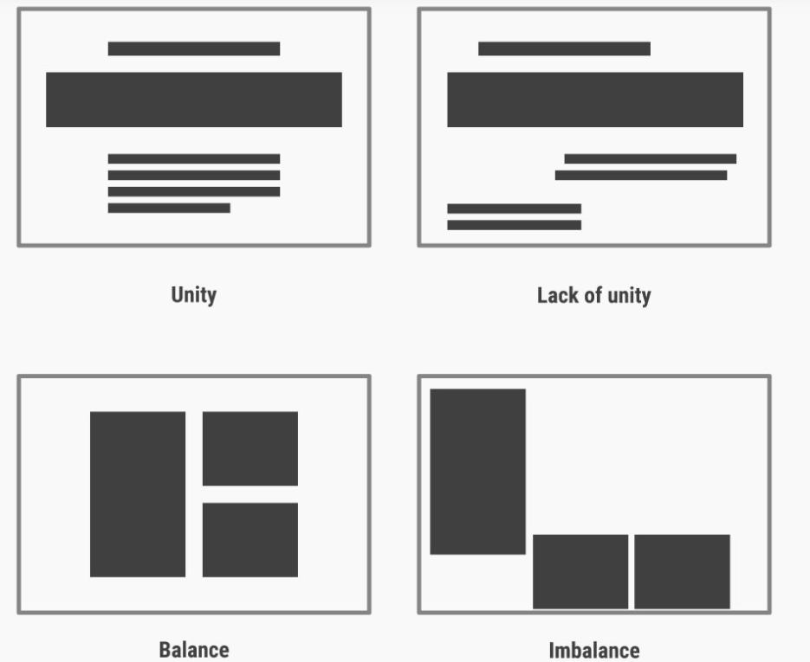

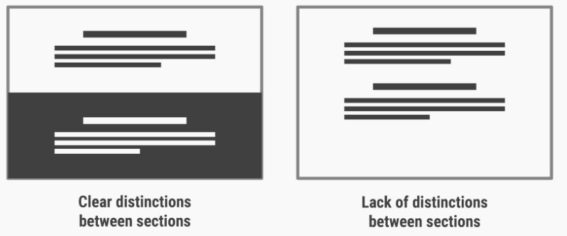

Slide 64
Careful Visual Design + Good Usability = Successful Design
As a visual designer, you should strive to create content that is consistent and predictably organized, but at the same time impressively distinct. You do this to give users the context they need. A visual designer wants to meet users’ expectations so they win and keep their trust, and impress them with a unique brand presence. Brand style guides typically define standards about color use, typography, etc.

Slide 65
Evaluation Research .
What is research?
Evaluation research, also known as program evaluation, refers to research purpose instead of a specific method. Evaluation research is the systematic assessment of the worth or merit of time, money, effort and resources spent in order to achieve a goal.
Why do evaluation research?
The common goal of most evaluations is to extract meaningful information from the audience and provide valuable insights to evaluators such as sponsors, donors, client-groups, administrators, staff, and other relevant constituencies. Most often, feedback is perceived as useful if it helps in decision-making.

Slide 66
Evaluation research.
Process evaluation research question examples:
How often do you use our product in a day?
Were approvals taken from all stakeholders?
Can you report the issue from the system?
Can you submit the feedback from the system?
Was each task done as per the standard operating procedure?
What were the barriers to the implementation of each task?
Were any improvement areas discovered?
Outcome evaluation research question examples:
How satisfied are you with our product?
Did the program produce intended outcomes?
What were the unintended outcomes?
Has the program increased the knowledge of participants?
Were the participants of the program employable before the course started?
Do participants of the program have the skills to find a job after the course ended?
Is the knowledge of participants better compared to those who did not participate in the program

Slide 67
UX Capstone project.
DESIGN CHALLENGE
Projects are defined in phases:
phase 1: define and research Define requirements, user research (survey, interviews, and focus group), user goals, task analysis
phase 2: concept development and product design Brainstorming, sketching, wireframes, visual research, information architecture
phase 3: build and implement Prototype, visual design + branding
phase 4: testing and refinements Usability testing

Slide 68
Thank you!

