Slide 1
Angular

Slide 2
Install visual studio
Install visual studio from below given link.
https://code.visualstudio.com/docs?dv=win

Slide 3
Angular components.
Major part of the development with Angular 4 is done in the components. Components are basically classes that interact with the .html file of the component, which gets displayed on the browser. We have seen the file structure in one of our previous chapters. The file structure has the app component and it consists of the following files −
app.component.css
app.component.html
app.component.spec.ts
app.component.ts
app.module.ts

Slide 4

Modify the html file.
Modify app.component.html, remove all the content and display a header and start the server. It will display the following.

Slide 5
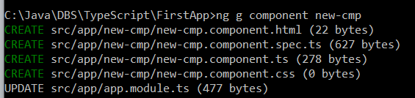
Create a new component.
Ng g component new-cmp → Generates the new component.
Open visual studio and check the files generated.

Slide 6
Angular modules.
In app.module.ts, first section has imports.
In @ngModule,
Declaration : It is an array of components created. If any new component gets created, it will be imported first and the reference will be included in declarations as shown below −
      declarations: [
      AppComponent,
      NewCmpComponent
      ],
Providers: This will include the services created..
Bootstrapping : This includes the main app component for starting the execution.

Slide 7
Data binding.
Databinding is a powerful feature of Angular. Angular Databinding is used for communication. It is used to communicate between your TypeScript code (your business logic) and the other component which is shown to the users i.e. HTML layout.
There are two types of data binding. One is
One-way databinding
One way databinding is a simple one way communication where HTML template is changed when we make changes in TypeScript code.
Two-way databinding
In two-way databinding, automatic synchronization of data happens between the Model and the View. Here, change is reflected in both components. Whenever you make changes in the Model, it will be reflected in the View and when you make changes in View, it will be reflected in Model.

Slide 8
One way data binding.
Add a variable as given below in app.component.ts
X : number = 20;
Display the value of the variable in app.component.html as {{x}}

Slide 9
Two way data binding.
Add FormsModule in app.module.ts and also add it in imports as given below:
import {FormsModule} from '@angular/forms‘
imports: [
BrowserModule,
AppRoutingModule,
FormsModule
],
Define a variable in the model / ts file.
name : string = “Charan”;
Bind it with html and display the binded variable data.
<input type=“text” [(ngModel)]=“name”/>
{{name}}

Slide 10
Event binding.
event binding is used to handle the events raised from the DOM like button click, mouse move etc. When the DOM event happens (eg. click, change, keyup), it calls the specified method in the component.

Slide 11
Event binding.
In app.component.ts
OnButtonClicked ($event)
{
console.log ("Button clicked...",$event);
}
In app.component.html
<button (click)="OnButtonClicked($event)" >Click on me...</button>
After clicking on the button open the console window using More tools → developer tools → console menu.

Slide 12
Property binding.
Property Binding is also a one-way data binding technique. In property binding, we bind a property of a DOM element to a field which is a defined property in our component TypeScript code.
In app.component.ts
imageURL:string = "../assets/manali.jpg";
In app.module.ts
<img [src]="imageURL"/> → ImageURL is evaluated and image is displayed.

Slide 13
Directives
Directives are instructions in the DOM. They specify how to place your components and business logic in the Angular.
Structural directives : Structural directives start with a * sign. These directives are used to manipulate and change the structure of the DOM elements. For example, *ngIf and *ngFor.
Attribute Directives: Attribute directives are used to change the look and behavior of the DOM elements. For example: ngClass, ngStyle etc.

Slide 14
ngFor
Define months in app.component.ts
months = ["Jan", "feb", "mar", "Apr", "May"];
In App.component.html
<li *ngFor="let i of months">
{{i}}
</li>
This will list the months as a line item.

Slide 15
ngStyle
ngStyle is a attribute directive. It is used for to change the look and behaviour of the DOM component.
In App.component.html
<h2> ngStyle to change the style of DOM </h2>
<h1 [ngStyle]="{backgroundColor:h1color}">Hello angular</h1>
<button (click)="changeColor()"> Change the color </button>
In app.component.ts
h1color:string='red';
changeColor()
{
this.h1color ='green';
}

Slide 16
Pipes
In Angular 7, it is known as pipe and used to transform data.
{{pipe_data|uppercase }}
{{pipe_data|lowercase }}
Converts the pipe_data into uppercase and lowercase.

Slide 17
Angular Service.
We might come across a situation where we need some code to be used everywhere on the page. It can be for data connection that needs to be shared across components, etc. Services help us achieve that. With services, we can access methods and properties across other components in the entire project.
It is like library functions which is used across the project.

Slide 18

Creating and using service.
Ng g service myservice
It creates two files myservice.service.spec.ts and myservice.service.ts
Modify app.module.ts as given below:
import {myserviceService} from './myservice.service‘
providers: [myserviceService],
Add a function in myservice.service.ts
showDate() :Date
{ let today = new Date();
return today;
}
In app.component.ts add the following code:
//For services.
//Dependency injection of this object.
constructor(private myservice: MyserviceService){}
ngOnInit()
{
this.today = this.myservice.showDate();
}
In app.component.html
<h2> Getting the todays date using services..</h2>
{{today}}

Slide 19
Dependency Injection.
Dependency Injection (DI) is a core concept of Angular 2+ and allows a class receive dependencies from another class. Most of the time in Angular, dependency injection is done by injecting a service class into a component or module class.

Slide 20
Communicate between components.
Parent to child component communication happens through @Input()
Child to Parent component communication happens through @Output()

Slide 21
Parent to child communication.
Define a variable in app.component.ts
Message:string “This is message from parent”;
Send this message data to child, in app.component.html
<input type="text" [(ngModel)]="Message"/>
<app-new-cmp [Message]="Message"></app-new-cmp>
In new-cmp-component.ts
@Input() Message : string;
In new-cmp-component.html
{{Message}}
Keep both the parent and child variable as same. Here Message is the communication variable. Edit box is given in the parent and it is mapped to a variable Message. This variable is passed from parent to Child. Child component, variable Message is defined with @Input() and the value of the variable Message is displayed in the child component html.

Slide 22
Send message from child to parent.
In new-cmpComponent.ts → On click of a button message emitted from child to parent.
@Output() public myOutput= new EventEmitter();
buttonClick():void{
this.myOutput.emit("Hello world!!");
}
In new-cmpComponent.html → Button is provided. On click of it, it calls a function buttonClick().
<button (click)="buttonClick()">Sed nessage to parent</button>
In app.ccomponent.html → This is how your receive the message from child to parent.
<app-new-cmp (myOutput)="MessageFromChild($event)"></app-new-cmp>
In app-component.ts → Receive the data in a function MessageFromChild€
childToParentStr:string;
MessageFromChild(e)
{
this.childToParentStr = e;
alert ("Message from child to parent is "+this.childToParentStr);
}

Slide 23
Routing.
The Angular router is an essential element of the Angular platform. It allows developers to build Single Page Applications with multiple states and views using routes and components and allows client side navigation and routing between the various components.

Slide 24
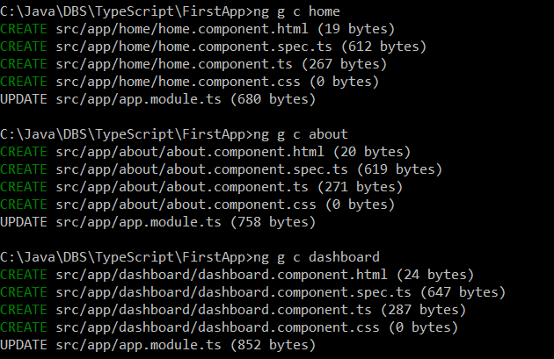
Routing.
From the command prompt, generate 3 components.
Ng g c home
Ng g c about
Ng g c dashboard
In App.module.ts
import {RouterModule, Routes} from '@angular/router';
const appRoutes : Routes = [
{path: 'home',
component: HomeComponent
},
{path: 'About',
component: AboutComponent
},
{path: 'Dashboard',
component: DashboardComponent
}
];
imports: [
BrowserModule,
AppRoutingModule,
FormsModule,
RouterModule.forRoot(appRoutes) → Add this in the imports section…
],

Slide 25
Routing.
In app.component.html
<a routerLink="home" routerLinkActive ="active">Home</a>
<a routerLink="about">About</a>
<a routerLink="dashboard">Dashboard</a>
<router-outlet></router-outlet>.

Slide 26
Parameterized routing.
In Parameterized routing, you can send the data to the destination routing component.
In App.module.ts
const appRoutes : Routes = [
{path: 'home',
component: HomeComponent
},
{path: 'About_param/:id',
component: AboutComponent
},
];
In App.component.html → You can pass the parameter like this in
<a [routerLink]="['/About_param', x]">About with param</a> &nbsp;&nbsp;&nbsp;
In about-component.ts
id:number;
constructor(private route: ActivatedRoute) {
this.route.params.subscribe(params => {this.id = +params['id'];});
console.log ("ID value is : "+this.id);
alert (this.id);
}
In About.component.html
Given data is : {{id}}

Slide 27
Http service
Http Service will help us fetch external data, post to it, etc. We need to import the httpClientmodule to make use of the http service.
Using http service, we can read json file and also we can make a http call. Once we get the response from the server, we can display the result in the html file.

Slide 28
Http service.
In App.module.ts
import {HttpClientModule} from '@angular/common/http';
imports: [
BrowserModule,
HttpClientModule
],
Create a book.ts and add the following code
export class Book
{
id:number;
name:string;
constructor(){}
}

Slide 29
http service
In App.component.ts
import {HttpClient} from '@angular/common/http';
import {Book} from './book';
Books: any = [];
book : Book;
errorMsg : string;
constructor(private httpClient : HttpClient){}
ngOnInit()
{ this.httpClient.get("assets/data/books.json").
subscribe (data =>
{
console.log(data);
this.Books = data;
},
(error) =>
{
console.error ("error has occured");
this.errorMsg = error.message;
alert (this.errorMsg);
}
);
}

Slide 30
http service.
<h2>Reading from json file through http service</h2>
<li *ngFor="let book1 of Books">
{{book1.id}} {{book1.name}}
</li>
This program will read books.json file and will display the content of it.

Slide 31
PWA
Progressive web application. The application works even if the network is not there. To show this…
Stop the ng serve if started.
npm cache verify --> Removes the old cache
npm install -g @angular/cli@latest --> Installs the latest angular
ng add @angular/pwa --project FirstApp --> Installs Pwa app. Project name should be same as in the file angular.json default parameter. File name should have the same case.
ng build --prod --> Builds the project
npm install --global http-server --> Installs the http serve
http-server -p 8080 -c-1 dist/FirstApp --> This brings the FirstApp in port 8080 by http-server.
Go to browser --> Tools --> Developers tools --> Network tab --> Offline box -- To simulate a network issue, disable network interaction for your application.
Try to search for a keyword in browser. Since the network is not there, it gives the error message No Internet.
Go to browser and try http://192.168.0.103:8080/ --> This will bring up the application irrespective of the network being down.

Slide 32
Unit testing.
Unit testing is done to check each and every function of the code to ensure it is working fine.
What is it?
Who uses it?
When it is used?
Where it is used?
Why it is used by?
How it is used?

Slide 33
Angular testing.
Create a new project.
Go to that directory
From command prompt, enter ng test
It compiles the project and runs the testing server on 9876 port and also opens the browser and runs all the tests.
By default it runs the app.component.spec.ts

Slide 34
App.component.spec.ts
import { TestBed } from '@angular/core/testing';
import { AppComponent } from './app.component';
describe('AppComponent', () => {
beforeEach(async () => {
await TestBed.configureTestingModule({
declarations: [
AppComponent
],
}).compileComponents();
});
it('should create the app', () => {
const fixture = TestBed.createComponent(AppComponent);
const app = fixture.componentInstance;
expect(app).toBeTruthy();
});
it(`should have as title 'TestApp'`, () => {
const fixture = TestBed.createComponent(AppComponent);
const app = fixture.componentInstance;
expect(app.title).toEqual('TestApp');
});
it('should render title', () => {
const fixture = TestBed.createComponent(AppComponent);
fixture.detectChanges();
const compiled = fixture.nativeElement;
expect(compiled.querySelector('.content span').textContent).toContain('TestApp app is running!');
});
});

Slide 35
Test the attribute of component.
In App.component.ts, define an attribute and assign value to it.
message : string = "My message";
In App.component.spec.ts, add a testcase to check the value of message attribute of the component.
it (`checking message parameter has 'My mesage' data or not`,() => {
const fixture = TestBed.createComponent(AppComponent);
const app = fixture.componentInstance;
expect(app.message).toEqual ('My message123 ');

Slide 36
Test a function of Angular.
In App.component.ts
sum (num1: number, num2: number) : number
{
return num1 + num2;
}
In App.component.spec.ts
it (`Testing a sum`,() => {
const fixture = TestBed.createComponent(AppComponent);
const num = fixture.componentInstance.sum(1,2);
expect (num).toEqual(3);
});

Slide 37
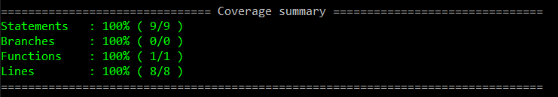
Code coverage
Ng test –code-coverage
This will run the test and shows how much of code coverage is done in terms of
Statements, branches, functions and lines.
Lines and statements are similar where many statements can be there in a line separated by ;
You can find the report of code-coverage in <Project Name>\coverage\<Project Name>\index.html

Slide 38
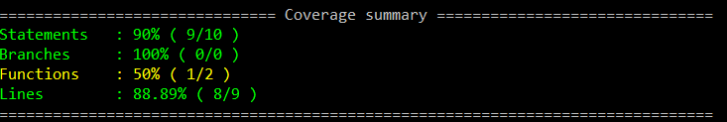
Code-coverage functions.
In app.component.ts, add a function
fun1 ()
{
console.log ("This is for testing..");
}
Because 1 function is added and it is not tested in the spec file. Unit testing is how many functions are there and how many are tested.

Slide 39
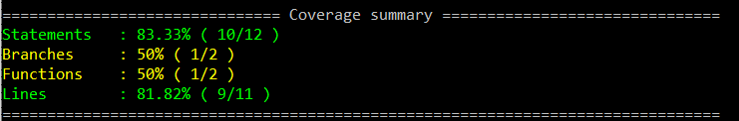
Code coverage – Branches.
Branches are, how many paths are travelled or tested in if condition branches.
In App.component.ts, modify the sum() function to add branches…
sum (num1: number, num2: number) : number
{
if (num1 > 0)
return num1 + num2;
else
return num2;
// return num1 + num2;
}
And now run the tests.

