Slide 1
Spring

Slide 2
Overview of Spring Technology
Spring is a comprehensive framework for building Java-based applications, widely used for enterprise-level software development. It provides a wide range of features and capabilities, making it one of the most popular frameworks in the Java ecosystem.

Slide 3
The Motivation for Spring, Spring Architecture
Spring was developed to address several challenges and limitations of traditional Java EE (Enterprise Edition) development. Here are the primary motivations behind the creation of the Spring Framework:
Complexity in Java EE: Early Java EE frameworks were heavy and complex, requiring a significant amount of configuration and boilerplate code.
Tight Coupling and Dependency Management: Traditional Java EE applications suffered from tight coupling between components.
Need for Better Testing.
Integration with Existing Technologies.
AOP (Aspect-Oriented Programming).

Slide 4
The Spring Framework
The Spring Framework is an open-source framework used for building Java-based applications. It is one of the most widely used frameworks in the Java ecosystem and offers a comprehensive programming and configuration model for modern Java applications. It was developed by Rod Johnson in 2002 to address the complexity and shortcomings of traditional Java EE (Enterprise Edition) applications. Spring simplifies Java development and promotes best practices in enterprise application design.

Slide 5
Declaring and Managing Beans
In Spring, beans are objects that are instantiated, configured, and managed by the Spring IoC (Inversion of Control) container. Beans are the backbone of any Spring application, and their lifecycle is managed by Spring’s IoC container. There are various ways to declare and manage beans in Spring, including XML configuration, annotation-based configuration, and Java-based configuration.

Slide 6
Inversion of Control Pattern
Inversion of Control (IoC) is a fundamental design principle in the Spring Framework. It refers to the delegation of control over object creation, lifecycle management, and dependencies to the Spring IoC container. Instead of the objects creating and managing their dependencies directly, the control is "inverted" and given to the container.
Key Concepts of IoC in Spring:
Dependency Injection (DI): IoC is primarily implemented in Spring through Dependency Injection, where the container injects required dependencies into the objects at runtime.
IoC Container: The Spring Framework provides an IoC container that is responsible for:
Instantiating beans.
Managing the lifecycle of beans.
Injecting dependencies into beans.
Bean Configuration: Dependencies can be configured in: XML-based configuration: Using <bean> and <property> tags. Annotation-based configuration: Using @Component, @Autowired, and other annotations. Java-based configuration: Using @Configuration and @Bean.

Slide 7
BeanFactory vs ApplicationContext
1. Core Purpose
BeanFactory: The fundamental interface for accessing a Spring container.
It provides basic dependency injection (DI) capabilities and bean lifecycle management. Uses lazy initialization by default. Beans are created only when explicitly requested. It has basic DI support. Lacks enterprise-level features like AOP, event handling, and declarative mechanisms.
ApplicationContext: A more advanced container built on top of BeanFactory. Provides additional features such as event propagation, internationalization, and integration with enterprise services. Initializes and instantiates all singleton beans eagerly at startup unless otherwise configured. Supports AOP.

Slide 8
Dependencies and Dependency Injection (DI)
Dependencies in Spring : Dependencies refer to the objects that a class depends on to function properly. These are the required collaborators or services that a class uses. For example, a service class may depend on a DAO (Data Access Object) to retrieve or store data. In Spring, dependency management is a critical concept where Spring manages the relationships between these objects.
Dependency Injection (DI) : Dependency Injection (DI) is a design pattern used to achieve Inversion of Control (IoC). In DI, the control of creating and managing the required objects (dependencies) is given to a framework like Spring, rather than the class managing them itself. There are two types of DI in Spring. They are (1) Setter Based (2) Constructor based.

Slide 9
XML Configuration of DI
Demonstrate the program for the same.

Slide 10
Spring Bean Autowiring
In Spring Framework, autowiring is a feature used to automatically inject bean dependencies into a Spring container. It simplifies the process of dependency injection by allowing Spring to resolve and inject the dependencies without explicit configuration. Autowiring works by matching properties in a bean to one or more beans defined in the application context.

Slide 11
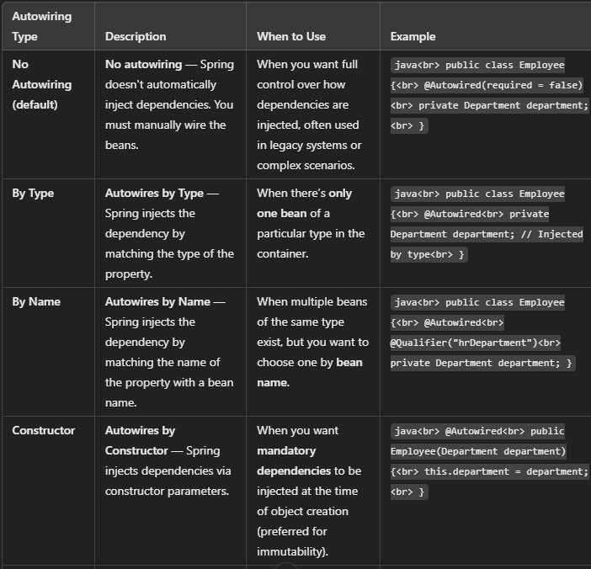
Spring Bean Autowiring

Slide 12
Injection with @Autowire
In Spring, the @Autowired annotation is used to enable dependency injection. It instructs the Spring container to resolve and inject the appropriate beans into the marked field, constructor, or setter method.

Slide 13
Java Based Configuration (@Configuration + @Bean)
In Spring, Java-based configuration allows you to configure Spring beans using pure Java code instead of XML. This approach leverages the @Configuration and @Bean annotations to define beans and their dependencies in a clean, type-safe manner.
@Configuration: This annotation marks a class as a source of bean definitions for the Spring IoC container. A class annotated with @Configuration can have methods annotated with @Bean to define beans.
@Bean: This annotation is used to define a method that will return an object that should be registered as a bean in the Spring container. The method will be called by Spring to get the bean, and the returned object will be managed by the Spring IoC container.
Add the code snippet in here.

Slide 14
Bean Scope and Lifecycle
In Spring, bean scope and bean lifecycle are crucial concepts that govern how beans are created, managed, and destroyed within the Spring container. Bean scopes are :
1. Singleton
2. Prototype
3. Request
4. Application.

Slide 15
Bean Lifecycle
The lifecycle of a bean in Spring refers to the sequence of steps that Spring performs when managing beans. These steps include initialization, custom destruction, and the management of lifecycle callbacks.
1. Bean Creation : The Spring container instantiates the bean. If the bean scope is singleton, it is created once. If the scope is prototype, it is created every time it is requested.
2. Dependency Injection (DI) : After the bean is created, Spring injects the dependencies specified via annotations like @Autowired or through XML configuration.
3. Post-Processors : BeanPostProcessors are used to modify or wrap the bean instance after it is created and before it is initialized. There are two phases of post-processing:
Before Initialization (postProcessBeforeInitialization)
After Initialization (postProcessAfterInitialization)

Slide 16
Bean Lifecycle
4. Initialization : If the bean implements the InitializingBean interface or has a custom @PostConstruct method, Spring will call the appropriate method after dependency injection but before the bean is used. @PostConstruct: This annotation marks a method to be invoked after the bean’s properties are set.
InitializingBean interface: The afterPropertiesSet() method is called by the container after all the properties are set.
Destruction : When the container is about to be destroyed, the bean’s destruction methods are called. If the bean implements the DisposableBean interface, the destroy() method will be invoked. If the bean has a custom @PreDestroy method, that method will be invoked.

Slide 17
Singleton, Prototype, and Other Scopes
Explained earlier.

Slide 18
Configuring Scope
In Spring, scope defines the lifecycle and visibility of beans within the application context. The scope of a bean determines when it is created, how long it exists, and how it is shared across different parts of the application. Spring provides several scopes, and configuring them correctly helps in controlling the behavior of beans in different environments (e.g., a web application vs. a stand-alone application).
Types of Bean Scopes in Spring : Spring supports the following scopes:
Singleton (Default Scope)
Prototype
Request
Session
Application

Slide 19
Bean Lifecycle / Callbacks
In Spring, the bean lifecycle refers to the sequence of steps that a Spring bean goes through from creation to destruction. The lifecycle consists of various phases, and you can hook into these phases using callbacks to perform custom initialization and cleanup actions.
Bean Lifecycle Phases
Instantiation: The bean is instantiated by the Spring container, either using a no-argument constructor or a factory method.
Populating Bean Properties: The Spring container populates the bean's properties (dependencies) by using dependency injection (via annotations like @Autowired or configuration methods with @Bean).
Post-Processors (Optional): Spring provides two types of bean post-processors:
BeanPostProcessor: These are invoked before and after bean initialization.
InstantiationAwareBeanPostProcessor: Invoked before and after the instantiation of the bean.

Slide 20
Bean Lifecycle / Callbacks
Initializing Bean (Optional): If the bean implements the InitializingBean interface, Spring will call the afterPropertiesSet() method after setting the properties.
Alternatively, you can define custom initialization logic using the @PostConstruct annotation or a @Bean method with an initMethod.
Bean Ready to Use: After the initialization phase, the bean is fully initialized and ready for use in the application.
Destroying Bean (Optional): If the bean implements the DisposableBean interface, Spring calls the destroy() method before the bean is destroyed.
Alternatively, you can specify a custom destroy method using the @PreDestroy annotation or a @Bean method with a destroyMethod.

Slide 21
Introduction To SpEL
Spring Expression Language (SpEL) is a powerful expression language integrated into the Spring Framework. It allows querying and manipulating objects at runtime. SpEL is often used in configurations, Spring beans, and annotations to dynamically access and manipulate data.

Slide 22
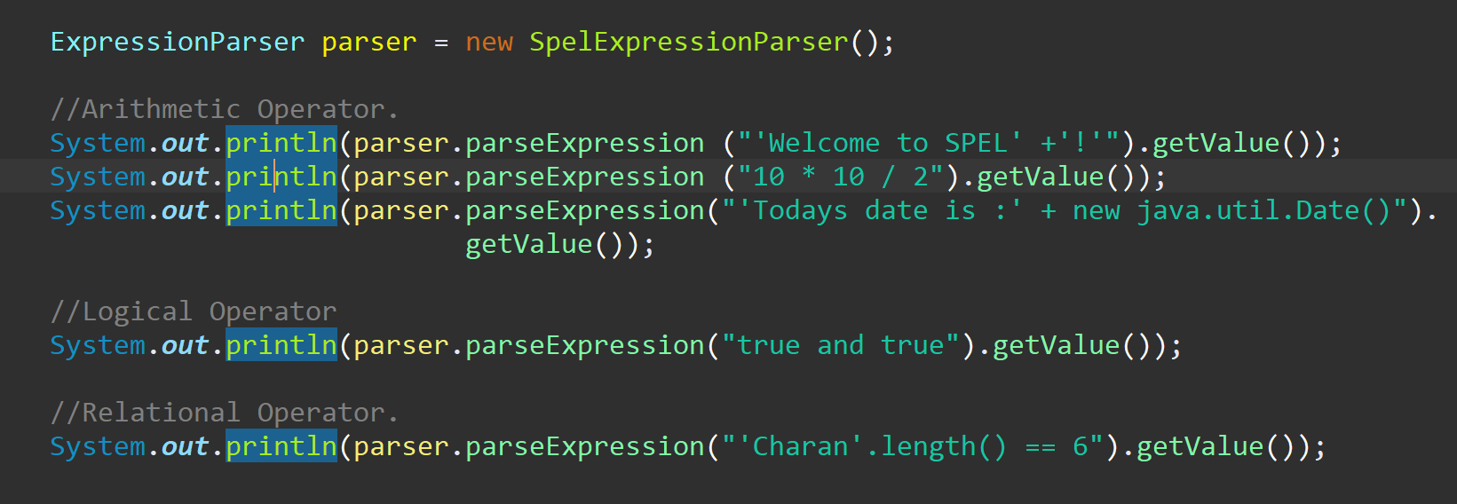
SpEL Features

Slide 23
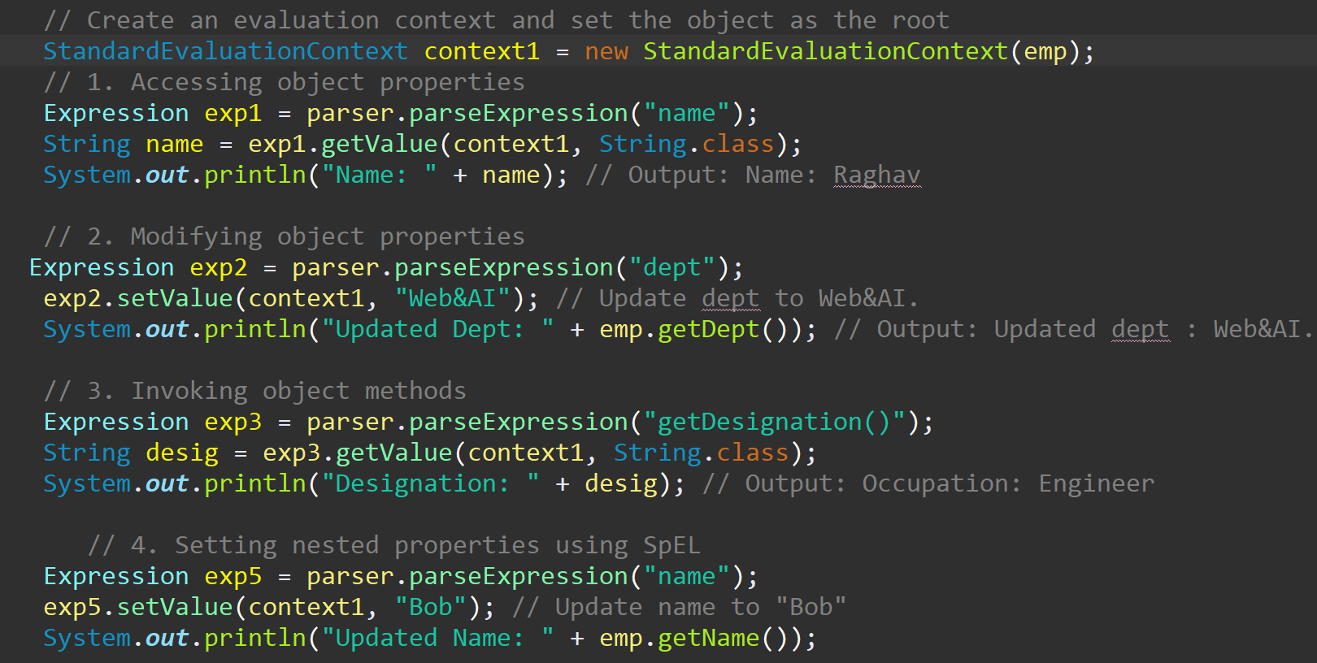
SpEL expression evaluation against a specific object instance

Slide 24
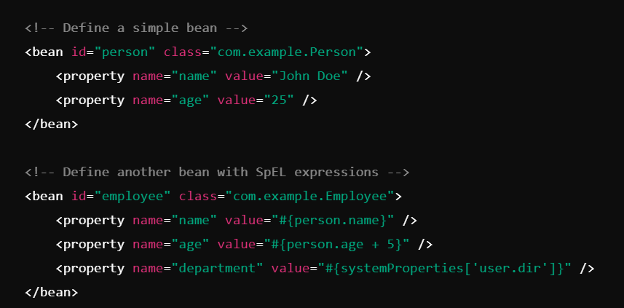
SpEL in Bean Definition
Spel can be defined in the xml file also.

Slide 25
Introduction of Aspect Oriented Programming (The Proxy Pattern)
Aspect-Oriented Programming (AOP) is a programming paradigm that aims to increase modularity by allowing the separation of cross-cutting concerns. Cross-cutting concerns are functionalities that affect multiple parts of an application, such as logging, security, transaction management, or caching.
AOP enables developers to isolate these concerns into reusable components called aspects, improving code readability, maintainability, and reusability.

Slide 26
Introduction of Aspect Oriented Programming (The Proxy Pattern)
The Proxy Pattern in AOP : The Proxy Pattern is a structural design pattern that provides a surrogate or placeholder for another object to control access to it. In AOP, the Proxy Pattern is used to wrap a target object with a proxy that adds cross-cutting behavior.
a. How the Proxy Pattern Works:
The proxy object intercepts method calls to the target object.
It executes the cross-cutting concern (e.g., logging) before or after delegating the method call to the target object.

Slide 27
AOP Terminology
Aspect-Oriented Programming (AOP) is a programming paradigm that aims to increase modularity by allowing the separation of cross-cutting concerns (e.g., logging, security, transaction management). Spring AOP provides an implementation to integrate AOP into your Spring applications. Understanding the terminology is crucial to effectively using AOP in Spring.

Slide 28
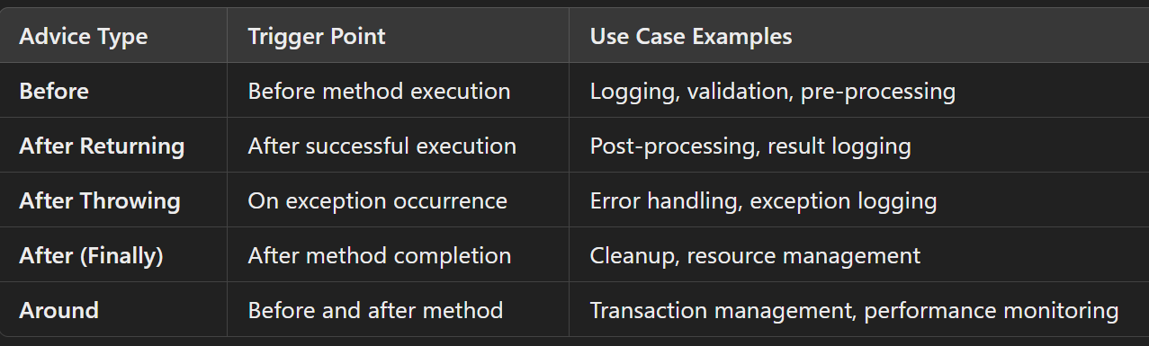
Types of Advice
In Spring AOP (Aspect-Oriented Programming), advice is the action taken by an aspect at a particular join point. There are five types of advice in Spring AOP, each executed at a specific point in the program flow:

Slide 29
Custom Logging support Aspect Implementation

Slide 30
DAO – Introduction.
DAO (Data Access Object) is a design pattern used in software development to provide an abstract interface to a database or other persistence mechanism. It isolates the application/business layer from the persistence layer by using an interface for database operations.
In Spring, the DAO pattern is implemented to interact with the database in a consistent and simplified way. Spring provides several features to make working with DAOs easier, such as support for JDBC, ORM frameworks like Hibernate, and JPA.
DAO encapsulates database interaction logic, keeping it separate from business logic.

Slide 31
Plain JDBC limitations
Using plain JDBC (Java Database Connectivity) for database interaction has several limitations. Here’s an overview:
Boilerplate Code : JDBC requires writing repetitive and verbose code for tasks like establishing a connection, creating statements, and closing resources.
Manual Resource Management : Developers need to manually manage resources like connections, statements, and result sets, leading to potential resource leaks if not handled properly.
Error Handling : JDBC requires explicit handling of SQLException for every database operation, making error handling cumbersome and verbose.
Transaction Management : Managing transactions programmatically can be complex, especially when handling nested transactions or ensuring rollback in case of failures.

Slide 32
Spring JDBC/DAO Advantages
Using Spring JDBC/DAO abstraction provides several advantages that make database interaction more efficient, maintainable, and less error-prone in Java applications. Here are the key benefits:
Simplifies Database Access
Consistent Exception Handling
Resource Management
Integration with Spring Framework
Template-Based Approach
Support for Named Parameters
Improved Readability and Maintainability
Cross-Database Portability
Batch Processing Support
Row Mapping and Object Mapping
Ease of Testing
Transaction Management

Slide 33
Working with different Data Sources
Spring JDBC provides a flexible framework for working with different data sources. This flexibility comes from its integration capabilities and support for configuring multiple data sources. You might need multiple data sources when your application connects to multiple databases (e.g., user management in one database and transaction data in another).
Spring's abstraction allows you to configure and work with multiple data sources seamlessly. For example, you can create 2 data sources one which connects to Mysql and another which connects to postGreSQL and operations on these two dbs can be performed from Spring JDBC.

Slide 34
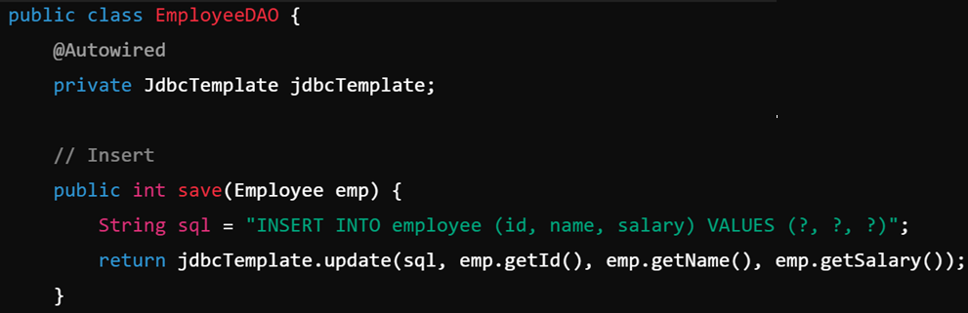
JdbcTemplate
JdbcTemplate is a central class in Spring JDBC that simplifies working with relational databases using JDBC (Java Database Connectivity). It provides methods to execute SQL queries, update statements, and perform batch operations, significantly reducing boilerplate code like managing connections, result sets, and exceptions.
Key Features of JdbcTemplate
Simplified Database Operations.
Exception Handling.
Query and Update Support.
Batch Operations.
Prepared Statements and Parameters.
Row Mapping.

Slide 35
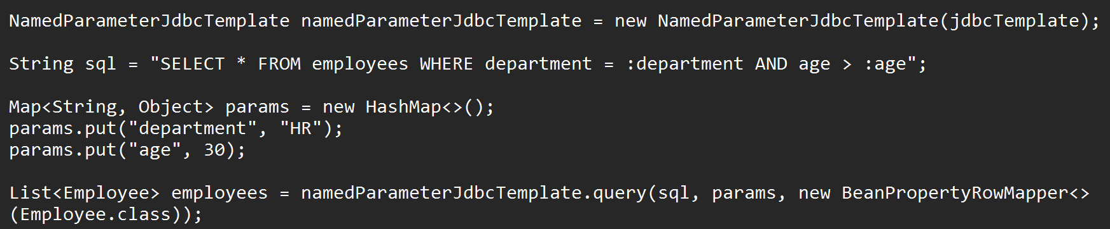
NamedParameterJdbcTemplate
The NamedParameterJdbcTemplate in Spring JDBC is a class that simplifies the usage of JDBC by providing support for named parameters in SQL queries. Unlike JdbcTemplate, which requires the use of positional parameters (e.g., ? placeholders), NamedParameterJdbcTemplate allows you to use named placeholders, making the code more readable and maintainable.
Key Features of NamedParameterJdbcTemplate
Named Parameters: Use named parameters (:paramName) instead of positional placeholders (?), improving clarity.
Readability: Makes SQL queries more descriptive and easier to understand.
Parameter Mapping: Supports mapping parameters from a Map, a SqlParameterSource, or even objects with property values.
Integration with JdbcTemplate: Internally uses JdbcTemplate, ensuring consistent behavior.

Slide 36
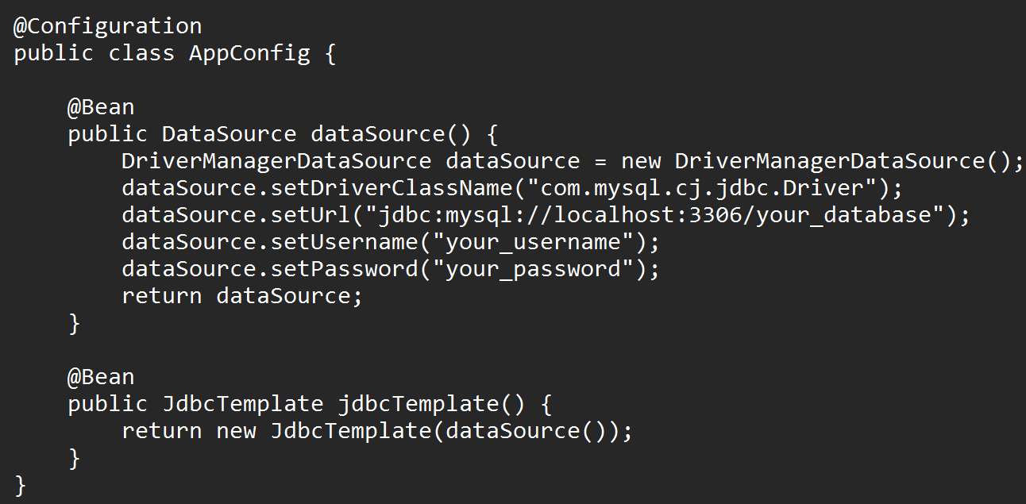
Spring JDBC/DAO with Annotations
Spring JDBC/DAO with annotations simplifies database access and configuration in Spring applications by eliminating the need for XML-based configuration.
@Repository : Indicates that the annotated class is a "Repository" or "DAO" component
@Autowired : Used to inject dependencies like JdbcTemplate into the DAO class.
@Configuration : Defines a configuration class that can declare @Bean methods to instantiate beans.
@Bean : Specifies a bean definition for objects like DataSource and JdbcTemplate.

Slide 37
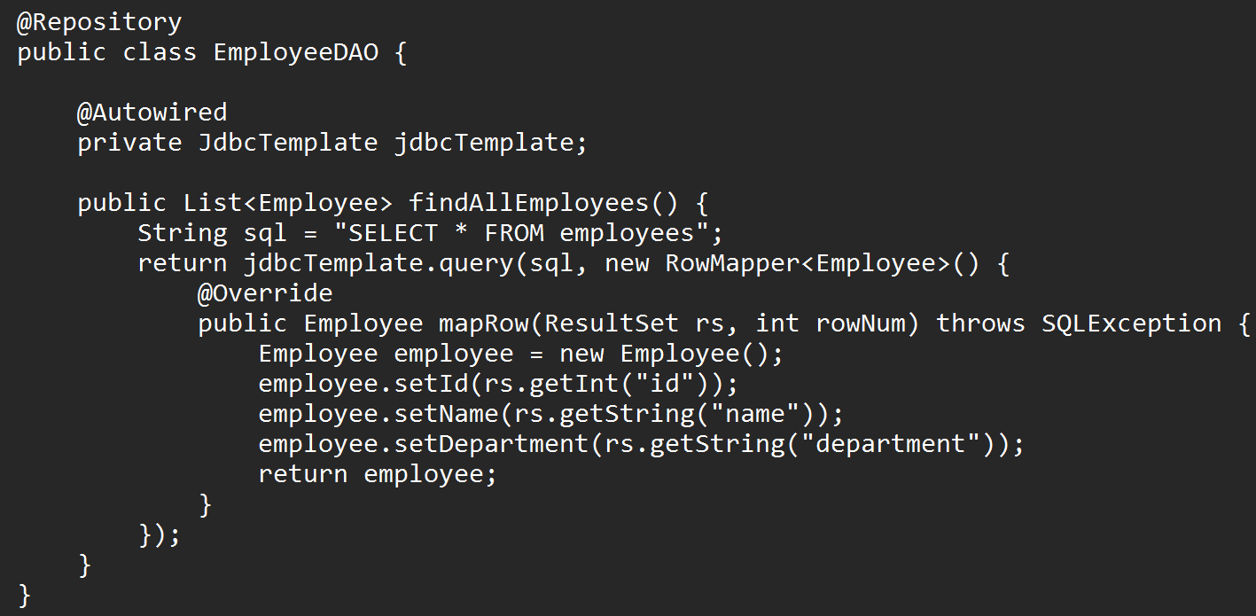
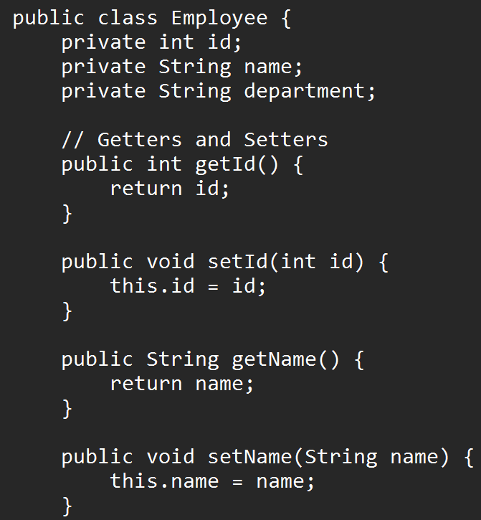
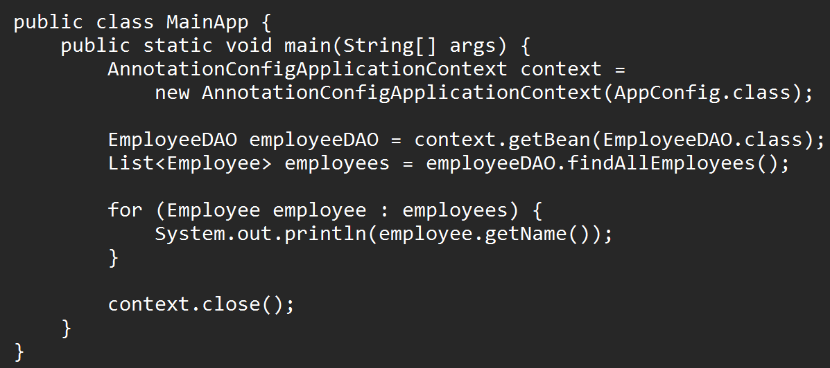

Slide 38
Introduction to Transaction Management
Transaction Management is a crucial part of any enterprise application to ensure data consistency and integrity. In the Spring Framework, transaction management provides a consistent programming model across different transaction APIs (JDBC, JTA, Hibernate, etc.), enabling declarative or programmatic management of transactions.
Transactions : A transaction is a sequence of operations performed as a single logical unit of work. It ensures the ACID properties (Atomicity, Consistency, Isolation, Durability).
Spring’s Transaction Abstraction : Spring provides an abstraction over various transaction APIs (e.g., JDBC, JPA, JTA) using its PlatformTransactionManager interface.

Slide 39
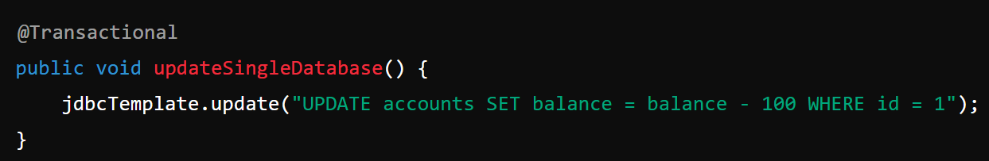
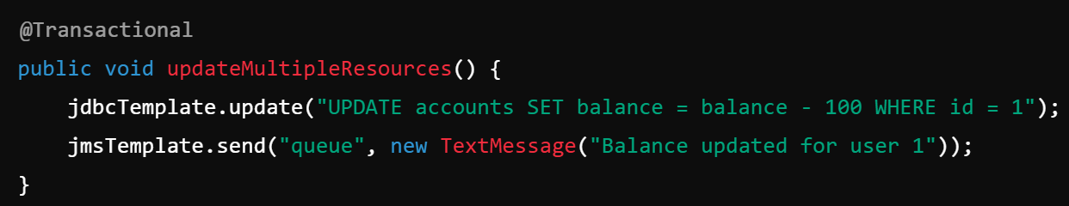
Local Transaction Vs Distributed Transaction
Local Transactions : A transaction that is confined to a single transactional resource, such as a single database or a JMS queue.
Distributed Transactions : A transaction that spans across multiple transactional resources, such as two databases or a database and a message broker.

Slide 40
Need of Spring Transaction Management
Need for Spring Transaction Management : Spring Transaction Management is essential for developing robust and reliable enterprise applications. It provides a mechanism to ensure data consistency and integrity across multiple operations. Below are the key reasons why Spring Transaction Management is important:
Data Consistency : In applications, multiple database operations might need to be performed together as a single unit of work. If one operation fails, the entire transaction must be rolled back to maintain data consistency. For example, in a banking application, transferring money involves debiting one account and crediting another. If one of these operations fails, the other must be reverted.
Error Handling and Rollbacks : Without transaction management, developers need to manually handle rollback operations when an error occurs.
Integration with Various APIs : Spring's transaction management is integrated with: JDBC, Hibernate, JPA, JDO, etc.
Declarative Support : Spring enables declarative transaction management through annotations (e.g., @Transactional), making the code more readable and maintainable.

Slide 41
Need of Spring Transaction Management
Concurrency and Performance : Spring ensures thread safety and proper locking mechanisms when multiple transactions are processed simultaneously.
Simplification of Complex Scenarios : Manually managing transactions for complex workflows can lead to errors. Spring provides a flexible model where you can use aspects and annotations to define when a transaction starts, commits, or rolls back.

Slide 42
Spring ORM with Hibernate Template
Spring ORM (Object-Relational Mapping) with Hibernate Template simplifies database interaction by abstracting repetitive tasks and managing Hibernate sessions efficiently. It provides a convenient way to integrate Hibernate into Spring applications, ensuring clean transaction management and exception handling.
Hibernate Template: Simplifies Hibernate operations like saving, updating, and deleting objects. Wraps Hibernate API calls and manages resource handling (e.g., Session, Transaction). Avoids boilerplate code required for Hibernate sessions.
Spring Context: Manages SessionFactory bean and integrates it with Hibernate.
Configures transaction management using @Transactional or XML-based configurations.
Transaction Management: Supports declarative transaction management using Spring's @Transactional annotation or configuration in applicationContext.xml.
Exception Translation:Converts Hibernate exceptions into Spring DataAccessException hierarchy.

Slide 43
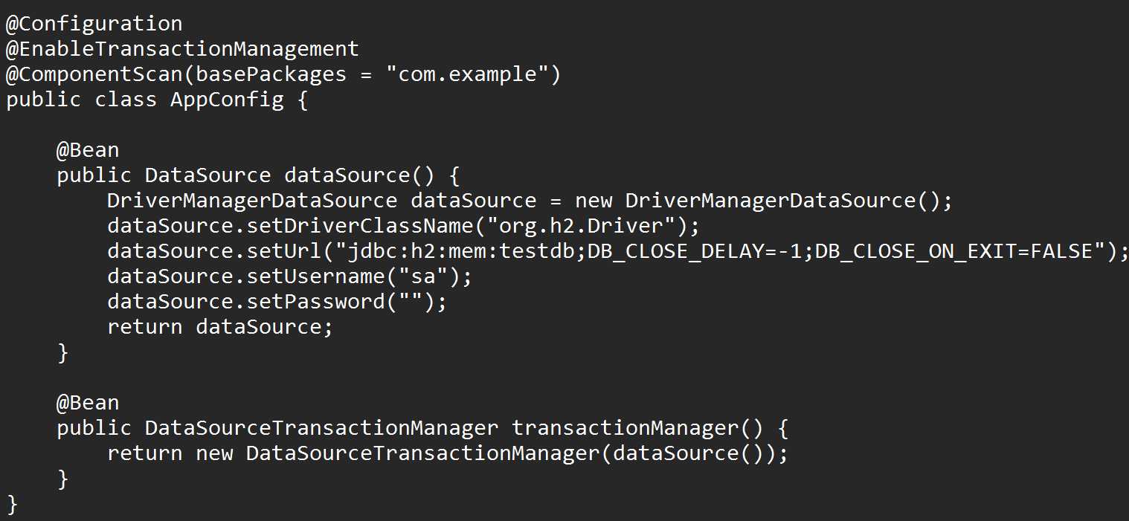
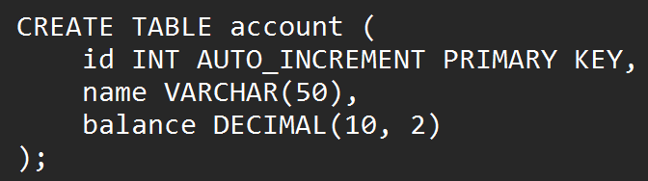
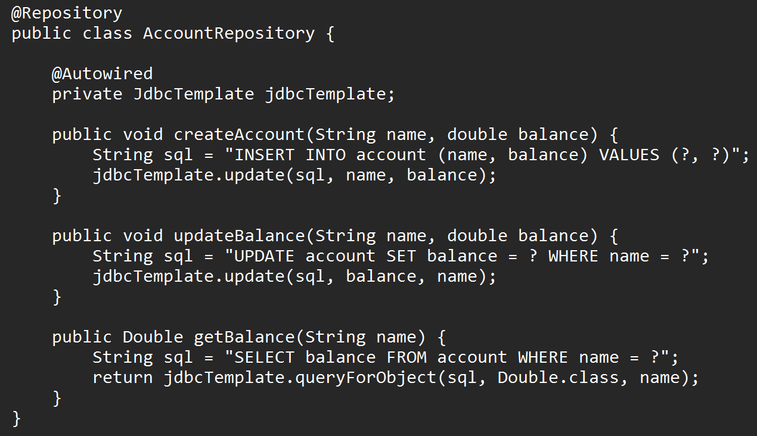
Implementing of Spring Transaction management using Annotation Driven Approach

Slide 44
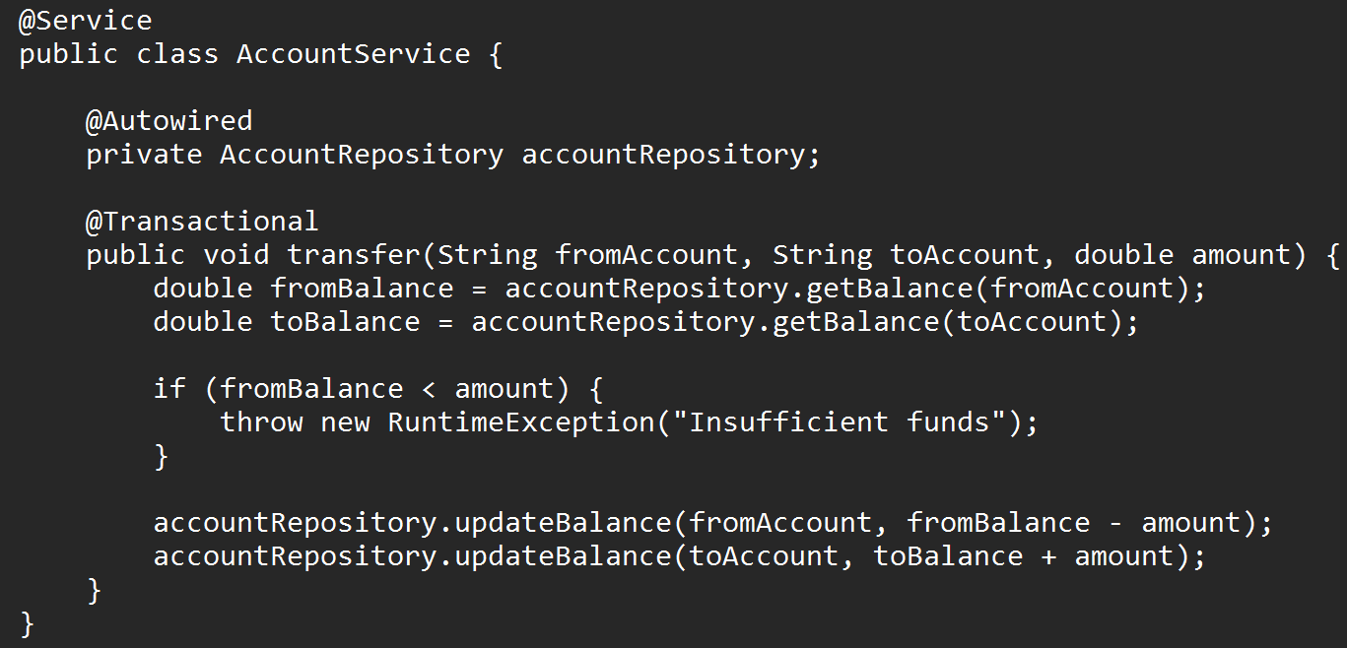
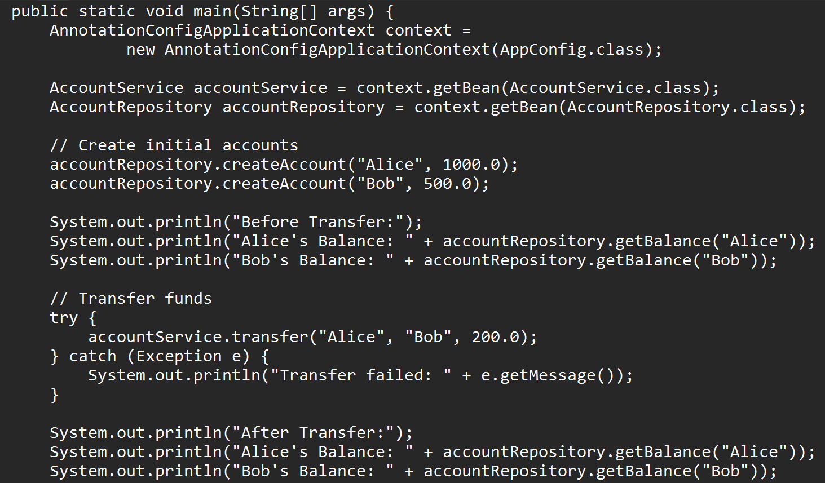
Implementing of Spring Transaction management using Annotation Driven Approach

Slide 45
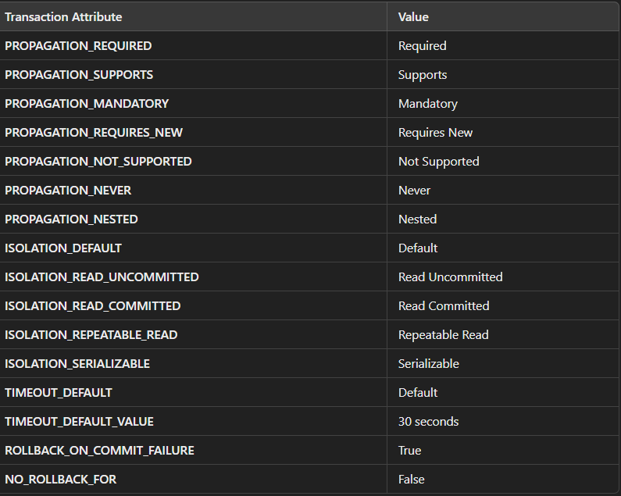
Transaction Attributes
Transaction attributes in Spring define how transactions are managed and what behaviors they exhibit. These attributes are typically specified when using declarative transaction management, either via XML configuration or annotations (e.g., @Transactional). Below are the key transaction attributes and their details:

Slide 46
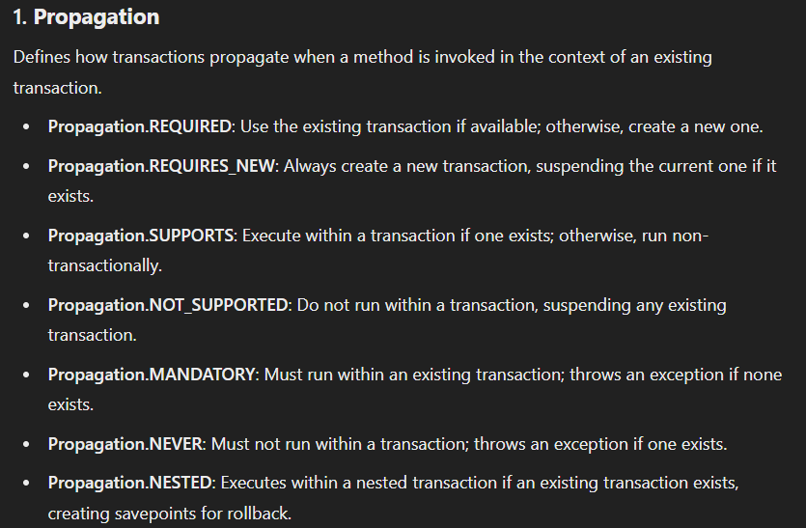
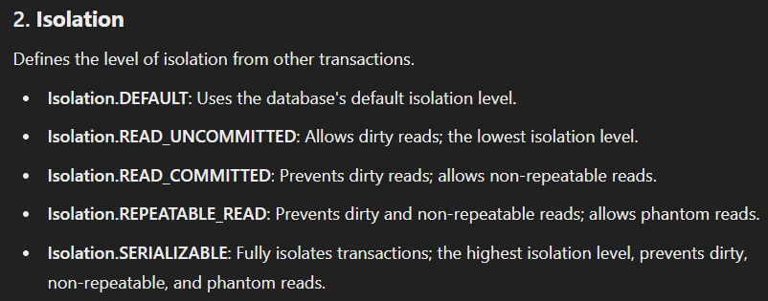

Slide 47
Transaction Attributes
Transaction attributes in Spring define how transactions are managed and what behaviors they exhibit. These attributes are typically specified when using declarative transaction management, either via XML configuration or annotations (e.g., @Transactional). Below are the key transaction attributes and their details:

Slide 48
Introduction To MVC
Model : Represents the data and the business logic of the application.
View : Represents the presentation layer or the user interface.
Controller : Acts as an intermediary between the Model and the View. Handles user inputs, processes them (using the Model), and determines what to display next (using the View).

Slide 49
Understanding MVC1, MVC2 Architectures
MVC1 : Controller (Servlet): The servlet acts as both the controller and the view in the MVC1 architecture. It processes the request, generates a dynamic page (via JSP), and returns the response to the client. View (JSP): The view is responsible for displaying the UI. In MVC1, the JSP page itself can also contain the logic for rendering the page and invoking backend operations. Model: The model is represented by Java beans or POJOs that contain the data.
MVC2 : Controller: In MVC2, the controller (often a servlet or a class in a framework) only manages the flow of the application. It does not contain the logic to render views. It receives input, processes it, interacts with the model (business logic), and forwards the request to a view.View: The view in MVC2 is typically a separate JSP, HTML, or any other UI component, which only renders the data passed by the controller. It does not contain business logic, making it easier to manage and maintain.Model: The model is a set of objects that contain business logic and data. The controller interacts with the model, retrieves or manipulates data, and passes it to the view for presentation.

Slide 50
Front Controller Design Pattern
The Front Controller Design Pattern is a structural design pattern that provides a centralized entry point for handling all requests in a web application. It decouples the request-handling process from the business logic and can provide uniform handling of requests for different views. This pattern is commonly used in web frameworks like Spring MVC.
Front Controller: This acts as the central controller for processing incoming requests. It intercepts requests and forwards them to the appropriate handler or controller for further processing.

Slide 51
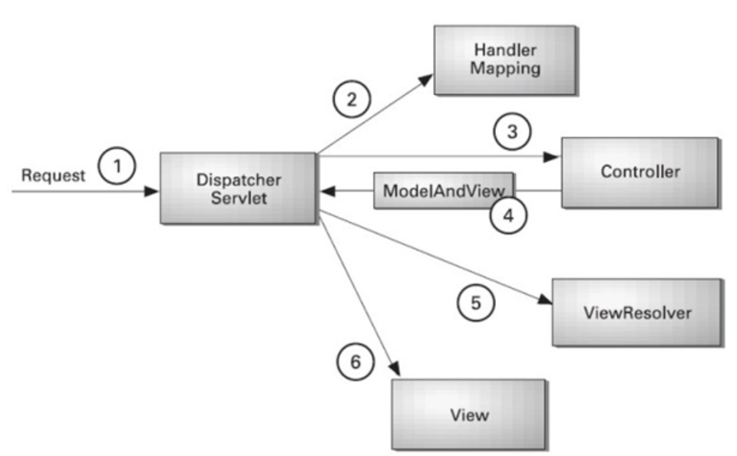
Spring MVC Basics
Architecture of Spring MVC.

Slide 52
Configuration and the DispatcherServlet
The DispatcherServlet is the front controller in Spring MVC, responsible for handling incoming HTTP requests and dispatching them to appropriate handlers (controllers). It is a key component in the Spring MVC architecture that integrates and orchestrates the components in the MVC framework.
Responsibilities of DistpatcherServlet: Intercepts all incoming HTTP requests mapped to it. Looks up appropriate handler methods (controller methods) based on request mappings. Manages the lifecycle of web application components, such as ViewResolver, HandlerMapping, and HandlerAdapter.

Slide 53
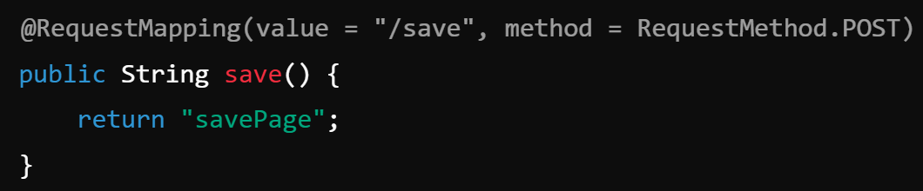
@Controller, @RequestMapping (Handlers)
@Controller Annotation : Marks a class as a Spring MVC controller, responsible for handling web requests.
@RequestMapping Annotation : Maps HTTP requests to specific controller methods or classes.

Slide 54
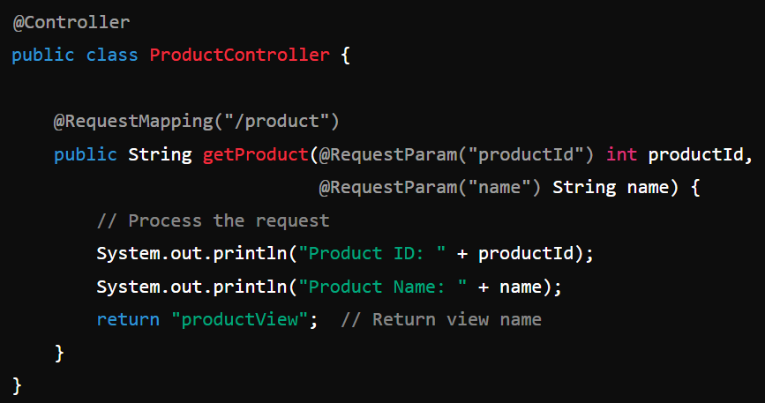
@RequestParam and Parameter Binding
In Spring MVC, @RequestParam annotation is used to bind HTTP request parameters (e.g., query parameters or form data) to the method parameters in a controller. This is commonly used for extracting data sent via the GET or POST HTTP methods.

Slide 55
View Resolvers
1. What is a View Resolver
A View Resolver is a strategy interface provided by Spring MVC that maps a logical view name (returned from the controller) to a specific view implementation.
The framework provides various built-in implementations for handling different view technologies.
2. How It Works :
A controller method returns a logical view name (e.g., "home").
The View Resolver translates this logical view name into a physical view resource path (e.g., /WEB-INF/views/home.jsp).
The resolved view is then rendered by the framework.

Slide 56
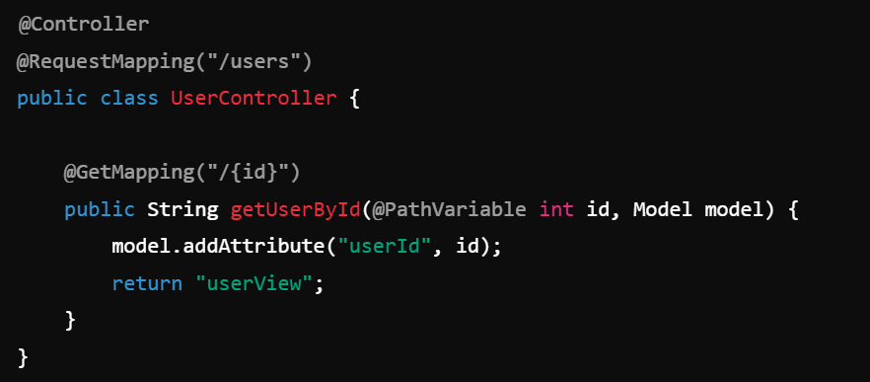
Controller Details - @RequestParam, @PathVariable
Request Param is discussed in earlier slides.
@PathVariable : The @PathVariable annotation is used to extract values from the URI path itself. It is often used for RESTful APIs where the path defines resources.

Slide 57
Model Data and @ModelAttribute
Purpose of @ModelAttribute
The @ModelAttribute annotation is used to bind method parameters or return values to a named model attribute, which can be accessed in the view.
It helps pass data between the controller and the view in a structured way.

Slide 58
RESTful Services with Spring
RESTful services (Representational State Transfer) are web services built on HTTP methods like GET, POST, PUT, DELETE, etc. These services expose endpoints (URLs) that clients can interact with over the web. Spring Framework provides a comprehensive way to build RESTful web services through Spring Web and Spring WebFlux modules.

Slide 59
REST Overview, URI Templates
REST Overview : REST (Representational State Transfer) is an architectural style for designing networked applications. It relies on a stateless communication model and uses HTTP as the communication protocol. RESTful services are widely used for building web services and APIs because of their simplicity and scalability.
HTTP Methods in REST: RESTful services typically use the following HTTP methods to perform actions on resources:
GET: Retrieve a resource or a list of resources.
POST: Create a new resource.
PUT: Update an existing resource.
DELETE: Delete a resource.
PATCH: Partially update a resource.

Slide 60
REST Overview, URI Templates
URI Template Syntax:
Path Variables: The curly braces {} are used to define variables in the URL, which are then extracted and passed to the controller method as arguments.
Example: /users/{id} - Here, {id} is a path variable, and Spring will map it to a method parameter.
Query Parameters: You can also define query parameters using @RequestParam.
Example: /users?id=1 where id=1 is a query parameter.

Slide 61
REST and Spring MVC
REST (Representational State Transfer) is an architectural style for building web services that allows communication between systems using HTTP. It is a stateless, lightweight, and scalable approach to developing APIs. Spring MVC (Model-View-Controller) is a powerful framework used to build web applications in Java. It integrates seamlessly with RESTful web services and allows for the development of robust, maintainable, and testable applications.

Slide 62
Spring support for REST
Spring provides robust support for developing RESTful Web Services through the Spring Web module, which is part of the Spring Framework. The REST support is primarily available through Spring MVC, which can be easily configured to handle HTTP requests and responses in a RESTful manner.

Slide 63
@RequestMapping/@PathVariable, @RequestBody, @ResponseBody
Example of all these annotations.

Slide 64
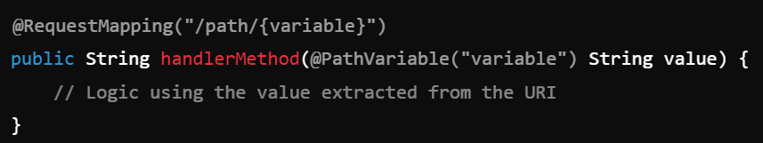
URI Templates and @PathVariable

Slide 65
Controllers with @RestController
In Spring MVC, @RestController is a specialized version of @Controller used for building RESTful web services. It combines @Controller and @ResponseBody, making it simpler to handle HTTP requests and return data directly (usually in JSON or XML format) without the need to define a view (like JSP or Thymeleaf).
@RestController Annotation : It is used to define a controller for RESTful APIs. Automatically serializes the returned object to JSON or XML, depending on the request's Accept header. You don't need to annotate each method with @ResponseBody because @RestController already includes it.

Slide 66
A brief Overview of Maven
Maven is a powerful build automation tool primarily used for Java projects. It simplifies the process of managing project dependencies, building projects, and deploying artifacts. Developed by the Apache Software Foundation, Maven has become a standard in the Java ecosystem for managing the software development lifecycle.

Slide 67
Intro to Spring Boot - What is Spring Boot and What It Does
Spring Boot is a framework designed to simplify the development of Spring-based applications. It provides a pre-configured, opinionated approach to building applications, reducing the need for boilerplate code and extensive configuration. By focusing on convention over configuration, Spring Boot allows developers to get started quickly and with minimal effort.
Spring Boot is built on top of the Spring Framework. It is designed to provide:
Auto-Configuration.
Embedded Servers.
Starter Dependencies.
Production-Ready Features : Simplifies Application Development: Eliminates the need to write complex XML configurations.
Encourages Microservices Architecture.
Provides Rapid Prototyping.
Supports RESTful APIs.
Production-Ready Features: Built-in health checks, metrics, and logging make it easier to deploy and monitor applications in production.

Slide 68
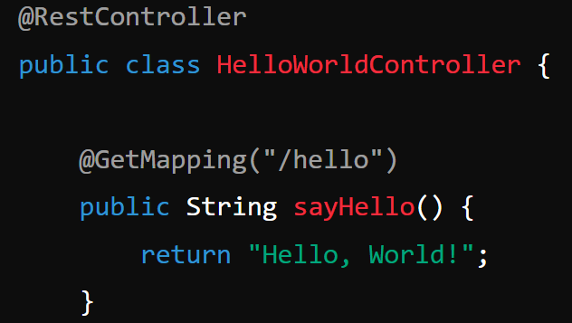
Spring Boot Hello World

Slide 69
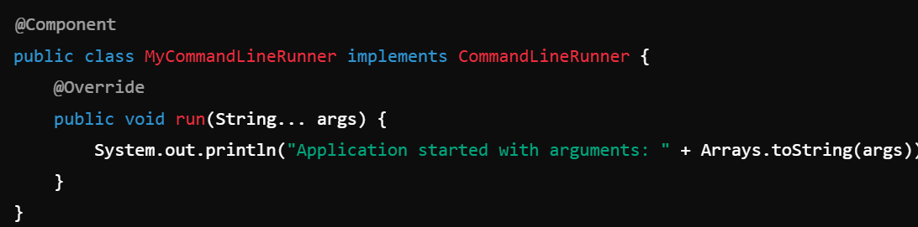
Different APIs such as SpringBootApplication, CommandLineRunner, ApplicationRunner
@SpringBootApplication
Purpose: A convenience annotation that combines three annotations:
@EnableAutoConfiguration: Enables Spring Boot's auto-configuration mechanism.
@ComponentScan: Scans the package where the class is located and its sub-packages for Spring components.
@Configuration: Marks the class as a source of bean definitions.
CommandLineRunner : A functional interface used to run specific code after the application context has been loaded and the application has started.

Slide 70
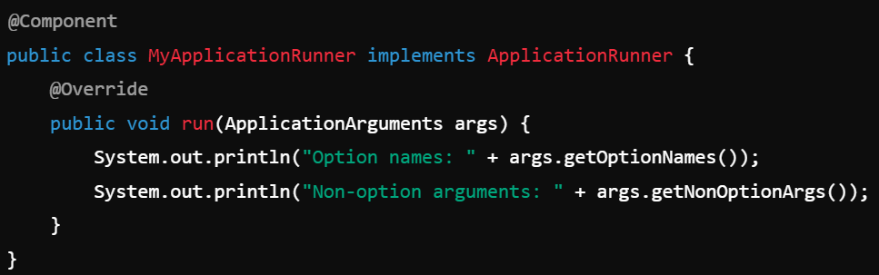
Different APIs such as SpringBootApplication, CommandLineRunner, ApplicationRunner
ApplicationRunner : Similar to CommandLineRunner, but provides access to ApplicationArguments, which makes it easier to parse and manage command-line arguments.

Slide 71
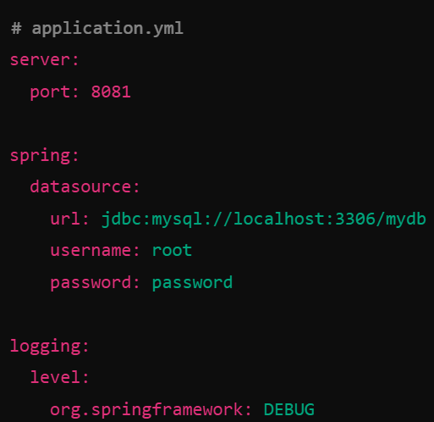
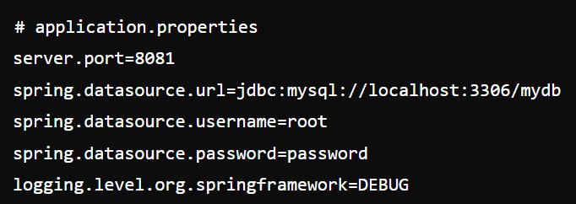
Working with Properties - YAML and .properties
In Spring Boot, you can use properties files or YAML files to configure application settings. These files allow you to externalize configuration, making your application easier to manage and adapt to different environments.

Slide 72
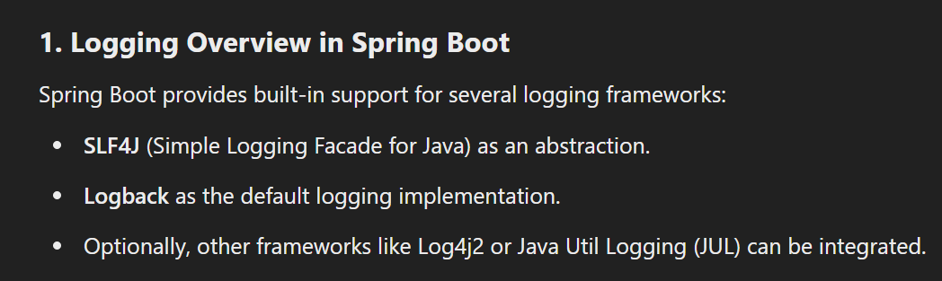
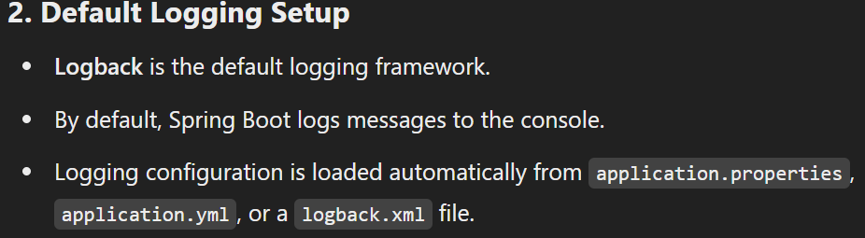
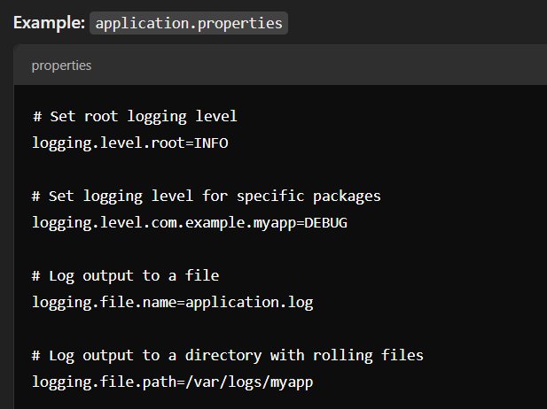
Logging and its Configuration

Slide 73
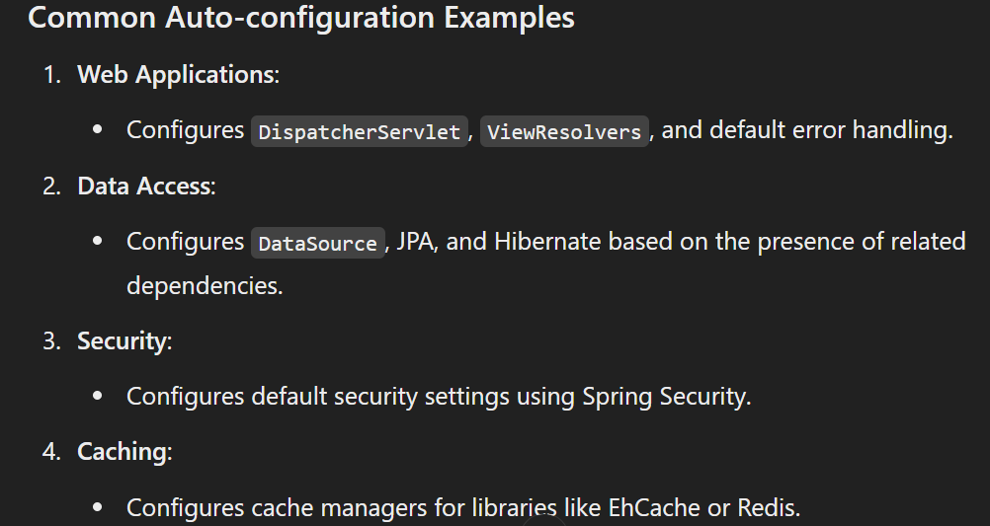
Auto-configuration Overview

Slide 74
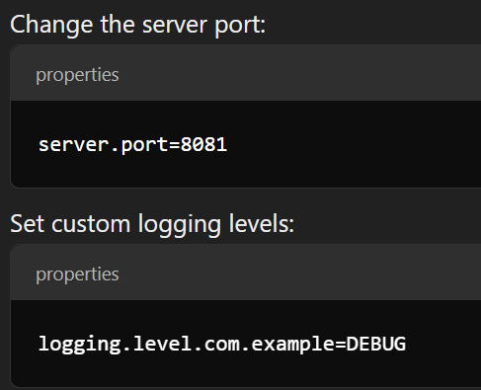
Customization
In Spring Boot, customization refers to modifying the default configurations to suit the specific needs of an application. Spring Boot provides several ways to customize its behavior, ensuring that developers can adapt the framework to their requirements without rewriting significant parts of the application.
Using Application Properties or YAML Files
Spring Boot allows customization using application.properties

Slide 75
Basic Auto-configuration - DataSource and Pooling
Spring Boot simplifies database connectivity and pooling configuration through auto-configuration. With Spring Data JPA, setting up a DataSource and enabling connection pooling is straightforward, requiring minimal configuration.
Spring Boot Auto-configuration: When the application starts, Spring Boot:
Detects the database driver.
Configures a default DataSource bean.
Sets up JPA repositories if @EnableJpaRepositories is present (it’s included by default in Spring Boot applications).
Provide the db parameters in application.properties, from there spring boot will pick and will connect with the database.

Slide 76
Configuring Spring Data
For spring jpa, follow these steps.
1. Add the starters to pom.xml
2. Add a repository
3. Connect pojo class with database.
4. Add DB parameters in application.properties.
5. Add DAO layer and add all the functions.
6. Call the DAO layer in the controller and perform the CRUD operations.

Slide 77
Repositories and JPA Repositories
In Spring JPA, repositories are used to abstract the data access layer, making it easier to interact with databases without writing boilerplate code. Spring Data JPA provides two main repository abstractions:
1. Repository : This is a marker interface provided by Spring Data.
It is the base interface for all repository interfaces in Spring Data.
It provides basic CRUD (Create, Read, Update, Delete) operations and serves as a parent to other specialized repository interfaces.
Developers rarely use this interface directly. Instead, they use more specific child interfaces like CrudRepository, PagingAndSortingRepository, and JpaRepository.
2. JpaRepository : JpaRepository is a sub-interface of PagingAndSortingRepository and is part of Spring Data JPA.
It adds additional JPA-specific methods for managing entities.
It extends CrudRepository and PagingAndSortingRepository, so it provides all their methods along with JPA-specific ones.

Slide 78
Using CrudRepository
In Spring JPA, CrudRepository is a core interface in the org.springframework.data.repository package that provides generic CRUD (Create, Read, Update, Delete) operations for entities. By extending this interface, you can perform basic database operations without writing boilerplate code.
Key Methods in CrudRepository
save(S entity) : Saves or updates an entity.
findById(ID id) :Retrieves an entity by its ID.
FindAll() : Returns all entities.
deleteById(ID id) : Deletes an entity by its ID.
DeleteAll() : Deletes all entities.
Count() : Returns the number of entities.

Slide 79
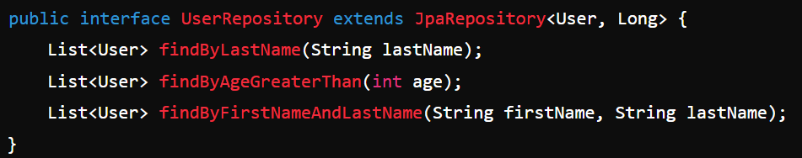
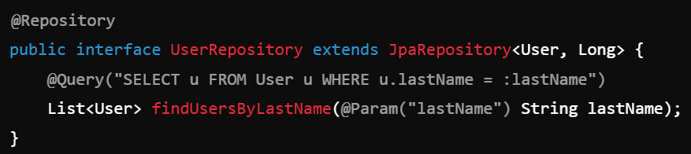
Spring Data Querying
Derived Queries (Query Methods) :
JPQL Queries : You can write JPQL queries directly in the @Query annotation.

Slide 80
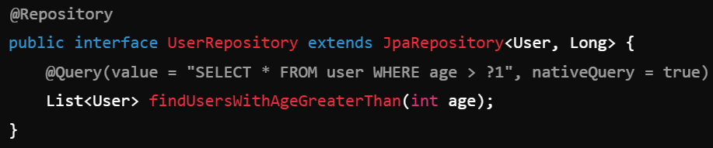
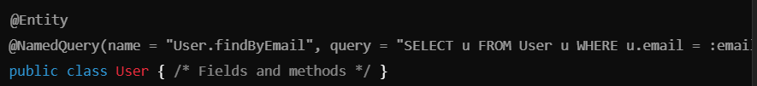
Spring Data Querying
Native Queries : For database-specific queries, use the nativeQuery attribute.
Named Queries : Define named queries in the entity class using @NamedQuery.

Slide 81
Naming Conventions for Querying
Spring Data JPA provides an elegant way to define queries using method naming conventions. By simply defining method names in your repository interfaces that follow specific patterns, Spring automatically derives the query without requiring custom SQL or JPQL.
In Spring JPA, the naming conventions for queries are based on the method name, which automatically generates the query. The method name should start with a keyword like find, read, get, or count, followed by the entity's field name, with logical operators such as By, And, Or. For example, findByLastName or findByFirstNameAndLastName. If using custom queries, @Query annotation allows writing JPQL or native SQL queries directly. Additionally, query methods can support pagination with Pageable and sorting with Sort parameters.

Slide 82
DispatcherServlet Review
In a Spring Boot REST service, the DispatcherServlet is a core component of the Spring MVC framework that handles HTTP requests and responses. While Spring Boot simplifies much of the configuration, understanding how the DispatcherServlet works in the context of a Spring Boot application is important for grasping the request flow.
What is DispatcherServlet? The DispatcherServlet is a central component in the Spring MVC architecture. It acts as the front controller that receives HTTP requests, delegates the requests to appropriate handlers, and returns the responses. The DispatcherServlet is responsible for request mapping, view resolution, handling exceptions, and intercepting HTTP requests.

Slide 83
Web Starters and Configuration spring-boot-starter-web
In Spring Boot, the spring-boot-starter-web dependency simplifies the setup for building RESTful web services. It comes with everything you need to get started with Spring MVC, including the embedded server (Tomcat by default), Jackson for JSON binding, and other essential components for handling HTTP requests. Here’s a detailed guide on Web Starters and configuring the spring-boot-starter-web in a Spring Boot REST service.
Adding spring-boot-starter-web Dependency : The spring-boot-starter-web provides the necessary dependencies for building web applications and RESTful services. It includes:
Spring MVC
Jackson (for JSON binding)
Embedded Tomcat (by default)
Other essential libraries for web applications

Slide 84
Using Embedded Servers (Tomcat, Netty)
In Spring Boot, the embedded servers (like Tomcat, Jetty, and Netty) are used by default to run the application in a standalone, self-contained way, without needing to deploy it on an external server. Spring Boot comes with pre-configured embedded server options, and you can easily switch between them as needed.
Embedded Tomcat (Default) : Tomcat is the default embedded server used in Spring Boot.
It is a widely used open-source Java servlet container and web server.
Spring Boot automatically configures it for you, and you don't need to do anything special to enable it.
Example: When you create a Spring Boot application using spring-boot-starter-web, Tomcat is automatically included as the embedded servlet container.

Slide 85
Usage of template thymeLeaf
In Spring Boot, Thymeleaf is a templating engine that can be used for rendering HTML pages with dynamic content, but it's commonly used for traditional MVC applications rather than REST APIs. However, you can use it within a REST service if your application also serves HTML views in addition to the JSON responses typically expected in a RESTful service.
If you want to render HTML pages with Thymeleaf in a Spring Boot application that has REST services, you can configure Spring Boot to use Thymeleaf as a template engine.

Slide 86
Actuator Overview and Capabilities
Spring Boot Actuator is a powerful feature that helps monitor and manage Spring Boot applications in production. It provides various built-in endpoints that allow you to interact with the application, obtain vital information, and even modify its behavior in real-time.
1. What is Spring Boot Actuator? Spring Boot Actuator is a collection of production-ready features that help you monitor and manage a Spring Boot application. It exposes various endpoints that provide useful metrics, health checks, environment properties, and more. Actuator helps make your Spring Boot applications easier to monitor and troubleshoot.
2. Key Features and Capabilities of Spring Boot Actuator : 2.1. Health Checks (/actuator/health) : This is one of the most important endpoints. It provides the health status of your application and can include information like database connectivity, disk space, and more.
Default Behavior: It checks system components and reports the status as UP, DOWN, or UNKNOWN. Common health indicators include db, diskSpace, mongo, redis, etc. Custom Health Indicators: You can define custom health indicators to check any condition in your application.

Slide 87
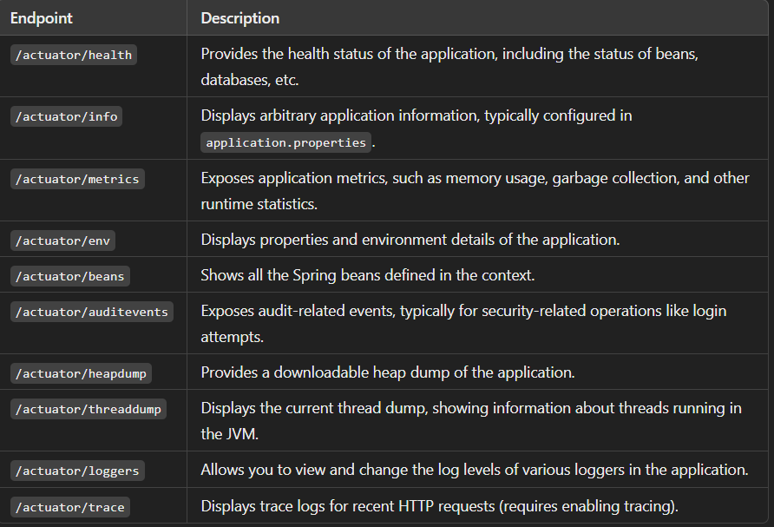
Actuator Endpoints

Slide 88
Custom Actuators and Health Checks
Spring Boot provides custom actuators and health checks to monitor and manage application health and behavior. You can create custom health indicators by implementing the HealthIndicator interface, allowing you to define logic for evaluating a component's health. For example, you can check the availability of a database, external service, or custom application logic. Custom endpoints can also be created using the @Endpoint annotation for exposing specific metrics or operational details.
The @ReadOperation, @WriteOperation, and @DeleteOperation annotations define operations in custom actuators for reading, modifying, or deleting data. Spring Boot Actuator automatically integrates these custom health indicators and endpoints into its /actuator base path. For security, you can configure the visibility of these endpoints through properties like management.endpoint.health.show-details. You can also group multiple health checks under one logical health indicator using CompositeHealthContributor.

Slide 89
Devtools Overview
Spring Boot DevTools is a module designed to enhance developer productivity by enabling automatic restarts, live reloads, and other conveniences during development.
It provides automatic application restarts whenever files in the classpath are modified, reducing the need for manual server restarts.
DevTools includes LiveReload integration, allowing browsers to refresh automatically when static files or templates change.
It supports property overrides to simplify the configuration, such as enabling debug logs during development.
DevTools can disable or optimize caching for template engines (like Thymeleaf or FreeMarker) to reflect UI changes instantly.
This module is intended for development environments and is excluded from production builds by default to avoid performance or security issues.
To use DevTools, simply add the dependency spring-boot-devtools to your project, and it works out-of-the-box with minimal configuration.

Slide 90
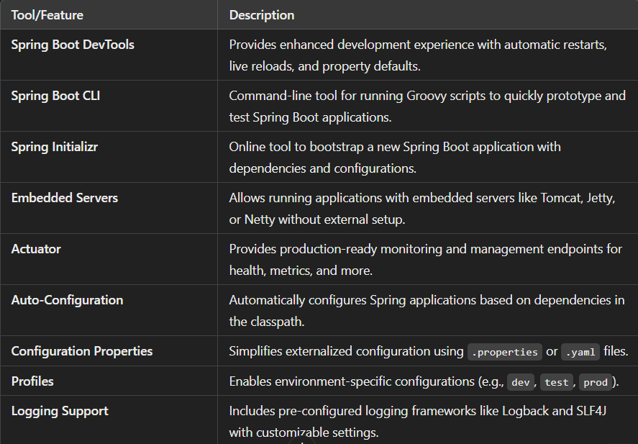
Other Tools and Features

Slide 91
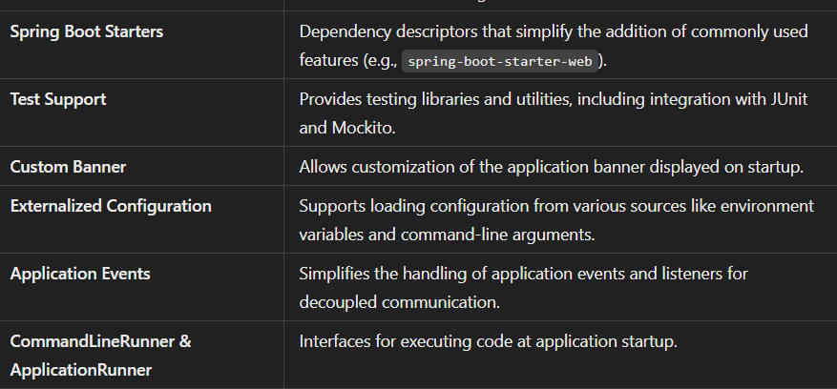
Other Tools and Features

Slide 92
API Strategy and Design
API Strategy and Design is critical for building robust, maintainable, and scalable applications. Here's a concise overview:
Define API Objectives: Clearly outline the purpose of the API, its target audience, and the problems it aims to solve. Align it with business goals and user needs.
Choose the Right API Type: Decide between REST, GraphQL, gRPC, or others based on requirements such as data complexity, performance, and client needs.
Design for Consumer Needs: Use a consumer-first approach by understanding use cases and designing APIs with simplicity, usability, and scalability in mind.
Follow API Design Principles: Ensure consistency by adhering to best practices like RESTful design, resource-based modeling, and proper use of HTTP methods and status codes.
Use OpenAPI Specification: Document your API using tools like Swagger or Postman to provide clear, interactive, and easily shareable API documentation.
Implement Security: Apply robust security measures like OAuth2, API keys, rate limiting, and HTTPS to protect data and control access.

Slide 93
API Strategy and Design
Versioning and Evolution: Plan for API versioning and backward compatibility to accommodate future changes without disrupting existing consumers.
Monitoring and Analytics: Include tools for monitoring API performance, usage patterns, and error tracking to maintain reliability and optimize performance.
Testing and Automation: Ensure your API is rigorously tested with unit, integration, and load tests, and automate these where possible to maintain quality.
Iterate Based on Feedback: Continuously refine the API based on user feedback, emerging requirements, and advancements in technology.

Slide 94
Richardson Maturity Model for APIs
The Richardson Maturity Model (RMM) is a framework proposed by Leonard Richardson to evaluate the maturity of web APIs based on their adherence to RESTful principles. It is divided into four levels (0 to 3), with each level building on the features of the previous one. Here's an overview of the levels:
Level 0: Swamp of POX : Characteristics: The API uses a single URI and communicates using a single protocol, typically HTTP, but does not leverage HTTP's features.
Level 1: Resources : Characteristics: Resources are introduced, and the API uses separate URIs for different entities (e.g., /users, /orders).
Level 2: HTTP Verbs : Characteristics: Proper use of HTTP methods (GET, POST, PUT, DELETE) to perform operations on resources.
Level 3: Hypermedia Controls (HATEOAS) : Characteristics: Hypermedia as the Engine of Application State (HATEOAS) is implemented. The API includes links in responses to guide clients on available actions.

Slide 95
API Design Reusability
API design reusability is a crucial aspect of software development, focusing on creating APIs that are flexible, scalable, and easy to reuse across different parts of an application or even across multiple applications. Here are some key principles and practices for achieving reusability in API design:
1. Modular Design : Break down APIs into smaller, focused, and modular components.
2. Clear and Consistent Naming : Use consistent naming conventions for endpoints, parameters, and responses.
3. Versioning : Include versioning in your API (e.g., /v1/), so updates don’t disrupt existing consumers.
4. Standardized Data Formats : Use widely accepted data formats like JSON.
5. Separation of Concerns : Decouple the API logic from business logic to make the API reusable for various clients or scenarios.

Slide 96
API Design Reusability
6. Parameterization : Allow dynamic customization via parameters (e.g., filters, sorting, pagination). Example: GET /products?category=electronics&page=2&sort=price_desc.
7. Error Handling : Use standardized error responses and codes to ensure clients can handle errors consistently. Example: Use HTTP status codes (400, 404, 500) and provide detailed error messages.
8. Security " Implement reusable authentication and authorization mechanisms (e.g., OAuth 2.0, JWT).
9. Documentation : Provide clear, comprehensive, and up-to-date documentation (e.g., using Swagger/OpenAPI).
10. Reusable Libraries/SDKs. 11. Idempotency : Example: PUT /resource/{id} should have the same result whether called once or multiple times.
12. Discoverability : Use HATEOAS (Hypermedia as the Engine of Application State) to allow APIs to provide links to related resources, making them easier to navigate and reuse.
13. Extensibility : Design APIs to accommodate future enhancements without breaking existing clients.

Slide 97
API Naming Conventions
1. Use RESTful Resource Names ✅ /users ❌ /getUsers
2. Consistent Case Style: ✅ /user-profiles, ✅ /userProfiles, ❌ /UserProfiles
3. HTTP Methods for Actions
4. Use Plural Nouns for Collections : ✅ /orders ❌ /order
5. Resource Hierarchies
6. Filter and Query Parameters: ✅ /products?category=electronics&sort=price&limit=10&page=2, ❌ /products/getByCategoryAndSort
7. Versioning : ✅ /v1/users, ❌ /users?version=1
8. Avoid File Extensions : Do not use file extensions in API paths.
9. Use Clear, Descriptive Names : ✅ /transactions ❌ /txns
10. Error Responses : Use descriptive error messages with status codes.

Slide 98
Swagger API Tools
Swagger is a popular toolset for designing, building, documenting, and consuming RESTful APIs. It provides an open-source framework for API development, which includes several tools. Below are some key Swagger tools you can use:
Swagger UI : A web-based interface for interacting with your API's documentation. It allows you to test your API endpoints directly from the browser.
It automatically generates interactive documentation for your API from the OpenAPI specification.

Slide 99
OpenAPI Specification
OpenAPI Specification (OAS) is a standard for describing RESTful APIs. It provides a format for specifying API endpoints, request/response formats, authentication methods, and more. Written in YAML or JSON, it is both human-readable and machine-readable. The specification allows developers to define operations, parameters, and responses in a structured manner. OAS supports features like data types, error handling, and security definitions. It helps in generating interactive documentation and client SDKs. The versioning of OpenAPI is maintained, with OAS 3 being the latest major release. OAS can be used to automate tasks like API testing, mocking, and validation. Tools like Swagger UI and Swagger Codegen use OAS to provide a rich development experience. OpenAPI improves communication among teams and enhances the overall API lifecycle management.

Slide 100
REST APIs Using OpenAPI
OpenAPI is a specification for describing and documenting RESTful APIs. It provides a standard way to define endpoints, request/response structures, and other aspects of a REST API, which can be used for code generation, testing, and documentation. Here’s an overview of how to use OpenAPI for REST APIs:1. OpenAPI Specification (OAS) Basics:
The OpenAPI Specification (OAS) is a language-agnostic interface that defines how REST APIs are described.
The OAS file is typically written in either YAML or JSON format, and it provides a structured format for the API’s paths, operations, parameters, responses, and data models.

Slide 101
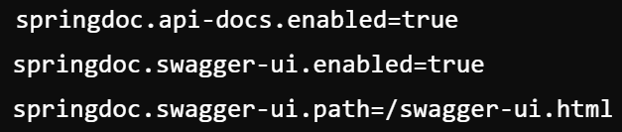
Creating REST APIs with YAML
Springdoc OpenAPI automatically generates an OpenAPI 3.0 specification for your REST APIs. It also provides a Swagger UI to visualize and interact with the API.
No additional configuration is required for basic setup. If you need to customize OpenAPI properties, you can add the following to your application.properties:

Slide 102
API Management Tools
API management tools help organizations design, deploy, and manage APIs efficiently. They enable developers to monitor and secure APIs, as well as control how they are accessed. Some popular API management tools include:
Apigee (by Google Cloud) – Offers a full suite for API management, including API analytics, security, traffic management, and monitoring.
AWS API Gateway – A managed service from Amazon Web Services to create and publish APIs at scale with integrated monitoring and security features.
Kong – An open-source API management tool designed for flexibility, with features like traffic control, security, and monitoring.
MuleSoft Anypoint Platform – A comprehensive solution for building, managing, and monitoring APIs across various environments with support for integrations.
Postman – Known for testing APIs, Postman also provides tools for building and managing APIs with features for version control, documentation, and testing.

Slide 103
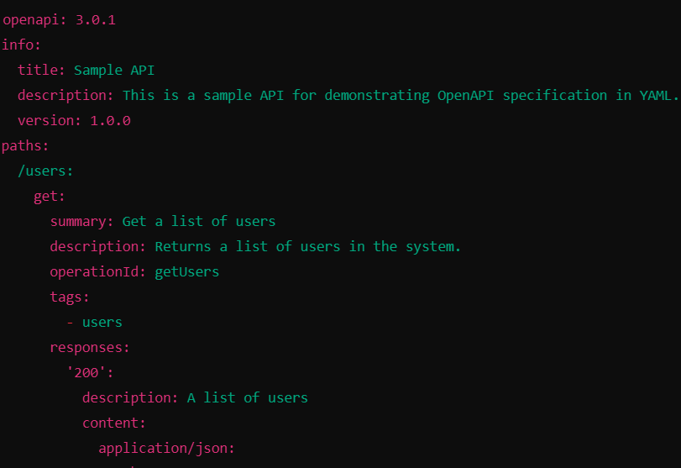
Writing YAML with Swagger
Writing YAML for Swagger (now often called OpenAPI) involves defining the structure of the API specification in a human-readable format. The OpenAPI Specification (OAS) defines endpoints, parameters, responses, and other API details. Here’s a simple example of writing YAML for a Swagger/OpenAPI 3.0 spec:

Slide 104
Swagger Web API
Swagger is a powerful tool that helps in designing, documenting, and consuming RESTful web APIs. It provides a rich framework to describe your API structure, including endpoints, request/response formats, and authentication methods. The most common way of using Swagger today is via OpenAPI specifications, which is a standardized way to describe the API.

Slide 105
API Management Requirements
API management is crucial for ensuring the effectiveness, security, scalability, and maintainability of your APIs. The following are the key requirements for effective API management:
API Gateway : Acts as a single entry point for API requests, providing routing, load balancing, security, and rate limiting.
Security
API Documentation.
Versioning.
Monitoring and Analytics
Caching
Response Codes
API Analytics & Monitoring

Slide 106
Thank you...

