Slide 1
Spring

Slide 2
Overview of Spring Technology
Spring is a comprehensive framework for building Java-based applications, widely used for enterprise-level software development. It provides a wide range of features and capabilities, making it one of the most popular frameworks in the Java ecosystem.

Slide 3
The Motivation for Spring, Spring Architecture
Spring was developed to address several challenges and limitations of traditional Java EE (Enterprise Edition) development. Here are the primary motivations behind the creation of the Spring Framework:
Complexity in Java EE: Early Java EE frameworks were heavy and complex, requiring a significant amount of configuration and boilerplate code.
Tight Coupling and Dependency Management: Traditional Java EE applications suffered from tight coupling between components.
Need for Better Testing.
Integration with Existing Technologies.
AOP (Aspect-Oriented Programming).

Slide 4
The Spring Framework
The Spring Framework is an open-source framework used for building Java-based applications. It is one of the most widely used frameworks in the Java ecosystem and offers a comprehensive programming and configuration model for modern Java applications. It was developed by Rod Johnson in 2002 to address the complexity and shortcomings of traditional Java EE (Enterprise Edition) applications. Spring simplifies Java development and promotes best practices in enterprise application design.

Slide 5
Declaring and Managing Beans
In Spring, beans are objects that are instantiated, configured, and managed by the Spring IoC (Inversion of Control) container. Beans are the backbone of any Spring application, and their lifecycle is managed by Spring’s IoC container. There are various ways to declare and manage beans in Spring, including XML configuration, annotation-based configuration, and Java-based configuration.

Slide 6
Inversion of Control Pattern
Inversion of Control (IoC) is a fundamental design principle in the Spring Framework. It refers to the delegation of control over object creation, lifecycle management, and dependencies to the Spring IoC container. Instead of the objects creating and managing their dependencies directly, the control is "inverted" and given to the container.
Key Concepts of IoC in Spring:
Dependency Injection (DI): IoC is primarily implemented in Spring through Dependency Injection, where the container injects required dependencies into the objects at runtime.
IoC Container: The Spring Framework provides an IoC container that is responsible for:
Instantiating beans.
Managing the lifecycle of beans.
Injecting dependencies into beans.
Bean Configuration: Dependencies can be configured in: XML-based configuration: Using <bean> and <property> tags. Annotation-based configuration: Using @Component, @Autowired, and other annotations. Java-based configuration: Using @Configuration and @Bean.

Slide 7
BeanFactory vs ApplicationContext
1. Core Purpose
BeanFactory: The fundamental interface for accessing a Spring container.
It provides basic dependency injection (DI) capabilities and bean lifecycle management. Uses lazy initialization by default. Beans are created only when explicitly requested. It has basic DI support. Lacks enterprise-level features like AOP, event handling, and declarative mechanisms.
ApplicationContext: A more advanced container built on top of BeanFactory. Provides additional features such as event propagation, internationalization, and integration with enterprise services. Initializes and instantiates all singleton beans eagerly at startup unless otherwise configured. Supports AOP.

Slide 8
Dependencies and Dependency Injection (DI)
Dependencies in Spring : Dependencies refer to the objects that a class depends on to function properly. These are the required collaborators or services that a class uses. For example, a service class may depend on a DAO (Data Access Object) to retrieve or store data. In Spring, dependency management is a critical concept where Spring manages the relationships between these objects.
Dependency Injection (DI) : Dependency Injection (DI) is a design pattern used to achieve Inversion of Control (IoC). In DI, the control of creating and managing the required objects (dependencies) is given to a framework like Spring, rather than the class managing them itself. There are two types of DI in Spring. They are (1) Setter Based (2) Constructor based.

Slide 9
XML Configuration of DI
Demonstrate the program for the same.

Slide 10
Spring Bean Autowiring
In Spring Framework, autowiring is a feature used to automatically inject bean dependencies into a Spring container. It simplifies the process of dependency injection by allowing Spring to resolve and inject the dependencies without explicit configuration. Autowiring works by matching properties in a bean to one or more beans defined in the application context.

Slide 11
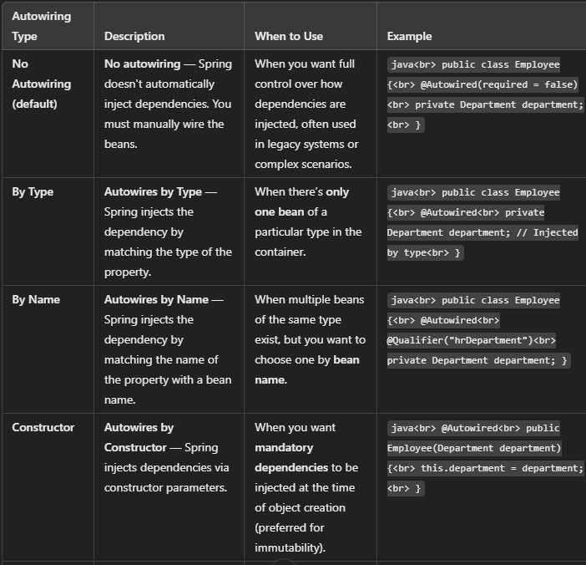
Spring Bean Autowiring

Slide 12
Injection with @Autowire
In Spring, the @Autowired annotation is used to enable dependency injection. It instructs the Spring container to resolve and inject the appropriate beans into the marked field, constructor, or setter method.

Slide 13
Java Based Configuration (@Configuration + @Bean)
In Spring, Java-based configuration allows you to configure Spring beans using pure Java code instead of XML. This approach leverages the @Configuration and @Bean annotations to define beans and their dependencies in a clean, type-safe manner.
@Configuration: This annotation marks a class as a source of bean definitions for the Spring IoC container. A class annotated with @Configuration can have methods annotated with @Bean to define beans.
@Bean: This annotation is used to define a method that will return an object that should be registered as a bean in the Spring container. The method will be called by Spring to get the bean, and the returned object will be managed by the Spring IoC container.
Add the code snippet in here.

Slide 14
Bean Scope and Lifecycle
In Spring, bean scope and bean lifecycle are crucial concepts that govern how beans are created, managed, and destroyed within the Spring container. Bean scopes are :
1. Singleton
2. Prototype
3. Request
4. Application.

Slide 15
Bean Lifecycle
The lifecycle of a bean in Spring refers to the sequence of steps that Spring performs when managing beans. These steps include initialization, custom destruction, and the management of lifecycle callbacks.
1. Bean Creation : The Spring container instantiates the bean. If the bean scope is singleton, it is created once. If the scope is prototype, it is created every time it is requested.
2. Dependency Injection (DI) : After the bean is created, Spring injects the dependencies specified via annotations like @Autowired or through XML configuration.
3. Post-Processors : BeanPostProcessors are used to modify or wrap the bean instance after it is created and before it is initialized. There are two phases of post-processing:
Before Initialization (postProcessBeforeInitialization)
After Initialization (postProcessAfterInitialization)

Slide 16
Bean Lifecycle
4. Initialization : If the bean implements the InitializingBean interface or has a custom @PostConstruct method, Spring will call the appropriate method after dependency injection but before the bean is used. @PostConstruct: This annotation marks a method to be invoked after the bean’s properties are set.
InitializingBean interface: The afterPropertiesSet() method is called by the container after all the properties are set.
Destruction : When the container is about to be destroyed, the bean’s destruction methods are called. If the bean implements the DisposableBean interface, the destroy() method will be invoked. If the bean has a custom @PreDestroy method, that method will be invoked.

Slide 17
Singleton, Prototype, and Other Scopes
Explained earlier.

Slide 18
Configuring Scope
In Spring, scope defines the lifecycle and visibility of beans within the application context. The scope of a bean determines when it is created, how long it exists, and how it is shared across different parts of the application. Spring provides several scopes, and configuring them correctly helps in controlling the behavior of beans in different environments (e.g., a web application vs. a stand-alone application).
Types of Bean Scopes in Spring : Spring supports the following scopes:
Singleton (Default Scope)
Prototype
Request
Session
Application

Slide 19
Bean Lifecycle / Callbacks
In Spring, the bean lifecycle refers to the sequence of steps that a Spring bean goes through from creation to destruction. The lifecycle consists of various phases, and you can hook into these phases using callbacks to perform custom initialization and cleanup actions.
Bean Lifecycle Phases
Instantiation: The bean is instantiated by the Spring container, either using a no-argument constructor or a factory method.
Populating Bean Properties: The Spring container populates the bean's properties (dependencies) by using dependency injection (via annotations like @Autowired or configuration methods with @Bean).
Post-Processors (Optional): Spring provides two types of bean post-processors:
BeanPostProcessor: These are invoked before and after bean initialization.
InstantiationAwareBeanPostProcessor: Invoked before and after the instantiation of the bean.

Slide 20
Bean Lifecycle / Callbacks
Initializing Bean (Optional): If the bean implements the InitializingBean interface, Spring will call the afterPropertiesSet() method after setting the properties.
Alternatively, you can define custom initialization logic using the @PostConstruct annotation or a @Bean method with an initMethod.
Bean Ready to Use: After the initialization phase, the bean is fully initialized and ready for use in the application.
Destroying Bean (Optional): If the bean implements the DisposableBean interface, Spring calls the destroy() method before the bean is destroyed.
Alternatively, you can specify a custom destroy method using the @PreDestroy annotation or a @Bean method with a destroyMethod.

Slide 21
Thank you...

