Slide 1
Hibernate

Slide 2
Review of Java EE (a.k.a. J2EE)
Revision of J2ee...Web Container, Servlets and jsp...

Slide 3
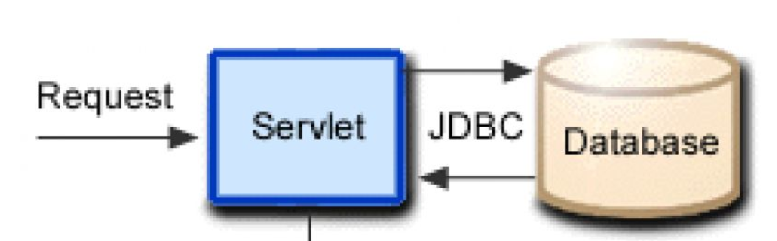
Review of Java Web Application development with JDBC and Servlets/JSPs/EL
A program to from servlet to JDBC.

Slide 4
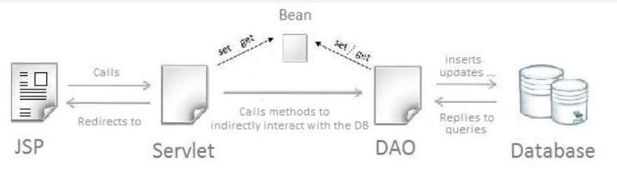
Overview of Data Access Object (DAO) design pattern
The Data Access Object (DAO) design pattern is a structural pattern used in software development to separate the persistence logic (interacting with a database or external data source) from the business logic of an application. This pattern promotes separation of concerns, making code more modular, maintainable, and testable.
How the DAO Pattern Works : DAO Interface
Defines a contract (methods like save, update, delete, findById) that will be implemented by DAO classes.
DAO Implementation : Implements the DAO interface and contains the actual database interaction logic using JDBC, JPA, Hibernate, or other persistence frameworks.

Slide 5
The pain of developing with JDBC and Servlets
Developing applications using JDBC and Servlets can be challenging, especially for large-scale or enterprise projects. While these technologies provide foundational capabilities for building Java web applications, they often lack the modern conveniences and abstractions developers have come to expect.
Challenges of Using JDBC : Boilerplate Code:
JDBC requires extensive boilerplate code for common operations like establishing connections, preparing statements, and handling results. This repetitive code clutters the application and makes it harder to maintain.
Error-Prone Code : Managing resources like connections, statements, and result sets manually can lead to resource leaks if they aren't closed properly in finally blocks.
Tight Coupling : SQL queries are tightly coupled with the Java code, making it difficult to refactor or switch databases without significant changes to the codebase.
No Built-in Connection Pooling and Limited Scalability.

Slide 6
Advantages of Hibernate compared to JDBC.
Hibernate is an Object-Relational Mapping (ORM) framework that abstracts and simplifies database interactions, providing numerous advantages over plain JDBC (Java Database Connectivity).
1. Minimized Boilerplate Code : JDBC: Developers must write repetitive code to establish database connections, prepare statements, execute queries, handle result sets, and close resources.
2. Database Independence : JDBC: Queries are written in SQL, making the code database-specific. If the database changes (e.g., from MySQL to PostgreSQL), significant query modifications may be required.
3. Object-Oriented Approach
4. Automatic Query Generation
5. Caching
6. Lazy and Eager Loading
7. Transaction Management and 8. Connection Pooling

Slide 7
Introduction
Hibernate is an Object-Relational Mapping (ORM) framework for Java that simplifies interaction with relational databases by bridging the gap between the object-oriented world of Java and the relational world of databases. It allows developers to work with database records as Java objects without writing explicit SQL queries, thus abstracting and simplifying database operations.
Key Features of Hibernate : Object-Relational Mapping (ORM), HQL, Automatic CRUD Operations, Caching, Database Independence, Lazy and eager loading, Transaction Management, Schema Generation.

Slide 8
ORM (Object Relational Mapping)
Object-Relational Mapping (ORM) is a programming technique that bridges the gap between the object-oriented programming model (used in languages like Java) and the relational database model. ORM allows developers to interact with a relational database using high-level object-oriented concepts instead of writing raw SQL queries.

Slide 9
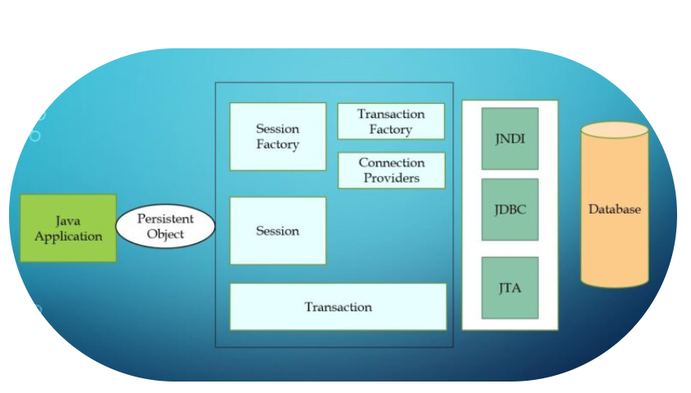
Hibernate Architecture

Slide 10
Hibernate Resources
More information about hibernate can be referred online.

Slide 11
Object Life Cycle in Hibernate
The object life cycle in Hibernate describes how an object transitions through different states during its interaction with the Hibernate framework and the database. Understanding these states is crucial for effective data manipulation and performance optimization in Hibernate.
1. Transient State : An object is in the transient state when it is created using the new keyword but is not yet associated with a Hibernate Session. It has no representation in the database and is not managed by Hibernate.
2. Persistent State : An object enters the persistent state when it is associated with an active Hibernate Session and Hibernate begins tracking it. Any changes to the object are automatically synchronized with the database.
3. Detached State : An object transitions to the detached state when the Hibernate Session that was managing it is closed or the object is explicitly evicted from the Session. The object still exists in the application memory but is no longer tracked by Hibernate.
4. Removed State : An object is in the removed state when it is marked for deletion from the database. Hibernate will delete the corresponding row in the database during the next transaction commit.

Slide 12
CRUD operations using Session methods using XML and Annotations
Annotations - @Entity, @Table and @Id has to be used in POJO class and in hibernate.cfg.xml should have mapping class.
Using xml file --> Use <mapping resource=hbm file>

Slide 13
Problem of Granularity using Annotations
Granularity refers to the level of detail or fine-grained nature of the data model. In Hibernate, the problem of granularity arises when:
Mismatch Between Object and Relational Models: In object-oriented programming, entities are modeled as objects that can have complex relationships and hierarchies. In relational databases, data is stored in a tabular form with rows and columns. This mismatch creates challenges in mapping objects to database tables.
Reusability and Complexity: When fine-grained components (e.g., Address) are reused across multiple entities, maintaining consistent mappings can become cumbersome. Managing annotations in such scenarios may lead to increased complexity and reduced maintainability.
Fine-Grained Objects:Java applications often use fine-grained objects, such as value objects or embedded objects (e.g., Address inside an Employee entity). Relational databases usually operate with coarse-grained structures (e.g., a single table for an entity). Mapping fine-grained objects to a relational database can lead to complex relationships and redundant configurations.

Slide 14
Problem of Inheritance using Annotations
In Hibernate, inheritance mapping refers to how object-oriented inheritance hierarchies are mapped to relational database tables. When using Hibernate annotations to map inheritance, several challenges can arise, such as handling relationships between entities, ensuring data integrity, and managing performance.
Inheritance Mapping Strategies in Hibernate:
Single Table per Hierarchy (SINGLE_TABLE) : In the Single Table per Hierarchy strategy, all classes in the inheritance hierarchy are stored in a single table. This can lead to data redundancy where columns that belong only to certain subclasses may contain NULL values for other subclasses.
Table per Class (TABLE_PER_CLASS) : The Table per Class strategy creates a separate table for each class in the inheritance hierarchy. This avoids null values in the columns but can lead to data duplication across multiple tables, as common properties are repeated in each table.
Joined Table (JOINED) : In the Joined Table strategy, a separate table is used for each class in the inheritance hierarchy. This leads to normalized tables but can introduce complexity in queries as multiple tables need to be joined when fetching data.The query performance can degrade when many joins are needed, especially if the inheritance hierarchy has many subclasses.

Slide 15
Problem of Relationship using Annotations
In Hibernate, managing relationships between entities can become complex, especially when using annotations to define the mappings.
Bidirectional vs. Unidirectional Relationships : Confusion arises when deciding between bidirectional and unidirectional mappings. As a solution, Unidirectional: Use when only one side needs access to the relationship. Bidirectional: Use when both sides require access. Ensure proper management of the mappedBy attribute to avoid unnecessary database tables.
Cascade Operations : Problem: Cascading operations (like PERSIST, REMOVE) may cause unintended changes to the database, such as deleting related entities unintentionally.
Lazy Loading and FetchType : FetchType.LAZY can lead to LazyInitializationException when accessing data outside of a transaction. As a solution, Use FetchType.EAGER carefully, only for critical relationships. Use DTOs to fetch required data or initialize relationships within a transaction.

Slide 16
Hibernate Query Language (HQL)
Hibernate Query Language (HQL) is an object-oriented query language provided by Hibernate, a Java framework for Object-Relational Mapping (ORM). HQL is similar to SQL but operates on Java objects rather than database tables. It allows developers to write queries to interact with the database using entities defined in the application rather than directly dealing with database tables and columns.
Couple of SQL Queries :
Example 1 : String hql = "FROM Employee"; // Select all employees
Example 2 : String hql = "FROM Employee WHERE salary > :minSalary";
Example 3 : String hql = "FROM Employee ORDER BY salary DESC";
Example 4 : String hql = "SELECT AVG(salary) FROM Employee";

Slide 17
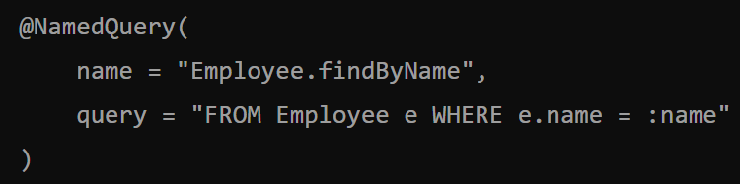
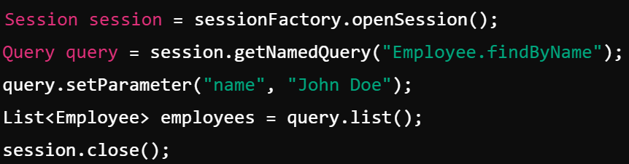
Named Queries
In Hibernate, Named Queries provide a way to define HQL (Hibernate Query Language) or SQL queries at the entity level, which can be reused throughout the application. Named Queries improve code readability, centralize query management, and allow for easier maintenance.
Types of Named Queries in Hibernate: :
Named HQL Query: Defines a Hibernate Query Language (HQL) query.
Define HQL Named
Query ---------------->
Use this named HQL
Query -------------->

Slide 18
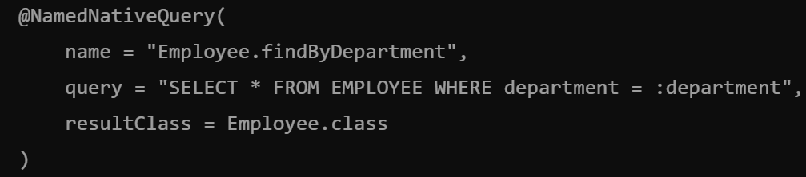
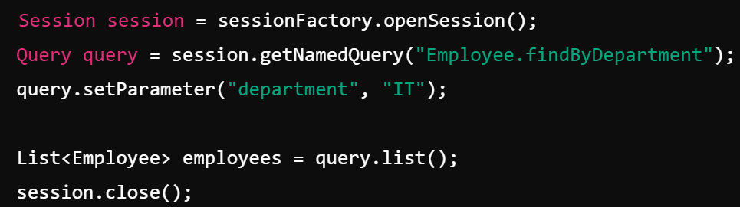
Named Queries
Define Named Native Query :
Use the named native query as given below:

Slide 19
Criteria API
The Criteria API in Hibernate is a powerful and type-safe way to construct queries dynamically. It allows developers to create queries programmatically without writing SQL or HQL, making it easier to build queries based on conditions that are determined at runtime.Level of Caching
Project : HibernateMavenProject.

Slide 20
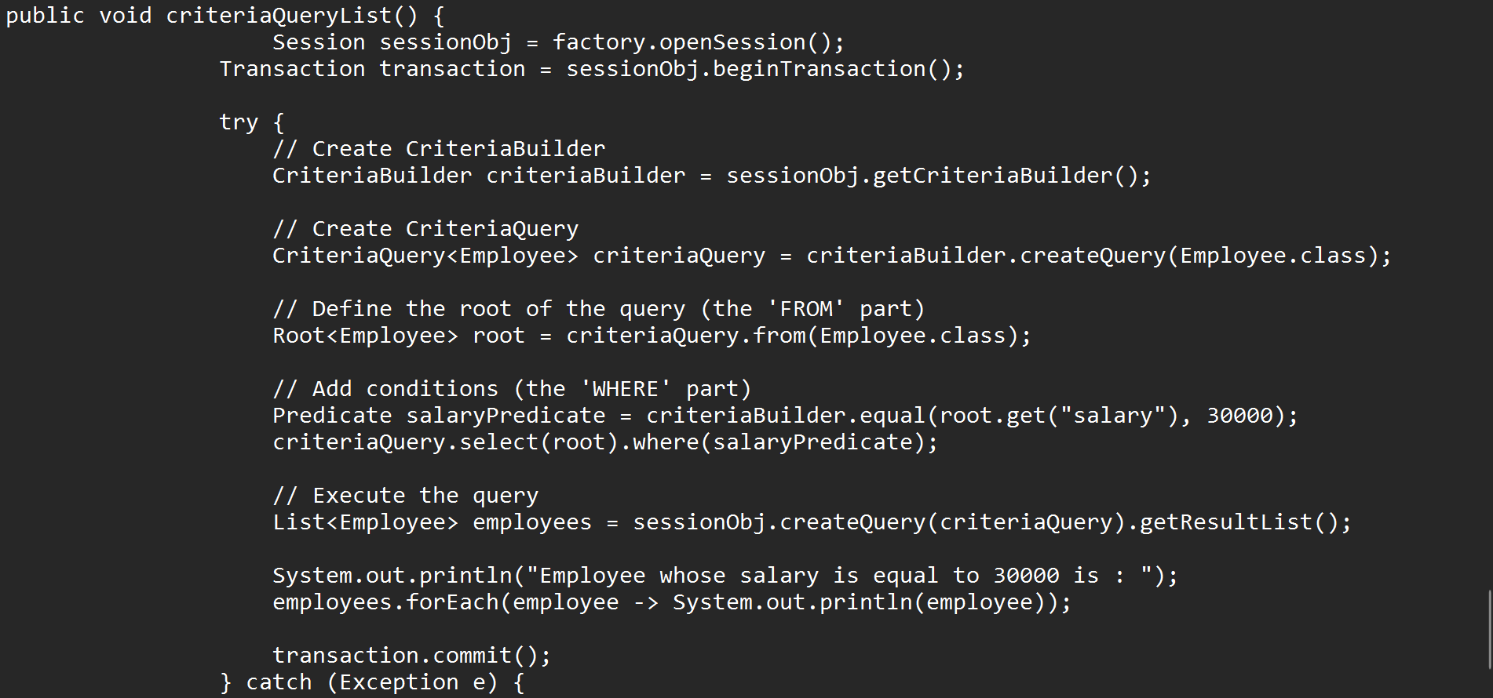
Criteria API

Slide 21
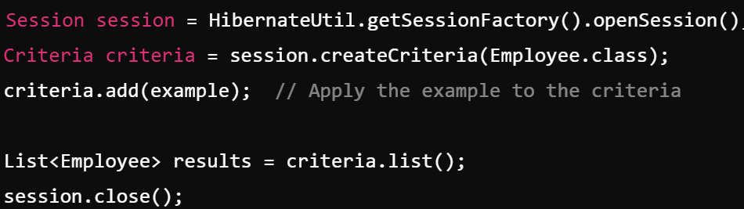
Query by example
Query by Example (QBE) in Hibernate is a feature that allows you to create queries dynamically based on an example object. It simplifies querying when you have an entity with several fields, but you only need to filter by a few of them. In QBE, you create an example object, set its fields (only the ones you want to filter on), and then Hibernate will automatically generate a query to retrieve records matching those fields.

Slide 22
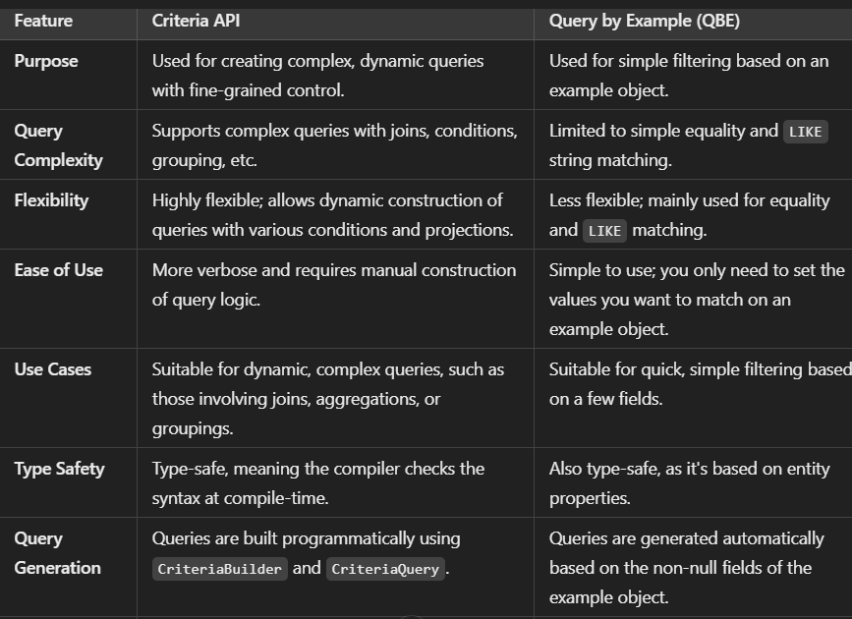
Query by example

Slide 23
Logging
In Hibernate, logging can help track the behavior of queries, transactions, and entity management. There are several logging mechanisms you can use to enable logging for Hibernate in your project
Set these properties in hibernate.cfg.xml
<property name="hibernate.show_sql">true</property> --> Displays the Generated SQL.
<property name="hibernate.format_sql">true</property> --> Shows the sql in a formatted way.
<property name="hibernate.use_sql_comments">true</property> --> Writes the comments for generated SQL.
<property name="hibernate.generate_statistics">true</property> --> Gives the statistics.

Slide 24
Lazy loading
Lazy loading in Hibernate refers to the technique of loading associated entities only when they are accessed, rather than loading them immediately when the parent entity is loaded. This helps in improving the performance by avoiding unnecessary database queries.
Hibernate uses proxies to implement lazy loading. When a lazy-loaded association is accessed for the first time, Hibernate will fetch the data from the database. If the association is not accessed, no database query is made.
Eager Loading: The associated entities are fetched immediately along with the parent entity. Lazy Loading: The associated entities are fetched only when explicitly accessed.
How It Works: When you declare a relationship between entities (e.g., @OneToMany, @ManyToOne, @ManyToMany), you can specify the fetch type.
The default fetch type for most associations is lazy loading, but it can be explicitly specified using the FetchType.LAZY enum. Fetching Eagerly when necessary using fetch = FetchType.EAGER.

Slide 25
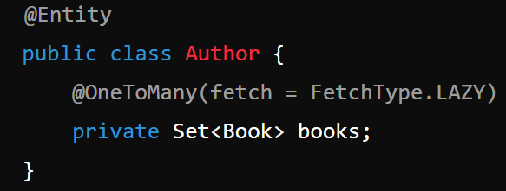
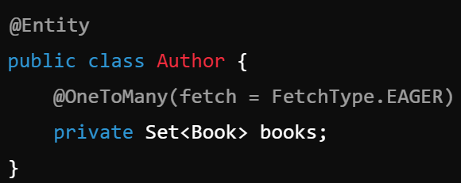
Fetching strategies
In Hibernate, fetching strategies define how the related entities (or collections) are loaded when querying for data. Hibernate supports two primary fetching strategies: Eager fetching and Lazy fetching.
1. Lazy Fetching : Lazy fetching means that the related entities are not loaded immediately when the parent entity is loaded. Instead, they are loaded only when accessed for the first time. This is the default fetch strategy for most relationships in Hibernate.
2. Eager Fetching
Eager fetching means that the related entities are loaded immediately when the parent entity is loaded, regardless of whether they are used or not. This is useful when you know you will need the related data in the same transaction.

Slide 26
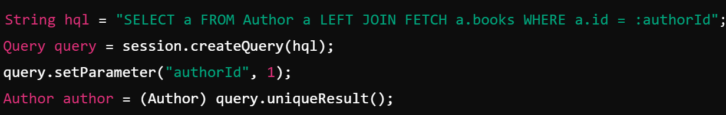
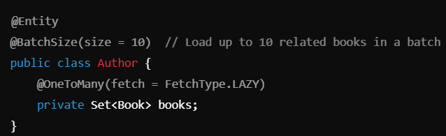
Fetching strategies
A Fetch Join : A Fetch Join is used in a HQL (Hibernate Query Language) query to eagerly load associations (e.g., collections or entities) in the same query as the parent entity. This is done by using the JOIN FETCH keyword, which performs an SQL JOIN and loads the associated entities at the same time as the parent entity, thereby reducing the number of SQL queries executed.
Suselect Fetching : Subselect Fetching is a Hibernate feature that can be used to optimize the retrieval of associations by fetching them in a separate query. However, unlike traditional lazy loading, Hibernate will use a single subquery to load all the associated entities for a set of parent entities, grouped together in one query. This avoids multiple queries per parent entity. In Subselect Fetching, Hibernate will execute a subselect query for each collection of parent entities, ensuring that related entities are loaded efficiently.
Batch Fetching : Batch Fetching is a strategy that allows Hibernate to fetch associations or collections in batches rather than one at a time. When multiple entities or collections are fetched lazily, Hibernate can group them into batches and execute a single query to load multiple entities or collections in one go. This significantly reduces the number of SQL queries executed and improves performance when loading many entities.

Slide 27
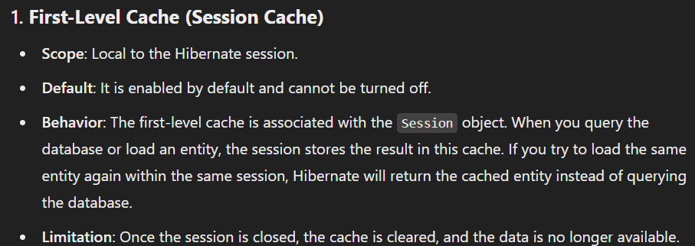
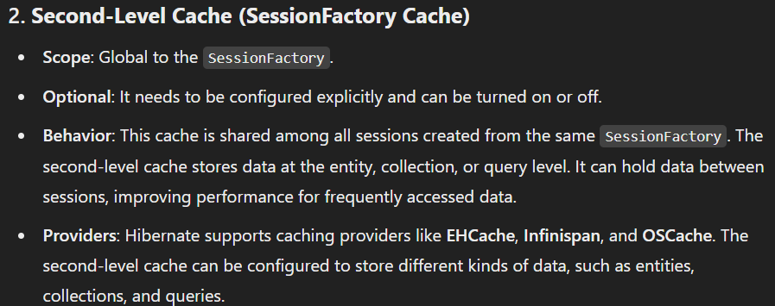
Caching and Levels of Caching
Caching in Hibernate is a mechanism that improves the performance of database operations by reducing the number of database queries. It allows the application to store objects in memory, so subsequent accesses to the same data can be served from the cache instead of querying the database again.

Slide 28
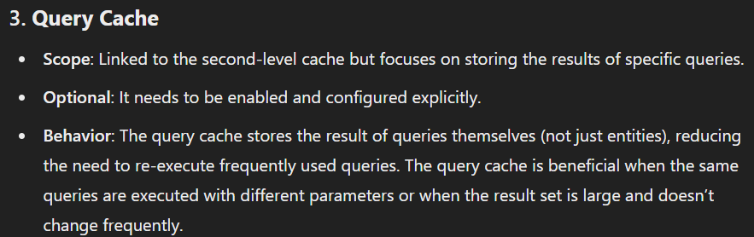
Caching and Levels of Caching

Slide 29
Thank you...

