Slide 1
Typescript and Angular

Slide 2
What is TypeScript?
TypeScript is a strongly typed, object-oriented, compiled programming language developed by Microsoft. It is a superset of JavaScript, meaning it extends JavaScript by adding static typing, interfaces, and other powerful features while remaining fully compatible with JavaScript.

Slide 3
Benefits of TypeScript
Benefits of TypeScript
Static Typing – Helps catch errors at compile time instead of runtime.
Improved Readability and Maintainability – Code is easier to understand with types.
Better IDE Support – Provides IntelliSense (code autocompletion and suggestions).
Object-Oriented Features – Supports classes, interfaces, and access modifiers.
Improved Code Scalability – Suitable for large-scale applications.
Better Refactoring Support – Type safety helps in smooth code refactoring.
Modern JavaScript Features – Supports ES6+ features with backward compatibility.

Slide 4
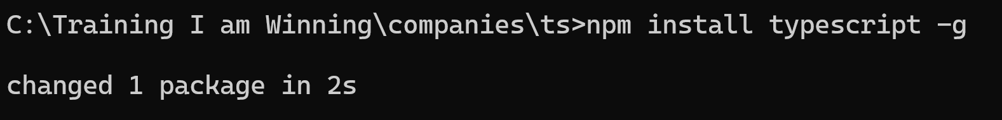
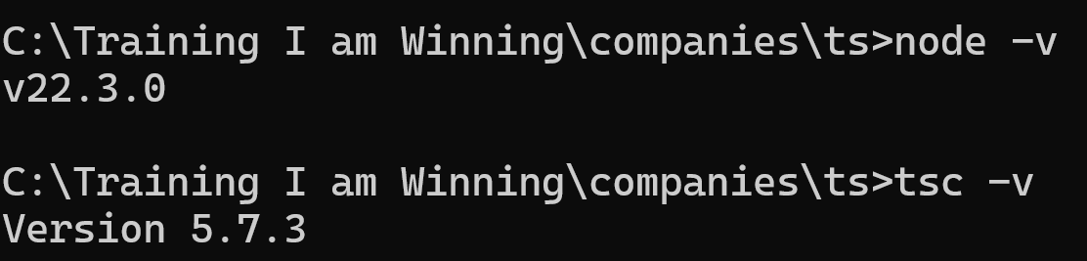
Setup the Environment
Install node. After the installation, give the command node -v from the command prompt. Install typescript as given below.

Slide 5
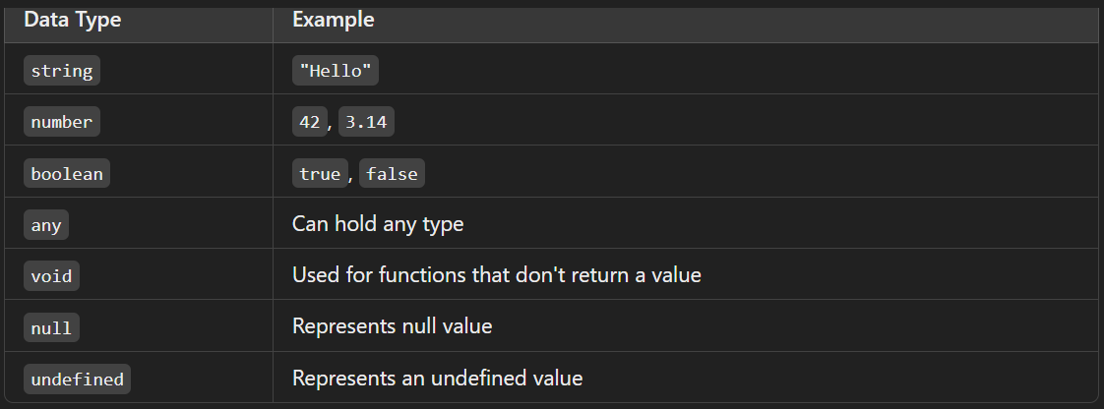
Basic Data Types

Slide 6
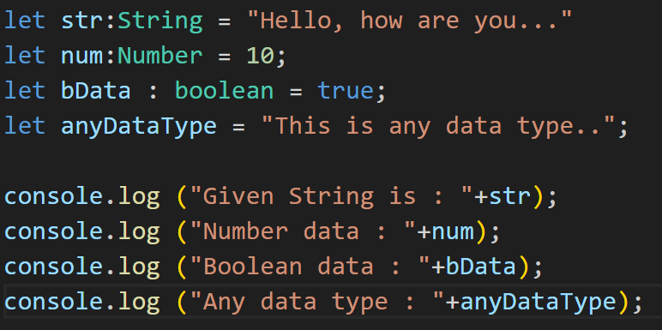
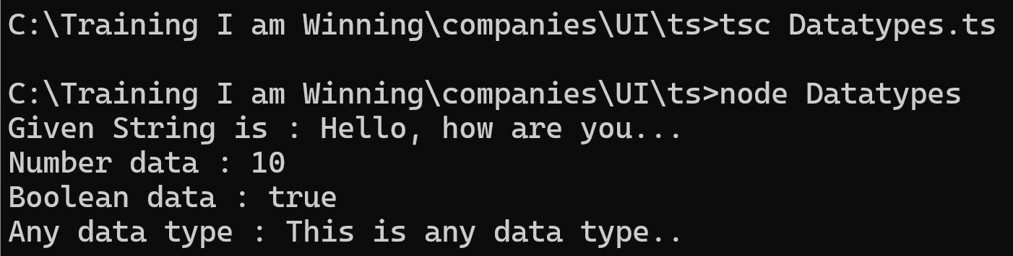
Basic Data Types

Slide 7
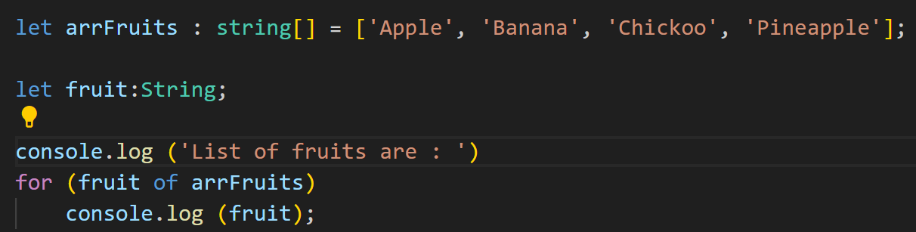
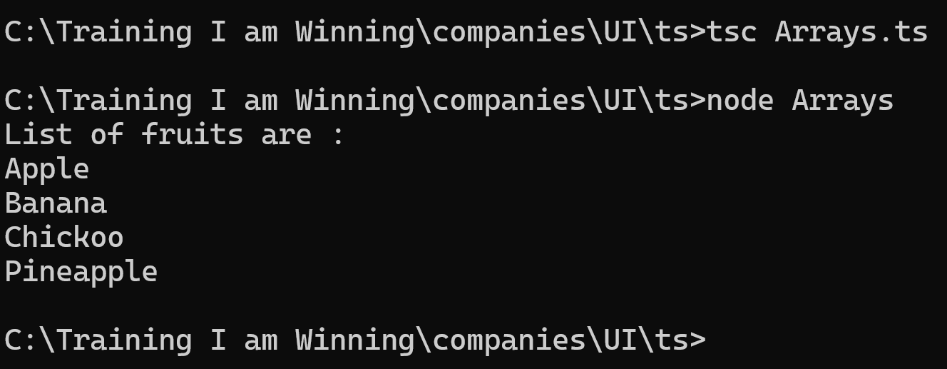
Arrays

Slide 8
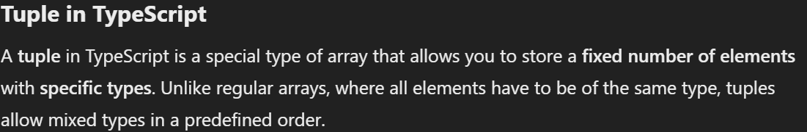
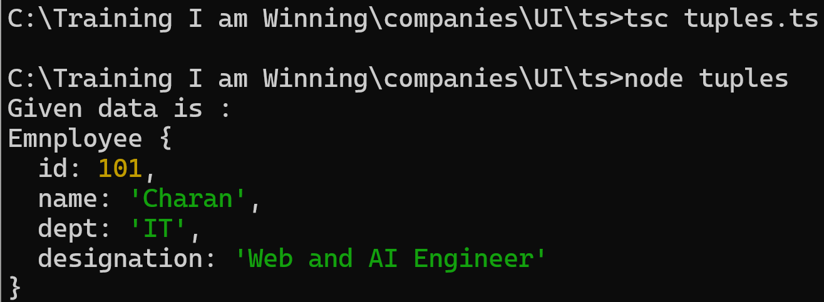
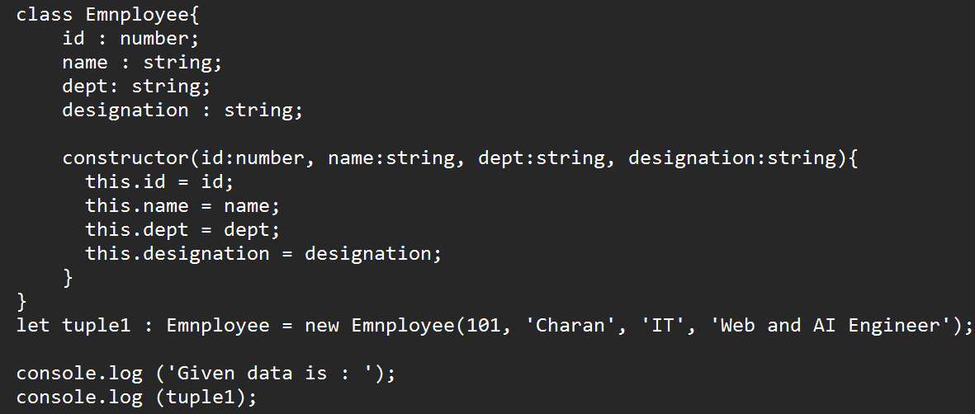
Tuples

Slide 9
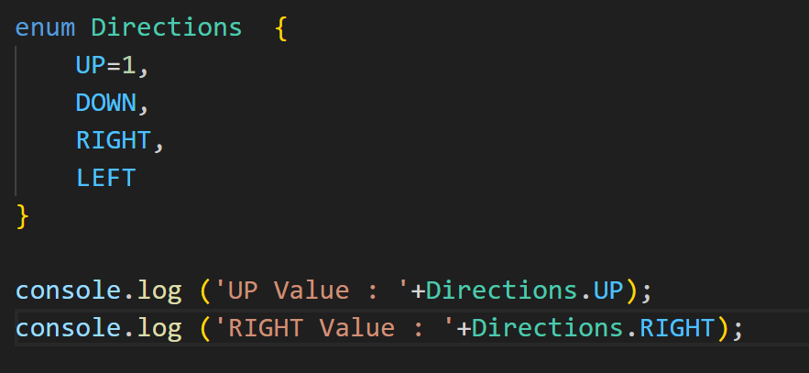
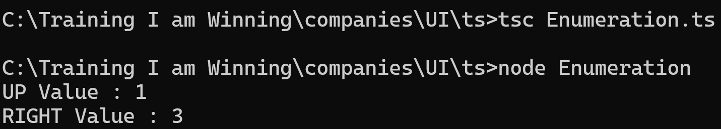
Enum

Slide 10
Any and void
Any : Anydata type can be assigned to it.
Void : A function is not returning anything is void.
Test (arguments):void{
}
Test is the fucntion which is not returning any datatype.

Slide 11
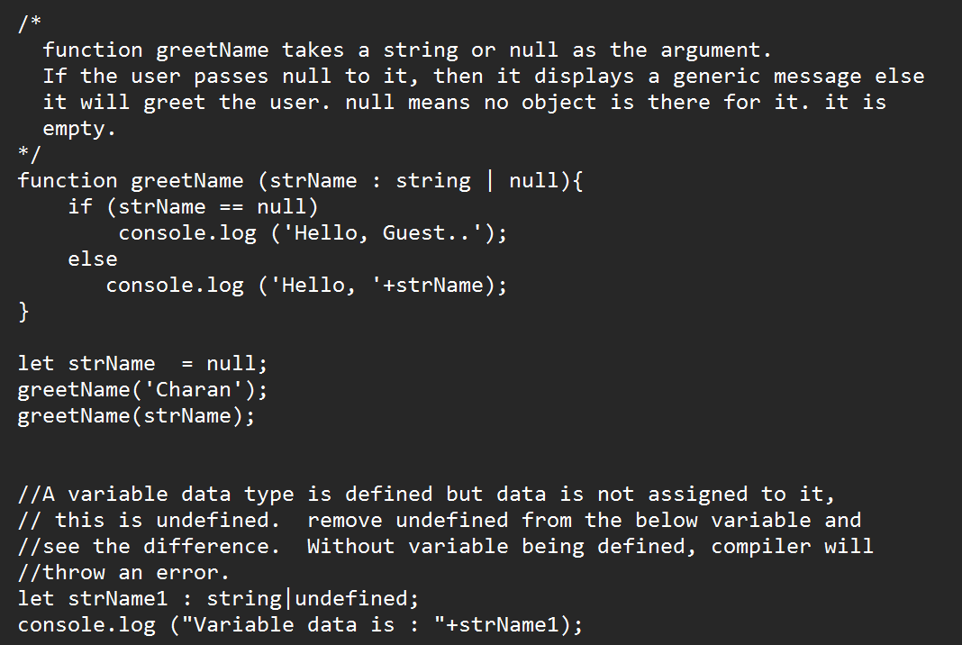
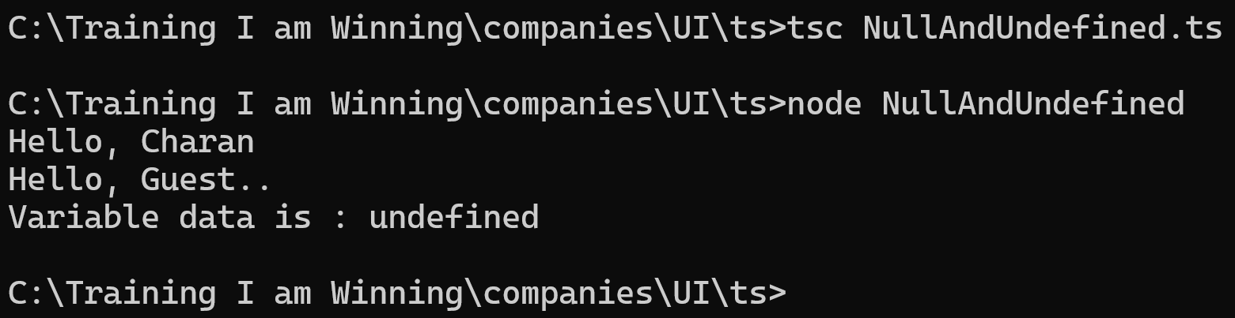
null and undefined
Null : null represents the intentional absence of any object value.
Undefined : undefined indicates that a variable has been declared but hasn’t been assigned any value
.

Slide 12
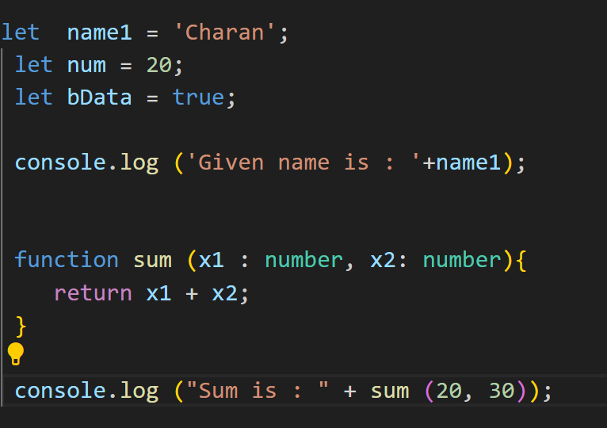
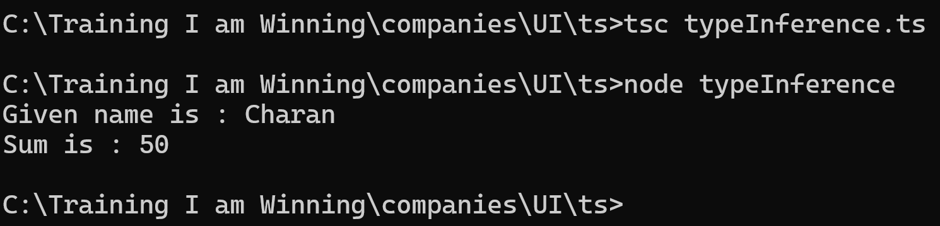
Type Inference
When you assign a value to a variable without specifying its type, TypeScript infers the type from the assigned value.

Slide 13
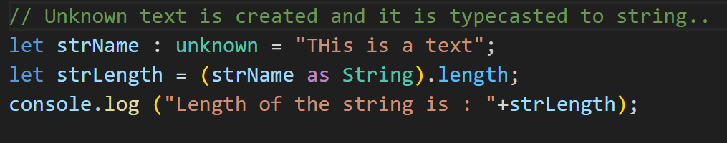
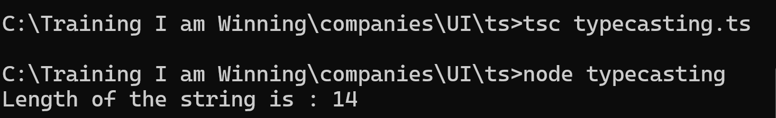
Type Casting

Slide 14
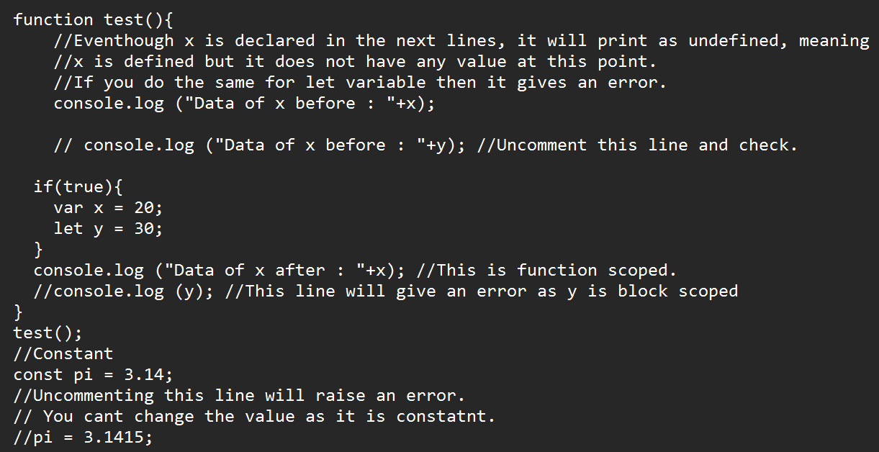
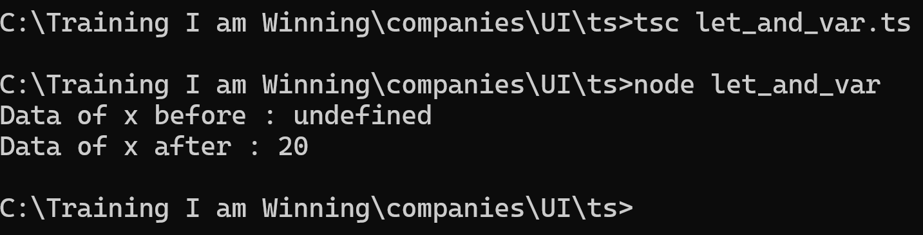
Difference between let and var and const declaration.

