Slide 1
React JS

Slide 2
React Introduction
ReactJS is a declarative, efficient, and flexible JavaScript library for building reusable UI components. It is an open-source, component-based front end library responsible only for the view layer of the application. It was created by Jordan Walke, who was a software engineer at Facebook. It was initially developed and maintained by Facebook and was later used in its products like WhatsApp & Instagram. Facebook developed ReactJS in 2011 in its newsfeed section, but it was released to the public in the month of May 2013.
Today, many JavaScript frameworks are available in the market(like angular, node), but still, React came into the market and gained popularity amongst them. The previous frameworks follow the traditional data flow structure, which uses the DOM (Document Object Model). DOM is an object which is created by the browser each time a web page is loaded. It dynamically adds or removes the data at the back end and when any modifications were done, then each time a new DOM is created for the same page. This repeated creation of DOM makes unnecessary memory wastage and reduces the performance of the application.

Slide 3
React Installation.
These need to be installed for React.
NodeJS and NPM
React and React DOM
Webpack
Babel
Node can be installed using the link
https://nodejs.org/en/download/
Give the following commands to check whether Node and NPM is installed or not.
c:\React> node – v
c: \React> npm -v

Slide 4
React Installation.
npm install react --save
npm install react react-dom --save
npm install webpack webpack-dev-server webpack-cli --save
npm install webpack --save
npm install babel-core babel-loader babel-preset-env babel-preset-react babel-webpack-plugin --save-dev
Create a new React App:
npx create-react-app reactproject
After the basic project is created: type the following commands
C:\React>Cd reactproject
C:\React\reactproject> npm start → This will start the server at port 3000.

Slide 5
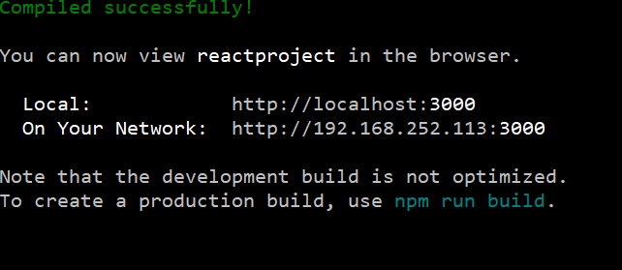
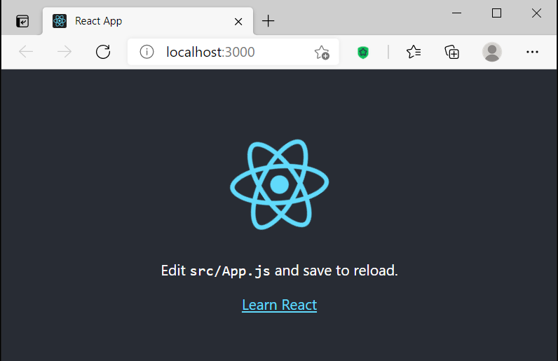
React Installation.
Open the browse and you should be able to see the first react project output.

Slide 6
React Features.
JSX
Components
One-way Data Binding
Virtual DOM
Simplicity
Performance

Slide 7
JSX
JSX stands for JavaScript XML. It is a JavaScript syntax extension. Its an XML or HTML like syntax used by ReactJS.
Components
ReactJS is all about components. ReactJS application is made up of multiple components, and each component has its own logic and controls. These components can be reusable which help you to maintain the code when working on larger scale projects.
One-way Data Binding
ReactJS is designed in such a manner that follows unidirectional data flow or one-way data binding. The benefits of one-way data binding give you better control throughout the application. If the data flow is in another direction, then it requires additional features. It is because components are supposed to be immutable and the data within them cannot be changed. Flux is a pattern that helps to keep your data unidirectional. This makes the application more flexible that leads to increase efficiency.

Slide 8
Virtual DOM
A virtual DOM object is a representation of the original DOM object. It works like a one-way data binding. Whenever any modifications happen in the web application, the entire UI is re-rendered in virtual DOM representation. Then it checks the difference between the previous DOM representation and new DOM. Once it has done, the real DOM will update only the things that have actually changed. This makes the application faster, and there is no wastage of memory.
Simplicity
ReactJS uses JSX file which makes the application simple and to code as well as understand. We know that ReactJS is a component-based approach which makes the code reusable as your need. This makes it simple to use and learn.
Performance
ReactJS is known to be a great performer. This feature makes it much better than other frameworks out there today. The reason behind this is that it manages a virtual DOM. The DOM is a cross-platform and programming API which deals with HTML, XML or XHTML. The DOM exists entirely in memory. Due to this, when we create a component, we did not write directly to the DOM. Instead, we are writing virtual components that will turn into the DOM leading to smoother and faster performance.

Slide 9
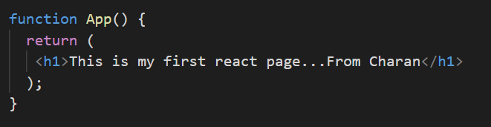
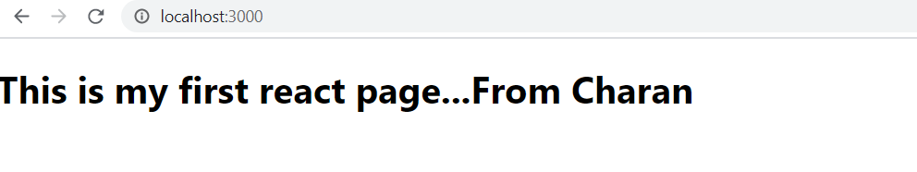
My First React Program.
Open the created project in Visual Studio.
Open App.js and put it as below and run in browser.

Slide 10
React Components.
React has two components.
(a) Functional components : This will have only render() to render the component.
(b) Class Components.

Slide 11
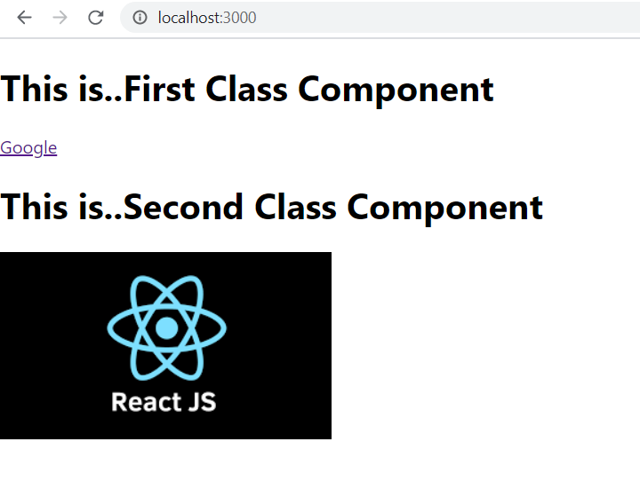
Functional Components.
class App extends React.Component
{
render()
{
return(
<div>
<First/>
<Second/>
</div>
);
}
}
class First extends React.Component
{
render()
{
return(
<div>
<h1> This is..First Class Component</h1>
<a href="http://www.google.co">Google </a>
</div>
);
}
}
class Second extends React.Component
{
render()
{
return(
<div>
<h1> This is..Second Class Component</h1>
<img src='React_logo.png' alt="No image is available"/>
</div>
);
}
}
First Component will display a message and a hyperlink.
Second component will display a message and an image. Place the image file in src public directory.

Slide 12
Class Component.
Class components are more complex than functional components. It requires you to extend from React. Component and create a render function which returns a React element. You can pass data from one class to other class components. You can create a class by defining a class that extends Component and has a render function.

Slide 13
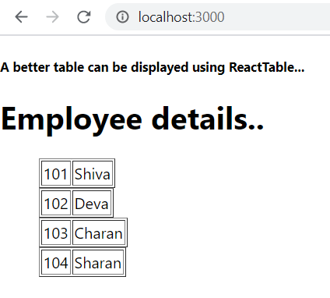
//In the App, 4 records are declared in json format and in render() DisplayName component is called.
//DisplayName component just displays a header.
// In the render() of App, every record of the json data is sent to DisplayData component.
// In the DisplayData component, received record data id and name is displayed as a table.
class App extends React.Component
{
constructor()
{
super();
this.state =
{
data:
[
{ "id":101, "name":"Shiva", "dept":"IT", "designation":"IT Manager"},
{ "id":102, "name":"Deva ", "dept":"IT", "designation":"IT Manager"},
{ "id":103, "name":"Charan", "dept":"IT", "designation":"IT Manager"},
{ "id":104, "name":"Sharan", "dept":"IT", "designation":"IT Manager"}
]
}
} //End of constructor
render()
{
return(
<div>
<DisplayName/>
<ul>
{this.state.data.map((item) => <DisplayData data={item} />)}
</ul>
</div>
);
}
}
class DisplayName extends React.Component
{
render(){
return(
<div>
<h5> A better table can be displayed using ReactTable...</h5>
<h1> Employee details..</h1>
</div>
);
}
}
class DisplayData extends React.Component
{
render(){
return(
<div>
<table border="1">
<tr>
<td> {this.props.data.id} </td>
<td> {this.props.data.name} </td>
</tr>
</table>
</div>
);
}
}

Slide 14
React State
The state is an updatable structure that is used to contain data or information about the component. The state in a component can change over time. The change in state over time can happen as a response to user action or system event. A component with the state is known as stateful components. It is the heart of the react component which determines the behavior of the component and how it will render. They are also responsible for making a component dynamic and interactive.

Slide 15
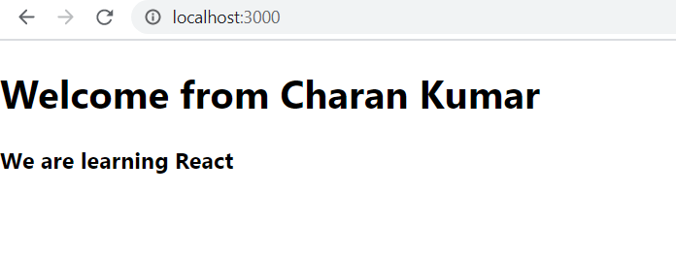
import React from 'react';
import './App.css'
//In App, displayBio variable is declared and assigned a value to it.
// Using ternary operator, what to display is given in the render ()
// Value of variable bio is displayed in return()
class App extends React.Component
{
constructor()
{
super();
this.state = { displayBio:true};
} //End of constructor
render()
{
const bio = this.state.displayBio ? (
<div>
<p>
<h3> We are learning React</h3>
</p>
</div>
) : null;
return(
<div>
<h1> Welcome from Charan Kumar</h1>
{bio}
</div>
);
}
}
export default App;

Slide 16
React Props
Props stand for "Properties." They are read-only components. It is an object which stores the value of attributes of a tag and work similar to the HTML attributes. It gives a way to pass data from one component to other components. It is similar to function arguments. Props are passed to the component in the same way as arguments passed in a function.

Slide 17
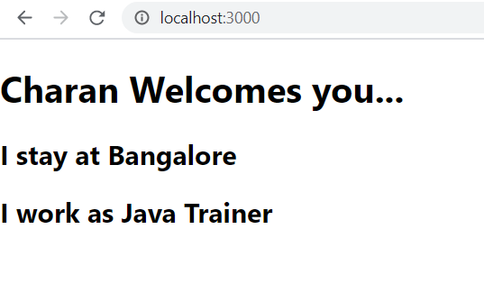
import React from 'react';
import './App.css';
//Props are propterties. They are like arguments.
//Value for props are define defaultProps section and used in the render() return() function.
class App extends React.Component
{
render()
{
return(
<div>
<h1>{this.props.name} Welcomes you...</h1>
<h2> I stay at {this.props.address}</h2>
<h2> I work as {this.props.profession}</h2>
</div>
);
}
}
App.defaultProps =
{
name: "Charan",
address:"Bangalore",
profession: "Java Trainer"
}
export default App;

Slide 18
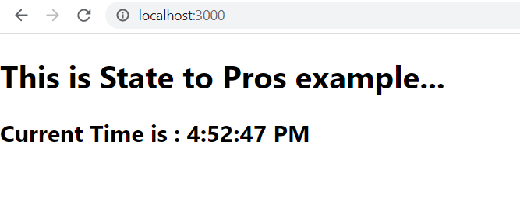
State to Props.
import React from 'react';
import './App.css';
//As a state variable date is declared and date object is created and assigned to it.
//This state variable is converted as props data and sent to a component StateToPropsComponent
//StateToPropsComponent is displaying the current time from the sent data.
//Here we are converting state to props. State stateful data to stateless props data or
//arguments of a function
class App extends React.Component
{
constructor(props)
{
super (props)
this.state = {date : new Date()};
}//End of constructor
render() {
return(
<div> <StateToPropsComponent stp = {this.state.date} />
</div>
);
}
}
class StateToPropsComponent extends React.Component
{
render()
{
return(
<div>
<h1> This is State to Pros example...</h1>
<h2> Current Time is : {this.props.stp.toLocaleTimeString()} </h2>
</div>
);
}
}
export default App;

Slide 19
PropTypes.
Props are an important mechanism for passing the read-only attributes to React components. The props are usually required to use correctly in the component. If it is not used correctly, the components may not behave as expected. Hence, it is required to use props validation in improving react components.

Slide 20
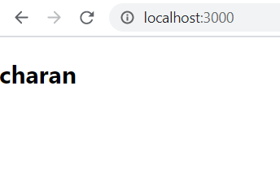
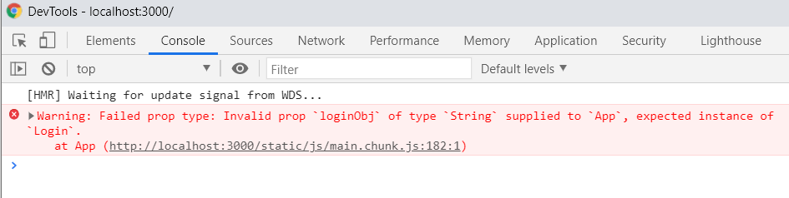
import React from 'react';
import './App.css';
import PropTypes from 'prop-types'
//A class Login is created receiving two parameters in constructor.
// In the APp, Displaying the loginObj userId
// In the defaultProps, loginObj variable is created and initialized.
// propTypes, we are saying that loginObj should be an instance of Login.
// Assign loginObj with string data type and check the output and in console.
//Console will give an error incase if the propTypes are not matching.
//
//for proptypes to work, install proptypes as
// npm install --save prop-types
class Login
{
constructor (userId, password)
{
this.userId = userId;
this.password = password;
}
}
class App extends React.Component
{
render() {
return(
<div>
<h2>{this.props.loginObj.userId}</h2>
</div>
);
}
}
App.defaultProps = {
loginObj : new Login ('charan','admin')
//uncomment this line and check in chrome console to see the error that proptypes are not matching.
//loginObj:'test'
}
App.propTypes = {
loginObj: PropTypes.instanceOf (Login)
}
export default App;

Slide 21
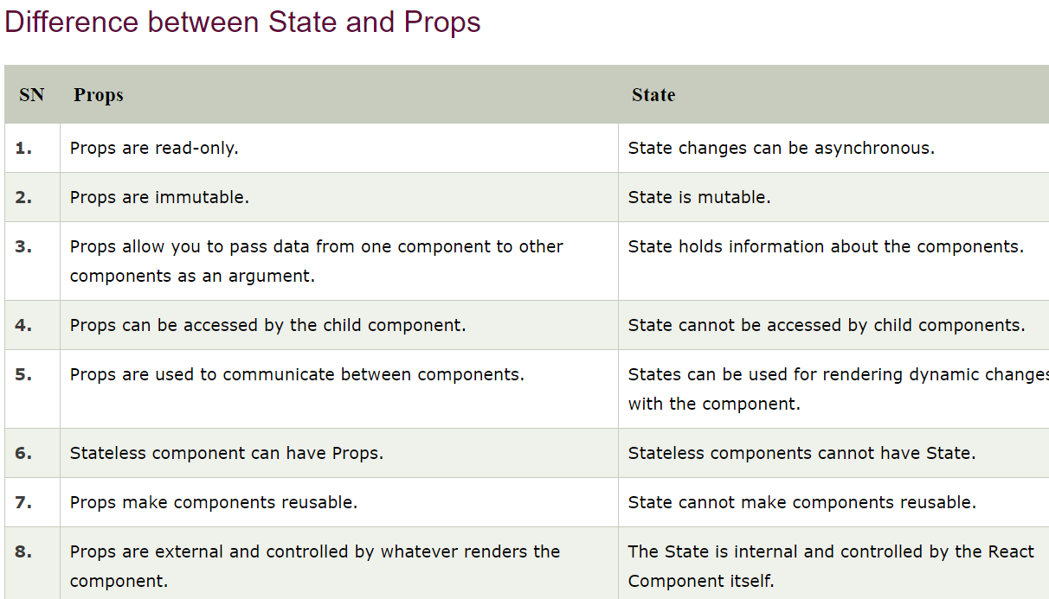
Difference between Props and State

Slide 22

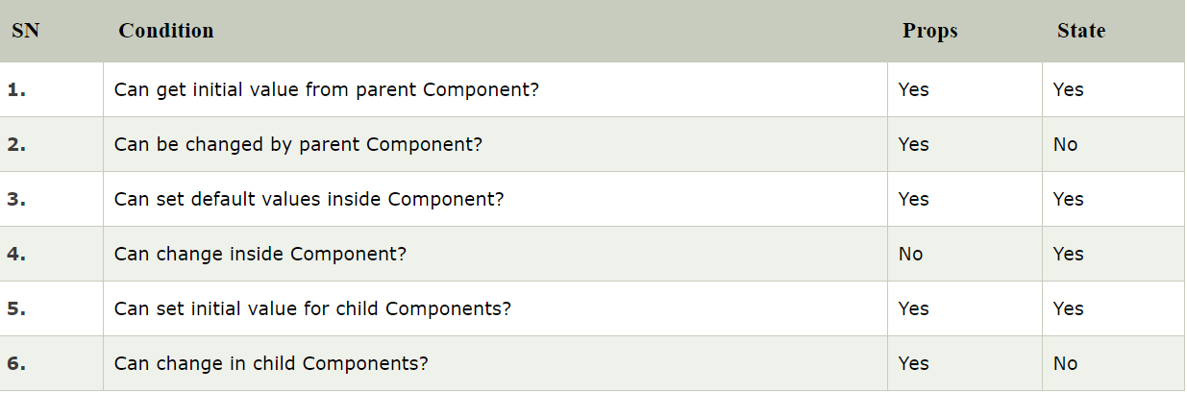
Difference between Props and State

Slide 23
Constructor
The constructor is a method used to initialize an object's state in a class. It automatically called during the creation of an object in a class.
The concept of a constructor is the same in React. The constructor in a React component is called before the component is mounted. When you implement the constructor for a React component, you need to call super(props) method before any other statement.

Slide 24
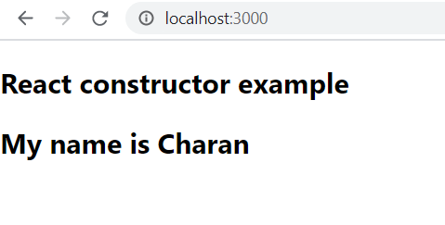
.//Program -7
import React from 'react';
import './App.css';
//This is an example of a constructor.
//In this constructor, variable state is initialized and it is printed in the render().
class App extends React.Component
{
constructor (props)
{
super (props)
this.state = {
name : 'Charan'
}
}
render() {
return(
<div>
<h2>React constructor example</h2>
<h2> My name is {this.state.name}</h2>
</div>
);
}
}
export default App;

Slide 25
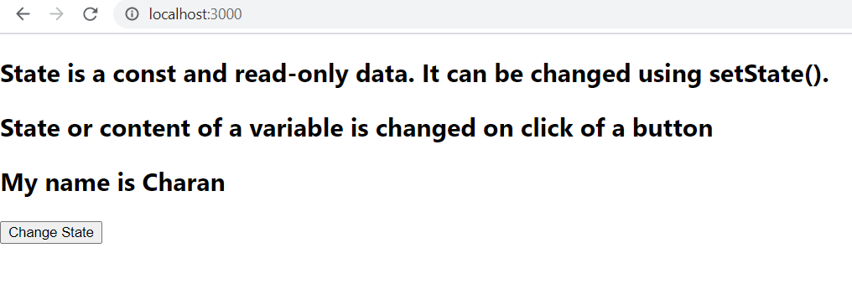
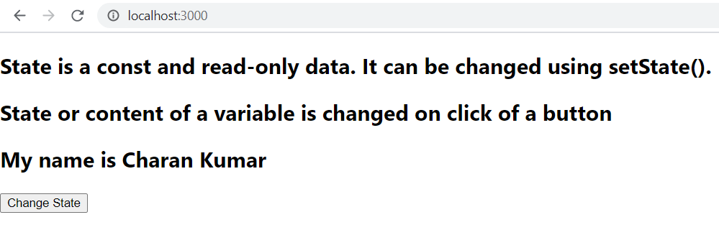
setState()
//Program-8.
import React from 'react';
import './App.css';
//A state is a const or read-only data.
//The state name is defined to Charan initially. On click of a button, the state is changed
// Charan Kumar for the state variable name.
class App extends React.Component
{
constructor (props)
{
super (props)
this.state = {
name : 'Charan'
}
this.updateState = this.updateState.bind(this);
}
updateState()
{
this.setState({name:'Charan Kumar'});
}
render() {
return(
<div>
<h2> State is a const and read-only data. It can be changed using setState().</h2>
<h2>State or content of a variable is changed on click of a button </h2>
<h2> My name is {this.state.name}</h2>
<button onClick={this.updateState}> Change State </button>
</div>
);
}
}
export default App;

Slide 26
What is forceUpdate()
By default, when your component's state or props change, your component will re-render. If your render() method depends on some other data, you can tell React that the component needs re-rendering by calling forceUpdate() .

Slide 27
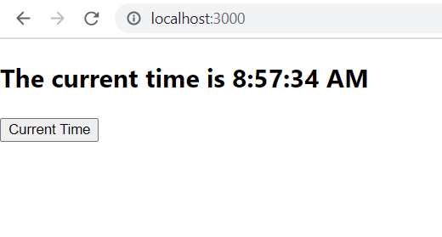
//Program 9
import React from 'react';
import './App.css';
//By default, when your component's state or props change, your component will re-render.
// If your render() method depends on some other data, you can tell React that the component
//needs re-rendering by calling forceUpdate() .
//In this program, on click of a button, it calls a function and in that function newDate
//state variable is updated with latest date. Date() has current time also. We are using
// toLocaleTimeString() to display the current time. On every click of the button, new time is also
//updated in the state variable and updated time is displayed on the screen.
class App extends React.Component
{
constructor (props)
{
super (props)
this.state={
newDate:new Date()
}
this.forceUpdateState = this.forceUpdateState.bind(this);
}
forceUpdateState()
{
this.setState({newDate: new Date()});
this.forceUpdate();
}
render() {
return(
<div>
<h2> The current time is {this.state.newDate.toLocaleTimeString()}</h2>
<button onClick={this.forceUpdateState }> Current Time </button>
</div>
);
}
}
export default App;

Slide 28
Compnent Life Cycle.
The lifecycle of the component is divided into four phases. They are:
Initial Phase - It is the birth phase of the lifecycle of a ReactJS component. Here, the component starts its journey on a way to the DOM. In this phase, a component contains the default Props and initial State.
Mounting Phase - In this phase, the instance of a component is created and inserted into the DOM
Updating Phase - When ever there is change in the state, methods of this phase will be executed.
Unmounting Phase – Before removing the components from DOM, this phase methods will be executed.

Slide 29
//Program - 10
import React from 'react';
import './App.css';
/*
The lifecycle of the component is divided into four phases. They are:
Initial Phase - It is the birth phase of the lifecycle of a ReactJS component. Here, the component starts its
journey on a way to the DOM. In this phase, a component contains the default Props and initial State.
Mounting Phase - In this phase, the instance of a component is created and inserted into the DOM
Updating Phase - When ever there is change in the state, methods of this phase will be executed.
Unmounting Phase – Before removing the components from DOM, this phase methods will be executed.
*/
class App extends React.Component
{
constructor (props)
{
super (props)
this.state={
newDate:new Date()
}
this.forceUpdateState = this.forceUpdateState.bind(this);
}
forceUpdateState()
{
this.setState({newDate: new Date()});
this.forceUpdate();
}
render() {
return(
<div>
<h2> The current time is {this.state.newDate.toLocaleTimeString()}</h2>
<button onClick={this.forceUpdateState }> Update Current Time </button>
<h3> test </h3>
</div>
);
}
//This is invoked immediately before a component gets rendered into the DOM.
componentWillMount()
{
alert ("componentWillMount() - This is invoked immediately before a component gets rendered into the DOM. . ");
console.log("componentWillMount()");
}
//This is invoked immediately after a component gets rendered and placed on the DOM.
componentDidMount()
{
alert ("componentDidMount() - This is invoked immediately after a component gets rendered and placed on the DOM.");
console.log("componentDidMount()")
}
// It is invoked just before the component updating occurs.
componentWillUpdate()
{
alert ("componentWillUpdate() - It is invoked just before the component updating occurs.");
console.log("componentWillUpdate()");
}
// It is invoked immediately after the component updating occurs.
componentDidUpdate()
{
alert ("componentDidUpdate() - It is invoked immediately after the component updating occurs.");
console.log("componentDidUpdate()");
}
// This method is invoked immediately before a component is destroyed and unmounted permanently
componentWillUnmount()
{
alert ("componentWillUnmount() - This method is invoked immediately before a component is destroyed and unmounted permanently");
console.log("componentWillUnmount()");
}
}
export default App;

Slide 30
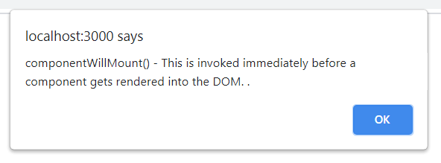
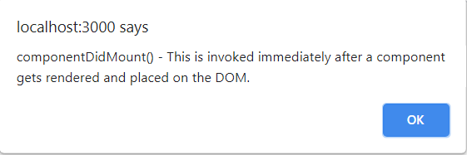
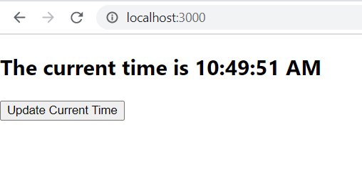

Slide 31
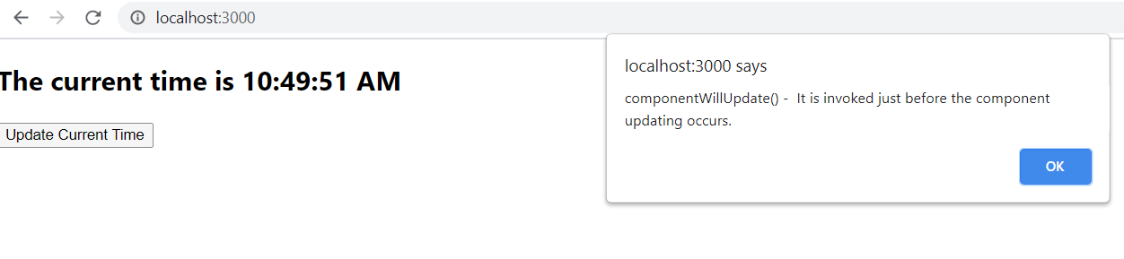
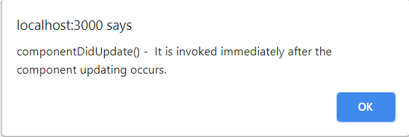
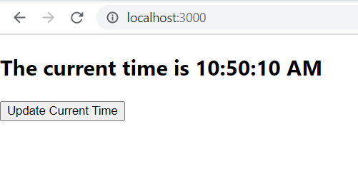

Slide 32
Forms.
export default function Login() {
const [UserID, setUserID] = useState("");
const [password, setPassword] = useState(" ");
function handleSubmit (event)
{
alert ("Given Data :"+ UserID + " Password :"+password)
event.preventDefault(); //Prevents refreshing the screen...Uncomment this line and check it.
}
return(
<div>
<h1> Login Form </h1>
<form onSubmit={handleSubmit}>
User ID : <input type="text" value={UserID} onChange={ (e) => setUserID(e.target.value)}/> <br/><br/>
Password : <input type="text" value={password} onChange={ (e) => setPassword(e.target.value)}/> <br/><br/>
<button type="Submit"> Login </button>
</form>
</div>
)
}
App.js
import React from 'react';
import './App.css';
import Login from './Login';
/*
In render(), Login funcational component is called to display the Login Form.
*/
class App extends React.Component
{
render() {
return (<Login/>);
}
}
export default App;
Login.js
import React, { useState } from "react";
//Two variable UserID and password is declared and it is set to initial value. setUserID and setPassword
//is automatically called with to set the values.
//handleSubmit is called when submit button is clicked.
// Login form is created. Initial values are set with UserID and password and whenever there is change in
// each edit box, corresponding variable is set with the alue.
//in handleSubmit, value of userID and password is printed.

Slide 33
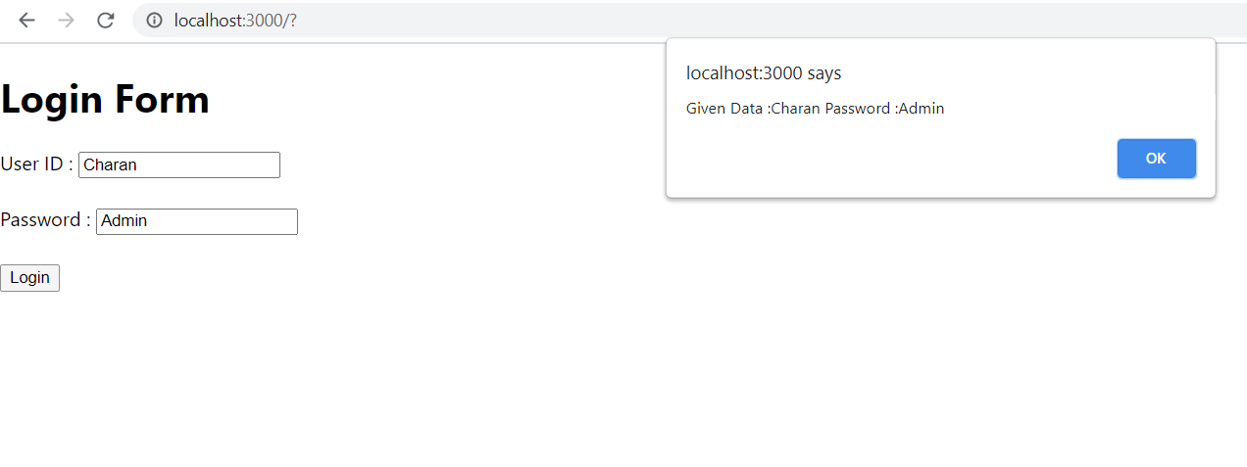
Output

Slide 34
Conditonal Rendering.
//Displays Login button. On button click, calls handleLogin() of App Component.
function DisplayLoginButton (props)
{
return (
<button onClick={props.handleLogin}>Login</button>
);
}
//Displays Logout button. On button click, calls handleLogout() of App Component.
function DisplayLogoutButton (props)
{
return (
<button onClick={props.handleLogOut}>Logout</button>
);
}
class App extends React.Component
{
constructor (props)
{
super (props);
this.handleLogin = this.handleLogin.bind(this);
this.handleLogOut = this.handleLogout.bind (this);
this.state = {isLoggedIn : false};
}
//sets the state variable isLoggedIn to true.
handleLogin()
{
this.setState({isLoggedIn:true});
}
//sets the state variable isLoggedIn to false.
handleLogout()
{
this.setState({isLoggedIn:false});
}
Based on the condition, corresponding component can be displayed.
import React from 'react';
import './App.css';
/*
Conditional rendering example. Based on the data, corresponding buttons are displayed in this program.
1. DisplayMessage functional component - displays a message based on isLoggedIn props. If it is true then it return Welcome back
if it is false then it return Please login.
2. DisplayLogin functional component - Displays a Login button and on click of the button it calls handleLogin() of App.
3. DisplayLogout functional component - Displays a Logout button, on click of this button it calls handleLogout() of App.
4. handleLogin() in App will set the state variable isLoggedIn to true.
5. handleLogout() in App will set the state variable isLoggedIn to false.
6. render() in App - It is calling DisplayMessage Functional component and DisplayLogout functional component. They will display the
buttons accordingly and when the buttons are clicked, corresponding given methods are exected.
*/
//Dislaying a message.
function DisplayMessage(props)
{
if (props.isLoggedIn)
return <h1> Welcome Back </h1>
else
return <h1> Please Login </h1>
}

Slide 35
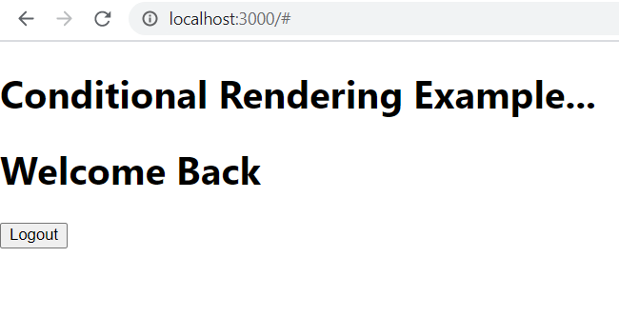
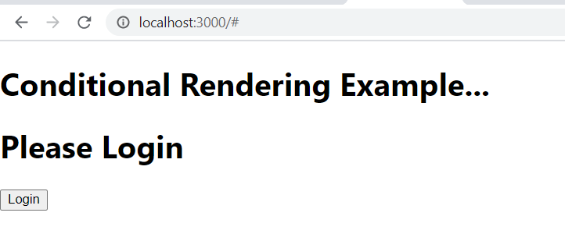
Conditonal Rendering.
//Displays a message from functional component DisplayMessage and
// also displays button Login or Logout based on isLoggedIn state variable.
render() {
return (
<div>
<h1> Conditional Rendering Example...</h1>
<DisplayMessage isLoggedIn = {this.state.isLoggedIn}/>
{
(this.state.isLoggedIn) ? (<DisplayLogoutButton handleLogOut = {this.handleLogOut} />):(<DisplayLoginButton handleLogin = {this.handleLogin} />)
}
</div>
);
}
}
export default App;

Slide 36
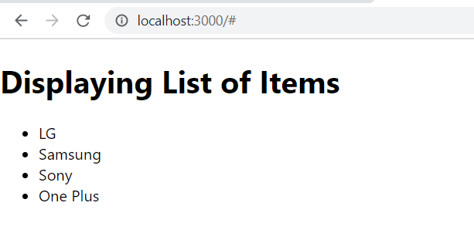
Lists in React
//Program - 13
import React from 'react';
import './App.css';
/*
In App, a list is defined. That list is passed to a functional component DisplayList.
Display list, iterates through each element and stores the result as <li> in a variable listItems.
return() returns what to be displayed. It displays the list of items in line items.
*/
function DisplayList (props)
{
const MyList = props.MyList;
const listItems = MyList.map( (listData) => <li> {listData} </li>);
return(
<div>
<h1> Displaying List of Items </h1>
<ul>
{listItems}
</ul>
</div>
);
}
class App extends React.Component {
render() {
const MyList = ["LG", "Samsung", "Sony", "One Plus"];
return (
<div>
<DisplayList MyList= {MyList} />
</div>
);
}
}
export default App;

Slide 37
Keys
A key is a unique identifier. In React, it is used to identify which items have changed, updated, or deleted from the Lists. It is useful when we dynamically created components or when the users alter the lists. It also helps to determine which components in a collection needs to be re-rendered instead of re-rendering the entire set of components every time.

Slide 38
//Program - 14
import React from 'react';
import './App.css';
/*
In the functional Component DisplayChapters, two constants are defined. They are titleBar and ChapterData.
titleBar iterates through the list and displays Chapter Topic.
chapterData const will have Chapter number, chapter topic, chapter Information about the topic.
In the return function of DisplayChapters(), both these constant contents are displayed.
App component defines the List, sends this list as props to DisplayChapters() functional component.
*/
function DisplayChapters(props)
{
const MyList = props.MyList;
const titleBar = (
<div>
<h1>Table of Contents </h1>
<ol>
{ MyList.map ( (ChapterTitle) => <li key={ChapterTitle.id.toString()}> {ChapterTitle.Chapter}</li> )}
</ol>
</div>
);
const chapterData = (
<ul>
<h1> Detailed Content </h1>
{ MyList.map ( (ChapterInfo) =>
<div>
<li key={ChapterInfo.id.toString()}><b> Chapter - {ChapterInfo.id} - {ChapterInfo.Chapter} </b> </li>
{ChapterInfo.Topic}
<hr/>
</div>)
}
</ul>
);
return (
<div>
{titleBar}
<hr/>
{chapterData}
</div>
)
}
class App extends React.Component {
render() {
const MyList = [{"id":1, "Chapter":"Introduction to React", "Topic":"React contains JSX and very simple and easy to learn"},
{"id":2, "Chapter":"Props and State", "Topic":"Props are arguments to the function and state maintains the state of the variable"},
{"id":3, "Chapter":"Forms", "Topic":"Forms are very essential. All the data from the user are carried out in forms"},
{"id":4, "Chapter":"PropType checking", "Topic":"Prop Type checking is important as it is important to check type of object before proceeding."},
{"id":5, "Chapter":"Lists and Keys", "Topic":"Lists contain the data and keys says which records are modified and requires re-rendering"}
];
return (
<div>
<DisplayChapters MyList= {MyList} />
</div>
);
}
}
export default App;

Slide 39
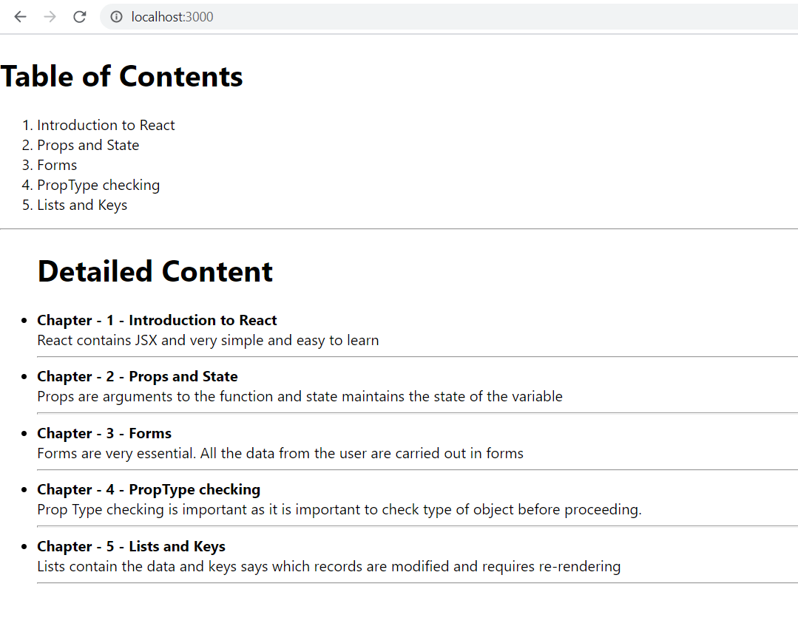

Slide 40
React Fragments
In React, whenever you want to render something on the screen, you need to use a render method inside the component. This render method can return single elements or multiple elements. The render method will only render a single root node inside it at a time. However, if you want to return multiple elements, the render method will require a 'div' tag and put the entire content or elements inside it. This extra node to the DOM sometimes results in the wrong formatting of your HTML output and also not loved by the many developers.

Slide 41
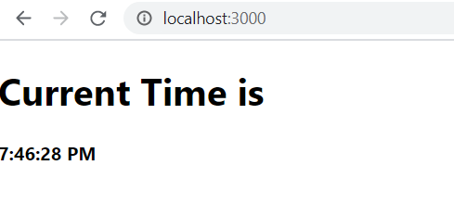
//Program - 15
import React from 'react';
import './App.css';
/*
In the App constructor a state variable CurrentDataTime is declared and assigned current date time using the new Date().
In componentDidMount(), when the components are rendered in DOM this method is called and at that time timer is started and for every
second tick() method is called.
In tick(), every second state variable is updated with the current date and time.
In componentWillUnmount(), timer is removed from memory. In render(), <React.Fragment> is used instead of <div>.
Instead <React.Fragment>, we can use <> and </>. This is equalent of <React.Fragment> and </React.Fragment>
*/
class App extends React.Component {
constructor (props)
{
super (props);
this.state = {currentDateTime : new Date()};
}
componentDidMount()
{
this.timerId = setInterval(() => this.tick(), 1000);
}
tick(){
this.setState ({currentDateTime : new Date()} );
}
componentWillUnmount()
{
clearInterval (this.timerId);
}
render() {
return(
<React.Fragment>
<h1> Current Time is </h1>
<b> {this.state.currentDateTime.toLocaleTimeString()} </b>
</React.Fragment>
);
}
}
export default App;

Slide 42
React Routing.
Routing is a process in which a user is directed to different pages based on their action or request. ReactJS Router is mainly used for developing Single Page Web Applications. React Router is used to define multiple routes in the application. When a user types a specific URL into the browser, and if this URL path matches any 'route' inside the router file, the user will be redirected to that particular route.
React Router is a standard library system built on top of the React and used to create routing in the React application using React Router Package. It provides the synchronous URL on the browser with data that will be displayed on the web page. It maintains the standard structure and behavior of the application and mainly used for developing single page web applications.
For routing, you need to install it through npm as given below:
C:\Java\ReactApp> npm install react-router-dom --save

Slide 43
Index.js
//Program 16.
import React from 'react';
import ReactDOM from 'react-dom';
import './index.css';
import App from './App';
import About from './About'
import Contact from './Contact'
import Register from './Register'
import Login1 from './Login'
import reportWebVitals from './reportWebVitals';
import { BrowserRouter as Router, Route, NavLink, Switch } from 'react-router-dom'
/*
ReactDOM.render(
<React.StrictMode>
<App />
</React.StrictMode>,
document.getElementById('root')
);
*/
const routing = (
<Router>
<div>
<NavLink to="/" exact activeStyle={{color:'red'}}>Home</NavLink> &nbsp;&nbsp;
<NavLink to="/about" exact activeStyle={{color:'green'}}>About</NavLink> &nbsp;&nbsp;
<NavLink to="/contact" exact activeStyle={{color:'magenta'}}>Contact</NavLink>
<Switch>
<Route exact path="/" component={App} />
<Route exact path="/about" component={About} />
<Route exact path="/contact" component={Contact} />
<Route exact path="/Register" component={Register} />
<Route exact path="/Login" component={Login1} />
</Switch>
</div>
</Router>
)
ReactDOM.render (routing, document.getElementById('root'));
// If you want to start measuring performance in your app, pass a function
// to log results (for example: reportWebVitals(console.log))
// or send to an analytics endpoint. Learn more: https://bit.ly/CRA-vitals
reportWebVitals();
App.js
Index.js
//Program 16.
import React from 'react';
import ReactDOM from 'react-dom';
import './index.css';
import App from './App';
import About from './About'
import Contact from './Contact'
import Register from './Register'
import Login1 from './Login'
import reportWebVitals from './reportWebVitals';
import { BrowserRouter as Router, Route, NavLink, Switch } from 'react-router-dom'
/*
ReactDOM.render(
<React.StrictMode>
<App />
</React.StrictMode>,
document.getElementById('root')
);
*/
const routing = (
<Router>
<div>
<NavLink to="/" exact activeStyle={{color:'red'}}>Home</NavLink> &nbsp;&nbsp;
<NavLink to="/about" exact activeStyle={{color:'green'}}>About</NavLink> &nbsp;&nbsp;
<NavLink to="/contact" exact activeStyle={{color:'magenta'}}>Contact</NavLink>
<Switch>
<Route exact path="/" component={App} />
<Route exact path="/about" component={About} />
<Route exact path="/contact" component={Contact} />
<Route exact path="/Register" component={Register} />
<Route exact path="/Login" component={Login1} />
</Switch>
</div>
</Router>
)
ReactDOM.render (routing, document.getElementById('root'));
// If you want to start measuring performance in your app, pass a function
// to log results (for example: reportWebVitals(console.log))
// or send to an analytics endpoint. Learn more: https://bit.ly/CRA-vitals
reportWebVitals();

Slide 44
Login.js
import React, { useState } from "react";
import { NavLink } from 'react-router-dom'
export default function Login1() {
const [UserID, setUserID] = useState("");
const [password, setPassword] = useState(" ");
function handleSubmit (event)
{
if (UserID == "Charan" && password == "Admin")
alert ("Valid user");
else
alert ("Invalid user");
event.preventDefault(); //Prevents refreshing the screen...Uncomment this line and check it.
}
return(
<div>
<h1> Login Form </h1>
<form onSubmit={handleSubmit}>
User ID : <input type="text" value={UserID} onChange={ (e) => setUserID(e.target.value)}/> <br/><br/>
Password : <input type="text" value={password} onChange={ (e) => setPassword(e.target.value)}/> <br/><br/>
<button type="Submit"> Login </button> <br/><br/>
<NavLink to="/Register" exact activeStyle={{color:'magenta'}}>Register</NavLink>
</form>
</div>
)
}
Register.js
import React, { useState } from "react";
import { NavLink } from 'react-router-dom'
export default function Register() {
const [UserID, setUserID] = useState("");
const [password, setPassword] = useState(" ");
const [confirmPassword, setConfirmPassword] = useState(" ");
function handleSubmit (event)
{
// alert ("Given Data :"+ UserID + " Password :"+password + " Confirm Password "+ confirmPassword);
if (password == confirmPassword)
alert ("User ID "+ UserID + " Is registered")
else
alert ("User not registered. Reason is : Password and confirm password is not same...")
event.preventDefault(); //Prevents refreshing the screen...Uncomment this line and check it.
}
return(
<div>
<h1> Register Form </h1>
<form onSubmit={handleSubmit}>
User ID : <input type="text" value={UserID} onChange={ (e) => setUserID(e.target.value)}/> <br/><br/>
Password : <input type="text" value={password} onChange={ (e) => setPassword(e.target.value)}/> <br/><br/>
Cofirm Password : <input type="text" value={confirmPassword} onChange={ (e) => setConfirmPassword(e.target.value)}/> <br/><br/>
<button type="Submit"> Register </button> <br/><br/>
<NavLink to="/Login" exact activeStyle={{color:'magenta'}}>Login</NavLink>
</form>
</div>
)
}

Slide 45
About.js
import React from 'react';
class About extends React.Component
{
render ()
{
return(
<div>
<h1> This is About Page </h1>
<h2> I live in Bangalore </h2>
</div>
);
}
}
export default About;
Contact.js
import React from 'react';
class Contact extends React.Component
{
render ()
{
return(
<div>
<h1> This is Contact Page </h1>
<h2> Contact : RR Nagar, Bangalore </h2>
</div>
);
}
}
export default Contact;
}

Slide 46
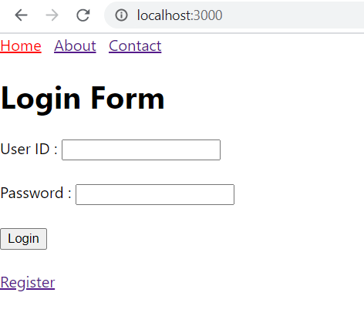
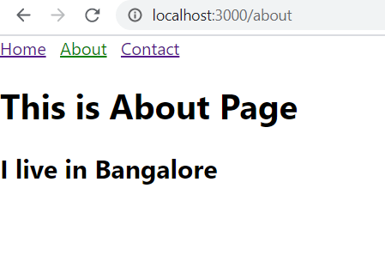
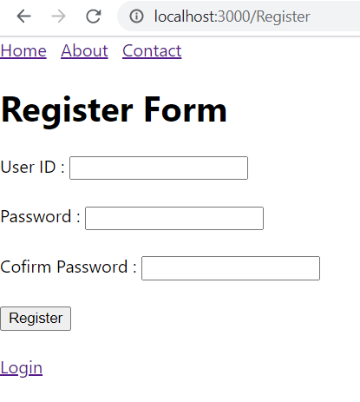
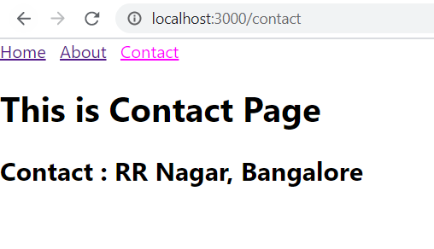
When About link is clicked on:
When Register button is clicked on Login screen
When Contact link is clicked on:

Slide 47
React CSS
CSS Style can be defined in App component in render() function. For the previous
import React from 'react';
//Program-17
Import Login1 from './Login'
/*
CSS style component is added with background image.
*/
class App extends React.Component {
render() {
const mystyle={
backgroundImage: 'url(Iced_Mountain.jpg)',
backgroundSize: "cover",
height: "100vh",
color:"white",
padding:"40px",
};
return(
<div
style={mystyle}
>
<Login1 />
</div>
);
}
}
export default App;
program, we are adding style component as given below:

Slide 48
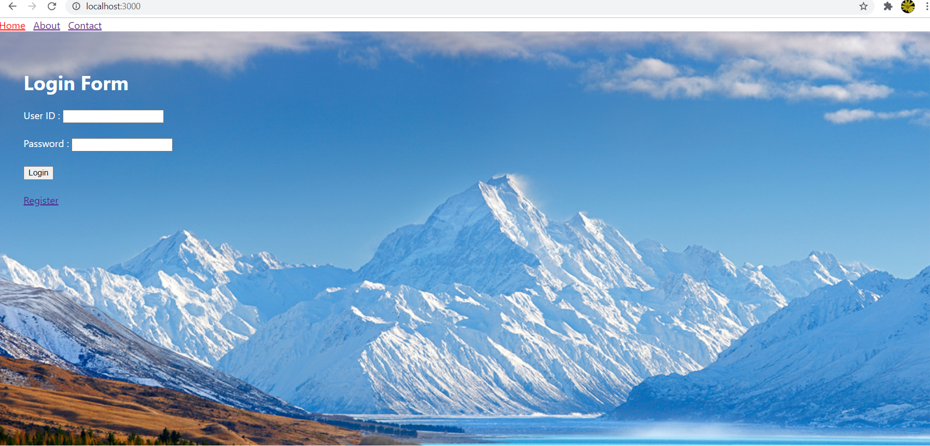
For the previous program, background image is added with CSS Style.

