Slide 1

What is a Successful Playlist?
Part 1
Notes:
Part 1 – Analyzing Spotify Playlists Overall
Part 2 – Analyzing within a targeted or focused area
Part 3 – Product Implementation

Slide 2
Agenda
What is success?
Conclusion
Potential Predictive Metrics
Future Research and Implementation
Notes:
As you can see the conclusion is up-front; that is because we will be following the BLUF Technique – Bottom Line Up-Front

Slide 3
Defining Success
Success: Active Users / Total Users [MAU/Users]
Why:
Return on Ad Spend (ROAS) and Subscriptions per a User
Active / Total normalizes for marketing efforts
MAU user count based on >30 seconds
Classification Process
Calculate and Rank by Success
If in Top 25% then classified as successful
Notes:
Per User as Opposed to Per Stream; we make money not by every stream that occurred but by every subscription that occurred
-Active / Total because our metric won’t be biased by a playlist promoted by a celebrity and would still be comparable to playlist of a non-celebrity
-Benefit:
-1 KPI is no confusion
-no conflicting priorities
-1 Cohesive idea
Classify it as successful if playlist is in Top 25%
Now we hare here to answer the question, What is a successful playlist?

Slide 4

Conclusion
There is No One Size Fits All
Goldilocks-Zone is ideal in overall data
Lack of monotonicity in many KPIs and high variation implies a “focused” playlist is ideal
Notes:
What makes a successful playlist?
There is not one answer. There is no one size fits all. From an overall perspective, there is a goldilocks zone. Yet, the lack of monotonicity in many KPIs and high variation implies a focused or targeted playlist is ideal. In summary, a successful Christmas playlist has a very different composition than a successful party playlist or an MGMT playlist.
So what’s the point on the analysis.
The analysis still benefit both Spotify and artists/brands in the following way:
- By breaking down success, Spotify/users are able to measure and
control success from multiple dimensions (long term success, user success etc.)
- Understanding the success patterns, users can set the optimal features
for their playlists, such as popular title, number of artists, genre, etc.
All this can happen within this targeted approach.
Now let’s investigate why and look into predictive metrics.

Slide 5
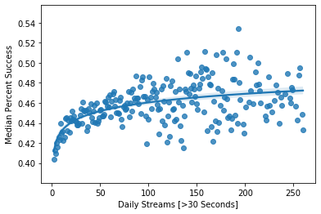
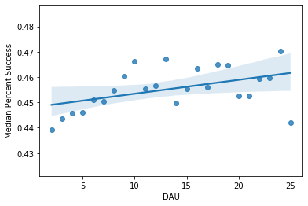
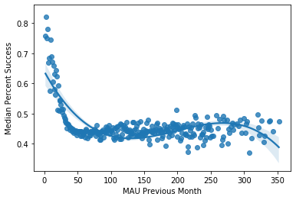
Potential Predictive Metrics
Pre-Usage / Composition KPIs
Tracks, Artists, Albums
Pre-Analysis / Early Usage KPIs
Daily Streams, DAU, MAU Previous Month
Notes:
Potential Predictive Metrics were chosen because we want to identify success in the future. It is not as helpful for us to know something was successful in the past.
Thus, this limits our metrics to two main categories – Pre-Usage or Composition KPIs and Pre-Analysis / Early Usage KPIs. Composition KPIs are metrics that can be known immediately upon playlist creation. Early usage are metrics that will be known before we can know our success KPI. Since our success KPI is defined in terms of current month, anything prior or smaller than a month is allowed.

Slide 6
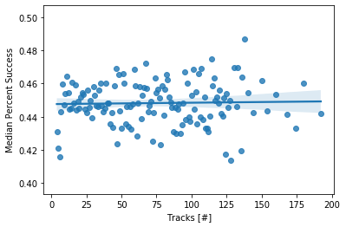
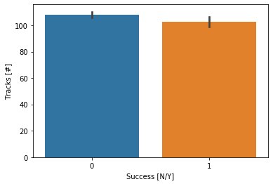
Tracks
Minimal Overall Negative Relationship
More Variance as number of Tracks Increases
Notes:
Let’s now begin on our composition KPIs. The track data shows that overall there is a negative relationship but that it is minimal and not statistically significant. It also shows that there is high variation in datapoints which leads to our conclusion that there is no one definition of a successful playlist for all playlist types.
Let’s move onto Artists and Albums

Slide 7
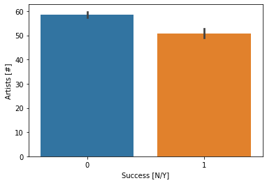
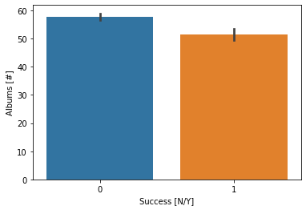
Artists & Albums
Overall Negative Relationship
But Both low and high # of Artists/Albums can result in High Percent Success
Notes:
For artists and albums there is an overall negative relationship meaning fewer artists and albums IN A SINGLE PLAYLIST overall had a higher percent success.
However, playlists classified as success had on average 50 artists and albums and there was higher percent success at both the lower and higher end thus showing the goldilocks zone.

Slide 8
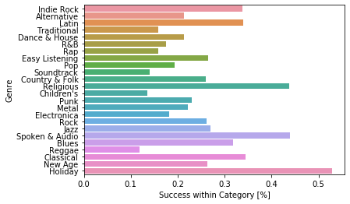
Genre
Holiday has the highest proportion of success
Notes:
Moving onto genre – you can see a large variation of success count percent within genre. Holiday had the highest percent success; along with religious. While these two categories were not statistically correlated, further investigation could show that the same users are common to both categories because many holidays are religious-based.
Genre was not monotonically correlated to percent success.

Slide 9
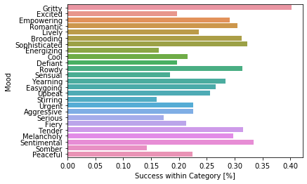
Mood
Gritty had the highest proportion of success
Notes:
Mood music shows a high variation too with Gritty mood music having the highest success count percent within the mood. Gritty music is unrefined sound; a common trait is obvious drumset on instrumental (ex. American Rejects; Phoenix) but mood can be subjective.
Like genre, mood was not correlated to percent success.

Slide 10
Next Step
Cluster Analysis of Successful Playlists within a User, Genre, and/or Mood Demographic
Notes:
What makes a successful playlist?
There is no on size fits all.
Too few artists, tracks, and albums, or streams and a playlist can get repetitive quickly or suffer from being unknown. To many and a playlist can become unrelevant to a user’s current desires and interests.
The large variance in the data and lack of monotonicity shows that there is a goldilocks zone for playlists and that to accurately define a successful playlist, the definition should be defined consistently across all of Spotify but within a focused, targeted, context such as a genre, user, and/or mood.
Thus the next step, is to do a cluster analysis.

Slide 11
Future Research & Implementation
Future Research
Include Artists/Songs Market Data and Number of Followers
Fit selected features into a predictive model and interpret feature importance
Expand to include more US data and more countries
Future Implementation
Targeted Questions behind Goals and Interests to Determine Recommended Playlist
Notes:
After an initial cluster analysis to prove the theory, you can expand into more data sets to get more specific and granular.
And then into implementations such as a system to identify the current interests of the customer at the time to make the most appropriate recommendations.

Slide 12

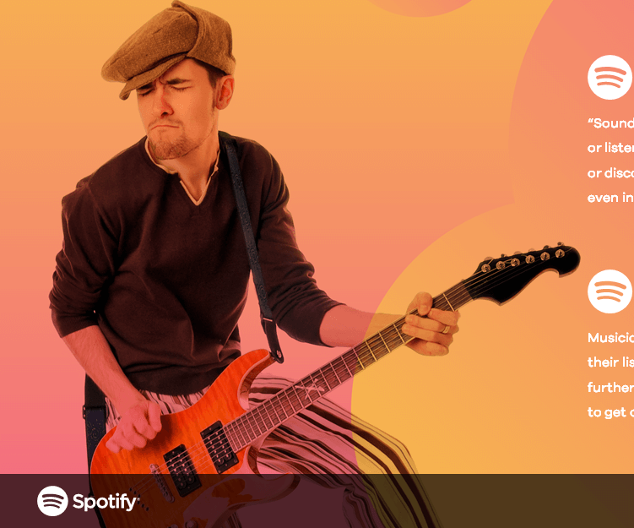
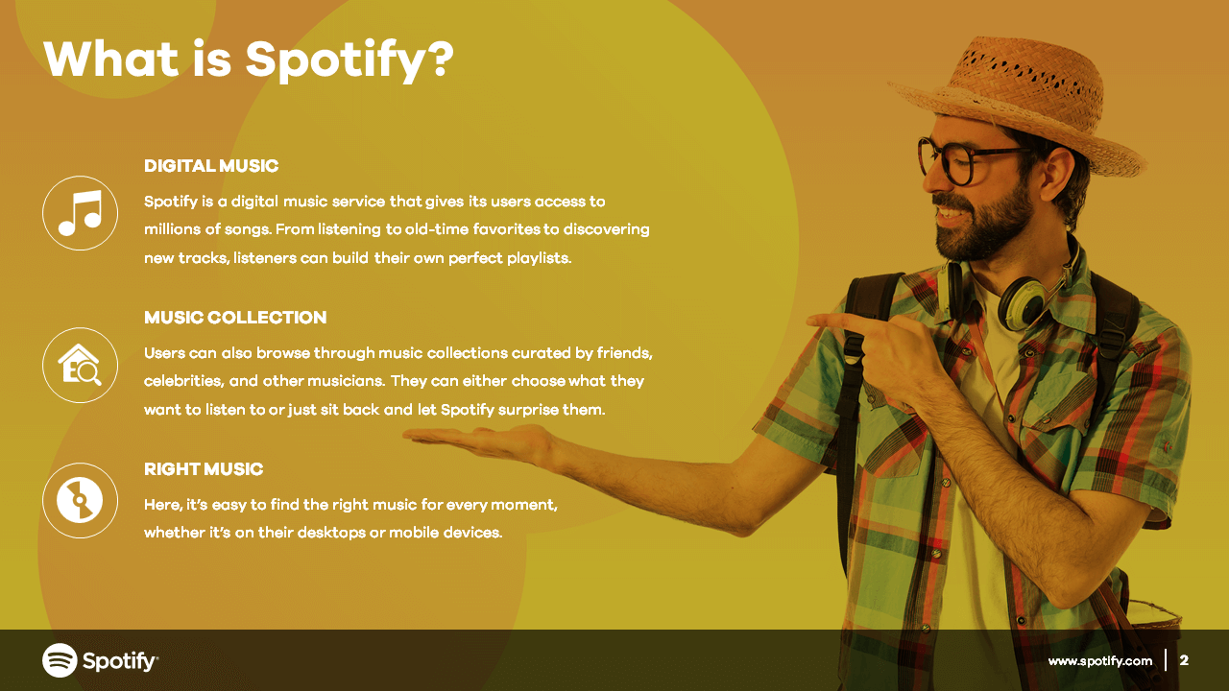
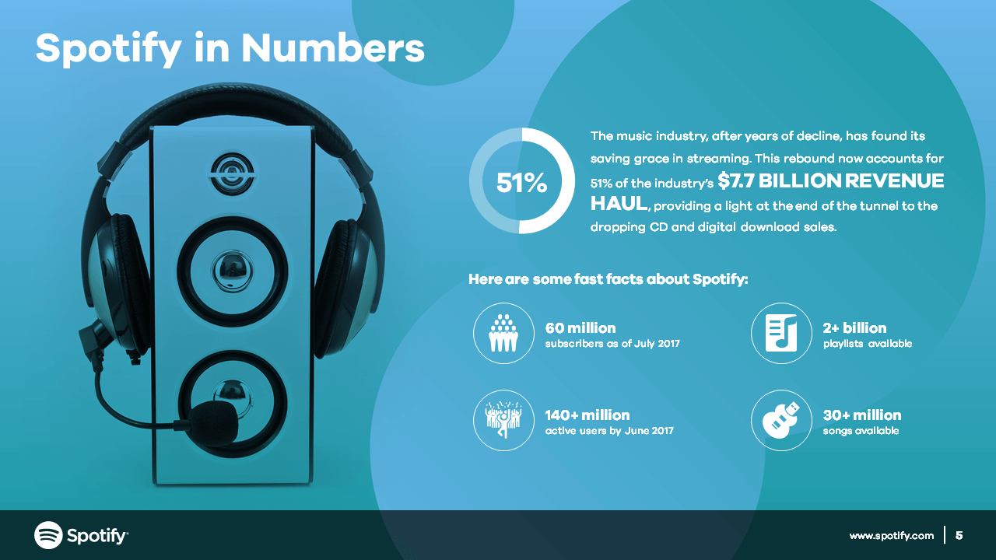
Thank You
Questions?

Slide 13
Appendix - Process
Applies to US Spotify Only
Non-Normal Distribution
Outliers removed using IQR (Median)
Spearman’s Correlation Used
Min 35 MAU playlists used
Genre and Mood only used the 1st / Highest Weighted Category
Analysis in terms of current Success Definition
Notes:
Interesting Find – Rap and Defiant are correlated

Slide 14
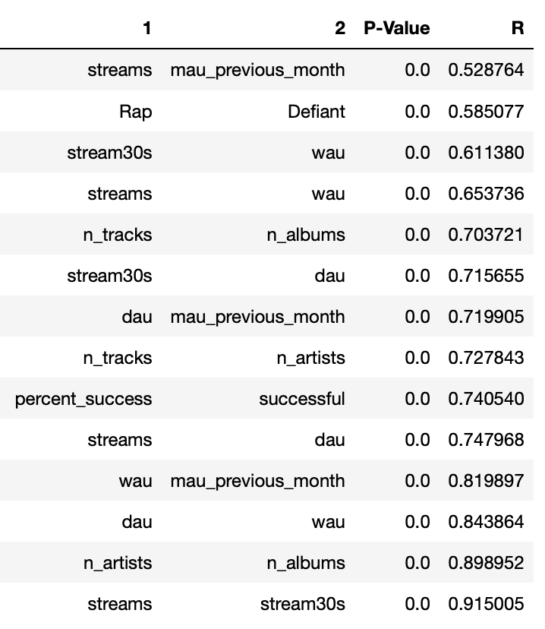
Appendix - Correlation
Notes:
Interesting Find – Rap and Defiant are correlated

Slide 15
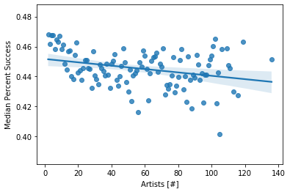
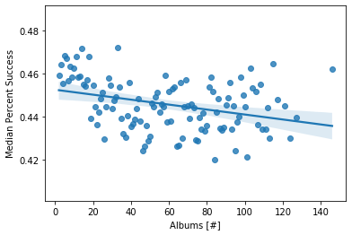
Appendix – Composition Graphs

Slide 16
Appendix – Code
Utilized Python Pandas, Numpy, Seaborn, Matplotlib, and Scipy

