Slide 1

Barry’s Bootcamp Seattle Expansion
Using K-means to find the ideal location for development
By: Kuan Yu Billy Chen, Feb 2020

Slide 2
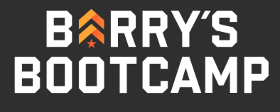
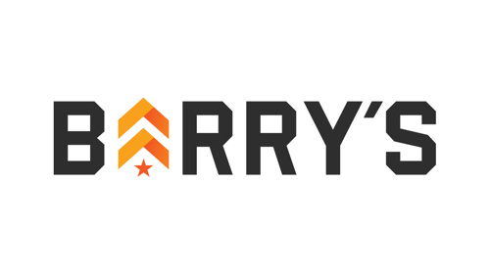
Introduction & Background
Millennials have become the majority of consumers today.
This generation is more focused on self-care and are more willingly to spend more on these activities than past generations:
Fitness
Mindfulness
Diet
Barry’s is one of the fastest growing boutique fitness studios.
Barry’s is focused on strategic expansion.
The millennial population and economic growth rate in Seattle are skyrocketing.
Barry’s is looking to open a second location in Seattle to accommodate the demand.

Slide 3

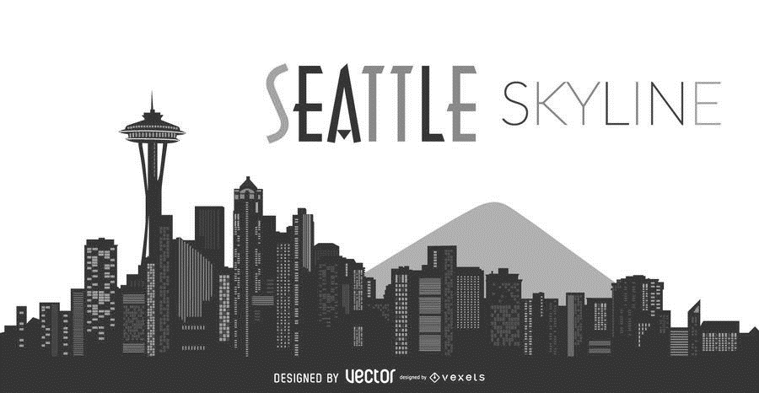
Introduction & Background
San Francisco is a well-established city that has a similar size, population, economic power, and industries to Seattle.
I will use the Barry’s locations in San Francisco as template to find the optimal locations for the Seattle expansion.
I will examine the surrounding venues/shops of these four San Francisco locations to find location patterns.
The Capitol Hill neighborhood has been chosen after some initial research of local consumers, spending, and lifestyle.
Within the Capitol Hill neighborhood, we will look for similar patterns as the San Francisco locations.

Slide 4

Data Collection & Source
Using the Foursquare API, I will be able to gather location data for the San Francisco Barry’s locations and Capitol Hill neighborhood’s popular venues:
Coordinates
Business categories
Distance from the Barry’s locations
The four Barry’s locations are as follows and the coordinates are derived from the addresses using the GeoPy library:
The Foursquare API’s explore search will yield the following information:
Locations: | atitude: | Longitude: | Address:
FiDi | 37.79046465 | -122.4030519 | 333 Bush St
Marina | 37.7996758 | -122.4385036 | 2246 Lombard St
SoMa | 37.77756473 | -122.392825 | 236 King St
Castro | 37.7648157 | -122.4327172 | 2280 Market Street
Field Name: | Data Type: | Description:
name | object | Venue name.
categories | object | Venue category.
address | object | Venue address.
cc | object | Venue country code.
city | object | Venue city.
country | object | Venue country.
crossStreet | object | The cross street from the provided location to explore.
distance | int64 | The distance from the provided location to explore.
formattedAddress | object | Formatted address displayed on the venue's information page.
labeledLatLngs | object | Formatted latitude and longitude.
lat | float64 | Latitude of the venue.
lng | float64 | Longitude of the venue.
neighborhood | object | The neighborhood of the location of the venue.
postalCode | object | Venue postal code.
state | object | Venue state.
id | object | Venue unique foursquare identifier.

Slide 5
Data Preprocessing
The results returned from the foursquare API has many unnecessary (duplicative or unhelpful) columns that will be dropped. Sample dataframe after cleaning:
name | categories | address | cc | city | country | cross Street | distance | formattedAddress | labeledLatLngs | lat | lng | neighborhood | postalCode | state | id
Pushkin | Russian Restaurant | 380 Bush St | US | San Francisco | United States | at Kearny St | 90 | [380 Bush St (at Kearny St), San Francisco, CA... | [{'label': 'display', 'lat': 37.79094301071348... | 37.79094 | -122.404 | NaN | 94104 | CA | 58cc4d2fe0adac17bbf4838e
Akiko’s Restaurant & Sushi Bar | Sushi Restaurant | 431 Bush St | US | San Francisco | United States | at Mark Ln. | 142 | [431 Bush St (at Mark Ln.), San Francisco, CA ... | [{'label': 'display', 'lat': 37.790623, 'lng':... | 37.79062 | -122.405 | NaN | 94108 | CA | 49e7e380f964a52027651fe3
Sababa | Mediterranean Restaurant | 329 Kearny St | US | San Francisco | United States | Bush | 130 | [329 Kearny St (Bush), San Francisco, CA 94108... | [{'label': 'display', 'lat': 37.791185, 'lng':... | 37.79119 | -122.404 | NaN | 94108 | CA | 5746063b498e3939498157c9
Satori Yoga Studio | Yoga Studio | 110 Sutter St #100 | US | San Francisco | United States | at Montgomery St | 69 | [110 Sutter St #100 (at Montgomery St), San Fr... | [{'label': 'display', 'lat': 37.79009789563369... | 37.7901 | -122.402 | NaN | 94104 | CA | 4acbef02f964a5205fc820e3
Blue Bottle Coffee | Coffee Shop | 199 Sutter St | US | San Francisco | United States | Kearny Street | 96 | [199 Sutter St (Kearny Street), San Francisco,... | [{'label': 'display', 'lat': 37.789744, 'lng':... | 37.78974 | -122.404 | NaN | 94104 | CA | 5daddd28a4f2c900078367c5
name | categories | distance | lat | lng | neighborhood | id
Cafe Okawari | Café | 108 | 37.77817 | -122.394 | NaN | 5cddccf91822230025707c7a
Petit Marlowe | Wine Bar | 99 | 37.7781 | -122.394 | NaN | 5941dd4ae2ead1688f35f615
Cento | Coffee Shop | 114 | 37.77814 | -122.394 | SoMa | 5ca6aa2db25fee0039757530
Tan Bella | Tanning Salon | 69 | 37.77701 | -122.393 | NaN | 4b09762ef964a520a41723e3
District | Wine Bar | 111 | 37.77851 | -122.393 | NaN | 461604b8f964a52045451fe3

Slide 6
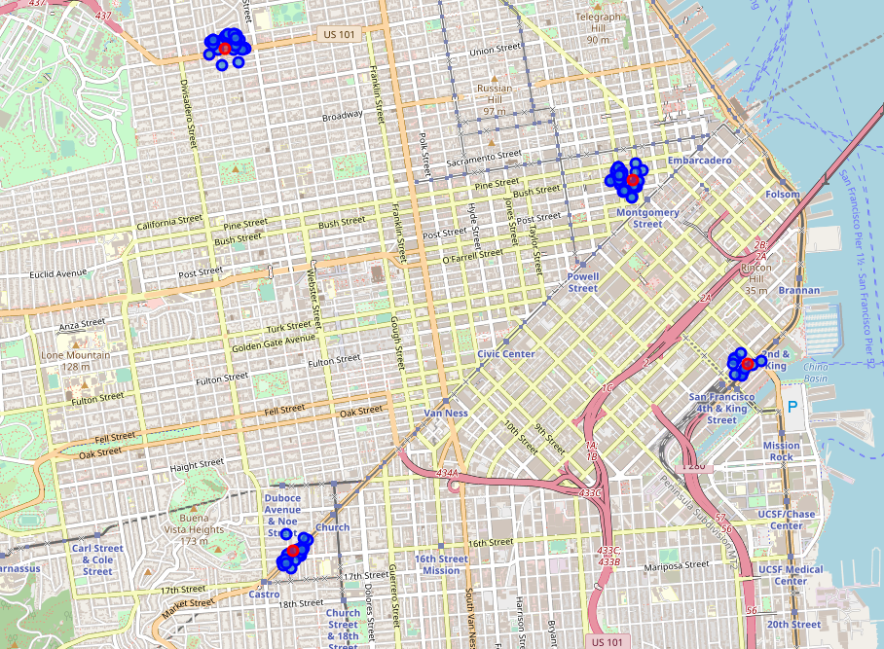
Exploratory analysis
This map shows the collected venues surrounding the four Barry’s locations in San Francisco.
Barry’s Bootcamp
Surrounding venue

Slide 7
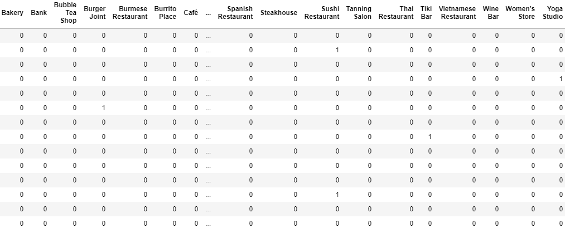
Exploratory Analysis
Combined the popular locations around the 4 Barry’s in San Francisco yield 115 lines.
Using one-hot encoding to turn the data into 0s (null) and 1s (is) for each venue category and sort the results to get the top location categories
Top Categories | Number of Venues
French Restaurant | 6
Gym | 6
Coffee Shop | 6
Sushi Restaurant | 5
Sandwich Place | 5
Burger Joint | 4
Salad Place | 3
Café | 3

Slide 8
Methodology
Using the San Francisco data, I learned that the most common type of venues surrounding Barry’s locations are:
French Restaurant
Gym
Coffee Shop
Sushi Restaurant
Sandwich Place
Burger Joint
Salad Place
Café
13 matching venues
In Seattle’s Capitol Hill neighborhood, there are 13 total venues that match these categories.
name | lat | lng
TRIBE Fitness | 47.624561 | -122.320756
Pro Sports Club | 47.62345 | -122.32955
Espresso Vivace | 47.623667 | -122.320692
Espresso Vivace Sidewalk Bar | 47.621634 | -122.321057
Joe Bar | 47.625108 | -122.321621
Victrola | 47.622364 | -122.312907
Analog Coffee | 47.620768 | -122.325448
Caffe Ladro | 47.623013 | -122.312765
Espresso Vivace | 47.620232 | -122.330508
Taneda Sushi In Kaiseki | 47.620583 | -122.3213
Dick's Drive-In | 47.619327 | -122.321076
Barjot | 47.625701 | -122.326748
Oddfellows Cafe & Bar | 47.614886 | -122.319493

Slide 9
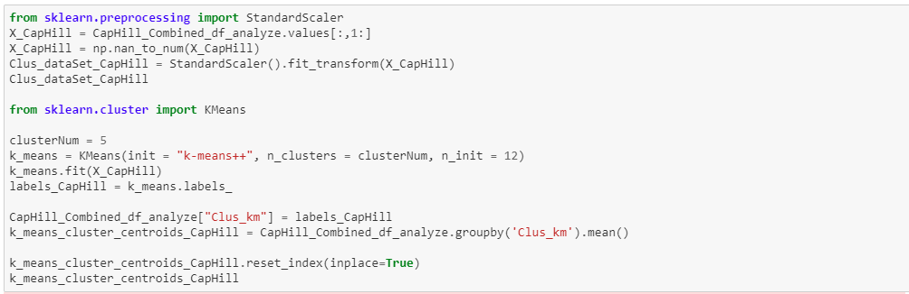
Methodology
Finally, I loaded the cleaned venue data from Seattle’s Capitol Hill neighborhood into the K-Means algorithm.
K = 5 clusters

Slide 10
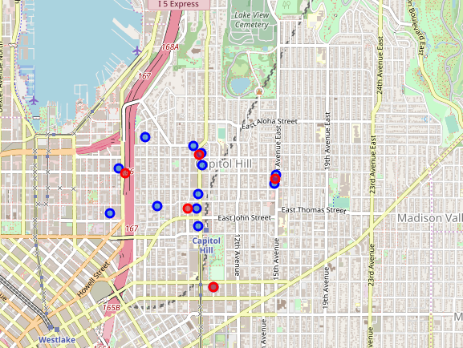
Results
The map below shows the 5 cluster centroids, which indicate possible locations for the second Barry’s bootcamp in Seattle.
Cluster | latitude | longitude
1 | 47.620578 | -122.32222
2 | 47.623128 | -122.328936
3 | 47.622689 | -122.312836
4 | 47.614886 | -122.319493
5 | 47.624446 | -122.321023
Possible Barry’s locations
Matching venues

Slide 11
Discussion
The data from the San Francisco locations points to high-end food and drink venues, which there are plenty of in Capitol Hill and centering the new Barry’s location around these venues will hopefully mimic the environment Barry’s wants their customers to feel.
Location data of popular venues may not produce the best recommendation for a new studio location, but it’s a good start. We will want to take in other features such as ease of transportation/commute, rent prices, average income, city ordinances, etc.
After the preprocessing phase, I was left with a limited number of data-points. If I were to repeat this study, I’d like to expand on my datasets, possible from other sources, to hopefully create better clusters.
I also noticed that one of my centroids does not seem to have any data points around it. This appears to be an outlier, and I believe I could mitigate this issue with more data.

Slide 12
Conclusion
The location data of popular locations in San Francisco helped me pinpoint ideal locations for a new Barry’s bootcamp in Seattle’s Capitol Hill neighborhood.
I believe that this data is a good starting point for Barry’s to continue their investigation, however, they’ll likely want to bring in more information about their consumers before making a final decision.
This has been an educational project that is applicable in other industries and business searching for physical locations to expand or open a new venue.

