Slide 1

Project1
A Simple Demonstration Of Big Data Analysis Using Apache Hive
By Robert Cheruiyot

Slide 2
introduction
A hypothetical coffeehouse chain has collected data over a period of time.
Data broadly divided into two categories each with three sets of information.
First set of data shows branches and coffee drinks they carry.
The second set of comprises of the number of consumption of each coffee drink.
We will use big data tools, specifically Hadoop and Apache Hive to answers questions requested by management.
Assume that our raw data is properly loaded to HDFS.

Slide 3
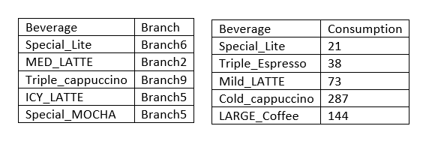
introduction

Slide 4
introduction
To solve the subsequent problems, we need to create tables for each set of data.
These are beverage/branch and beverage/count tables.
CREATE TABLE IF NOT EXISTS beverage_count_a(beverage string, count int) row format delimited fields terminated by ',' stored as textfile;
CREATE TABLE IF NOT EXISTS beverage_count_b(beverage string, count int) row format delimited fields terminated by ',' stored as textfile;
CREATE TABLE IF NOT EXISTS beverage_count_c(beverage string, count int) row format delimited fields terminated by ',' stored as textfile;

Slide 5
introduction
CREATE TABLE IF NOT EXISTS beverage_branch_a(beverage STRING, branch STRING) row format delimited fields terminated by ',' stored as textfile;
CREATE TABLE IF NOT EXISTS beverage_branch_b(beverage STRING, branch STRING) row format delimited fields terminated by ',' stored as textfile;
CREATE TABLE IF NOT EXISTS beverage_branch_c(beverage STRING, branch STRING) row format delimited fields terminated by ',' stored as textfile;
LOAD DATA INPATH '/user/project1/Bev_ConscountA.txt' OVERWRITE INTO TABLE beverage_count_a;

Slide 6
introduction
LOAD DATA INPATH '/user/project1/Bev_ConscountB.txt' OVERWRITE INTO TABLE beverage_count_b
LOAD DATA INPATH '/user/project1/Bev_ConscountC.txt' OVERWRITE INTO TABLE beverage_count_c;
LOAD DATA INPATH '/user/project1/Bev_BranchA.txt' OVERWRITE INTO TABLE beverage_branch_a;
LOAD DATA INPATH '/user/project1/Bev_BranchB.txt' OVERWRITE INTO TABLE beverage_branch_b;
LOAD DATA INPATH '/user/project1/Bev_BranchC.txt' OVERWRITE INTO TABLE beverage_branch_c;

Slide 7
Problem Scenario 1
What is the total number of consumers for Branch1?
Create beverages found in branch1
CREATE TABLE IF NOT EXISTS branch1 AS SELECT * FROM beverage_branch_a WHERE branch = 'Branch1';
INSERT INTO TABLE branch1 SELECT * FROM beverage_branch_b WHERE branch = 'Branch1';
INSERT INTO TABLE branch1 SELECT * FROM beverage_branch_c WHERE branch = 'Branch1’;
Create table of beverages consumed from branch1
CREATE TABLE IF NOT EXISTS branch1_cons_count (beverage STRING, count INT);

Slide 8
Problem Scenario 1
What is the total number of consumers for Branch1?
INSERT INTO TABLE branch1_cons_count select c.beverage, SUM(c.count) FROM branch1 b JOIN beverage_count_a c ON (c.beverage = b.beverage) GROUP BY c.beverage;
INSERT INTO TABLE branch1_cons_count select c.beverage, SUM(c.count) FROM branch1 b JOIN beverage_count_b c ON (c.beverage = b.beverage) GROUP BY c.beverage;
INSERT INTO TABLE branch1_cons_count select c.beverage, SUM(c.count) FROM branch1 b JOIN beverage_count_c c ON (c.beverage = b.beverage) GROUP BY c.beverage;
Sum all the beverages found in branch 1
SELECT SUM(count) AS `branch 1 consumers` FROM branch1_cons_count;

Slide 9
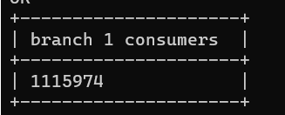
Problem Scenario 1
What is the total number of consumers for Branch1?

Slide 10
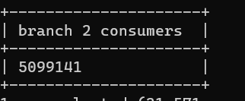
Problem Scenario 1
What is the total number of consumers for Branch2?

Slide 11
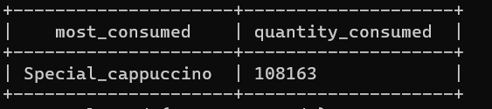
Problem Scenario 2
What is the most consumed beverage on Branch1
SELECT beverage , SUM(count) as total from branch1_cons_count GROUP BY beverage ORDER BY total DESC LIMIT 1;

Slide 12
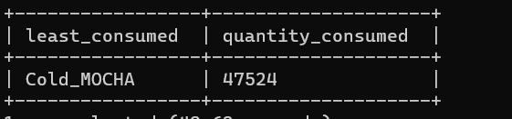
Problem Scenario 2
What is the least consumed beverage on Branch2
SELECT beverage , SUM(count) AS TOTAL FROM branch2_cons_count GROUP BY beverage ORDER BY total LIMIT 1;

Slide 13
Problem Scenario 3
What are the beverages available on Branch10, Branch8, and Branch1?
CREATE TABLE IF NOT EXISTS branch10_8_1 AS (
SELECT * FROM beverage_branch_a WHERE branch IN ('Branch1', 'Branch8', 'Branch10’)
UNION
SELECT * FROM beverage_branch_b WHERE branch IN ('Branch1', 'Branch8', 'Branch10’)
UNION
SELECT * FROM beverage_branch_c WHERE branch IN ('Branch1', 'Branch8', 'Branch10’)
);

Slide 14
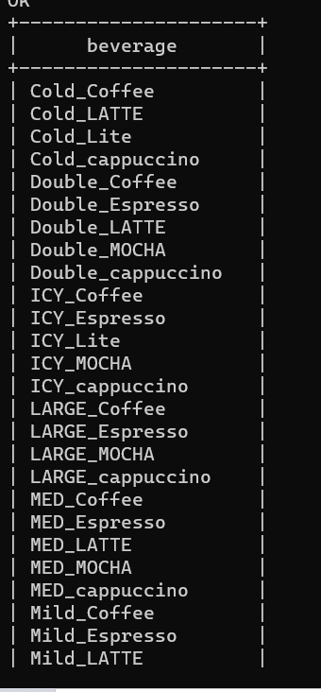
Problem Scenario 3
What are the beverages available on Branch10, Branch8, and Branch1?
SELECT * FROM branch10_8_1;

Slide 15
Problem Scenario 3
What are the common beverages available in Branch4,Branch7?
CREATE TABLE IF NOT EXISTS branch4 AS (
SELECT * FROM beverage_branch_a WHERE branch = 'Branch4’
UNION
SELECT * FROM beverage_branch_b WHERE branch = 'Branch4’
UNION
SELECT * FROM beverage_branch_c WHERE branch = 'Branch4’
);

Slide 16
Problem Scenario 3
What are the common beverages available in Branch4,Branch7?
CREATE TABLE IF NOT EXISTS branch7 AS (
SELECT * FROM beverage_branch_a WHERE branch = 'Branch7’
UNION
SELECT * FROM beverage_branch_b WHERE branch = 'Branch7’
UNION
SELECT * FROM beverage_branch_c WHERE branch = 'Branch7’
);

Slide 17
Problem Scenario 3
What are the common beverages available in Branch4,Branch7?
CREATE TABLE IF NOT EXISTS branch4_7 as (
SELECT beverage FROM branch7
INTERSECT
SELECT beverage FROM branch4
);

Slide 18
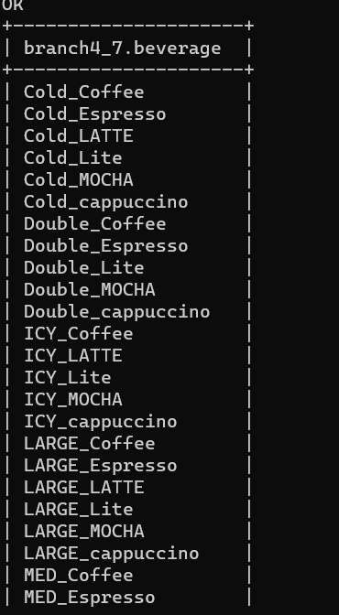
Problem Scenario 3
What are the beverages available on Branch10, Branch8, and Branch1?
SELECT * FROM branch4_7;

Slide 19
Problem Scenario 4
Create a partition, index, view for the scenario3.

Slide 20
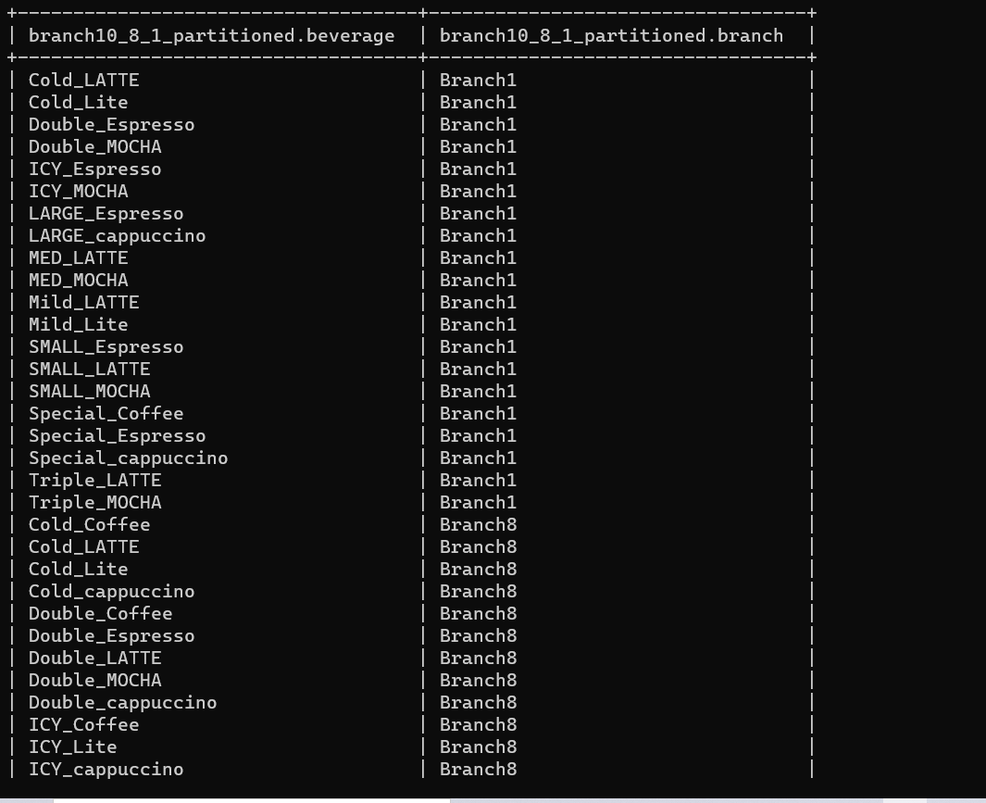
Problem Scenario 4 Create Partition
CREATE TABLE IF NOT EXISTS branch10_8_1_partitioned (beverage string) partitioned by (branch string);
INSERT INTO branch10_8_1_partitioned (
SELECT * FROM beverage_branch_a WHERE branch IN ('branch1', 'branch8', 'branch10')
UNION
SELECT * FROM beverage_branch_b WHERE branch IN ('branch1', 'branch8', 'branch10')
UNION
SELECT * FROM beverage_branch_c WHERE branch IN ('branch1', 'branch8', 'branch10'));

Slide 21
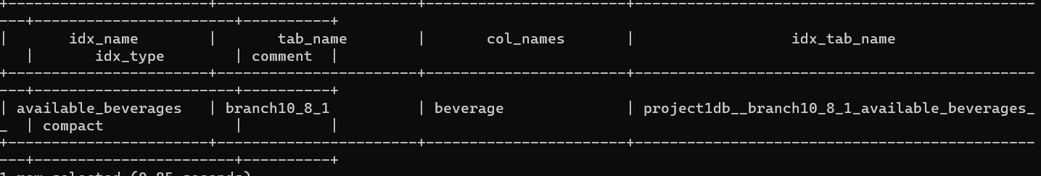
Problem Scenario 4 Create Index
CREATE INDEX available_beverages ON TABLE branch10_8_1(beverage) AS 'org.apache.hadoop.hive.ql.index.compact.CompactIndexHandler' WITH DEFERRED REBUILD;

Slide 22
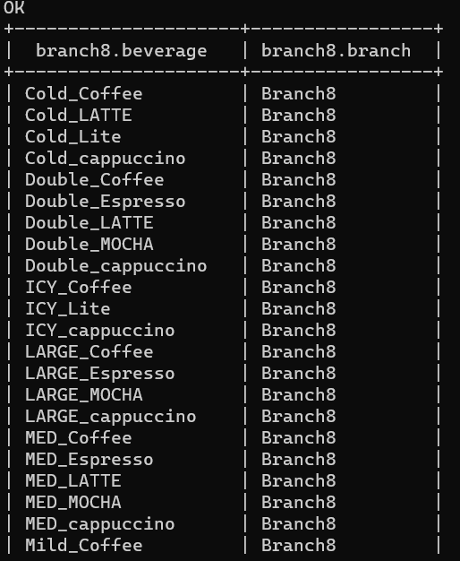
Problem Scenario 4 Create View
create view branch1_8 as select * from branch10_8_1 where branch='Branch1' or branch='Branch8';

Slide 23
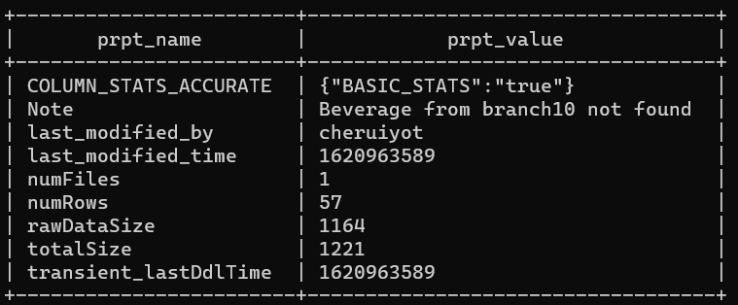
Problem Scenario 5
Alter the table properties to add "note","comment“
ALTER TABLE branch10_8_1 Set TBLPROPERTIES('Note'='Beverage from branch10 not found');

Slide 24
Problem Scenario 6
Remove the row 5 from the output of Scenario 1
INSERT INTO to_be_deleted (
SELECT b.beverage, b.branch from(
SELECT ROW_NUMBER() OVER(ORDER BY beverage) AS rownum, beverage, branch from branch10_8_1) b WHERE b.rownum=5);

Slide 25
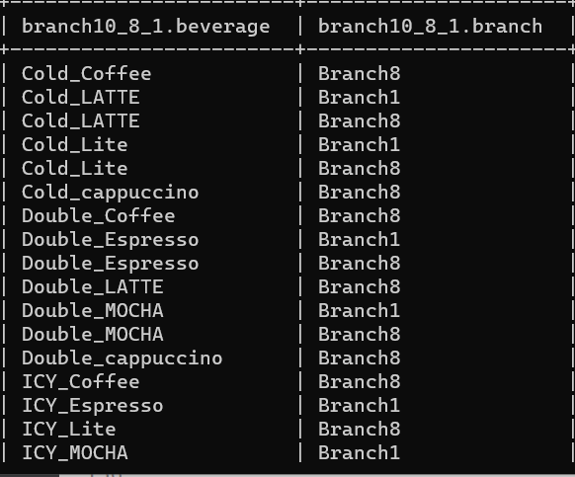
Problem Scenario 6
Remove the row 5 from the output of Scenario 1
INSERT OVERWRITE TABLE branch10_8_1 (
SELECT a.beverage, a.branch FROM branch10_8_1 a
LEFT OUTER JOIN to_be_deleted b
on a.beverage=b.beverage AND a.branch=b.branch
WHERE b.branch is null);

Slide 26
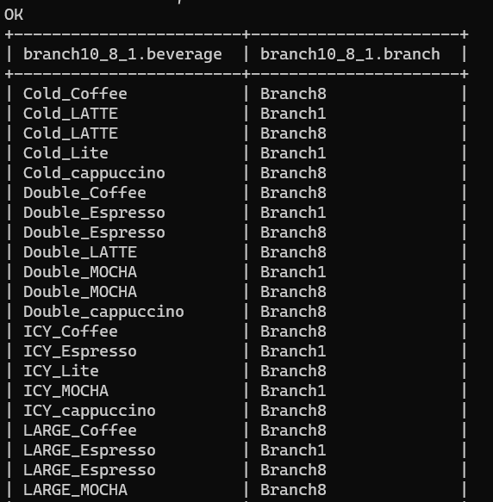
Problem Scenario 6
Remove the row 5 from the output of Scenario 1
INSERT OVERWRITE TABLE branch10_8_1 (
SELECT a.beverage, a.branch FROM branch10_8_1 a
LEFT OUTER JOIN to_be_deleted b
on a.beverage=b.beverage AND a.branch=b.branch
WHERE b.branch is null);

Slide 27
Thank you

