Slide 1
DOCUMENT SUMMARIZER
BY,
GROUP 15 (IRE @ IIIT-HYDERABAD)
MENTOR:MR.LITTON J KURISINKEL
CHETAN KASIREDDY
ANKIT YADAV
SAMEER JAIN
AVINASH R

Slide 2
WHAT IS DOCUMENT SUMMARIZER?
Summarizer can analyze a text of any length, on any subject and create a document summary as short as possible.

Slide 3
What’s the use of it?
Suppose a huge document is given
So to get an overview of the document the summary could be read .

Slide 4
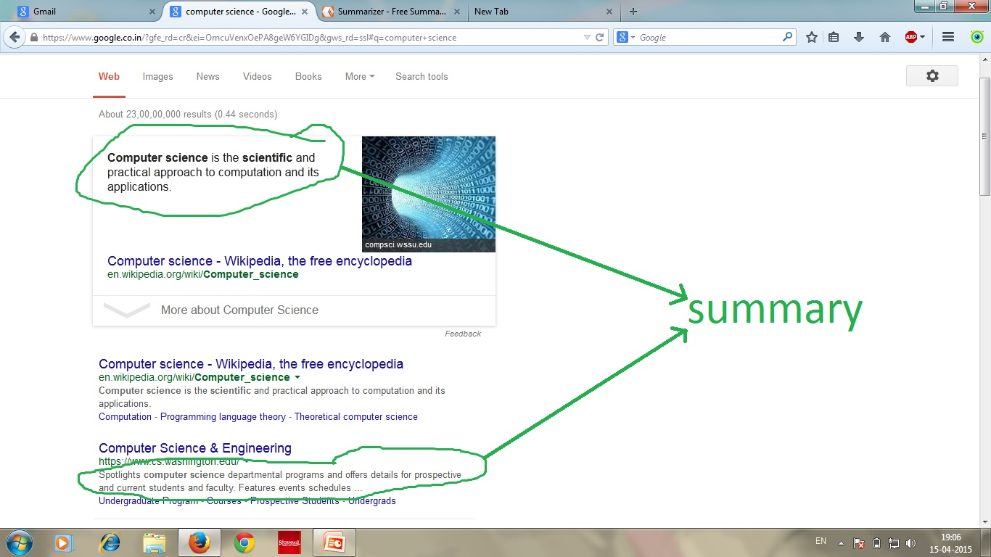

Slide 5
HOW IS IT DONE?
The given input document is extracted using the apache tika parser.
The summarizer which should be used to summarize the text is given by the user .
The system generates a summary of three to four lines of input text .

Slide 6
WHAT IS THE BASIC FUNCTIONALITY OF THE PROJECT?
SIMPLY TO SUMMARIZE THE GIVEN DOCUMENT OF ANY FORMAT.
Input File formats supported .txt,.doc,.docx,.ppt,.pdf …….

Slide 7
SO WHAT’S NEW ?
URL SUMMARY
Given a url of a webpage something like a wikipedia page our summarizer can summarize the web page also.

Slide 8
Is there something more?
Yes,
What if we want to check upto what extent the summarization is correct.
For the above task WORD2VEC model is applied.
An important feature any new summarizer can be added.

Slide 9
Word2vec model
Obtain a list of computer science terms from the DMOZ site(a taxonomy site)
For each term, get the relevant Wikipedia article
Create a corpus document out of all the Wikipedia articles
Use the Word2Vec engine to get a binary model from the obtained corpus document

Slide 10
Dataset
For our project we have trained the Word2vec model with the www.dmoz.org content.
So whatever the words in the summary are there ,the relevance with the computer science domain (ww.dmoz.org’s contents) is checked and the cosine values’ are summed up to get the final value of relevance of a summary.

Slide 11
Scoring
Get the similarity measure of each word using the word2vec similarity.
The similarity measure of each word is found by averaging the similarity scores for all the 10 words given as output.
After extracting the average score for each word , the total score for the summary is found by averaging the score for all the words.

Slide 12
Application domain of the project
In search engines where summary of a url could be displayed so that the decision could be made , whether the webpage is desirable or not.
For large documents to get the idea about (what the document is about ) .
And many more.

