Slide 1
ALGORAND
BYZANTINE AGREEMENT
IN DISTALGO
Chetan Kasireddy, Sai Parthasarathy, Zenab Bhinderwala

Slide 2
Project Overview
Algorand is a blockchain based cryptocurrency which confirms transactions within a minute and ensures users do not have divergent confirmed transactions in the presence of malicious users or a weakly synchronous network.
The core of Algorand uses a Byzantine Agreement algorithm called BA* which allows Algorand to reach consensus on a new block with low latency and without the possibility of forks.

Slide 3

Proposal Step
Broadcast (Gossip)cast Gossip
Highest Priority Proposed block selected
BA* starts here
Broadcast (Gossip)cast Gossip
Reduction starts here
Reduction step 1
Notes:
The Proposal step is when some of the users are selected to propose a block and send it to their neighbours which then gossip about this proposal to their peers and so on.
All the users keep the highest priority block and discard the rest and then start BA* with this block.
In the Reduction step 1 the committee members vote for the blocks and return the block with votes greater than the threshold within lambda_step time else it timesout and returns empty block

Slide 4
Broadcast (Gossip)cast Gossip
Reduction step 2
Broadcast (Gossip)cast Gossip
Binary BA* is performed
Binary BA* step 1
Broadcast (Gossip)cast Gossip
Notes:
Reduction step 2 takes the output of Reduction step 1 and start the committee gossip and voting process again to ensure any empty hash proposed earlier does not get sufficient enough votes and we get the highest block as the output.
Binary BA* does the Committee votes and for N steps , in ideal case Binary BA* will exit in first step only when consensus is reached.

Slide 5
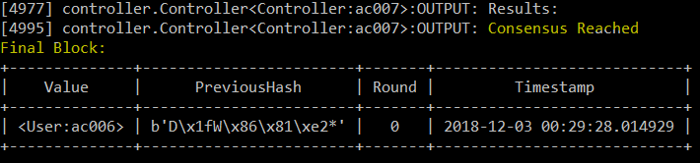
Binary BA* step N
Final Votes are counted
Broadcast (Gossip)cast Gossip
Consensus reached

Slide 6
Implementation Complexities
Algorand uses a Cryptographic Sortition algorithm based on Verifiable Random Functions (VRFs) to choose committees and proposers from users holding greater stakes (assumed to be more honest users, with investment in the currency).
We spent the first two weeks figuring out ways to abstract the functionalities provided by the VRFs, by using a Controller to assign tasks.
The Controller process assigns stakes to each user every round, as a probability distribution.
The sum of probabilities of all traitors is equal to total stake of traitors, and total available stake is 1.0.
Probability is used to randomly select committee members for each step.
Controller also prevents users from knowing who other committee members are until voting is done.
Neighbors of each user for gossip are determined by randomly choosing 2 or more neighbors, and ensuring connectivity.
Controller notifies chosen traitors about the way they must fail in that round.
Notes:
We faced some issues translating the Algorand algorithm to Distalgo code.

Slide 7
Byzantine Failures
We have examined byzantine faults in our implementation in the following ways:
Proposers
The highest priority proposer sends 2 different versions of the block to different (non-overlapping) sets of receivers.
All traitor users who are proposers will propose multiple blocks to increase the time spent by users to process these.
Committee Members
Committee Members vote for Empty blocks or introduce new fake blocks and block hashes into the system
A “Sybil Attack” is also simulate-able by increasing the number of traitor users in the system, but they all still have the same total of stake. Detrimental to adversary’s goal.
The algorithm checks against more trivial attacks, such as spoofing another user, or modifying Gossiped messages, by using Public Key Security. So we have not simulated these kinds of attacks.

Slide 8
Results: Correctness
Agreement is satisfied if BA* in all the users returns the same block as tentative or final consensus.
Validity is satisfied if the agreed block is either a proposed block or an empty block.
Liveness is satisfied if the BinaryBA* returns a block_hash before maximum steps are reached.
Notes:
We have used the following criteria for correctness as per the paper.

Slide 9
Results: Correctness
Varying Number of users
Users | Traitors | Stake traitors | Tau_step (No. of Committee members) | Lambda_block (Timeout for receiving a block) | Lambda_step (Timeout for BA* step) | Consensus | Agreement | Validity | Liveness
20 | 5 | 0.33 | 5 | 4 | 4 | Final | ✅ | ✅ | ✅
26 | 5 | 0.33 | 5 | 4 | 4 | Final | ✅ | ✅ | ✅
32 | 5 | 0.33 | 5 | 4 | 4 | Final | ✅ | ✅ | ✅
38 | 5 | 0.33 | 5 | 4 | 4 | Final | ✅ | ✅ | ✅
44 | 5 | 0.33 | 5 | 4 | 4 | Final | ✅ | ✅ | ✅
50 | 5 | 0.33 | 5 | 4 | 4 | Final | ✅ | ✅ | ✅
Varying Number of traitors
Users | Traiators | Stake Traitors | Tau_step | Lambda_block | Lambda_step | Consensus | Agreement | Validity | Liveness
30 | 0 | 0.33 | 5 | 4 | 4 | Final | ✅ | ✅ | ✅
30 | 3 | 0.33 | 5 | 4 | 4 | Final | ✅ | ✅ | ✅
30 | 7 | 0.33 | 5 | 4 | 4 | Final | ✅ | ✅ | ✅
30 | 11 | 0.33 | 5 | 4 | 4 | Final | ✅ | ✅ | ✅
30 | 15 | 0.33 | 5 | 4 | 4 | Final | ✅ | ✅ | ✅
Notes:
We can see that varying the number of users and number of traitors in the system does not change the correctness of the result, and the consensus reached is final, as the stake of the traitors is less than 33 percent.

Slide 10
Varying Stake of traitors
Users | Traiators | Stake Traitors | Tau_step | Lambda_block | Lambda_step | Consensus | Agreement | Validity | Liveness
30 | 5 | 0 | 5 | 4 | 4 | Final | ✅ | ✅ | ✅
30 | 5 | 0.072 | 5 | 4 | 4 | Final | ✅ | ✅ | ✅
30 | 5 | 0.144 | 5 | 4 | 4 | Final | ✅ | ✅ | ✅
30 | 5 | 0.216 | 5 | 4 | 4 | Final | ✅ | ✅ | ✅
30 | 5 | 0.288 | 5 | 4 | 4 | Final | ✅ | ✅ | ✅
30 | 5 | 0.36 | 5 | 4 | 4 | Tentative | ✅ | ✅ | ✅
Varying Tau_step ( No. of committee members at every step of Binary BA*)
Users | Traiators | Stake Traitors | Tau_step | Lambda_block | Lambda_step | Consensus | Agreement | Validity | Liveness
30 | 5 | 0.33 | 5 | 3 | 3 | Final | ✅ | ✅ | ✅
30 | 5 | 0.33 | 7 | 3 | 3 | Final | ✅ | ✅ | ✅
30 | 5 | 0.33 | 10 | 3 | 3 | Final | ✅ | ✅ | ✅
30 | 5 | 0.33 | 12 | 3 | 3 | Final | ✅ | ✅ | ✅
30 | 5 | 0.33 | 15 | 3 | 3 | Final | ✅ | ✅ | ✅
Notes:
While varying the stake of the traitors, as it goes above 0.33 the tentative consensus reached.

Slide 11
Varying Wait Time for receiving a proposal (Lambda_block)
Users | Traiators | Stake Traitors | Tau_step | Lambda_block | Lambda_step | Consensus | Agreement | Validity | Liveness
30 | 5 | 0.33 | 10 | 0.1 | 3 | Final | ✅ | ✅ | ✅
30 | 5 | 0.33 | 10 | 0.88 | 3 | Final | ✅ | ✅ | ✅
30 | 5 | 0.33 | 10 | 1.66 | 3 | Final | ✅ | ✅ | ✅
30 | 5 | 0.33 | 10 | 2.44 | 3 | Final | ✅ | ✅ | ✅
30 | 5 | 0.33 | 10 | 3.22 | 3 | Final | ✅ | ✅ | ✅
30 | 5 | 0.33 | 10 | 4 | 3 | Final | ✅ | ✅ | ✅
Varying Timeout for Counting votes ( Lambda_step)
Users | Traiators | Stake Traitors | Tau_step | Lambda_block | Lambda_step | Consensus | Agreement | Validity | Liveness
30 | 5 | 0.33 | 10 | 3 | 0.5 | Final | ✅ | ✅ | ✅
30 | 5 | 0.33 | 10 | 3 | 1.2 | Final | ✅ | ✅ | ✅
30 | 5 | 0.33 | 10 | 3 | 1.9 | Final | ✅ | ✅ | ✅
30 | 5 | 0.33 | 10 | 3 | 2.6 | Final | ✅ | ✅ | ✅
30 | 5 | 0.33 | 10 | 3 | 3.3 | Final | ✅ | ✅ | ✅
30 | 5 | 0.33 | 10 | 3 | 4 | Final | ✅ | ✅ | ✅

Slide 12
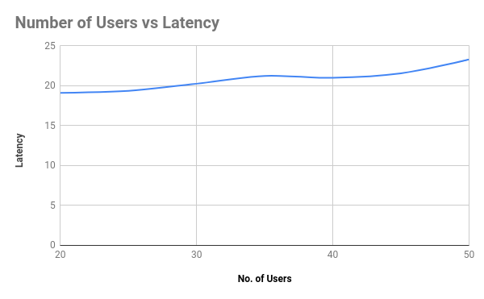
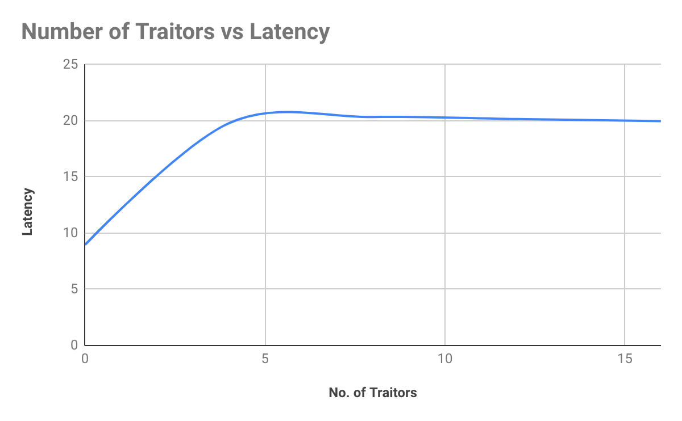
Results: Performance
Notes:
The paper compares there parameters vs latency
The latency is almost same even if the no. of users increase or no. of traitors increase., when the committee size is constant.
The results are almost identical to those presented in the paper.

Slide 13
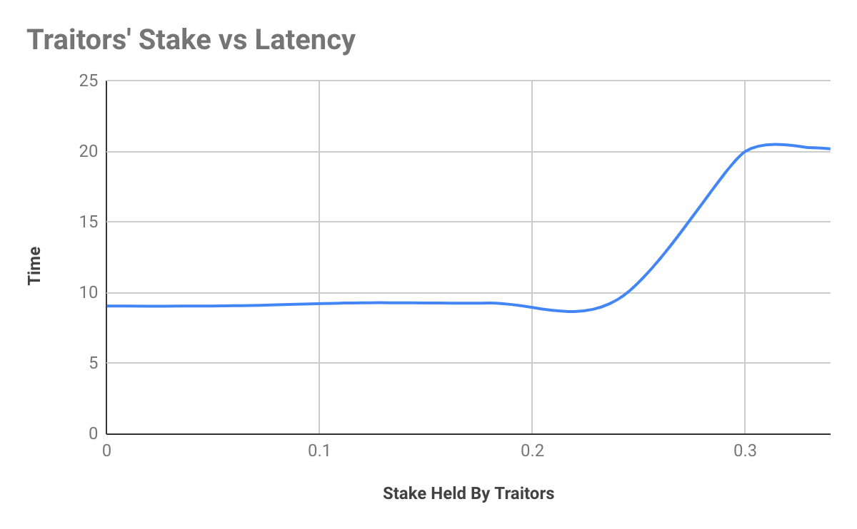
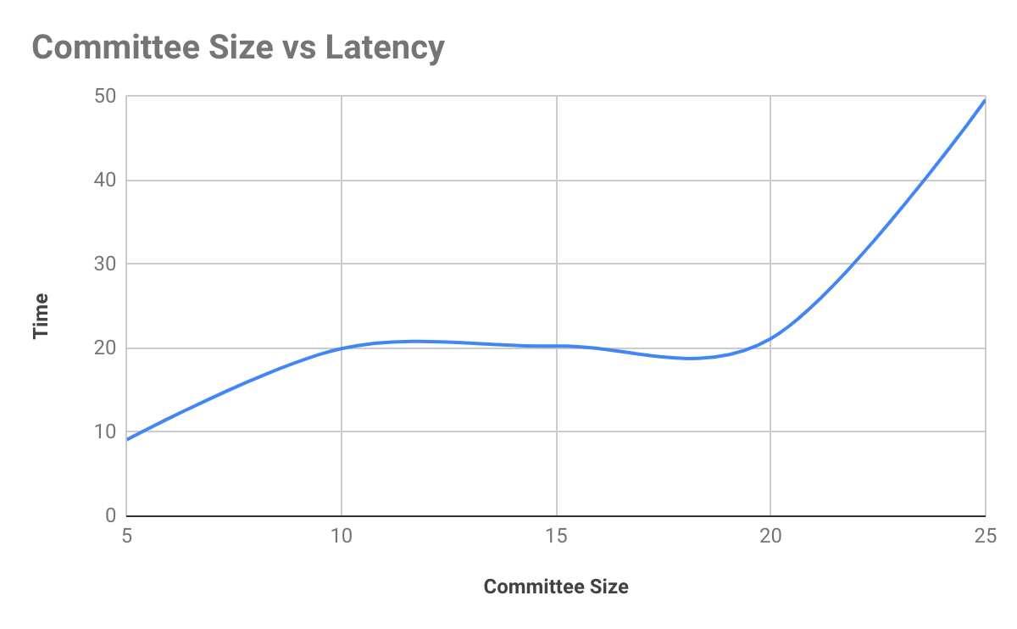
Results: Performance
Notes:
These parameters were not compared in the paper, we thought it would be interesting to see.
As the traitors stake approaches 0.33 the latency increases because the consensus takes more steps to reach the threshold number of votes despite traitor committee members.
As committee size increases, we expect the latency to increase because more messages are exchanged and the threshold rises.

Slide 14
QUESTIONS?
THANK YOU

