Slide 1
Object Oriented Programming in JAVA

Slide 2
Introduction

Slide 3
Course Objectives
On completion of this course we will be able to:
Little History of Java
Identify the additional features of Java compared to C++ .
Identify the difference between Compiler and Interpreter .
Identify the difference between applet and application .
Apply Object Oriented Principles of Encapsulations, Data abstraction, Inheritance, Polymorphism.
Program using java API (Application Programming Interface).
Program using Exception Handling, Files and Threads .
Program Using applets and swings .

Slide 4
History
James Gosling - Sun Microsystems
Oak - Java, May 20, 1995, Sun World
JDK Evolutions
JDK 1.0 (January 23, 1996)
JDK 1.1 (February 19, 1997)
J2SE 1.2 (December 8, 1998)
J2SE 1.3 (May 8, 2000)
J2SE 1.4 (February 6, 2002)
J2SE 5.0 (September 30, 2004)
Java SE 6 (December 11, 2006)
Java SE 7 (July 28, 2011)
Java SE 8 (Apr, 2014)
Notes:
Java was conceived by james gosling,patrick naughton….
Java was initially called as Oak..
But renamed as java in 1995
Standard edition, management edition, enterprise edition (used for adv.. Java concepts)
You can write the java program in any editors, notepads. But it will be easy if you use editplus

Slide 5

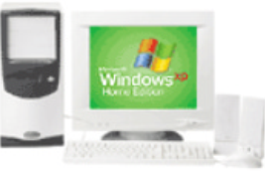
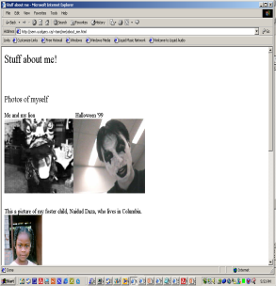

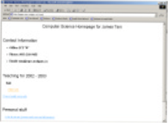
Java: History
The popularity of the Internet resulted in Sun’s re-focusing of Java on computers.
Prior to the advent of Java, web pages allowed you to download only text and images.
Your computer at home running a web browser
Server containing a
web page
User clicks on a link
Images and text get downloaded

Slide 6
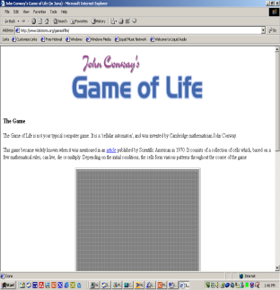
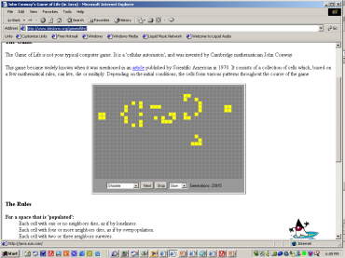
Java: History
Java enabled web browsers allowed for the downloading of programs (Applets).
Java is still used in this context today:
Facebook (older version)
Hotmail (older version)
Your computer at home running a web browser
Server containing a web page
User clicks on a link
Java Applet downloaded
Java version of the Game of Life: http://www.bitstorm.org/gameoflife/
Online checkers: http://www.darkfish.com/checkers/index.html

Slide 7
Why Java is Important
Two reasons :
Trouble with C/C++ language is that they are not portable and are not platform independent languages.
Emergence of World Wide Web, which demanded portable programs
Portability and security necessitated the invention of Java

Slide 8
Cont..
Java Editions.
J2SE(Java 2 Standard Edition) - to develop client-side standalone applications or applets.
J2ME(Java 2 Micro Edition ) - to develop applications for mobile devices such as cell phones.
J2EE(Java 2 Enterprise Edition ) - to develop server-side applications such as Java servlets and Java ServerPages.

Slide 9
What is java?
A general-purpose object-oriented language.
Write Once Run Anywhere (WORA).
Designed for easy Web/Internet applications.
Widespread acceptance.
Notes:
Due to the simillarities of java with C++ it si called “Internet version of C++”
Based on C/C++

Slide 10
How is Java different from C…
C Language:
Major difference is that C is a structure oriented language and Java is an object oriented language and has mechanism to define classes and objects.
Java does not support an explicit pointer type
Java does not have preprocessor, so we cant use #define, #include and #ifdef statements.
Java does not include structures, unions and enum data types.
Java does not include keywords like goto, sizeof and typedef.
Java adds labeled break and continue statements.
Java adds many features required for object oriented programming.

Slide 11
How is Java different from C++…
C++ language
Features removed in java:
Java doesn’t support pointers to avoid unauthorized access of memory locations.
Java does not include structures, unions and enum data types.
Java does not support operator over loading.
Preprocessor plays less important role in C++ and so eliminated entirely in java.
Java does not perform automatic type conversions that result in loss of precision.

Slide 12
Cont…
Java does not support global variables. Every method and variable is declared within a class and forms part of that class.
Java does not allow default arguments.
Java does not support inheritance of multiple super classes by a sub class (i.e., multiple inheritance). This is accomplished by using ‘interface’ concept.
It is not possible to declare unsigned integers in java.
In java objects are passed by reference only. In C++ objects may be passed by value or reference.

Slide 13
Cont …
New features added in Java:
Multithreading, that allows two or more pieces of the same program to execute concurrently.
C++ has a set of library functions that use a common header file. But java replaces it with its own set of API classes.
It adds packages and interfaces.
Java supports automatic garbage collection.
break and continue statements have been enhanced in java to accept labels as targets.
The use of unicode characters ensures portability.

Slide 14
Cont …
Features that differ:
Though C++ and java supports Boolean data type, C++ takes any nonzero value as true and zero as false. True and false in java are predefined literals that are values for a boolean expression.
Java has replaced the destructor function with a finalize() function.
C++ supports exception handling that is similar to java's. However, in C++ there is no requirement that a thrown exception be caught.

Slide 15
Characteristics of Java
Java is simple
Java is object-oriented
Java is distributed
Java is interpreted
Java is robust
Java is architecture-neutral
Java is portable
Java’s performance
Java is multithreaded
Java is dynamic
Java is secure

Slide 16
Java Environment
Java includes many development tools, classes and methods
Development tools are part of Java Development Kit (JDK) and
The classes and methods are part of Java Standard Library (JSL), also known as Application Programming Interface (API).
JDK constitutes of tools like java compiler, java interpreter and many.
API includes hundreds of classes and methods grouped into several packages according to their functionality.

Slide 17
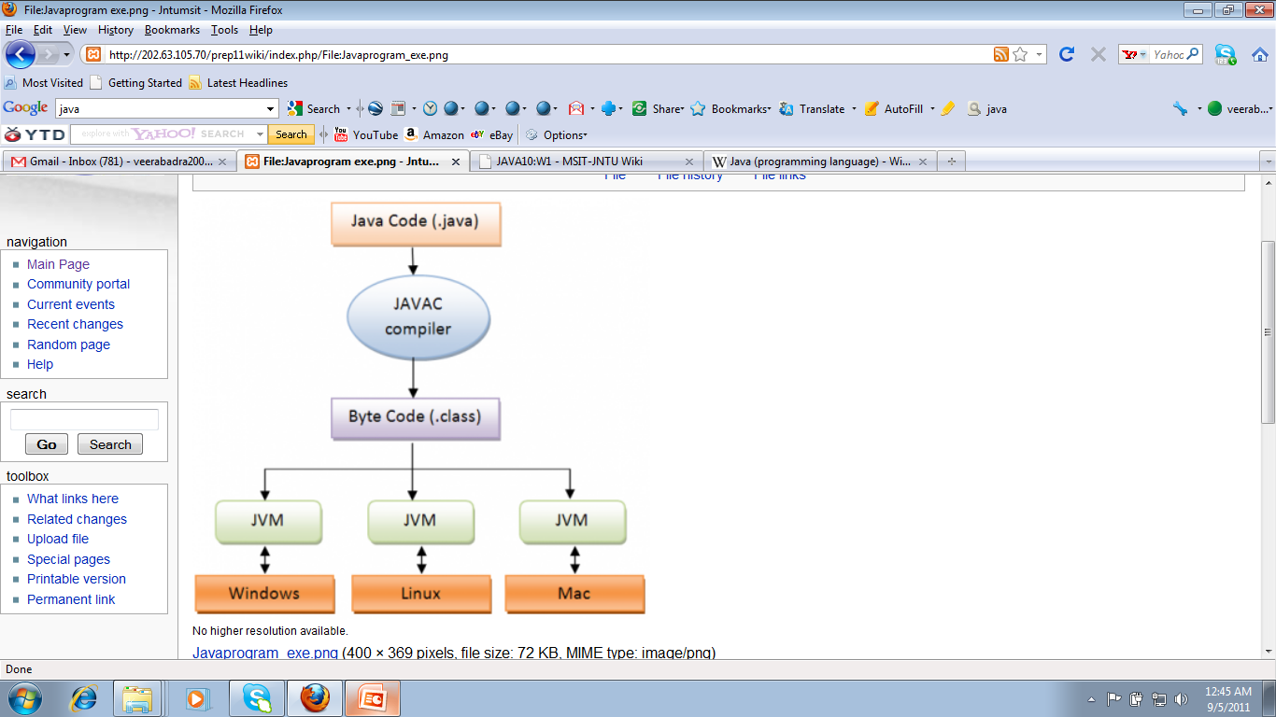
Java is architecture-neutral
JAVA Program Execution

Slide 18
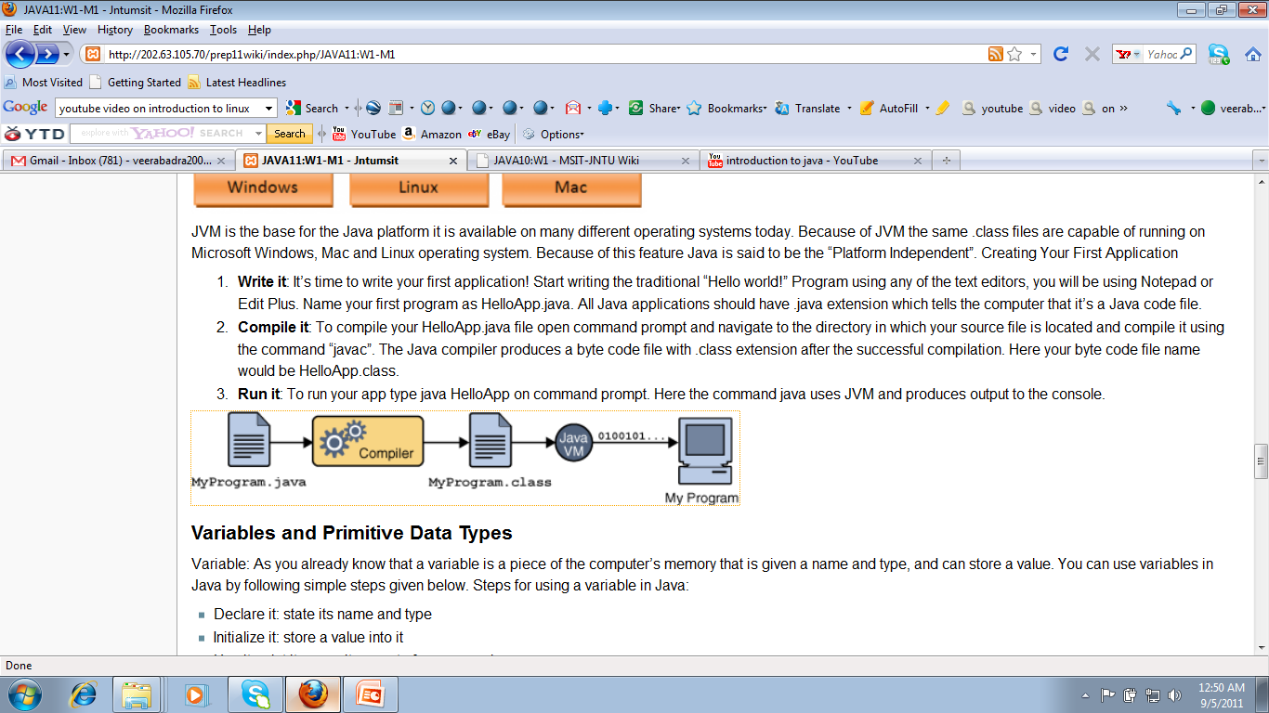
WORA(Write Once Run Anywhere)

Slide 19

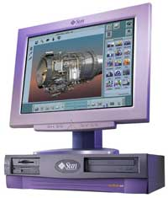
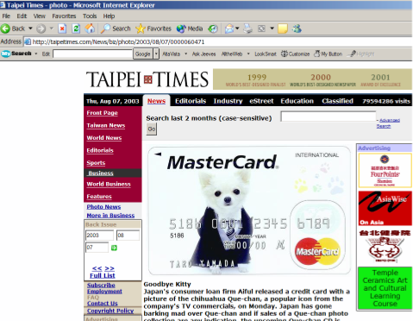

Java: Write Once, Run Anywhere
Consequence of Java’s history: platform-independence
Click on link to Applet
Mac user running Safari
Virtual machine translates byte code to
native Mac code and the Applet is run
Web page stored on Unix server
Byte code is downloaded
Windows user running Internet Explorer
Byte code (part of web page)

Slide 20
Java: Write Once, Run Anywhere
Consequence of Java’s history: platform-independent
Mac user running Safari
Web page stored on Unix server
Click on link to Applet
Byte code is downloaded
Windows user running Internet Explorer
Virtual machine translates byte code to
native Windows code and the Applet is run

Slide 21
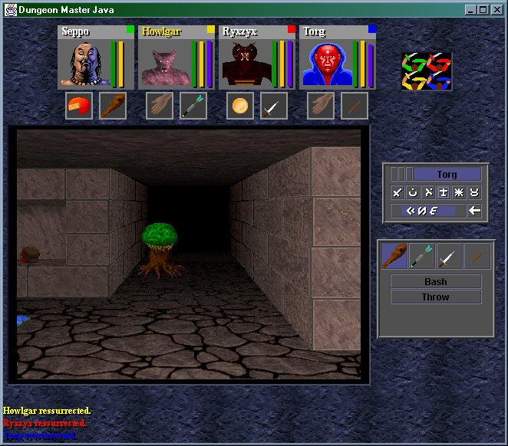

Java: Write Once, Run Anywhere (2)
But Java can also create standard (non-web based) programs
Dungeon Master (Java version)
http://homepage.mac.com/aberfield/dmj/
Kung Fu Panda 2: THQ
Examples of mobile Java games: http://www.mobilegamesarena.net

Slide 22
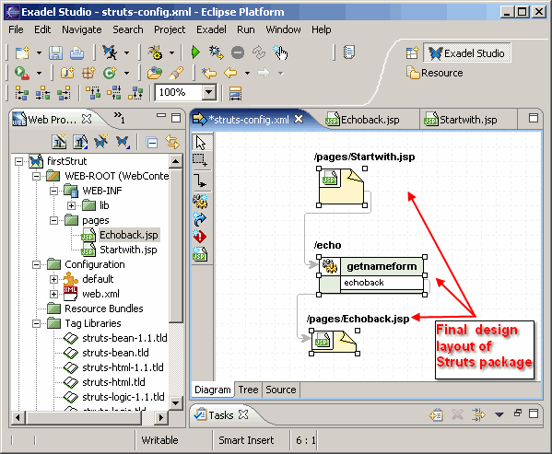
Java: Write Once, Run Anywhere (3)
Java has been used by large and reputable companies to create serious stand-alone applications.
Example:
Eclipse: started as a programming environment created by IBM for developing Java programs. The program Eclipse was itself written in Java.

Slide 23
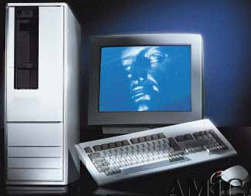
Compiled Programs With Different Operating Systems
Windows compiler
Executable (Windows)
Computer program
Mac OS compiler
Executable (Mac)
UNIX compiler
Executable (UNIX)

Slide 24
A High Level View Of Translating/Executing Java Programs
Stage 1: Compilation
Filename.java
Java compiler (javac)
Filename.class
Java program
Java bytecode (generic binary)

Slide 25
A High Level View Of Translating/Executing Java Programs (2)
Stage 2: Interpreting and executing the byte code
Machine language instruction (UNIX)
Filename.class
Java interpreter (java)
Machine language instruction (Windows)
Java bytecode (generic binary)
Machine language instruction (Apple)

Slide 26
Smallest Compilable And Executable Java Program
The name of the online example is: Smallest.java (Important note: file name matches the word after the keyword ‘class’)
public class Smallest
{
public static void main (String[] args)
{
}
}

Slide 27
Creating, Compiling And Running Java Programs On The Computer Science Network
Type it in with the text editor of your choice
Java program
filename.java
(Unix file)
Java compiler
javac
Java byte code
filename.class
(UNIX file)
To compile the program at the command line type "javac filename.java"
Java Interpreter
java
To run the interpreter, at the command line type "java filename"

Slide 28
Compiling The Smallest Java Program
Smallest.java
public class Smallest
{
public static void main (String[] args)
{
}
}
Type “javac Smallest.java”
javac
Smallest.class
(Java byte code)
10000100000001000 00100100000001001
: :

Slide 29

Running The Smallest Java Program
Smallest.class
(Java byte code)
10000100000001000 00100100000001001
: :
java
Type “java Smallest”
(Platform/Operating specific binary
10100111000001000 00100111001111001
: :

Slide 30
Running The Java Compiler At Home
After installing Java you will need to indicate to the operating system where the java compiler has been installed (‘setting the path’).
For details of how to set your path variable for your particular operating system try the Sun or Java website.
Example of how to set the path in Windows:
http://java.sun.com/j2se/1.4.2/install-windows.html (see step 5)

Slide 31
Java Translation
Java source
code
Java
bytecode
Java
compiler
Bytecode
interpreter
Bytecode
compiler
Machine
code

Slide 32
Basic Program Development
Edit and
save program
errors
errors
Compile program
Execute program and
evaluate results

Slide 33
A Simple Application
Example 1.1
//This application program prints Welcome
//to Java!
package chapter1;
public class Welcome {
public static void main(String[] args) {
System.out.println("Welcome to Java!");
}
}
Source
Run
NOTE: To run the program, install slide files on hard disk.

Slide 34
Creating and Compiling Programs
On command line
javac file.java

Slide 35
Executing Applications
On command line
java classname

Slide 36
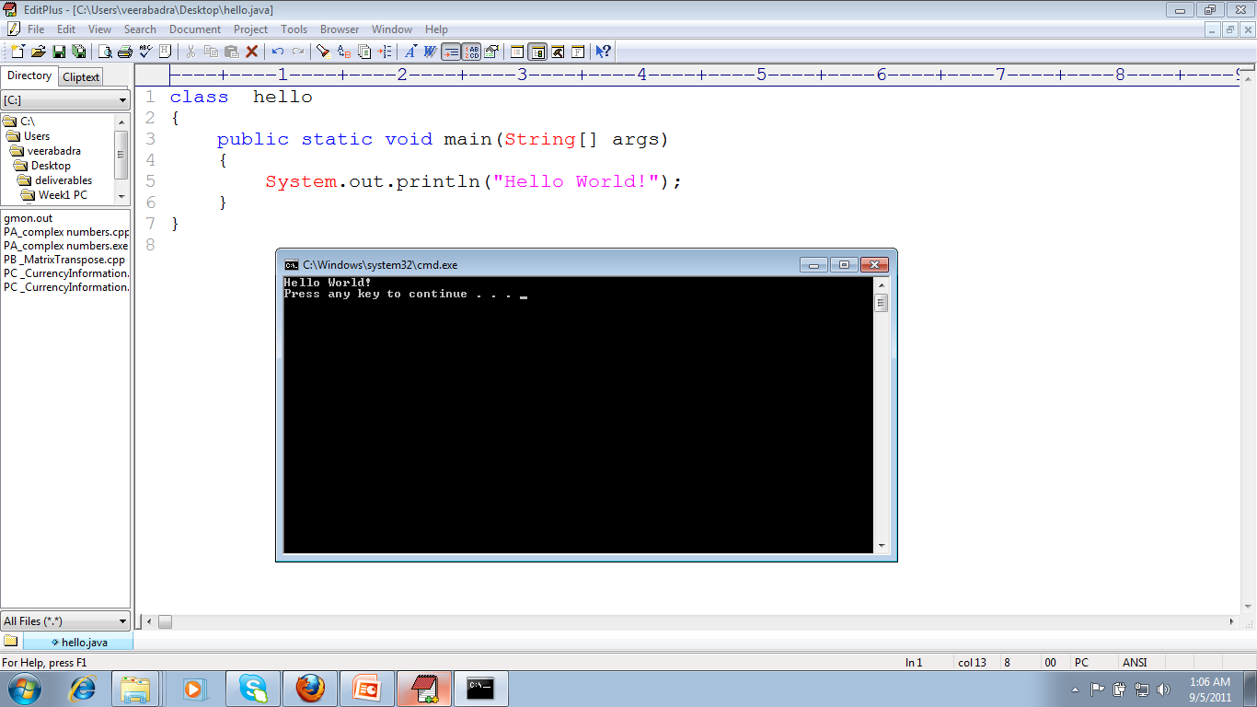
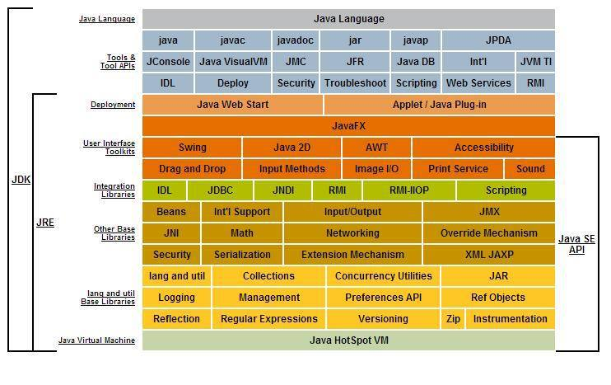
Execution of Hello world Program

Slide 37
JDK vs JRE vs JVM

Slide 38
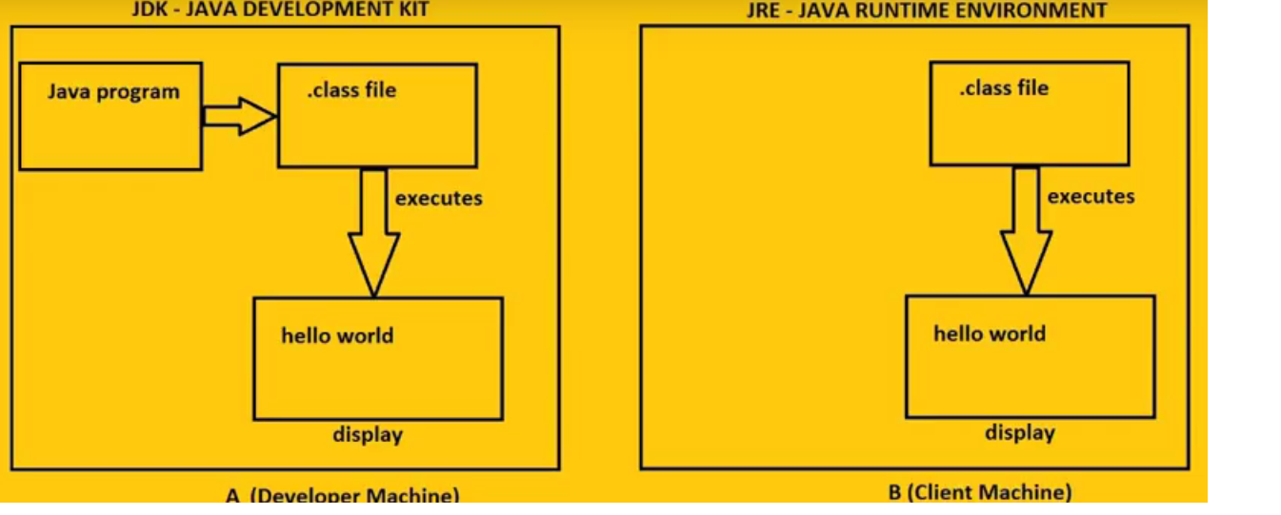

Slide 39
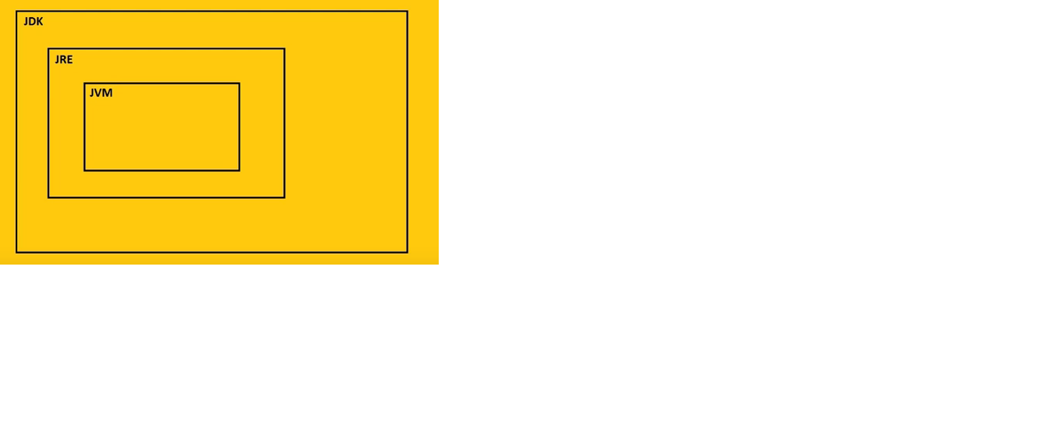
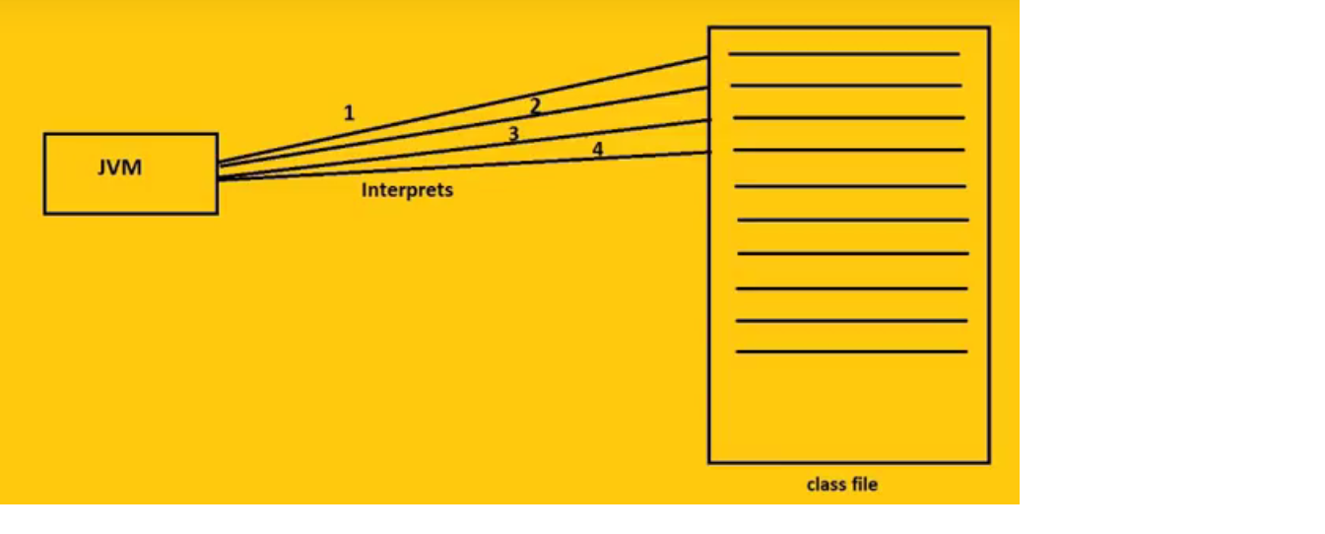

Slide 40
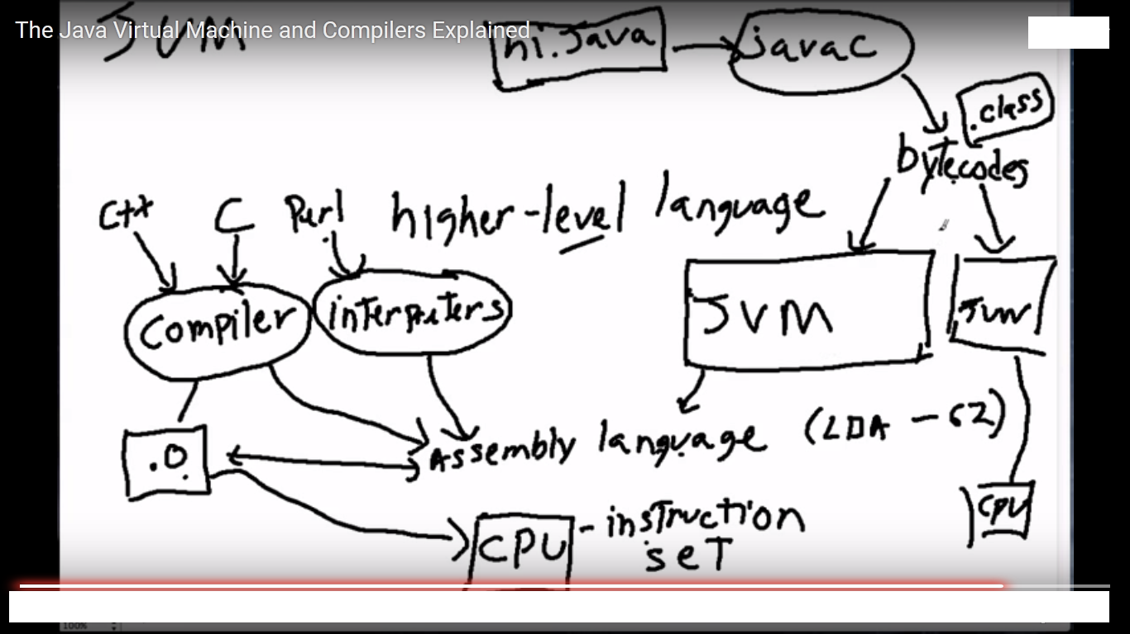

Slide 41
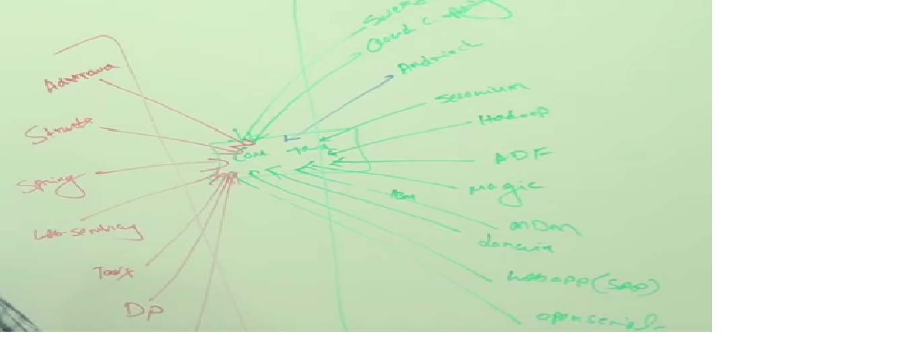

Slide 42
Thank you

