Slide 1
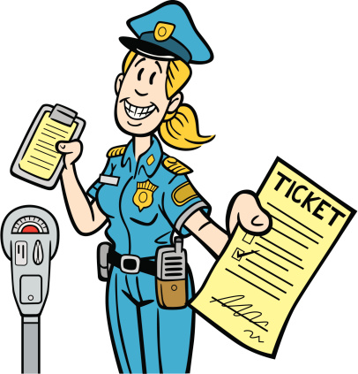
Chicago Parking Tickets Data Exploration and Revenue Development Strategies
Kin-Yip Chien
Notes:
Good afternoon everyone.
My name is Kin-Yip, and I’m going to introduce you to the Chicago parking tickets data set as well as explore some revenue development strategies using this data.

Slide 2
Project Overview
The City of Chicago has a long history of public corruption dating back over 150 years.¹
Public corruption convictions are estimated to cost the Illinois state economy $550 million every year.²
The full potential of municipal revenue streams must be unlocked to keep up with corruption costs.
Notes:
The city of Chicago has a long history of public corruption dating back over 150 years.
A 2019 report by the Illinois Policy Institute estimated that public corruption cases cost the state of Illinois 550 million dollars every year between 2000 and 2017.
In order to maintain its reputation as the most corrupt city in America, the City of Chicago must find ways to unlock the full potential of its revenue streams.

Slide 3
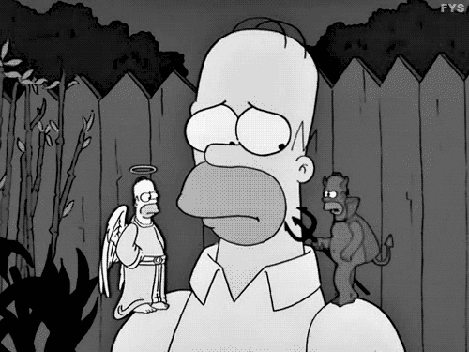
Motivation
Notes:
I originally hoped to follow in the footsteps of ProPublica, the investigative journalism organization that compiled this data set, and examine how parking fines burdened different segments of Chicago society, but I was not able to find demographic data from the Census Bureau website in a format that would be easy to merge with my data set.
So I rescoped and determined that I could use the data I had to investigate the levers that affect ticket revenue.

Slide 4
Data Overview/Pipeline
Compiled by ProPublica, an investigative journalism organization, using City of Chicago records
Data spans 1/1/96 - 5/14/18
Every record was generated when a ticket was issued.
54,430,547 records. 22 features + 14 features engineered by ProPublica
- wc -l chicago_parking_tickets.csv
Features contain information about:
- date ticket issued - location ticket issued - violation
- vehicle information/owner zipcode - officer and dept - fine amount
- ticket status as of 5/14/18 (paid, unpaid, dismissed etc.)
Notes:
The data set I am working with was compiled by ProPublica from FOIA requests to the City of Chicago for parking ticket records.
The data span January 1, 1996 to May 14, 2018.
Every record corresponds to a ticket issued.
In total, there were over 54 million records, with 22 features from the City of Chicago and a further 14 features engineered by ProPublica
Features contained information about the date and location a ticket was issued, the violation, information about the vehicle and zipcode it was registered to, the issuing officer, fine amounts, and the ticket status as of May 14, 2018 (was it paid, unpaid, dismissed, etcetera.)

Slide 5
Data Overview/Pipeline
Uncompressed csv is 19.6 GB
- too large to load into memory
Unix command line used to systematically sample every 25th record to yield 2,177,221 records (806 MB, 650 MB in memory)
- awk 'NR == 1 || NR % 25 == 0' chicago_parking_tickets.csv > parking_sample.csv
Pandas used to explore data
Notes:
The uncompressed csv is nearly 20 gb and too large to load into memory. I used unix to systematically sample every 25th record in order to produce a data subset with 2 million records that could be loaded into python.
From there, I used pandas to explore the data.

Slide 6
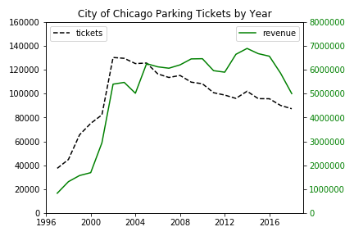
Data Exploration
Notes:
Now I’m going to show you some plots that demonstrate the information that can be gleaned from this data set.
Here is a plot of the number of tickets issued by the City of Chicago aggregated by year, with another superimposed plot of the fine amounts paid by year. You can see that although the number of tickets issued has declined since 2002, the revenue drawn by the City has been robust to that decline.

Slide 7
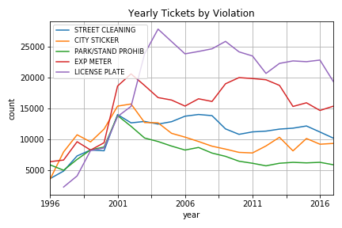
Data Exploration
Notes:
I will skip this slide for time.
This is a plot of the number of tickets issued by year for 5 selected types of violations. I believe the low number of tickets prior to 2001 indicates an issue with data completeness rather than reflecting a large increase in the number of tickets issued.
The top violations every year are related to street cleaning, license plates, expired meters, parking in prohibited areas, and city sticker violations.
In Chicago, the city sticker is a city registration fee for vehicles.

Slide 8
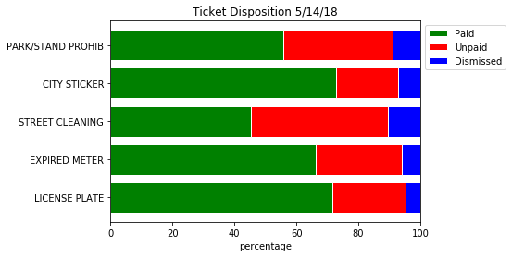
Data Exploration
Notes:
This is a plot of the disposition of various categories of tickets as of May 14, 2018. I categorized the tickets as paid, unpaid, or dismissed. I need to look into it so I won’t speculate as to the differences in distributions between violations.

Slide 9
Data Exploration
Issue date | geocoded address | violation_description | license plate type | current amount due | total payments
2000-05-06 09:25:00 | 200 S Clark St, Chicago, IL 60604 | PARKING/STANDING PROHIBITED ANYTIME | TRK | 0 | 100
2000-05-15 17:41:00 | Chicago, IL 60601 | PARKING/STANDING PROHIBITED ANYTIME | PAS | 50 | 0
2000-06-22 17:41:00 | 300 S Clark St, Chicago, IL 60605 | WITHIN 15' OF FIRE HYDRANT | TRK | 0 | 200
2000-08-10 15:54:00 | 300 S Clark St, Chicago, IL 60605 | PARK OR STAND IN BUS/TAXI/CARRIAGE STAND | TRK | 0 | 60
2000-08-21 17:15:00 | 300 S Clark St, Chicago, IL 60605 | NO STANDING/PARKING TIME RESTRICTED | TRK | 0 | 100
Notes:
I will skip this slide for time.
This is a view of ticket issued to a single license plate number with selected features. It was a CHEVY with a commercial truck license plate. You can see whether the fine is paid or outstanding, the date, location, and the specific violation. This inconsistency, where the license has been categorized as a passenger vehicle, illustrates a data entry error or inconsistency, of which there are many in this data.

Slide 10
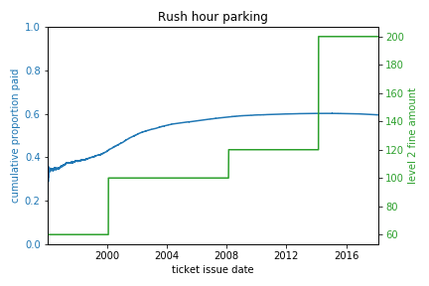
Hypothesis Testing
Does raising ticket fine affect probability of payment?
Notes:
One question I was interested in was whether raising the fine on a violation affected the probability of the ticket being paid.
Here I have plotted the cumulative proportion of tickets paid in blue, and the price of a ticket in green. Because there are so many observations, it is not easy to see if the slope of the blue line changes when fines increase.

Slide 11
Hypothesis Testing
6 month window before and after fine increase
H₀: p^_{after} = p^_{before} H_{a}: p^_{after} > p^_{before}
p~_{pooled} = (n_{after} p^_{after} + n_{before} p^_{before}) / (n_{after} + n_{before})
test statistic:
p^_{after} – p^_{before} / sqrt[p~_{pooled} (1 – p~_{pooled}) (1 / n_{before} + 1/n_{after})]
p-value: 1 - Φ(test statistic)*
*Φ = norm.cdf()
Notes:
So I turned to hypothesis testing. Here I performed a difference in proportions hypothesis test. I took a window of tickets issued in the 6 months before and after a fine increase as my two samples and compared the proportion of tickets paid. A simplifying assumption is that the two samples are independent, but I would need to spend more time in my data checking that assumption, as some drivers receive multiple violations and make up a nontrivial proportion of the total tickets issued, so they may have been ticketed both before and after a fine increase.
The difference in proportions test is a parametric test that relies on the Central Limit Theorem, which applies to my data as the windows capture a few hundred observations.
Here I have sketched the calculations involved in the difference in proportions test.

Slide 12
Hypothesis Testing
Rush hour parking level 1 fine increased
$30 > $50 (+67%) on 02/02/00 (p-val: 0.336)
$50 > $60 (+20%) on 02/19/08 (p-val: 0.345)
$60 > $100 (+67%) on 02/23/14 (p-val: 0.964)
Conclusion: There is not enough evidence to reject the null hypothesis that raising ticket fines decreases payment probability.
Notes:
Level 1 fines are issued for a violation, and level 2 fines can be assessed for unpaid tickets and enduring violations.
In the period of my data, fines for rush hour parking violations were increased three times. I windowed tickets 6 months before and after the fine increase and present here the p-values associated with one-sided difference in proportions tests.
There is not enough evidence to reject the null hypothesis that raising ticket fines decreases payment probability.

Slide 13
Hypothesis Testing
Rush hour parking level 2 fine increased
$60 > $100 (+67%) on 02/02/00 (p-val: 0.997)
$100 > $120 (+20%) on 02/19/08 (p-val: 0.588)
$120 > $200 (+67%) on 02/23/14 (p-val: 0.007)
No fine increase
02/02/00 (0.782), 02/02/01 (0.630)
02/19/07 (0.819), 02/19/09 (0.799)
02/23/13 (0.050), 02/23/15 (0.364)
Notes:
I will skip this slide for time.

Slide 14
Hypothesis Testing
Conclusion: After Bonferroni correction for multiple testing, there is not enough evidence to reject the null hypothesis that raising ticket fines reduces the probability of payment.
Even disregarding the Bonferroni correction, which is a very strong correction when performing a large number of tests, the weight of the evidence from multiple hypothesis tests is that increasing ticket fines doesn’t seem to decrease the probability of payment.
Notes:
I will skip this slide for time

Slide 15
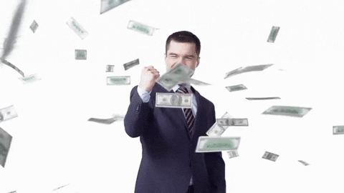
Conclusion
Notes:
In conclusion, the City of Chicago should raise fines to increase revenue, as drivers don’t seem to be sensitive to fine increases.

Slide 16
Future Directions
Generate a data set of change in payment probabilities and change in fine amount (e.g. (0.65 – 0.70, $200 - $100) => (-0.05, 200)
(1 - 0.65/0.70, $200/$100) => (0.07, 2)
Investigate the correlation between change in payment probability and change in price.
Investigate other violations.
Investigate revenue amounts rather than probability of payment.
Notes:
Generate a data set of change in payment probabilities and change in fine amount (e.g. (0.65 – 0.70, $200 - $100) => (-0.05, 200)
(1 - 0.65/0.70, $200/$100) => (0.07, 2)
Investigate the correlation between change in payment probability and change in price.
Investigate other violations.
Investigate revenue amounts rather than probability of payment, as increasing fines may discourage drivers from offending in the first place.

Slide 17
References
1. Simpson, D., Gradel, T.J., Rossi, M.R, & Taylor, K. Continuing Corruption in Illinois: Anti-Corruption Report #10. (2018) https://pols.uic.edu/wp-content/uploads/sites/273/2018/10/cpl_continuingcorruptioinillinois.pdf
2. Johnson, N.D., LaFountain, C.L. & Yamarik, S. Corruption is bad for growth (even in the United States). Public Choice 147, 377–393 (2011) doi:10.1007/s11127-010-9634-5
Notes:
And these are my references. Any questions?

