Slide 1
Comment Moderation: Identifying Toxic Comments
Kin-Yip

Slide 2
Comment Moderation
Problems:
Scale: 11,000 comments are posted to the New York Times website each day.
Consistency: Human moderators can be fickle.
Different websites may want different standards of moderation with regards to swearing and tone.
Solutions:
Computers are fast, consistent, and can handle different policies.
160,000 comments scored in minutes.

Slide 3
English Wikipedia Comments Corpus
160,000 comments labeled by up to 10 human annotators each through Crowdflower.
Multiple labels:
Toxic (perceived as likely to make people want to leave the discussion)
Subtypes: (Severe toxic, obscene, threat, insult, identity hate)
Goal:
Build the best model in the world.

Slide 4
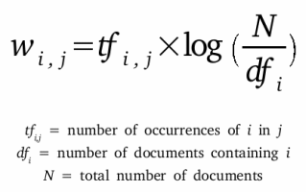
Term Frequency-Inverse Document Frequency

Slide 5
Soft Voting Classifier
Ensemble of:
Multinomial Naive Bayes
Elastic net Logistic Regression
Scikit-learn Random Forest
LightGBM
Averages predicted probabilities from each base learner.
Theoretically, an ensemble formed from uncorrelated models will reduce bias and variance.

Slide 6
Model Selection
model | fit_time | fit_std | score_time | score_std | AUC | AUC_std
Multinomial NB | 2.521 | 0.172 | 0.509 | 0.090 | 0.951 | 0.002
Elastic Net Logit | 2.842 | 0.286 | 0.475 | 0.062 | 0.968 | 0.002
sklearn RF | 112.597 | 0.401 | 1.271 | 0.038 | 0.929 | 0.003
LightGBM Classifier | 129.962 | 0.806 | 0.894 | 0.141 | 0.967 | 0.002
Soft Voting Ensemble | 242.908 | 7.552 | 9.956 | 5.467 | 0.972 | 0.001

Slide 7
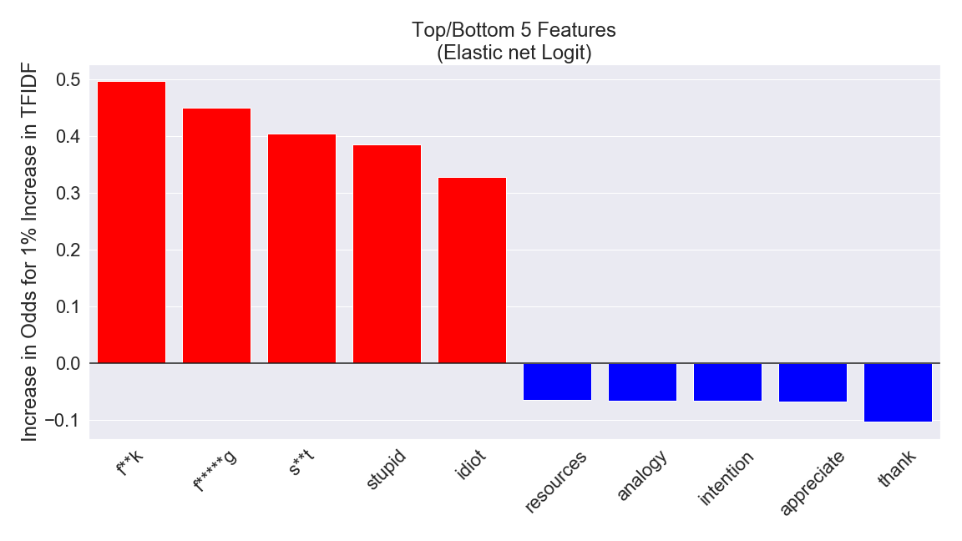

Slide 8
Toxic Comments Classified as Not Toxic
Models cannot understand tone:
“... In my humble opinion this draft is a pathetically watered-down rendition of what's been discussed and usually agreed upon by everyone except you-know-who. Denazification reduced to half a sentence?...”
Comments referencing other non-toxic comments:
I have to put this as sittign here cackling my head off. Are you peopel on leave from a psyche hospital? I just found the following post from prissy Dame Ewart on some other user's talk page…
“Ms Gundagai, normally I would be thrilled to be the centre of so much attention (so far all your edits, except those to your userpage, have been devoted to me)...”

Slide 9
Not Toxic Comments Classified as Toxic
Models only check for offensive words and cannot understand context:
“But keep in mind I am a gay Jew.”
Human raters are flawed:
“hey dude i d like to know who is in charge of all of this deleting that is going on, i did a thing on the harly drags, and some punk ass f****t deleted it and i really dont appreciate that very much at all, and im kinda very extremely pissed and i think that since it wasnt good enough for yall nerds then yall should write abput it , but yall dont have any clue what it is cuz you aint been you no p***y gettin guy.... feel free to write me back dude”

Slide 10
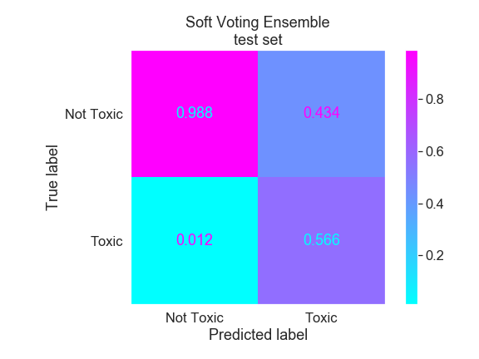
Soft Voting Ensemble
AUC: 0.972

Slide 11
Future Directions
Extract more features: parts-of-speech
Hyperparameter tuning:
other methods to handle imbalanced classes, character n-grams, word n-grams, model hyperparameters, prediction thresholding, stacking ensembles, etc.
Predict subclasses
Address unintended bias

Slide 12
QUESTIONS?

