Slide 1


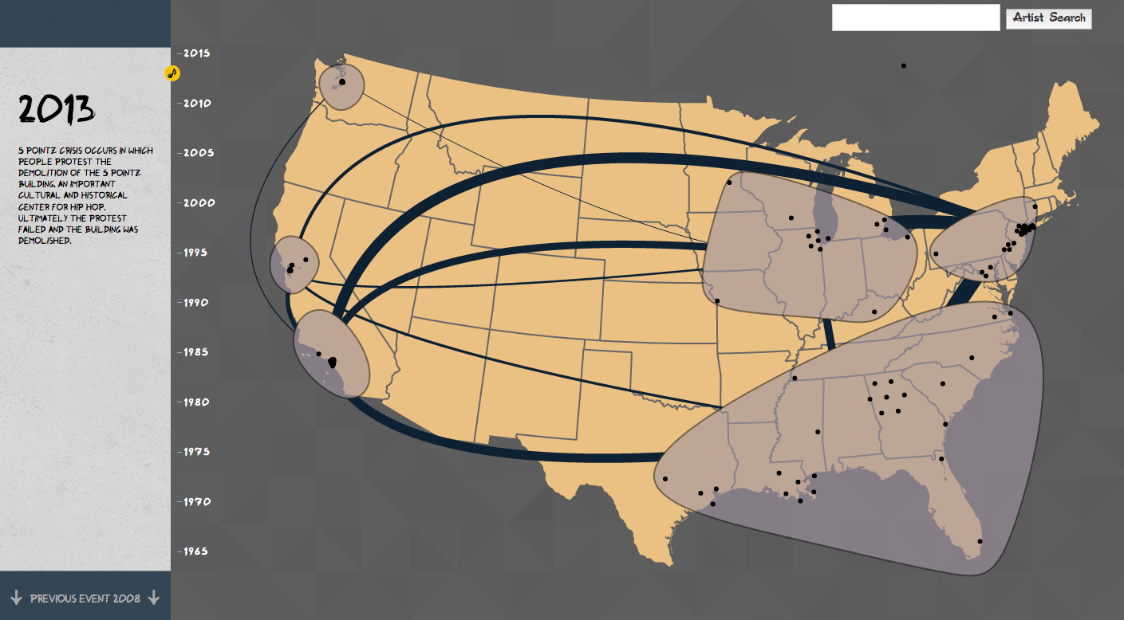
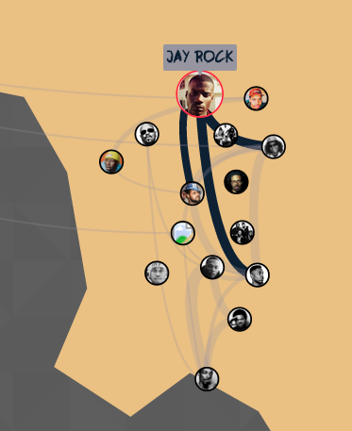
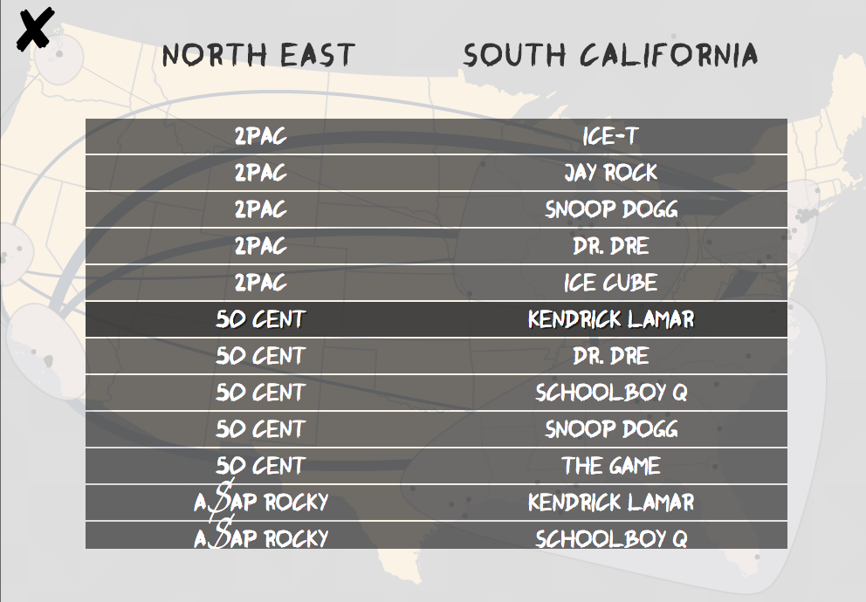
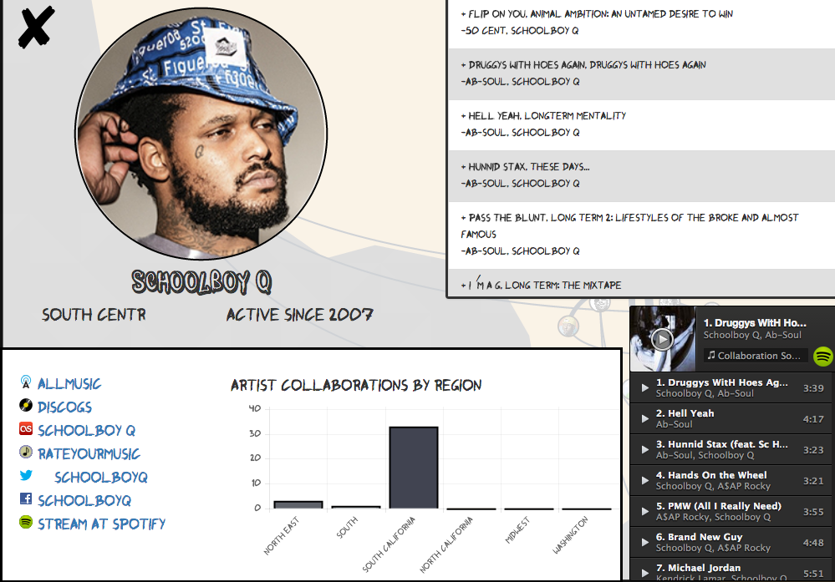
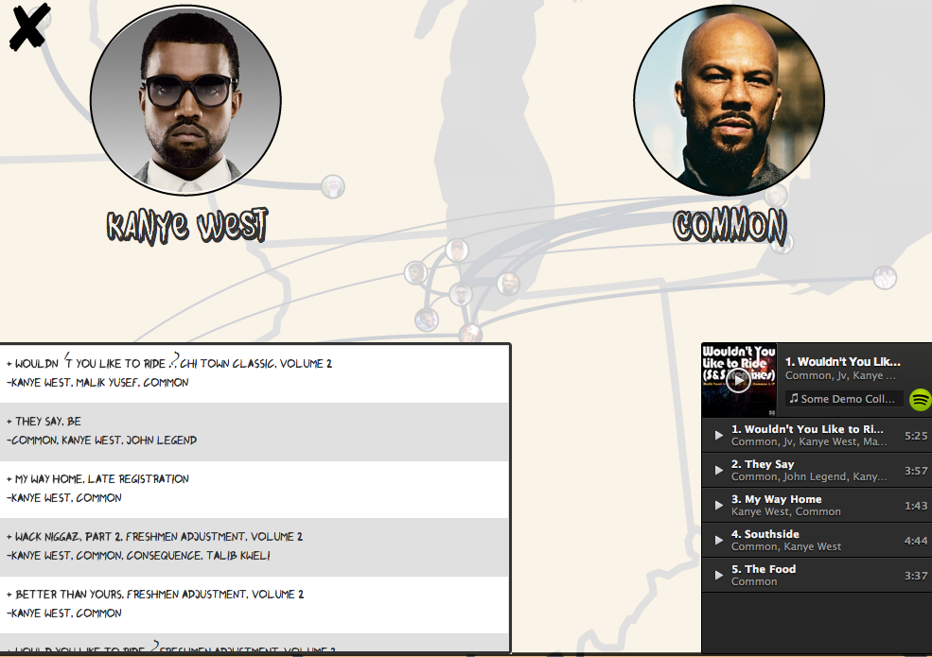

Feat.
A history of Hip Hop collaborations in the US
“Speech is my hammer, bang the world into shape, now let it fall.” –Mos Def
Problem
Visualize inter/intra-regional Hip Hop collaborations in the United States from its birth to the present day
Motivation
Limited availability of Hip Hop data sets
Few exsisting visualizations in this area provide an exploratory tool to analyze Hip Hop
Regional and temporal changes are not visualized
Approach
Show multiple levels of granularity to let users explore inter- and intra-regionally
Represent collaborations on tracks as links between artists
Provide interacion for exploration through time as well as narration fron context
Allow drilling down for extra detailed information on artists and collaborations
Provide sound to enhance experience
Interaction Flow
Future work
Incorporate other datasets including song lyrics or other related genres
Provide more contextual information
Overall view with timeline. Scrolling shows changes in number of artists in region and collaborations over time.
View of a single artist’s work with others in the Visualization, including linked chart with intra-regional collaborations.
View of two artists’ collaborations together, including spotify integration
Kevin Quinn | Sonja Khan | Vinod Rathnam | Riley Porter
http://cse512-15s.github.io/fp-kchq-vinodr-sonjak3-rileymp2
CSE 512
Spring 2015

