Slide 1



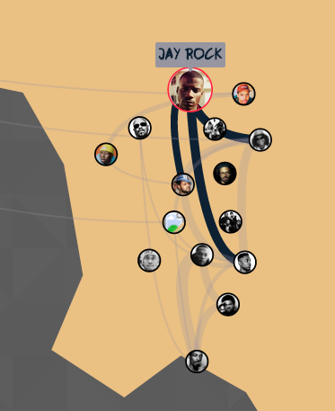
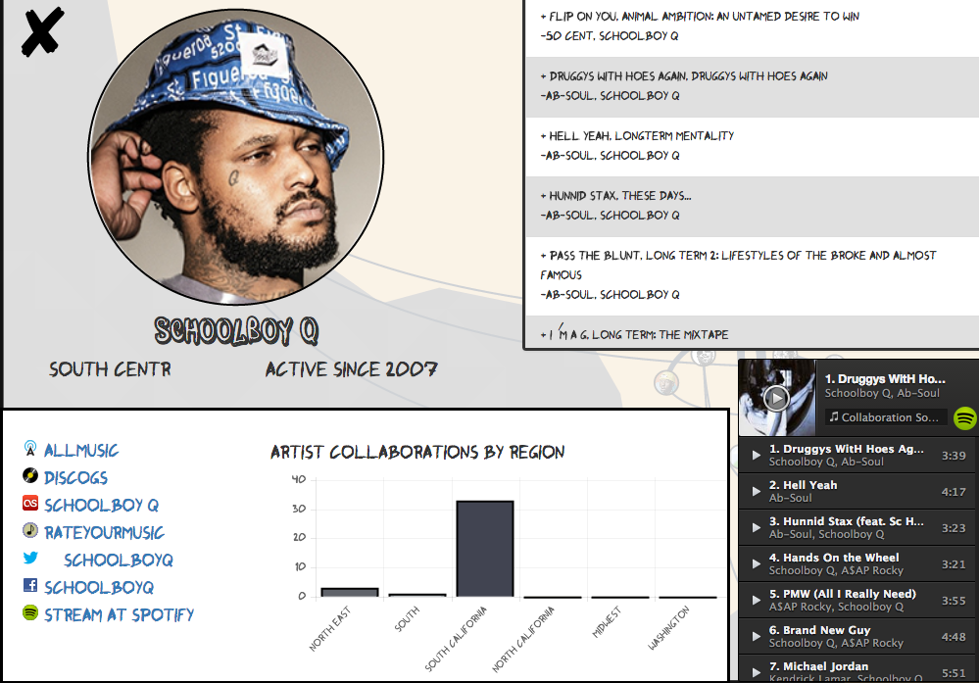
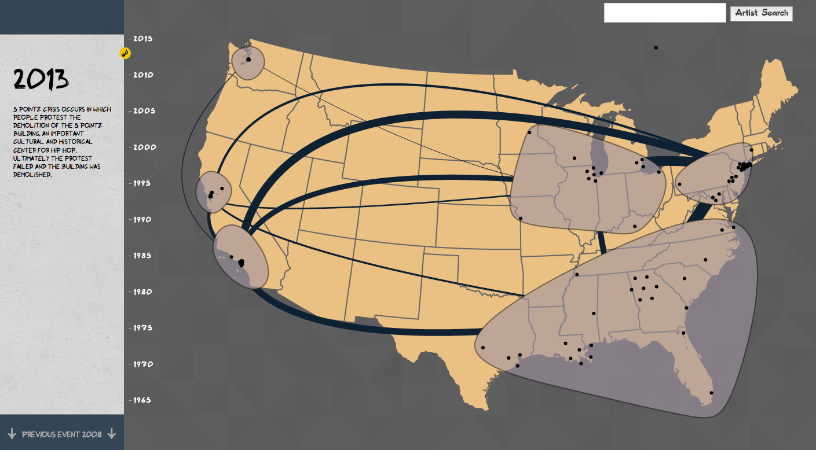
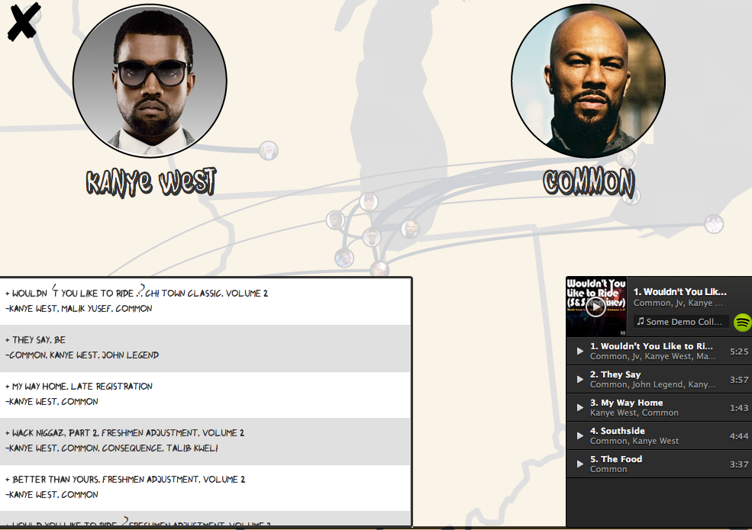
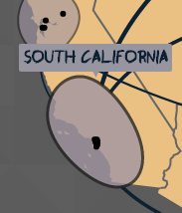
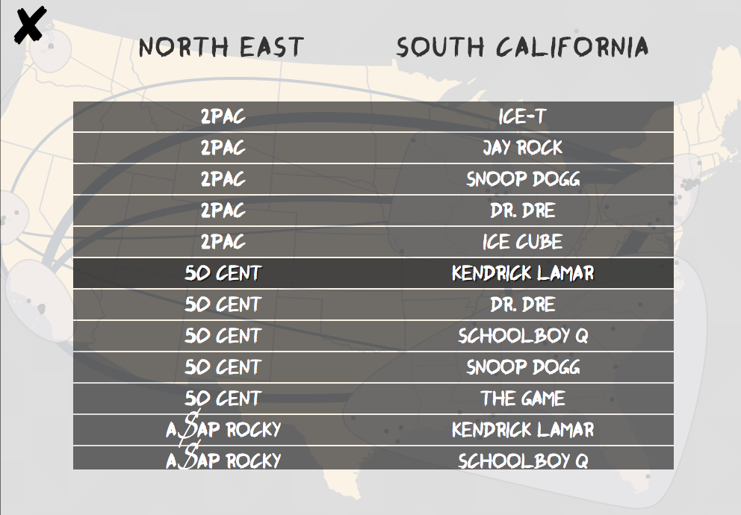

Feat
A brief history of Hip Hop collaborations in the US
Problem
Visualize inter- and intra-regional Hip Hop collaborations in the United States.
Motivation
Limited availability of Hip Hop data sets
Few exsisting visualizations in this area
Provide an exploratory tool to analyze Hip Hop and how it has evolved regionally
Approach
Show multiple levels of granularity to let users explore inter- and intra-regionally
Represent collaborations on tracks as links between artists
Provide functionality for exploration through time
Allow drilling down for extra detailed information on artists and collaborations
Provide sound to enhance experience
Inter-regional collaborations for a single artist activated on hover.
View of a single artist’s work including linked chart with intra-regional collaborations.
Overall view with timeline. On scroll, shows changes in number of artists in region and collaborations over time.
View of two artists’ collaborations together.
View of a single region, with links representing collaborations with another region.
Future Work
Incorporate other datasets including song lyrics or other related genres
Provide more contextual information
Integrated Spotify web player.
View of artist collaborations between two regions.
Kevin Quinn | Sonja Khan | Vinod Rathnam | Riley Porter
http://cse512-15s.github.io/fp-kchq-vinodr-sonjak3-rileymp2
CSE 512
Spring 2015

