Slide 1
KCI Geospatial Solutions
Jim Somerville, Solutions Architect
TUgis 2017
Maryland’s Geospatial Conference

Slide 2
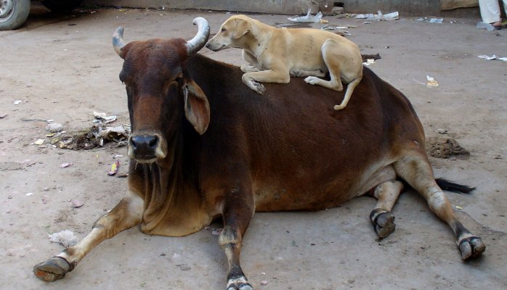
Cloud Prototype Purpose
Setup sandbox for prototypes, demos, etc.
Low cost, quick to implement
Treat servers like cattle, not pets

Slide 3
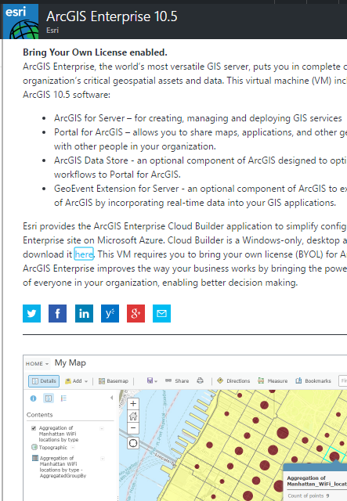
Infrastructure
Physical Server
Virtual Machine
Cloud
Can start w/ images
Add software as needed
Manage costs

Slide 4
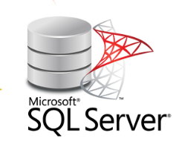



Steps
Obtain cloud subscription
Create Resource Groups: base images, sandbox
Provide Owner permissions to RGs
Provision base images
Use dev or free licenses
Build on each other
Clone custom image into sandbox
Use
Delete custom image

Slide 5


Manage Costs
Compute is biggest concern
Consolidate onto single servers
Light on resources
Stop servers when not in use
Limited storage needed
Delete custom images

Slide 6

Results
Provision in < 1 hr
Limited costs: running < 15%; $35/month/server
Can provide capability to non-IT staff
Limit rights to sandbox resource group
Clone / decommission scripts available on GitHub
https://github.com/kcigeospatial/Cloud-Tools

