Slide 1
Swami Sachchidanand Polytechnic college, Visnagar
CRIME REPORTING SYSTEM
Developed By: KAILASH CHANDRA JINDAL
Guide: Prof. Veena Parihar

Slide 2
INTRODUCTION
No. | Index
[01] | Introduction
[02] | System Analysis
[03] | Data Directory
[04] | System Design
 | Database Design
 | User interface Design
 | Report Design
[05] | Testing & Implementation plan
[06] | Basic System Requirement
[07] | Further Enhasement of the Project
[08] | Technology Used
[09] | Bibilography

Slide 3
INTRODUCTION
Introduction
Developer Name | : | Mr. PATEL BRIKESH.R
Exam No. | : | 7025
Project Name | : | CRIMEREPORTING System
Company Name | : | 20, 3rd floor, Shukan Mall, Nr. Rajasthan Hospital, Shahibaug, Ahmedabad – 380004, Gujarat, India. Email : info@sharmainfoway.com Website : www.sharmainfoway.com Ph : 079 – 65423194

Slide 4
INTRODUCTION OF THE SYSTEM
Introduction
Purpose:
This Software Requirements Specification provides a complete description of all the functions and specifications CRIME REPORTING WEBSITE. With the help of this software people can easily submit their FIR in the Police Station. So all the processes of FIR done very easily.
Scope:
(Following are the jobs to be done by the system:
A FIR form is provided through which citizens can enter the details in FIR form of the crime reported. This data once entered can be edited/deleted as required there will be vast entries of data administrator can scroll the data.
Citizens can serach nerearest police station.
User can reading news of crime, criminals, and many information .

Slide 5
Introduction
Purpose:
This Software Requirements Specification provides a complete description of all the functions and specifications CRIME REPORTING WEBSITE. With the help of this software people can easily submit their FIR in the Police Station. So all the processes of FIR done very easily.
Scope:
(Following are the jobs to be done by the system:
A FIR form is provided through which citizens can enter the details in FIR form of the crime reported. This data once entered can be edited/deleted as required there will be vast entries of data administrator can scroll the data.
Citizens can serach nerearest police station.
User can reading news of crime, criminals, and many information .
Definition
“WEBSITE ON CRIME REPORTING” can handle data of criminals who are under the judicial surveillance or are trial.
This portal will be most use for Police Department/ DEFENCE for searching for criminals.
Anyone can report a FIR online, MISSING citizen search, secure registration and profile management facilities for detectives and security agencies, Facilitate communication between all stakeholders- Discussion forms.

Slide 6
Reference:-
- www.Delhi police.com
- www.CrimeNews.com
- www.crimezone.com
Technologies to be used
In following description we are going to introduce what
technology we are going to use.
(1) PHP
-Dreamweaver 0.8
(2)Mysql 5.0
-query browser
-Work Banch 05.0.1
3) XAMPP WIN-32-1.6.3a
System Analysis

Slide 7
2.1 Preliminary Investigation
2.1.1 Interviewing
The information is collected from system leader by interviewing to them and took suggesting from end user as per their requirement.
2.1.2 Visiting
For clarification, visited some site like www.Google.com , www.Examonline.com ,
www.4test.com, www.code4u.com , www.w3school.com etc.
2.1.3 Questionnaires
By asking possible questions to the system leader at the time of interview by making some questionnaires to collect the required information.

Slide 8
(1) Introduction to PHP
What is php?
-PHP stands for PHP: Hypertext Preprocessor .
-PHP is a server-side scripting language, like ASP .
-PHP supports many databases (MySQL, Informix, Oracle,
Sybase, Solid, PostgreSQL, Generic ODBC, etc.)
-PHP is an open source software.
-PHP is free to download and use.
Some of the main features of PHP are listed below:
that page. The PHP module executes the script, which then sends out the result in the form
of HTML back to your browser, which you see on the screen. Here is a basic
php diagram which illustrate the process.
-PHP runs on different platforms (Windows, Linux, Unix, etc.)
-PHP is compatible with almost all servers used today (Apache, IIS, etc.)
-PHP is FREE to download from the official PHP resource
-PHP Is easy to learn and runs efficiently on the server side
Introduction to PHP:
PHP sits between your browser and the web server. When you type in the URL of a PHP website
in your browser, your browser sends out a request to the web server. The web server then calls the
PHP script on

Slide 9
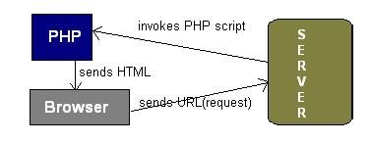
PHP Process Diagram
PHP is a server-side, cross-platform, HTML-embedded scripting language.
there are over half a million domains running PHP and it is freely available for download .
Much of PHP’s syntax is borrowed from C, Java and Perl with a couple of unique PHP-specific
features thrown in. The goal of the language is to allow web developers to write dynamically generated
pages quickly. PHP eliminates the need for numerous small cgi programs by allowing you to place simple
scripts directly in your HTML files.
It also makes it easier to manage large web sites by placing all components of a web page in a single
html file. PHP is an excellent alternative to such similar programming solutions as Microsoft's
proprietary scripting engine ASP and Allaire's rather expensive ColdFusion. As mentioned before,
PHP is a cross-platform language.
This doesn't stop with the core PHP code but can be extended to all of PHP's libraries and all code written in
PHP. Neither ASP nor ColdFusion can make this claim. PHP has a large feature set which includes built-in
support for numerous databases (including Access, LDAP, Oracle, and MSSQL), networking support, zip
archiving ,and an excellent set of built-in functions. Furthermore, due in part to it being open source and
freely available for download on the web, the language enjoys an active developing environment.
Since the syntax structure borrows heavily from C, it is easy for even the novice programmer to learn
the language. PHP is also the oldest HTML-embeded scripting language, giving it a head start on all the others.
If you are a content developer, you probably won’t want to learn PHP scripting by heart. But, it is nice to
know how PHP can help you create more powerful web applications and user-friendly designs.

Slide 10
Hardware Requirement
Minimum Configuration:
To run the application software of the system in the computer the minimum configuration required is as below:
233 MHz processor.
128 MB SD-RAM
2 – 4 GB Hard-Disk.
4x Compact Disc drive or faster.
1.44 MB Floppy Disk Drive.
Monitor. [ 640 x 480 Display ]
This is the brief introduction of Hardware Configuration for the system. The system can work in newest
technology also. It is just telling that system can work with old technology also but, it consist this
minimum configuration of Hardware.
Software Requirement
To Handel the system, Administrator requires some software. This software is used for the development
such as coding and testing. Lists are given below:
Front End -PHP
Back End -MySQL 5.0
Server -Apache Server 2.0
Design Tool -Macromedia Dreamweaver 8.0
Documentation Tools -Microsoft Word
-Microsoft PowerPoint
PHP – It is used for front end tools for the system.
MYSQL - Used to maintain the database. So, you can call it to back-end of system.
Web Server - Apache web server or other who concern with PHP codes or scripts.
It is basically used to run the PHP code or file on browser.
Web-browsing software-Mozilla Firefox, Internet Explorer or other
-Flash Player.
This phase of the software development process deals with a brief study of different hardware
used in the computerized system.
All the hardware needed here are generally the basic configuration of a typical office computer.
A list of the hardware requirement used in the system given below:

Slide 11
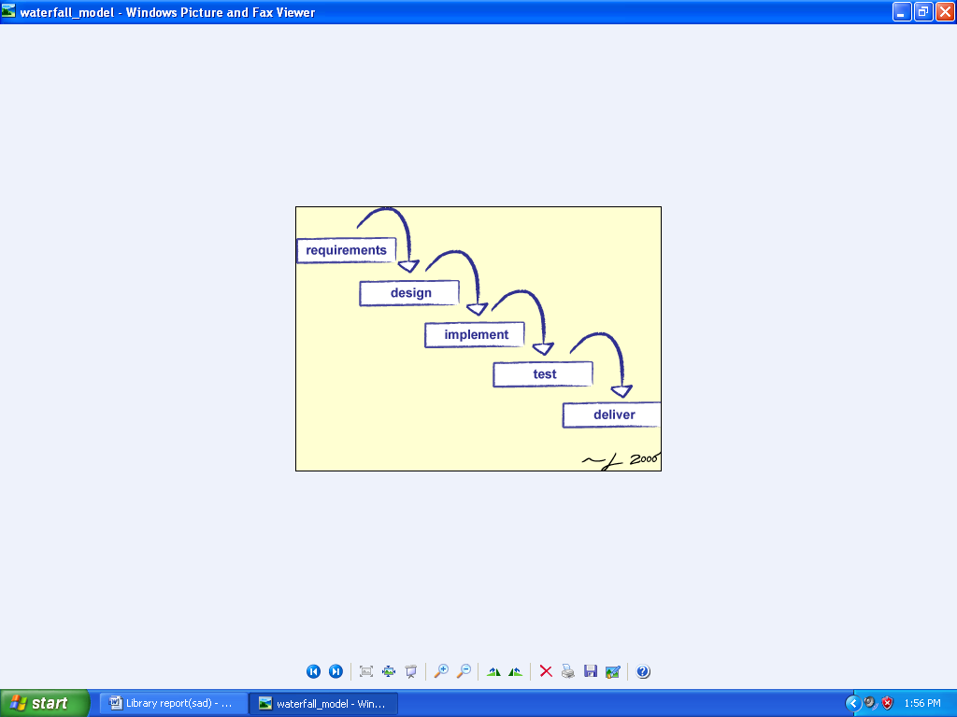
2.7 Software Engineering Paradigm Applied
2.7 Software enginnering
Paradigm Applied

Slide 12
Waterfall Model
The waterfall model derivers its name due to the cascading effect from one phase to the other as is illustrated in above figure. In this model each phase well define starting and ending point, with identifiable deliveries to the next phase. Note that this model is sometime referred to as the linear sequential model or the software life cycle model.
The water fall diagram is basically divided into following 5 models.
Requirement
Design
Implementation
Verification
Maintenance
Requirement:-
In the requirement phase the need to create the application is specified. What is the need of the system is defined. What information to be feeder to create the application will come under the requirement phase?
Design:
After the requirement phase the next phase is the Design phase where the application is designed according to the forms and other modules created. This phase is much important phase because it will structure the layout of your application.
Implementation:
Implementation is the process of having a system personnel phase check out and put new equipment into use, train users, install new application and construct any file of data need to use it.
Verification:
After the whole application is being the developed the main phase is the verification phase where the whole application tested and verified to check the whole application.
Maintenance:
After the successful verification of the application the main phase is the maintenance phase where the application needs to be maintained for its successful operation in future.

Slide 13
2.8 Information gathering
2.8.1 Information from field:
The main information of this system is gathering from the websites like WWW.Google.Com and WWW.eng123.Com.
The error of this system are seen and studied. Because of this error we need necessary to develop
This type of system
The system mainly developed for the organized for remove the paper work.
Other details are given to us from lecturer of our Institute.
2.8.2 Information from books:
The details of the designing and coding of this system are viewed from the “The Complete
Reference of VB.net programming book”, Master in vb.net.
2.8.3 Information from Sites:
Other details are collect from sites like.
WWW.google.com
www.yahoosearch.com
WWW.wikipedia.com
www.code4u.com
www.microsoft.com (For MSDN of Visual Studio.net)

Slide 14
* Architecture Diagram & Database Design
Login
Profile
View police
p
USER
ADMIN
Emergency Contact
FIR Registration
View FIR
Missing Person

Slide 15
Data Flow Diagram
FIR Information
Complaining Person
FIR
Reg. FIR
On line
Print out of FIR
Registration
Submit FIR
Officer Detail
Check
Police Station
sending
FIR
Sending info.
Investigation FIR
&
Registration
Detail
Collection of Crime
Received
Sending info.
Company Person
Detail of FIR
Crime Related Person

Slide 16
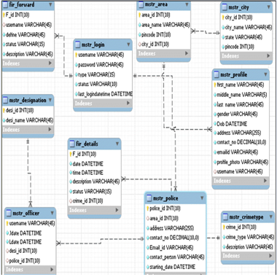
Entity Relationship Diagram:(E-R DIAGRAM)

Slide 17
ER-DIAGRAM(2)

Slide 18
Symbols used in DFDs:
Process: Here flow of data is transformed. E.g. Charge Calculations, etc.
External Entity: A source or destination of data which is external to the system.
E.g. Customer etc.

Slide 19
A data flow: It is packet of data. It may be in the form of document, letter etc.
Data store: Any store data but with no reference to the physical method of storing.
Notes:
Data store: Any store data but with no reference to the physical method of storing.

Slide 20
DATA ELEMENTS
The different data elements used in the system irrespective of the
tables used in the system are as below:
User : User Name
Pass : Password
Fame : First Name
pHs : Police station
Amount : Amount
Sedate : start Date
Mob : Mobile Number
DOB : Date Of Birth
PO : Police Officer
Ps id : Police Station id
Design : Designation id

Slide 21
Database of Crime Reporting Website
Table structure for table area_master
Table structure for city
Table structure for table crime_type
Table structure for table designation
Field | Type | Null | Default
Area_id | int(10) | Yes | NULL
Area name | archer(45) | Yes
Citywide | varchar(45) | Yes
Field | Type | Null | Default
City_id | varchar(45) | Yes
City_name | varchar(45) | Yes
State_id | varchar(45) | Yes
Field | Type | Null | Default
Ct_id | int(10) | Yes | NULL
Ct_description | varchar(45) | Yes
Field | Type | Null | Default
Desig_id | int(10) | Yes | NULL
Desig_name | varchar(45) | Yes

Slide 22
Table structure for table fir_forward
Table structure for table fir_registration_master
Table structure for table login_master
Field | Type | Null | Default
Fw_id | int(10) | Yes | NULL
FIR_id | varchar(45) | Yes
Officer_Uname | varchar(45) | Yes
Date&Time | Datetime | Yes
Status | varchar(45) | Yes
Remark | varchar(45) | Yes
Field | Type | Null | Default
FIR_id | int(10) | Yes
FIR_Uname | varchar(45) | Yes
FIR_aria | varchar(45) | Yes
FIR_time&date | Datetime | Yes
FIR_description | varchar(45) | Yes
Crime_type_id | int(10) | Yes
Field | Type | Null | Default
Uname | varchar(45) | Yes
Password | int(10) | Yes
Type | varchar(45) | Yes
Status | varchar(45) | Yes

Slide 23
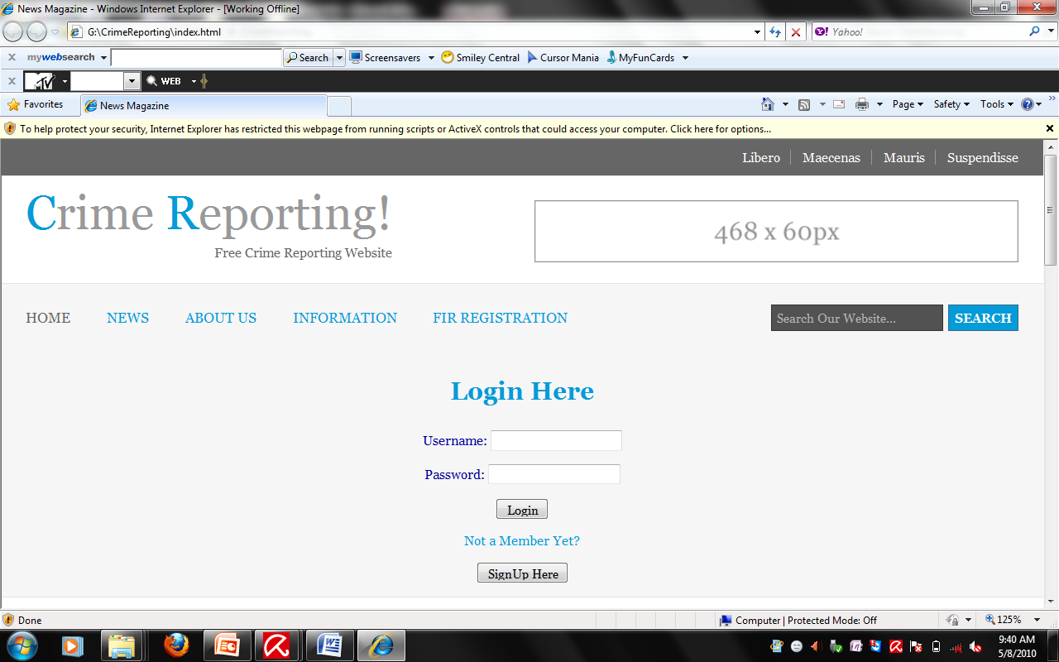
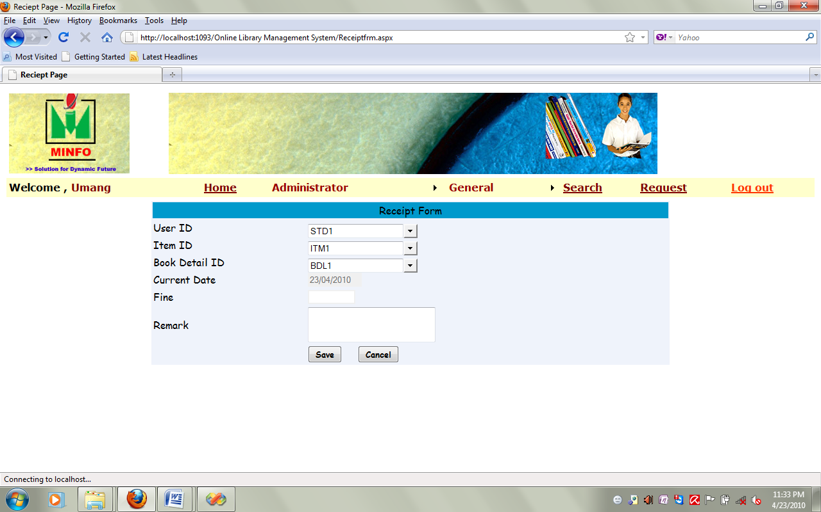
Receipt Form
This is Receipt Master Form you can see all details of receipt.

Slide 24
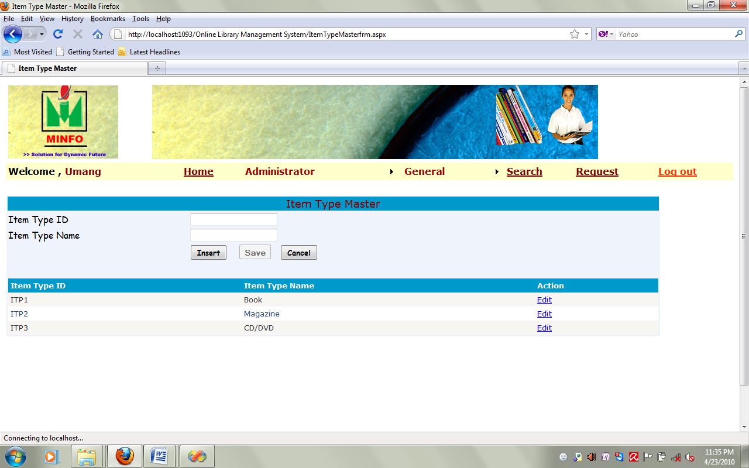
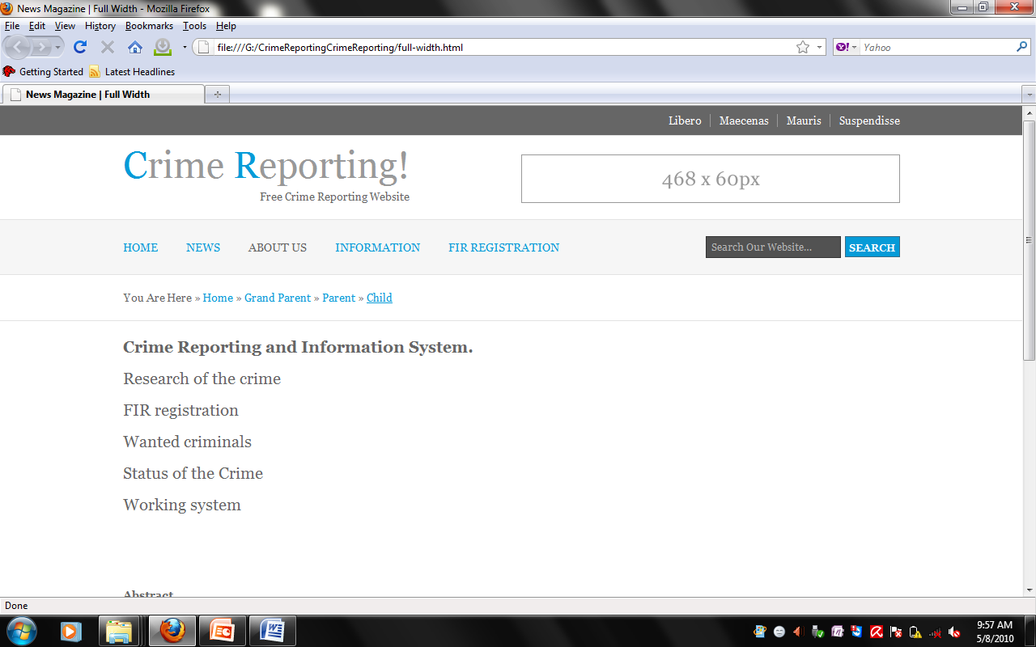
Item Type Master
This form is used for the Item Details and item Id.

Slide 25
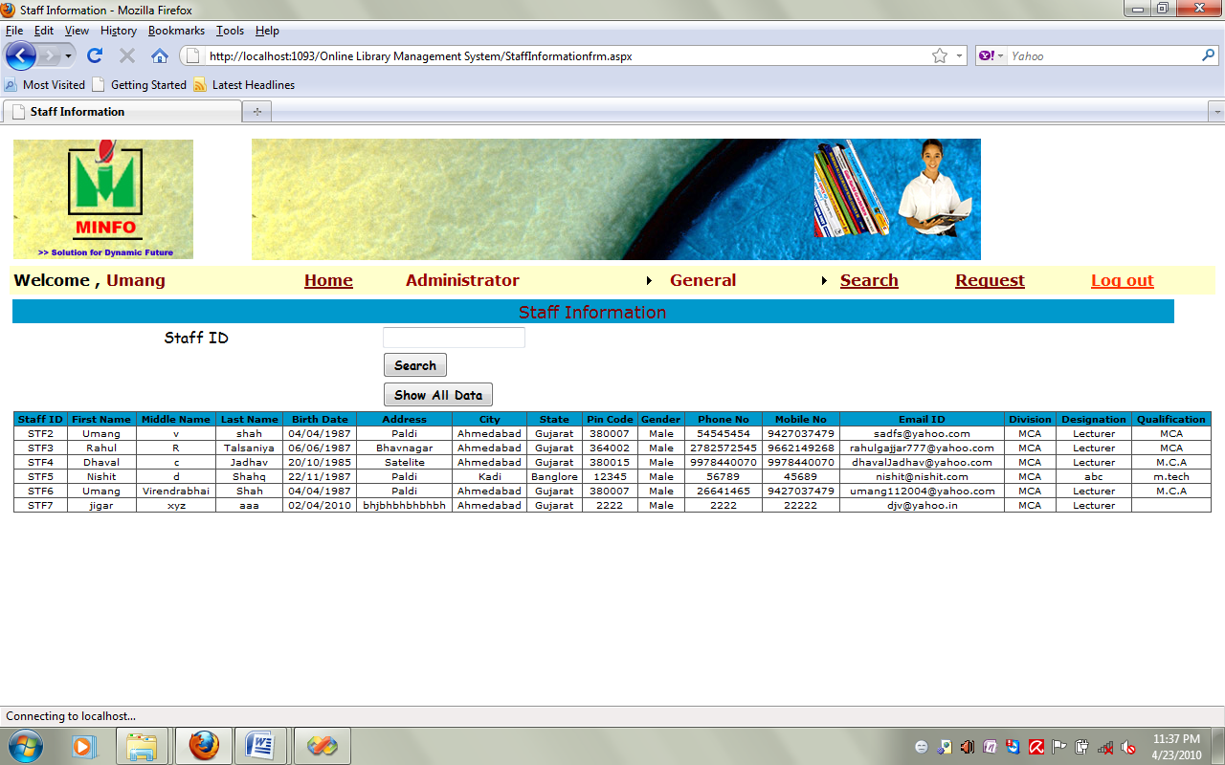
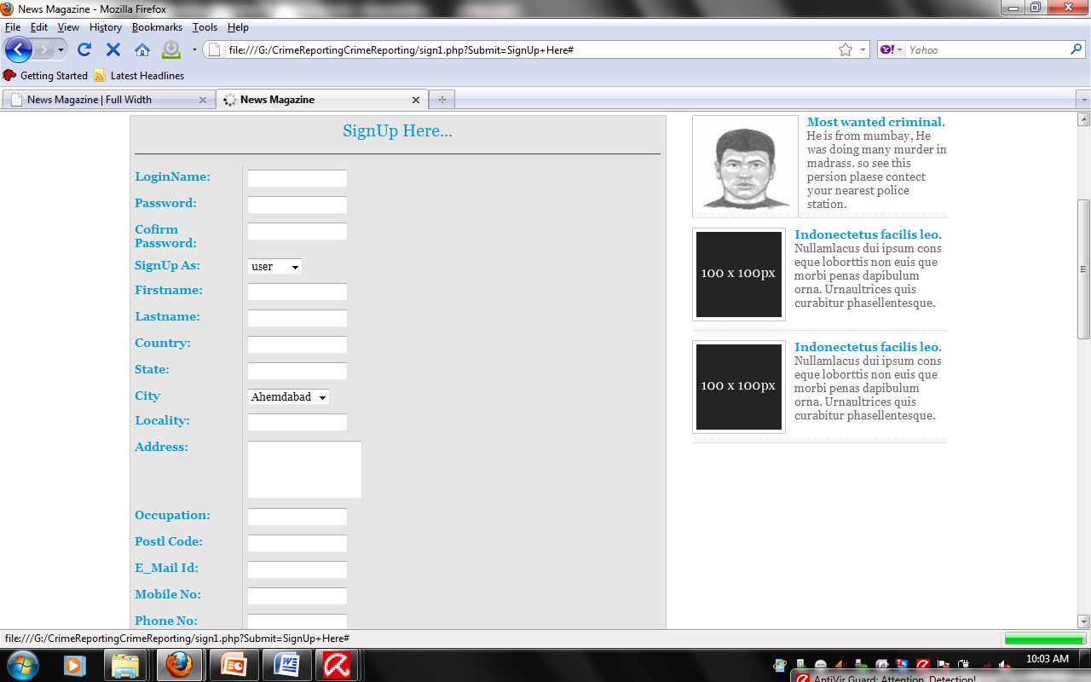
Staff Information
This is staff form Form you can see all details of Staff.

Slide 26
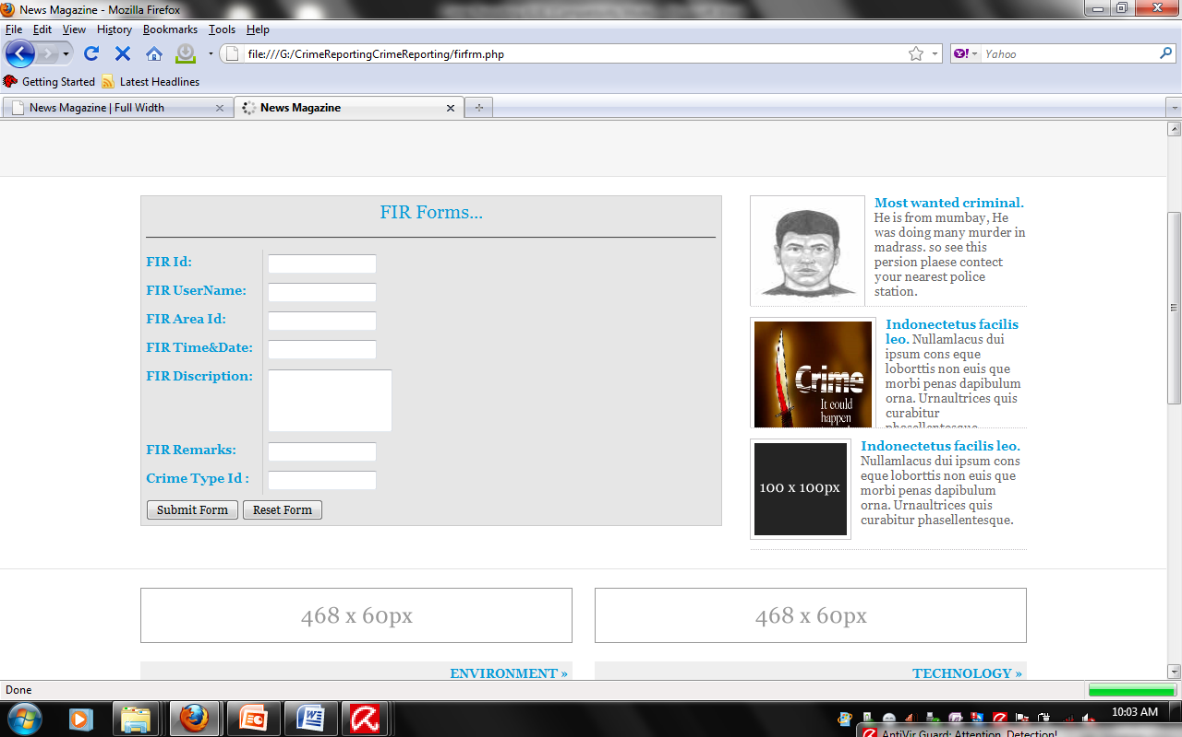
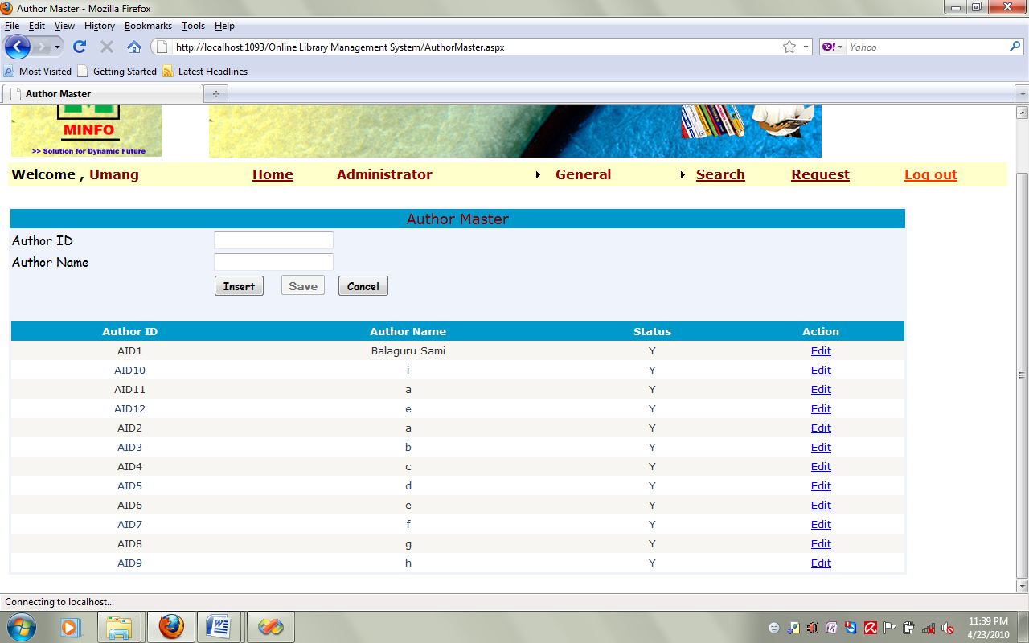
Author_Master
1.Author_Master Information
This is Student Master Form you can give all details of Student and Add new Student as well as Update and Delete Student.
Administrator and User have right his Add new Student in the Student Master.

Slide 27
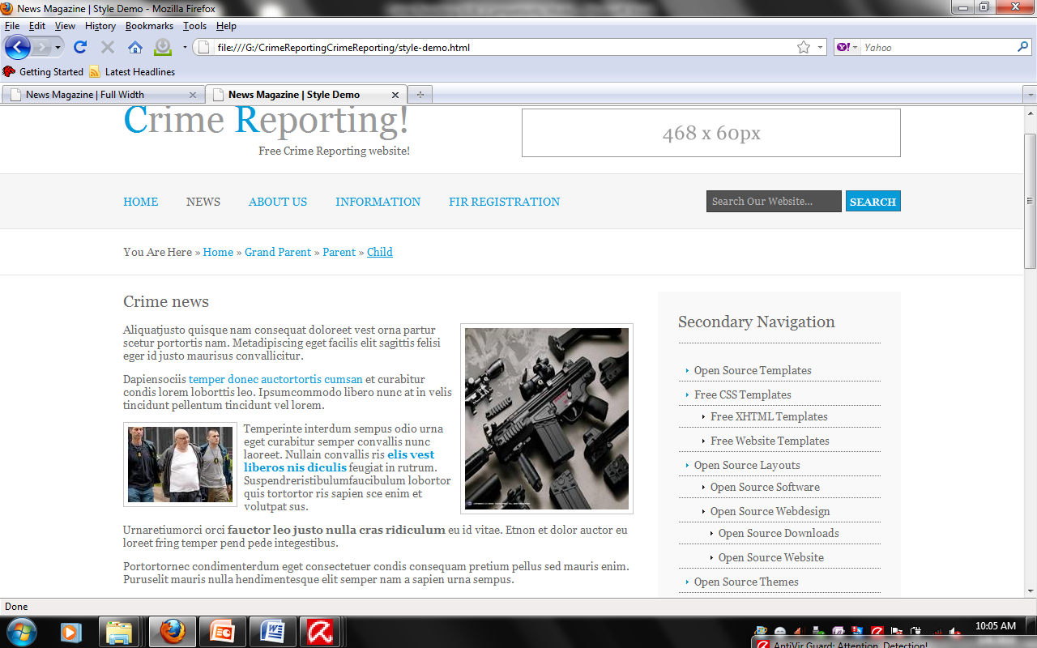
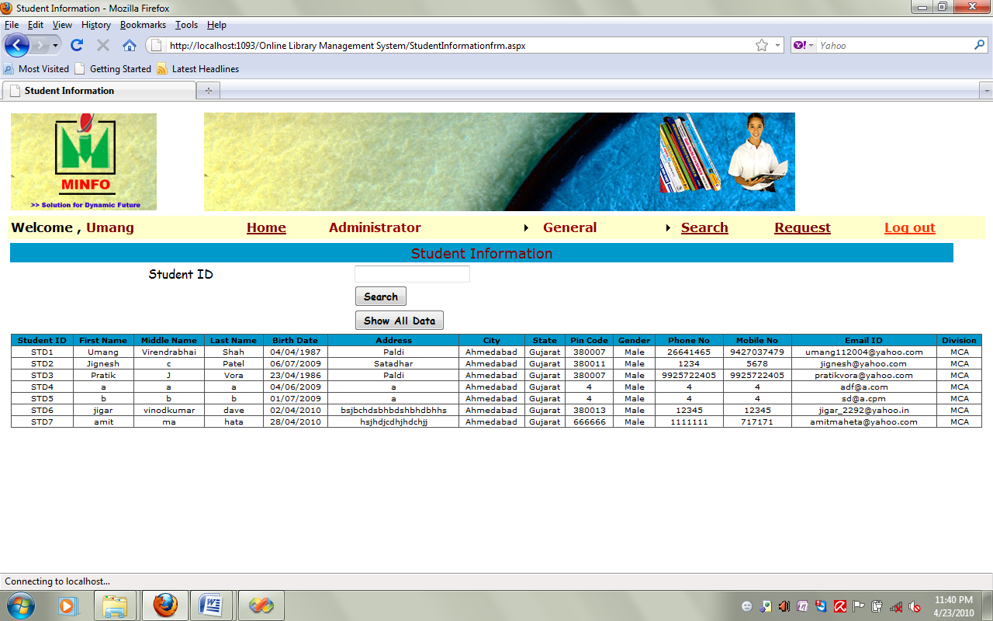
Student Information
This is Student Master Form you can see all details of Student.

Slide 28
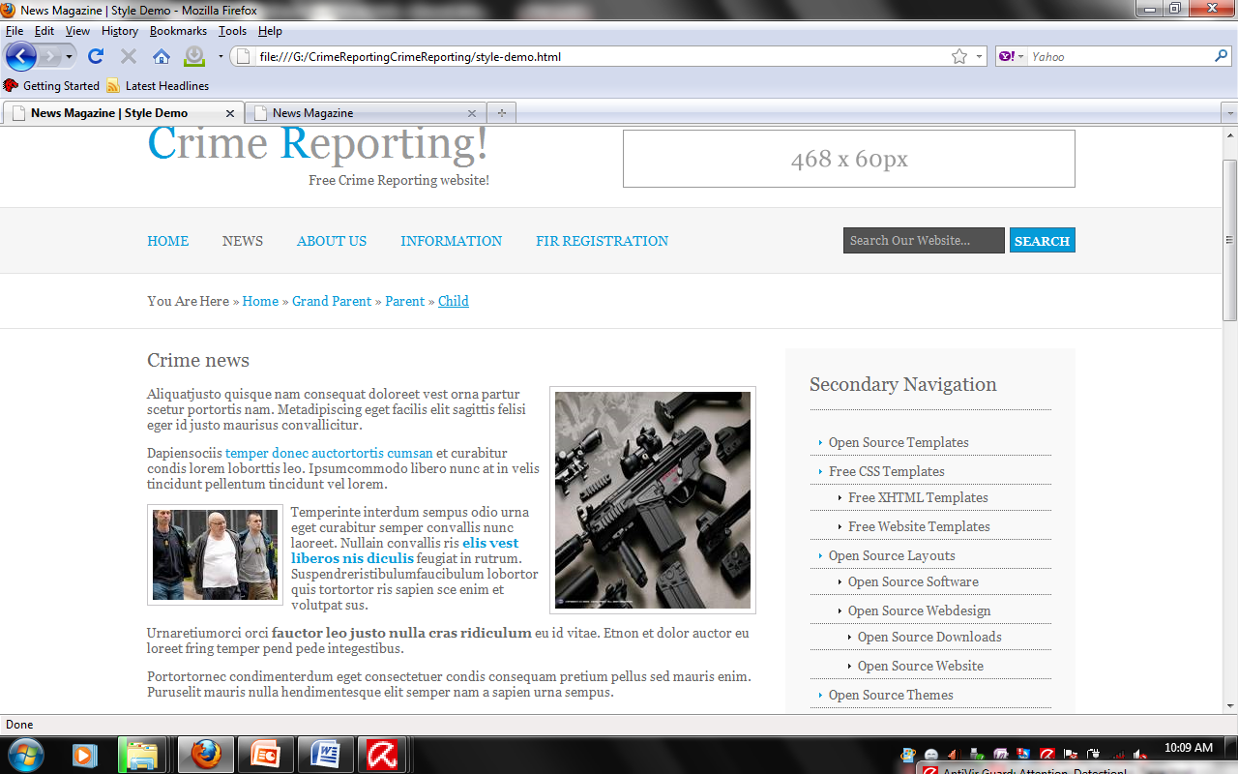
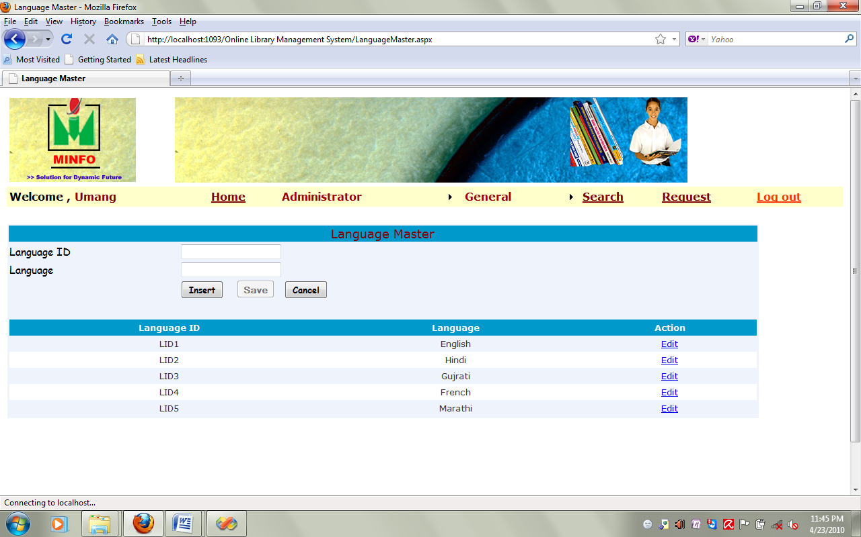
Language Master
This is form is used for theLaguage of wise book we can find it in language master form.

Slide 29
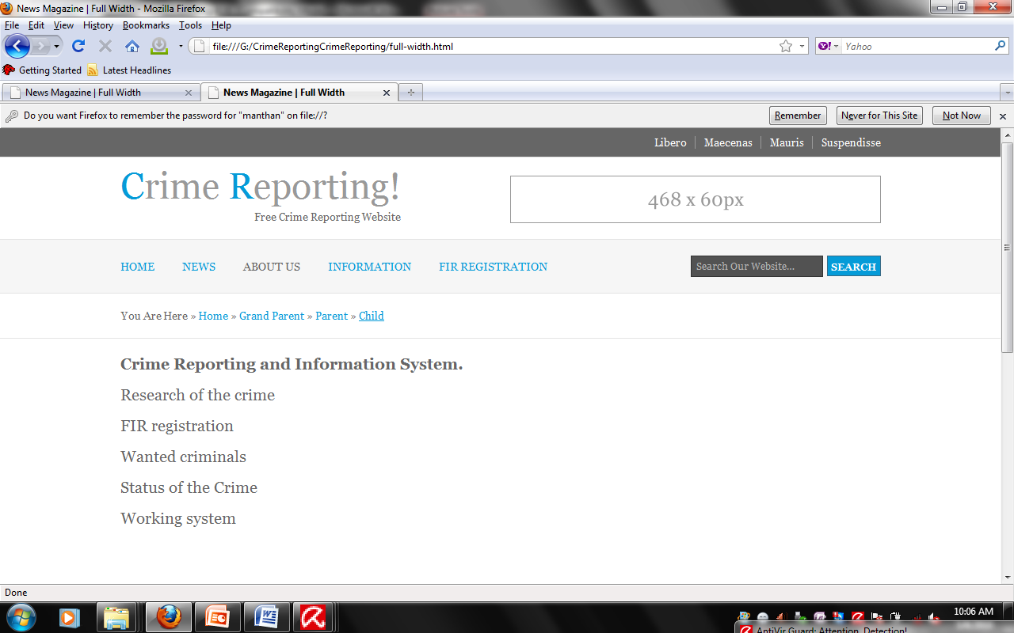
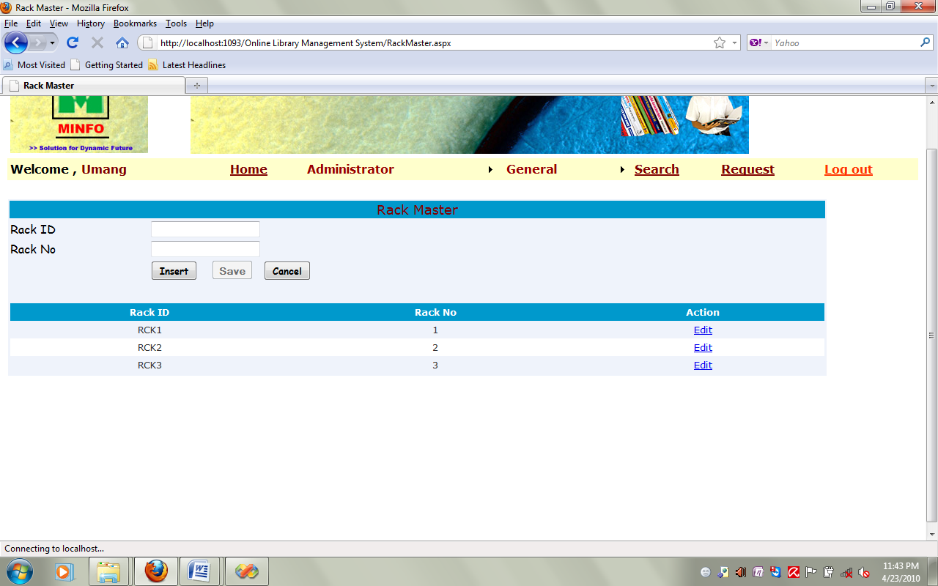
Rack Master
This form is Rack Master we can add the books.

Slide 30
7. Basic System Requirement:
Increase the revenue and reduce the cost of the organization
Personal information of Student
Personal information of Staff
Branch information
Attendance information of Students
Result information of Students
Particular subject information of every Branch
Ensure user friendly student interaction by providing different interfaces
Keeps track of the information Administrator and their experience each time the Administrator make any operation

Slide 31
10. Bibliography
10.1 Books:
php.
Web Basic Application
System Analysis and Design
Mastering in Asp.NET
10.2 Links:
www.Eng123.com
www.livesearch.com
www.wikipedia.com
www.4tests.com
www.w3school.com

