Slide 1
A comparison of two build systems
Fred Bloom & Dan Dowma

Slide 2
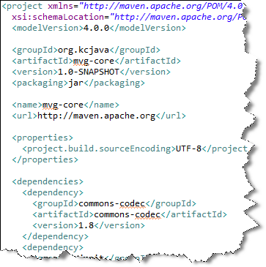
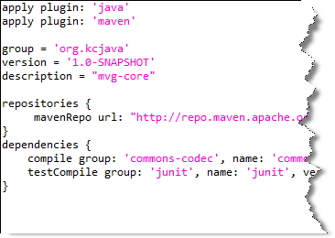
Maven is XML based
Gradle uses a groovy DSL

Slide 3
Features….
 | Advantages | Disadvantages
Maven | Dependency management Standardized project structure IDE integration support Good at what it does, difficult when things need to go ‘off script’ Major industry and commercial support | XML gets verbose Historical baggage for backwards compatibility Difficult to make it do custom tasks
Gradle | Dependency management Smaller build files (DSL vs. XML) Harnesses groovy to build custom tasks | DSL to learn Poorly-structured builds can become difficult to follow and/or maintain (like Ant)

Slide 4
Demo time!
Software used:
Netbeans 7.3
Groovy/Grails Tool Suite 3.2
Gradle extension
Gradle 1.6
All demo code found at:
https://github.com/kcjava/public

