Slide 1
A comparison of two build systems
Fred Bloom & Dan Dowma

Slide 2
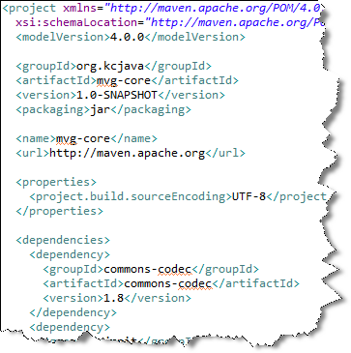
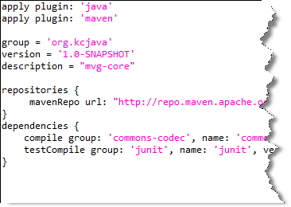
Maven is XML based
Gradle uses a groovy DSL

Slide 3
Available plugins…

Slide 4
Demo time!
Software used:
Netbeans 7.3
Groovy/Grails Tool Suite 3.2
Gradle extension
Tomcat 7

