Slide 1
Satellite Communication
Name : Kamal Charan
Roll No : 17001003029
Branch : ECE (7th Semester)
Topics : C/N and G/T ratios

Slide 2
Basic Transmission Theory:
For a transmitter with output Pt watts driving a lossless antenna with gain Gt, the flux density at distance R meters is F=Pt Gt / 4πr²
The product PtGt is called effective isotropic radiated power or EIRP, it describes the combination of transmitting power & antenna gain in terms of an equivalent isotropic source with power Pt Gt watts.

Slide 3
If we had an ideal receiving antenna with an aperture of A m², we would collect power Pr watts given by Pr = F * A watts.
Thus the power received by real antenna with effective aperture area Ae m² is
Pr = Pt GtAe/ 4 πR²(watts)
A fundamental relation in antenna theory is gain & area of an antenna are related by
G = 4π Ae / λ²
Substituting above in equation gives .
Pr = [Pt Gt Gr/ (4 πR / λ²]watts
This expression is known as link equation.

Slide 4
The term (4 πR / λ )² is known as path loss Lp.
Collecting various factors, we can write Power received= (EIRP * Receiving antenna gain / path loss)watts
In decibel, we have,
Pr = EIRP + Gr – Lp
Where EIRP= 10log10 (Pt Gt) dBW
Gr = 10log10 (4π Ae/ λ²) dB
Lp= 10log10 (4 πR / λ )² dB
The received power, Pr is commonly referred to as carrier power, C.

Slide 5
System Noise Temperature & G/T ratio:
The noise power is given by Pn = kTn B.
Where k= Boltzmann’s constant= 1.38 * 10-23 J/K =-228.6 dBW/K/Hz Tn = Noise temperature of source in K B= noise bandwidth in which noise power is measured, in Hz.
System noise temperature Ts , is the noise temperature of noise source at the input of noiseless receiver which gives same noise power as the original receiver, measured at the output of receiver.

Slide 6
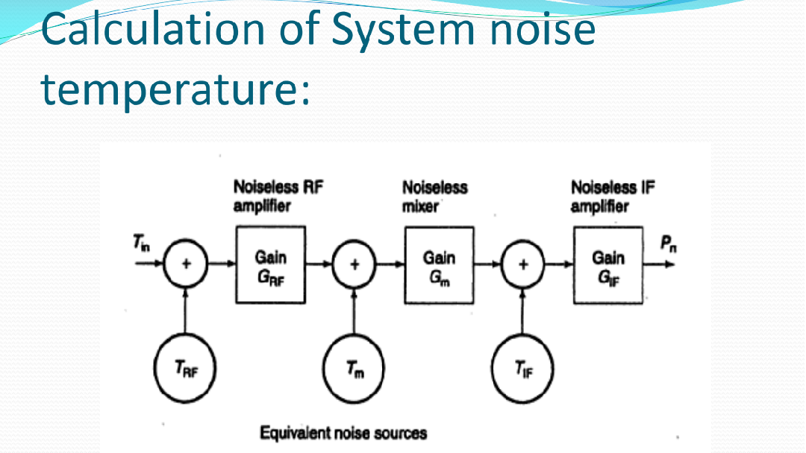

Slide 7
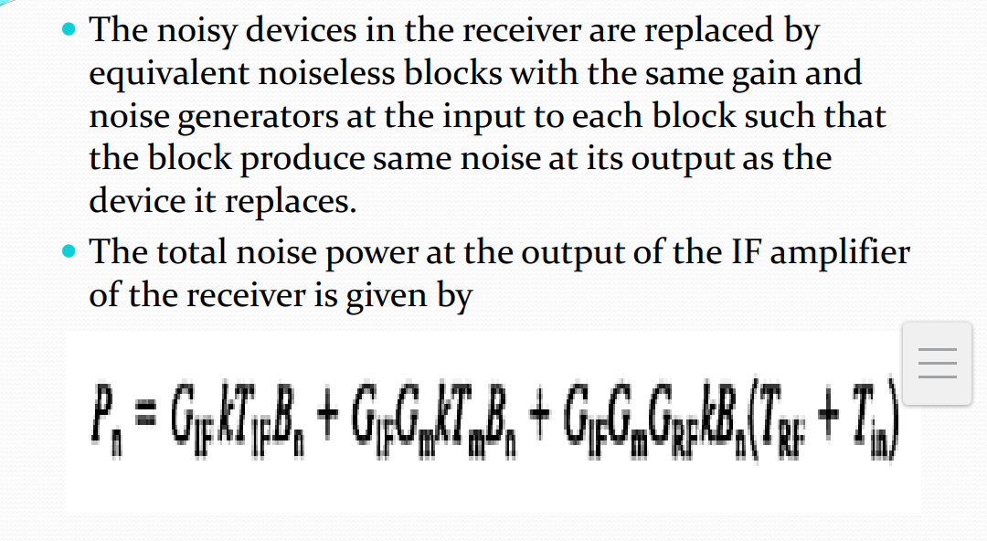

Slide 8
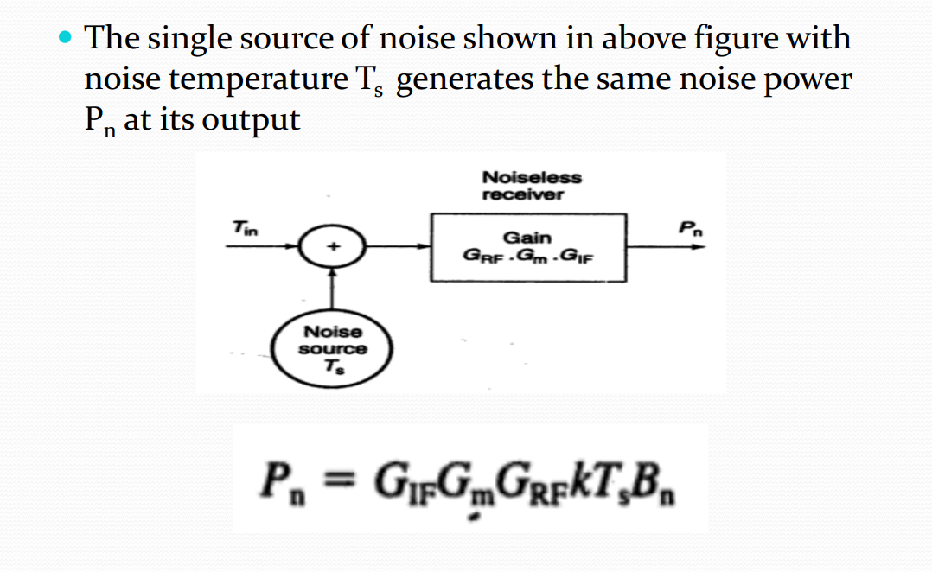

Slide 9
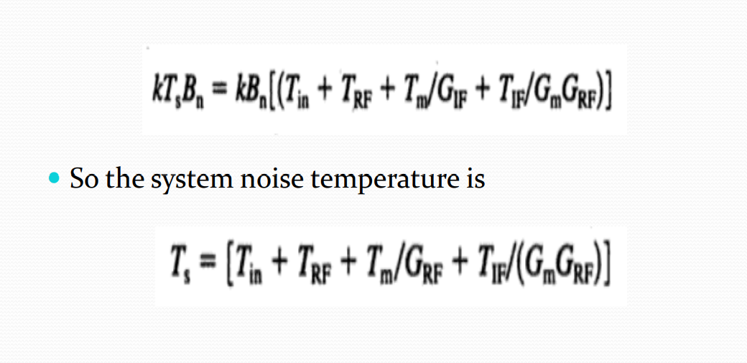

Slide 10
