Slide 1
Costco
Wrapped
In 2025, you…
Visited
Spent
Bought
“Saved”
## Times
$$$
## Items
$$$

Slide 2
Gas Summary:
Total $
Gallons of Gas
Average $/gal
Regional Average
## Times
$$$
## Items
$$$

Slide 3
Image of your most frequently purchased Item
_____ was your most frequently purchased Item.
You bought it ## times but and spent $$$

Slide 4
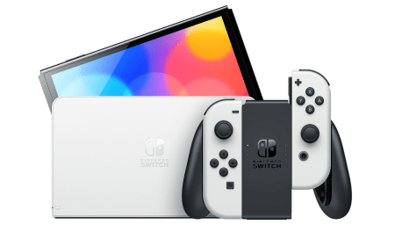
Your largest individual purchase was the Nintendo Switch for $399.99
…About 7 years later than everyone else

Slide 5
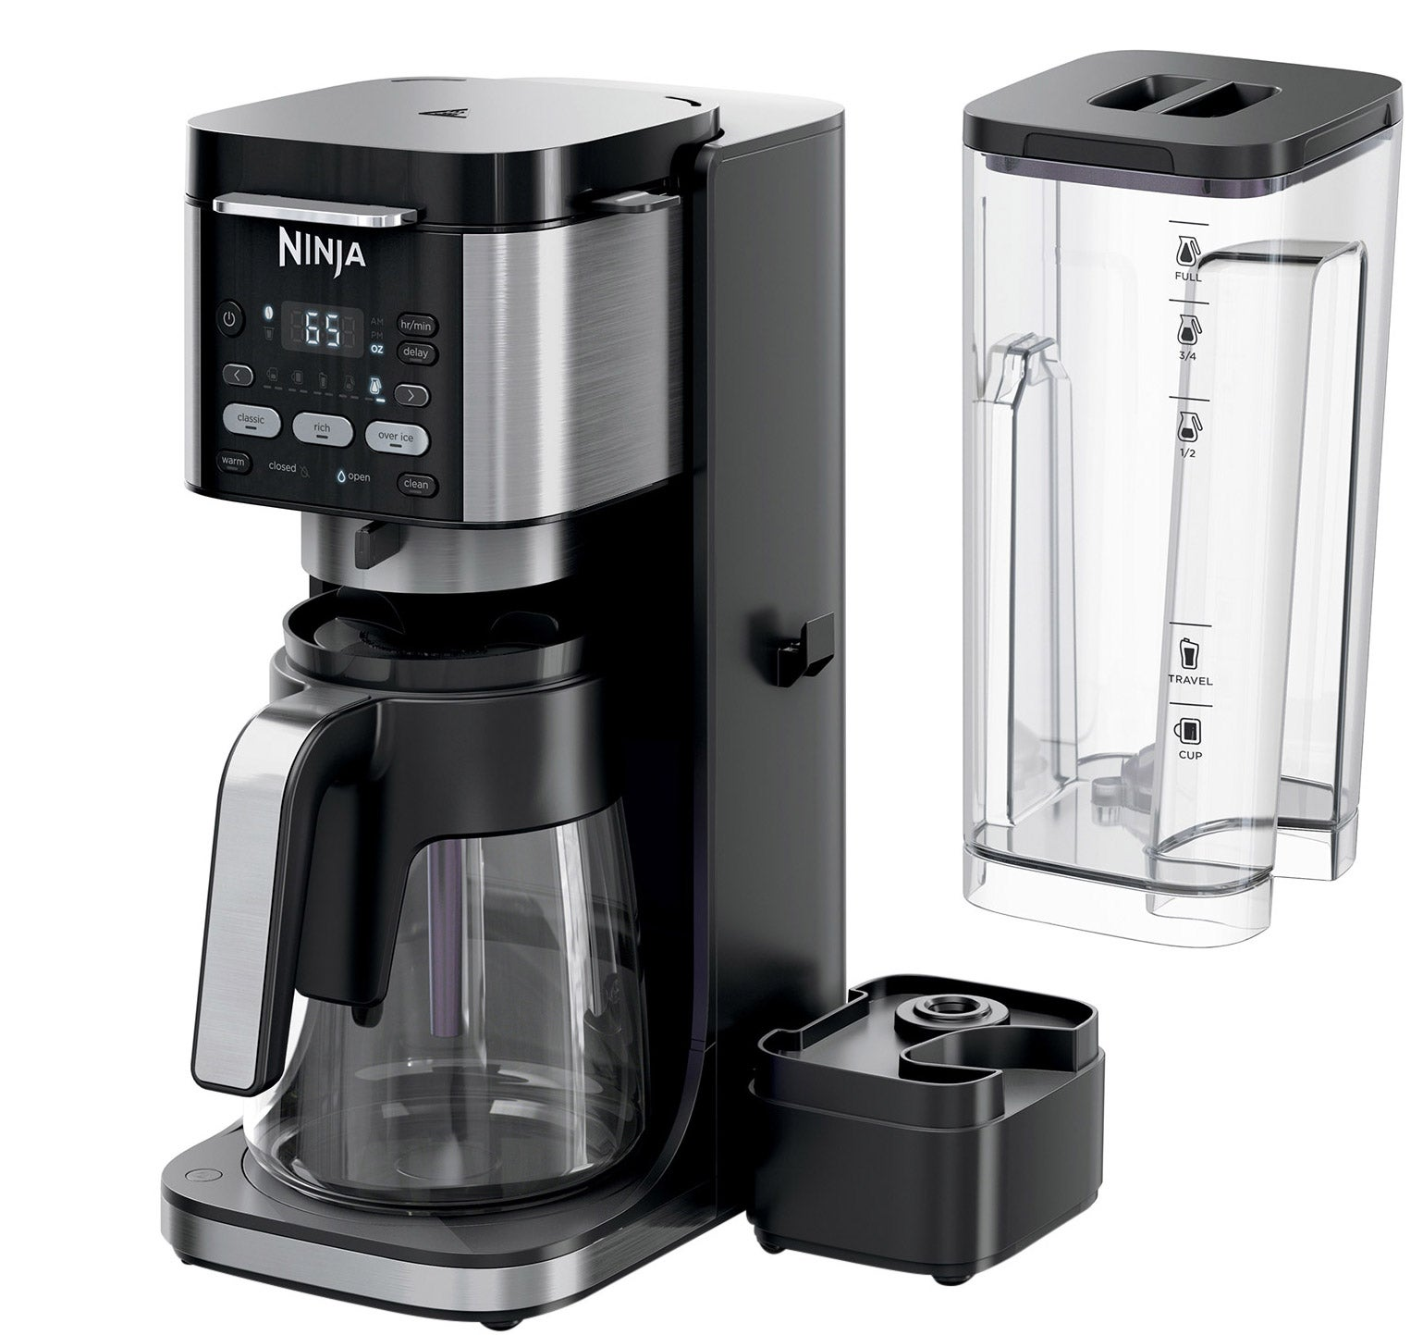
Your largest discount was on the Ninja DualBrew XL Grounds & Pods Hot & Iced Coffee Maker.
Original Price: $129.99
Discount: $40.00

Slide 6
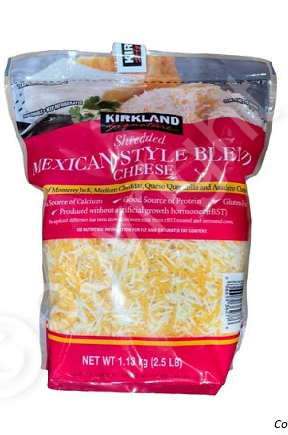
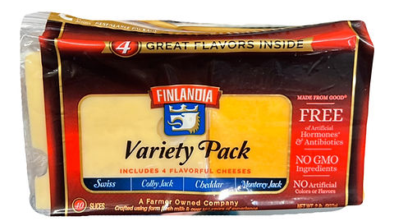
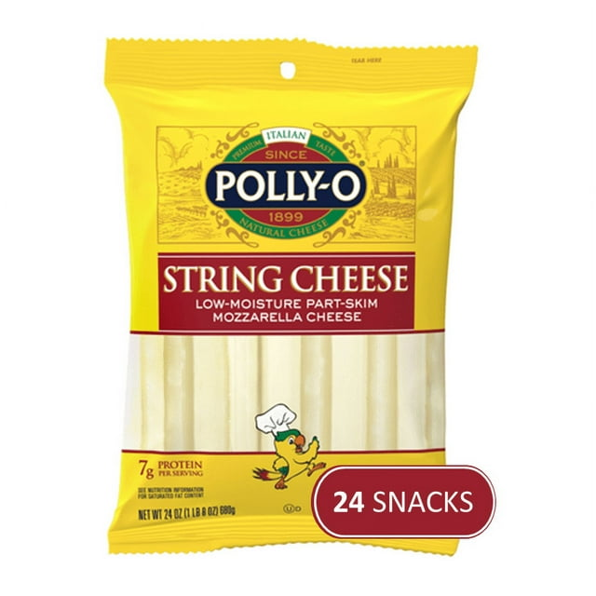
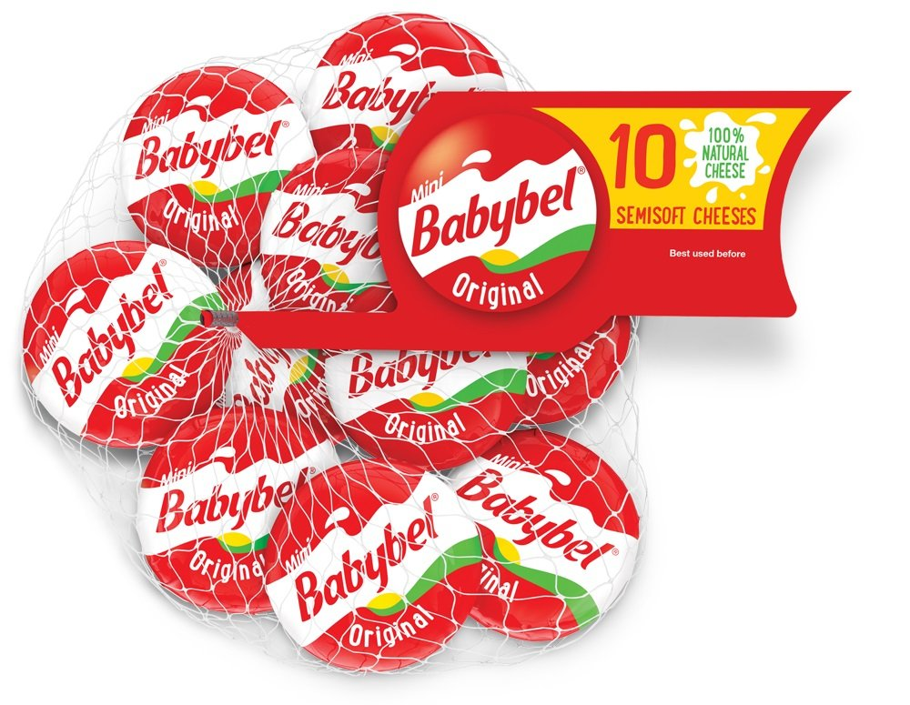
You spent $175 just on cheese

Slide 7
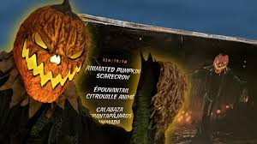
You bought an Animated Pumpkin Scarecrow for $129.97

Slide 8
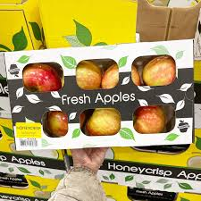
How do you like THESE apples?
Probably a lot. You bought them 13 times and spent $75.87

Slide 9
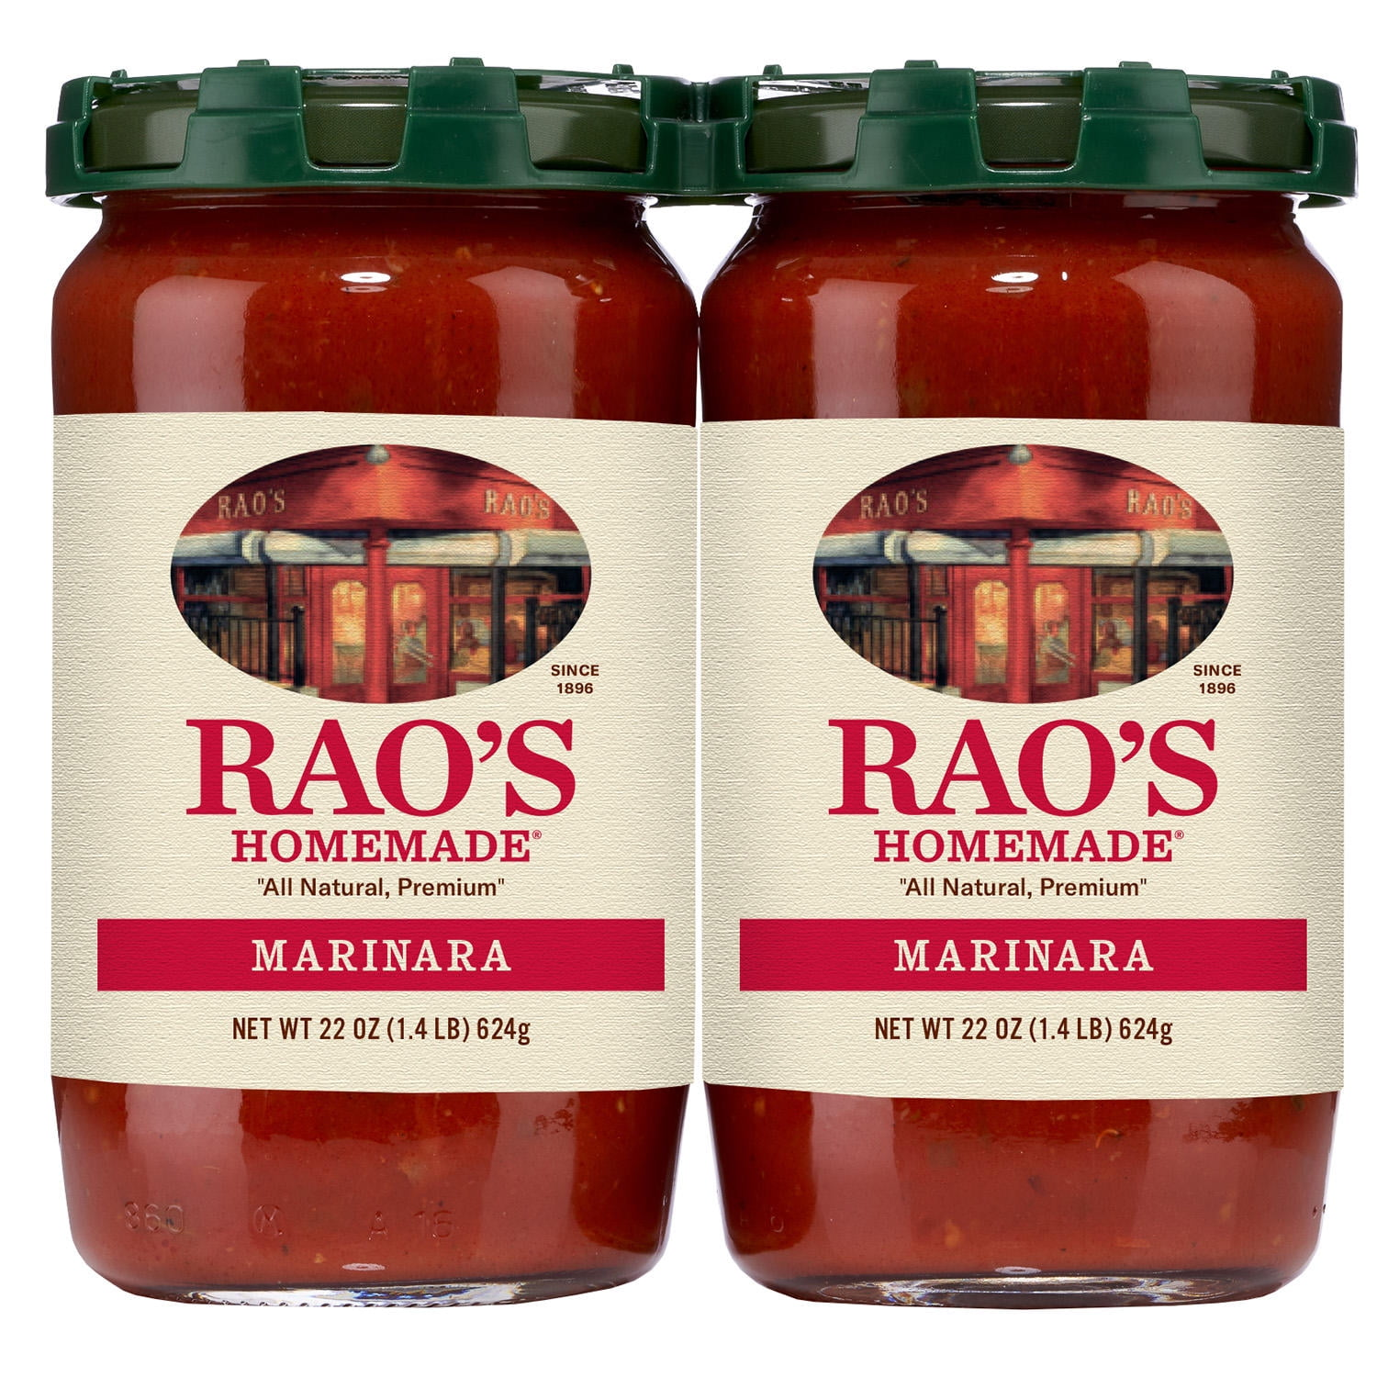
You bought the Rao’s 2-Pack 5 times
And it was on sale every time

Slide 10
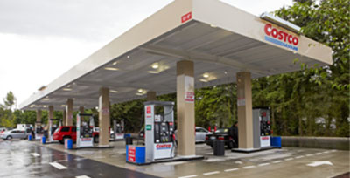
Too bad the gas receipts weren’t all there
Because it would’ve been a lot

Slide 11
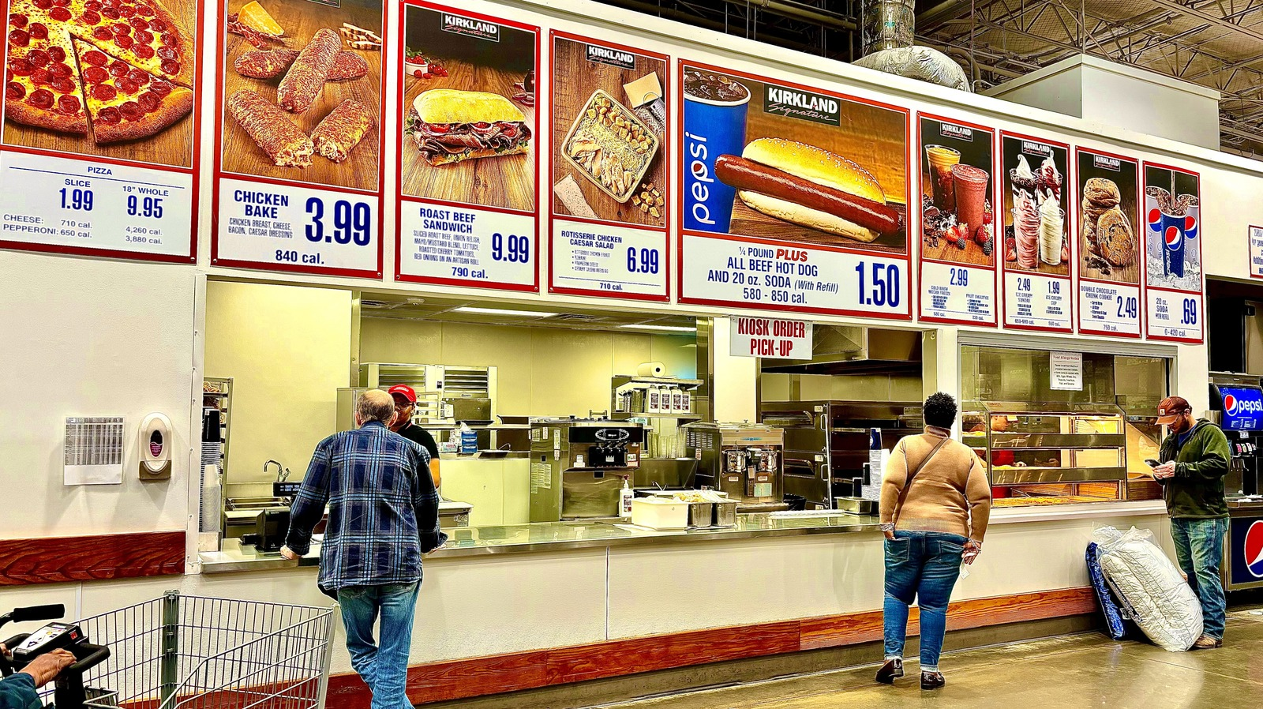
Same with the Food Court…

Slide 12
The
End

